Slide 1

FAKE NEWS DETECTION
Foundation Of Data Analytics (Project)
Review - 3

Slide 2
Novelty
We have used 4 Machine learning algorithms to test their efficiency in order to provide people info about which algorithm can be used for maximum efficiency , this will save people’s time in going through all the algorithms rather they can refer our research and get to a conclusion easily , this way their time and effort both are getting saved.
The algorithms which we have chosen and compared are as follows:-
1. LR (Linear Regression)
2. DT (Decision Tree Classifier)
3. GBC (Gradient Boosting Classifier)
4. RFC (Random Forest Classifier)

Slide 3

TABLE OF CONTENTS
01
02
03
04
05
06
07
08
ABSTRACT
INTRODUCTION
OBJECTIVES
PROBLEM STATEMENT
LITERATURE SURVEY
PROPOSED SYSTEM
CONCLUSION
REFERENCES

Slide 4


01
ABSTRACT

Slide 5
ABSTRACT
Fake news exist way before from social media but it multifold when soc media was introduced.Fake news is a news designed to deliberately spread hoaxes, propaganda and disinformation.Fake News stories usually spread through social media sites like Facebook, Twitter etc.The fake news on social media and various other media is wide spreading and is a matter of serious concern due to its ability to cause a lot of social and national damage with destructive impacts. A lot of research is already focused on detecting it. This paper makes an analysis of the research related to fake news detection and explores the traditional machine learning models to choose the best, in order to create a model of a product with supervised machine learning algorithm, that can classify fake news as true or false, by using tools like python scikit-learn, NLP for textual analysis. This process will result in feature extraction and vectorization; we propose using Python scikit-learn library to perform tokenization and feature extraction of text data, because this library contains useful tools like Countvectorizer and Tiff Vectorizer. Then, we will perform feature selection methods, to experiment and choose the best fit features to obtain the highest precision, according to confusion matrix results.

Slide 6
02
INTRODUCTION

Slide 7
INTRODUCTION
As more and more of our lives are spent communicating online across social networking channels, more and more individuals prefer to search for and absorb social media news instead of conventional news organisations.
First, the essence of these social media sites is implicit in the reasons for this shift in consumption behaviour. The widespread distribution of false news can have a significant adverse effect on people and society. Second, fake news will break the news ecosystem's balance of credibility. For instance, it is obvious that during the U.S. presidential election of 2016, the most popular fake news was much more frequently circulated on Facebook than the most popular authentic mainstream news. Thus, we begin our work by understanding the crucial role of the art to detect a fake news or not.

Slide 8
How much of what we read on social media and on supposedly “credible” news sites is trustworthy? It is extremely easy for anyone to post what they desire and although that can be acceptable, there is the notion of taking it a step too far, such as posting false information online in order to cause a panic, using lies to manipulate another person’s decision, or essentially anything else that can have lasting repercussions. There is so much information online that it is becoming impossible to decipher the true from the false. Thus, this leads to the problem of fake news.

Slide 9
03
OBJECTIVES

Slide 10
OBJECTIVES
Our main Aim is to detect the fake news, which is a classic text classification problem with a straightforward proposition. The work is to create a system or model that can use the data of past news reports and predict the chances of a news report being fake or not.

Slide 11

04
PROBLEM
STATEMENT
TO STOP THE SPREAD OF FAKE NEWS WHICH CHAOS IN THE PUBLIC ENVIRONMENT.

Slide 12
Problem Statement
MAJOR PROBLEM
By clicking on a clickbait, users are led to a page that contains false information.
• Fake news influences people's perceptions.
• The rise of Fake news has become a global problem that even major tech companies like Facebook and google are struggling to solve. It can be difficult to determine whether a text is factual without additional context and human judgement.

Slide 13
05
LITERATURE SURVEY

Slide 14
Literature Survey
What is fake news? Fake news is the deliberate spread of misinformation via traditional news media or via social media. False information spreads extraordinarily fast. This is demonstrated by the fact that, when one fake news site is taken down, another will promptly take its place. In addition, fake news can become indistinguishable from accurate reporting since it spreads so fast. People can download articles from sites, share the information, re-share from others and by the end of the day the false information has gone so far from its original site that it becomes indistinguishable from real news

Slide 15
06
PROPOSED SYSTEM

Slide 16
PROPOSED SYSTEM
In this proposed system we collected the data sets , applied various data cleaning techniques are applied to clean the raw data sets ,libraries were imported to get all the functionality that is required in this process , various features were extracted from the data in order to get a proper understanding of each feature after that natural language processing techniques like countvectorizer is used for the textual analysis of the data that is to convert the text data to vector , after this step we have to train and test the data sets as required by using Machine learning algorithms like LR (Linear Regression), DT (Decision Tree Classifier),GBC (Gradient Boosting Classifier) ,RFC (Random Forest Classifier) after the model training has been done the the output will be there.

Slide 17
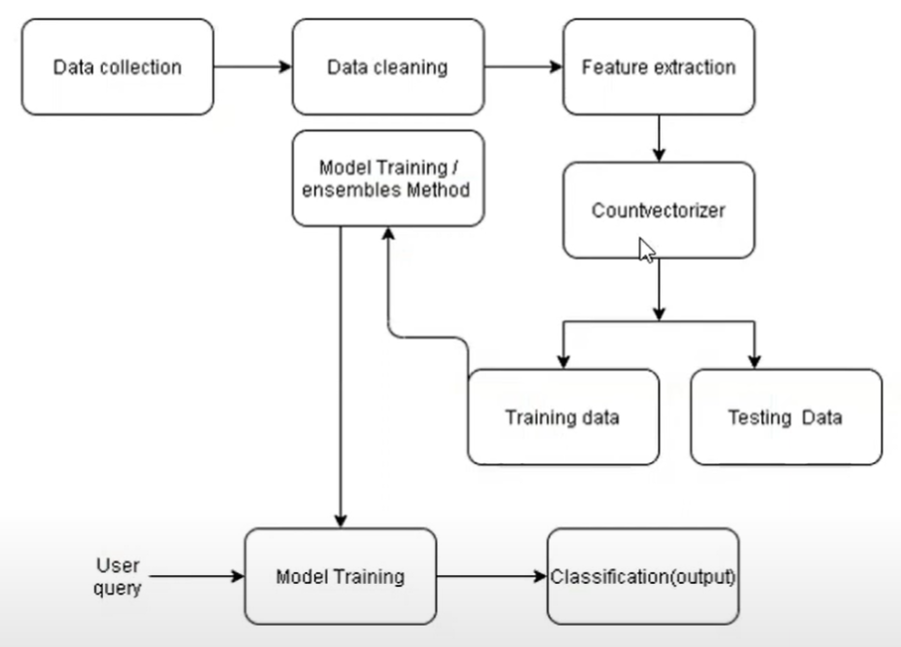


PROPOSED SYSTEM

Slide 18
07
ALGORITHM

Slide 19
ALGORITHM
The algorithms used in our project as as follows:-
1. LR (Linear Regression)
2. DT (Decision Tree Classifier)
3. GBC (Gradient Boosting Classifier)
4. RFC (Random Forest Classifier)

Slide 20
07
CONCLUSION

Slide 21
CONCLUSION
As mentioned earlier, the concept of deception detection in social media is particularly new and there is ongoing research in hopes that scholars can find more accurate ways to detect false information in this booming, fake-news-infested domain. For this reason, this research may be used to help other researchers discover which combination of methods should be used in order to accurately detect fake news in social media. The proposed method described in this paper is an idea for a more accurate fake news detection algorithm.
In the future, We wish to improvise out the current existing model analysis, but, due to limited knowledge and time, this will be a project for the future. It is important that we have some mechanism for detecting fake news, or at the very least, an awareness that not everything we read on social media may be true, so we always need to be thinking critically. This way we can help people make more informed decisions and they will not be fooled into thinking what others want to manipulate them into believing

Slide 22
09
REFERENCES

Slide 23
REFERENCES
https://link.springer.com/article/10.1007/s10844-021-00646-9
https://nishitpatel01.github.io/Fake_News_Detection/
https://www.interviewbit.com/blog/r-projects/
https://iopscience.iop.org/article/10.1088/1757-899X/1099/1/012040
https://www.ijert.org/survey-on-fake-news-detection-using-machine-learning-algorithms
https://www.researchgate.net/publication/343916946_Fake_News_Detection_Using_Machine_Learning_Algorithms

Slide 24
OUR TEAM
APURV CHOUDHARY - 20BEC1233
SALUGU JANAKI MANOJ - 20BEC1213
PRATYUSH RAJ - 20BEC1273

Slide 25
THANK YOU

