Slide 1

A Project Report On
" Let’s Clean ( Waste Management ) "
Submitted To
MES Garware College of Commerce and Savitribai Phule Pune University
In partial fulfilment of the degree of
Bachelor of Business Administration - Computer Application
By
Pratyush Majumdar
and Mahendra Jat Seat No: 15429
and
Seat No: 15422
BBA-CA
Semester V Under the guidance of
Mrs. Padma Nene
Research Guide
MES Garware College of Commerce, Autonomous, Karve Road, Deccan Gymkhana, Pune – 411004 (2023-2024)

Slide 2
Maharashtra Education society’s
GARWARE COLLEGE OF COMMERCE, AUTONOMOUS
Karve Road, Deccan Gymkhana, Pune - 411004
CERTIFICATE
This is to certify that Mr. Pratyush Prakash Majumdar and Mr. Mahendra Devaram Jat Roll Number 15429
and 15422 University Exam Seat Number ----- Students of BBA-CA Semester-V have successfully completed the
project work in specialization subject HTML, CSS, JS, PHP, MySQL and Bootstrap entitled as Let’s Clean ( Waste Management ) a partial fulfillment of the degree of Bachelors of Business Administration Computer Application as per the syllabus of Garware College of Commerce and Savitribai Phule Pune University for Year 2023-2024.
I further clarify that the work has been carried out under my supervision.
Project Guide
BBA Coordinator
Principal Internal
Examiner
External Examiner

Slide 3
CONTENT
Introduction Introduction of System Objective of System
Requirements Hardware and Software Requirements
System Design Entity Relationship Diagram Context Level Diagram
Website Design Homepage E-waste Products Paper Products Cart Upload Products About Us Backend Subscription and Contact Table Product and Subscription data Feedback and Login data
5) System Limitations
6) Conclusion
7) References

Slide 4
INTRODUCTION OF SYSTEM
Our platform is dedicated to making a positive impact on the environment through effective waste collection and recycling practices.
At Let's Clean, we prioritize responsible and sustainable waste management.
Community engagement is at the heart of our service.
We actively collaborate with local communities, educational institutions, and businesses to raise awareness about waste management and the importance of recycling.

Slide 5
OBJECTIVES OF SYSTEM
The objective of our website is to create a platform that encourages and facilitates the collection and recycling of e-waste, paper, plastic and cloth materials.
Our aim is to promote environmental sustainability by providing a convenient and efficient way for individuals to recycle these items, reducing the negative impact on the environment.
Our aim is not just to collect waste but also to educate and inspire change.
By facilitating the proper disposal of e-waste, the platform can create economic opportunities by connecting refurbishers and recyclers with potential customers.

Slide 6
SYSTEM REQUIREMENT SPECIFICATION
1) HARDWARE REQUIREMENT
Internet connection or wireless adapter (Wi-Fi)
Processor: Intel i3
Memory(RAM): 4GB
2) SOFTWARE REQUIREMENT
Operating System
: Windows 10.
Application Software : HTML, CSS, JavaScript, PHP, MySQL and Bootstrap.
Browser
: Google Chrome

Slide 7
SYSTEM DESIGN
1) ENTITY RELATIONSHIP DIAGRAM
Visitor
1
has
1
Product
Visitor
1
has
1
Subscription
Visitor
1
has
1
Collecting
Product
M
has
M
Collecting team
Product
1
has
1
Subscription
Subscription
M
has
M
Collecting team

Slide 8
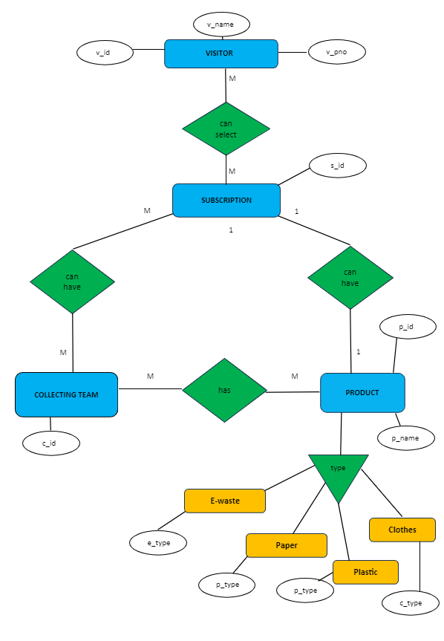

Slide 9
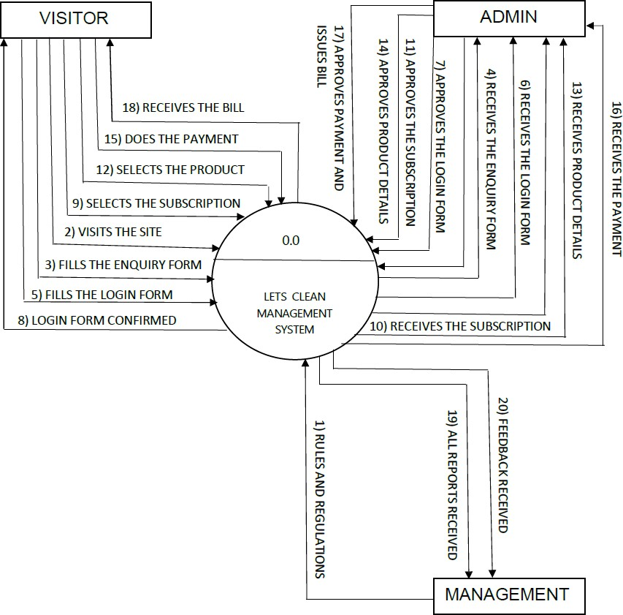
2) CONTEXT LEVEL DIAGRAM

Slide 10
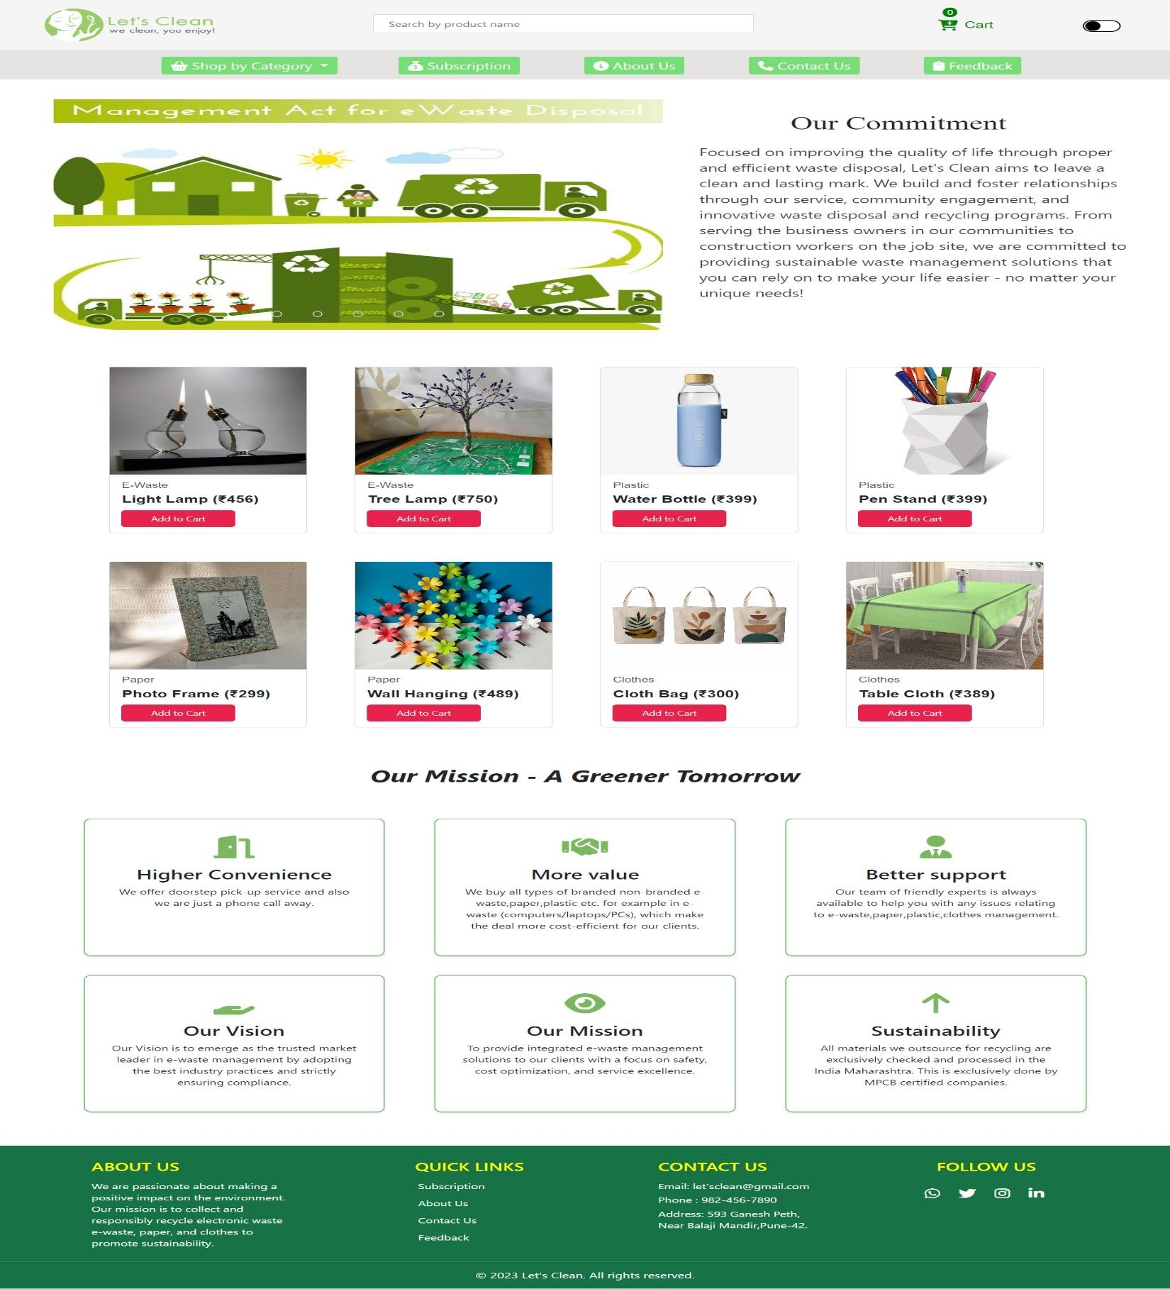
SNAPSHOTS
1) HOMEPAGE

Slide 11
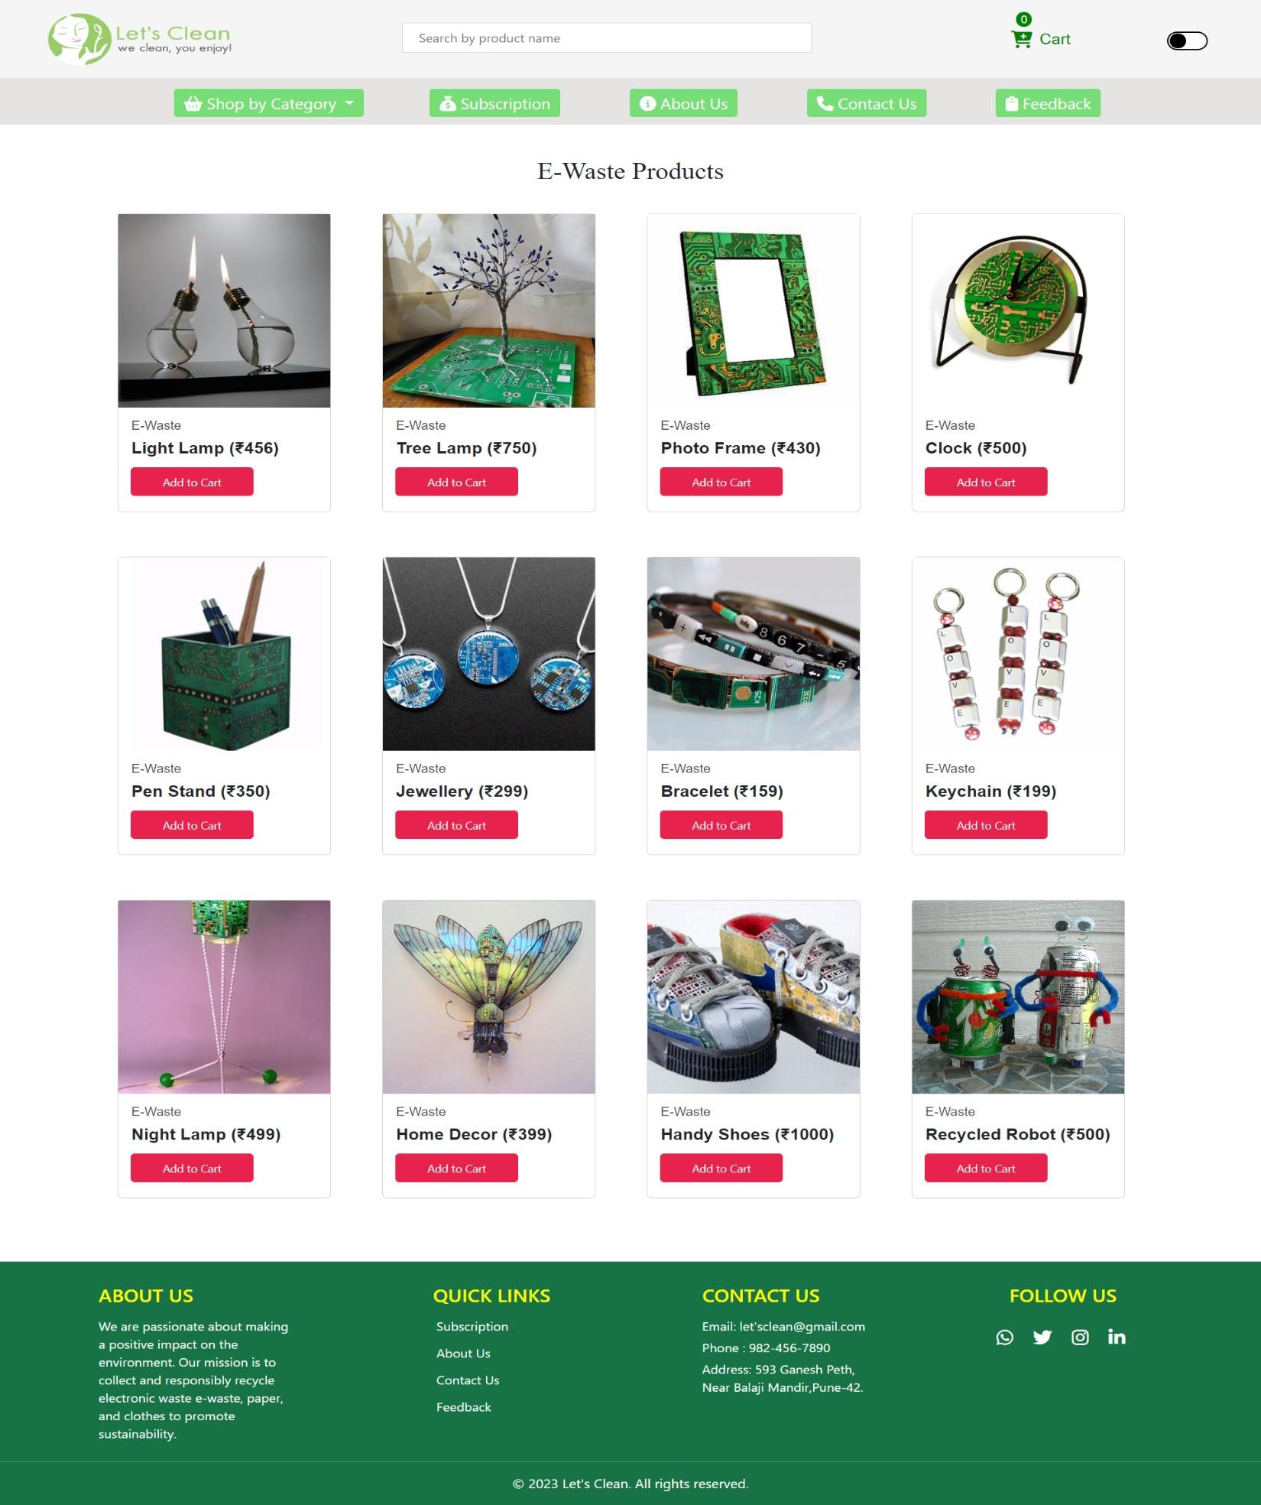
2) E-WASTE PRODUCTS

Slide 12
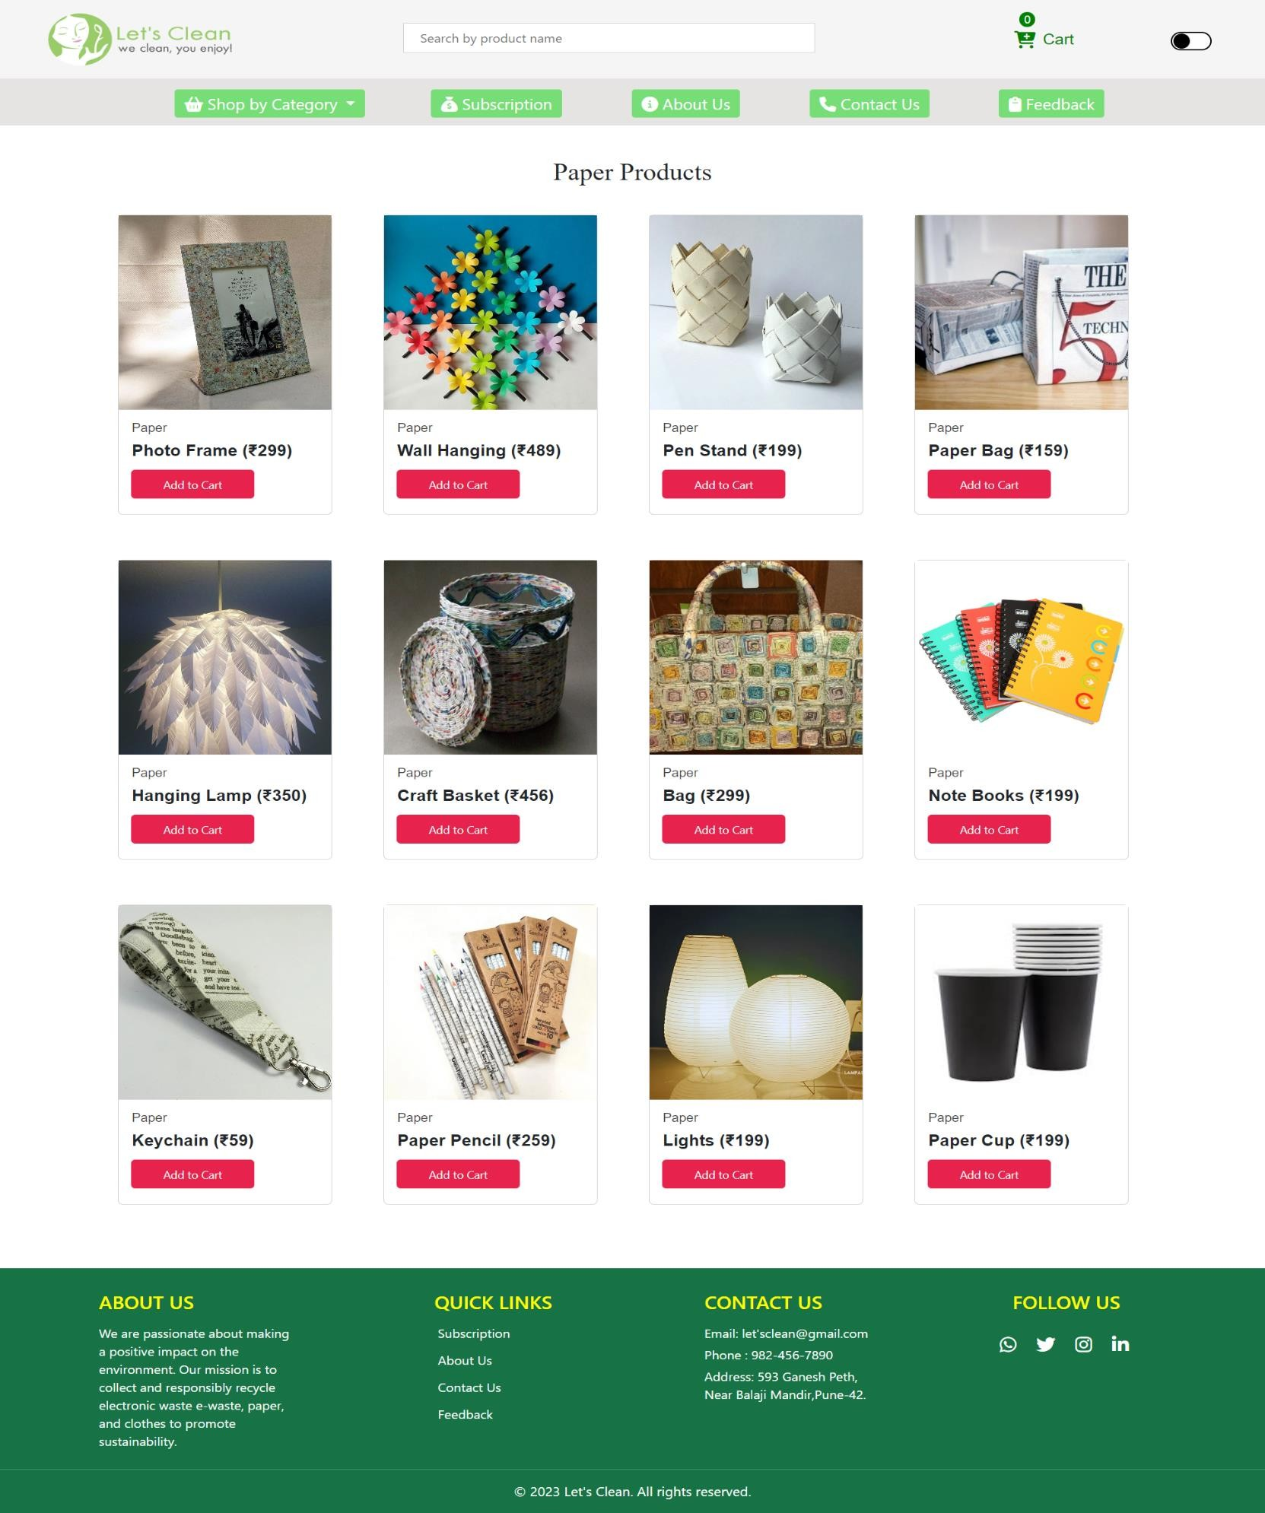
3) PAPER PRODUCTS

Slide 13
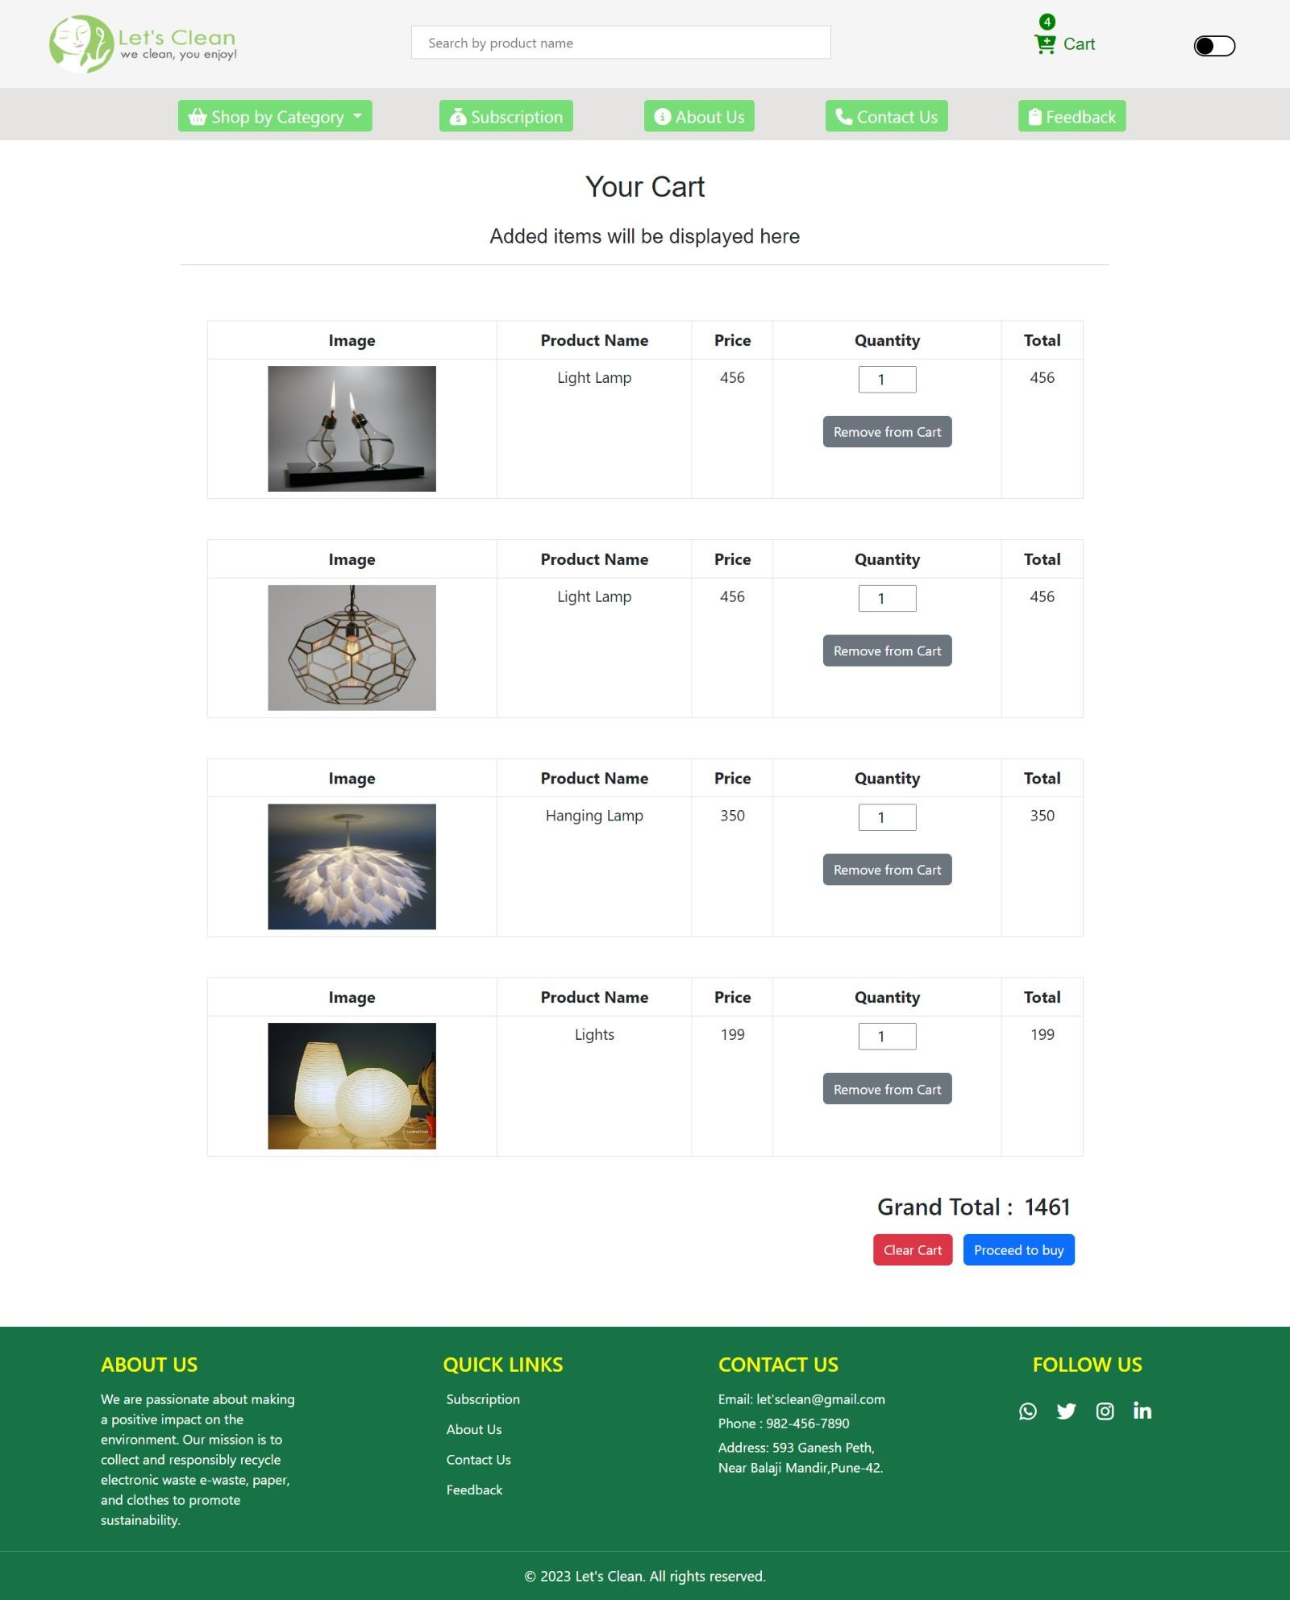
4) CART

Slide 14
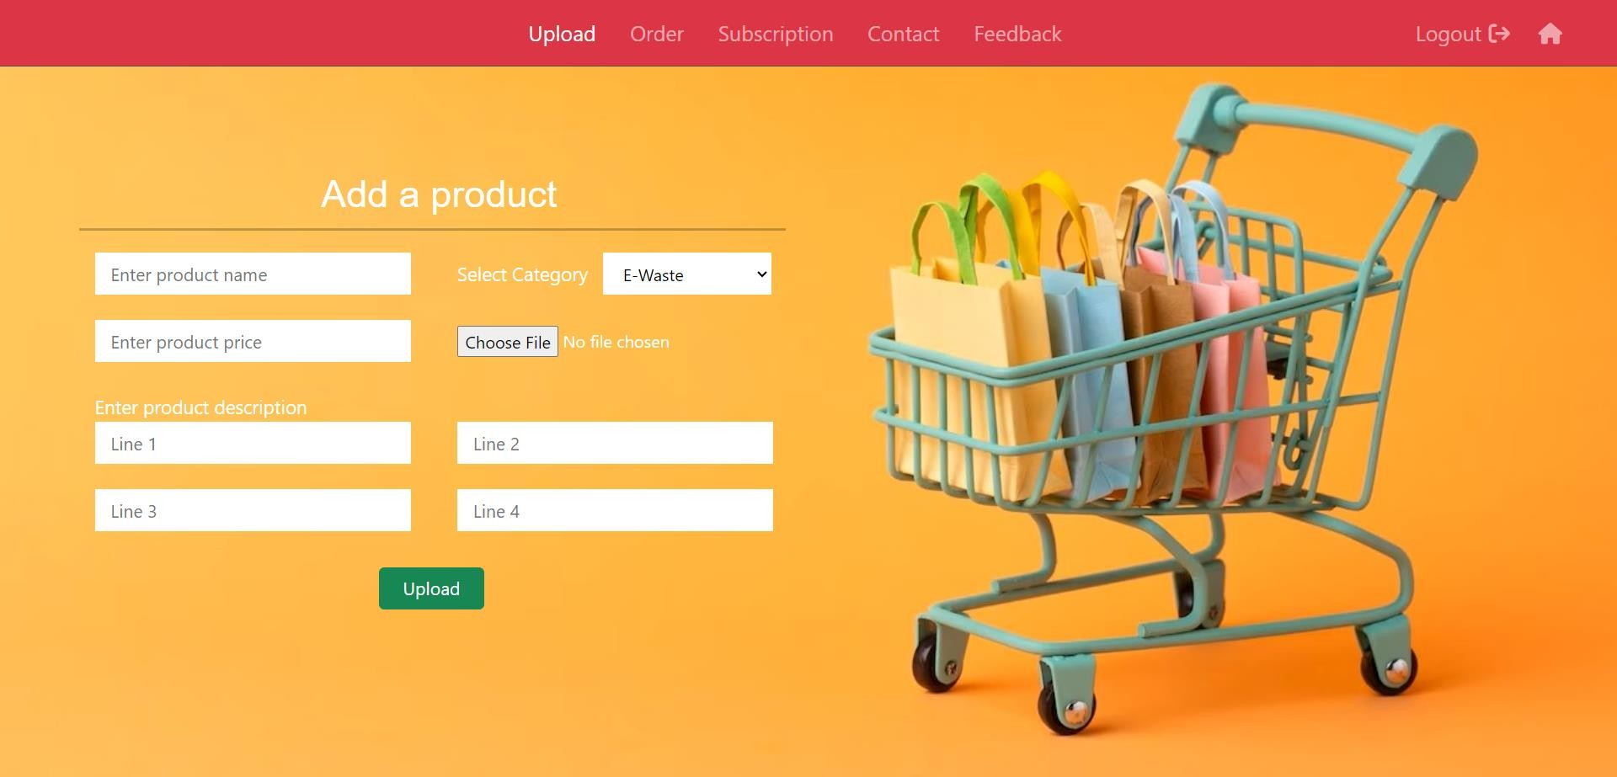
5) UPLOAD PRODUCTS

Slide 15
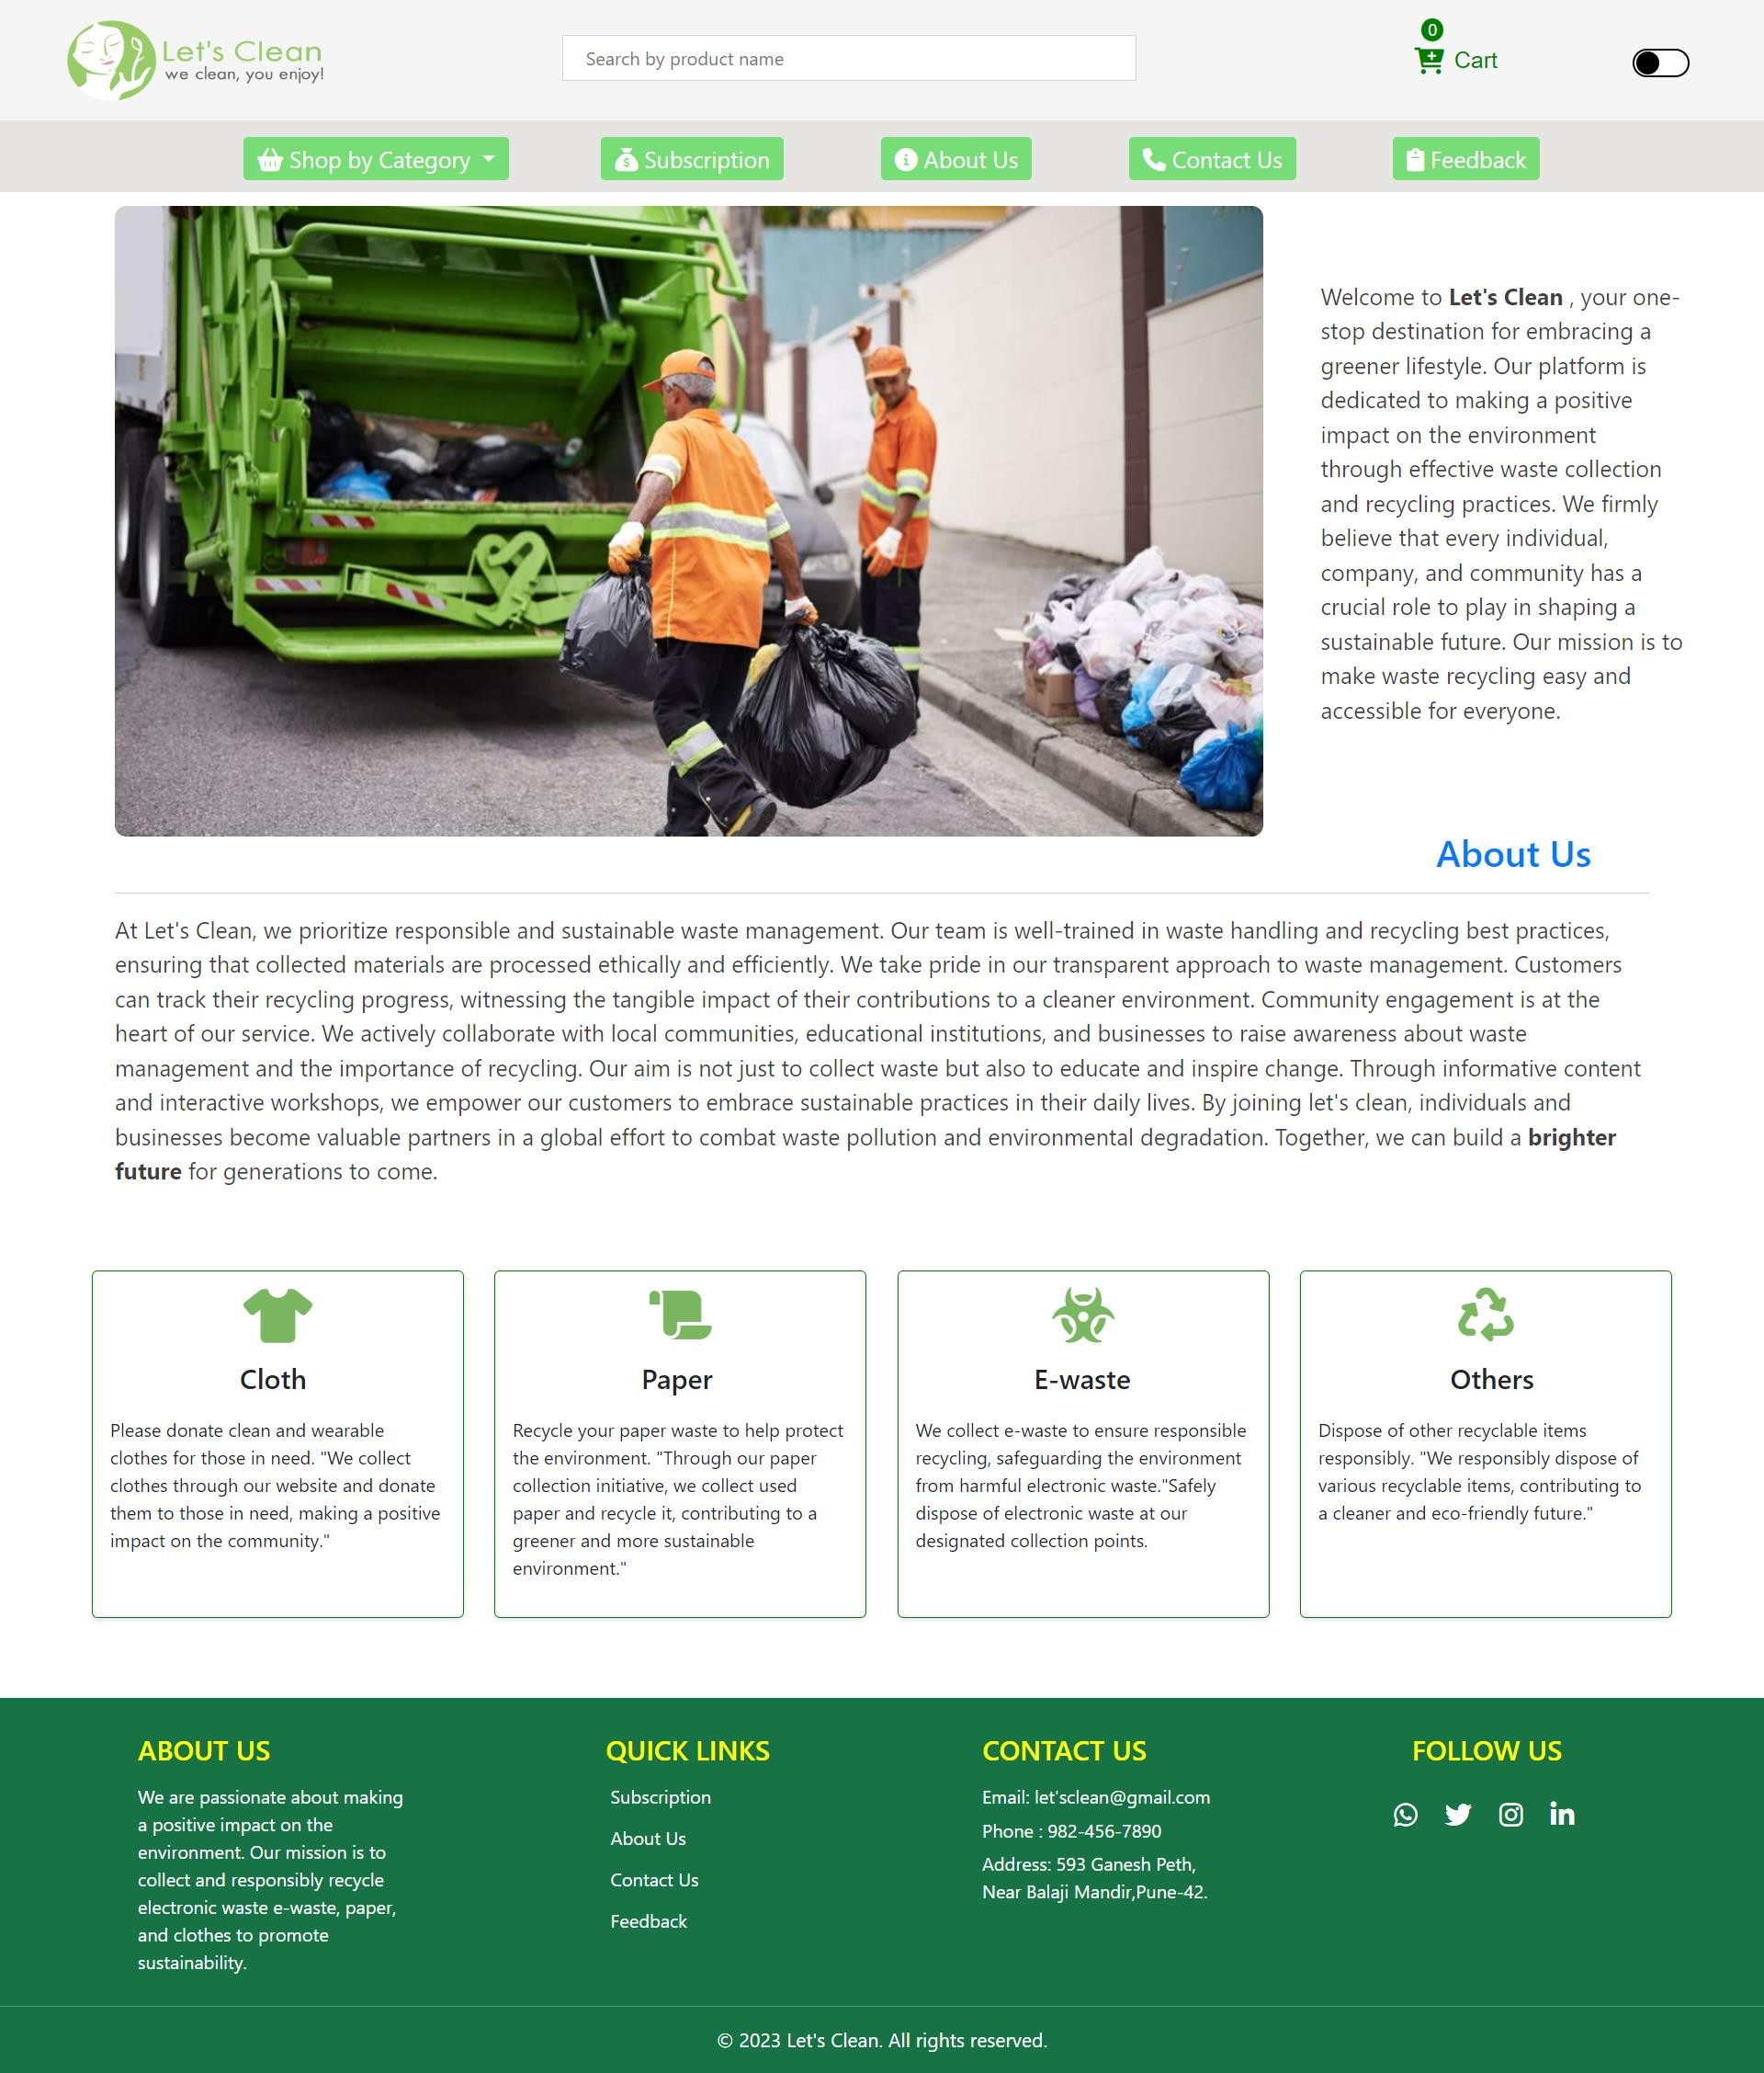
6) ABOUT US

Slide 16
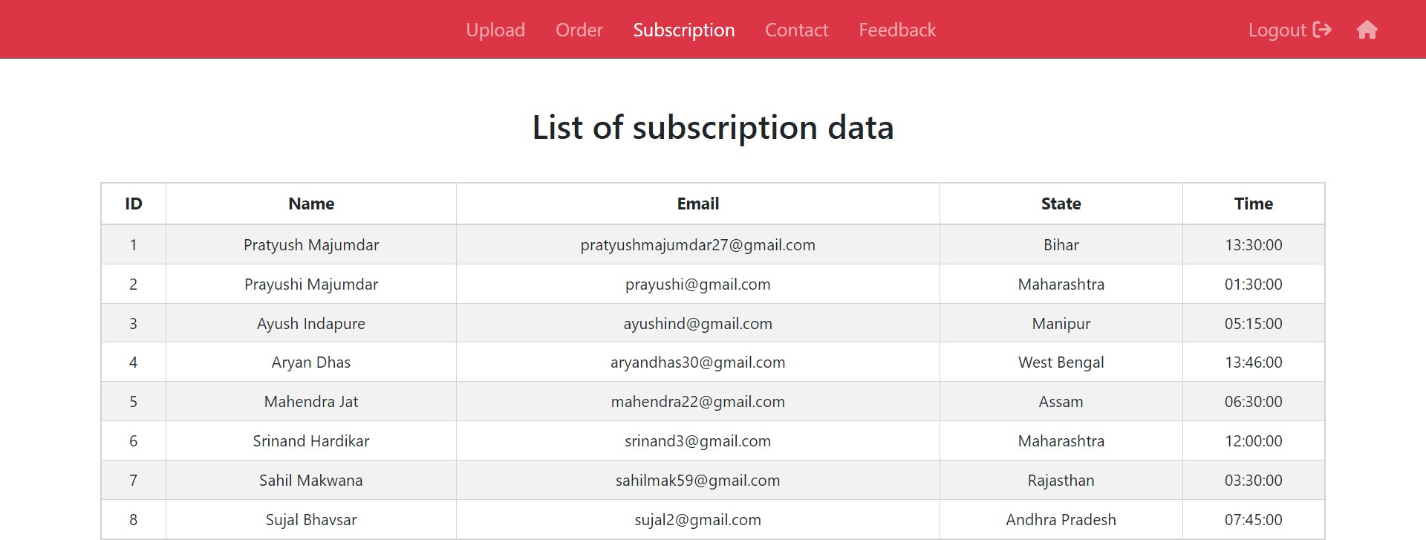
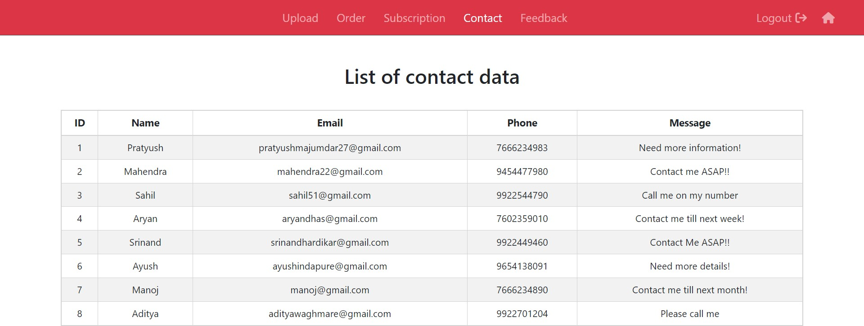
7) SUBSCRIPTION AND CONTACT TABLE

Slide 17
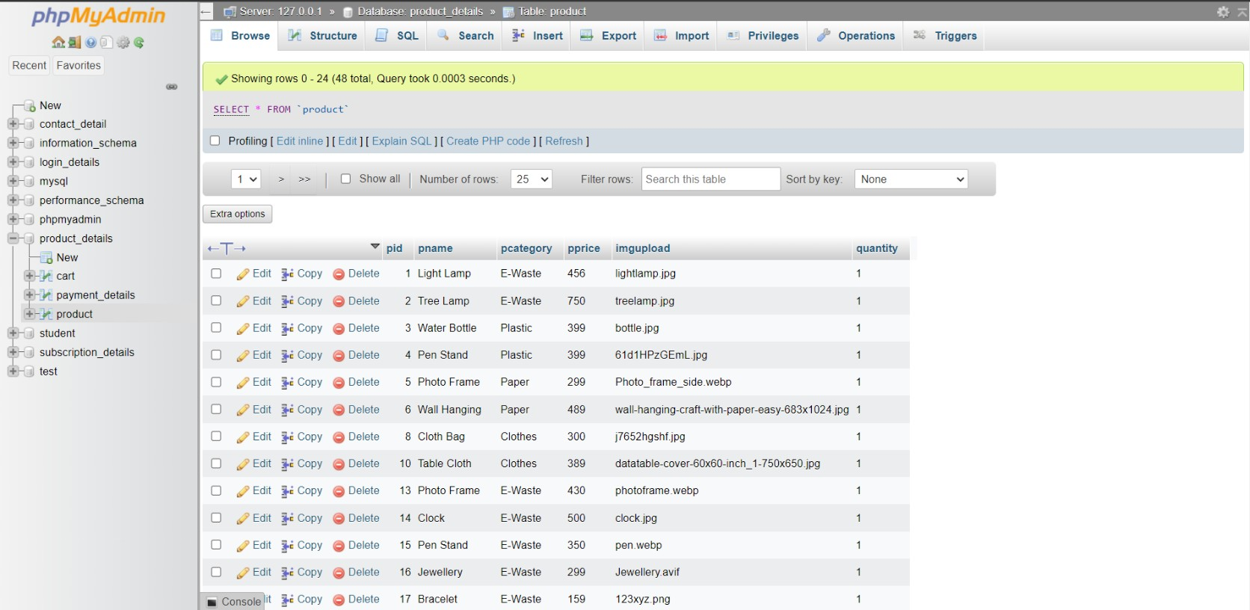
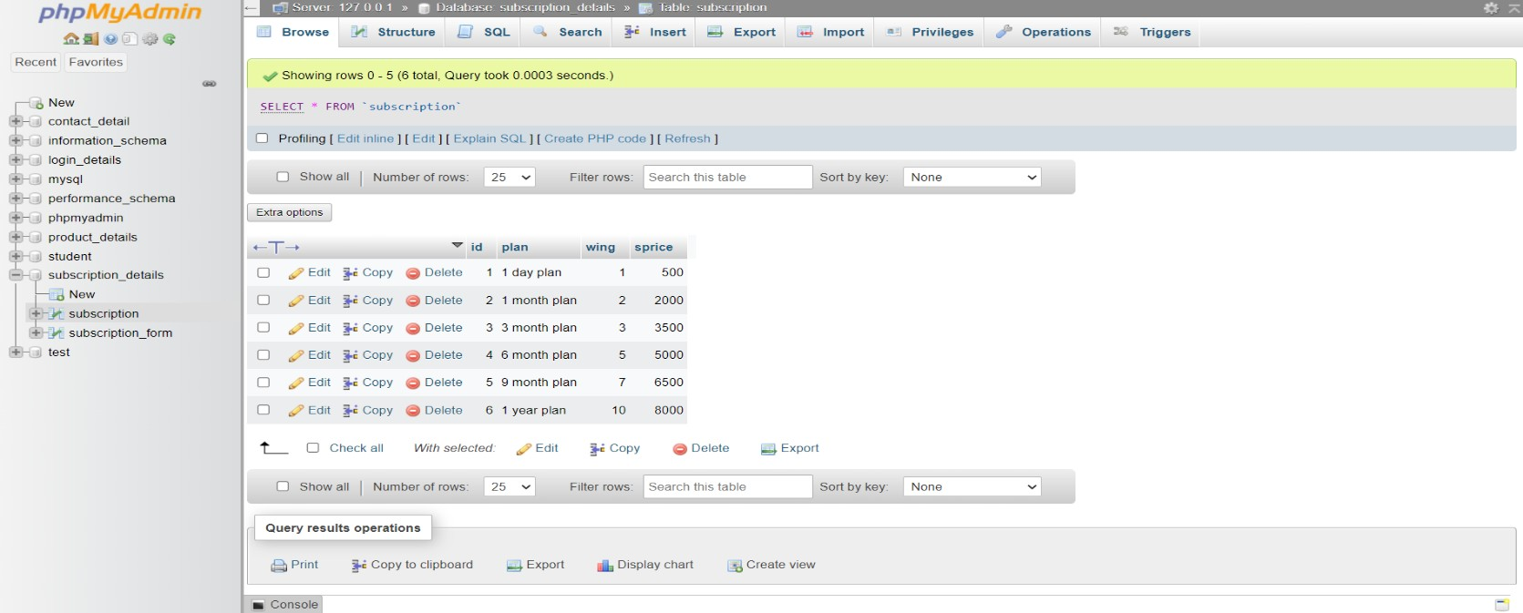
8) PRODUCTS AND SUBSCRIPTION DATA
17

Slide 18
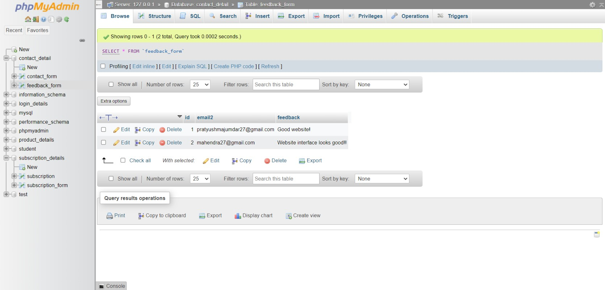
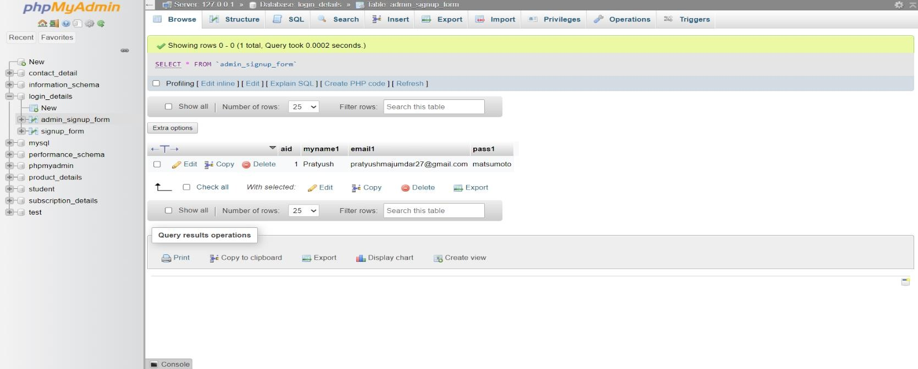
9) FEEDBACK AND LOGIN DATA
17

Slide 19
SYSTEM LIMITATIONS
Waste management services are typically localized, so the services are only available in specific regions. Users from outside those areas may find the website irrelevant.
Weather conditions, natural disasters, or other environmental factors can disrupt waste collection schedules, and the website may not always reflect these changes in real-time.
Keeping the website up to date with changing regulations, schedules, and user needs is an ongoing challenge that requires dedicated resources.
17

Slide 20
CONCLUSION
The website serves as a valuable tool for raising awareness about the importance of e-waste management and educating users on the proper disposal methods.
The website's accessibility and information may lead to a reduction in illegal disposal practices, such as dumping e-waste in landfills or improper disposal in the environment.
By facilitating the location of e-waste recycling centers and drop-off points, the website encourages users to recycle their old electronics, contributing to resource conservation and reduced electronic waste.
Over time, the website's efforts in promoting responsible e-waste disposal can lead to a reduction in the environmental impact of electronic waste, including reduced pollution and resource depletion.
17

Slide 21
REFERENCES
1) https ://www.zolopik.com
17

