Slide 1
Business Analysis for Opening A Restaurant in Manhattan Of New York City
By – Pratyush Sinha

Slide 2
Introduction/Business Problem
A UK restaurants chain plans to open a new restaurant in Manhattan in New York City, since it is the most densely populated borough of New York City. Due to its dense population there is a huge increase in demand for restaurant business and is Ideal place to open a restaurant. The vendor does not have an idea of location that would be optimal for opening a restaurant hence they have reached out to me.
Can I suggest an optimal location for opening a new restaurant to the vendor by doing data analysis on current Restaurants and Geographical factors?

Slide 3
Data Description
The dataset used for this project is the json data of New York City. This data is made available by IBM and it can be found here and is ready to use. The data contains info about all the Borough, its neighborhood and their Latitude, Longitude info. Below are the two rows of above dataset
Also, we will use FourSquare developer API to extract data for all the restaurants in Manhattan. We will combine the Manhattan data with data extracted from FourSquare API and create a new dataframe. This dataframe would be available for Data Science modeling.

Slide 4
Methodology
The location data of Manhattan, New York City is downloaded in the format of JSON files, which is then converted to a panda’s data frame. By importing Folium library, a map of Manhattan city is drawn and all the neighborhoods were marked.
Then one hot encoding is used to convert the categorical variable(for our scenario, restaurant name variable is used).
The mean of frequency of occurrence of restaurant are grouped by postal codes.
Our goal is identify the current restaurant distribution of Manhattan. I used for K-mean clustering on the preprocessed data. Since K-mean clustering is an efficient model for pattern recognition, data segregation and comparison.
Our goal is identify the current restaurant distribution of Manhattan. I used for K-mean clustering on the preprocessed data. Since K-mean clustering is an efficient model for pattern recognition, data segregation and comparison.

Slide 5
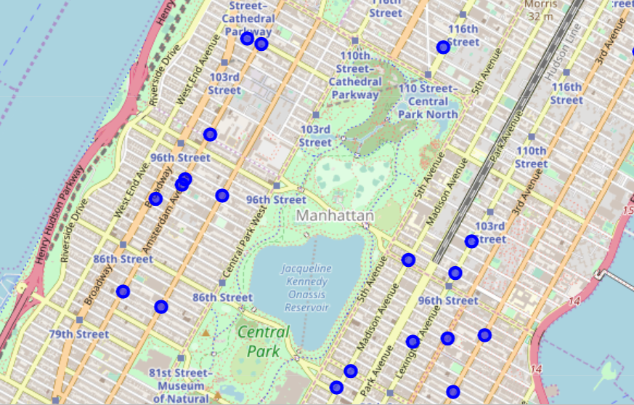
Restaurants marked in Manhattan

Slide 6
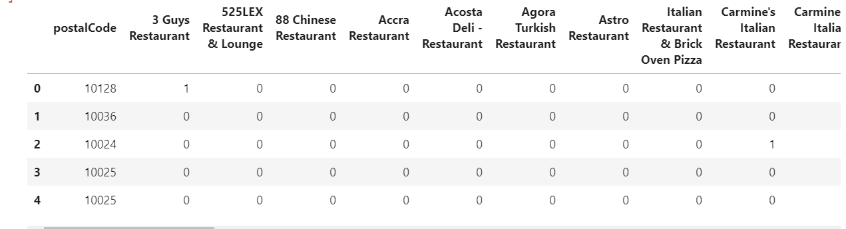
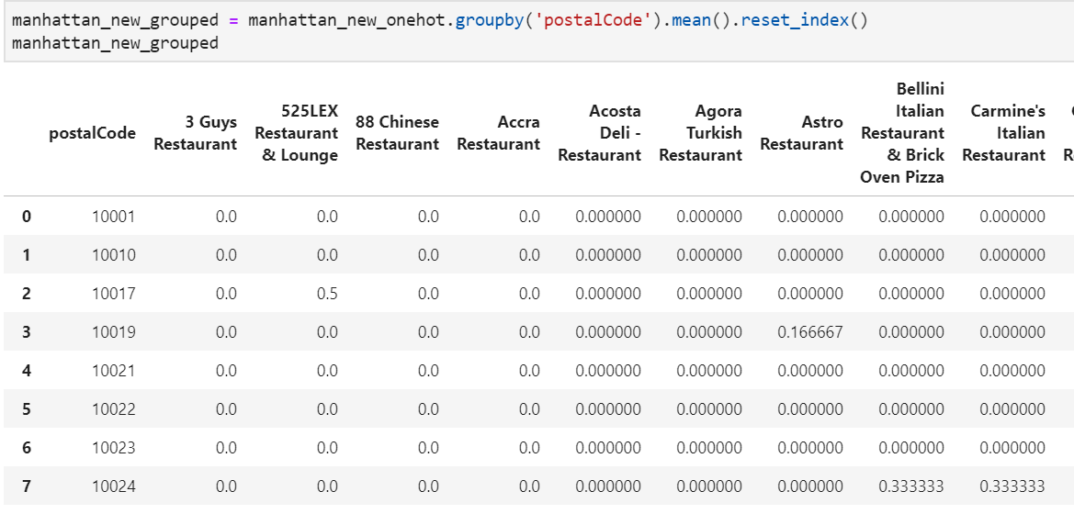

Slide 7
Results
k-mean clustering is performed using 5 clusters. The results showed that some of the locations have a higher density of cafes while some other has lower density of restaurants. Hence, places with medium density will be ideal for opening restaurants.

Slide 8
Observations and recommendations
Based on the business analysis of the restaurant density. The neighborhood regions under postcode 10024, 10029, 10027 are optimal for opening a restaurants.

Slide 9
Conclusion
In this project we aimed to do a business analysis to find a suitable location opening a new restaurant in Manhattan of New York City using the Manhattan data and FourSquare data. I choose k-mean which clustered the restaurant according to postal code. After analyzing the cluster, we found the best place to open a restaurant.

