Slide 1
AI For Everyone
Pratyush Kumar Sinha

Slide 2

Pratyush Kumar Sinha
Business Technology Analyst at Deloitte consulting.
Volunteer at ML.India.
Student Mentor at K.L. University.
Tech Speaker, AI and Data science enthusiast.
Aim is to make non tech people comfortable in AI.

Slide 3
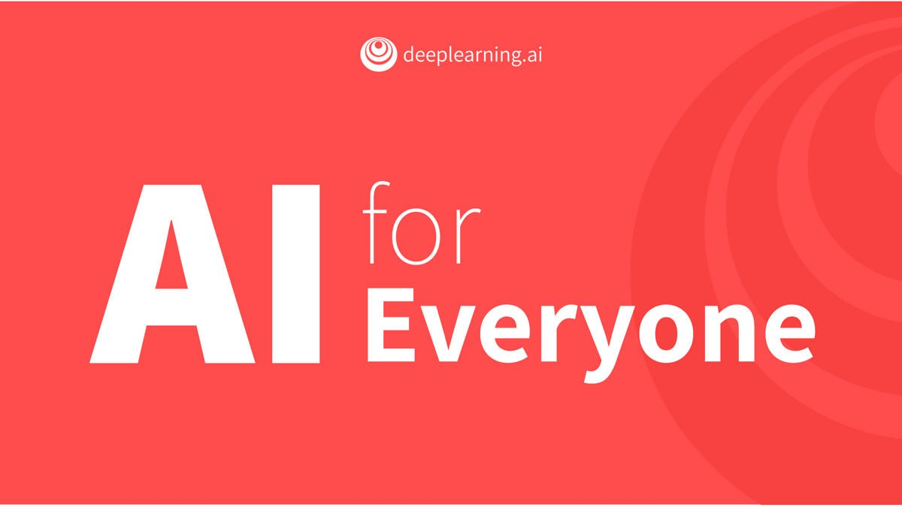
Source

Slide 4
Contents
Value creation in all sectors
Understand AI.
Why now?
Problems with the data
Machine Learning Vs Data Science
Characteristics of an AI company
5 steps to becoming an AI company
Three Rules for Making a Company Truly Great

Slide 5
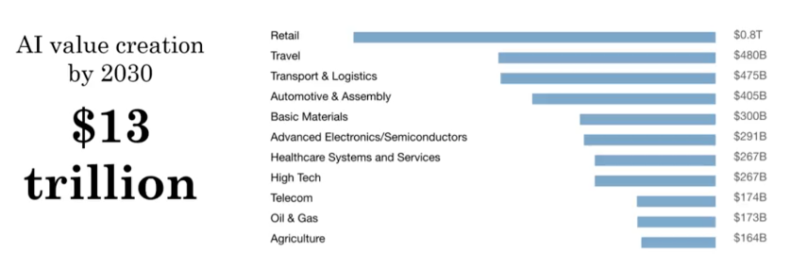
What are REST APIs?
Value creation in all sectors

Slide 6
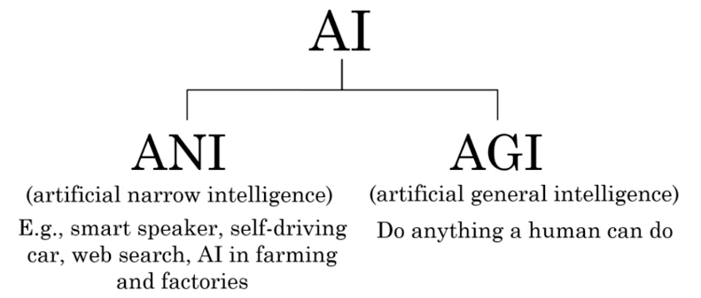
What are REST APIs?
Understand AI

Slide 7
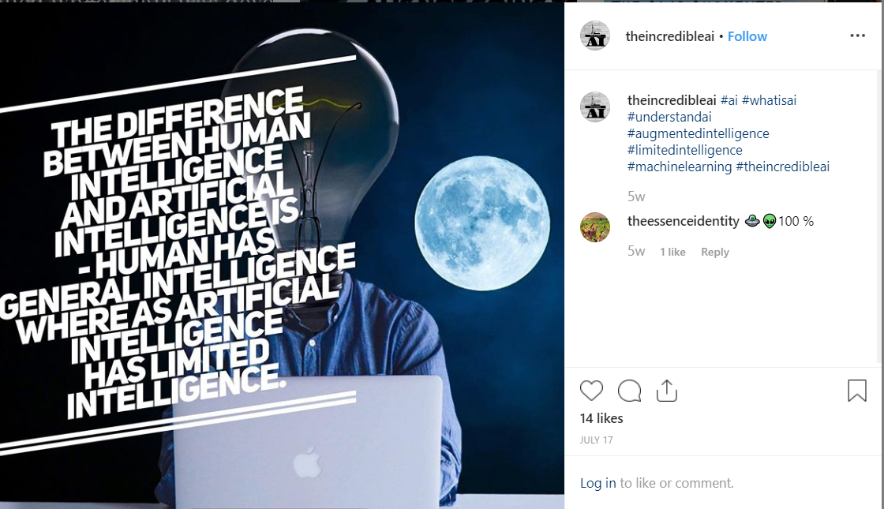
What are REST APIs?
Understand AI

Slide 8
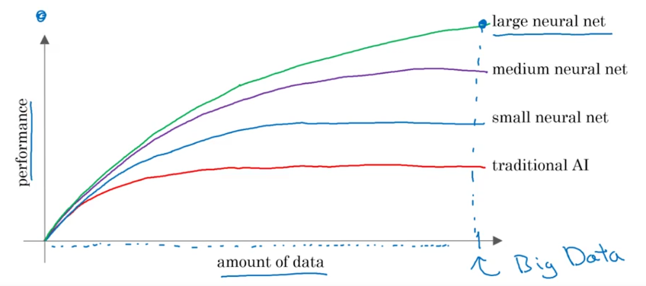
What are REST APIs?
Why now?

Slide 9
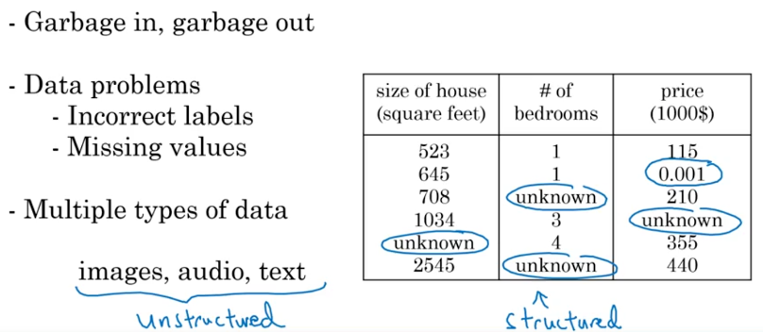
What are REST APIs?
Problems with the data?

Slide 10
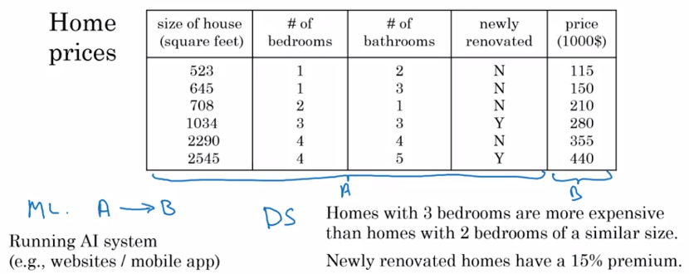
What are REST APIs?
Machine Learning Vs Data Science

Slide 11
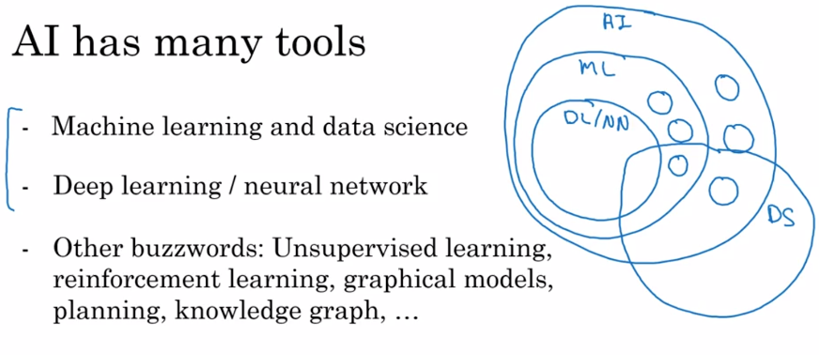
What are REST APIs?
Machine Learning Vs Data Science

Slide 12

What are REST APIs?
Machine Learning Vs Data Science

Slide 13
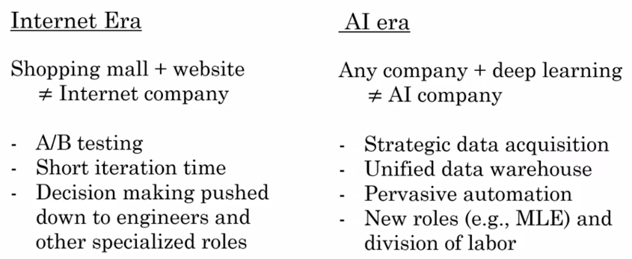
Characteristics of an AI company

Slide 14
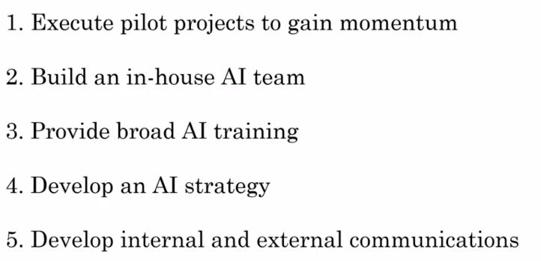
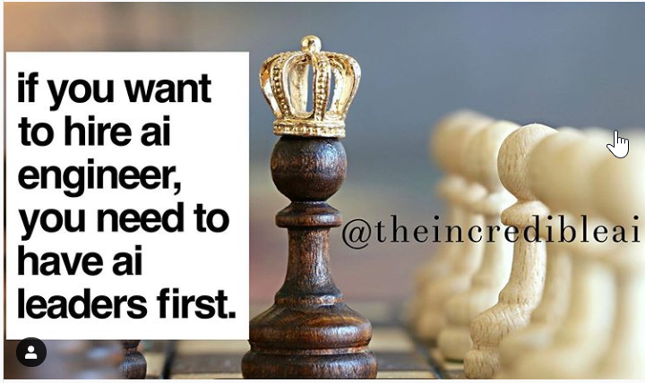
5 steps to becoming an AI company

Slide 15
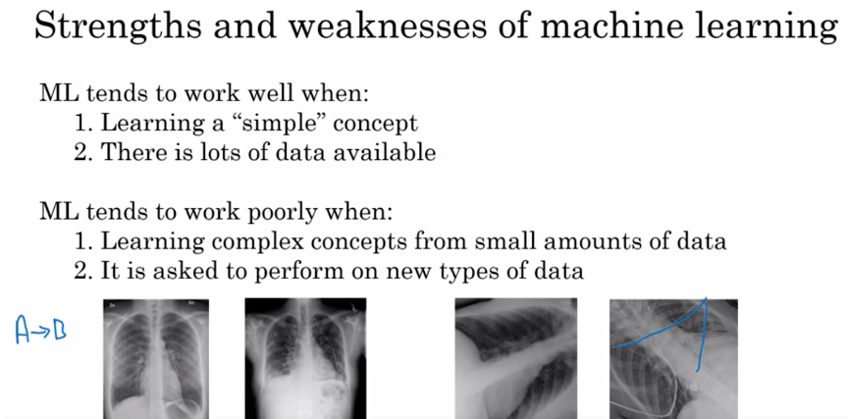
Notes:
Emphasizes and encourages on Process flow

Slide 16
Three Rules for Making a Company Truly Great
Better before cheaper—in other words, compete on differentiators other than price.
Revenue before cost—that is, prioritize increasing revenue over reducing costs.
There are no other rules—so change anything you must to follow Rules 1 and 2.

Slide 17
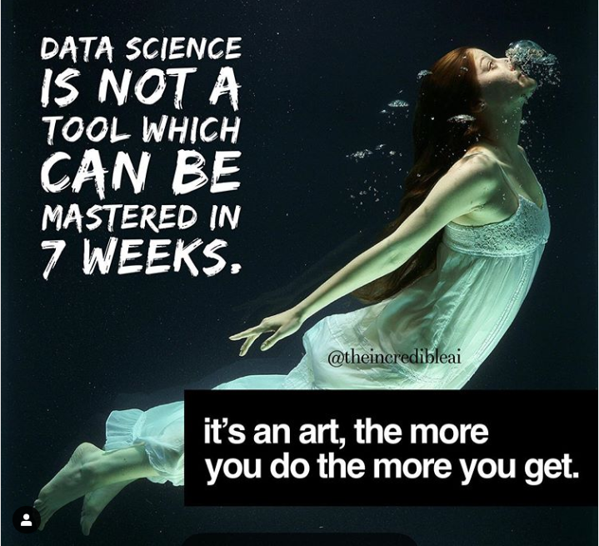
Queries?

Slide 18

Reach out to me on:
LinkedIn: @pratyush773/
Instagram: @theincredibleai/
Twitter: @yourpratyush
Thank you

