Slide 1
The Incredible AI
Pratyush Kumar Sinha

Slide 2

Pratyush Kumar Sinha
Business Technology Analyst at Deloitte consulting.
Tech Speaker, AI and Data science enthusiast.
Aim is to make non tech people comfortable in AI.

Slide 3
Contents
What is AI.
History of AI.
Is AI really Artificial Intelligence.
Difference between human intelligence and Machine Intelligence
Why AI is so popular now.
Need of AI
Challenges of AI
Conclusion

Slide 4
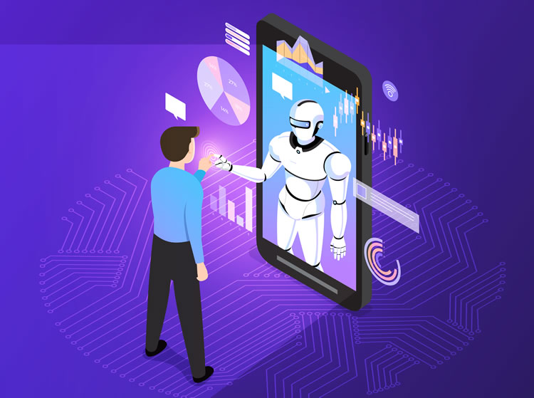
What are REST APIs?
What is AI
Intelligence demonstrated by machines, in contrast to the natural intelligence displayed by humans.

Slide 5
How do REST APIs work with IDCS?
What Experts say?
AI is the new electricity.
-Andrew Ng
AI technology could be impossible to control.
-Stephen Hawking
Mark my words — A.I. is far more dangerous than nukes.
-Elon Musk

Slide 6
Is AI really Artificial Intelligence?
Artificial" is too artificial of a word for the AI equation. Augmented intelligence describes the essence of the technology in a more elegant and accurate way.
Notes:
Emphasizes and encourages on Process flow

Slide 7
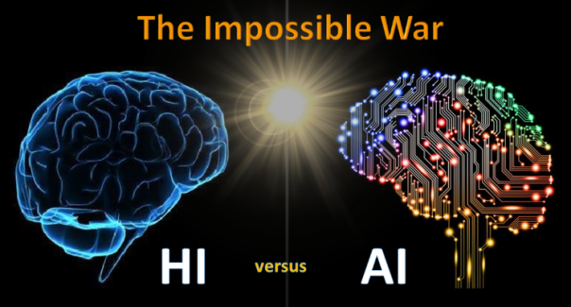
Difference between human intelligence and Machine Intelligence
Human Intelligence is General.
Machine Intelligence is Limited.

Slide 8
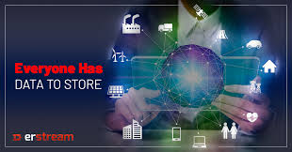
Why AI is so popular now.
There are two fuels of AI-
Data
Machine Computation.

Slide 9
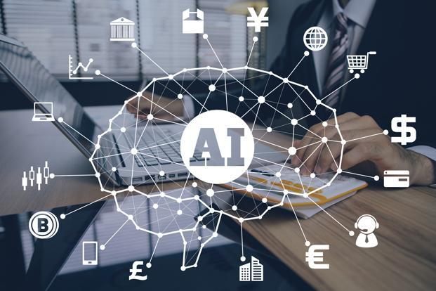
Need of AI
Work in hazardous environment as human life is more valuable than machine.
Medical negligence - 70% of deaths are a result of miscommunication.

Slide 10
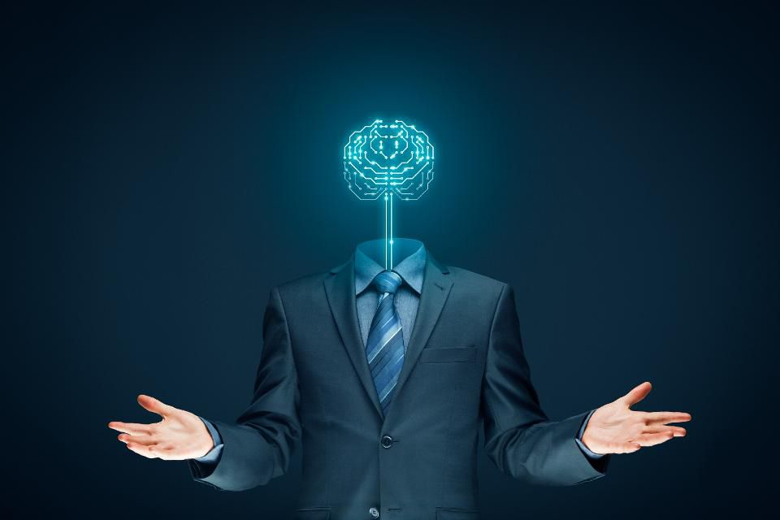
Challenges of AI
Building Trust
AI Human Interface
Investment
Higher Expectations

Slide 11
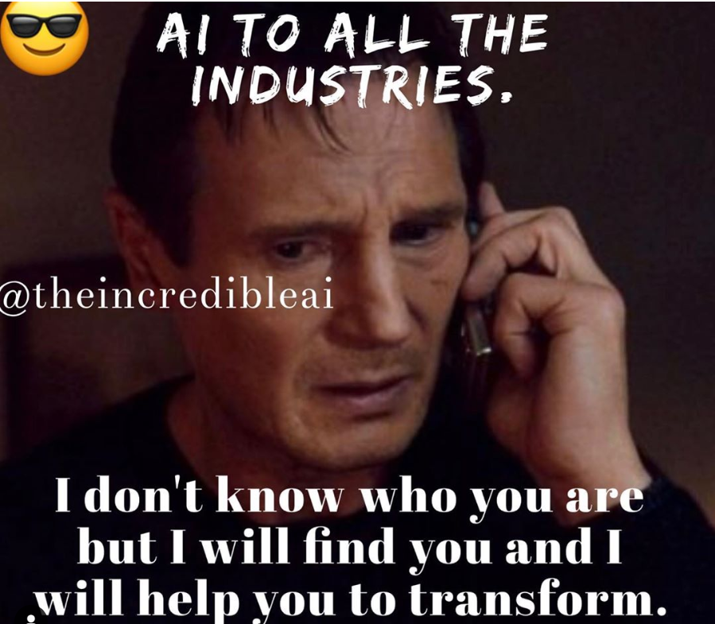
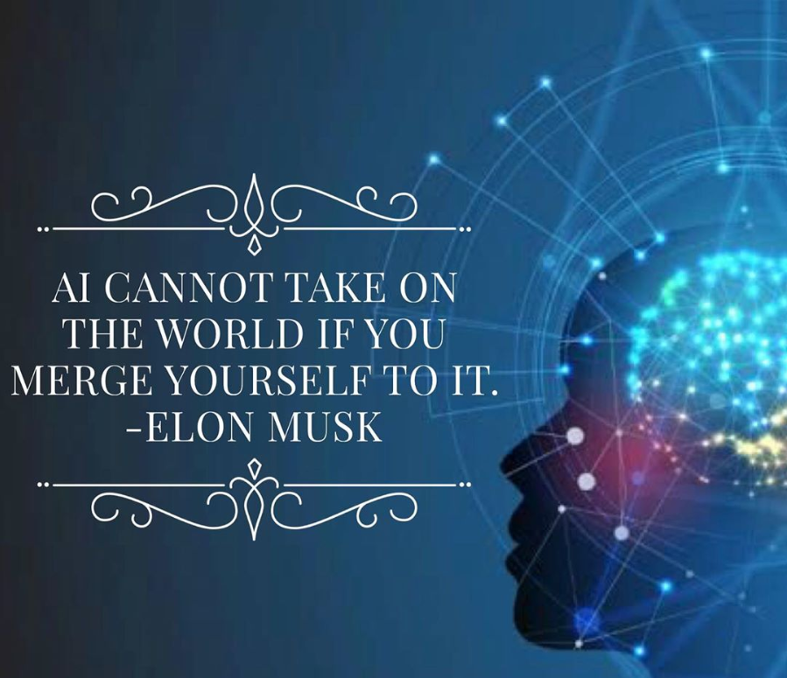
Conclusion

Slide 12
Queries?

Slide 13
Reach out to me on:
LinkedIn: @pratyush773/
Instagram: @theincredibleai/
Twitter: @yourpratyush
Thank you

