Slide 1
AI For Healthcare
Pratyush Kumar Sinha

Slide 2

Pratyush Kumar Sinha
Analyst at Deloitte consulting.
Volunteer at ML.India.
Student Mentor at K.L. University.
Tech Speaker, AI and Data science enthusiast.
Aim is to make non tech people comfortable in AI.

Slide 3
Source

Slide 4
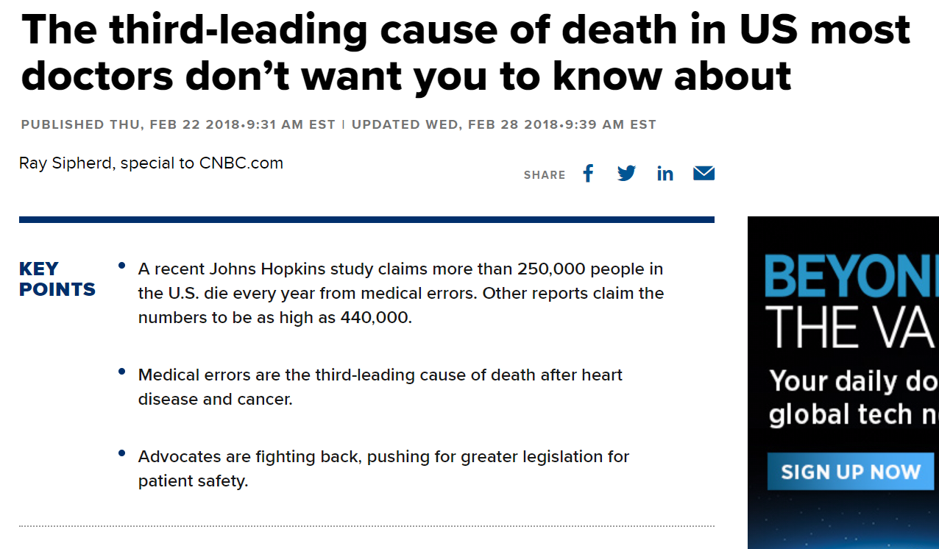
What are REST APIs?
Current challenges

Slide 5
What are REST APIs?
Current challenges of healthcare
Long term chronic disease
Neglect of Rural Population
Inadequate Outlay for Health
Social Inequality
Shortage of Medical Personnel
Medical Research
Expensive Health Service
According to health information 31.5% of hospitals and 16% hospital beds are situated in rural areas where 75% of total population resides.
health sector constitutes only 0.9 percent of the GDP

Slide 6
What are REST APIs?
Why Artificial Intelligence in Healthcare?
Machine learning has the potential to provide data-driven clinical decision support (CDS) to physicians and hospital staff – paving the way for an increased revenue potential. It can be used in below ways:
Descriptive
Predictive
Prescriptive

Slide 7
What are REST APIs?
Where AI can help
Radiology
Imaging
Disease Diagnosis
Telehealth
Electronic health records
Drug Interactions
Creation of New Drugs

Slide 8
What are REST APIs?
Where AI can help
According to Business Insider Intelligence, 30% of healthcare costs are associated with administrative tasks like –
pre-authorizing insurance,
following-up on unpaid bills
maintaining records,
to ease the workload of healthcare professionals
AI can automate some of these tasks.

Slide 9
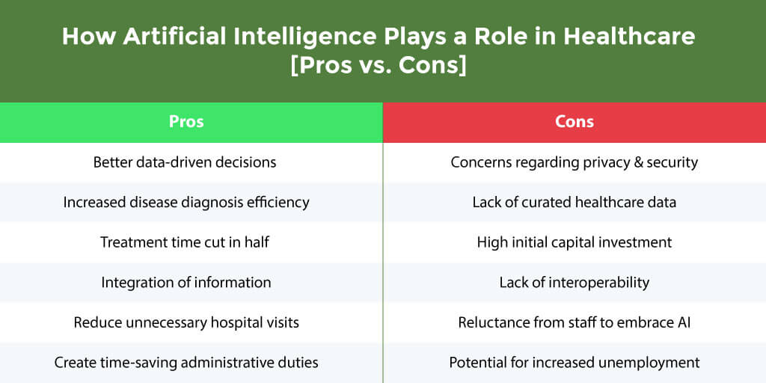
What are REST APIs?
Why AI?

Slide 10
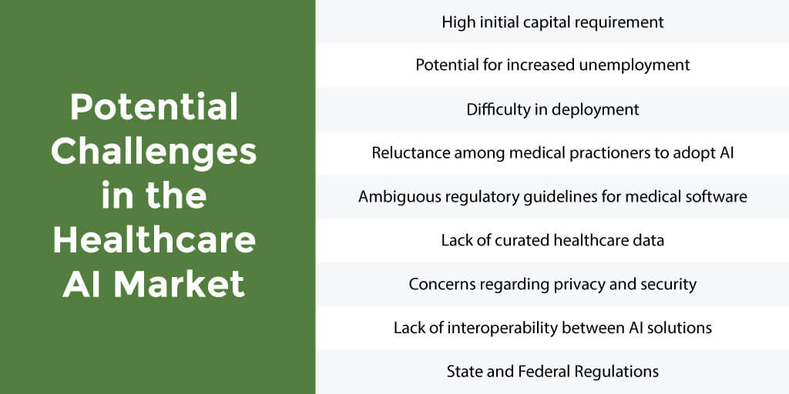
What are REST APIs?
Challenges of AI in Healthcare

Slide 11
What are REST APIs?
Existing AI based healthcare systems
IBM Watson’s
Google Cloud's Healthcare app

Slide 12
Why should Government Invest in AI?

Slide 13
Queries?

Slide 14
Reach out to me on:
LinkedIn: @pratyush773/
Instagram: @theincredibleai/
Twitter: @yourpratyush
Thank you

