Slide 1
Digital signature generation and verification
By
181fa04198
181fa04222
181fa04229

Slide 2
Contents
Introduction
Abstract
Scope
Objectives
Applications
Hardware and Software Requirements
Implementation
Output
Summary

Slide 3
Introduction
Digital signatures are created and verified by using public key cryptography, also known as asymmetric cryptography. By the use of a public key algorithm, such as RSA, one can generate two keys that are mathematically linked- one is a private key, and another is a public key.
The user who is creating the digital signature uses their own private key to encrypt the signature-related document. There is only one way to decrypt that document is with the use of signer's public key.
This technology requires all the parties to trust that the individual who creates the signature has been able to keep their private key secret. If someone has access the signer's private key, there is a possibility that they could create fraudulent signatures in the name of the private key holder.

Slide 4
Abstract
A digital signature is a mathematical technique which validates the authenticity and integrity of a message, software or digital documents. It allows us to verify the author name, date and time of signatures, and authenticate the message contents.
The digital signature offers far more inherent security and intended to solve the problem of tampering and impersonation (Intentionally copy another person's characteristics) in digital communications.

Slide 5
SCOPE
A digital signature consists of three algorithms:
Key generation algorithm
The key generation algorithm selects private key randomly from a set of possible private keys. This algorithm provides the private key and its corresponding public key.
Signing algorithm
A signing algorithm produces a signature for the document.
Signature verifying algorithm
A signature verifying algorithm either accepts or rejects the document's authenticity.

Slide 6
OBJECTIVES
To create create a digital signature. Steps to be followed are :
Select a file to be digitally signed.
The hash value of the message or file content is calculated. This message or file content is encrypted by using a private key of a sender to form the digital signature.
Now, the original message or file content along with the digital signature is transmitted.
The receiver decrypts the digital signature by using a public key of a sender.
The receiver now has the message or file content and can compute it.
Comparing these computed message or file content with the original computed message. The comparison needs to be the same for ensuring integrity.

Slide 7
Applications of digital signature
The important reason to implement digital signature to communication is:
Authentication
Non-repudiation
Integrity

Slide 8
Hardware Requirements
Processor: speed of 500Mhz and above
RAM:128mb and above
System type:64-bit OS

Slide 9
Software Requirements
Java, JDK
Text Editor
Minimum Windows Configuration

Slide 10
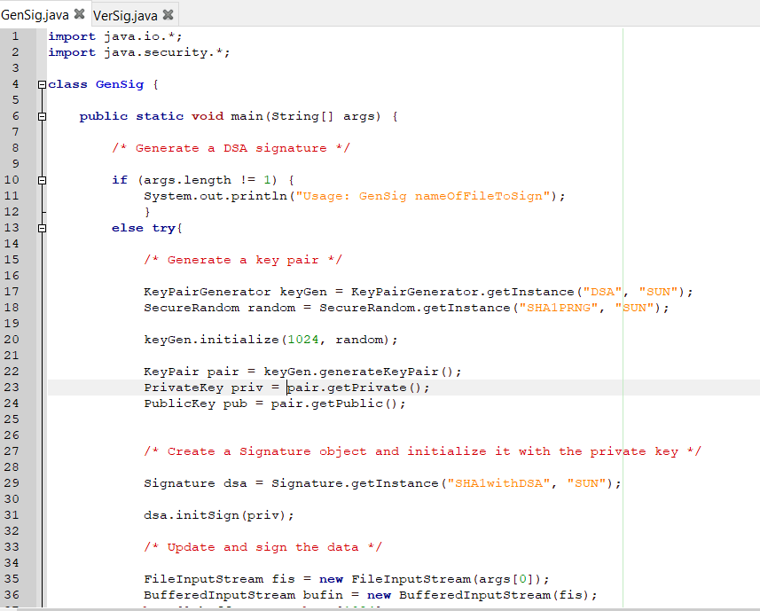
Implementation

Slide 11
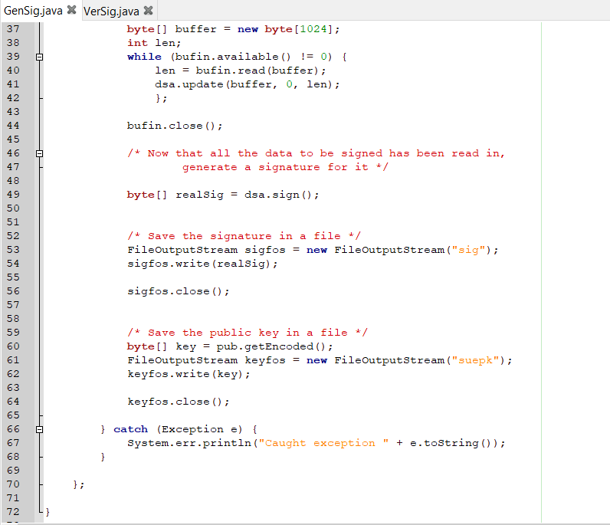
1.

Slide 12
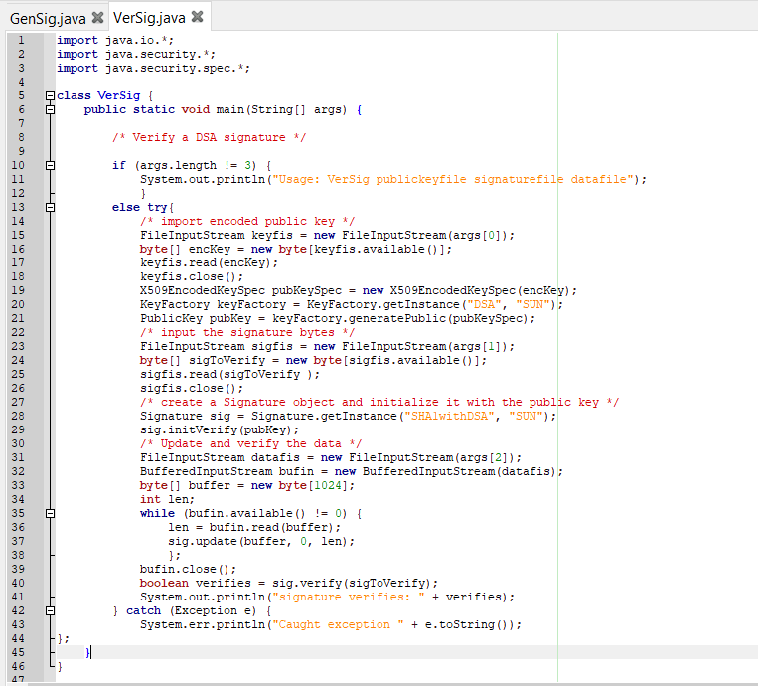
2.

Slide 13
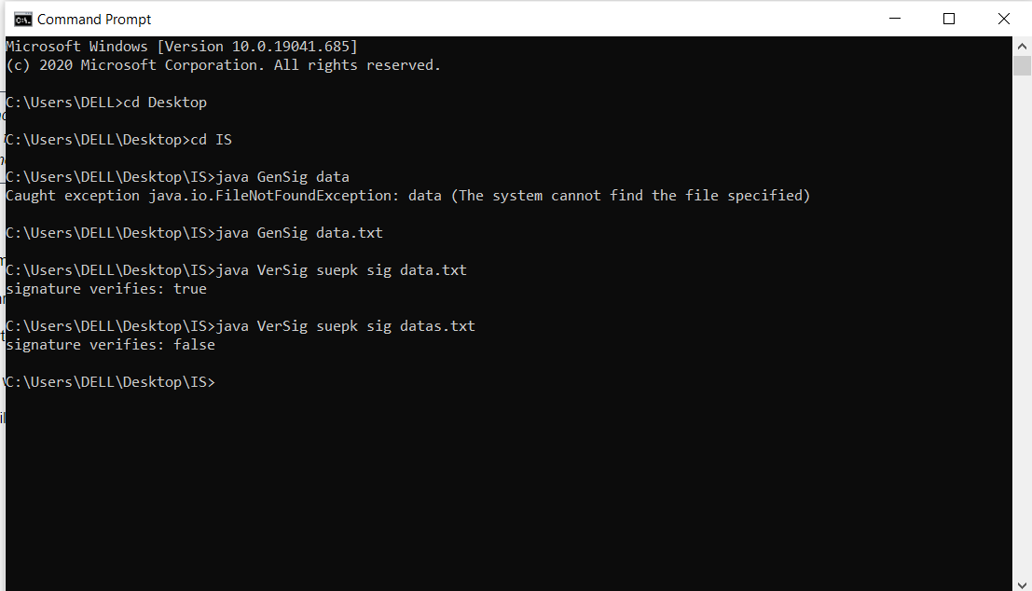
OUTPUT

Slide 14
SUMMARY
The digital signature is one of the best authentication tools for the electronic record.On account of its cost, security, time, and speed, digital signatures are popular nowadays.
In today’s interconnected and digital world, the digital signature algorithm is a vital aspect for creating a safer and secure environment.

Slide 15
THANK YOU

