Slide 1

Employee Management System
SQL Project — Database Design & Analysis
N.Pratyusha

Slide 2
Agenda :
1. Domain & objective
2. Dataset & ER diagram
3. Schema design
4. Analysis results
- Employee insights
- Job role & department
- Leave patterns
- Payroll & compensation
5. Challenges & conclusion

Slide 3
Domain Knowledge :
What is EMS?
EMS centralizes employee-related information for day-to-day HR operations.
Tracks: employee profile, job role & department, pay structure, leave records, qualifications. This system allows for efficient tracking of employee details, job assignments, qualifications, and performance metrics
Enables reporting: headcount, compensation distribution, payroll processing, leave impact.

Slide 4
Problem Statement & Objectives :
Problem: Build an Employee Management System database to store and manage employee, job, payroll, leave, and qualification data with integrity.
Objectives:
Design relational schema with correct primary/foreign keys
Enforce integrity using cascading and set-null rules
Analyse data using SQL queries and show outputs
Provide insights about employees, salaries, leaves, payroll

Slide 5
Dataset Overview :
JobDepartment: departments + job roles + salary ranges
SalaryBonus: salary/annual/bonus per role
Employee: employee master data + role mapping
Qualification: qualifications and role requirements
Leaves: leave dates and reasons
Payroll: payroll records and computed totals

Slide 6
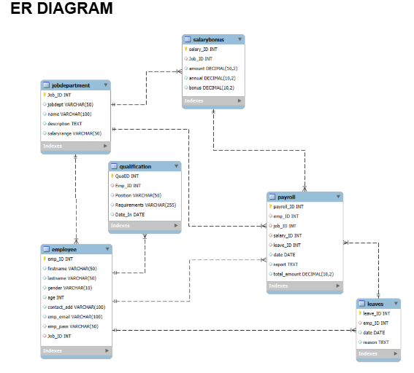
ER Diagram & Relationships :
JobDepartment → Employee (role assignment)
JobDepartment → SalaryBonus (pay mapped to role)
Employee → Qualification (employee skill records)
Employee → Leaves (employee leave history)
Payroll references Employee + JobDepartment + SalaryBonus (+ Leaves optionally)
Integrity rules:
ON DELETE CASCADE / ON UPDATE CASCADE; Payroll–Leaves uses ON DELETE SET NULL

Slide 7
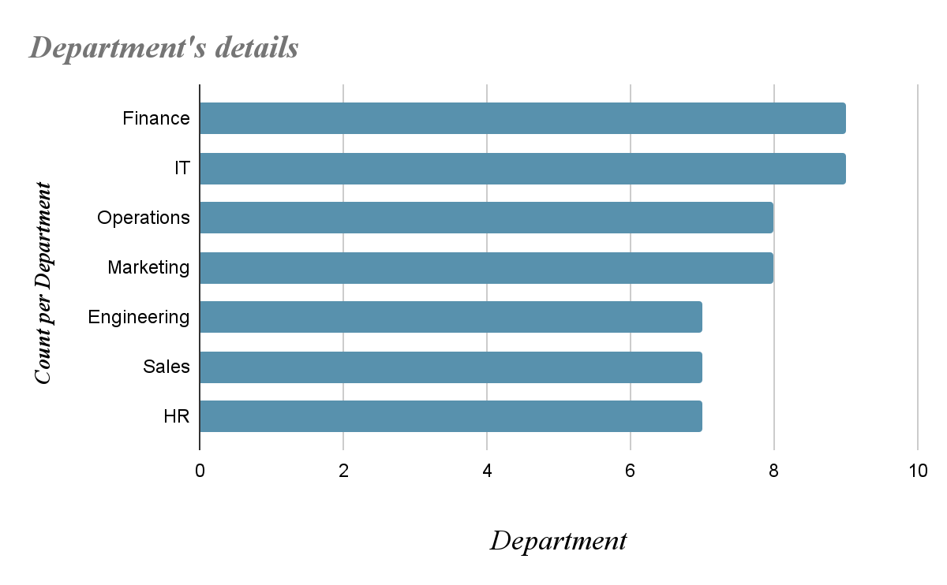
Employee Insights :(department ,no of employee,Total Salary)
Unique employees in the system: 60
Total salary expenditure (annual + bonus): 52,482,700.00

Slide 8
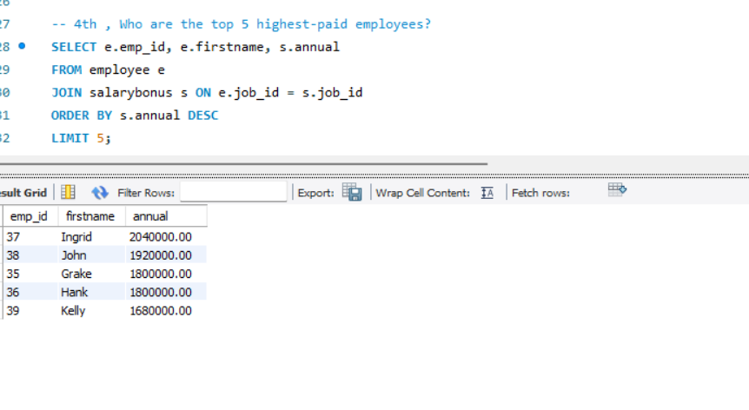
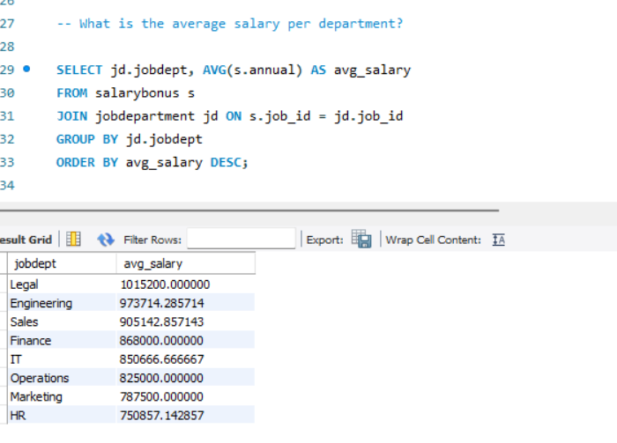
Salary insights :
Who are the top 5 highest-paid employees?
What is the average salary per department?

Slide 9
Job Role & Department Analysis :
How many different job roles exist in each department?
What is the average salary range per department?
Which job roles offer the highest salary?
Which departments have the highest total salary allocation?

Slide 10
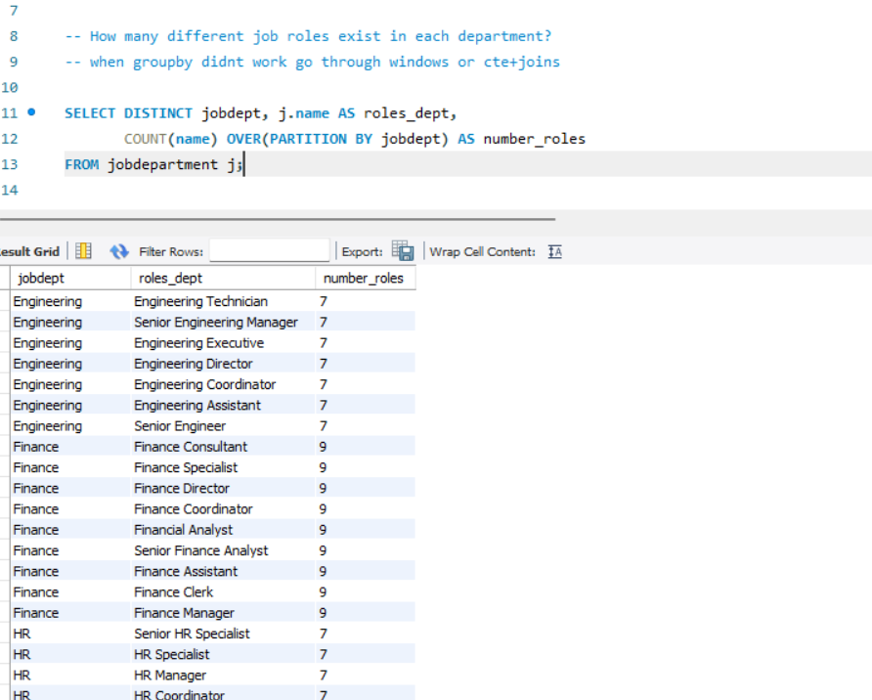
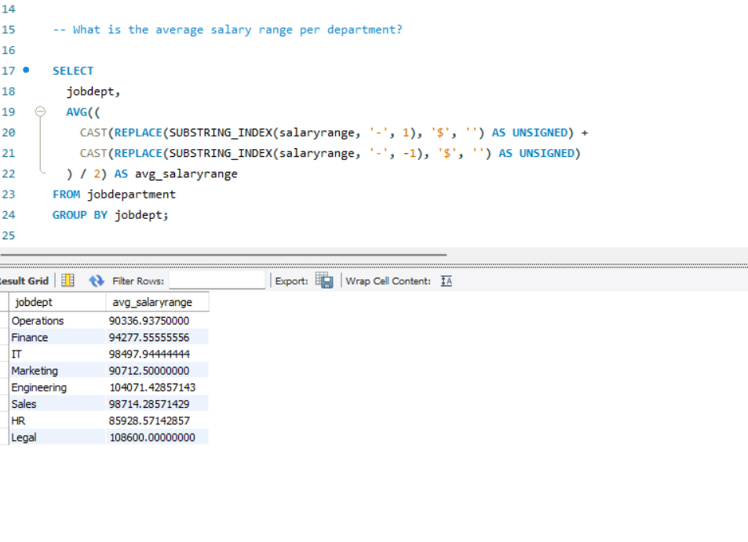
Roles per department (examples from output):
Finance: 9 roles
Engineering: 7 roles
HR: 7 roles
Avg salary range per department (highest shown): Legal (108,600.00)
Insight: role variety helps explain differences in average salaries and allocation.

Slide 11
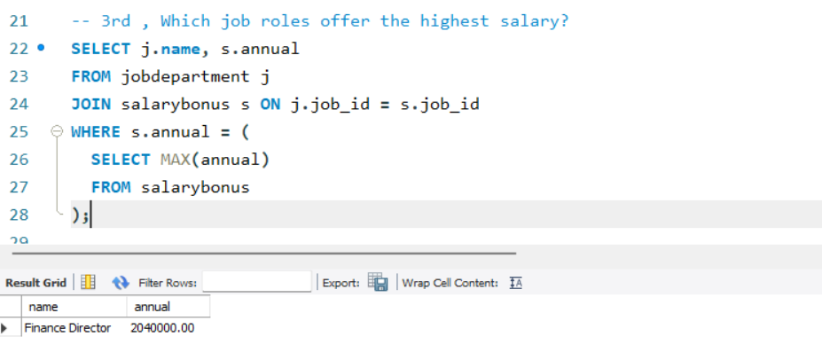
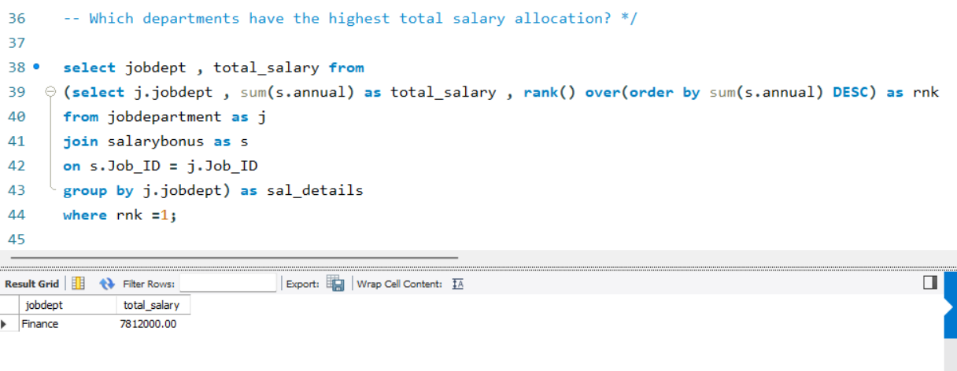
Highest salary role: Finance Director — 2,040,000.00
Highest total salary allocation dept: Finance — 7,812,000.00

Slide 12
QUALIFICATION AND SKILLS ANALYSIS :
How many employees have at least one qualification listed?
Which positions require the most qualifications?
Which employees have the highest number of qualifications?

Slide 13
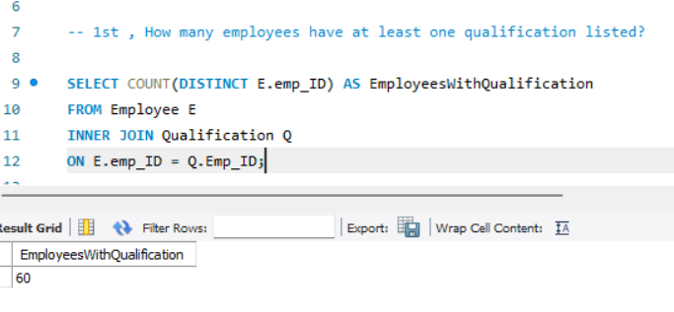
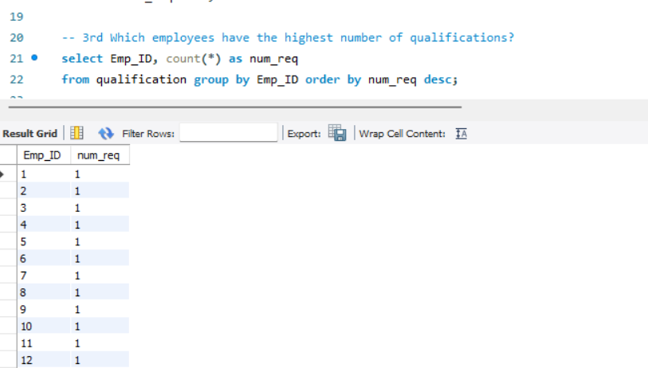
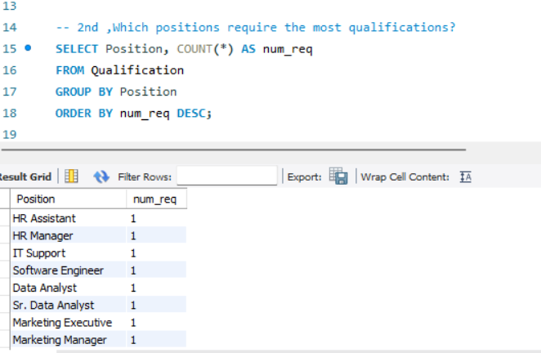

Slide 14
LEAVE AND ABSENCE PATTERNS :
Which year had the most employees taking leaves?
What is the average number of leave days taken by its employees per department?
Which employees have taken the most leaves?
What is the total number of leave days taken company-wide?
How do leave days correlate with payroll amounts?

Slide 15
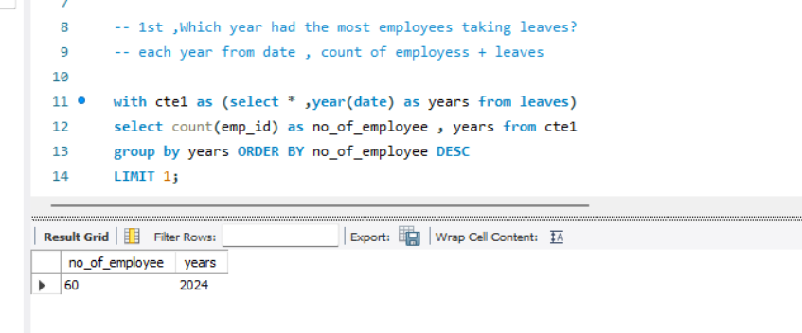
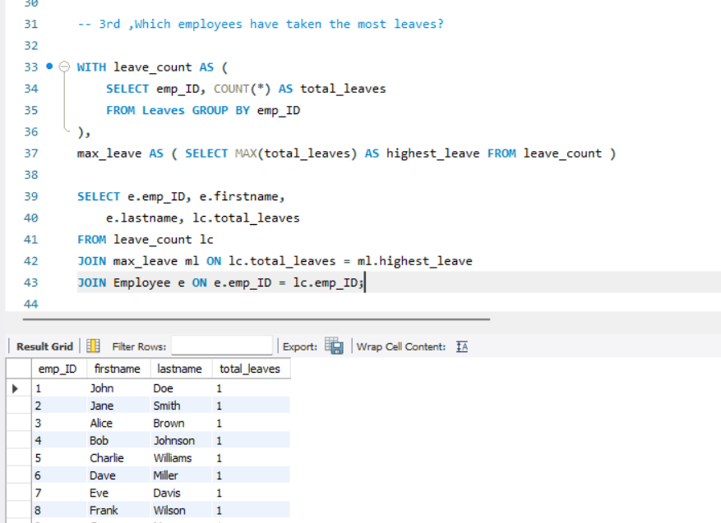
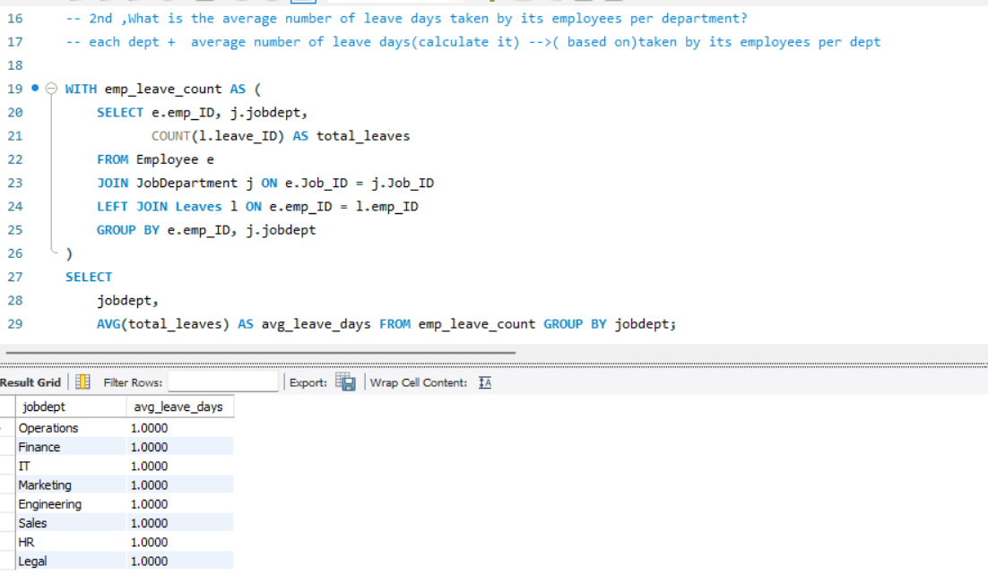

Slide 16
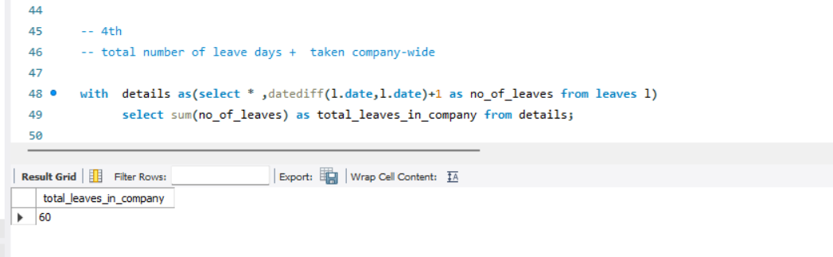
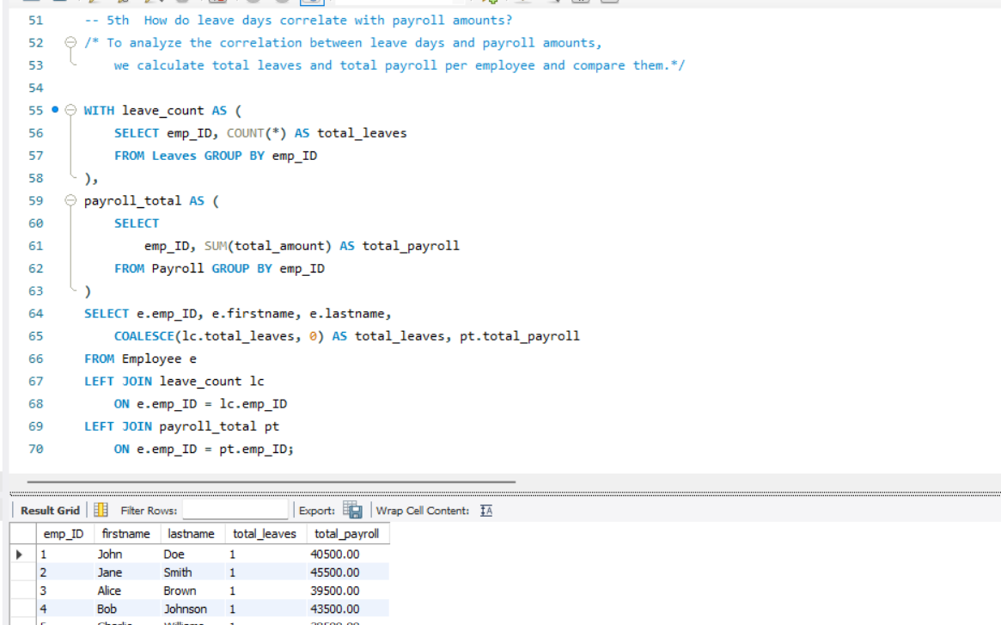

Slide 17
PAYROLL AND COMPENSATION ANALYSIS :
What is the total monthly payroll processed?
What is the average bonus given per department?
Which department receives the highest total bonuses?
What is the average value of total_amount after considering leave deductions?

Slide 18
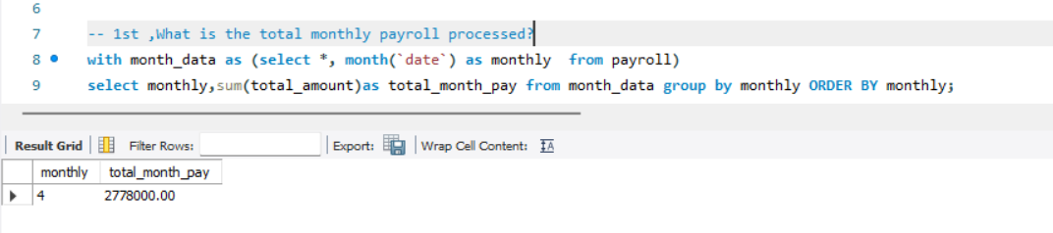
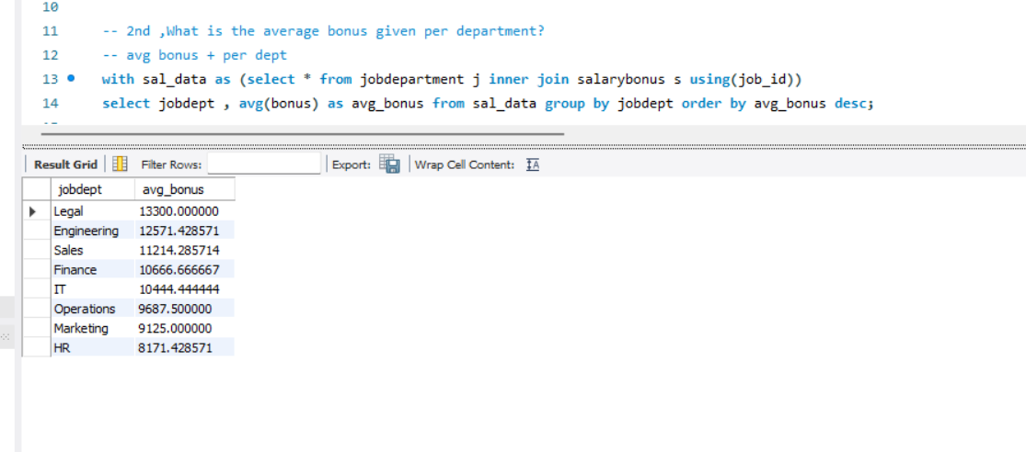

Slide 19
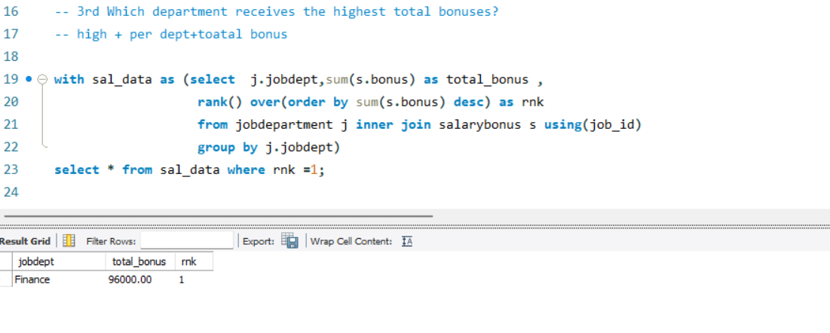
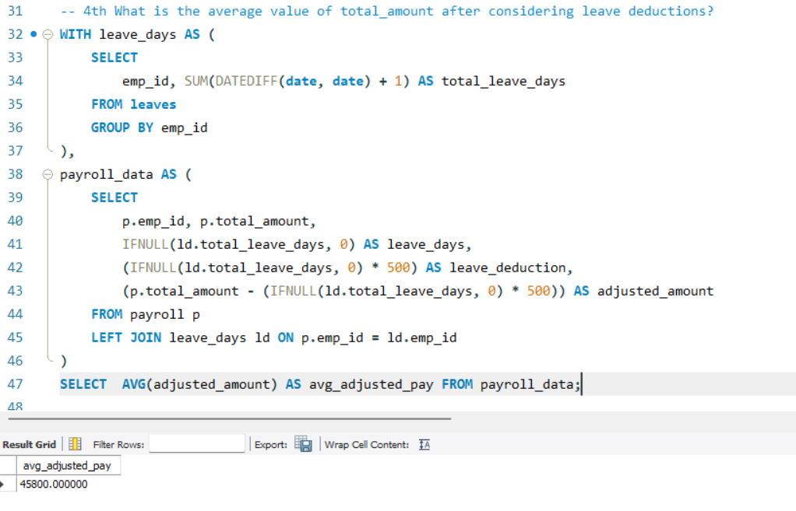

Slide 20
Challenges:
correct foreign key mapping across 6 tables
cascading updates/deletes vs set-null behavior
complex joins + CTEs + window functions
date format consistency for time analysis
Learnings:
CTEs for readable multi-step queries
RANK() and window functions for “top” results
multi-table joins for payroll + leave impact

Slide 21

THANK YOU

