Slide 1
Multi Segmented Image in Delay Tolerant Networks using Bandwidth Reduction Technique Final Presentation – May 2013
Pratyush Anand
Part Time MS(R) Student in Computer Technology,
Department of Electrical Engineering, IIT Delhi
Entry Number: 2010EEY7515
Research Supervisor: Prof. Subrat Kar

Slide 2
Introduction
It is very important to achieve, reduction in amount of data to be transmitted due to lack of end to end connectivity.
For surveillance data
Entire image need not be transmitted
Only a few segments of image need to be transmitted(the fast changing scenes)
Transmitting only significant features pre-extracted locally from the image can reduce transmission requirement significantly.
Extraction of such image information is possible if end node is intelligent.
Semantic information transfer can reduce this further
We also need to ensure that this minimization of content allows us to reconstruct the image with relevant details at the other end.

Slide 3
Low BW surveillance image processing steps
Grab gray scale frame
Subtract background
Clean unnecessary foreground
Find out all moving contours
Skeletonize each contour
Detect moving human

Slide 4
Background subtraction algorithm
Method described by Yao and Odobez [1] is based on use of texture features present in Local Binary Pattern(LBP).
LBP works well with local illumination changes, however there can be issues in case of global illumination change.
Photometric invariant color measurement method has been used to overcome these issues.
Method by Barnich and Van Droogenbroeck [2] (Vibe) re-places background values for last N frames randomly.
Furthermore, it diffuses updated values to neighboring pixels, and again that too on random basis.
So far this algorithm surpasses other existing algorithm in computation complexities

Slide 5
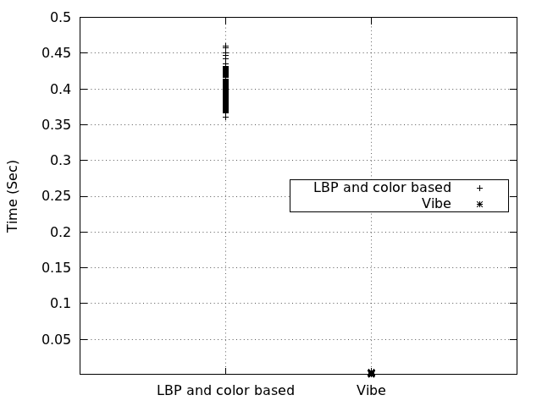
Background subtraction algorithm comparison
Variation of background subtraction execution time of
[1] and [2] with frame number. This timing was observed with
a system with DMIPS = 800.

Slide 6
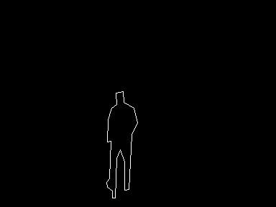
Human skeleton algorithm comparison: Contour skeleton
Find out boundary points (cvFindContours)
Approximate these points to a polygon. (cvApproxPoly)
Vertices of these polygon connected together gives an outer skeleton of object

Slide 7
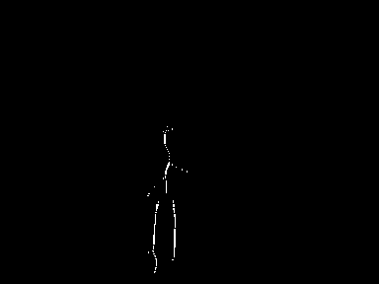
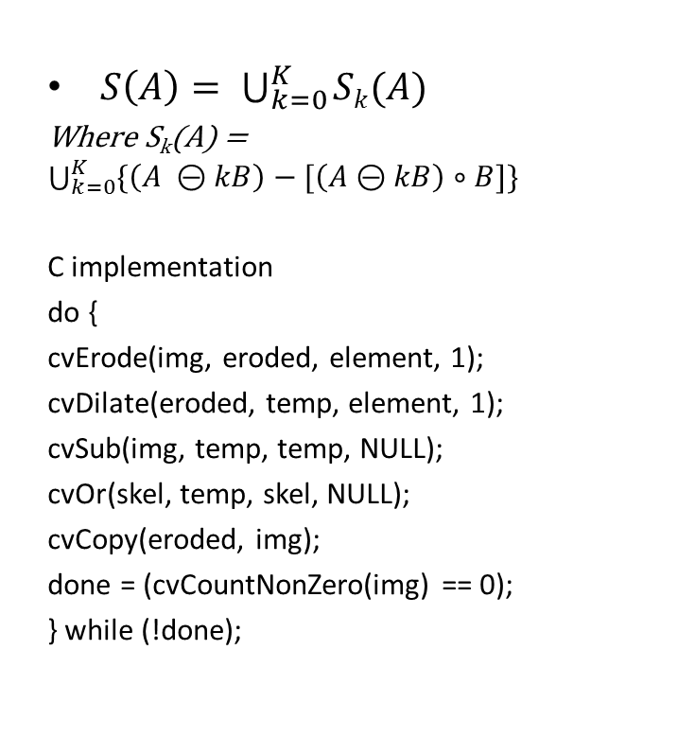
Human skeleton algorithm comparison: Morphological skeleton
$S\left(A\right)= \bigcup_{k=0}^{K}{Sk(A)}$
Where S_{k}(A) = $\bigcup_{k=0}^{K}{\{\left(A ⊝kB\right)−[\left(A⊝kB\right)∘B]\}}$
C implementation
do {
cvErode(img, eroded, element, 1);
cvDilate(eroded, temp, element, 1);
cvSub(img, temp, temp, NULL);
cvOr(skel, temp, skel, NULL);
cvCopy(eroded, img);
done = (cvCountNonZero(img) == 0);
} while (!done);

Slide 8
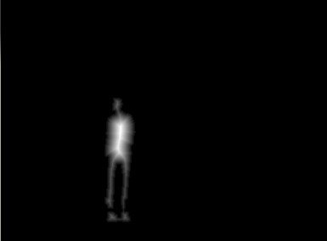
Human skeleton algorithm comparison: Distance transform skeleton
Transformed image pixel is set to a value equal to the distance to the nearest zero pixel in the input image.
cvDistTransform (img, transformed, CV_DIST_L2, 5, NULL, NULL);
cvNormalize(transformed, transformed, 0.0, 1.0, CV_MINMAX);

Slide 9
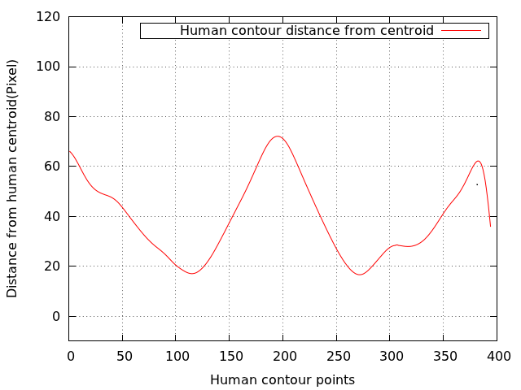
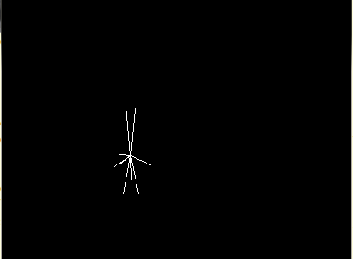
Human skeleton algorithm comparison: Star Skeleton
Plots distance of each boundary point from the centroid.
Low pass filter this plotted curve
Use peaks of the curve as skeleton point.

Slide 10
Our human detection algorithm
There are some peaks which is not of our interest in star skeleton
We are using 2 most relevant peaks which are nearest to each bottom corner of bounding box of contour respectively.
Only these two peaks along with centroid gives us sufficient information to distinguish human from human, vehicle or animal etc.
When the case considered is human, then the two peaks correspond to the two legs of human. When case considered is vehicle, then the peaks correspond to the two extrema points of lower portion of back and front. When it is an animal, then peaks correspond to front and back leg of animal.
Let P₁(X₁, Y₁), P₂(X₂, Y₂) and C(C_{x}, C_{y}) are two peaks nearest to bottom right and bottom left corner and centroid respectively. Let Ɵ is the angle between line segment P₁C and P₂C, then Ɵ can be calculated as follows.
Ɵ = tan⁻¹[(Y₂ - C_{y}) / (X₂ - C_{x})] - tan⁻¹ [(Y₁ - C_{y}) / (X₁ - C_{x})]

Slide 11
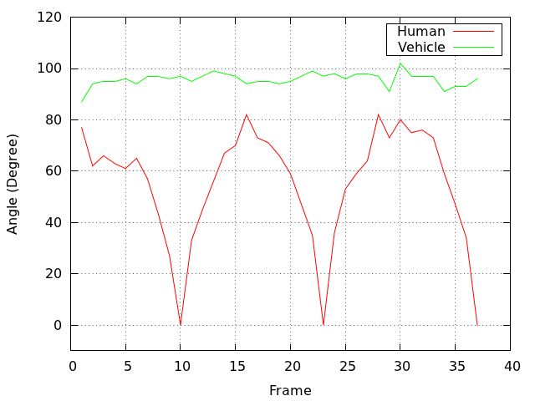
Our algorithm continued…..
If variation of Ɵ is plotted in respective frames for human and vehicle then the resultant plot is as shown in Figure.
For a human subject, angle variation pattern is repeatable, and it is zero for almost at regular intervals.
For vehicle, it is constant.
The experiment with images containing animal has not been done.
For images with animals in it, there are variations with repeatable patterns but which never touch zero.

Slide 12
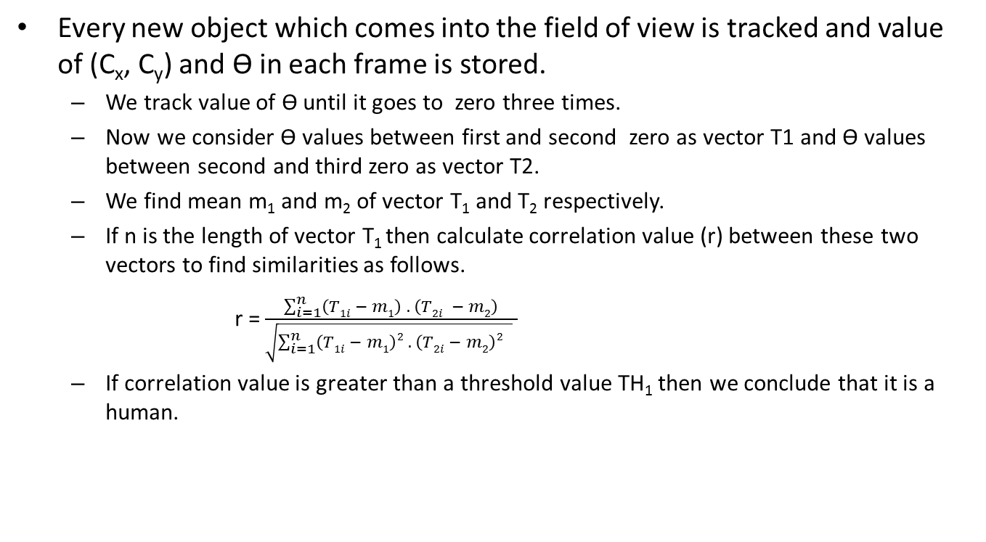
Our algorithm continued…..
Every new object which comes into the field of view is tracked and value of (C_{x}, C_{y}) and Ɵ in each frame is stored.
We track value of Ɵ until it goes to zero three times.
Now we consider Ɵ values between first and second zero as vector T1 and Ɵ values between second and third zero as vector T2.
We find mean m₁ and m₂ of vector T₁ and T₂ respectively.
If n is the length of vector T₁ then calculate correlation value (r) between these two vectors to find similarities as follows.
r =$\frac{\sum_{i=1}^{n}{\left(T1i − m1\right) . \left(T2i − m2\right)}}{\sqrt{\sum_{i=1}^{n}{\left(T1i − m1\right)2 . \left(T2i − m2\right)2 } } }$
If correlation value is greater than a threshold value TH₁ then we conclude that it is a human.

Slide 13
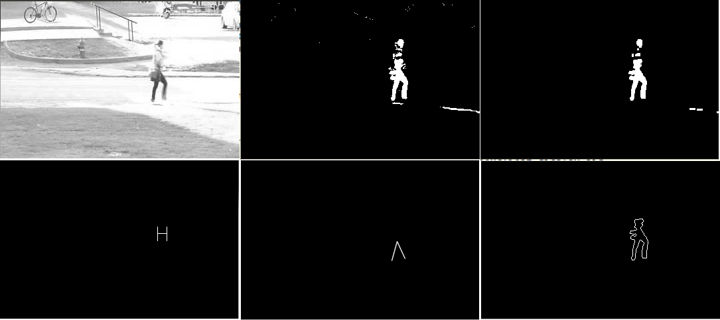
Results : Images at different processing stages

Slide 14
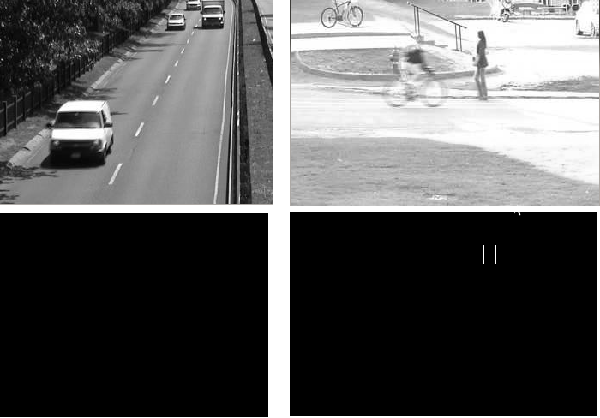
Results : With negative false objects

Slide 15
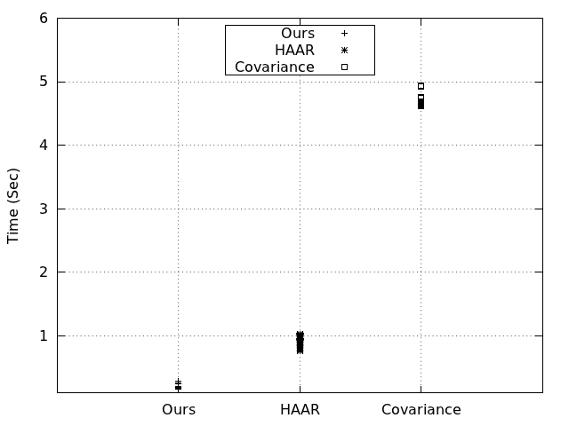
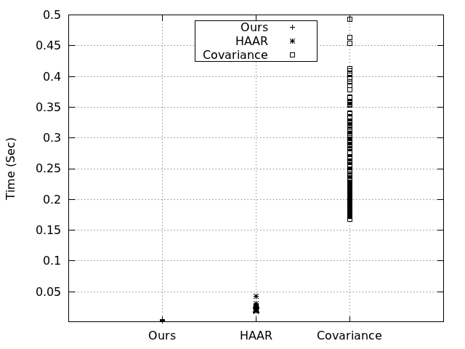
Results : Comparison of execution time
Variation of execution time with an ARM11 system having DMIPS=44
Variation of execution time with a x86 system having DMIPS=800
With embedded ARM platform
Our algorithm takes just 182 ms on the average,
HAAR [6] and covariance feature based [15] algorithm take around 942 ms and 4.65 ms respectively per frame

Slide 16
Conclusion
We have exploited the unique property of human leg motion, that it is periodic and also angle between two legs varies between zero and a maximum value.
We have demonstrated that with our proposed framework one can achieve almost real time pedestrian detection even with low cost embedded platforms, making it viable for implementation for low cost vision/surveillance platform.

Slide 17
Thank You Sir

Slide 18
References
[1] J. Yao and J. Odobez, “Multi-layer background subtraction based on color and texture,” in Computer Vision and Pattern Recognition, 2007. CVPR ’07. IEEE Conference on, 2007, pp. 1–8.
[2] O. Barnich and M. Van Droogenbroeck, “Vibe: A universal background subtraction algorithm for video sequences,” Image Processing, IEEE Transactions on, vol. 20, no. 6, pp. 1709–1724, Jun. 2011. [Online].
[3] C. Stauffer and W. E. L. Grimson, “Adaptive background mixture mod-els for real-time tracking,” in Computer Vision and Pattern Recognition, 1999. IEEE Computer Society Conference on., vol. 2, 1999, pp. –252 Vol. 2.
[4] R. Cucchiara, C. Grana, M. Piccardi, and A. Prati, “Detecting moving objects, ghosts, and shadows in video streams,” IEEE Transactions on Pattern Analysis and Machine Intelligence, vol. 25, no. 10, pp. 1337–1342, Sep. 2003.

Slide 19
References
[5] R. Venkatesh Babu and A. Makur, “Object-based surveillance video compression using foreground motion compensation,” in Control, Au-tomation, Robotics and Vision, 2006. ICARCV ’06. 9th International Conference on, 2006, pp. 1–6.
[6] P. Viola, M. Jones, and D. Snow, “Detecting pedestrians using patterns of motion and appearance,” in Computer Vision, 2003. Proceedings. Ninth IEEE International Conference on, 2003, pp. 734–741 vol.2.
[7] C. Stauffer and W. E. L. Grimson, “Adaptive background mixture mod-els for real-time tracking,” in Computer Vision and Pattern Recognition, 1999. IEEE Computer Society Conference on., vol. 2, 1999, pp. –252 Vol. 2.
[8] P. Dollar, S. Belongie, and P. Perona, “The fastest pedestrian detector in the west,” in Procedings of the British Machine Vision Conference 2010. British Machine Vision Association, 2010, pp. 68.1–68.11. [Online]. Available: http://dx.doi.org/10.5244/c.24.68

Slide 20
References
[9] T.-H. Tsai and C.-Y. Lin, “Exploring contextual redundancy in improv-ing object-based video coding for video sensor networks surveillance,” Multimedia, IEEE Transactions on, vol. 14, no. 3, pp. 669–682, 2012.
[10] S. Chaudhury, S. Tripathi, and S. Roy, “Parametric video compression using appearance space,” in Pattern Recognition, 2008. ICPR 2008. 19th
International Conference on, 2008, pp. 1–4.
[11] H. Fujiyoshi and A. Lipton, “Real-time human motion analysis by image skeletonization,” in Applications of Computer Vision, 1998. WACV ’98. Proceedings., Fourth IEEE Workshop on, 1998, pp. 15–21.
[12] J. Ding, Y. Wang, and L. Yu, “Extraction of human body skeleton based on silhouette images,” in Education Technology and Computer Science (ETCS), 2010 Second International Workshop on, vol. 1, 2010, pp. 71–74

Slide 21
References
[13] K. saeed, M. Tabedzki, and M. R. andMarcin Adamski, “K3m: A universal algorithm for image skeletonizationand a review of thinning techniques,” in Int. J. Appl. Math. Comput. Sci, vol. 20, no. 2, 2010, pp. 317–335.
[14] G. Bradski, “The opencv library,” Dr. Dobb’s Journal of Software Tools, 2000.
[15] J. Yao and J.-M. Odobez, “Fast human detection from videos using covariance features,” in European Conference on Computer Vision, workshop on Visual Surveillance (ECCV-VS), 10 2008, pp. 15–21

