Slide 1
Synopsis of Multi Segmented Image in Delay Tolerant Networks using Bandwidth Reduction Technique
Pratyush Anand
Part Time MS(R) Student in Computer Technology,
Department of Electrical Engineering, IIT Delhi
Entry Number: 2010EEY7515
Research Supervisor: Prof. Subrat Kar

Slide 2
Introduction
It is very important to achieve, reduction in amount of data to be transmitted due to lack of end to end connectivity.
For surveillance data
Entire image need not be transmitted
Only a few segments of image need to be transmitted(the fast changing scenes)
Transmitting only significant features pre-extracted locally from the image can reduce transmission requirement significantly.
Extraction of such image information is possible if end node is intelligent.
Semantic information transfer can reduce this further
We also need to ensure that this minimization of content allows us to reconstruct the image with relevant details at the other end.

Slide 3
Image Transmission
Bandwidth Requirement
Intelligence Level
High
Event Description
Low
Low
As we go above in the hierarchy, we attain higher level of intelligence and save lot of bandwidth
This is achieved at the cost of increased computational power required at the mote node
5
High
Object Description
4
Intelligence
Level
Bandwidth
Requirement
Object Detection
3
Moving Scenes
2
Raw Video Stream
Low
1
High
Low
High

Slide 4
Low BW surveillance image processing steps
Grab gray scale frame
Subtract background
Clean unnecessary foreground
Find out all moving contours
Skeletonize each contour
Detect moving human

Slide 5
Objectives
Evaluation of background subtraction algorithms (with reasonably good result for surveillance applications) in terms of computational complexity
Evaluation of different techniques for moving object skeletonization in terms of its suitability to calculate motion descriptor feature
Development of low computation algorithm to detect objects using motion descriptor
Integration of proposed algorithm with low cost COTS embedded hardware environment

Slide 6
Background subtraction algorithm
Frame differencing: computationally least expensive, but work with many limitations like when both object and camera are stationary, ambient light is constant etc.
Gaussian Average, Median Filter [1-2]: Mid level of computational complexity
Gaussian Mixture Model [3]: Works even with multi-modal situation, but computationally very expensive.
Texture based method [4]: Method described by Yao et al. is based on use of texture features present in Local Binary Pattern(LBP).
LBP works well with local illumination changes, however there can be issues in case of global illumination change.
Photometric invariant color measurement method has been used to overcome these issues.
Vibe(Random replacement of background pixel) [5]:Method by Barnich and Van Droogenbroeck (Vibe) replaces background values for last N frames randomly.
Furthermore, it diffuses updated values to neighboring pixels, and again that too on random basis.
So far this algorithm surpasses other existing algorithm in computation complexities

Slide 7
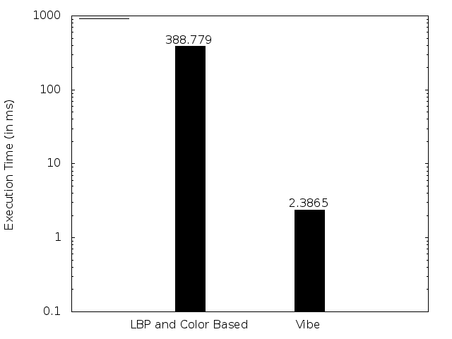
Background subtraction algorithm comparison
Average Background subtraction execution time of
[4] and [5] with frame number.

Slide 8
Object detection techniques
Person Finder(PFinder) [1] :
works with Maximum A Posteriori Probability (MAP)
uses color and shape based descriptor
Viola and Jones [VJ] method [6,7]:
Uses Haar-like features
Uses integral image concept for faster computation
Using Histogram of oriented gradient [8, 9]:
Image is divided into small cell of histogram of edge/gradient
Invariant to geometric and photometric transformations
Using Covariance features [10]:
Covariance matrix encodes information about variance of features and their correlation with each other
integral image concept has been used for faster computation
Using skeleton motion feature [11-13]:
Basic idea is to detect periodicity of angle variation between legs.
Computationally very fast

Slide 9
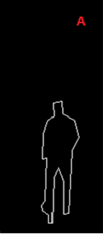
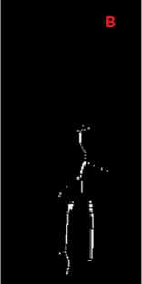
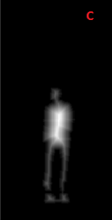
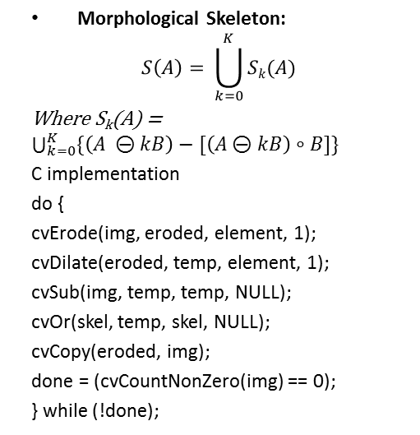
Human skeletonization algorithms
Morphological Skeleton:
$$S\left(A\right)= \bigcup_{k=0}^{K}{Sk(A)}$$
Where S_{k}(A) = $\bigcup_{k=0}^{K}{\{\left(A ⊝kB\right)−[\left(A⊝kB\right)∘B]\}}$
C implementation
do {
cvErode(img, eroded, element, 1);
cvDilate(eroded, temp, element, 1);
cvSub(img, temp, temp, NULL);
cvOr(skel, temp, skel, NULL);
cvCopy(eroded, img);
done = (cvCountNonZero(img) == 0);
} while (!done);
Contour Skeleton:
Find out boundary points (cvFindContours)
Approximate these points to a polygon. (cvApproxPoly)
Vertices of these polygon connected together gives an outer skeleton of object
Skeleton by distance transform:
Transformed image pixel is set to a value equal to the distance to the nearest zero pixel in the input image.
cvDistTransform (img, transformed, CV_DIST_L2, 5, NULL, NULL);
cvNormalize(transformed, transformed, 0.0, 1.0, CV_MINMAX);

Slide 10
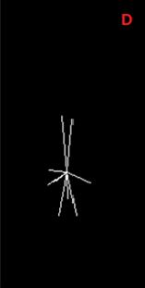
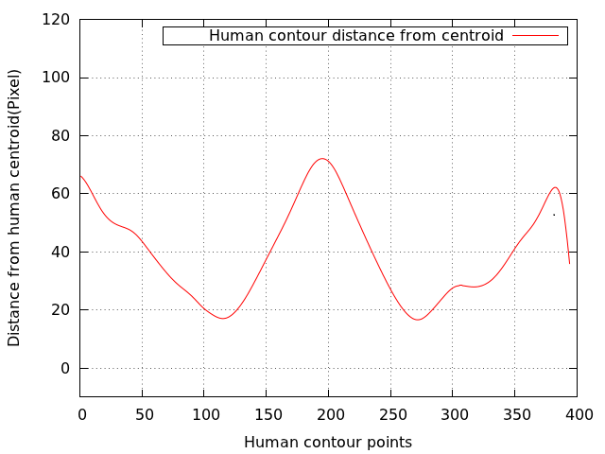
Human skeletonization algorithms
Star Skeleton
Plots distance of each boundary point from the centroid.
Low pass filter this plotted curve
Use peaks of the curve as skeleton point.

Slide 11
Our human detection algorithm
Since Skeletonized Motion Analysis has been used for human detection, therefor we name this method as SKELMOT
There are some peaks which is not of our interest in star skeleton. we are using two most relevant peaks which are nearest to each bottom corner of bounding box of contour respectively.
Only these two peaks along with centroid gives us sufficient information to distinguish human from human, vehicle or animal etc.
For human subjects, the two peaks correspond to the two legs of human. For vehicles, the peaks correspond to the two extrema points of lower portion of back and front. When it is an animal, the peaks correspond to front and back leg of animal.
Let P₁(X₁, Y₁), P₂(X₂, Y₂) and C(C_{x}, C_{y}) are two peaks nearest to bottom right and bottom left corner and centroid respectively. Let Ɵ is the angle between line segment P₁C and P₂C, then Ɵ can be calculated as follows.
Ɵ = tan⁻¹[(Y₂ - C_{y}) / (X₂ - C_{x})] - tan⁻¹ [(Y₁ - C_{y}) / (X₁ - C_{x})]

Slide 12
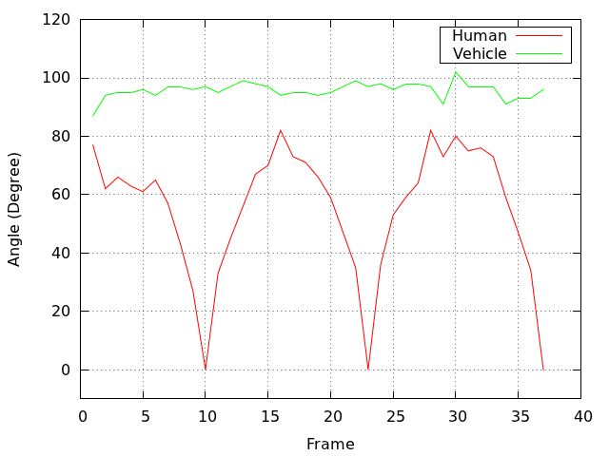
Our algorithm continued…..
If variation of Ɵ is plotted in respective frames for human and vehicle then the resultant plot is as shown in Figure.
For a human subject, angle variation pattern is repeatable, and it is zero for almost at regular intervals.
For vehicle, it is constant.
The experiment with images containing animal has not been done.
For images with animals in it, there are variations with repeatable patterns but which never touch zero.

Slide 13
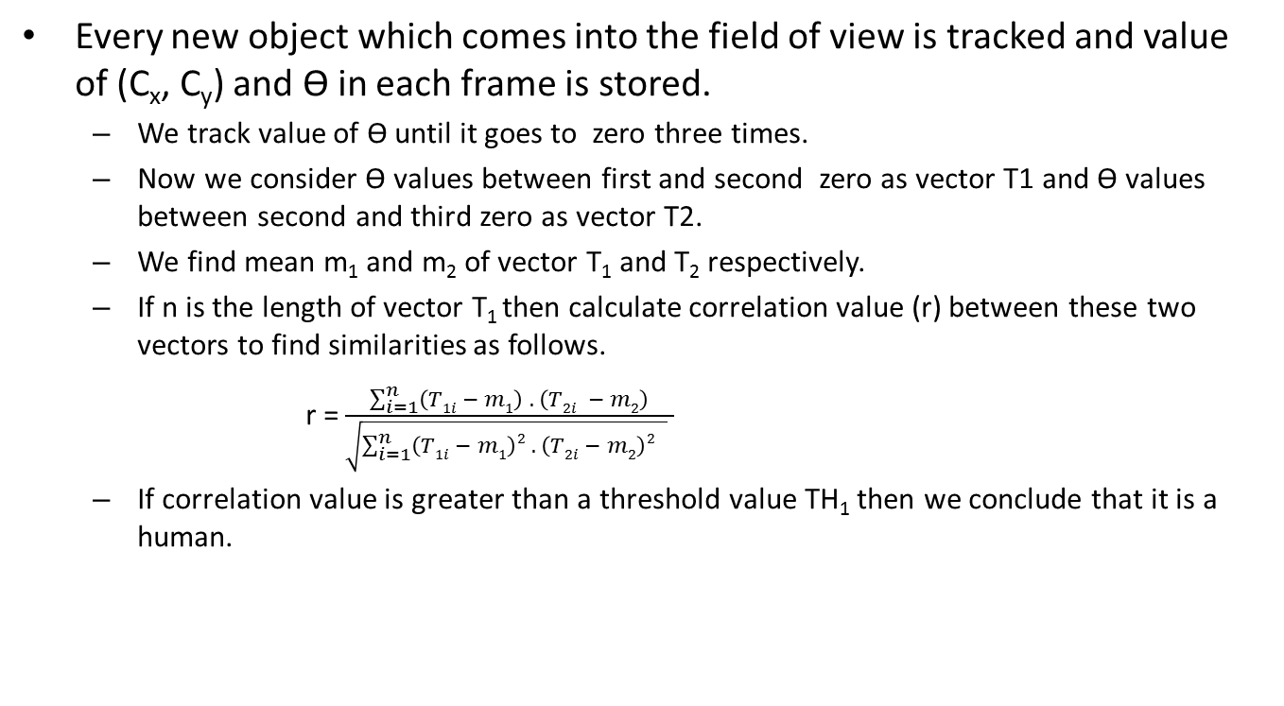
Our algorithm continued…..
Every new object which comes into the field of view is tracked and value of (C_{x}, C_{y}) and Ɵ in each frame is stored.
We track value of Ɵ until it goes to zero three times.
Now we consider Ɵ values between first and second zero as vector T1 and Ɵ values between second and third zero as vector T2.
We find mean m₁ and m₂ of vector T₁ and T₂ respectively.
If n is the length of vector T₁ then calculate correlation value (r) between these two vectors to find similarities as follows.
r =$\frac{\sum_{i=1}^{n}{\left(T1i − m1\right) . \left(T2i − m2\right)}}{\sqrt{\sum_{i=1}^{n}{\left(T1i − m1\right)2 . \left(T2i − m2\right)2 } } }$
If correlation value is greater than a threshold value TH₁ then we conclude that it is a human.

Slide 14
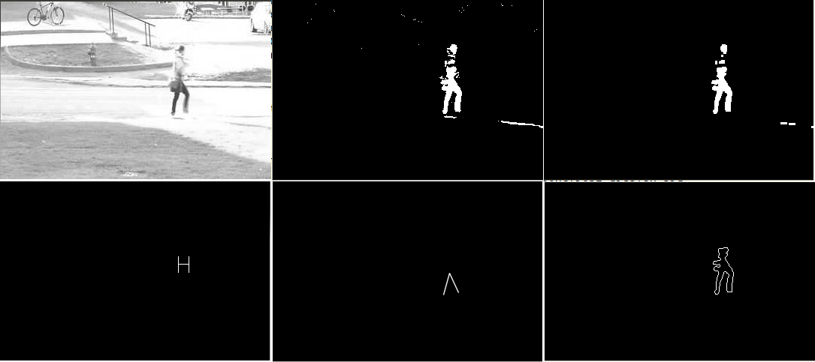
Results : Images at different processing stages

Slide 15
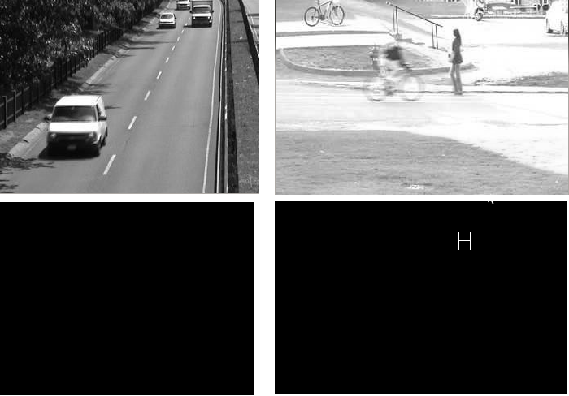
Results : With negative false objects

Slide 16
Embedded Implementation
We have done evaluation of embedded solution of our implementation on the basis of following:
Low cost:
Low power
Computational power
Rapid software development
We selected ARM CPU based SOC from various embedded CPUs available in the market such as MIPS, AVR32, PPC, Atom and ARM
ARM is very low power
Has strong support available
Almost all of it’s variant are supported well by Linux
OpenCV library is also available for ARM architecture
Two readily available ARM based boards: BeagleBone from TI and Raspberry Pi from Qalcomm
We used Raspberry Pi because:
It is chipper
Linux is well supported
We developed C code on Linux OS, because:
Same application can work across various other platform
OpenCV library is supported
Support for various camera drivers, Zigbee module is already available
Average power can be saved with Run Time Power management support framework
Last but not least, it is free.

Slide 17
Component of embedded Linux software
Cross Tool-chain:
Needed because we want to generate executable for ARM platform on x86 PC.
Other alternative would be to use native ARM GCC compiler, but it is very slow.
Second Level Boot Loader
First Level Boot Loader
BootROM
Kernel
Root FileSystem [OpenCV Lib + SKELMOT C implementation]
Hardware
BootROM
This piece of software is hardcoded within chip and can not be modified.
Raspberry-PI supports boot from SD card
First level boot loader
BootROM code copies first level boot loader from SD card to its internal SRAM and executes it.
First Level boot loader initializes onboard SDRAM
Control goes back to bootROM
Now booROM copies second level bootLoader, Kernel and root filesystem to SDRAM and passes control to second level boot loader
Second level boot loader
It prepares for OS booting
Kernel
Initializes necessary hardware drivers
Loads Root Filesystem
Root FileSystem
Contains all needed libraries and application executable binaries

Slide 18
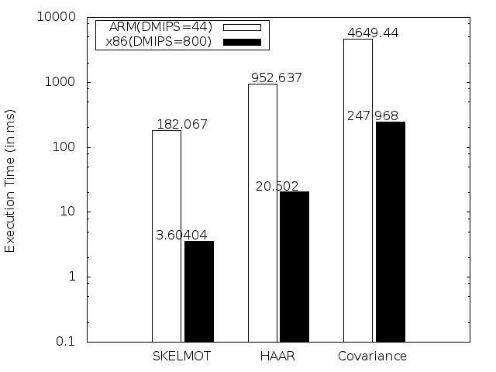
Execution time of evaluated algorithms on ARM and x86 platform

Slide 19
Conclusion
We have exploited the unique property of human leg motion, that it is periodic and also angle between two legs varies between zero and a maximum value.
We have demonstrated that with SKELMOT one can achieve almost real time pedestrian detection even with low cost embedded platforms, making it viable for implementation for low cost vision/surveillance platform.
To use other methods such as Haar-like or covariance features based descriptor in real time environment, dedicated hardware accelerator would be needed.

Slide 20
Future Work
Uses of SKELMOT with Zigbee network and then to monitor it’s performance would be a good idea.
A research work may be initiated to see actual power saving using such a low complexity pipeline.
There can be improvement in blob tracking algorithm to predict next position on the basis of past N number of frames.
We have seen that low end micro-controller is not able to work with single frame human detection algorithms . These algorithm can either run on high performance CPU, or GPU. A work can be initiated to implement such algorithms in hardware and then to use this hardware with low end micro-controller. It would be interesting to see difference between power consumption of two systems.

Slide 21
Thank You Sir

Slide 22
References
C. Wren, A. Azarbayejani, T. Darrell, and A. Pentland, “Pfinder: real-time tracking of the human body,” in Automatic Face and Gesture Recognition, 1996., Proceedings of the Second International Conference on, pp. 51–56, 1996.
N. J. B. McFarlane and C. P. Schofield, “Segmentation and tracking of piglets in images,” Machine Vision and Applications, vol. 8, pp. 187–193, May 1995
C. Stauffer and W. E. L. Grimson, “Adaptive background mixture mod-els for real-time tracking,” in Computer Vision and Pattern Recognition, 1999. IEEE Computer Society Conference on., vol. 2, 1999, pp. –252 Vol. 2.
J. Yao and J. Odobez, “Multi-layer background subtraction based on color and texture,” in Computer Vision and Pattern Recognition, 2007. CVPR ’07. IEEE Conference on, 2007, pp. 1–8.
O. Barnich and M. Van Droogenbroeck, “Vibe: A universal background subtraction algorithm for video sequences,” Image Processing, IEEE Transactions on, vol. 20, no. 6, pp. 1709–1724, Jun. 2011.
P. Viola, M. J. Jones, andD. Snow, “Detecting pedestrians using patterns of motion and appearance,” in ICCV ’03: Proceedings of the Ninth IEEE International Conference on Computer Vision, (Washington, DC, USA), IEEE Computer Society, 2003.

Slide 23
References
P. Viola and M. Jones, “Rapid object detection using a boosted cascade of simple features,” in Computer Vision and Pattern Recognition, 2001. CVPR 2001. Proceedings of the 2001 IEEE Computer Society Conference on, vol. 1, pp. I–511–I–518,2001.
Q. Zhu, M.-C. Yeh, K.-T. Cheng, and S. Avidan, “Fast human detection using a cascade of histograms of oriented gradients,” in Computer Vision and Pattern Recognition, 2006 IEEE Computer Society Conference on, vol. 2, pp. 1491–1498, 2006.
N. Dalal and B. Triggs, “Histograms of oriented gradients for human detection,” in Computer Vision and Pattern Recognition, 2005. CVPR 2005. IEEE Computer Society Conference on, vol. 1, pp. 886–893 vol. 1, 2005.
J. Yao and J.-M. Odobez, “Fast human detection from videos using covariance features,” in European Conference on Computer Vision, workshop on Visual Surveillance (ECCV-VS), Oct 2008.
H. Fujiyoshi and A. Lipton, “Real-time human motion analysis by image skeletonization,” in Applications of Computer Vision, 1998. WACV ’98. Proceedings., Fourth IEEE Workshop on, pp. 15–21, 1998.
M. Ekinci and M. Aykut, “Human identification using gait,” in Signal Processing and Communications Applications, 2006 IEEE 14th, pp. 1–4, 2006.

Slide 24
References
N. Zarka, Z. Alhalah, and R. Deeb, “Real-time human motion detection and tracking,” in Information and Communication Technologies: From Theory to Applications, 2008. ICTTA 2008. 3rd International Conference on, pp. 1–6, 2008.

