Slide 1

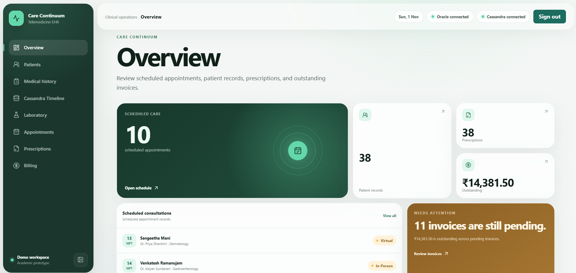
CARE CONTINUUM
BACSE202 - DATABASE MANAGEMENT SYSTEMS
A Telemedicine Consultation and
Electronic Health Records (EHR) System
TEAM:
Dhuna Chavda – 25BCE1072
Sarbajeet Pattadar – 25BCE1920
Pratyush Deo Singh – 25BCE5101

Slide 2
Problem Statement
The existing healthcare system uses fragmented databases, where data about patients, doctors, laboratories and pharmacies is stored in separate databases.
This might lead to increased data retrieval costs and even data duplication or loss.
This also results in difficulty managing huge volumes of logs in case the history of a patient grows too much.
Objectives
1. Design a relational database schema to store information regarding patients, doctors, appointments, prescriptions, lab order and so on
2. Ensure normalisation of relational tables up to BCNF
3. Implement relational database using Oracle SQL to store operational medical records
4. Implement modern database using Apache Cassandra to store patient medical health records

Slide 3
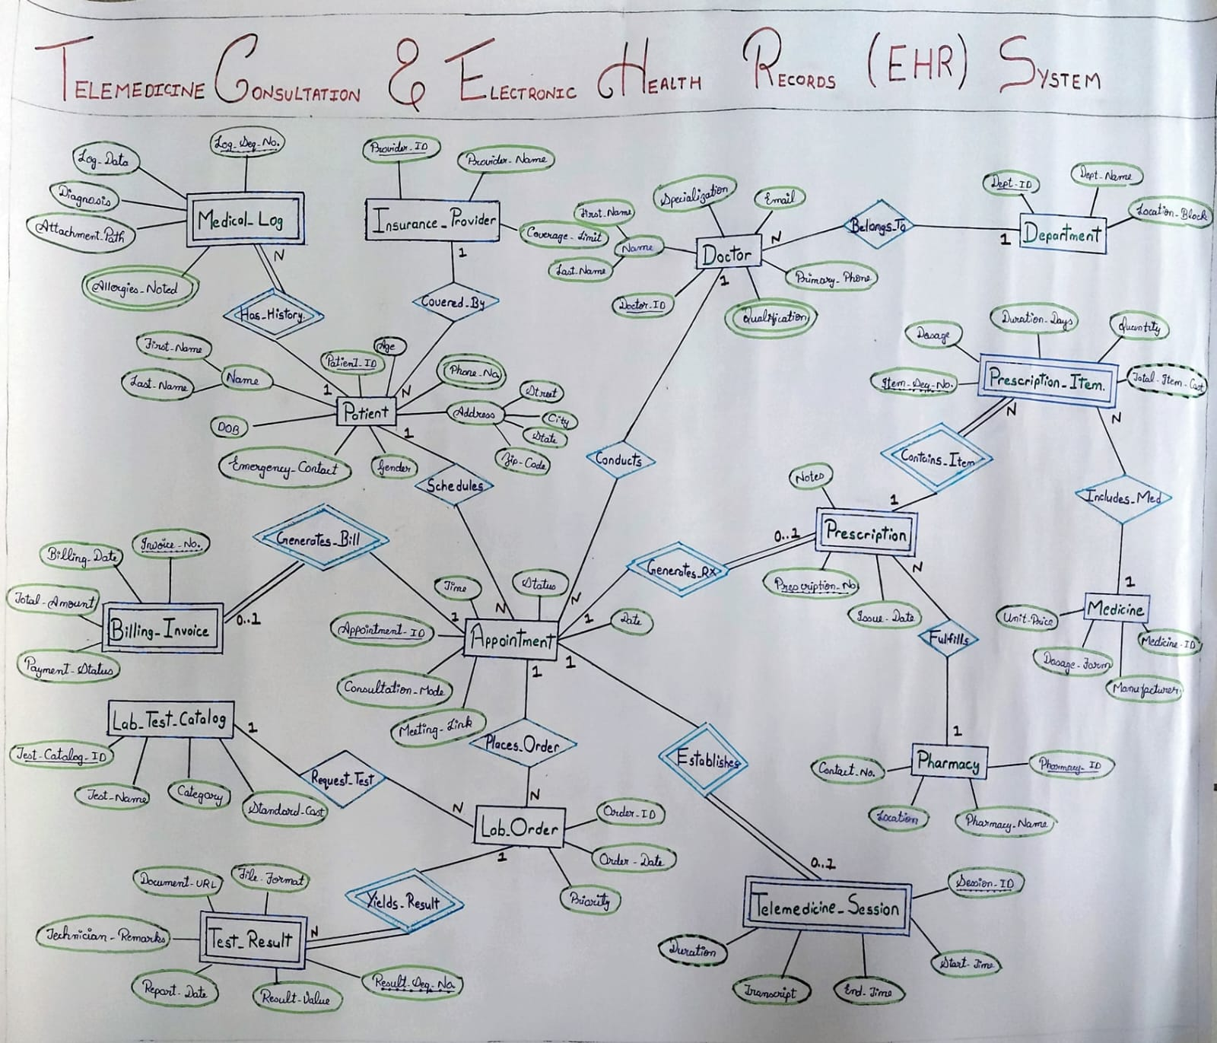
Proposed System Architecture and ER Diagram

Slide 4
Relational Mapping of the ER Model
PATIENT (Patient_ID, First_Name, Last_Name, Street, City, State, Zip_Code, DOB, Gender, Emergency_Contact, Policy_No)
FK: Policy_No → INSURANCE_PROVIDER (Policy_No)
PATIENT_PHONE (Patient_ID, Phone_Number)
FK: Patient_ID → PATIENT (Patient_ID)
DOCTOR (Doctor_ID, First_Name, Last_Name, Specialization, Email, Primary_Phone, Dept_ID)
FK: Dept_ID → DEPARTMENT (Dept_ID)
DEPARTMENT (Dept_ID, Dept_Name, Location_Block)
DOCTOR_QUALIFICATION (Doctor_ID, Qualification)
FK: Doctor_ID → DOCTOR (Doctor_ID)
APPOINTMENT (Appointment_ID, Patient_ID, Doctor_ID, Appointment_Date, Appointment_Time, Status, Consultation_Mode, Meeting_Link)
FK: Patient_ID → PATIENT (Patient_ID)
Doctor_ID → DOCTOR (Doctor_ID)
PHARMACY (Pharmacy_ID, Pharmacy_Name, Location, Contact_Number)
MEDICINE (Medicine_ID, Medicine_Name, Manufacturer, Allergen_Class, Dosage_Form, Unit_Price)
LAB_TEST_CATALOG (Test_Catalog_ID, Test_Name, Category, Standard_Cost)
INSURANCE_PROVIDER (Policy_No, Provider_Name, Coverage_Limit)
PRESCRIPTION (Appointment_ID, Prescription_No, Issue_Date, Notes, Pharmacy_ID)
FK: Appointment_ID → APPOINTMENT (Appointment_ID)
Pharmacy_ID → PHARMACY (Pharmacy_ID)
PRESCRIPTION_ITEM (Appointment_ID, Prescription_No, Item_Seq_No, Medicine_ID, Dosage, Duration_Days, Quantity)
FK: (Appointment_ID, Prescription_No) → PRESCRIPTION (Appointment_ID, Prescription_No)
Medicine_ID → MEDICINE (Medicine_ID)
LAB_ORDER (Order_ID, Appointment_ID, Test_Catalog_ID, Order_Date, Priority)
FK: Appointment_ID → APPOINTMENT (Appointment_ID)
Test_Catalog_ID → LAB_TEST_CATALOG (Test_Catalog_ID)
TEST_RESULT (Order_ID, Result_Seq_No, Result_Value, Report_Date, Technician_Remarks, Document_URL, File_Format)
FK: Order_ID → LAB_ORDER (Order_ID)
MEDICAL_LOG (Patient_ID, Log_Seq_No, Log_Date, Diagnosis, Attachment_Path)
FK: Patient_ID → PATIENT (Patient_ID)
LOG_ALLERGIES (Patient_ID, Log_Seq_No, Allergy_Name)
FK: (Patient_ID, Log_Seq_No) → MEDICAL_LOG (Patient_ID, Log_Seq_No)
BILLING_INVOICE (Appointment_ID, Invoice_No, Billing_Date, Total_Amount, Payment_Status)
FK: Appointment_ID → APPOINTMENT (Appointment_ID)
TELEMEDICINE_SESSION (Appointment_ID, Session_ID, Start_Time, End_Time, Network_Quality_Log, Chat_Transcript_URL)
FK: Appointment_ID → APPOINTMENT (Appointment_ID)

Slide 5
Keys, Constraints & Normalization
KEYS
PK: PATIENT.Patient_ID
PK: APPOINTMENT.Appointment_ID
Composite PK: PRESCRIPTION(Appointment_ID, Prescription_No)
Composite PK: PRESCRIPTION_ITEM(Appointment_ID, Prescription_No, Item_Seq_No)
FK: APPOINTMENT.Patient_ID → PATIENT.Patient_ID
FK: APPOINTMENT.Doctor_ID → DOCTOR.Doctor_ID
Constraints
PRIMARY KEY — uniquely identifies each record
PATIENT(Patient_ID)
FOREIGN KEY — maintains referential integrity
APPOINTMENT.Patient_ID → PATIENT.Patient_ID
NOT NULL — mandatory fields cannot be left empty
e.g. patient/doctor names and required identifiers
UNIQUE — prevents duplicate values
DOCTOR.Email
CHECK — restricts values to valid domain values
e.g. appointment status, consultation mode, payment status
Referential Actions — control deletion of referenced records
ON DELETE CASCADE / ON DELETE SET NULL, where applicable
Normalization
1NF
Atomic values; multivalued attributes separated
→ PATIENT_PHONE, DOCTOR_QUALIFICATION, LOG_ALLERGIES
2NF
No partial dependencies on composite keys in given mapping.
3NF
No transitive dependencies in given mapping
BCNF
Every given non-trivial determinant is a superkey.

Slide 6
Implementation and Important SQL Operations
Database Implementation
Oracle Autonomous Database — 18 relational tables for operational healthcare data
Apache Cassandra / Astra DB — chronological patient medical timeline
React → Express REST API → Oracle / Cassandra
Database connectivity using node-oracledb and cassandra-driver
Important SQL Operations
Multi-table JOINs — retrieve related patient, doctor, appointment and clinical data
Subqueries & EXISTS — filter records using related healthcare information
GROUP BY & Aggregates — generate summaries using COUNT, SUM and AVG
CRUD Operations — manage patient, appointment, prescription and laboratory records
PL/SQL Implementation
Calculate_Invoice_Total() — calculates medicine + lab costs
Telemedicine Session Trigger — creates a session for virtual appointments
Allergy Prevention Trigger — blocks prescriptions with allergen conflicts

Slide 7
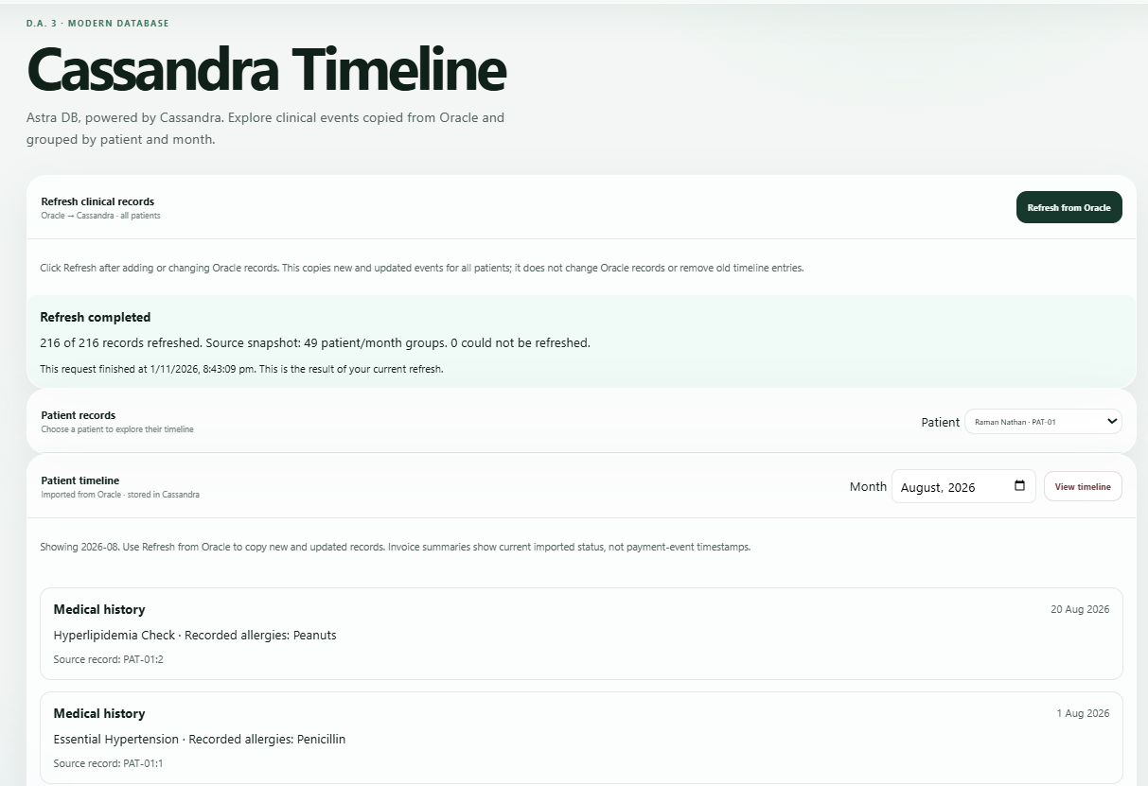
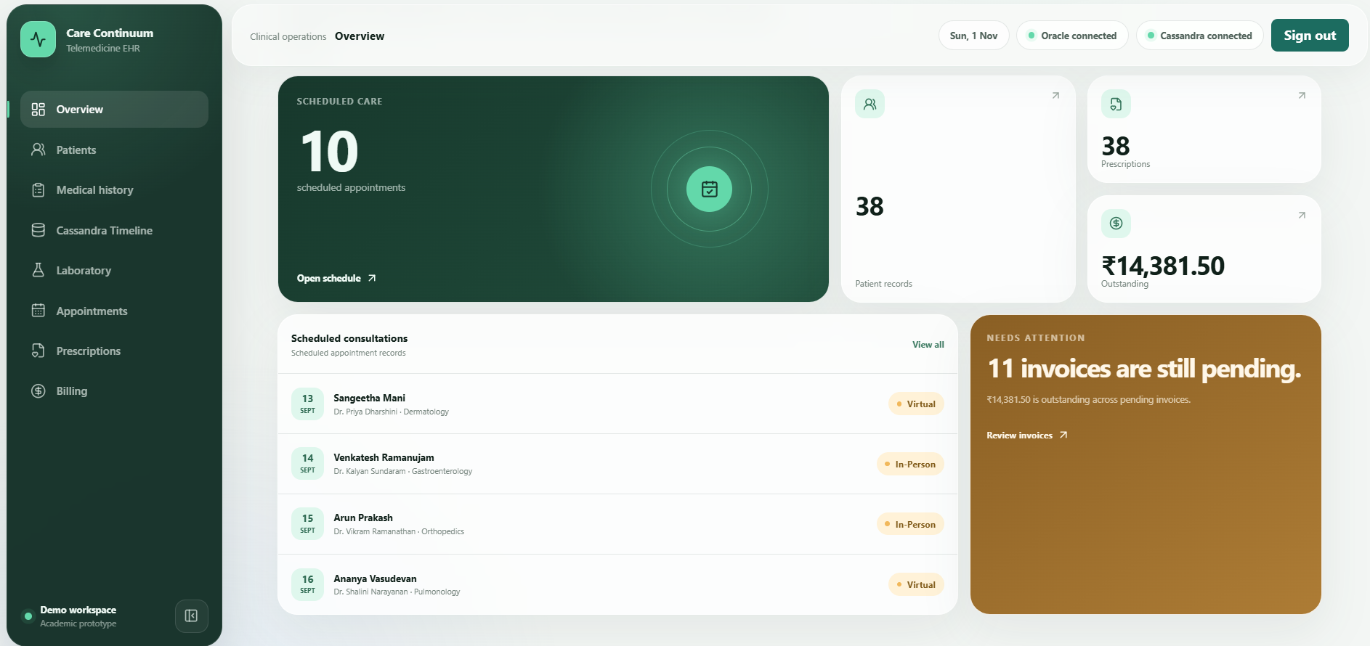
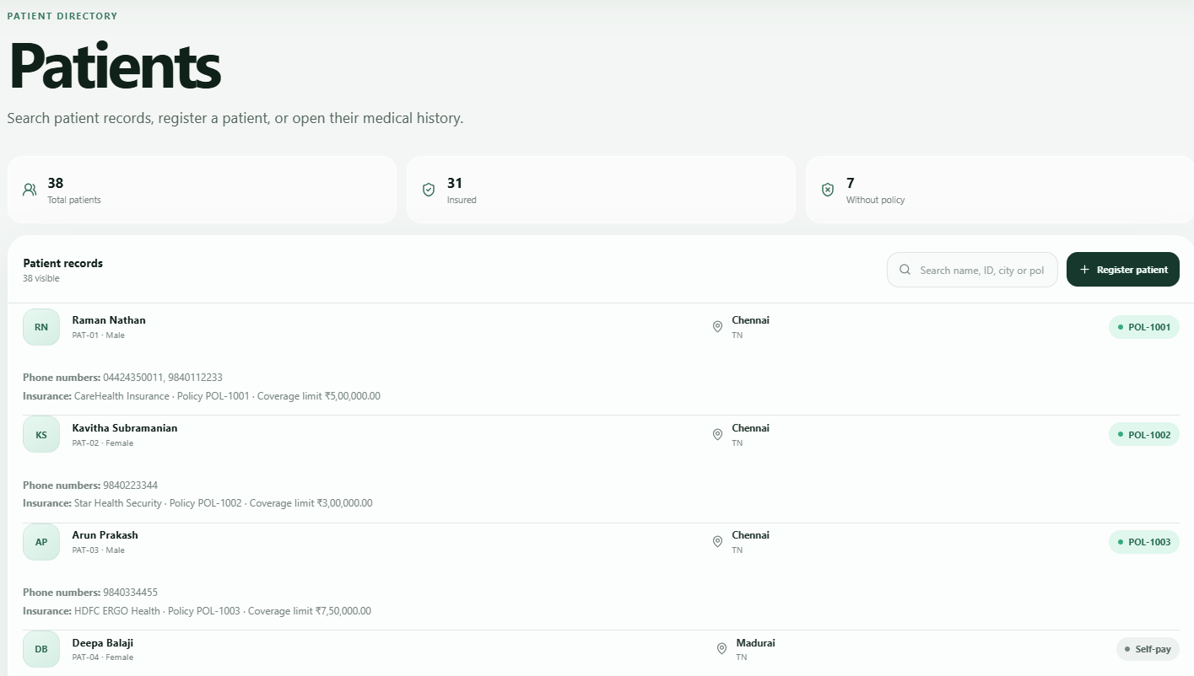
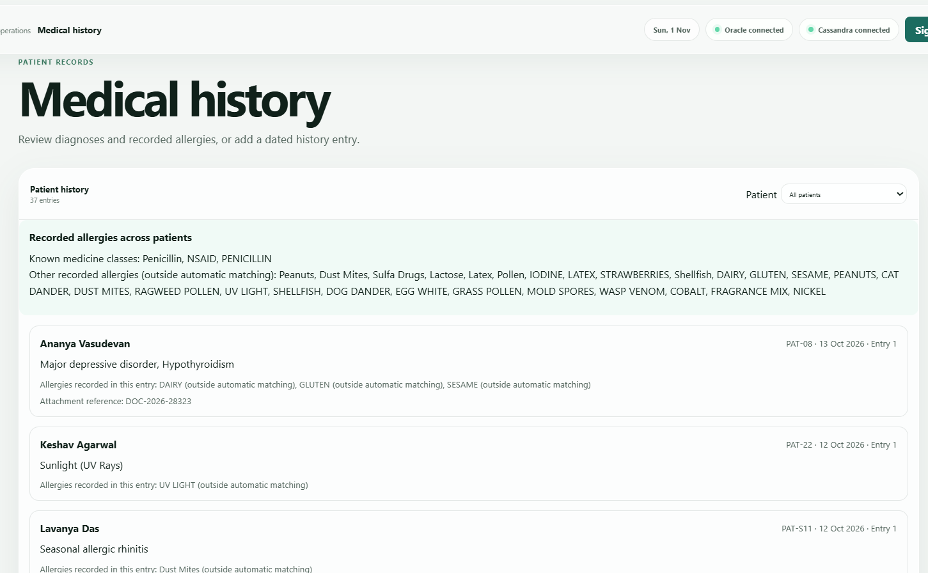
Screenshots

Slide 8
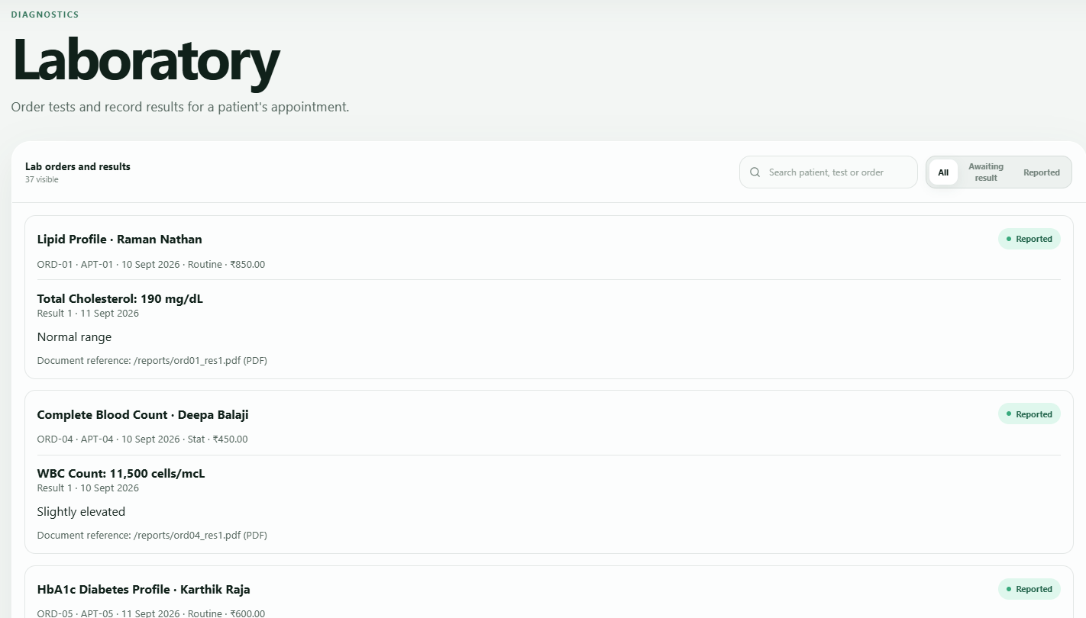
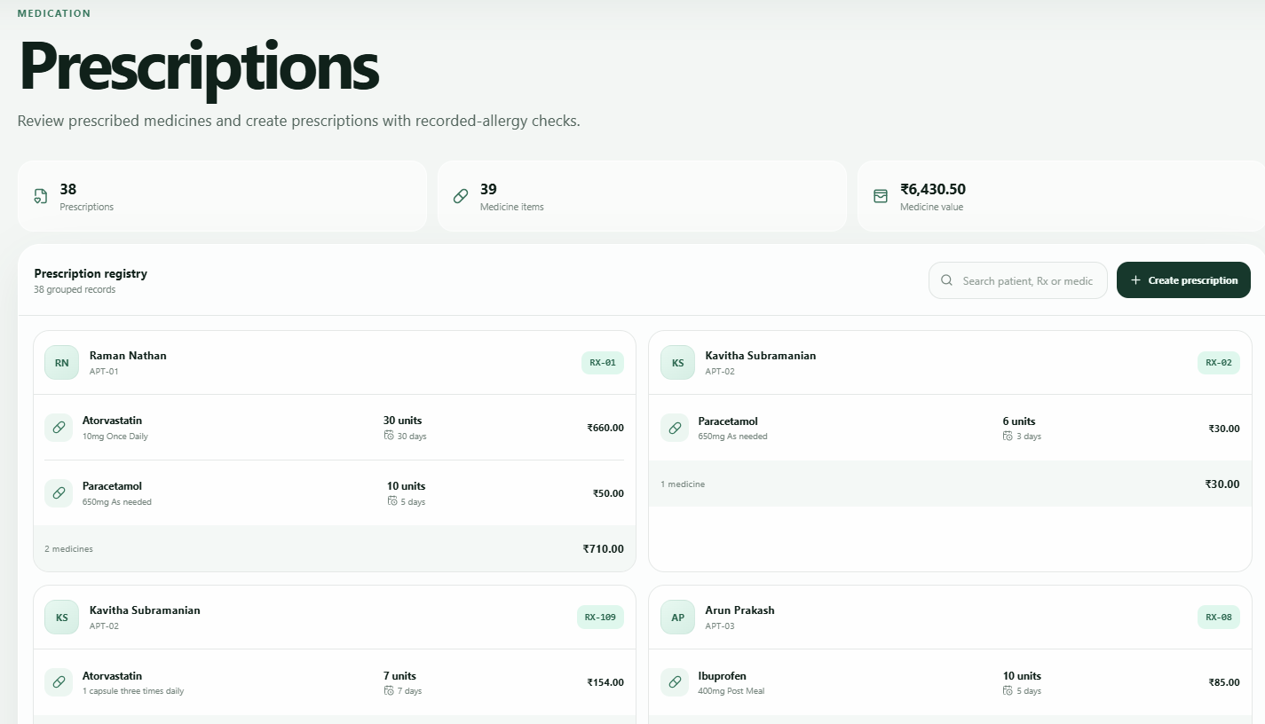
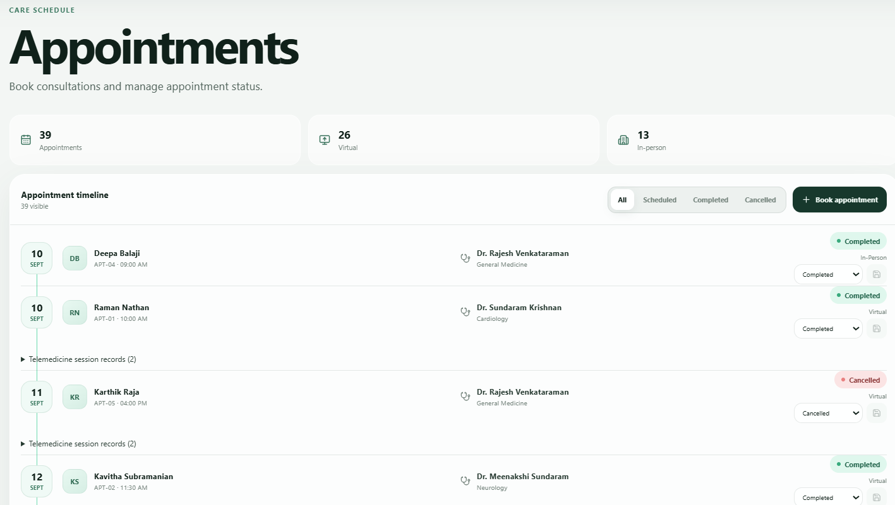
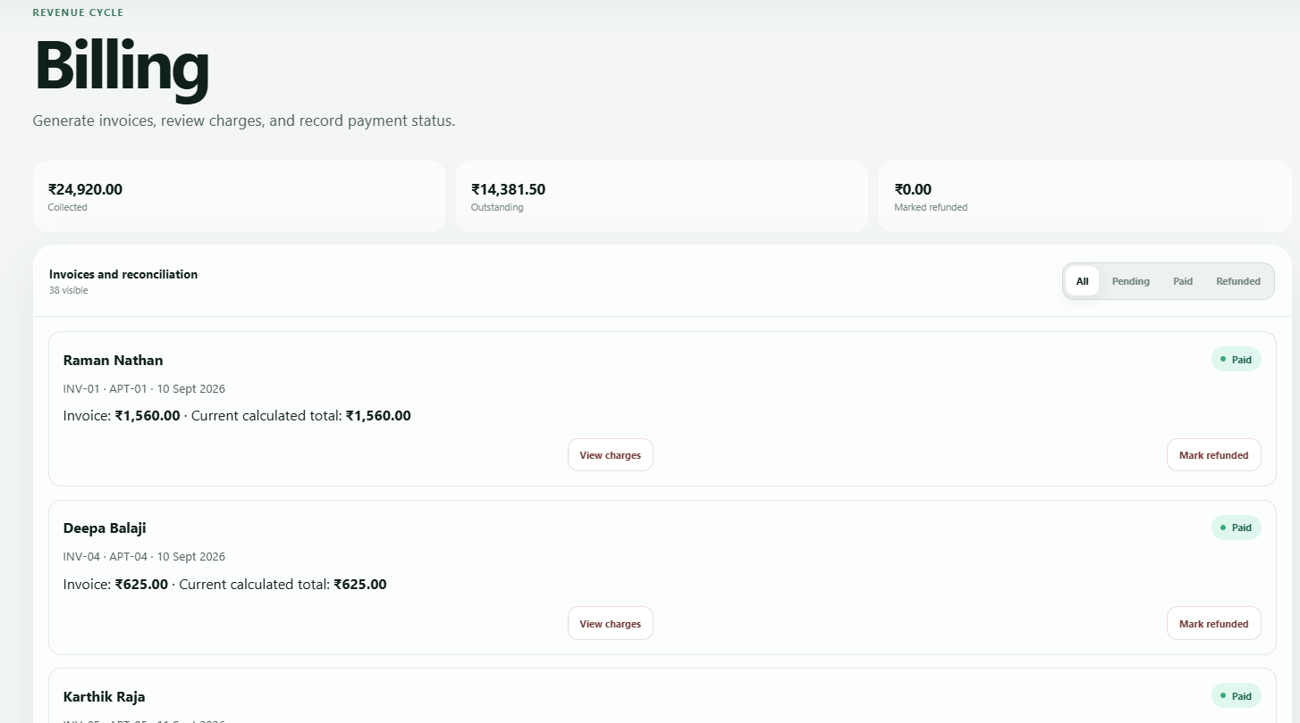

Slide 9
Testing & Results: Implementation Validation
Feature | Database Mechanism | Expected Outcome | Status
Patient / Appointment Operations | REST API → Oracle / PL/SQL | Records stored and retrieved | Implemented
Virtual Appointment | trg_create_telemedicine_session | Session row automatically created | Implemented
Allergic Prescription | Prevent_Allergic_Prescription | Conflicting item rejected | Implemented
Invoice Calculation | Calculate_Invoice_Total | Medicine + lab charges calculated | Implemented
Timeline Refresh | POST /timeline/import | Oracle records mapped to Cassandra events | Implemented
Timeline Retrieval | GET /timeline/:patient_id?month= | Events returned chronologically | Implemented
Key Result
The application demonstrates end-to-end connectivity between the React interface, Express backend, and Oracle + Cassandra database layer.

Slide 10
Limitations, Future Work & Conclusion
LIMITATIONS
FUTURE ENHANCEMENTS
CONCLUSION
Integration of real-time video consultation
2. Automated database synchronization with deletion and update reconciliation
3. Multi-node Cassandra deployment to support scalability
4. Role-based access control with security enhancements like MFA, detailed audit logs and encryption policies.
No integrated video/audio calling (meeting URL is stored instead)
Oracle - Cassandra refresh is manual
Outdated Cassandra events are not deleted automatically
Documents are stored as external links (like Google Drive)
Scalability is limited due to implementation of single-node Cassandra
Care Continuum integrates telemedicine and EHR workflows into a unified system. Oracle stores normalized operational data, while Cassandra maps medical records into a chronological timeline without fully transferring the medical history. This helps reduce data fragmentation and makes it more accessible, also providing a scalable solution for managing healthcare data.

Slide 11
Thank You

