Slide 1
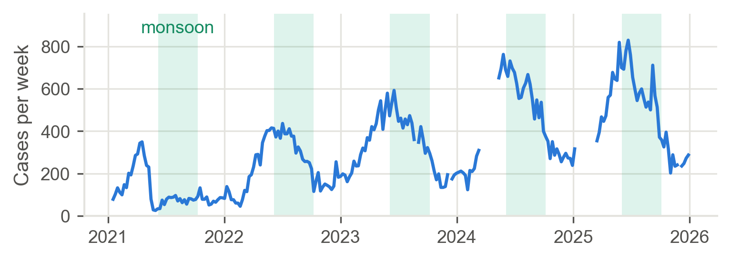
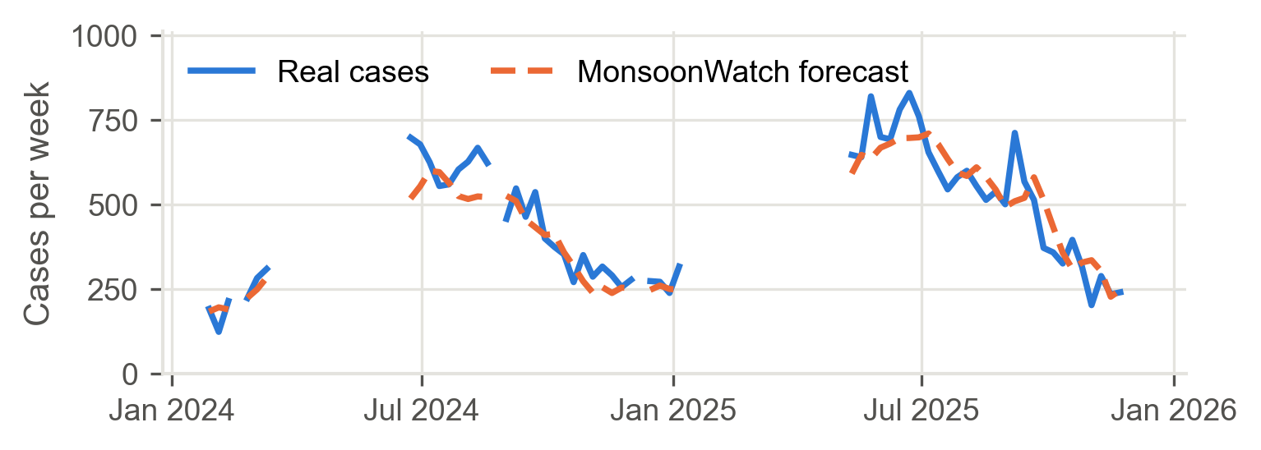
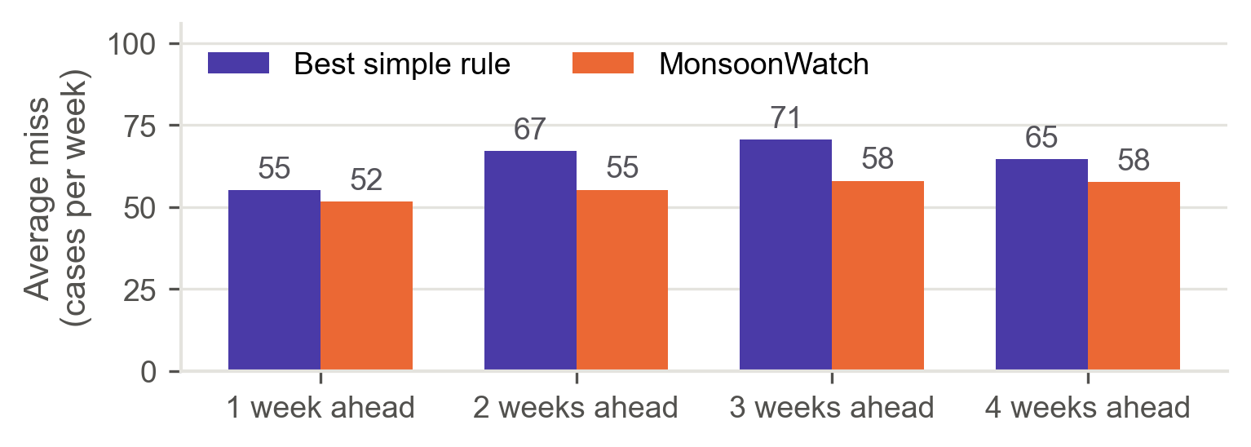
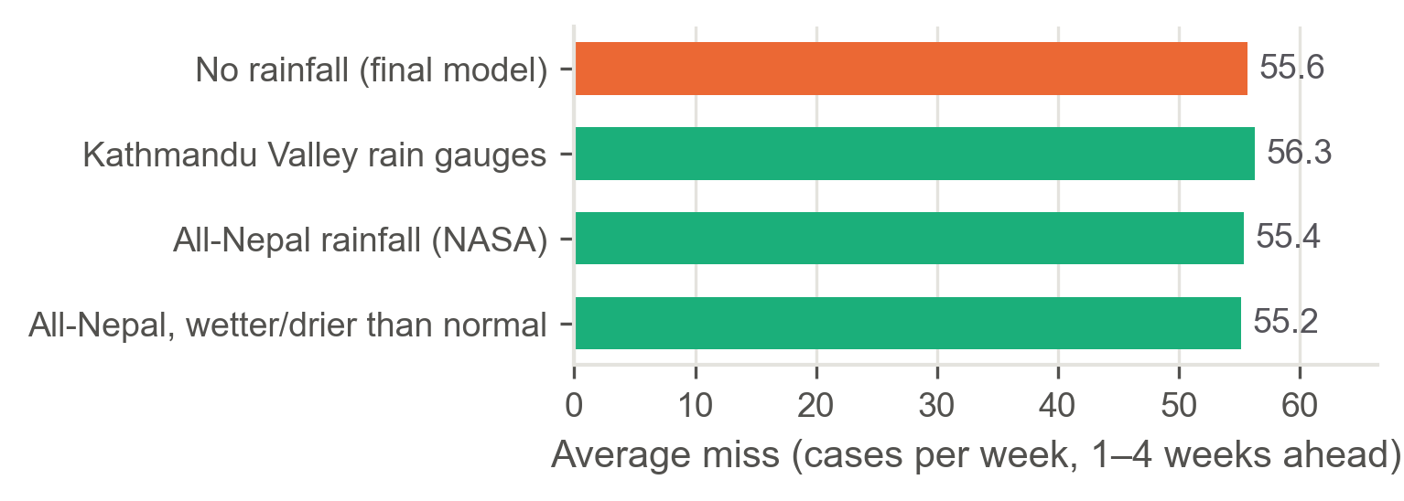
MonsoonWatch
SDG 3 · Good health
Forecasting diarrhoeal disease in Nepal, 1–4 weeks ahead
SDG 6 · Clean water
Pratyush Amatya · Macquarie University · Pitch for the Planet
SDG 13 · Climate action
Introduction
Background
Objectives
Every monsoon, floods make drinking water dirty in Nepal. Cases of diarrhoeal disease (acute gastroenteritis, AGE) shoot up, and young children suffer most.
A warning a few weeks early would give health teams time to get ready.
EWARS, Nepal's warning system, counts cases every week.
It reports cases only after they happen. It does not forecast.
The weekly numbers are stuck in PDFs
Rain is often blamed for outbreaks but does it help forecasting?
Turn 5 years of PDF reports into clean weekly data.
Forecast national AGE cases 1–4 weeks ahead.
Test whether rainfall makes forecasts better.
Build a simple web tool that makes the forecast.
Methodology
1. Collect
241 weekly EWARS
PDF reports
(2021–2025)
2. Extract
A program reads
the PDFs into
one table
3. Inputs
Recent cases, same
week last year,
time of year
4. Train
180 set-ups of 5
machine-learning
model types
5. Combine
Average the
best 15–30
models
6. Test
Forecast 2024–25
weeks the models
never saw
Fair test: each forecast used only data available at that time, and the models were retrained every week. Rainfall (23 Kathmandu Valley gauges + NASA satellite for all of Nepal) was tested as an extra input.
Results
1 · Cases peak every monsoon (green bands)
2 · Forecast vs real cases, 2 weeks ahead (2024–25)
3 · Smaller miss than simple rules at every length
4 · Adding rainfall did not reduce the miss
Discussion
Future work
Past cases and the season drive the forecast.
Rainfall did not help, even for all of Nepal. The time of year already covers the monsoon.
The model type mattered little. Averaging many models and weekly retraining mattered more.
Limits: more clinics reporting made counts rise 4×; big peaks are under-forecast (829 vs ~700).
Forecast by district to show where help is needed most.
Adjust for new health centres joining EWARS reporting.
Predict big peaks better and add clear alert levels.
Update automatically when new EWARS reports come out.
Re-test rainfall using district-level cases.
Conclusion
MonsoonWatch warns of diarrhoeal disease in Nepal 1–4 weeks ahead, using only data Nepal already collects. It beats simple rules every time, and needs no weather data.
12–14%
typical
forecast error
6–18%
better than
simple rules
1–4 wks
of early
warning
Data: EDCD EWARS weekly bulletins 2021–2025 · DHM rain gauges · NASA POWER satellite. Aim to build an interactive forecast tool: MonsoonWatch web app.

