Slide 1
A Presentation on
Hibernate
“A powerful object-relational persistence framework for Java applications”

Slide 2
(A.) Introduction
1. Preface
A major portion of the development of an enterprise application involves the creation and maintenance of the persistence layer used to store and retrieve objects from the database. If changes are made to the underlying database schema, it can be expensive to propagate those changes to the rest of the application. Hibernate steps into fill this gap, providing an easy-to-use and powerful object-relational persistence framework for Java applications. It not only takes care of the mapping from Java classes to database tables (and from Java data types to SQL data types), it also provides data query and retrieval facilities and can significantly reduce development time. Hibernates goal is to relieve the developer from 95 percent of common data persistence related programming tasks
Hibernate is typically used in Java Swing applications, Java Servlet-based applications, or J2EE applications using EJB session beans

Slide 3
2. Purpose and Scope
The purpose of the presentation is to enable developer to understand the concept of Hibernate framework and its features.
The scope of the documents is providing a detail introduction about the Hibernate 3.x and its various features

Slide 4
Hibernate
3. What is Hibernate Framework?
Hibernate is an object/relational mapping solution for Java environments.
  Hibernate is a powerful, ultra-high performance object/relational persistence and query service for Java.
  The term object/relational mapping (ORM) refers to the technique of mapping a data representation from an object model to a relational data model with a SQL-based schema.
  Hibernate maps the Java classes to the database tables.
  It also provides the data query and retrieval facilities that significantly reduces the development time.
  . It is most useful with object-oriented domain modes and business logic in the Java-based middle-tier.
  Hibernate allows transparent persistence that enables the applications to switch any database.
  Hibernate can be used in Java Swing applications, Java Servlet-based applications, or J2EE applications using EJB session beans.
  Hibernate reduces the effort needed to convert between relational database result-sets and graphs of Java objects.
One of its unique features is that Hibernate does not require developers to implement proprietary interfaces or extend proprietary base classes in order for classes to be made persistent. Instead, Hibernate relies on Java reflection and runtime augmentation of classes using a powerful, high-performance, code-generation library for Java called CGLIB. CGLIB is used to extend Java classes and implement Java interfaces at runtime

Slide 5
4. Current version & features of hibernate
The current version of hibernate is 3.0
Hibernate 3.0 provides three full-featured query facilities: Hibernate Query Language, the newly enhanced Hibernate Criteria Query API, and enhanced support for queries expressed in the native SQL dialect of the database.
Filters for working with temporal (historical), regional or permission data.
Enhanced Criteria query API: with full support for projection/aggregation and sub selects.
Runtime performance monitoring: via JMX or local Java API, including a second-level cache browser.
Hibernate is Free under LGPL: Hibernate can be used to develop/package and distribute the applications for free.
Hibernate is Scalable: Hibernate is very performant and due to its dual-layer architecture can be used in the clustered environments.

Slide 6
Hibernate
Less Development Time: Hibernate reduces the development timings as it supports inheritance, polymorphism, composition and the Java Collection framework.
Automatic Key Generation: Hibernate supports the automatic generation of primary key for your.
JDK 1.5 Enhancements: The new JDK has been released as a preview earlier this year and we expect a slow migration to the new 1.5 platform throughout 2004. While Hibernate3 still runs perfectly with JDK 1.2, Hibernate3 will make use of some new JDK features. JSR 175 annotations, for example, are a perfect fit for Hibernate metadata and we will embrace them aggressively. We will also support Java generics, which basically boils down to allowing type safe collections.
EJB3-style persistence operations: EJB3 defines the create () and merge () operations, which are slightly different to Hibernates saveOrUpdate () and saveOrUpdateCopy () operations. Hibernate3 will support all four operations as methods of the Session interface
Hibernate XML binding enables data to be represented as XML and POJOs interchangeably.
The EJB3 draft specification support for POJO persistence and annotations

Slide 7
Benefits of hibernates
Productivity
Maintainability
Performance
Vender independence

Slide 8
5. Why Hibernate & when to use hibernate?
Hibernates goal is to relieve the developer from 95 percent of common data persistence related programming tasks.
Hibernate adapts to the development process, no matter if you start with a design from scratch or work with a legacy database.
It generates SQL for us relives us from manual result set handling and objects conversion automatically and keeps the application portable to all SQL databases.
It provides transparent persistence and efficient caching layer
It provides rich query language to retrieve objects from the database.
It can also be used in standalone java application.
It includes lazy initiation, outer join fetching, batch fetching, support for optimistic locking with versioning and time stamping

Slide 9
Need of ORM (Object relational mapping?
  The main need of ORM is when there is need to map between the java objects and relational real world entities.
  These objects act as a template through which the different CRUD operations are performed on the objects which in turn triggers the actions to be performed on the database.
  When we pass an object to a Session.save() method, Hibernate reads the state of the variables of that object and executes the necessary query
Persistence is defined as storing the data to the stable storage

Slide 10
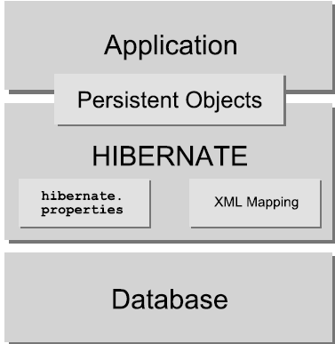
Hibernate Architecture

Slide 11
EXPLANATION OF THE DIAGRAM
  This diagram shows Hibernate using the database and configuration data to provide persistence services (and persistent objects) to the application.
  The hibernate acts as a mediator between the application & with the database .it perform the CRUD opertions on the database through the java interfaces like session & transaction.
  Hibernate makes use of existing java API java tractions API.
  Hibernate defines mapping files which has the mapping defined for a particular column and of the attribute in the java persistent object.
  Persistent objects are otherwise called as plain old java object

Slide 12
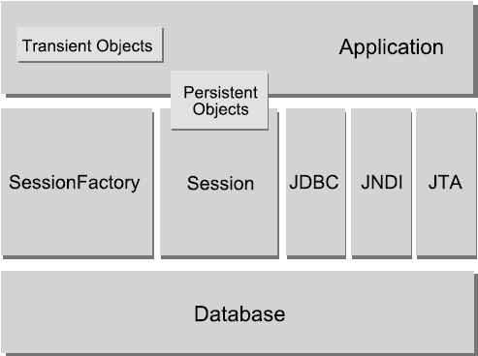
Hibernate Architecture

Slide 13
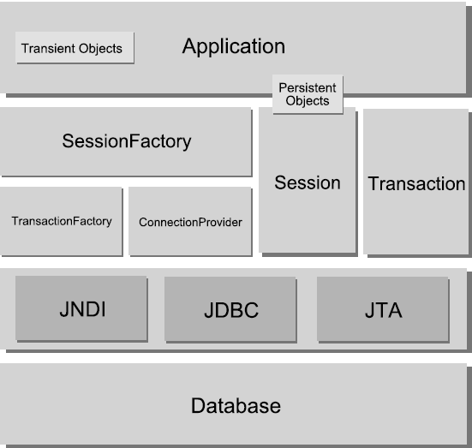
Hibernate Architecture

Slide 14
The "full cream" architecture abstracts the application away from the underlying JDBC/JTA APIs and lets Hibernate take care of the details
  Some definitions of the objects in the diagrams:
  Hibernate uses runtime reflection to determine the persistent properties of a class.
  The objects to be persisted are defined in a mapping document, which serves to describe the persistent fields and associations, as well as any subclasses or proxies of the persistent object.
  The mapping documents are compiled at application startup time and provide the framework with necessary information for a class.
  SessionFactory is created from the compiled collection of mapping documents.
  The SessionFactory provides the mechanism for managing persistent classes, the Session interface.
  The Session class provides the interface between the persistent data store and the application.
  The Session interface wraps a JDBC connection, which can be user-managed or controlled by Hibernate.

Slide 15
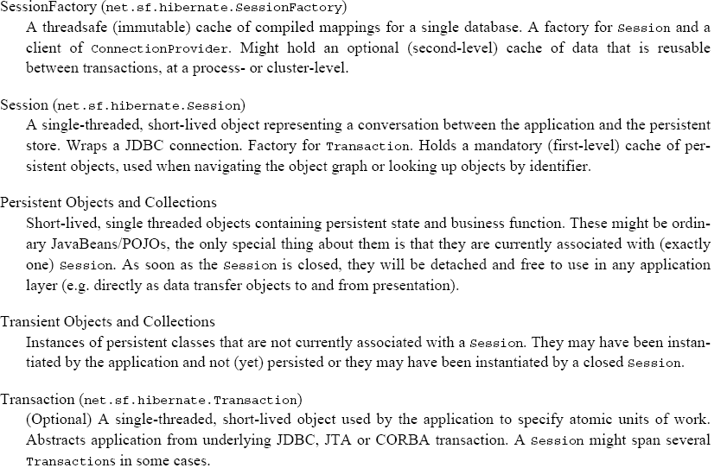
Hibernate Architecture

Slide 16
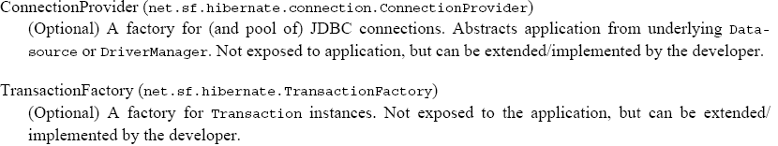
Hibernate Architecture

Slide 17
8. Pros & cons of using hibernate
Pros
Easy to learn and apply
Caching objects. The session is a transaction-level cache of persistent objects. You may also enable a JVM-level/cluster cache to memory and/or local disk. By default, Hibernate supports for EHCache plug in and the link is provided in the References section of the document.
Executing SQL statements later, when needed. The session never issues an INSERT or UPDATE until it is actually needed. So if an exception occurs and you need to abort the transaction, some statements will never actually be issued. Furthermore, this keeps lock times in the database as short as possible (from the late UPDATE to the transaction end).
Never updating unmodified objects. It is very common in hand-coded JDBC to see the persistent state of an object updated, just in case it changed.....for example, the user pressed the save button but may not have edited any fields. Hibernate always knows if an object's state actually changed.
Efficient Collection Handling. Likewise, Hibernate only ever inserts / updates / deletes collection rows that actually changed.
Rolling two updates into one. As a corollary to (1) and (3), Hibernate can roll two seemingly unrelated updates of the same object into one UPDATE statement.
Updating only the modified columns. Hibernate knows exactly which columns need updating and, if you choose, will update only those columns.
Outer join fetching. Hibernate implements very efficient outer join fetching algorithm!
Lazy collection initialization.
Lazy object initialization. Via CGLIB proxies!
Cons
Mass update and mass delete. In this scenario hibernate issues more queries.
No Specification behind hibernate

Slide 18
9. Differences between hibernate and entity beans
EJBs are supposed to be components. In the sense that they're not just one class, but a set of classes, descriptors (that’s an XML and/or annotations in EJB 3) and usage and management contracts.
Hibernate is "just" an ORM (Object/Relational Mapping) tool. This means you can store an object tree belonging to a class hierarchy in a relational DB without writing a single SQL query. . But no transaction control, no instance pooling, no concurrency control, and certainly no security.
Inheritance and polymorphism are IMPOSSIBLE with EJB.
With hibernate inheritance and polymorphisms are possible

Slide 19
Sample example of hibernate framework
How Hibernate Framework used in Nokia ACMMIS project?
Nokia ACMMIS project is a Channel Management System.
Involves the Nokia Central and Retail Distributors in the system.
On Central application is running Weblogic 8.1, Oracle 10G on Solaris.
On Retail Distributors is running on Tomcat, MySql on Windows.
Data Synchronization is implemented between the Central and RDS.
Two applications are developed with same code base at most 90% reusable.
Using Hibernate common objects are created and common queries to support the Oracle and MySql databases

Slide 20
(B) Using Hibernate
(1) Creating mapping document:
The mapping file tells Hibernate what table in the database it has to access, and what columns in that table it should use.
The basic structure of a mapping file looks like this:
<?xml version="1.0"?>
<!DOCTYPE hibernate-mapping PUBLIC
"-//Hibernate/Hibernate Mapping DTD 3.0//EN"
"http://hibernate.sourceforge.net/hibernate-mapping-3.0.dtd">
<hibernate-mapping>
[...]
</hibernate-mapping>
Between the two hibernate-mapping tags, include a class element. All persistent entity classes (again, there might be dependent classes later on, which are not first-class entities) need such a mapping, to a table in the SQL database
It is like <hibernate-mapping> <class name="events.Event" table="EVENTS"> </class></hibernate-mapping>
Finally we include declarations for the persistent properties of the class in the mapping file. By default, no properties of the class are considered persiste

Slide 21
Using Hibernate Contd.
it looks like as below:
<hibernate-mapping <class name="events.Event" table="EVENTS"> <id name="id" column="EVENT_ID"> <generator class="native"/> </id> <property name="date" type="timestamp" column="EVENT_DATE"/> <property name="title"/> </class> </hibernate-mapping>
the name attribute of the property element tells Hibernate which getter and setter methods to use.This mapping file should be saved as Event.hbm.xml, right in the directory next to the Event Java class source file. The naming of mapping files can be arbitrary, however the hbm.xml suffix is a convention in the Hibernate developer community.The directory structure should now look like this: .
+lib
<Hibernate and third-party libraries>
+src
+events
Event.java
Event.hbm.xml

Slide 22
2.creating persistence class(pojo)plain old java objects
A java object generated from the mapping file is called as persistent object.
It contain the attribute which represents columns in the table And generates getters and setters for the attribute.
all manipulations or CRUDS operationds are performed on this object.
Hibernate uses the Plain Old Java Objects (POJOs) classes to map to the database table.

Slide 23
The sample code is as below
package events;
import java.util.Date;
public class Event {
private Long id;
private String title;
private Date date;
public Event() {}
public Long getId()
{ return id; }
private void setId(Long id)
{ this.id = id; }
public Date getDate()
{ return date; }
public void setDate(Date date)
{ this.date = date; }
public String getTitle()
{ return title; }
public void setTitle(String title)
{
this.title = title;
}

Slide 24
contnd
this class uses standard JavaBean naming conventions for property getter and setter methods. as well as private visibility for the fields.
Hibernate can also access fields directly, the benefit of accessor methods is robustness for refactoring.
Place this Java source file in a directory called src in the development folder, and in its correct package.
The directory should now look like this:
.+lib
<Hibernate and third-party libraries>
+src
+events
Event.java

Slide 25
(3.) creating hibernate configuration
We now have a persistent class and its mapping file in place. It is time to configure Hibernate.
Hibernate is the layer in your application which connects to this database, so it needs connection information. The connections are made through a JDBC connection pool, which we also have to configure.
The configuration interface is used to configure and bootstrap hibernate.this is the entry point to communicate with hibernate.it specifies the locations of the mapping files and will associates all the below listed interfaces to the application.
The hibernate can be configure in managed and non - managed environments .

Slide 26
The sample code for the configuration file is as below
<?xml version='1.0' encoding='utf-8'?><!DOCTYPE hibernate-configuration PUBLIC "-//Hibernate/Hibernate Configuration DTD 3.0//EN" "http://hibernate.sourceforge.net/hibernate-configuration-3.0.dtd">
<hibernate-configuration>
<session-factory> <!-- Database connection settings --> <property name="connection.driver_class">org.hsqldb.jdbcDriver</property> <property name="connection.url">jdbc:hsqldb:hsql://localhost</property> <property name="connection.username">sa</property> <property name="connection.password"></property>
<!-- JDBC connection pool (use the built-in) -->
<property name="connection.pool_size">1</property> <!-- SQL dialect -->
<property name="dialect">org.hibernate.dialect.HSQLDialect</property> <!-- Enable Hibernate's automatic session context management -->
<property name="current_session_context_class">thread</property> <!-- Disable the second-level cache -->
<property name="cache.provider_class">org.hibernate.cache.NoCacheProvider</property> <!-- Echo all executed SQL to stdout -->
<property name="show_sql">true</property> <!-- Drop and re-create the database schema on startup -->
<property name="hbm2ddl.auto">create</property>
<mapping resource="events/Event.hbm.xml"/>
</session-factory>
</hibernate-configuration>

Slide 27
contind
Hibernate provided connection pooling and transaction management is used for simplicity. Hibernate uses the hibernate.cfg.xml to create the connection pool and setup required environment.
The hibernate. Properties are the part where we write the database connections.The 2nd part is hibernate.cfg.xml where we write the connection between the java classes and databases tables.
Onces a mapping document has been created, the appropriate database table can be added to the database server

Slide 28
4.creating session factory & session:
When we use hibernate a singleton class called SessionFactory in instantiated.
The sessionfactory configures hibernate for the application using the supplied configuration files.and allows for a session object to be instantiated.
There should be one sessionfactory per application.When we begin persisting or loading objects to /from the data base a session object is instantiated.
Session is light weiht,when session is created ,an object or two is persisted or loaded from the database,and the session object is closed.
When a session object is instantiated , a connection is made to the database.
The sample code for creating a session factory (for CD class’s constructor): .

Slide 29
continud
Public CDTest()
{
Configuration cfg=new Configuration().addClass(CD.class);
Sessionfactory=cfg.buildSessionFactory();..buildGUI();
}
The buildSessionFactory()method build a factory based on the specifics of the mapping document processed by configuration object.
Once the sessionfactory object has been created,the configuration object can be discarded.
The hibernate.cfg.xml file defines the session factory and used to build an immutable session factory
.The session class is shared by all application threads.The session object is used to load,save,and delete an objectfrom/to the database,
it can be also used to create Hibernate specific transactions
The some of the important methods used by session class areload(),2.save(),)(3).find,(4).update(),(5). Save or update(), (6)lock(),(7)delete(),(8)flush(),(9)begin transaction(),(10.)commit()(11)rollback(),(12)close().

Slide 30
Some of the properties of sessionfactory are as below
Property name Purpose
hibernate.connection.driver_class jdbc driver class
hibernate.connection.url jdbc URL
hibernate.connection.username database user
hibernate.connection.password database user password
hibernate.connection.pool_size maximum number of pooled connections

Slide 31
c. the hibernate jdbc properties
Property name | Purpose
hibernate.jdbc.fetch_size | A non-zero value determines the JDBC fetch size (calls Statement.setFetchSize()).
hibernate.jdbc.batch_size | A non-zero value enables use of JDBC2 batch updates by Hibernate. e.g.. recommended values between 5 and 30
hibernate.jdbc.batch_versioned_data | Set this property to true if your JDBC driver returns correct row counts from executeBatch() (it is usually safe to turn this option on). Hibernate will then use batched DML for automatically versioned data. Defaults to false. eg. true | false
hibernate.jdbc.factory_class | Select a custom Batcher. Most applications will not need this configuration property. eg. classname.of.Batcher
hibernate.jdbc.use_scrollable_resultset | Enables use of JDBC2 scrollable resultsets by Hibernate. This property is only necessary when using user supplied JDBC connections, Hibernate usesconnection metadata otherwise. eg. true | false
hibernate.jdbc.use_streams_for_binary | Use streams when writing/reading binary or serializable types to/from JDBC (system-level property). eg. true | false
hibernate.connection.provider_class | The class name of a custom Connection Provider which provides JDBC connections to Hibernate. eg.classname.of.ConnectionProvider
hibernate.connection.isolation | Set the JDBC transaction isolation level. Check java.sql.Connection for meaningful values but note that most databases do not support all isolation levels. eg. 1, 2, 4, 8
hibernate.connection.autocommit | Enables autocommit for JDBC pooled connections (not recommended). eg. true | false
hibernate.connection.<propertyName> | Pass the JDBC property propertyName to DriverManager.getConnection().
hibernate.jndi.<propertyName> | Pass the property propertyName to the JNDI InitialContextFactory
hibernate.connection.release_mode | Specify when Hibernate should release JDBC connections. By default, a JDBC connection is held until the session is explicitly closed or disconnected. For an application server JTA data source, you should use after_statement to aggressively release connections after every JDBC call. For a non-JTA connection
hibernate.connection.autocommit | Enables autocommit for JDBC pooled connections (not recommended). eg. true | false

Slide 32
The code for database connection
the sample code for making jdbc database connection is as below:
try{
class.forname(“my.mysql.jdbc.driver”).newInstance();
Connection connection=DriverManager.getConnection(“jdbc:mysql://localhost/accounts”);
SessionFactory sessionfactory=Configuration.buildSessionFsctory();
Session session=sessionFactory.openSession(connection);
Catch(Exception e)
{ }

Slide 33
2. hibernate callbacks
some of the callback functions are as below
public Boolean onSave(Session s) ; called before the object is saved to the database
public Boolean onUpdate(Session s) ; called before the object is updated.
public Boolean onDeleteSession s) ; called before the object is deleted.
public Boolean onLoad(Session s) ; called after the object is loaded from the database

Slide 34
D.persistent object concept
1.) creating the persistent object
As far as Hibernate is concerned, classes are either transient or persistent. Transient classes are instances that have not been saved to the database.
To make a transient instance persistent, simply save it using the Session class
The sample code is as below:
Team team = new Team (); // … populate team object Session session = SessionFactory.openSession (); session.saveOrUpdate (team);
The saveOrUpdate (Object) call will save the object if the id property is null, issuing a SQL INSERT to the database. This refers to the unsaved-value attribute that we defined in the Player mapping document. If the id is not null, the saveOrUpdate (Object) call would issue an update, and a SQL UPDATE would be issued to the database

Slide 35
2. Retrieving Persistent Object
If we know the primary key value of the object that we want to retrieve, we can load it with the Session. Load () method. This method is overloaded to provide support for standard classes and BMP entity beans
Sample code is as below:
// method 1: loading a persistent instance
Session session = SessionFactory.createSession (); Team team = session. load (Team.class, teamId);
To retrieve a persistent class without knowing its primary key value, we can use the Session. Find () methods.
The find () method allows us to pass an HQL (Hibernate Query Language) statement and retrieve matching objects as a java.util.List. The find () method has three signatures, allowing we to pass arguments to JDBC-like "?" parameters as a single argument, named parameters, or as an Object [].

Slide 36
3. Deleting Persistent Object
Making a persistent object transient is accomplished with the Session.delete () method. This method supports passing either a specific object to delete or a query string to delete multiple objects from the database.
The sample code for it is as below:
// method 1 - deleting the Team loaded in figure 12 session.delete (team); // method 2 –
deleting all of the Teams with a // salary greater than 4 million Session. Delete ("from team in class example.Team where team.annualSalary > 4000000");

Slide 37
(E.) Hibernate Query Language (HQL)
What is Hibernate Query Language (HQL)
HQL is much like SQL and are case-insensitive, except for the names of the Java Classes and properties.
Hibernate Query Language is used to execute queries against database. Hibernate automatically generates the sql query and execute it against underlying database if HQL is used in the application.
HQL is based on the relational object models and makes the SQL object oriented. Hibernate
Query Language uses Classes and properties instead of tables and columns. Hibernate Query Language is extremely powerful and it supports Polymorphism, Associations, Much less verbose than SQL.

Slide 38
Why to use HQL?
Full support for relational operations: HQL allows representing SQL queries in the form of objects. Hibernate Query Language uses Classes and properties instead of tables and columns.
Return result as Object: The HQL queries return the query results) in the form of objects), which is easy to use. This elemenates the need of creating the object and populate the data from result set.
Polymorphic Queries: HQL fully supports polymorphic queries. Polymorphic queries results the query results along with all the child objects if any.
Easy to Learn: Hibernate Queries are easy to learn and it can be easily implemented in the applications.
Support for Advance features: HQL contains many advance features such as pagination, fetch join with dynamic profiling, Inner/outer/full joins, Cartesian products. It also supports Projection, Aggregation (max, avg) and grouping, Ordering, Sub queries and SQL function calls.
Database independent: Queries written in HQL are database independent (If database supports the underlying feature

Slide 39
2. Understanding HQL Syntax
Any Hibernate Query Language may consist of following elements:
Clauses
Aggregate functions
Sub queries
Clauses in the HQL are:
from
select
where
order by
group by
Aggregate functions are:
Avg (...), sum (...), min (...), max (...)
count(*)
Count (...), count (distinct ...), and count (all...)
Sub queries
Sub queries are nothing but it’s a query within another query. Hibernate supports Sub queries if the underlying database supports it.

Slide 40
continud
2.1) Clauses: Here we going to create one table by the name Insurance:
The fields of the table is as below
*Table structure for table `insurance` */
Drop table if exists `insurance`;
CREATE TABLE `insurance` (
`ID` int (11) NOT NULL default '0',
`insurance name` varchar (50) default NULL,
`invested_amount` int (11) default NULL,
`investement_date` datetime default NULL,
PRIMARY KEY (`ID`)
) TYPE=MyISAM;

Slide 41
The from clause sample code is as below
import org.hibernate.Session;
import org.hibernate.*;
import org.hibernate.cfg.*;
import java.util.*;
/**
* @author purushottam Kumar
* Select HQL Example
*/
public class SelectHQLExample {
public static void main(String[] args) {
Session session = null;
try{
// This step will read hibernate.cfg.xml and prepare hibernate for use
SessionFactory sessionFactory = new Configuration().configure().buildSessionFactory();
session =sessionFactory.openSession();
//Using from Clause
String SQL_QUERY ="from Insurance insurance";
Query query = session.createQuery(SQL_QUERY);
for(Iterator it=query.iterate();it.hasNext();){
Insurance insurance=(Insurance)it.next();
System.out.println("ID: " + insurance.getLngInsuranceId());
System.out.println("First Name: " + insurance.getInsuranceName());
}
session.close();
}catch(Exception e){
System.out.println(e.getMessage());
}finally{
}
}
}

Slide 42
continud
The same way we can implement the other clauses, aggregate functions and Sub queries can be implemented.
Most of the time, you will need to assign an alias, since you will want to refer to the insurance in other parts of the query.
Multiple classes may appear, resulting in a cartesian product or "cross" join.
The select clause picks which objects and properties to return in the query result set. Queries may return properties of any value type including properties of component type.
The where clause allows you to narrow the list of instances returned. Compound path expressions make the where clause extremely powerful.
The list returned by a query may be ordered by any property of a returned class or components.
A query that returns aggregate values may be grouped by any property of a returned class or components

Slide 43
Associations and joins
We may also assign aliases to associated entities, or even to elements of a collection of values, using a join. The supported join types are borrowed from ANSI SQL
• inner join
• left outer join
• right outer join
• full join (not usually useful)
The inner join, left outer join and right outer join constructs may be abbreviated.

Slide 44
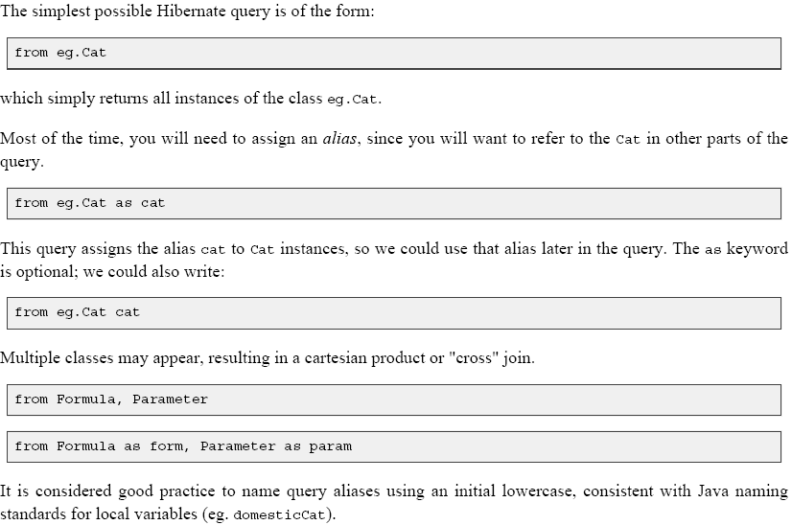
More fun with hql

Slide 45
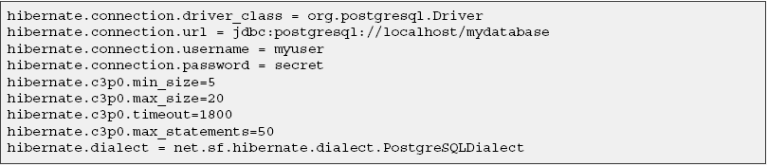
hibernate.properties

Slide 46
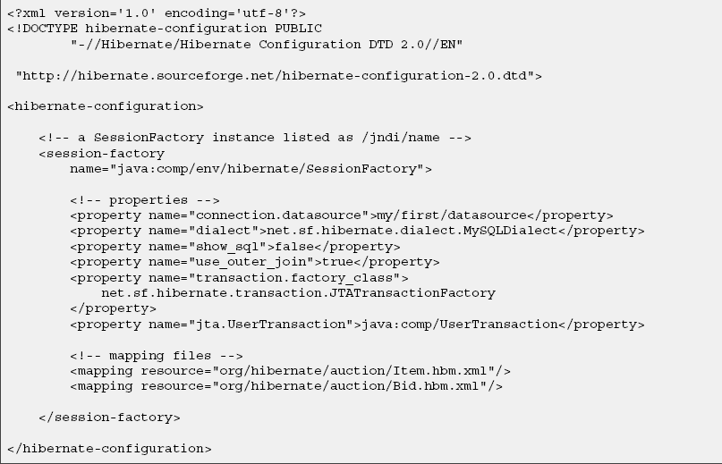
hibernate.cfg.xml

Slide 47
A Simple Hibernate Application that contain following .jar files
+lib
antlr-2.7.4.jar
cglib-full-2.0.2.jar
commons-collections-2.1.1.jar
commons-logging-1.0.4.jar
hibernate3.jar
jta.jar
dom4j-1.5.2.jar
jdbc2_0-stdext.jar
log4j-1.2.9.jar

Slide 48
Directory Structure for hibernate application
+lib
<here are the jar files>
+src
+com
+Hibernate
+FirstApp
Event.java

Slide 49
The mapping file
The outer structure of a mapping file looks like this:
<?xml version="1.0"?>
<!DOCTYPE hibernate-mapping PUBLIC
"-//Hibernate/Hibernate Mapping DTD 3.0//EN"
"http://hibernate.sourceforge.net/hibernate-mapping-3.0.dtd">
<hibernate-mapping>
</hibernate-mapping>
Between the two <hibernate-mapping> tags, we will include a class element, where we can declare which class this mapping refers to and to which table in our SQL database the class should be mapped.

Slide 50
Configuration and Database
As we now have our persistent class and the mapping file it is time to configure Hibernate. Before we do this, we will need a database however, so we go on and get HSQLDB, a java-based in-memory SQL Database, from the HSQLDB website. What we need is the hsqldb.jar from the lib directory of the zip download. We will place it in our lib directory.
In addition, we will create a directory data right under our development directory, where hsqldb will store its files.

Slide 51
hibernate.cfg.xml
Now Hibernate configuration can be done in an xml file, which we will call hibernate.cfg.xml and place it directly in the src folder of our development directory.

Slide 52
hibernate.cfg.xml
<?xml version='1.0' encoding='utf-8'?>
<!DOCTYPE hibernate-configuration PUBLIC
"-//Hibernate/Hibernate Configuration DTD 3.0//EN"
"http://hibernate.sourceforge.net/hibernate-configuration-3.0.dtd">
<hibernate-configuration>
<session-factory>
<property name="hibernate.connection.driver_class">org.hsqldb.jdbcDriver</property>
<property name="hibernate.connection.url">jdbc:hsqldb:data/test</property>
<property name="hibernate.connection.username">sa</property>
<property name="hibernate.connection.password"></property>
<property name="dialect">org.hibernate.dialect.HSQLDialect</property>
<property name="show_sql">true</property>
<property name="transaction.factory_class">
org.hibernate.transaction.JDBCTransactionFactory
</property>
<property name="hibernate.cache.provider_class">
org.hibernate.cache.HashtableCacheProvider
</property>
<property name="hibernate.hbm2ddl.auto">update</property>
<mapping resource=“com/Hibernate/FirstApp/Event.hbm.xml"/>
</session-factory>
</hibernate-configuration>

Slide 53
hibernate.cfg.xml
The first four <property> elements contain the necessary configuration for the JDBC-Connection Hibernate will use.
The dialect <property> element specifies the SQLdialect Hibernate shall generate. Next we specify that Hibernate shall delegate transactions to the underlying JDBC connection and specify a simple cache provider (this is without effect because we don't use any caching yet).
The next property tells hibernate to automatically adjust the tables in the database according to our mappings.
Finally we give the path to our mapping file.

Slide 54
Building
, we create a batch file in our development directory which contains all commands necessary for compilation. Under Windows, this would look like this:
javac -classpath .\lib\hibernate3.jar -d bin src\com\ Hibernate\name of the app\*.java
copy /Y src\hibernate.cfg.xml bin
copy /Y src\com\hibernate\ Hibernate\name of the app \*.xml bin\com\Hibernate\ Hibernate\name of the app
We place this file called build.bat in our development directory.
Finally we create the bin subdirectory of our development directory to place the compiled classes in

Slide 55
for Running the hibernate
Now compile everything by starting build.bat in the development directory.
Run the application by running this in the development directory (all in one line):
.java -classpath .\lib\hibernate3.jar;.\lib\log4j-1.2.9.jar;.\lib\jta.jar;
.\lib\antlr-2.7.4.jar.\lib\commons-logging-1.0.4.jar;.\lib\hsqldb.jar;
.\lib\cglib-full-2.0.2.jar;.\lib\commons-collections-2.1.1.jar;
.\lib\dom4j-1.5.2.jar;.\lib\jdbc2_0-stdext.jar;
.\bin com.Hibernate. Hibernate\name of the app.EventManager

Slide 56
EventManager.java
What we do here is using a HQL (Hibernate Query Language) query to load all existing Events from the database. Hibernate will generate the appropriate SQL, send it to the database and populate Event objects with the data.

Slide 57
F. Sample Hibernate Example
Pre-requisites:
MySQL should be installed on your machine.
  Download link : http://dev.mysql.com/get/Downloads/MySQL-4.1/mysql-4.1.20-win32.zip/from/http://mysql.orst.edu/
Eclipse 3.1.x is also required to Edit, Compile and run Hibernate Example.
  Download link : http://download3.eclipse.org/eclipse/downloads/drops/R-3.2-200606291905/download.php?dropFile=eclipse-SDK-3.2-win32.zip

Slide 58
Actual Coding
1.The first step is to create the hibernate.cfg.xml file.
<?xml version='1.0' encoding='utf-8'?>
<!DOCTYPE hibernate-configuration PUBLIC"-//Hibernate/Hibernate Configuration DTD//EN""http://hibernate.sourceforge.net/hibernate-configuration-3.0.dtd">
<hibernate-configuration>
<session-factory>
<property name="hibernate.connection.driver_class">com.mysql.jdbc.Driver</property> <property name="hibernate.connection.url">jdbc:mysql://localhost/test</property> <property name="hibernate.connection.username">root</property>
<property name="hibernate.connection.password">root123</property>
<property name="hibernate.connection.pool_size">10</property>
<property name="show_sql">false</property>
<property name="dialect">org.hibernate.dialect.MySQLDialect</property>
<property name="hibernate.hbm2ddl.auto">update</property>
<!-- Mapping files -->
<mapping resource="contact.hbm.xml"/>
</session-factory>
</hibernate-configuration>

Slide 59
2.To create a contact.hbm.xml file
  This file is required to map between the database table and your java code.
  Here contact is the table name.
<?xml version="1.0"?>
<!DOCTYPE hibernate-mapping PUBLIC "-//Hibernate/Hibernate Mapping DTD 3.0//EN" "http://hibernate.sourceforge.net/hibernate-mapping-3.0.dtd">
<hibernate-mapping>
<class name="com.wipro.hibernate.Contact" table="CONTACT">
<id name="id" type="long" column="ID" >
<generator class="assigned"/>
</id>
<property name="first Name">
<column name="FIRSTNAME" />
</property>
<property name="last Name">
<column name="LASTNAME"/>
</property>
<property name="email"> <column name="EMAIL"/>
</property>
</class>
</hibernate-mapping>

Slide 60
continud
3.The last file is our FirstExample.java file which will create Hibernate session and handle your database
package com.wipro.hibernate;
import org.hibernate.Session;
import org.hibernate.SessionFactory;
import org.hibernate.cfg.Configuration;
public class FirstExample {
public static void main(String[] args) {
Session session = null; try{ // This step will read hibernate.cfg.xml and prepare hibernate for use
SessionFactory sessionFactory = new Configuration().configure().buildSessionFactory();
session =sessionFactory.openSession();
//Create new instance of Contact and set values in it by reading them from object System.out.println("Inserting Record");
Contact contact = new Contact();
contact.setId(6); contact.setFirstName("Deepak");
contact.setLastName("Kumar");
contact.setEmail(“purush_cdac@yahoo.com");
session.save(contact);
System.out.println("Done"); }catch(Exception e){
System.out.println(e.getMessage());
}finally{ // Actual contact insertion will happen at this step
session.flush();
session.close(); } }

Slide 61

Setting up Environment:
First create a directory structure as follows,
Put your .xml and .java file in src folder.
Put all required library files (.jar) in lib folder.
The classes folder is used by Eclipse to put the class files in it.
Now, create a new project in Eclipse.
  File -> New -> Project.
  Select Java Project. Click Next.
  Give the Project name (any thing you please).
  And give the path where you have stored the Sample Project.
  Click Next.
  The Eclipse automatically takes the source and libraries from the folder.
No need to worry of how will you compile your source code? Eclipse will do it for you automatically. If there are any errors then it will show them as red.

Slide 62
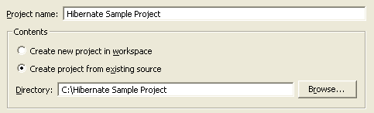
Running Your Example:
1.Go to Run -> Run….
2.Select Java Application form left side. And click New (below).
3.It will automatically take the Project name.
4.Now add “com.wipro.hibernate.FirstExample” in the Main Class.
5.Press Apply and Run. The Console window will look like as follows

Slide 63
Advantage of Using Hibernate
Hibernate addresses both sides of the problem: not only how to get objects into the database but also how to get them out again.
Transparent Persistence no required interfaces or base classes for persistent classes.
Object-Oriented Query Language - powerful query language expressed in a familiar SQL-like language.
Support for Wide Range of Databases -including Oracle, DB2, Sybase, MS SQL Server, PostgreSQL, MySQL, HypersonicSQL, MckoiSQL, SAP DB, Interbase, Pointbase, Progress, FrontBase, Ingres, Informix, andFirebird.

Slide 64
G.1. Conclusion
This presentation has given you an introduction to what Hibernate can do.
Hibernate delivers a high-performance, open source persistence framework comparable to many of its open source and commercial counterparts.
Developers utilizing Hibernate can greatly reduce the amount of time and effort needed to code, test, and deploy applications.
However, we’ve only scratched the surface and I encourage you to explore Hibernate for yourself

Slide 65
References
http://www.allapplabs.com/hibernate/introduction_to_hibernate.htm
http://www.allapplabs.com/hibernate/introduction_to_hibernate.htm
http://www.developer.com/open/article.php/3322131
http://www.allapplabs.com/hibernate/overview_of_hibernate.htm
http://www.roseindia.net/hibernate/selectclause.shtml
Hibernate website: http://www.hibernate.org/
Hibernate performance FAQ: http://www.hibernate.org/15.html
Hibernate feature list: http://www.hibernate.org/4.html
Hibernate EHCache : http://www.hibernate.org/158.html
Hibernate Wiki overview: http://www.hibernate.org/37.html
Hibernate API doc: http://www.hibernate.org/hib_docs/v3/api/
Hibernate forums: http://forum.hibernate.org/
A comparison of various ORM frameworks: http://c2.com/cgi-bin/wiki?ObjectRelationalToolComparison
C3P0 Connection Pooling
Apache DBCP Pooling

