Slide 1
Bank Marketing
Campaign Analysis
Exploratory Data Analysis | Python • Pandas • Seaborn

Slide 2
Project Objective & Dataset
Objective: explore factors associated with term deposit subscriptions.
Dataset: 41,188 customer records and 21 columns.
Subscribed: 4,640 customers (11.27%).
Not subscribed: 36,548 customers (88.73%).
Methods: data quality checks, group comparisons and visualizations.

Slide 3
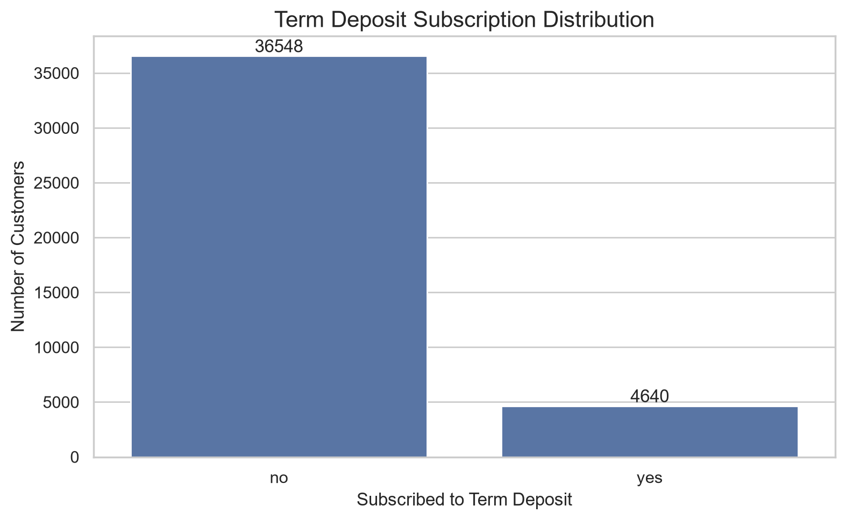
Subscription Distribution
Key takeaway
Only 11.27% of records resulted in a subscription. The target is imbalanced, so comparing percentages is more informative than relying only on raw counts.

Slide 4
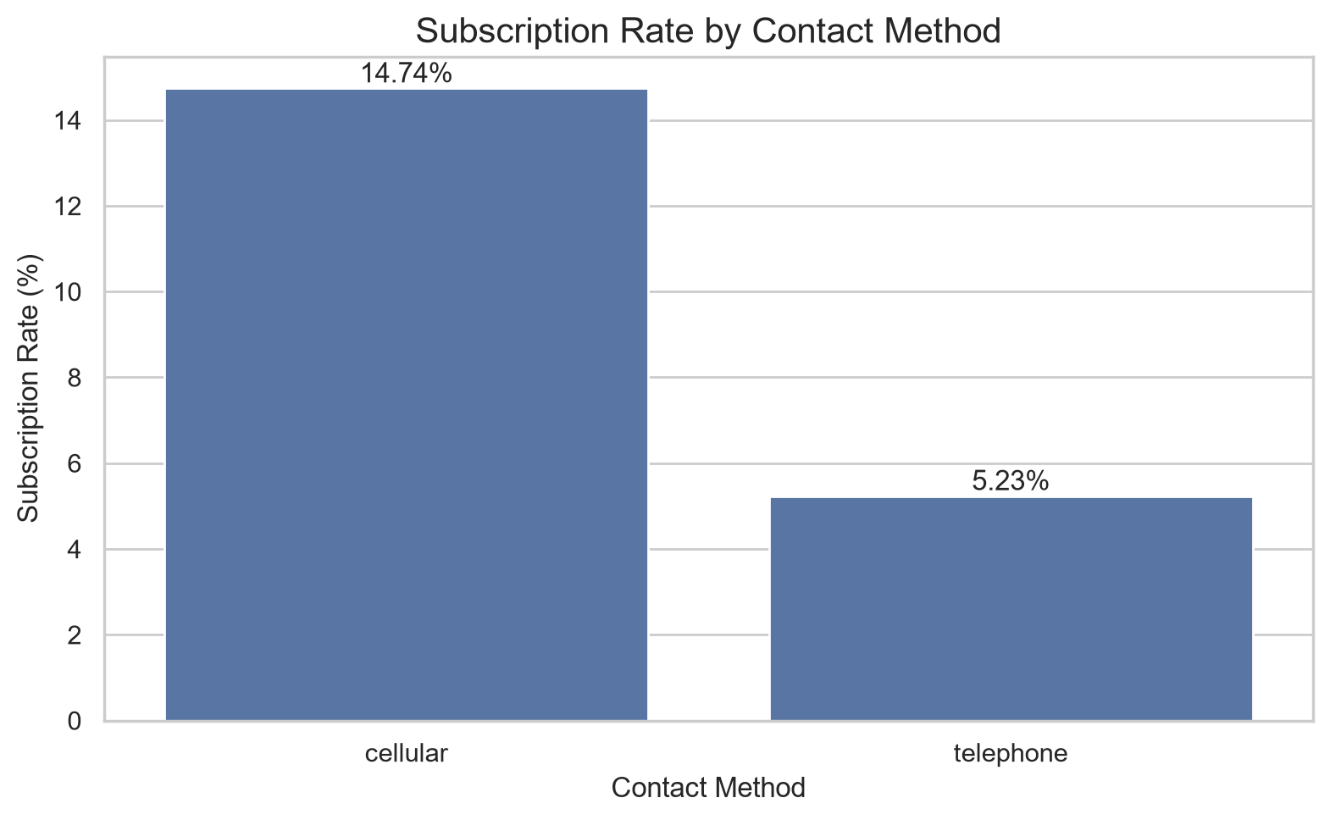
Subscription Rate by Contact Method
Key takeaway
Observed rates differ by contact method. cellular: 14.74%; telephone: 5.23%. This is an association, not proof that contact method alone caused the difference.

Slide 5
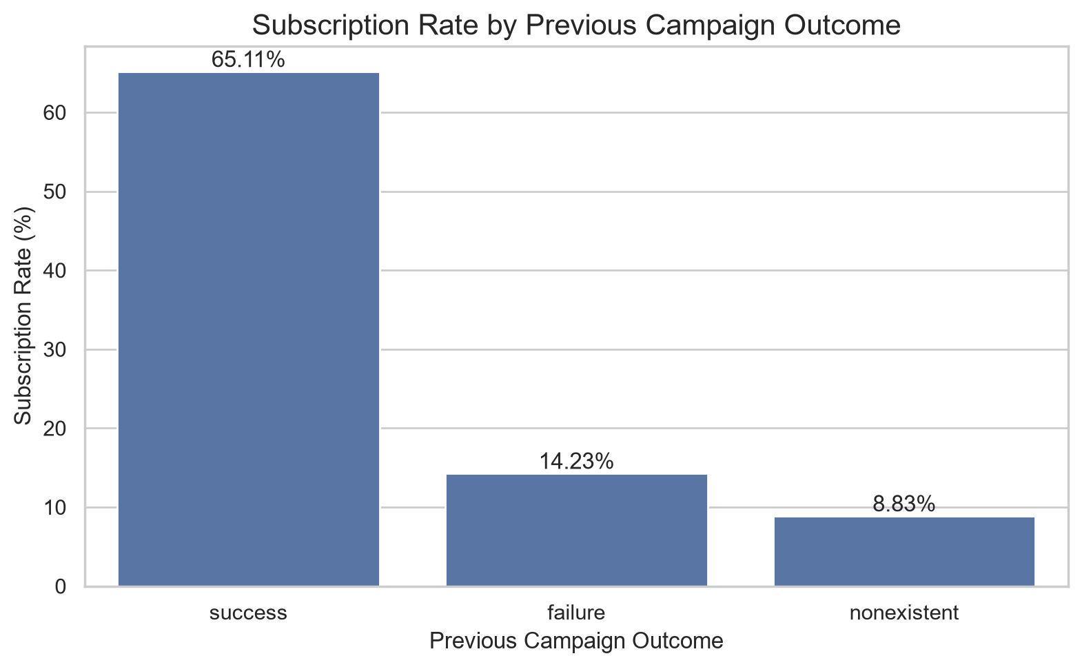
Previous Campaign Outcome
Key takeaway
Subscription rates vary with the recorded previous campaign outcome. success: 65.11%; failure: 14.23%; nonexistent: 8.83%. Group sizes and other customer characteristics also matter.

Slide 6
Additional Patterns
Job categories with the highest observed subscription rates:
student: 31.43%; retired: 25.23%; unemployed: 14.20%
Months with the highest observed subscription rates:
mar: 50.55%; dec: 48.90%; sep: 44.91%
These are descriptive comparisons; they do not establish causation.

Slide 7
Conclusion & Limitations
Overall subscription rate: 11.27%.
Customer and campaign characteristics show differing subscription rates.
The dataset contains 'unknown' category values; these are not automatically missing values.
Call duration is known after the call, so it should not be used for pre-call targeting.
Next step: validate potential campaign improvements with new data or controlled tests.

