Slide 1
Form
Forms are documents that collect information from one's clients, customers, and respondents. Some common examples of forms include forms for purchases, incident reports, hazards, quality control, contact tracing, and feedback gathering.

Slide 2
Form opening
In laravel, this is a way to open the form:
https://localhost:8000/login

Slide 3
Form field
The <form> element is a container for different types of input elements, such as: text fields, checkboxes, radio buttons, submit buttons, etc.

Slide 4
Form buttons
Form buttons allow the user to submit the filled-in form to the server for processing.

Slide 5
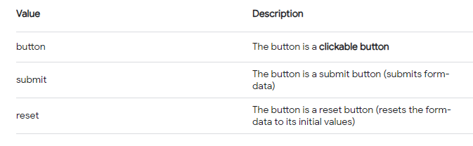
Types

Slide 6
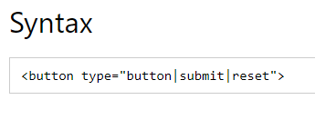
syntax

Slide 7
Form security
Secure web forms are forms that are used on websites to securely collect data from users. They are designed to use data encryption, authentication, and secure communication protocols to protect the information that is collected. This prevents malicious users from obtaining or altering the data.

Slide 8
How do I create a secure form for my website?
SSL to secure form data.
Encrypt all your data (in transit and at rest)
Activate virus and malware protection.
Enable CAPTCHA authentication.
Control user input.
Secure data in a trusted database.
Ensure password protection for your forms.

Slide 9
SSL (Secure Sockets Layer) protocol
SSL is standard technology for securing an internet connection by encrypting data sent between a website and a browser (or between two servers). It prevents hackers from seeing or stealing any information transferred, including personal or financial data.

Slide 10
Laravel validations
Validation is the most important aspect while designing an application. It validates the incoming data.
By default, base controller class uses a ValidatesRequests trait which provides a convenient method to validate incoming HTTP requests with a variety of powerful validation rules.

Slide 11
Validation Rules in Laravel
Laravel will always check for errors in the session data, and automatically bind them to the view if they are available. So, it is important to note that a $errors variable will always be available in all of your views on every request, allowing you to conveniently assume the $errors variable is always defined and can be safely used. The following table shows all available validation rules in Laravel.

Slide 12
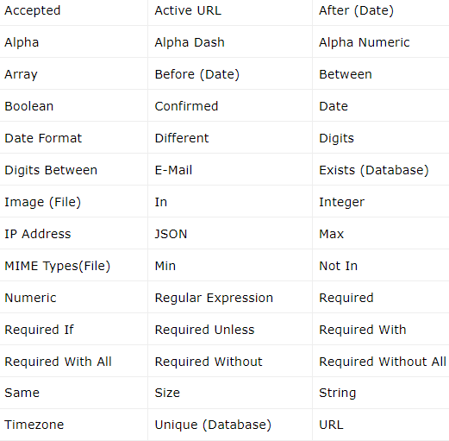
Validation rules

Slide 13
Error Message
The $errors variable will be an instance of Illuminate\Support\MessageBag. Error message can be displayed in view file by adding the code as shown below.

Slide 14
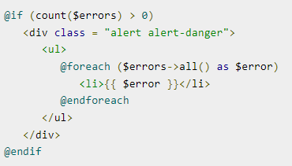
Error message code

Slide 15
Example
Step 1 − Create a controller called ValidationController by executing the following command.

Slide 16
Step 1

Slide 17
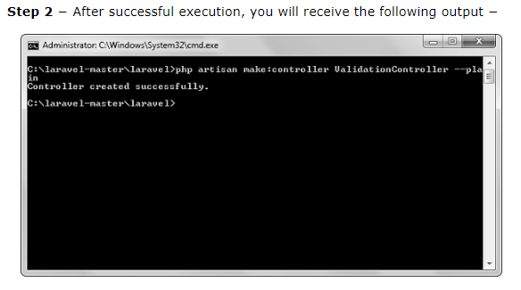
Step 2

Slide 18
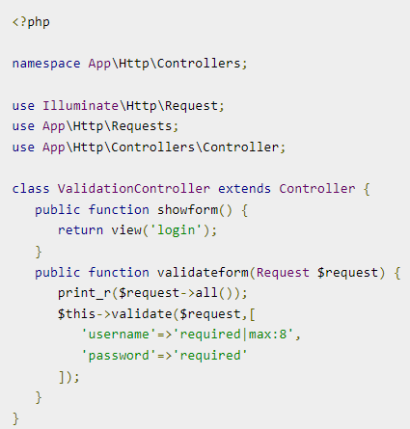
Step 3

Slide 19
Step 4
Step 4 − Create a view file called resources/views/login.blade.php and copy the following code in that file.
resources/views/login.blade.php

Slide 20
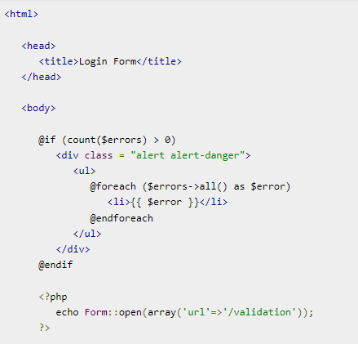
Step 4 conti..

Slide 21
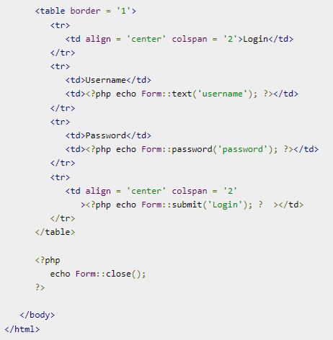
Step 4 conti..

Slide 22
Step 5
Step 5 − Add the following lines in app/Http/routes.php.
app/Http/routes.php

Slide 23

Step 5 conti..

Slide 24

Step 6

Slide 25
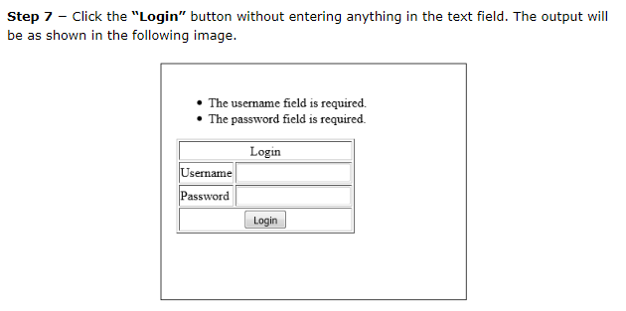
Step 7

Slide 26
Reference
https://www.tutorialspoint.com/laravel/laravel_validation.htm

