Slide 1

To –Do List App
Department of Computer Science
Program Name: M. Sc. (Computer Science)
Presented By:- Asmita Raj (CUSB2202312004)
Medha Madhvi (CUSB2202312016)
Pratyush Pritam (CUSB2202312021)
December, 2023
To-Do List App

Slide 2
Table of Contents
Department of Computer Science
Program Name: M. Sc. (Computer Science)
Introduction
Functionality
Working of project
Result/Output
Conclusion and Future Scope
Reference
To-Do List App

Slide 3
Introduction
Department of Computer Science
Program Name: M. Sc. (Computer Science)
Problem Statement:
Task management is a pervasive challenge faced by individuals in both personal and professional spheres.
The existing methods for organizing and keeping track of tasks often prove to be inefficient, leading to disorganization and decreased productivity.
The To-Do List App aims to address this challenge by providing a user-friendly platform for managing tasks, offering features such as task addition, viewing, editing, and deletion.
To-Do List App

Slide 4
Purpose of the To-Do List App:
Department of Computer Science
Program Name: M. Sc. (Computer Science)
Introduction…
The To-Do List App is designed to address this common problem by providing a simple and effective solution for managing tasks.
This application aims to streamline the task management process, offering users an intuitive and user-friendly platform to organize their responsibilities efficiently.
Let's delve into how this app tackles the challenges associated with task management and enhances the overall user experience.
To-Do List App

Slide 5
Functionality
Department of Computer Science
Program Name: M. Sc. (Computer Science)
Button Functions:
The script defines various functions to handle button clicks, including:
add_item(): Adds a task to the in-memory list (task) and inserts it into the MySQL database.
view_task(): Displays details of the selected task from the listbox in a message box.
edit_task(): Allows users to edit an existing task and updates it in both the in-memory list and the database.
delete_item(): Deletes the selected task from both the in-memory list and the database.
clear_item(): Deletes all tasks from both the in-memory list and the database.
retrieve_database(): Retrieves tasks from the MySQL database.
To-Do List App

Slide 6
Working of project
Department of Computer Science
Program Name: M. Sc. (Computer Science)
For Source Code & Report –
Used this Link:
https://github.com/AsmitaSin/To_do_list_aap.git
https://github.com/MedhaMadhvi/Python/tree/main/Mini_Project
https://github.com/pratyushpritam34/Python-Mini-Project
To-Do List App

Slide 7
Result And Output Of the Project
Department of Computer Science
Program Name: M. Sc. (Computer Science)
To-Do List App

Slide 8
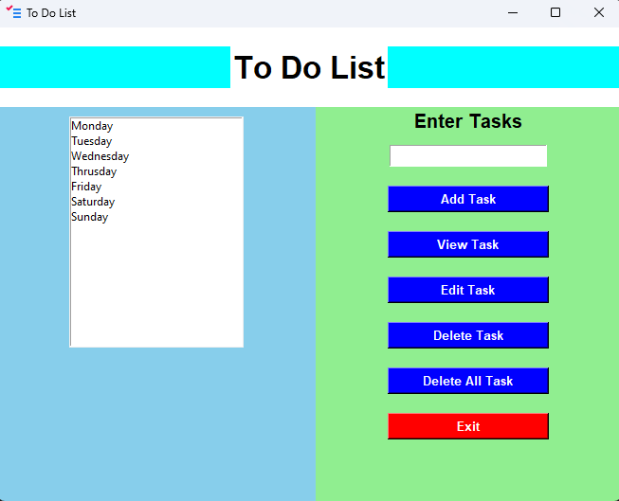
Snapshot of App Interface
Department of Computer Science
Program Name: M. Sc. (Computer Science)
To-Do List App

Slide 9
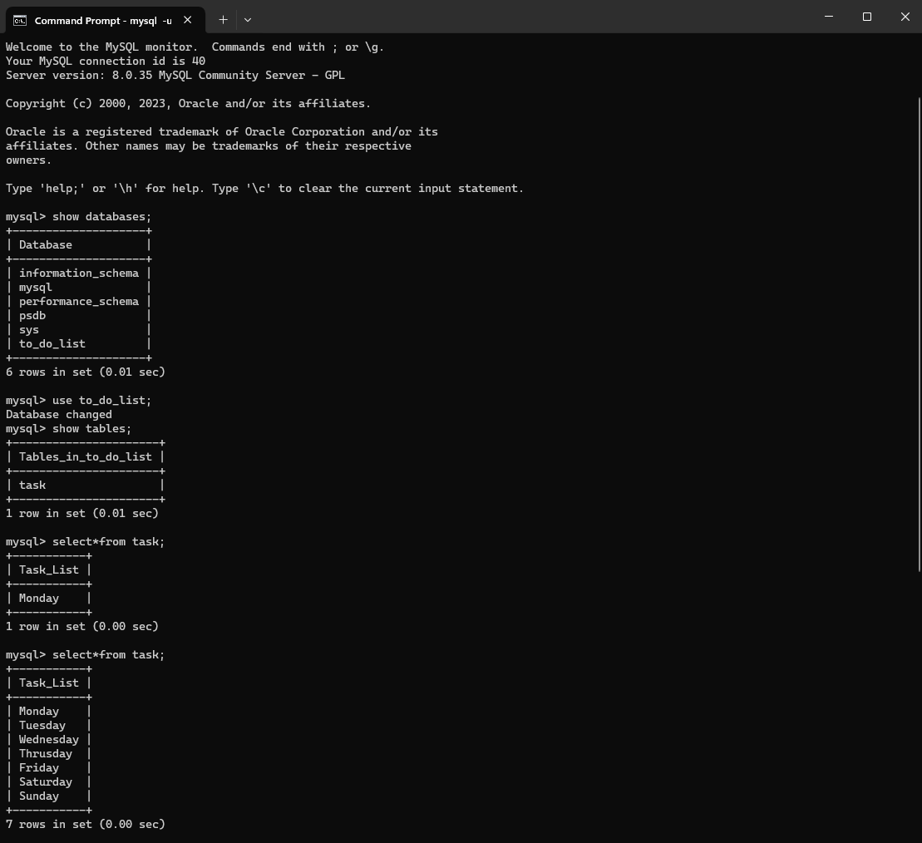
Snapshot of Database
Department of Computer Science
Program Name: M. Sc. (Computer Science)
To-Do List App

Slide 10
Conclusion and Future Scope
Department of Computer Science
Program Name: M. Sc. (Computer Science)
Conclusion :
The To-Do List App represents a valuable solution to the challenges of task management, offering users a simple and effective platform for organizing their responsibilities. The application successfully achieves its objectives, providing an intuitive user interface, robust task management functionalities, and a visually appealing design. The journey of development has been guided by a commitment to user-friendly design and efficient task handling.
To-Do List App

Slide 11
Future Scope
Department of Computer Science
Program Name: M. Sc. (Computer Science)
The To-Do List App holds promising potential for further development and enhancement. The future scope includes:
Task Prioritization: Implementing a task prioritization feature to enable users to focus on high-priority items.
Due Dates and Reminders: Introducing due dates and reminder functionalities to enhance time-sensitive task management.
User Authentication: Incorporating user accounts and authentication mechanisms to enable personalized task management for multiple users.
Data Persistence: Adding the ability to save tasks between sessions, ensuring users do not lose their task list when restarting the application.
Improved User Interface: Enhancing the visual design and layout based on user feedback to create a more aesthetically pleasing and intuitive interface.
Mobile Compatibility: Adapting the application for mobile devices to extend its accessibility and usability.
Collaborative Features: Enabling collaboration on tasks among multiple users, making it suitable for team-based projects.
Analytics and Insights: Incorporating analytics features to track task completion rates and provide insights into task management patterns.
To-Do List App

Slide 12

Any Queries-
Department of Computer Science
Program Name: M. Sc. (Computer Science)
Contact: https://github.com/MedhaMadhvi/Python/tree/main/Mini_Project
To-Do List App

Slide 13
Thank you
Department of Computer Science
Program Name: M. Sc. (Computer Science)
To-Do List App

