Slide 1
🇮🇳 India-Focused Threat Intelligence & Safety Monitoring Dashboard
Presented By: Pratyush Pattnaik

Slide 2
SOCIETAL BENEFITS OF THIS PROJECT
Domain | Benefit | Description
Public Safety | Early detection of violent or extremist narratives | Helps prevent escalation and allows rapid response
Governance & Policy | Data-driven insight for decision-makers | Provides concise, AI-summarized briefs on dynamic topics
Media Literacy | Counter misinformation | Helps identify narrative manipulation or bias
AI Ethics | Promotes safe AI interactions | Built-in LLM content safety layer for responsible usage
Education & Research | Accessible analytical framework | Teaches how NLP + visualization can serve society
Technology Democratization | Low-cost, open-source solution | Enables smaller organizations to use AI intelligence tools

Slide 3
Web Scrape
An agent would be automatically analyzing the data and providing about the key insights about the country’s current geo-financial scenario
The second llm model would be studying the summarized data and then would be scoring them on the basis of criticality as well as showing the most crucial or related key words or phrases searched in the search bar
In the search bar for security purposes if any person searches with any kind of malicious intent or the agent finds that person may pose threat to the society then it will be alerting the authorities through a popup
If anyone interested about the agents they can ask there queries or receive updates through the mail they have shared.
Another agent built whose purpose is to fight crime in the society and eliminate or reduce that so it is working on it and it will be needing your assistance or guidance in that also
EXA_API
GITHUB CRON THE API HITS EVERY 12HRS
NLTK LIBRARRY
Summarization of the context
CEREBRAS API, PUSHOVER: for push notifications,
LLAMA models
Dashboard for visualization using LLM
Containerized using Docker
An agent whoose sole motive is to figure out to how to decrease crime by analyzing dataset
MCP

Slide 4
CEREBRAS API KEY
PUSHOVER
META MODELS
STREAMLIT
MCP
DOCKERIZATION
FLY.IO
EXA-API
NLTK Lib

Slide 5
Component | Innovation
Scraping → Summarization → Visualization | Fully automated 12-hour pipeline with fallback cache
LLM Curation | Cleans, categorizes, and ranks key phrases intelligently
Safety Monitor | Hybrid rule + LLM model for threat-level classification
Push Alerts | Real-time Pushover integration for high-risk detections
Excel Analyzer | ML-assisted profiling and chat interface for structured datasets
Lightweight Deployment | Docker + Fly.io + GitHub data hosting reduces memory footprint

Slide 6
Layer | Tools / Libraries
Language & Environment | Python 3.11, Docker
Frameworks | Streamlit, Plotly, Matplotlib
NLP & AI | NLTK, RAKE, WordCloud, LLM APIs (Cerebras/OpenAI)
Networking & Requests | requests, urllib3.Retry
Automation | Docker Containerization, Fly.io Deploy
Data Handling | pandas, openpyxl
Alerting | Pushover API
Deployment | Fly.io, Docker Hub (optional)
Version Control | GitHub with auto-updating datasets

Slide 7
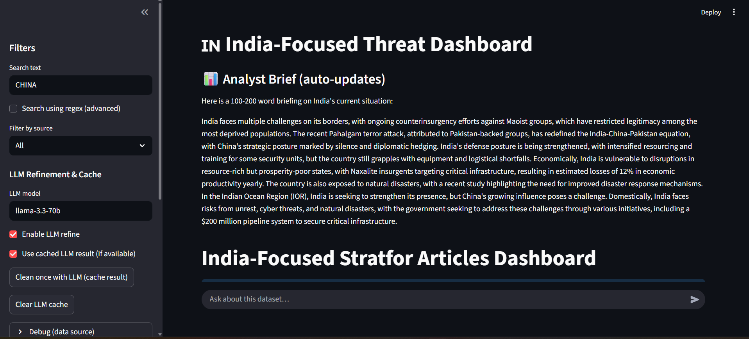
RESULTS/ FINDINGS

Slide 8
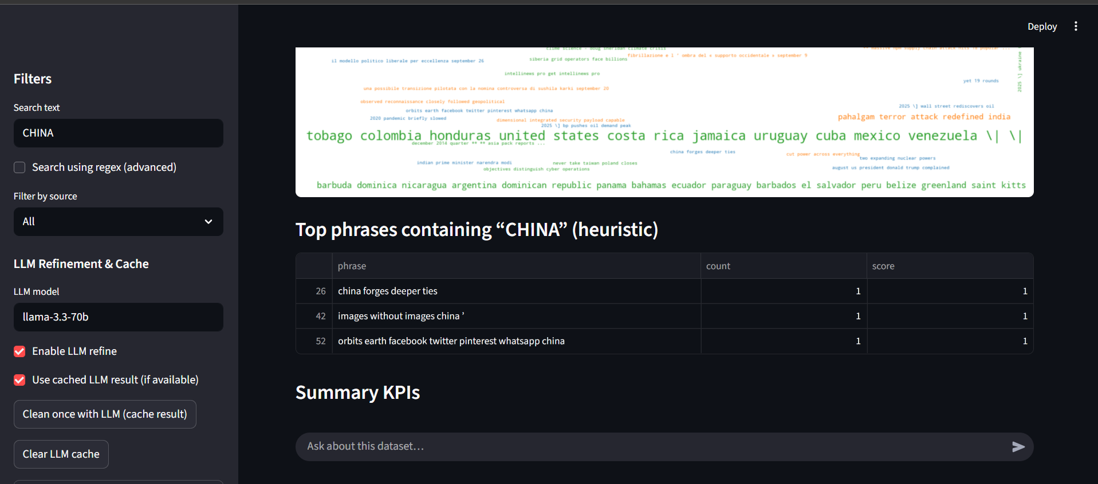

Slide 9
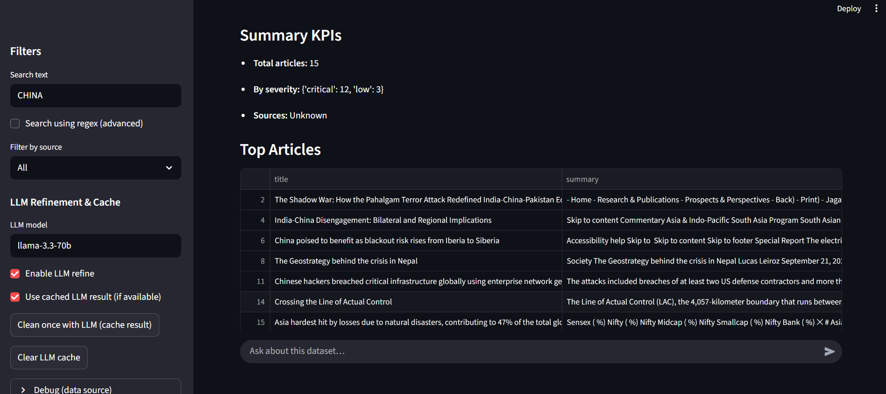

Slide 10
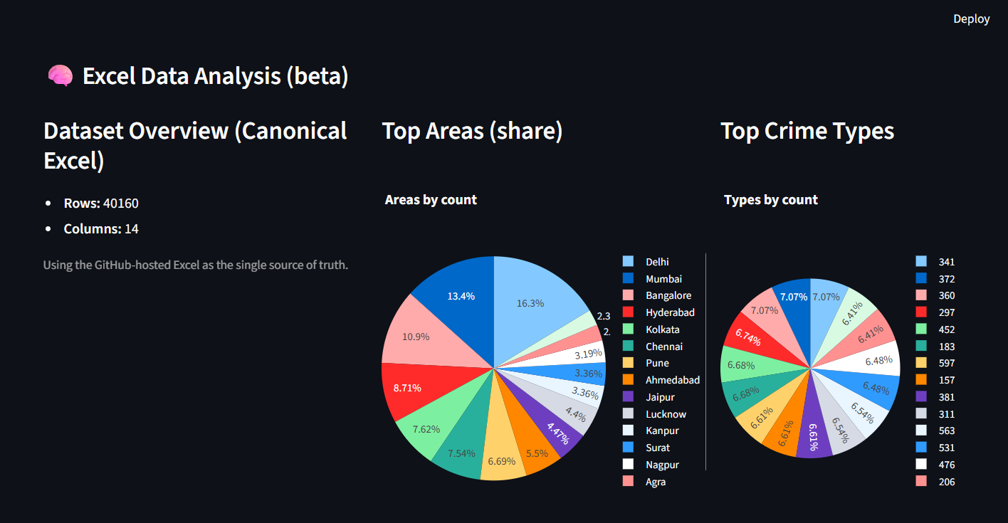

Slide 11
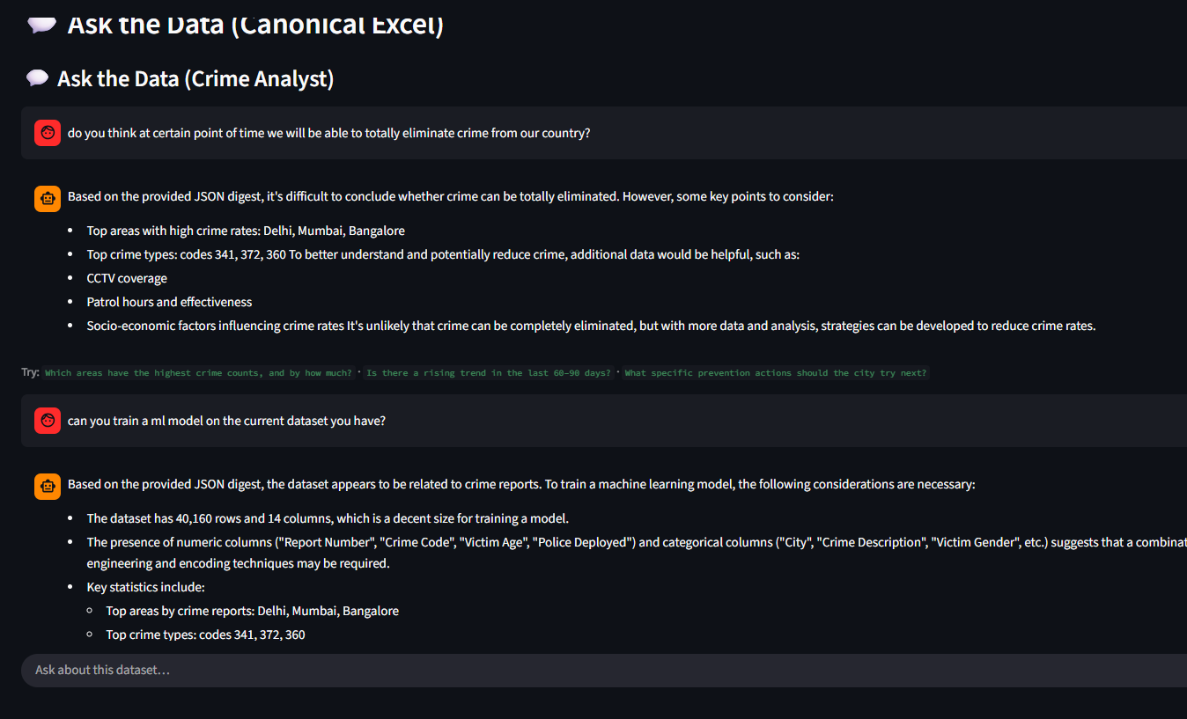

Slide 12
