Slide 1
Food Harvest Supply Chain
BY
Madhura Avachat
Mayur Choudhary
Kalpaj Patil
Poorvi Raut
Using Blockchain

Slide 2
Introduction
Enables the decentralized and immutable storage of verified data
Logistics and supply chain management community recognises potential. [5]
Food quality change and environmental load for new scenarios is as important as the analysis of efficiency and responsiveness requirements. [2]

Slide 3
Motivation
Food Safety: Tampering, Stale Food
Supply Chain Traceability System
Production, processing, warehousing, distribution and selling links. [1]

Slide 4
Problem Statement
Food Harvest Supply Chain traceability system using Smart Contracts, RFID.

Slide 5
Literature Survey
Smart contracts and their application in supply chain management. Angwei Law - 2017 - dspace.mit.edu
Feng Tian. (2016). An agri-food supply chain traceability system for China based on RFID c blockchain technology. 2016 13th International Conference on Service Systems and Service Management (ICSSSM
Traceability in Agri-Food Sector using RFID Arun N.Nambiar Department of Industrial Technology California State University Fresno, California 93740

Slide 6
SOFTWARE REQUIREMENTS SPECIFICATIONS

Slide 7
Functional Requirements
Traceability Thrust
Information must be collected and merged when tracing the source of a problem, or tracking down affected product
Cyber-security Assessment Thrust
Cyber-security assessment and system configuration checking are essential for assuring trust in a supply chain [4]

Slide 8
Non-Functional Requirements
Food Safety and Identification
Implementation of effective traceability systems improves the ability to implement verifiable safety and quality compliance programs. The resulting visibility of relevant information enables agri-food businesses to better manage risks and allows for quick reaction to emergencies, recalls, and withdrawals.

Slide 9
Software Requirements
Solidity language for creating smart contracts.
Mongo DB language for back-end database.
Node JS
WEB3 JS
ReactJS for front-end.
Arduino IDE
Geth
Local Databases
Notes:
Geth is a command line interface (CLI) tool that communicates with the Ethereum Network and acts as the a link between your computer, its hardware and the rest of the ethereum nodes or network computers.

Slide 10
Hardware Requirements
Linux (64-bit ) Operating system .
4GB RAM

Slide 11
SYSTEM DESIGN

Slide 12
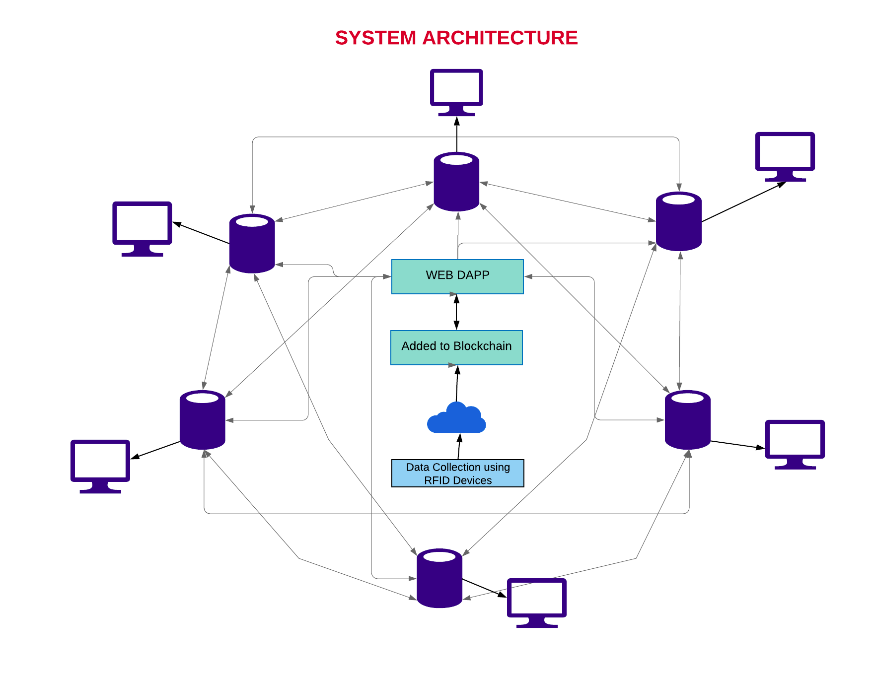

Slide 13
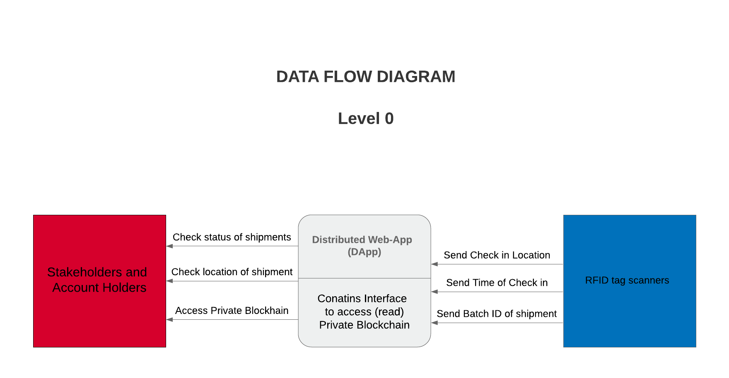

Slide 14
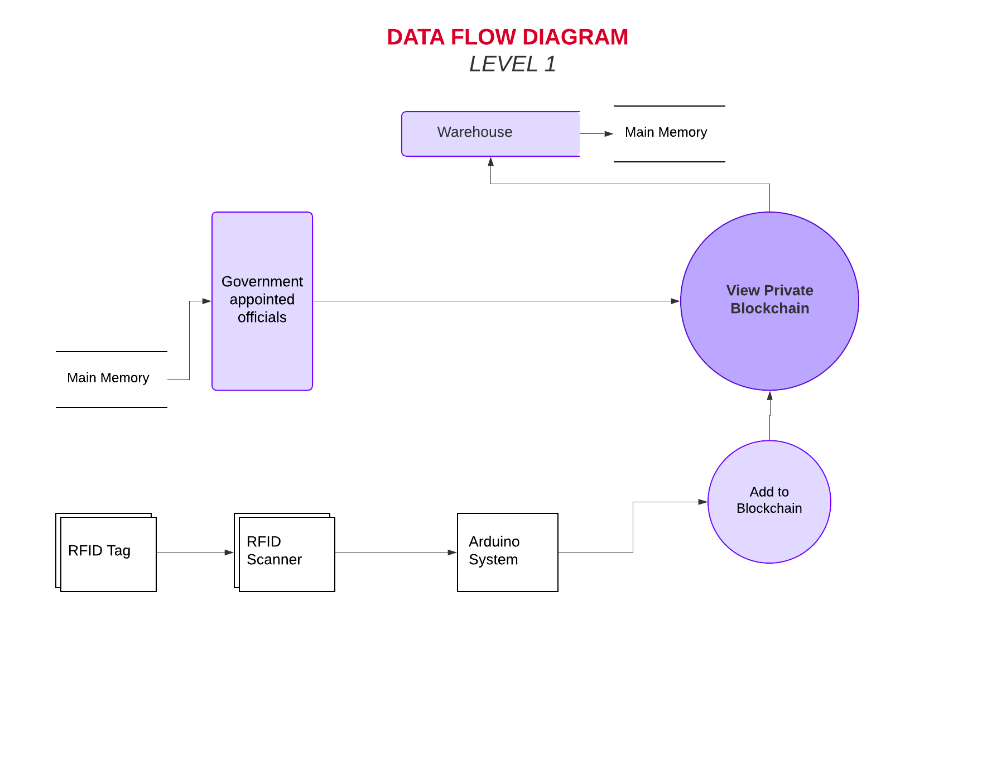

Slide 15
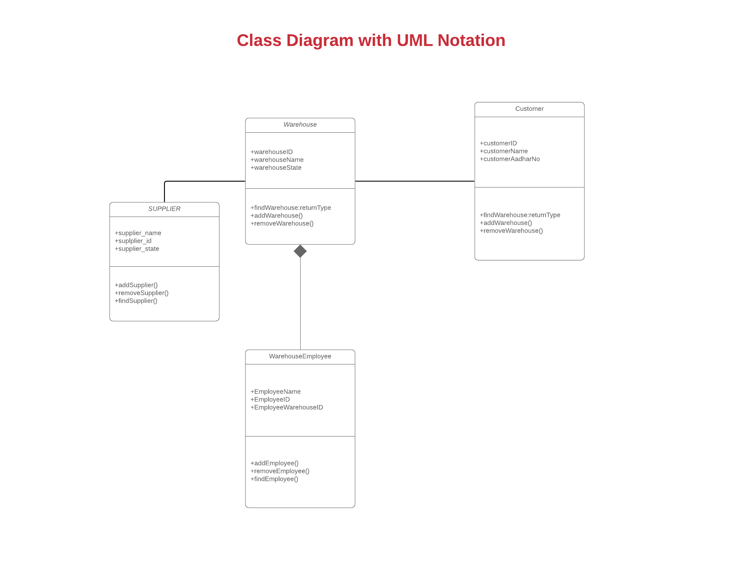

Slide 16
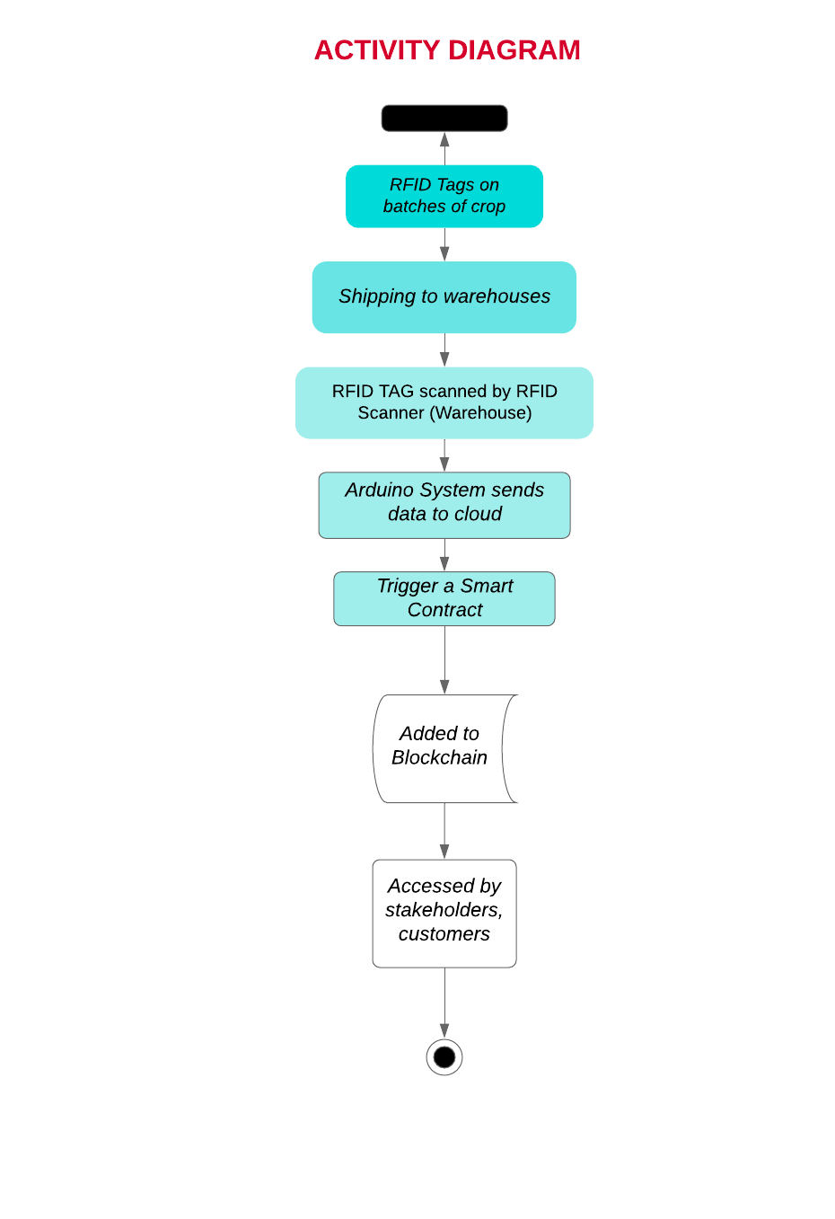

Slide 17
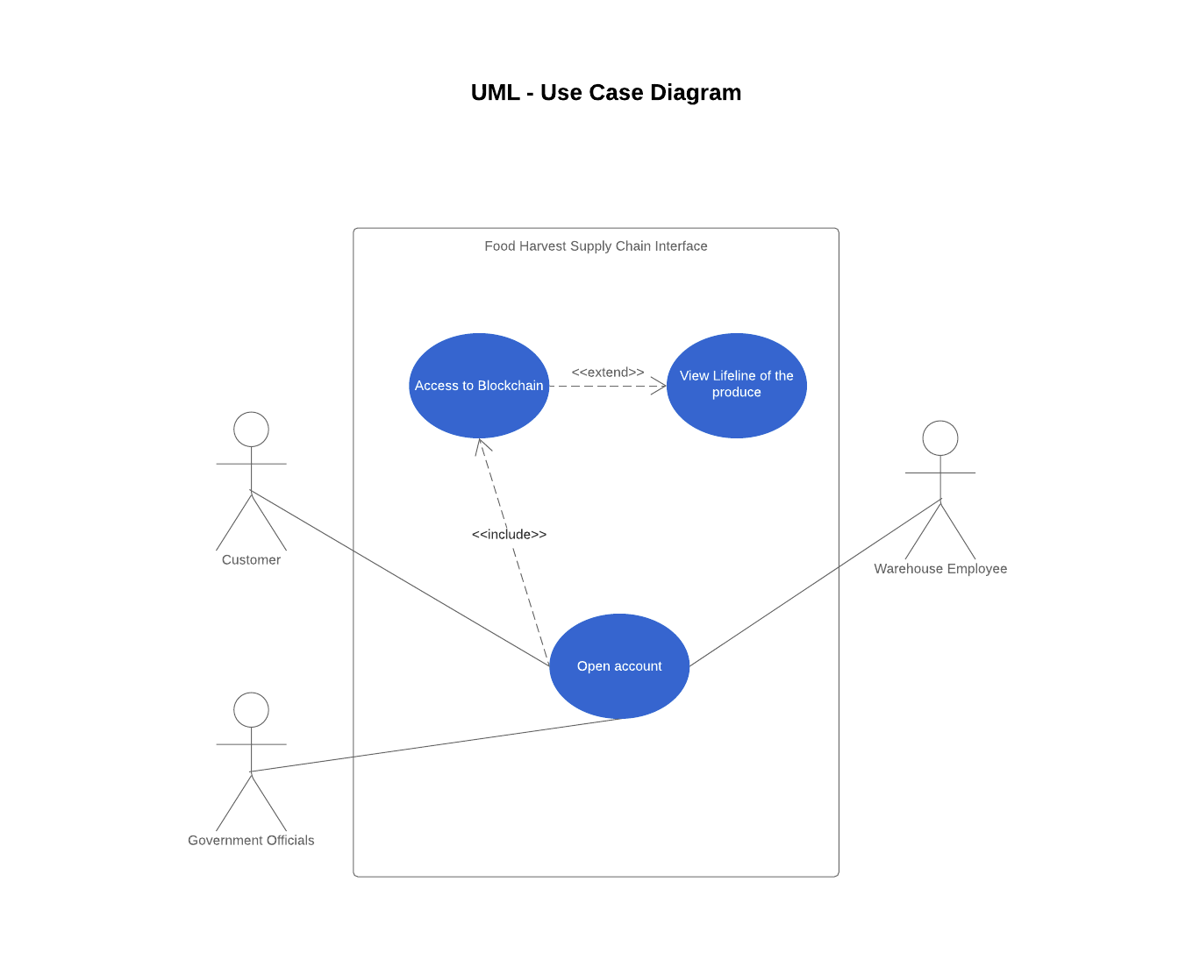

Slide 18
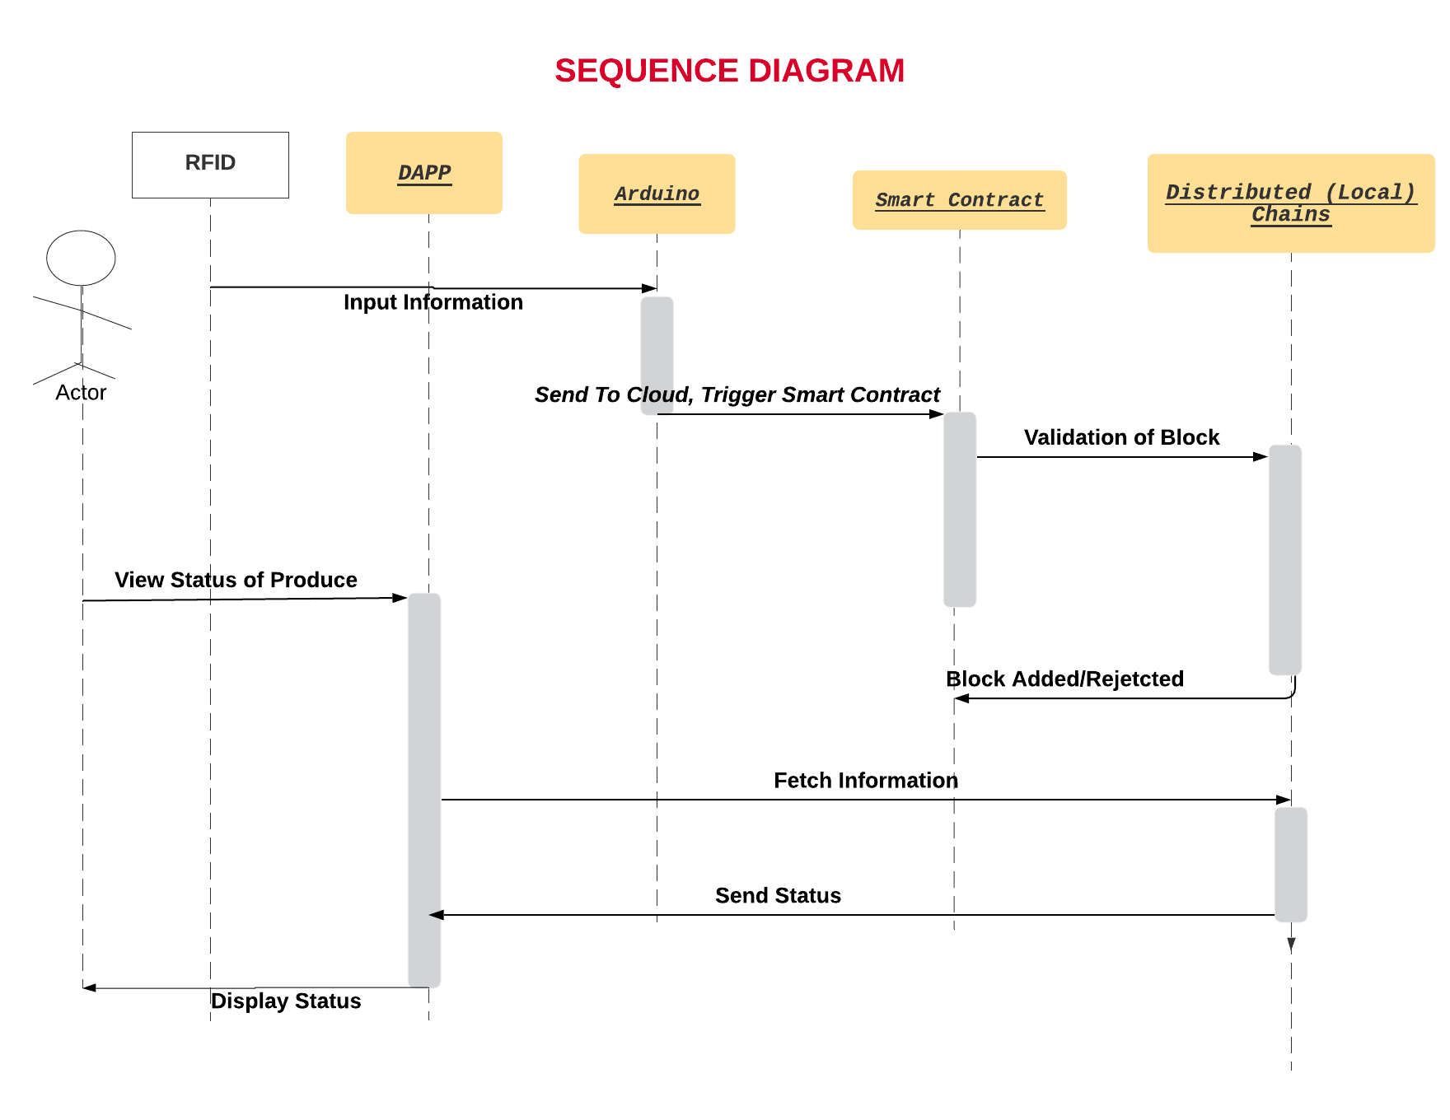

Slide 19
PROJECT RESOURCES

Slide 20
Project Resources
Human Resources :
Number of people : 4
Skills :
Communication
Critical Thinking
Creativity
Decision Making
Situational Leadership
Technical Skills

Slide 21
Hardware & Software Resources
Hardware :
RFID Tag
RFID Reader
Arduino Uno Microcontroller
Wifi Module
Buzzer
Software :
Ethereum
Ganache CLI
Truffle
Node.js
MongoDB
React js

Slide 22
Project Estimates :
Hardware Cost :
Component Name | Cost in Rs
RFID Tag | 20
RFID Reader | 250
Arduino Uno | 450
Wifi Module | 180
Buzzer | 50

Slide 23
Risk Management
Potential Risks :
Description | Hardware Failure
Category | Hardware
Probability | Low (15 %)
Impact | Marginal
Strategy | Replace with new Hardware
Above risk is certain to occur because hardware failures are common and unavoidable.

Slide 24
Description | Logical Error in Smart Contract
Category | Software
Probability | Medium low (30 %)
Impact | Critical
Strategy | Code Debugging
Above risk is uncertain. It deals with the issues and complexities in Smart Contract.

Slide 25
PROJECT MODULES

Slide 26
Project Modules
Decentralised Application
Smart Contracts Module
IoT Module

Slide 27
Decentralised Application
User will login/register on Dapp and create a copy of their own blockchain.
Once the user registers, their data gets saved on the blockchain.
Each account will have a private key associated to it which will be used to access the blockchain.
With the help of the shipment ID, the user will be able to track the current status of the shipment as well as the history of the shipment.

Slide 28
Smart Contracts Module
Smart contracts will when self execute when the conditions are met i.e. the shipments enters or leaves a registered user’s site.
The outcome is then recorded on the blockchain and updated across all the nodes.
Smart contracts will address two main challenges :-

Slide 29
Determining the provenance of goods
The first supplier will record the details about the vegetable of fruit on the blockchain which will be immutably stored.
This will allow any other user to update the information about the particular shipment on the blockchain

Slide 30
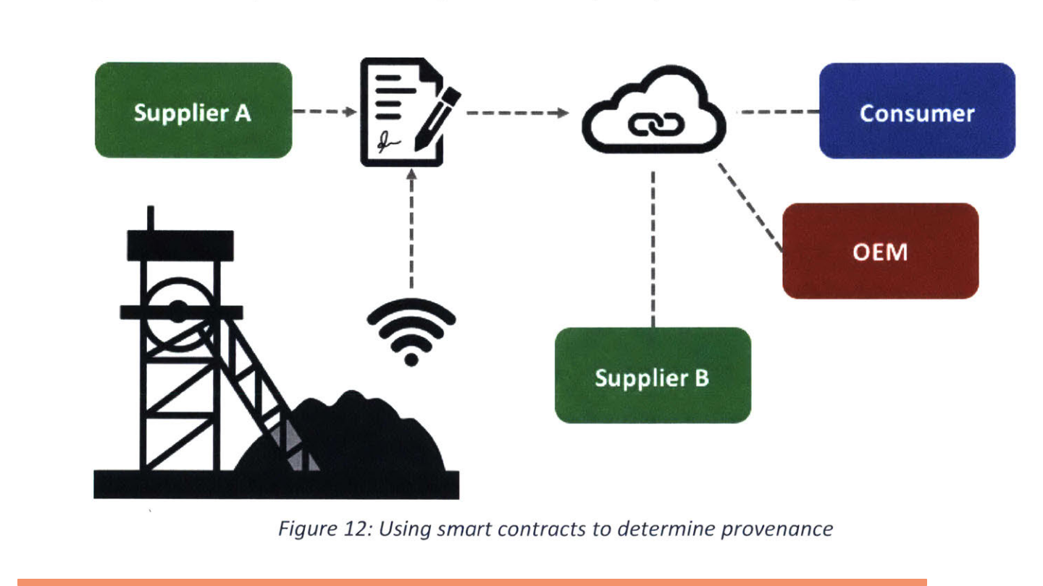

Slide 31
B. Tracking the progress of goods
Each user will record the details to the blockchain whenever they send out the shipment or receive a shipment.
The IoT Module will sense the incoming or outgoing and will automatically trigger the smart contract to execute. [3]

Slide 32
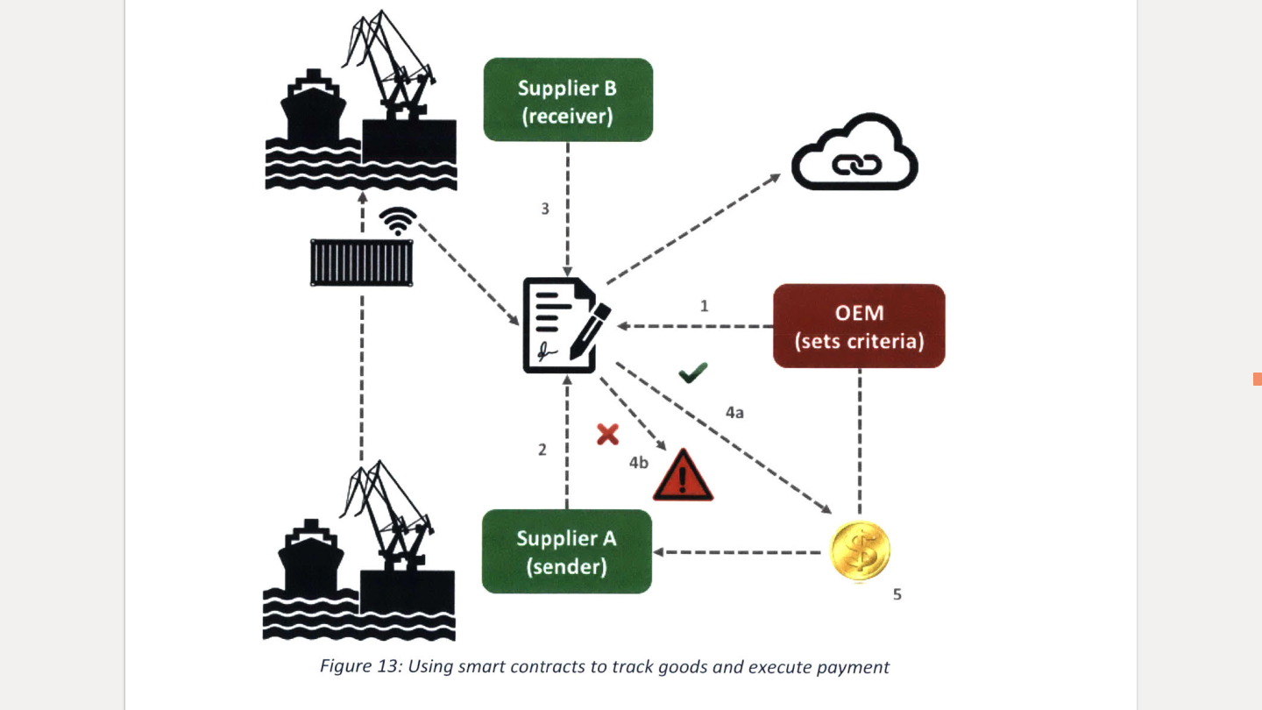

Slide 33
C. Building trust among the participants
A reputation score is maintained for each user to determine the number of successful shipments handled by them.
This is used to incentivize users to work towards maintaining a good reputation and help build trust among users with greater transparency.

Slide 34
IoT Module
IoT Module consists of the RFID scanner, RFID tag and the Arduino Uno which is connected to ESP8266 (WiFi module).
When scanner recognises the tag, the tag ID is sent to Arduino Uno through the RFID scanner.
The Arduino Uno then uses tag ID to trigger the smart contract deployed on the web via the WiFi Module.

Slide 35
Advantages
Limitations
Advantages
Enhances transparency
Maintains continuity of supply.
Reduced costs as less physical documentation
Less time and manual effort wasted.
Hardware cost and installation.
Hardware faults are common.
Blockchain can be tampered if control of > 50% is lost.
Smart contracts are complex to code.

Slide 36
Future scope
Scalable extension on a nationwide level.
Reputation score of each user could be recorded and updated regularly to maintain trust among users.
Addition of GPS system to track the real time live location of the shipment.
Using ML/AI to predict supply and demand so that the inventory can be managed efficiently.

Slide 37
Conclusion
We have hereby built a robust system in order to address the several issues discussed earlier in food harvest life cycle with help of Smart Contracts and IoT.

Slide 38
References
[1] Smart contracts and their application in supply chain management. Angwei Law - 2017 - dspace.mit.edu
[2] Feng Tian, ”An agri-food supply chain traceability system for China based on RFID blockchain technology,” 2016 13th International Conference on Service Systems and Service Management (ICSSSM), Kunming, 2016, pp.
1-6.
[3] Traceability in Agri-Food Sector using RFID Arun N. Nambiar Department of Industrial Technology California State University Fresno, California 93740
[4] Feng Tian, ”A supply chain traceability system for food safety based on HACCP, blockchain Internet of things,” 2017 International Conference on Service Systems and Service Management, Dalian, 2017, pp. 1-6.
[5] D. Tse, B. Zhang, Y. Yang, C. Cheng and H. Mu, ”Blockchain application in food supply information security,” 2017 IEEE International Conference
on Industrial Engineering and Engineering Management (IEEM), Singapore,
2017, pp. 1357-1361.

