Slide 1
ALGORITHM EFFICIENCY ANALYZER TOOL
Team 3 - Algo Wizards
CPSC 535: Advanced Algorithms (Fall 2023)
Project 1

Slide 2
Team Members & Roles
GUI Developer - Anthony Martinez
Algorithm Specialist - James kim
Data Visualization Experts - Anshika Khandelwal & Pravallika Bahadur
Testing & Documentation Leads - Tejashwa Tiwari & Rishitha Bathini
Project Coordinator - Param Venkat Vivek Kesireddy

Slide 3



Software Development & Project Management
We used Jira & GitHub - They offer a complete solution for software development teams, enabling team members to work more productively, maintain order, and produce high-quality software.

Slide 4

Introduction
This project aims to provide a practical and user-friendly solution for algorithm efficiency analysis, ultimately contributing to better-informed algorithm selection and enhanced problem-solving capabilities.
Users can input a list of numbers of their choice and get a bar-graph with the time taken by every sorting algorithm to sort the given input.

Slide 5
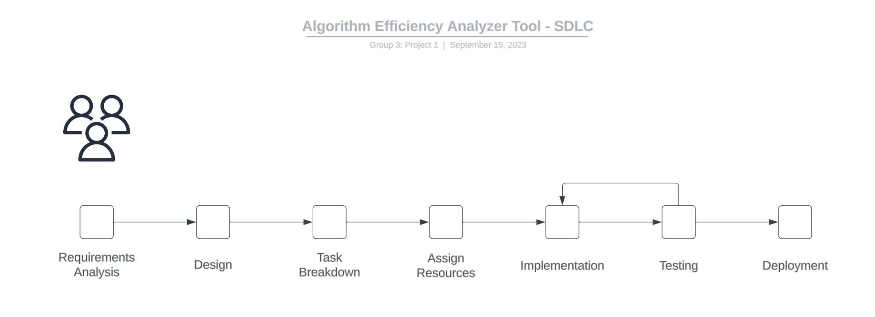
Objective & Overview
The Algorithm Efficiency Analyzer employs Flask (Python) for its back-end, react js framework with Material UI design library for the front-end, and incorporated sorting algorithms and charting libraries to visualize sorting efficiency. The flask server, which serves the static build produced by the react app, is hosted by PythonAnywhere.

Slide 6
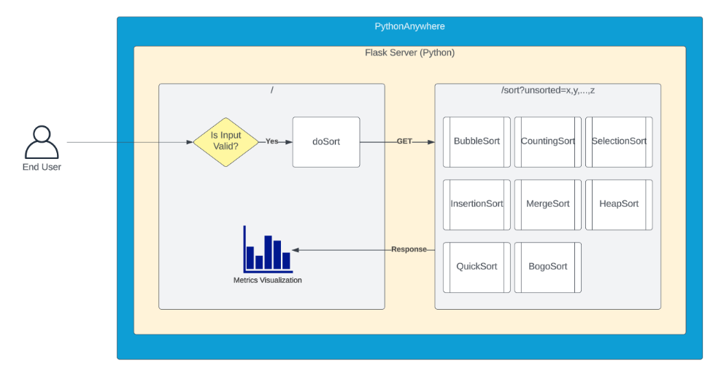
UML
Diagram

Slide 7
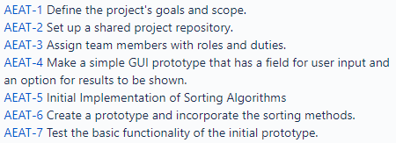
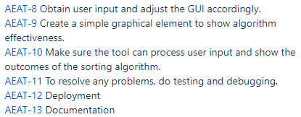

Sprint 1
9/4 - 9/9
Sprint 2
9/10 - 9/16
https://github.com/CPSC-535-Group3/project-1

Slide 8

Target Users
Use Cases
The "Algorithm Efficiency Analyzer Tool" is appealing to a wide range of people, including skilled programmers, computer science students, algorithm lovers, and data analysts.
Scientific Research
Educational Purposes
Supply chain
Financial Services
Algorithm Development
Data Processing and Analysis
Software Development
Quality Assurance and Testing

Slide 9
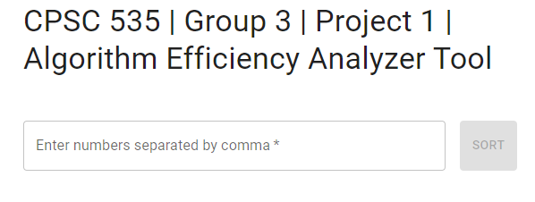
User Interface
To initiate the sorting process, the first step is to input the numbers or data elements that you wish to sort. Once these values have been provided, our system will proceed to generate a sorted array based on the input. Users enter input and view results on a single page, creating a straightforward user flow.

Slide 10
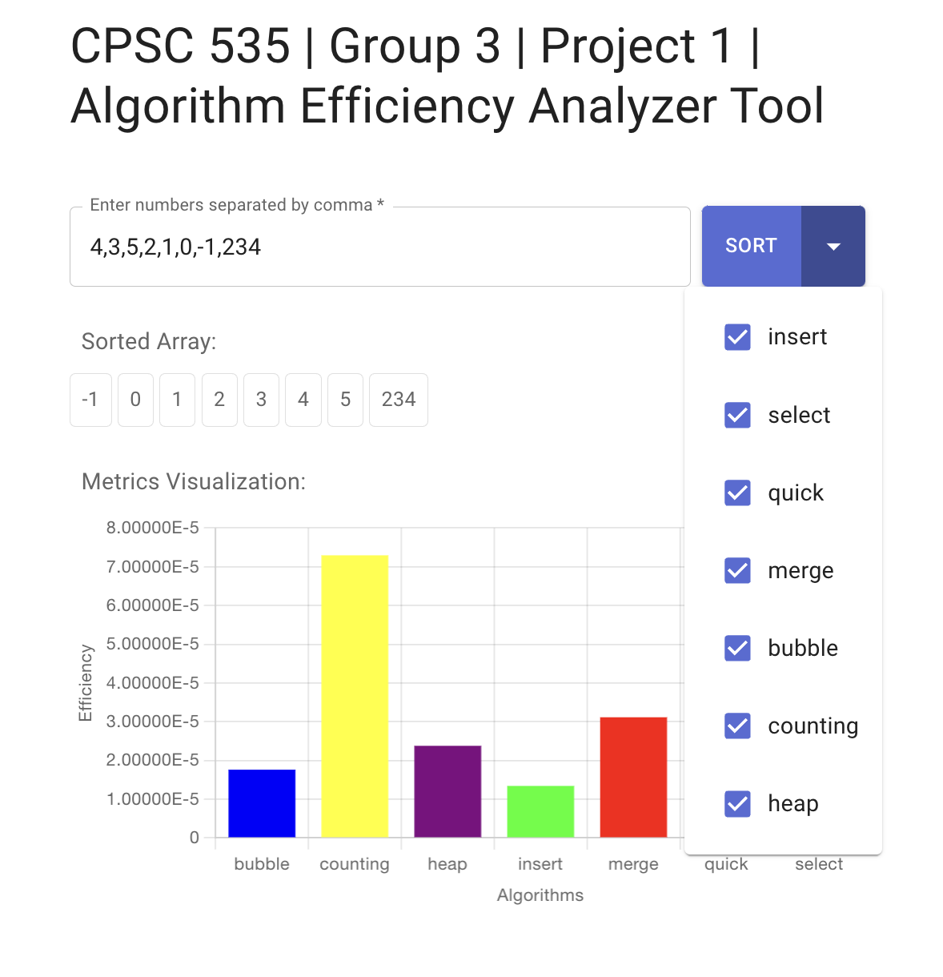
Data Visualization
We used Chart.js library for data visualization in our Algorithm Efficiency Analyzer tool. Chart.js is a popular JavaScript library that allows you to create various types of interactive charts and graphs.

Slide 11
Challenges
It was difficult to design a user-friendly and intuitive GUI. In order for users to submit data, choose algorithms, and examine results without ending up confused, we had to build a layout that is simple to browse and comprehend.
Making a product that users find beneficial and simple to use requires doing user testing to get input and make adjustments depending on user preferences and pain areas.
It is essential to guarantee that the implemented sorting algorithms function properly. To detect and correct any algorithmic mistakes, we need thorough testing and debugging processes.
To keep track of activities, problems, and progress, we used project management tools such as Jira and other tools to keep the team organised.

Slide 12

Demo (Our Project App is LIVE now)
Go to the LINK given below!
http://amart088.pythonanywhere.com/

Slide 13
Testing
Verified that every UI component—including input validation and error handling—is operating as expected.
To guarantee compatibility, tested our tool across a range of web browsers (such as Chrome, Firefox, and Safari) and platforms (such as desktop, tablet, and mobile).
Tested how the Flask server interacts with the front-end HTML templates.
Have real users interact with ourtool and took feedback.
Made sure that our tool operates well and doesn't crash when presented with strange data, tested it using extreme or unexpected inputs.
Ensure that error messages are properly shown, and assist users in understanding what went wrong and how to fix it.

Slide 14

Conclusion
In conclusion, our team's creation of the Algorithm Efficiency Analyzer Tool, which enables users to research and assess the effectiveness of various sorting algorithms, was a success. This project improved our comprehension of data visualisation, GUI design, and algorithm efficiency.
This effort advances our knowledge of sorting algorithms while simultaneously serving as an important instructional tool that makes difficult ideas understandable to a wider audience.

Slide 15
Thank you! Any Questions?
Group 3 - Algo Wizards
Anthony Martinez | James kim
Anshika Khandelwal | Pravallika Bahadur
Tejashwa Tiwari | Rishitha Bathini
Param Venkat Vivek Kesireddy

