Slide 1

Bank Document CLASSIFICATION

Slide 2
Team Members
N190422 - P.BUJJI
N190897 - B.SRUTHI
N190201 - B.NAGARANI
N190396 - B.PRAVALLIKA
N191106 - R.UMADEVI
N190392 - G.SIDDARDHA

Slide 3

Table of contents
Abstract
Introduction
Theoretical Framework for Document Classification
Proposed Methodology
Model selection
Results and Discussions
Observations
Challenges And Limitations
Conclusion
Future work
References

Slide 4
abstract
Bank Document Classification using Machine Learning Techniques
Bank Document Classification using ML is a process of automatically categorizing financial documents such as bank statements, invoices, credit card statements, and tax returns using machine learning algorithms. ML Techniques used for bank document classification can improve the accuracy and speed of document categorization, helping organizations to save time, resources, and money. This can help banks to automate the process of document classification, reducing manual effort and improving accuracy.The Project uses Machine Learning to classify bank documents into four categories: bank statements, invoices, credit card statements, and tax returns. It combines text and image analysis to achieve this. Key techniques include Computer Vision for image data, Natural Language Processing for text data. These technologies work together to automate the document classification process.

Slide 5
Introduction
Classification of the bank documents/images such as bank statements, credit card statements, invoices and tax returns using ensemble Machine Learning algorithms. The most effective and efficient way to determine the best models to classify the bank documents using machine learning algorithms. The collected data sets are pre-processed and convert into machine readable format using Natural Language Processing (NLP) and Optical Character Recognition (OCR) techniques. Extract relevant features from preprocessed using techniques such as TF-IDF and word embeddings. An appropriate machine learning models are used to classify the documents, Random Forest, Cat Boost, XG Boost and Voting Classifier to achieve better accuracy. The model performance is evaluated by using the evaluation metrics such as Accuracy, Recall, Precision, and F1 score.

Slide 6

Theoretical Framework for Document Classification
The purpose of document classification in banking is to organize and categorize documents such as bank statements, invoices, credit card statements, and tax returns, available in various formats (PDFs, Docs, Images), to improve processing efficiency, accuracy, compliance, and data security. Documents contain structured and unstructured data requiring preprocessing to remove unwanted elements. The text extraction process involves preparing and scanning documents, converting them to digital formats using OCR, preprocessing the text to clean and normalize it, and classifying it using machine learning algorithms. Online classification uses ML and NLP for quick, automated handling of digital documents, while offline classification involves manual processing of physical documents, essential for non-digital records.

Slide 7
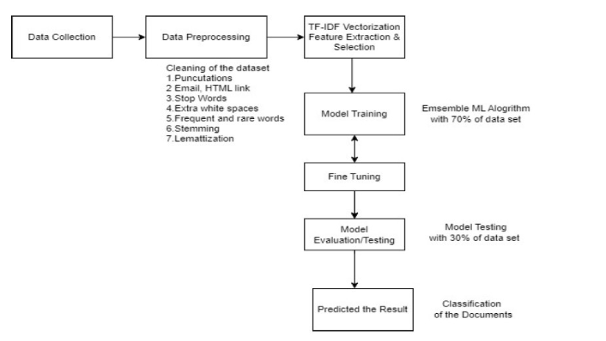
Proposed MethodOLOGY :
The document classification process involves determining document types, collecting and preprocessing data, extracting features using TF-IDF vectorization , training and evaluating the model, and predicting the best-performing model.

Slide 8
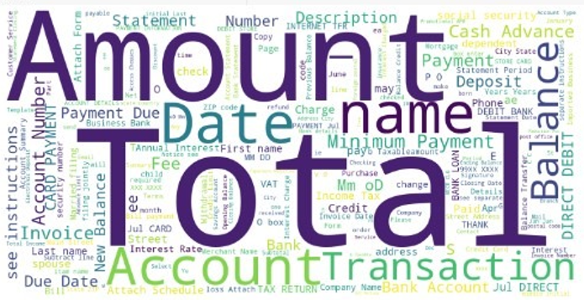
Word Cloud Representation of Keywords

Slide 9
Data Acquisition and Preprocessing :
Optical Character Recognition (OCR):
Utilize OCR technology to extract text from scanned or photographed bank documents, converting images into machine-readable data.
Text Extraction:
Apply advanced text extraction techniques to parse and isolate relevant information from the OCR output, preparing the data for classification.
Data Cleaning:
Implement robust data cleaning and normalization processes to address any inconsistencies, typos, or formatting issues in the extracted text.

Slide 10
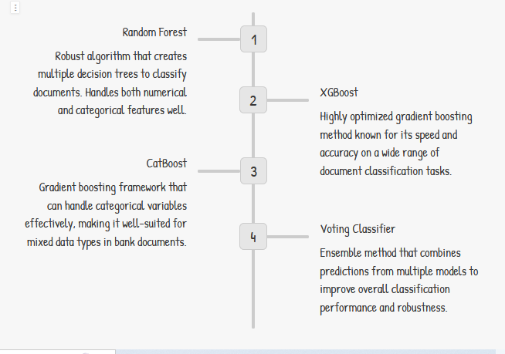
Model selection and training

Slide 11
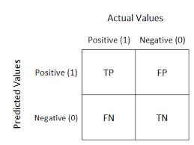
Evaluation Parameters
Confusion Matrix:
A confusion matrix, also known as an error matrix, is a table that provides a summary of the performance of a classification model on a set of test data. It allows us to visualize the performance of a model by showing the number of correct and incorrect predictions made for each class. The confusion matrix is particularly useful when dealing with multi-class classification problems.

Slide 12
Evaluation Parameters :
A confusion matrix typically has four cells representing different outcomes:
True Positives (TP): The number of samples that are correctly predicted as positive (belonging to the positive class).
True Negatives (TN): The number of samples that are correctly predicted as negative (not belonging to the positive class).
False Positives (FP): The number of samples that are incorrectly predicted as positive (misclassified as belonging to the positive class when they actually don't).
False Negatives (FN): The number of samples that are incorrectly predicted as negative (misclassified as not belonging to the positive class when they actually do).

Slide 13
various performance metrics
From this confusion matrix, various performance metrics can be calculated, including:
Accuracy: The overall accuracy of the model, calculated as (TP + TN) / (TP + TN + FP + FN).
Precision: Also known as the positive predictive value, it measures the proportion of correctly predicted positive samples out of all samples predicted as positive, calculated as TP / (TP + FP).
Recall: Also known as sensitivity or true positive rate, it measures the proportion of correctly predicted positive samples out of all actual positive samples, calculated as TP / (TP + FN).
F1-score: The harmonic mean of precision and recall, providing a balanced measure of a model's performance, calculated as 2 * (Precision * Recall) / (Precision + Recall).

Slide 14
Random Forest algorithm
Random Forest algorithm is highly beneficial for bank document classification projects due to its capability to effectively manage large and varied datasets. By utilizing ensemble learning, Random Forest combines multiple decision trees, thereby improving classification accuracy while mitigating overfitting. It identifies influential features within documents, such as words, phrases, and metadata, essential for precise classification in banking contexts. Moreover, its robustness against noise and scalability to handle extensive datasets make it particularly suitable for real-world applications within banking environments.

Slide 15
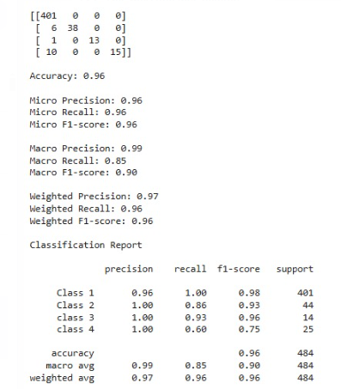
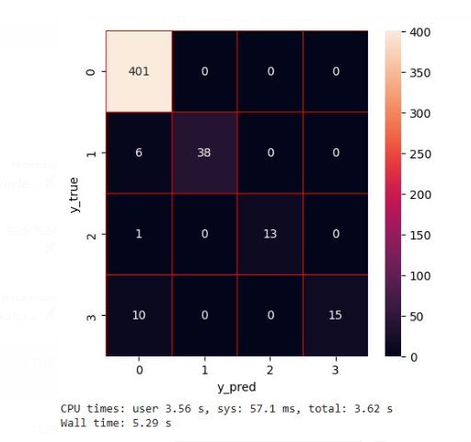
Classifier-1 RANDOM FOREST
1.a Classifier-1 Evaluation Metrics values
1.b Classifier -1 Heat Map
The Random Forest gives Accuracy (0.96), Precision(0.97), Recall(0.96),F1-Score(0.96)

Slide 16
XGBoost ALGORITHM(Gradient Boosting)
XGBoost, known as Extreme Gradient Boosting, is a powerful machine learning method specifically designed for handling structured data tasks efficiently. It works by building a series of simple predictive models, often decision trees, in a step-by-step manner. Each new model corrects errors made by the previous ones, leading to improved accuracy. What sets XGBoost apart is its ability to manage large datasets swiftly, handle missing data effectively, and deal with complex relationships between features. In our bank document classification project, XGBoost played a crucial role in achieving high accuracy by integrating with customized data preprocessing and feature engineering steps.

Slide 17
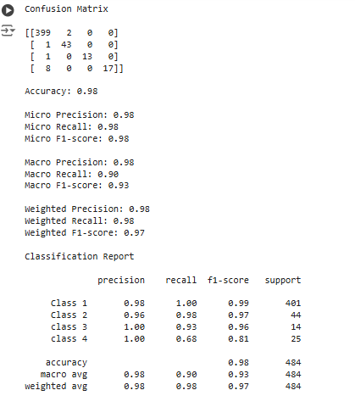
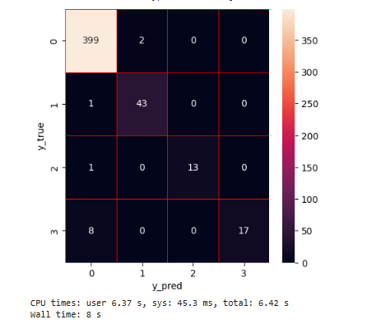
XGBoost ALGORIthm
2.a Classifier-2 Evaluation Metrics values
2.b.Heat Map
XGBoost gives the Accuracy (0.98), Precision (0.98), Recall(0.98),F1-Score (0.98)

Slide 18
Categorical Boosting ALGORITHM
CatBoost, short for Categorical Boosting, is a state-of-the-art machine learning algorithm specifically designed to handle categorical data efficiently. It uses gradient boosting on decision trees, similar to other boosting algorithms, but stands out due to its ability to directly process categorical features without extensive preprocessing. This results in more accurate and faster models. In our bank document classification project, CatBoost excelled by automatically handling the categorical nature of the data, leading to improved accuracy and efficiency. This made it an ideal choice for categorizing various bank documents, enhancing the overall performance and decision-making process within the financial institution.

Slide 19
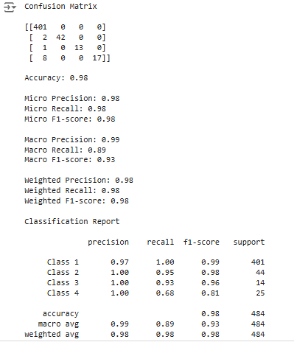
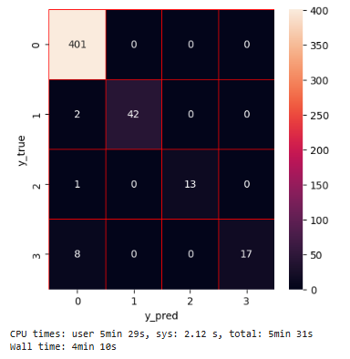
Classifier-3: CatBoost
3.a. Classifier-3 Evaluation Metrics values
3.b Heat Map
CatBoost gives the Accuracy (0.98), Precision(0.98), Recall(0.98),F1-Score (0.98)

Slide 20
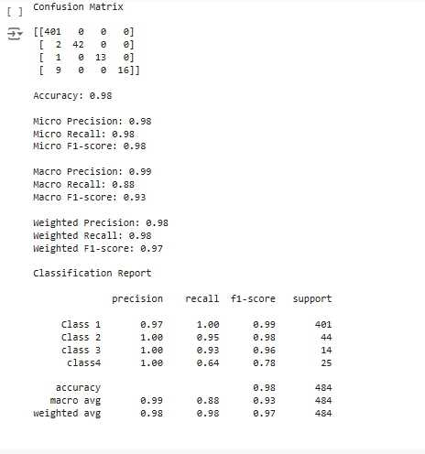
CLASSIFIER:4-VOTING CLASSIFIER
A Voting Classifier is an ensemble method that combines the predictions of multiple models, such as XGBoost, CatBoost, and Random Forests, to improve accuracy. By leveraging the strengths of each algorithm, it enhances robustness and performance. In our bank document classification project, the Voting Classifier significantly boosted accuracy and reliability, improving document categorization efficiency within the financial institution.
Voting Classifier gives the Accuracy (0.98), Precision (0.99), Recall(0.98),F1-Score (0.97)

Slide 21
Technologies and Libraries used
Jupyter Notebook:
Jupyter Notebook is an open-source web-based application that allows you to create and share documents containing live code, visualizations, explanatory text, and more. Jupyter Notebook provides an interactive environment where you can write and execute code in cells, view the output, and document your work.
Python Libraries:
Numpy:
NumPy is a popular Python library for numerical computations. It stands for "Numerical Python." NumPy provides a powerful and efficient way to work with arrays, matrices, and multi-dimensional data in Python. It is a fundamental library for scientific computing and data analysis in Python.

Slide 22
Technologies and Libraries used
Pandas:
Pandas is a powerful and popular open-source Python library for data manipulation and analysis. It provides data structures and functions that make it easier to work with structured data, such as CSV files and more. Pandas is built on top of NumPy and is widely used in data science, machine learning, and data analysis workflows.
Matplotlib:
Matplotlib is a widely used Python library for creating static, animated, and interactive visualizations. It provides a flexible and comprehensive set of tools for generating various types of plots, charts, and graphs. Matplotlib is often used in data analysis, scientific research, and data visualization tasks.
Seaborn:
Seaborn is a Python data visualization library built on top of Matplotlib. It provides a high-level interface for creating attractive and informative statistical graphics.

Slide 23
Text Preprocessing Techniques
Tokenization: Tokenization is the process of separating the text into words, sentences using the NLTK library. These tokens are useful for understanding context or developing NLP models.
Stemming: Stemming is a process which reduces a word to its base or root form. It is used to normalize the text.
Lemmatization: Lemmatization is a method of normalizing text documents. The main purpose of text normalization is to keep the vocabulary small and to remove noise, which helps improve the accuracy of many language modeling tasks
Vectorization: In general, Machines can’t understand or processed text data in a raw form. The text is converted into numerical format (Vector) that easily readable by the Machine. TF-IDF(Term frequency — Inverse document frequency)

Slide 24
Hardware and software requirements
Minimum Hardware requirement:
RAM : 4GB
Storage: HDD or SSD with sufficient storage
System type: 64-bit
Minimum Software requirements:
Operating System: Windows 8 and above
Programming Language : Python 3.9
IDE: Jupyter-notebook

Slide 25
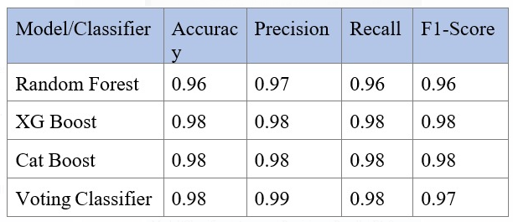
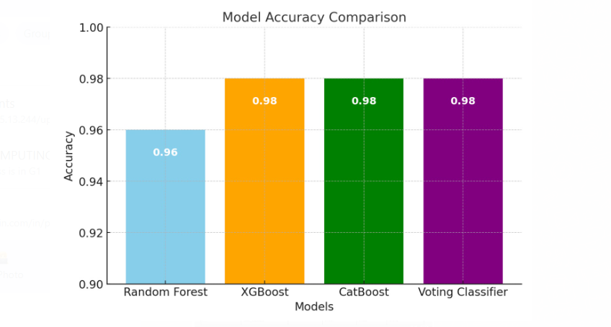
Results
Accuracy Analysis:
The classification models performed well, with accuracies between 96% and 98%.
Models like Random Forest, XGBoost, CatBoost, and Voting Classifier were tested.
Individual Classifier Results:
Random Forest: 96% accuracy.
XGBoost, CatBoost, and Voting Classifier: 98% accuracy.

Slide 26
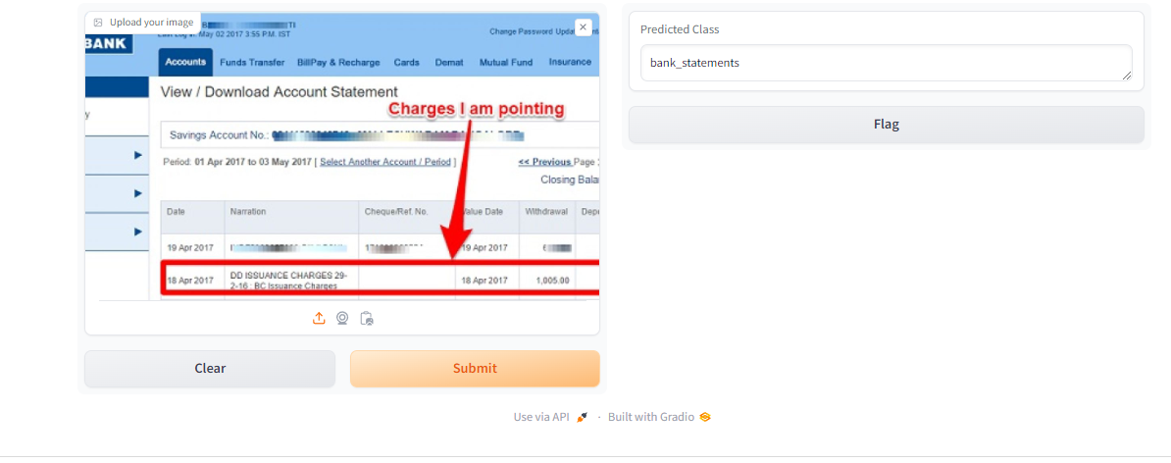
Bank_Statements Output:

Slide 27
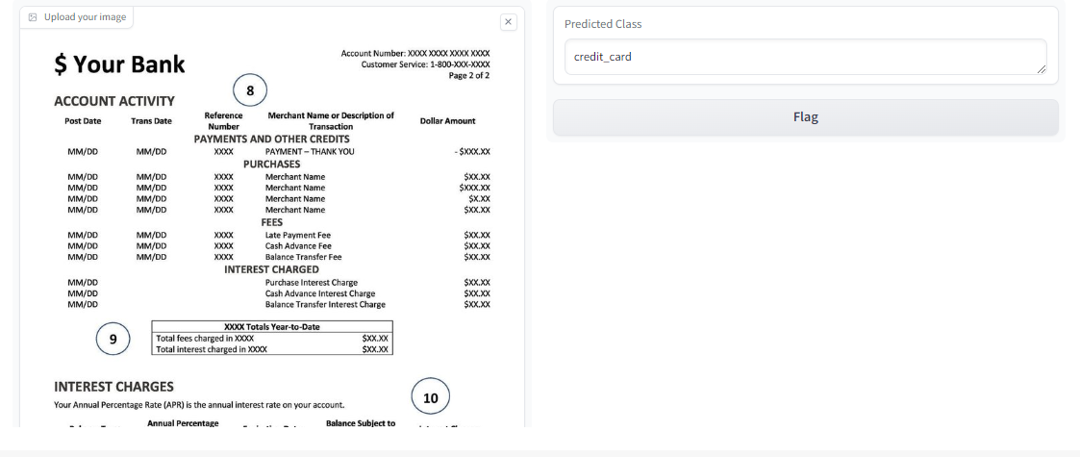
Credit_card Output:

Slide 28
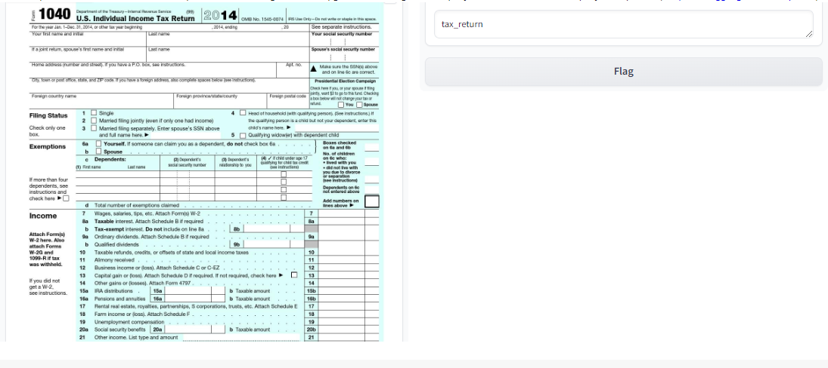
Tax_Return Output:

Slide 29
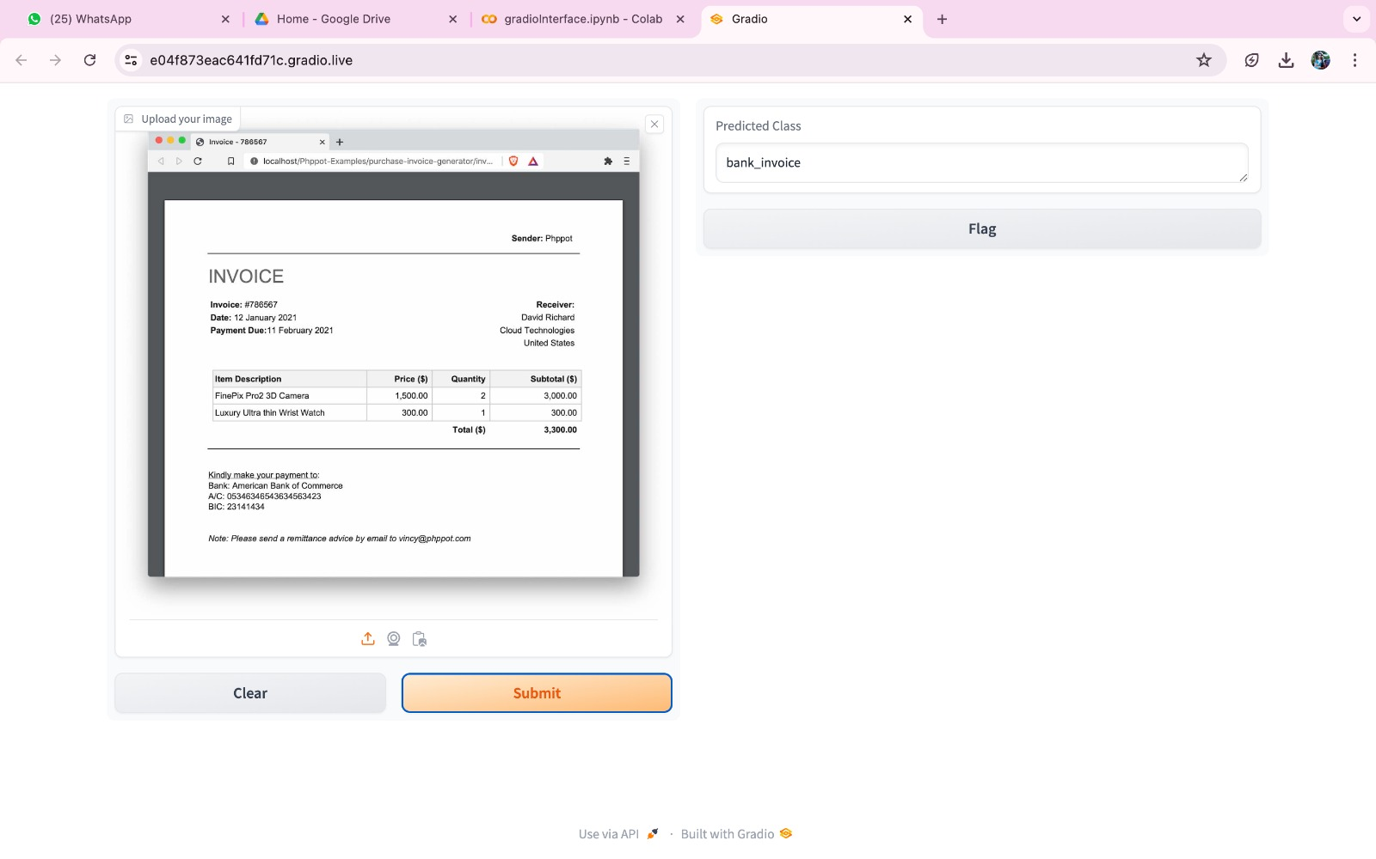
Bank Invoice Output:

Slide 30
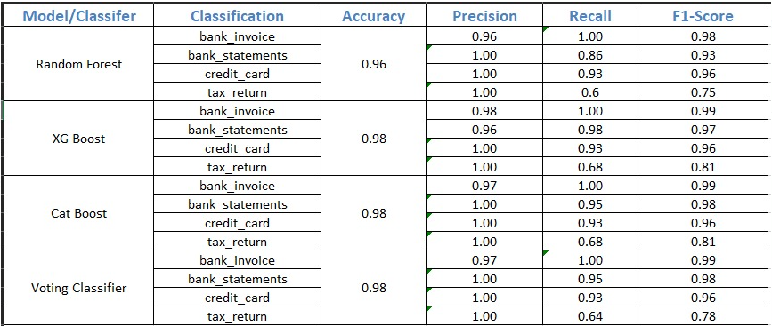
Comparative Analysis of Classifier’s Results
XGBoost, CatBoost, and Voting Classifier achieved the highest accuracy of 91%, outperforming Random Forest.
The Voting Classifier combined predictions from multiple models, making it the most reliable and robust.

Slide 31
Observation
It is observed that the classification of the bank documents achieved better results with different ensemble Machine Learning Models (i.e Random Forest, XG Boost and Cat Boost as model and Voting Classifier is bench mark model
The performance of the individual classifier is measured based on the output values of evaluation metrics (Accuracy, Precision, Recall and F1-Score)
i. The Random Forest gives Accuracy (0.96), Precision(0.96), Recall(0.96),F1-Score (0.96)
ii. XGBoost gives the Accuracy (0.98), Precision (0.98), Recall(0.91),F1-Score (0.98)
iii. CatBoost gives the Accuracy (0.98), Precision(0.98), Recall(0.98),F1-Score (0.98)
iv. Voting Classifier gives the Accuracy (0.98), Precision (0.98), Recall(0.98),F1- Score (0.98)
Based the results obtained from the above mentioned 4 classifiers , It is observed that Voting Classifier, XGBoost and CatBoost algorithms gives highest accuracy(98%) among all four classifiers and equally performed.

Slide 32
Challenges:
Cleaning the datasets (Scanned documents )
Bank documents can come in a variety of formats, including PDF files, scanned images, and handwritten notes, making it difficult to extract useful information. Some files may contain information belonging to more than one category, making it difficult to categorize them correctly.
Banks may update their document formats, which requires retraining of classification patterns to recognize new patterns.
LIMITATIONS:
Extracting handwritten signatures and converting to computer generated text
While converting PDF documents(text and images) into text only text information is retrieved.

Slide 33
FUTURE WORK:
As part of future work , finance and Banking sectors are tremendously developed globally integrating the Deep Learning and Natural Language Processing techniques into document classification can enhance accuracy and efficiency by reducing errors.

Slide 34
Conclusion :
The proposed system uses advanced ensemble machine learning algorithms and natural language processing techniques, which helps to automatically categorize and classify the bank documents that contains both structured and unstructured data. The salient features extracted from the ensemble machine learning model are fed into output classification.
The proposed ensemble machine learning models XGBoost(98%) and Voting Classifier(98%) achieved highest accuracy in comparison with Random Forest (96%) and CatBoost(98%).

Slide 35
References
Sarosh Dandoti,(2022), Text Document Classification System,International Research Journal of Engineering and Technology (IRJET), 9(6),2847-2850
Arslan, Ö., & Uymaz, S. A. (2022). Classification of Invoice Images by Using Convolutional Neural Networks. Journal of Advanced Research in Natural and Applied Sciences, 8(1), 8-25.
Sheth, V., Tripathi, U., & Sharma, A. (2022). A Comparative Analysis of Machine Learning Algorithms for Classification Purpose. Procedia Computer Science, 215, 422-431.
Ghumade, T. G., & Deshmukh, R. A. (2019). A document classification using NLP and recurrent neural network. Int. J. Eng. Adv. Technol, 8(6), 632-636.
Engin, D., Emekligil, E., Oral, B., Arslan, S., & Akpınar, M. (2019). Multimodal deep neural networks for banking document classification. In International Conference on Advances in Information Mining and Management (pp. 21-25).

Slide 36
Thank you

