Slide 1
SHOP SMART
(Online Store)
A report by Swapna Kandimalla(N191061)

Slide 2
TABLE OF CONTENTS
Abstract
Introduction
Related Works
Proposed Method
Designing Setup
Conclusion
Future Scope
References

Slide 3
ABSTRACT
The "Shop Smart" project is an innovative e-commerce platform designed to streamline the buying and selling process for users while providing robust administrative control. The primary objective of this project is to create an intuitive and efficient online marketplace where the administrator can manage products, and users can seamlessly list and sell items. In the "Shop Smart" platform, the admin has comprehensive control over the product catalog. This includes adding new products, updating existing product details, deleting existing product and viewing the added products. On the other hand, User can log in into the website and can seamlessly find the various products added under clothes, accessories and groceries by the admin and can add the products to cart.

Slide 4
INTRODUCTION
Welcome to Shop Smart, an innovative e-commerce platform designed to revolutionize the online shopping experience by providing seamless functionality for both administrators and users. Our platform allows administrators to efficiently manage the product catalog by adding, updating, and categorizing products to ensure a comprehensive and up-to-date selection. Simultaneously, it empowers users to easily register, list, and sell their products, transforming them into active sellers in the marketplace. The primary objective of Shop Smart is to simplify and enhance the buying and selling process, fostering a vibrant and efficient online marketplace that caters to the diverse needs of all participants, ultimately ensuring a seamless and satisfying e-commerce experience.

Slide 5
RELATED WORKS/ EXISTED WORKS
Mostly used platforms like flipkart, amazon etc. offer robust product management tools for administrators, enabling them to add, update, and categorize products effectively. Users benefit from streamlined registration processes, allowing them to create profiles, manage listings, and track sales seamlessly. Secure payment gateways ensure safe transactions, while dynamic shopping carts enable users to modify their selections before checkout. Comprehensive review and rating systems build trust by facilitating user feedback. Advanced search and filtering options enhance product discovery, and personalized recommendations based on user behavior improve engagement. Responsive customer support channels ensure prompt assistance, and mobile optimization ensures accessibility across devices. These features collectively aim to provide a user-friendly and efficient e-commerce experience, catering to diverse consumer needs and preferences.

Slide 6
PROPOSED METHOD
Admin Adds products
Added products goes to user page
Shop Smart distinguishes itself by offering a seamless integration of comprehensive product management tools for administrators and effortless user registration processes. Unlike other platforms, Shop Smart emphasizes admins to add products and user to buy products.
User sees products
User can select products based on categories
User can add liked products to cart
User can place order

Slide 7
DESIGNING SETUP
Initially designed a login and signup forms for both User and Admin.
If the person logged in as user then user page will be visible.
If the person logged in as admin then the admin page will be visible.

Slide 8
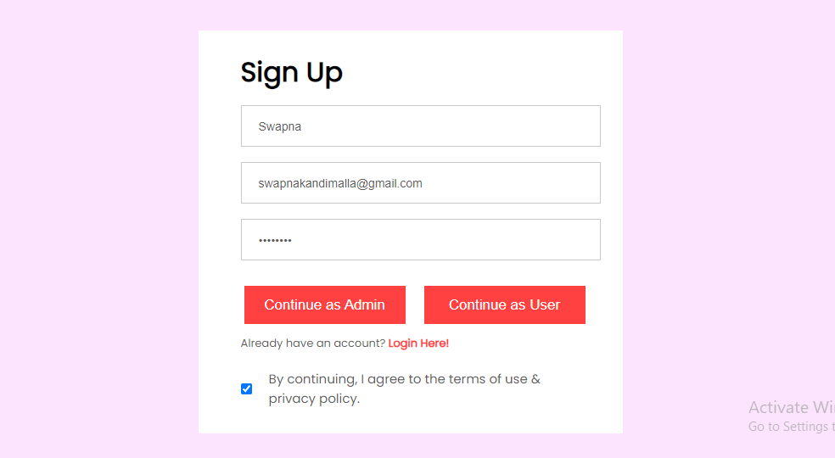

Slide 9
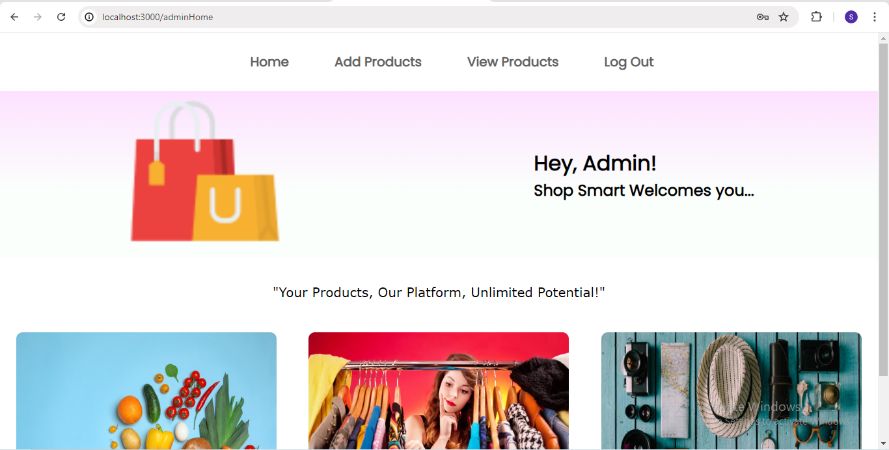

Slide 10
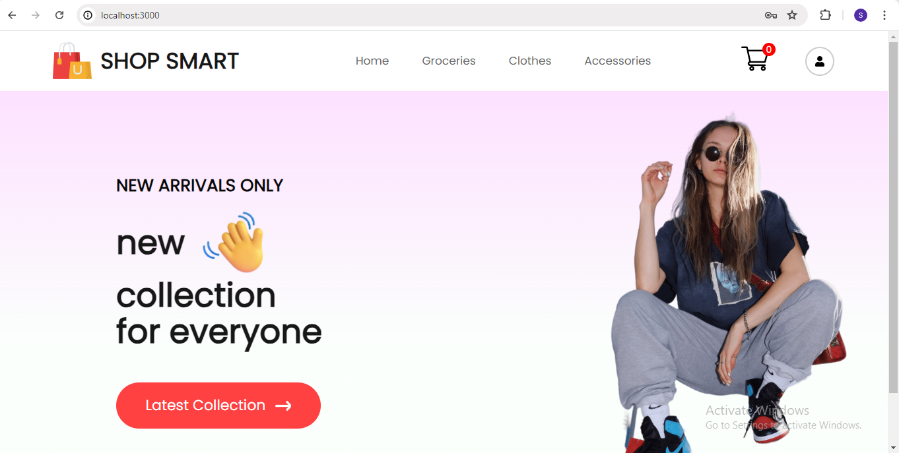

Slide 11
Admin Page
The Admin Page in Shop Smart offers administrators a streamlined interface to manage the product catalog effectively. Administrators can add new products under categories such as Clothes, Accessories, and Groceries, providing detailed descriptions, images, pricing, and inventory levels. Additionally, they can view all added products in a consolidated list, update product details as needed, and delete products that are no longer available. This comprehensive control ensures that the online marketplace remains well-organized and up-to-date, enhancing the overall shopping experience for users.

Slide 12
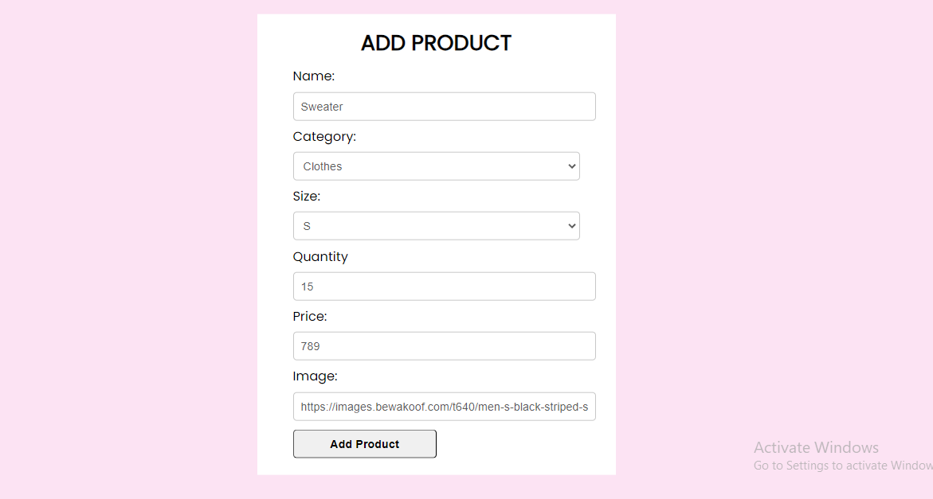
Admin adds product in admin page

Slide 13
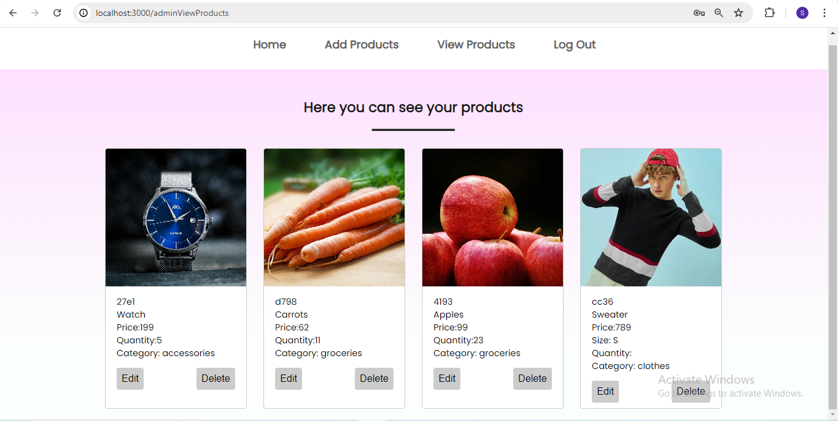
Admin can we view added products under view products

Slide 14
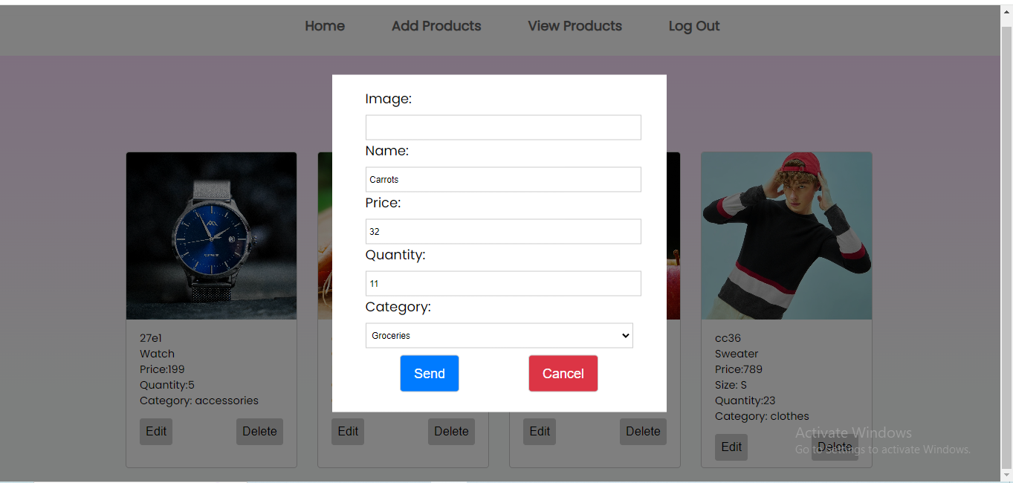
Admin can edit the added products
Note: Here I edited the price of the carrot.

Slide 15
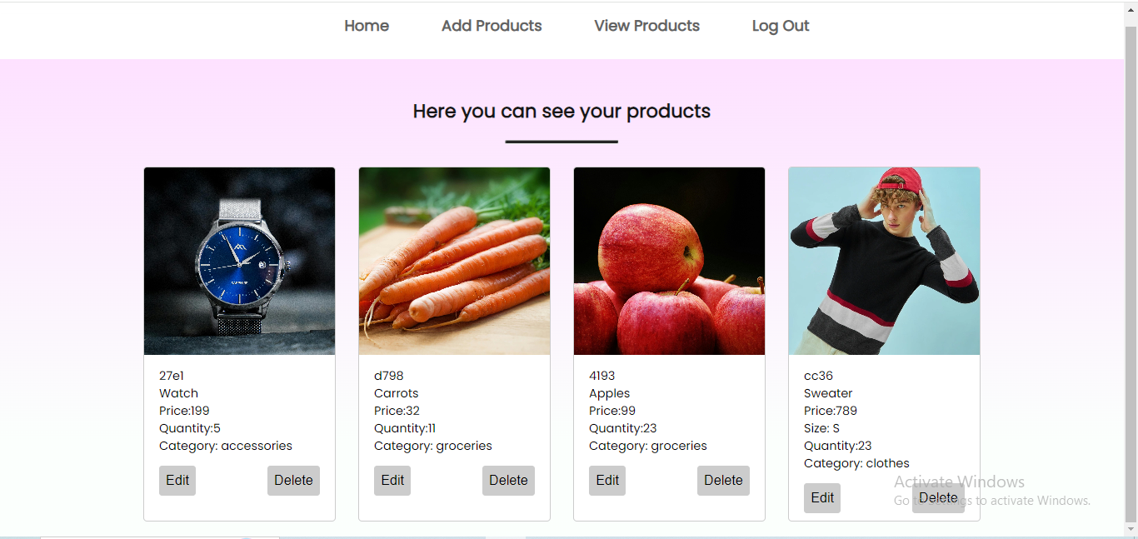
The edited price is displayed here.

Slide 16
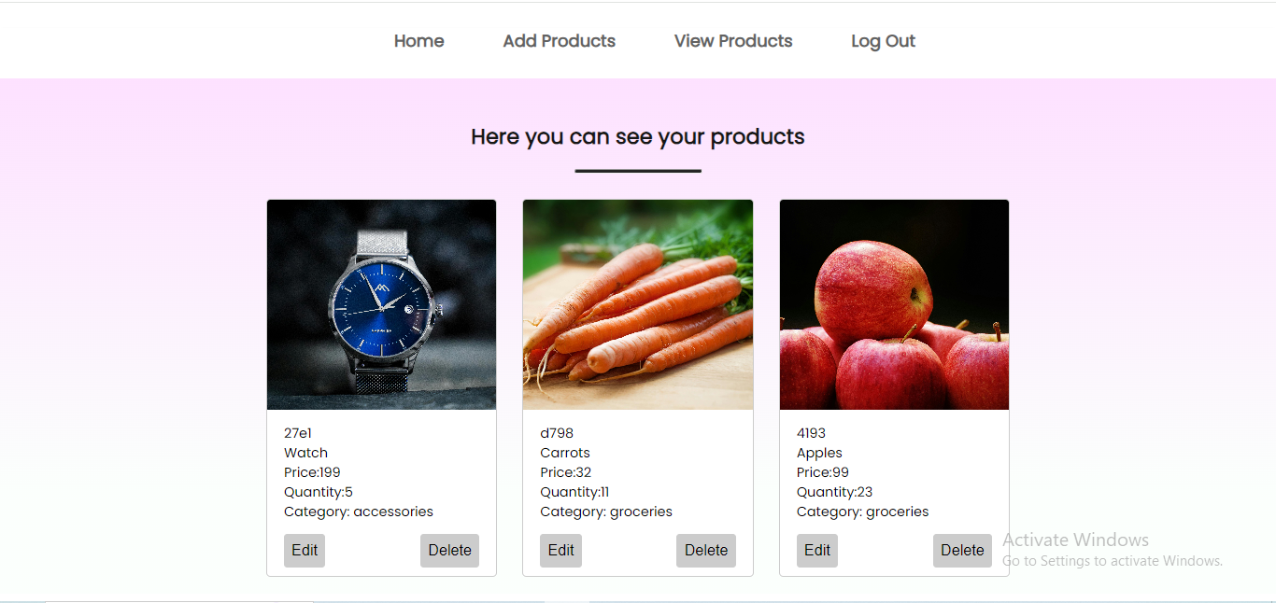
Admin can delete the existing products.

Slide 17
User Page
The User Page in Shop Smart offers a user-friendly interface where customers can browse products added by the administrator under categories such as Clothes, Accessories, and Groceries. Users can view detailed product descriptions, images, and prices, and easily add desired items to their shopping cart. This intuitive design ensures a seamless shopping experience, allowing users to find and purchase products effortlessly.

Slide 18
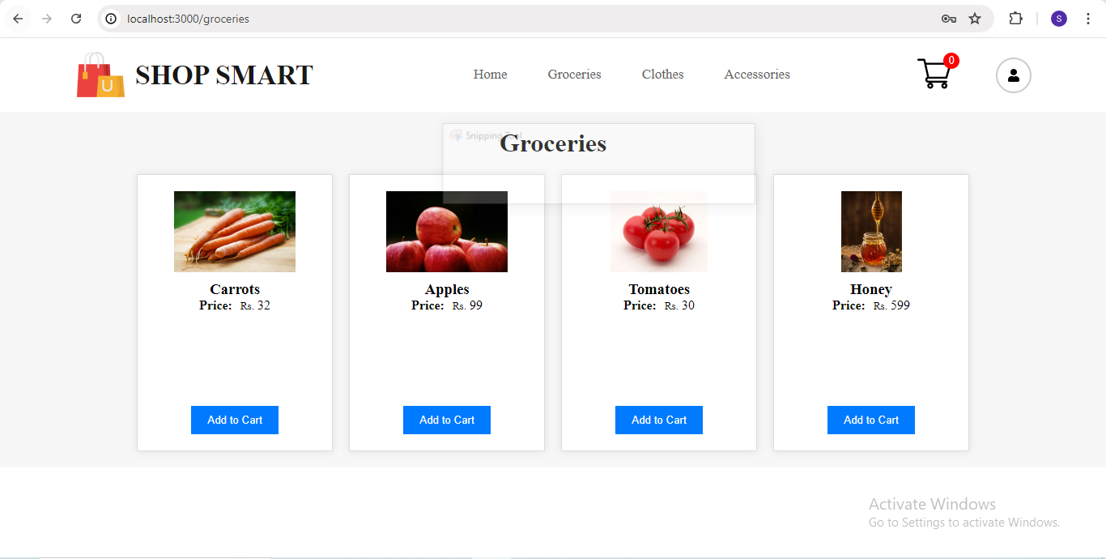
Groceries added by admin is visible under groceries page

Slide 19
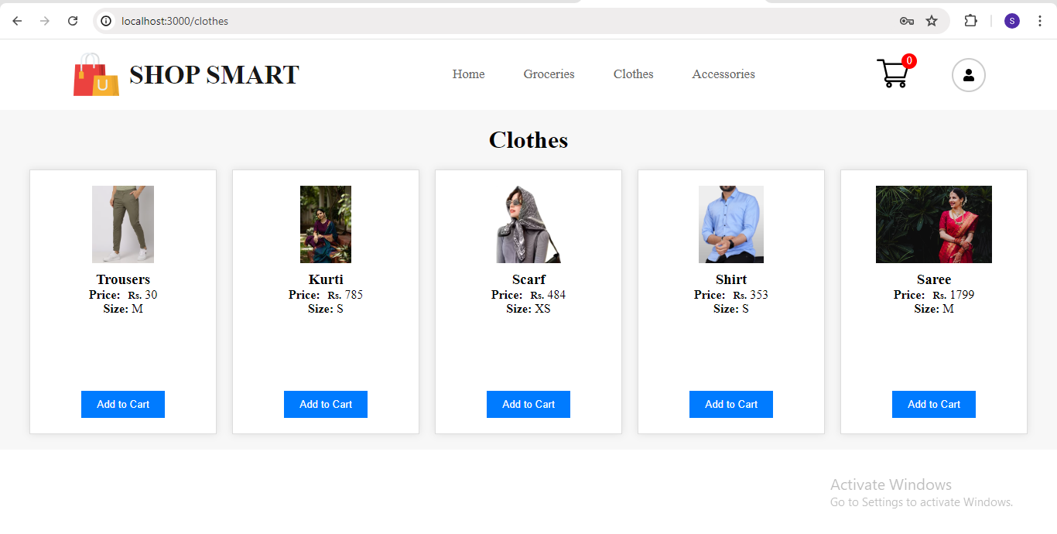
Clothes added by admin is visible under Clothes page

Slide 20
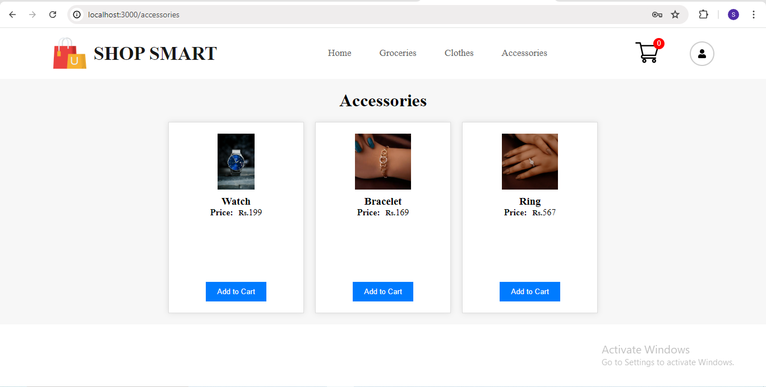
Accessories added by admin is visible in accessories page

Slide 21
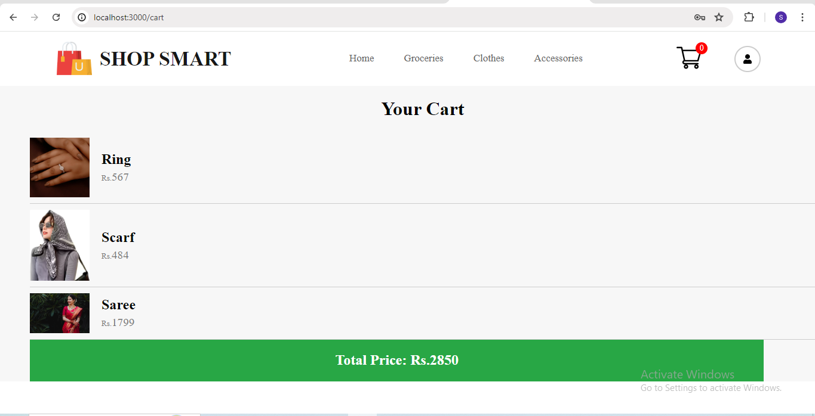
Cart page

Slide 22
CONCLUSION
In conclusion, Shop Smart provides a robust and intuitive e-commerce platform designed to meet the diverse needs of both administrators and users. The Admin Page offers comprehensive tools for adding, updating, and managing products across various categories, ensuring the marketplace is always well-organized and current. Simultaneously, the User Page delivers a seamless shopping experience, allowing customers to easily browse and add products to their cart. Through these features, Shop Smart fosters a user-friendly and efficient online shopping environment, enhancing the overall e-commerce experience for all participants.

Slide 23
FUTURE SCOPE
The future scope of Shop Smart includes developing dedicated mobile apps for iOS and Android to enhance accessibility, implementing AI-driven personalization for better recommendations, and integrating advanced security features like multi-factor authentication. Additionally, the platform aims to incorporate social media integration for wider reach, support various payment methods including digital wallets and cryptocurrencies, and offer advanced analytics tools for sellers to optimize their strategies and improve sales. These enhancements will ensure Shop Smart continues to meet the evolving needs of its users and maintain its competitive edge in the e-commerce market.

Slide 24
REFERENCES
Reference 1: https://github.com/topics/ecommerce-website
Reference 2: https://www.scribd.com/document/224306640/PROJECT-REPORT-ON-E-Commerce
Reference 3: https://www.geeksforgeeks.org/e-commerce-website-project-in-software-development/

Slide 25
THANK YOU

