Slide 1



CNN Waste Classification Project

Slide 2

Learning Objectives
Automate Waste Classification
Improve Waste Segregation Efficiency
Achieve High Accuracy in Classification
Enable Real-Time Waste Detection
Reduce Human Effort in Waste Management
Integrate AI with IoT for Smart Waste Solutions
GOAL
Source :
www.freepik.com/

Slide 3
Tools and Technology used
1. Programming Languages:
Python – Used for model development, training, and evaluation.
2. Deep Learning Frameworks:
TensorFlow / Keras – To build and train the Convolutional Neural Network (CNN).
PyTorch (alternative) – Another deep learning framework that can be used.
3. Image Processing Libraries:
OpenCV – For image preprocessing (resizing, noise removal, etc.).
Pillow (PIL) – For handling and modifying images.
4. Dataset & Storage:
Garbage Classification Dataset – A dataset containing labeled waste images.
Google Drive / Local Storage – For dataset storage and model checkpoints.

Slide 4
5. Data Preprocessing & Augmentation:
NumPy – For numerical operations and handling image arrays.
Pandas – For managing dataset metadata.
Matplotlib / Seaborn – For visualizing dataset distribution and model performance.
6. Training & Evaluation Tools:
Jupyter Notebook / Google Colab – For running and experimenting with the model.
Confusion Matrix / Classification Report – To evaluate model performance.

Slide 5
Methodology
Data Collection & Preprocessing
Gather labeled images of waste categories.
Preprocess images (resize, normalize, augment).
Model Development
Design CNN architecture with convolutional, pooling, and fully connected layers.
Select activation functions, optimizers, and loss functions.
Training the Model
Train CNN using the dataset with batch processing and multiple epochs.
Monitor accuracy and loss during training.
Evaluation & Performance Tuning
Use test data to evaluate model accuracy.
Adjust hyperparameters to optimize performance.

Slide 6
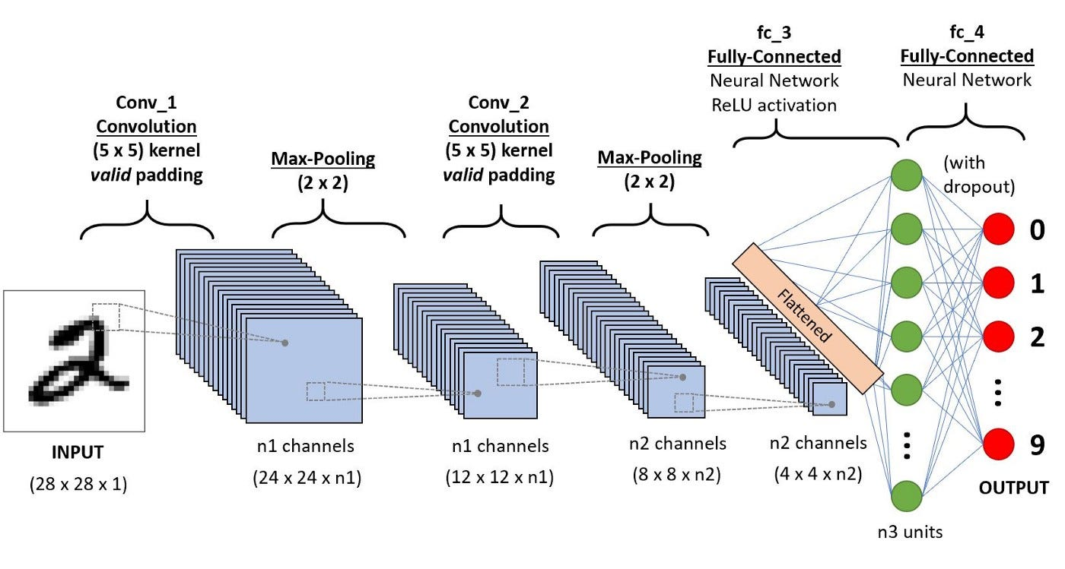
The CNN architecture includes:
Convolutional Layers: Feature extraction
Pooling Layers: Dimensionality reduction
Fully Connected Layers: Classification
Activation Functions: ReLU and Softmax
Basic CNN Architecture

Slide 7
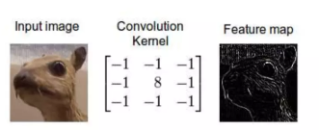
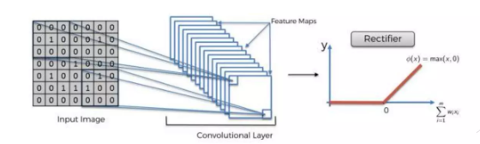
ReLU Layer
Connvolutional Layer

Slide 8
Problem Statement:
Improper waste disposal leads to environmental hazards.

Slide 9
Solution:
Use Convolutional Neural Networks (CNNs) to classify waste automatically.

Slide 10
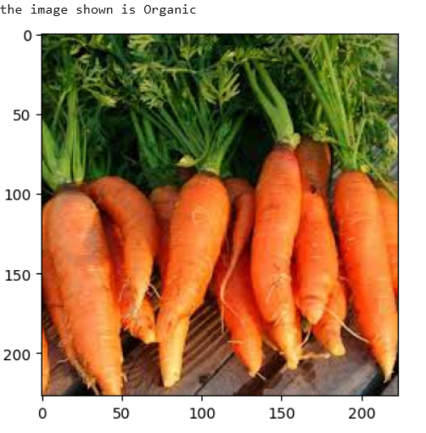
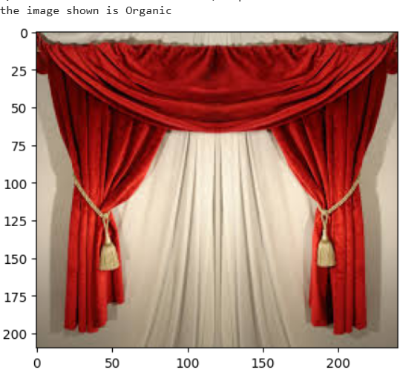
Screenshot of Output:

Slide 11
Conclusion:
CNN-based waste classification provides an effective, automated approach to sorting waste into different categories. The model enhances recycling efforts, reduces manual labor, and promotes efficient waste management. Through deep learning, waste segregation becomes more accurate, enabling better environmental sustainability.

