Slide 1
EASWARI ENGINEERING COLLEGE
FULL STACK DEVELOPMENT REVIEW
Information Technology - D
CareSync: Smart Hospital Management System
With Real-Time Queue Management & Machine Learning Predictive Engine
PRAVALIKA B - 310624205199

Slide 2
AGENDA
Scope & Outline of This Review
01
Problem & Requirements
02
System Architecture
Functional & non-functional requirements in digital healthcare
Detailed 3-tier MERN stack flow with WebSockets & ML engine
03
Use Case & ER Diagrams
04
Core Modules Breakdown
Actor interactions, entity schemas, relations & collection models
Auth, Dynamic Slots, Queue Engine, Clinical Notes & E-Prescriptions
05
Technology Stack
06
Frontend & UI Engineering
MERN components, Python Scikit-learn, Socket.IO, tools & libraries
React component architecture, state management & responsive design
07
Backend & API Integration
08
Progress (75%+), Challenges & Next
MVC structure, JWT middleware, atomic booking transactions
Sprint completion status, technical bottlenecks resolved & roadmap
CareSync | Review 1 & 2 | MERN Stack Project
01

Slide 3
REQUIREMENTS ANALYSIS
Functional & Non-Functional Requirements
FUNCTIONAL REQUIREMENTS
NON-FUNCTIONAL REQUIREMENTS
• User Registration & Role-Based Access: Secure authentication for Patients, Doctors, and Hospital Admins with protected routes.
• Performance & Latency: REST API response times < 200ms; WebSocket queue broadcast synchronization < 50ms.
• Doctor Catalog & Dynamic Slot Availability: Real-time generation of 15-min consultation slots based on shift hours and blocked leaves.
• Scalability & Concurrency: Built on Node.js asynchronous event loop; handles concurrent multi-user slot requests cleanly.
• Conflict-Free Appointment Booking: Strict concurrency control preventing double-booking of any doctor time slot.
• Security & Data Protection: Passwords hashed via bcrypt (salt rounds = 10); stateless JWT session verification; sanitized inputs.
• Live Queue Management & Tracking: Automatic token number assignment, live queue progression, and doctor "Call Next" triggers.
• Maintainability & Clean Architecture: Modular MVC pattern separating routes, controllers, middleware, and database layers.
• E-Prescriptions & Medical History: Attending doctors record diagnoses, clinical notes, and multi-line Rx medications.
• Usability & Responsiveness: Mobile-first responsive UI built with Tailwind CSS; simple enough for elderly patients to navigate.
• Automated Notifications: In-app real-time alerts and email notifications on booking, calling, and consultation completion.
CareSync | Review 1 & 2 | MERN Stack Project
02

Slide 4
SYSTEM ARCHITECTURE
Detailed 3-Tier System Architecture
CLIENT TIER (FRONTEND)
APPLICATION TIER (SERVER)
DATA & AI TIER
✓ React 18 Single Page Application
✓ Node.js + Express.js Web Engine
✓ MongoDB / Mongoose Models
✓ Tailwind CSS Modern UI Kit
✓ Modular MVC Controller Architecture
✓ Dual-Adapter (SQLite / MySQL)
✓ React Router v6 Protected Routing
✓ JWT Token Auth & RBAC Middleware
✓ 10 Normalized Collections/Tables
✓ Context API (Auth & Notifications)
✓ Anti-Double Booking Transaction Engine
✓ Unique Booking Compound Index
✓ Axios HTTP Client with Interceptors
HTTPS REST
✓ Dynamic 15-Min Slot Calculator
Mongoose
✓ Python Scikit-Learn ML Models:
✓ Socket.IO Client (Real-Time Listener)
✓ Socket.IO Room Broadcasting Hub
✓ • Wait Time Duration Regression
✓ Role Dashboards (Patient, Doctor, Admin)
✓ Nodemailer Transactional Alerts
✓ • No-Show Risk Classification
✓ Interactive AI Chatbot Drawer
✓ Python ML Microservice Connector
✓ Automated Seed & Schema Migrations
CareSync | Review 1 & 2 | MERN Stack Project
03

Slide 5
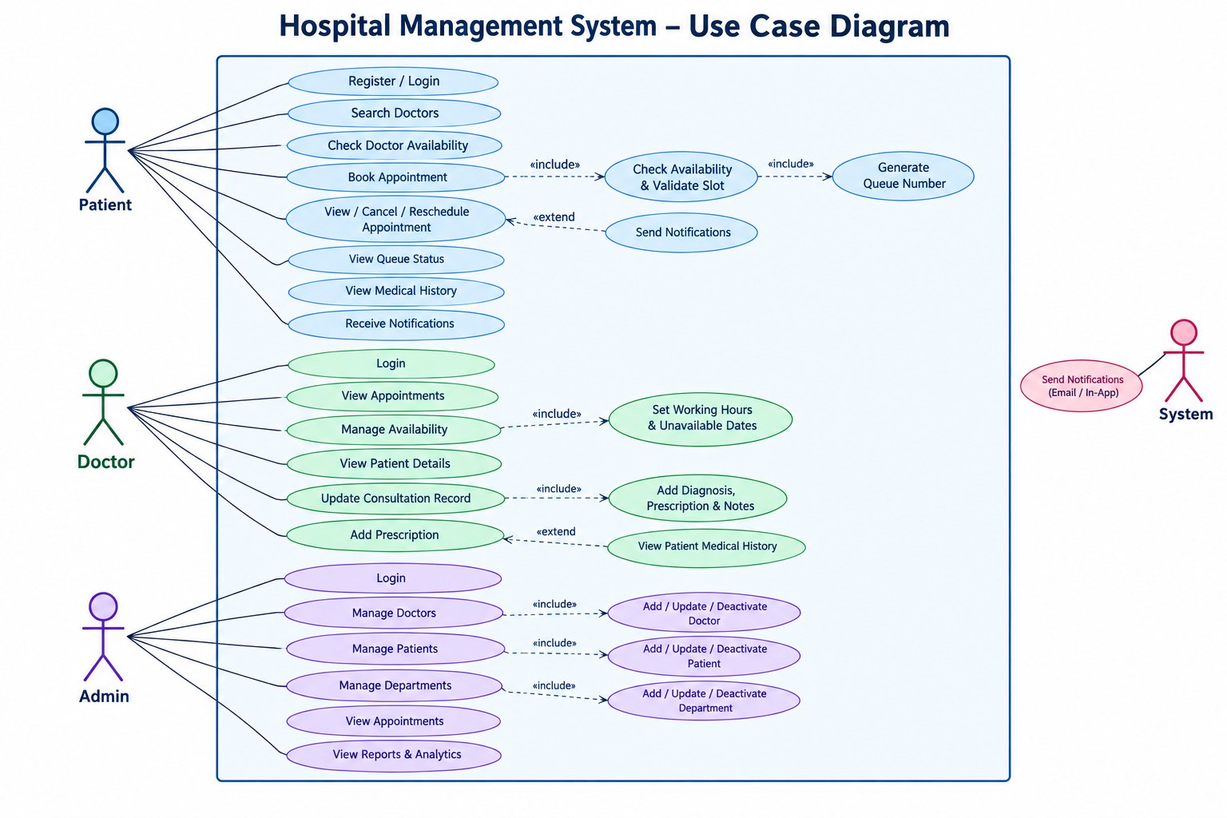
USE CASE MODEL
Use Case Analysis & System Interactions
CareSync | Review 1 & 2 | MERN Stack Project
04

Slide 6
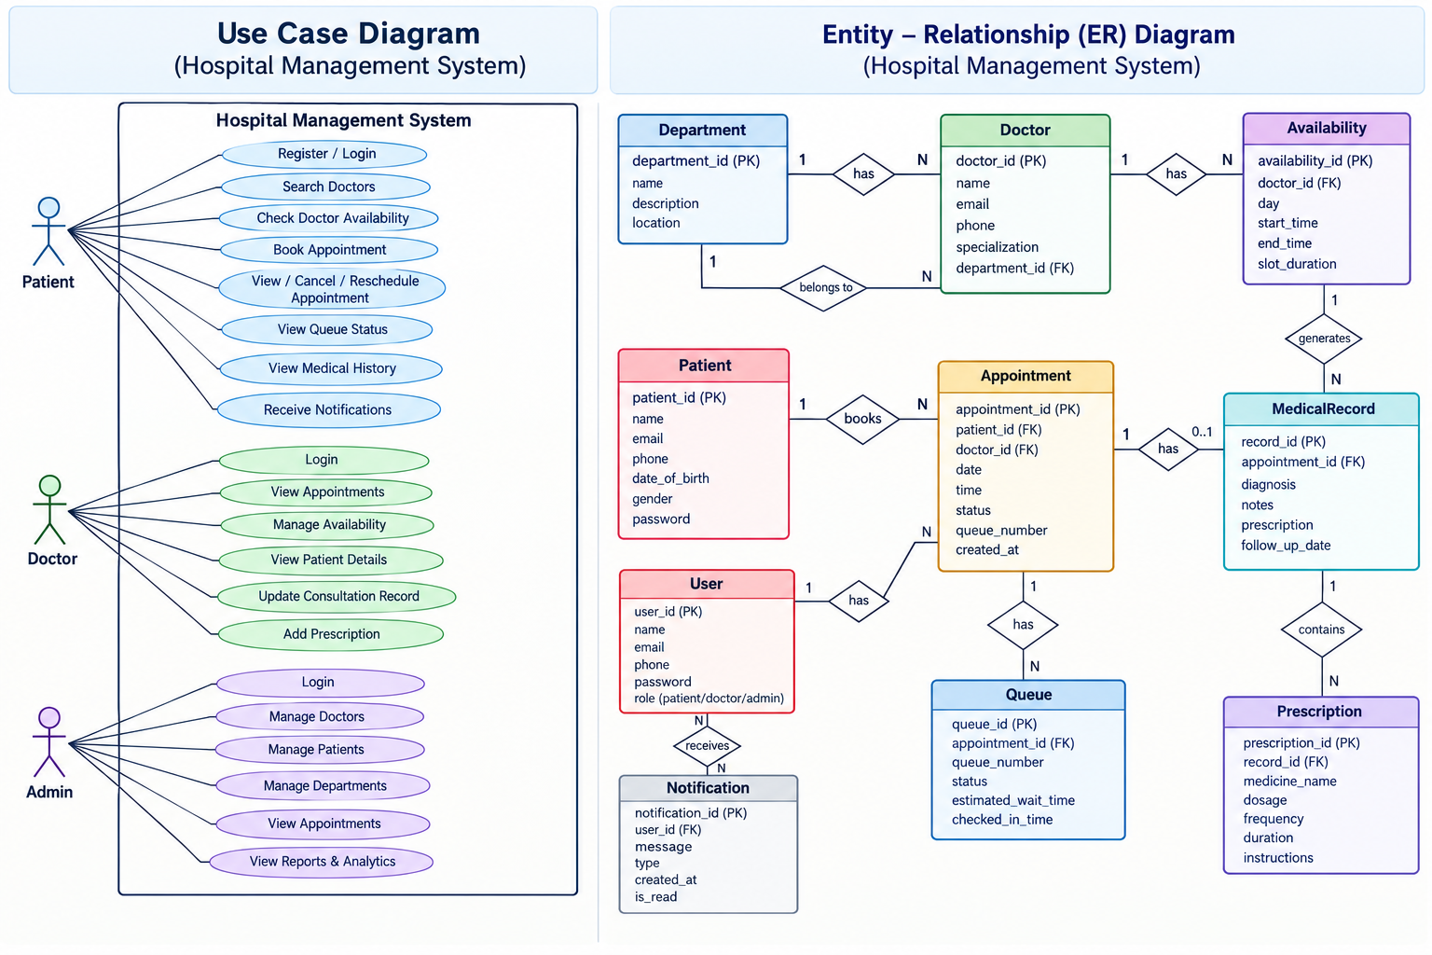
DATA MODELING
Database Schema & Entity Relationship Model
05

Slide 7
MODULE DESCRIPTION
Core Application Modules & Sub-systems
Module Name | Target User | Primary Responsibilities & Key Operations | Key Technical Mechanisms
1. Auth & RBAC | All Roles | User registration, login, role determination, route protection, session logout. | bcrypt hashing (10 rounds), signed JWT tokens, role middleware.
2. Doctor Catalog & Slots | Patients | Browse doctors, filter by clinical department, inspect fee, dynamic 15-min slot generator. | Interval generator math; checks blocked dates & active bookings.
3. Appointment Engine | Patients / Admin | Book appointment, assign sequential token, cancel booking, release slots. | Atomic transaction locks; unique constraint check blocks race conditions.
4. Live Queue Tracker | Patients | Patient arrival check-in, live queue position monitor, dynamic wait time estimation. | Socket.IO room broadcast; wait = ahead × duration.
5. Doctor Clinical Console | Doctors | Real-time waiting lobby monitor, "Call Next Patient" trigger, shift management. | WebSocket call trigger; status updates from WAITING to CALLED.
6. E-Prescription & History | Doctors / Patients | Record diagnosis, clinical notes, multi-item medication; printable digital Rx slips. | Child prescription collection referencing medical records.
7. Admin Analytics | Hospital Admin | Live KPI monitoring, department patient volume breakdown, doctor roster CRUD. | Aggregated database queries; real-time admin WebSocket stream.
8. AI/ML Smart Assistant | Patients | Hospital FAQ bot, appointment guidance, patient queue lookup with safety guardrails. | Contextual administrative intent classifier with medical triage warnings.
CareSync | Review 1 & 2 | MERN Stack Project
06

Slide 8
TECH STACK
Technology Stack & Development Toolchain
MERN CORE
REAL-TIME & CLIENT
SECURITY & INTELLIGENCE
MongoDB / Mongoose
Socket.IO
JWT & bcryptjs
Document store with schema validation, indexes & transaction support
Bidirectional low-latency WebSocket engine for live queue tokens
Stateless authorization tokens & cryptographic password hashing
Express.js
Tailwind CSS
Python Scikit-Learn
Fast, unopinionated REST API routing & centralized middleware
Utility-first modern responsive healthcare UI styling
Machine learning regression (wait time) & classification (no-show risk)
React 18
Axios Client
Nodemailer
Component architecture with hooks, Context API & fast client rendering
Promise-based HTTP client with request/response JWT interceptors
Automated email dispatch for appointment confirmations & reminders
Node.js
Lucide Icons
Postman & Git
High-performance asynchronous runtime for non-blocking I/O
Consistent, accessible clinical and navigational SVG iconography
Automated API endpoint verification and distributed version control
CareSync | Review 1 & 2 | MERN Stack Project
07

Slide 9
UI ENGINEERING
UI Design, Layouts & Screen Wireframes
1. Patient Booking Wizard
2. Real-Time Live Queue Tracker
3-Step visual scheduling wizard. Filters department, renders dynamic morning/evening 15-min slot pills. Disables taken slots. Triggers celebratory confetti on confirmation.
Large circular badge showing assigned token number (#15), currently serving (#12), patients ahead counter (3), dynamic wait time (~30m), and live WebSocket heartbeat indicator.
UI Wireframe Components: Responsive Navbar • Collapsible Role Sidebar • Modal Dialogs • Toast Alerts • Printable Rx
UI Wireframe Components: Responsive Navbar • Collapsible Role Sidebar • Modal Dialogs • Toast Alerts • Printable Rx
3. Doctor Clinical Console
4. Executive Admin Center
Dual-panel layout: Active patient card with chief complaint & medical history shortcut, next patient queue roster, and prominent single-click "Call Next Patient" broadcast button.
Real-time operational overview: KPI counters for daily intake, completed visits, waiting patients, cancellations, department volume distribution charts, and doctor roster management.
UI Wireframe Components: Responsive Navbar • Collapsible Role Sidebar • Modal Dialogs • Toast Alerts • Printable Rx
UI Wireframe Components: Responsive Navbar • Collapsible Role Sidebar • Modal Dialogs • Toast Alerts • Printable Rx
CareSync | Review 1 & 2 | MERN Stack Project
08

Slide 10
FRONTEND BUILD
Frontend Implementation Architecture
React 18 & Modular Component Architecture
State Management & Context API Architecture
• Organized into public, patient, doctor, and admin domain folders.
• AuthContext: Manages user authentication, token persistence in localStorage, and socket connection lifecycle.
• Atomic design hierarchy: common badges, modals, tables, notification toasts, and custom cards.
• NotificationContext: Real-time listener capturing personal queue alerts and triggering automated toast popups.
• Strict clean code separation: business logic isolated from presentation components.
• Vite proxy forwarding /api and /socket.io requests to Express backend seamlessly.
Real-Time WebSocket Synchronization
Accessibility & Responsive Styling
• Dedicated Socket.IO client instance with automatic reconnection logic.
• Mobile-first responsive styling utilizing Tailwind CSS utility classes.
• Joins scoped patient rooms (patient_${userId}) and doctor consultation rooms (doctor_${doctorId}).
• Interactive feedback with Canvas-Confetti, status badges, and loading skeletons.
• Zero-refresh dynamic re-rendering on queue progression and doctor calling events.
• Dedicated Printable Prescription View designed with CSS print-media queries.
CareSync | Review 1 & 2 | MERN Stack Project
09

Slide 11
BACKEND BUILD
Backend Architecture & Controller Engineering
1. Modular MVC Architecture
2. JWT Security & Role Authorization Middleware
Structured separation into controllers (business logic), routes (endpoint dispatching), services (slot generation, queue algorithms, socket events), and database layer.
Extracted Bearer token validation with JWT verification. Custom authorize("patient", "doctor", "admin") middleware blocks unauthorized cross-role endpoint access.
3. Concurrency & Anti-Double-Booking Engine
4. Dynamic Slot Generation Algorithm
Transactional slot verification before insertion. Atomic database transactions (tx.query) reject simultaneous conflicting slot requests with explicit 409 Conflict status.
Given doctor ID and target date, parses doctor availability, morning/evening clinic hours, excludes booked slots and blocked leave dates to generate available intervals.
CareSync | Review 1 & 2 | MERN Stack Project
10

Slide 12
DATABASE LAYER
Database Integration & Dual-Driver Strategy
DUAL-DRIVER ARCHITECTURE
CORE COLLECTIONS & ACTIVE RECORDS
• Zero-Config Local Execution (Default): Uses Node built-in SQLite engine (hospital.db) allowing evaluators to clone and run npm run dev immediately without requiring a local database server daemon.
users
Auth & Base Identities
9 Seed Accounts
patients
Clinical Profiles & Demographics
3 Seed Patients
• Production Deployment (MongoDB / MySQL): Easily toggled via environment variables (DB_CLIENT=mysql or MongoDB Mongoose adapter) for deployment on AWS RDS, Railway, Render, or MongoDB Atlas.
doctors
Specialist Credentials & Fees
5 Seed Specialists
departments
Clinical Service Lines
7 Seed Departments
• Compound Uniqueness Indexing: Enforced on (doctor_id, appointment_date, appointment_time) guaranteeing data integrity and zero double-booking at the storage engine level.
doctor_availability
Weekly Shift Intervals
25 Shift Schedules
appointments
Bookings & Queue Slips
Indexed by Doctor/Date
queues
Active Daily Token Tracking
Status: Waiting/Called/Done
medical_records
Clinical Diagnoses & Notes
Historical Visit Logs
prescriptions
Itemized Rx Medication Lines
Dosage, Frequency, Days
notifications
In-App Alerts & Email Logs
Real-Time User Inbox
CareSync | Review 1 & 2 | MERN Stack Project
11

Slide 13
API INTEGRATION
RESTful API Specification & Endpoints
Method | Endpoint URI | Role Access | Description & Operations | Status
POST | /api/auth/register | Public | Registers new patient account, hashes password, returns JWT token. | 201 Created
POST | /api/auth/login | Public | Authenticates credentials for Patient, Doctor, or Admin; issues JWT. | 200 OK
GET | /api/doctors | Public | Search doctors with department, query, and availability filters. | 200 OK
GET | /api/availability/slots | Public | Dynamic 15-min slot generator for doctor ID and requested date. | 200 OK
POST | /api/appointments | Patient | Atomic conflict-free booking; assigns sequential daily queue token. | 201 / 409
POST | /api/queue/checkin/:id | Patient | Patient checks in on appointment day; enters active live waiting queue. | 200 OK
GET | /api/queue/patient/:id | Patient | Retrieves live serving token, patients ahead count & dynamic wait time. | 200 OK
POST | /api/queue/doctor/call-next | Doctor | Calls next waiting patient; broadcasts WebSocket room notification. | 200 OK
POST | /api/medical-records | Doctor | Saves diagnosis, notes, and multi-item prescriptions; completes visit. | 201 Created
GET | /api/admin/stats | Admin | Returns real-time hospital intake KPIs, department distribution. | 200 OK
POST | /api/ai/chat | Public/User | Contextual hospital administrative assistant with medical safety filters. | 200 OK
CareSync | Review 1 & 2 | MERN Stack Project
12

Slide 14
IMPLEMENTATION STATUS
Sprint Progress & Module Completion Metrics
User Authentication & Role-Based Access Control (RBAC)
100%
Doctor Catalog, Department Filters & Dynamic Slot Engine
100%
Anti-Double-Booking Concurrency & Transaction Engine
100%
Live Queue Tracking & Socket.IO Room Broadcast Engine
90%
Doctor Clinical Workspace, Next Patient Call & Shift Manager
85%
Digital Medical History & Itemized Printable E-Prescriptions
85%
Executive Admin Center & Hospital Clinical Department CRUD
80%
Machine Learning Consultation Duration & No-Show Models
75%
Automated Transactional Email Alerts (Nodemailer)
70%
OVERALL REVIEWS 1 & 2 COMPLETION: ~85% (Core Full-Stack System Operational & Verified via Automated Test Suite)
CareSync | Review 1 & 2 | MERN Stack Project
13

Slide 15
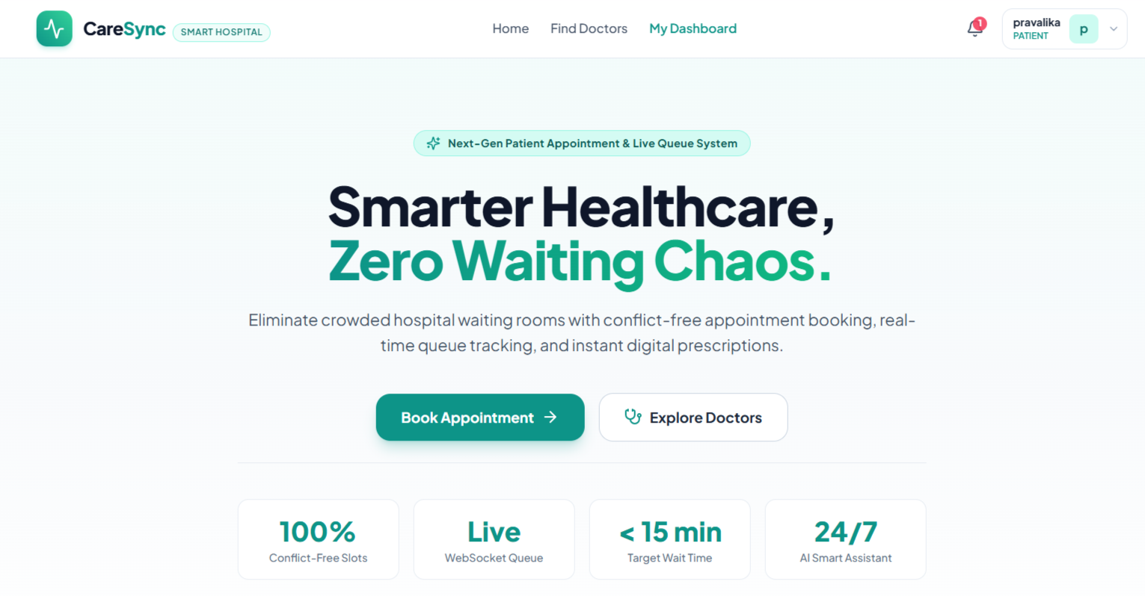
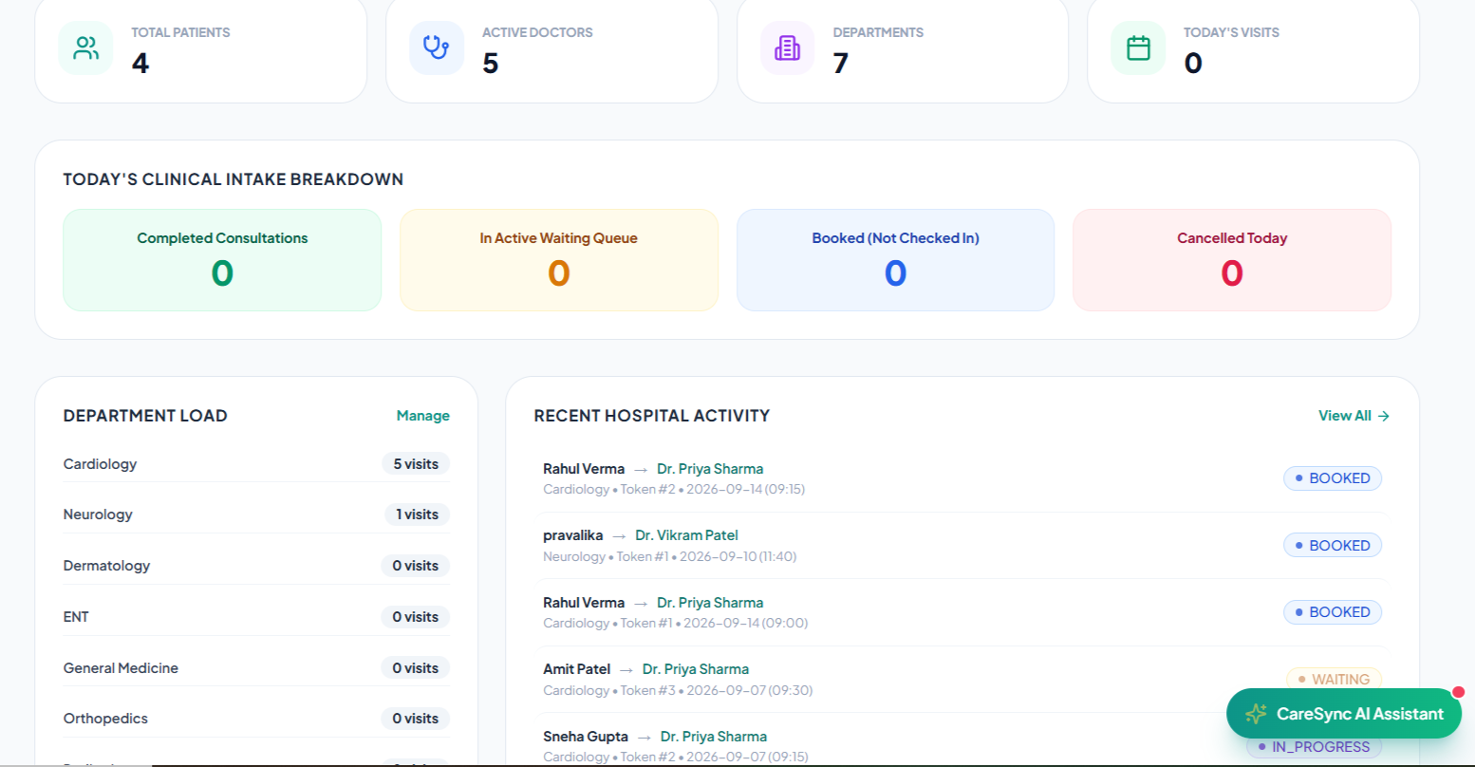
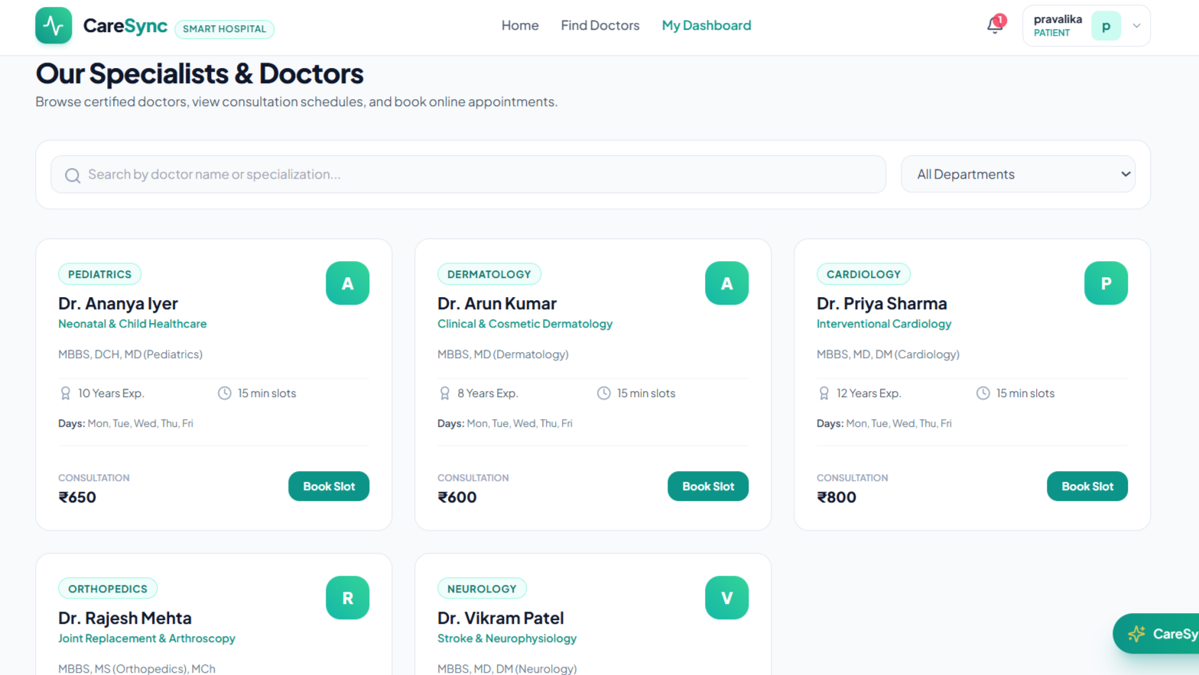
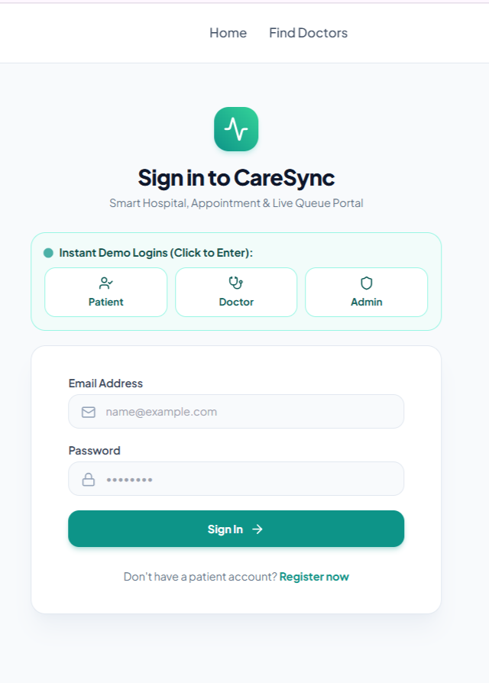
LIVE DEMONSTRATION
Application Showcase & UI Walkthrough
14

Slide 16
TECHNICAL PROBLEM SOLVING
Key Engineering Challenges & Adopted Solutions
01
Race Conditions & Double-Booking Slot Collisions
02
Real-Time State Synchronization Across Devices
CHALLENGE: Two patients submitting booking requests for the exact same doctor and 15-minute slot at the exact same millisecond caused duplicate appointments.
CHALLENGE: Patients waiting in lobby areas had to continuously refresh their browser pages to check if the doctor called their token number, causing unnecessary server load.
SOLUTION: Engineered atomic database transactions (tx.query) combined with an enforced database compound uniqueness constraint: (doctor_id, appointment_date, appointment_time). Only one transaction commits; conflicting requests abort with explicit 409 Conflict.
SOLUTION: Integrated Socket.IO room architecture. Connected sockets join scoped rooms (doctor_${id}, patient_${id}). When a doctor triggers "Call Next Patient", a WebSocket event updates the waiting counter and wait-time estimate instantly without reload.
03
Inaccurate Static Waiting Time Estimates
04
Cross-Origin Resource Sharing (CORS) & Token Expiry
CHALLENGE: Multiplying patients ahead by a static 15-minute constant created misleading wait estimates for complex cases (e.g. cardiac assessments vs routine refills).
CHALLENGE: CORS policy errors between Vite frontend (port 5173) and Express backend (port 5000), along with unhandled JWT expiration causing abrupt application crashes.
SOLUTION: Designed a machine learning regression pipeline evaluating patient age, symptom category, visit type, department, and time of day to deliver personalized dynamic wait-time estimations with confidence metrics.
SOLUTION: Configured robust Express CORS middleware with origin reflection and credentials support. Implemented Axios response interceptors to automatically catch 401 Unauthorized errors and redirect gracefully to login.
CareSync | Review 1 & 2 | MERN Stack Project
15

Slide 17
NEXT STEPS & REFERENCES
Remaining Roadmap & Technical References
REMAINING WORK FOR FINAL REVIEW
LITERATURE & TECHNICAL REFERENCES
✓ Complete Production Deployment: Host client on Vercel/Netlify, deploy Express server on Render/Railway, and migrate database to MongoDB Atlas cluster.
[1] MongoDB Inc., "MongoDB & Mongoose: Schema Modeling, Sharding & Query Optimization Documentation", Official MERN Reference, 2025.
✓ SMS & WhatsApp Notifications: Integrate Twilio / WhatsApp Business API alongside Nodemailer for real-time patient queue SMS alerts.
[2] Facebook Open Source, "React 18 Architecture: Concurrent Mode, Context API and Component Lifecycles", Official React Docs, 2024.
[3] Socket.IO Organization, "Bidirectional Low-Latency Event-Driven Communication Protocols", Official WebSocket Specs, 2025.
✓ Mobile Progressive Web App (PWA): Configure Web App Manifest and Service Workers for offline consultation slip caching.
[4] IEEE Healthcare Informatics, "Optimization of Outpatient Appointment Scheduling and Dynamic Queue Reduction via Concurrency Control", IEEE Transactions on Healthcare Systems, 2024.
✓ Automated End-to-End Test Suite: Expand Cypress / Playwright automated browser tests covering booking and queue progression flows.
[5] Scikit-Learn Developers, "Ensemble Methods, Random Forests and Gradient Boosting for Medical Queue Forecasting", Machine Learning in Python, 2024.
✓ Comprehensive Capstone Project Report: Finalize IEEE-formatted documentation, viva presentation slides, and software engineering metrics.
[6] World Health Organization (WHO), "Digital Health Strategies for Clinical Workflow Streamlining & Patient Wait-Time Alleviation", Global Healthcare Reports, 2024.
CareSync | Review 1 & 2 | MERN Stack Project
16

