Slide 1

InspireMe-AI
SREYAS INSTITUTE OF ENGINEERING & TECHNOLOGY
(AUTONOMUS)
(Approved by A.I.C.T.E.,New Delhi., Affiliated to JNTUH Hyderabad, Accredited by NAAC ‘A’ Grade & NBA)
Presented by:
A. Pravalika
A. Mahitha
S. Dedeepya
M. Akshitha
P. Rakshitha
K. Navya

Slide 2
PROBLEM STATEMENT
Low motivation reduces productivity and mental well-being
Generic quotes feel repetitive
No personalization for mood or goals
Need an intelligent motivational system

Slide 3
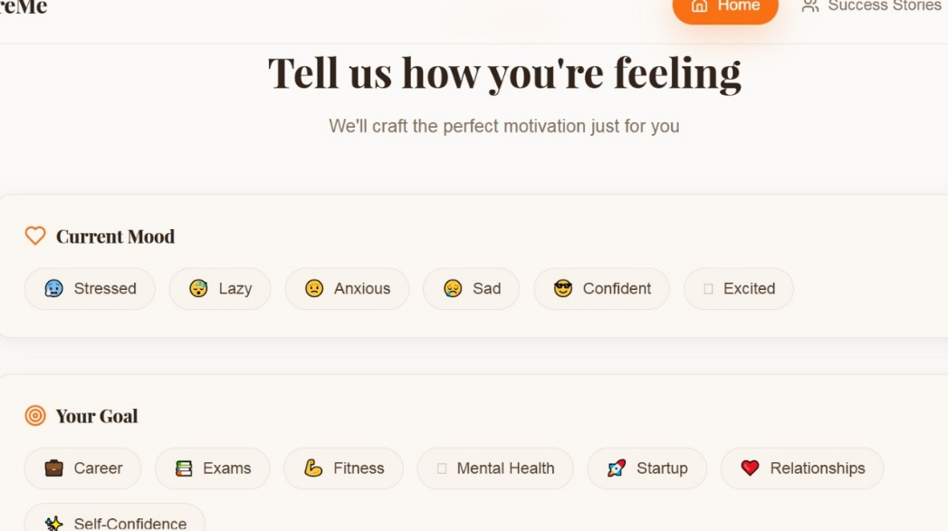
PROPOSED SOLUTION
AI Motivational Generator
Uses AI to generate motivational messages
Personalized based on user input
Provides instant encouragement
Accessible anytime and anywhere

Slide 4
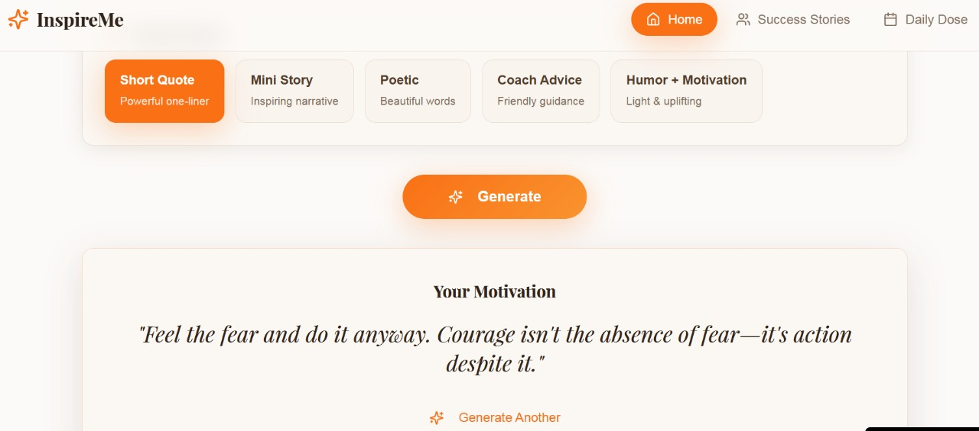
HOW IT WORKS
User inputs mood, goal, or situation
AI processes the input
Natural Language Processing (NLP) analyzes context
AI generates a customized motivational message
Output displayed to the user

Slide 5
ADVANTAGES
Personalized motivation
Reduces stress and burnout
Easy to use
Available 24/7
Improves emotional well-being

Slide 6
CONCLUSION
AI can positively impact mental well-being
The AI Motivational Generator provides personalized inspiration
It is a step toward smarter emotional support systems
Combines technology with human emotions

