Slide 1

CMR COLLEGE OF ENGINEERING & TECHNOLOGY
Kandlakoya, Medchal, Hyderabad - 501401
Department of Computer Science and Engineering
Visual Question Generation From Remote Sensing Images
Batch No:47
Name of the student:
Y.Laxmi Narayana - 20H51A0581
B.Pravalika -20H51A05B6
P.Arya Patel - 20H51A05F3
Under esteemed guidance of
Guide Name:Mrs. M. Kamala
(Assistant Professor)
Batch: 2020-2024 Major Project Phase 2

Slide 2
Outline
Abstract
Introduction
Literature survey
Existing system
- Problems in existing system
Research Objective of Presentation
Problem Definition
Research work
- Proposed system architecture
- Methods
- Comparison of Proposed system with an existing system
Performance Measure
Results
Conclusion
Future Work
References
Notes:
2

Slide 3
Abstract
Notes:
3

Slide 4
ABSTRACT
Visual question generation (VQG) is an emerging research area that aims to automatically generate natural language questions based on visual content.
Here, this focuses on the application of VQG to remote sensing images, which are obtained from aerial or satellite sensors and provide valuable information for various domains, including agriculture, urban planning, and environmental monitoring.
Convolution Neural Networks (CNNs) are utilized to capture spatial information from the images. Pre-trained models like Gemini API are employed to model sequential patterns in the generated questions.
The combination of these architectures enables the model to effectively comprehend and translate the visual context into human-readable questions.

Slide 5
INTRODUCTION
Notes:
5

Slide 6
Introduction
Visual Question Generator (VQG) merges computer vision and natural language processing.
It leverages state-of-the-art deep learning techniques.
VQG automatically generates meaningful questions about images.
Potential applications include content generation, education, and accessibility.
It enables machines to interact with the visual world more intelligently.
VQG assists users in a more human-like manner.
Notes:
6

Slide 7
Literature Survey
Notes:
7

Slide 8
Existing system
Rule-Based Approaches: These systems rely on predefined rules to generate questions from visual content.
Deep Learning-Based Models: These models employ neural networks to learn representations of images and generate questions. While they can capture complex patterns, they may suffer from data scarcity.
Hybrid Approaches: Combining rule-based techniques with deep learning methods can provide more robust question-generation systems.
Notes:
8

Slide 9
Research Objective
Notes:
9

Slide 10
Research objective
Integration of Gemini API with BERT
Enhanced Image Understanding
Context-Aware Question Generation
Evaluation Metrics and Benchmarking
Real-World Application and Impact Assessment

Slide 11
Problem Definition
Notes:
11

Slide 12
Problem Definition
Objective: Develop a question generation system for remote sensing images using Gemini API, enhancing understanding in the field.
Scope: Utilize Gemini API to access image data and metadata, focusing on generating contextually relevant questions.
Key Components: Utilize pre-trained models from Gemini API for image and text retrieval; Develop algorithms for direct question generation.
Approach: Integrate Gemini API for information extraction; Develop algorithms using text processing and sequence models for question generation; Fine-tune pre-trained models for improved accuracy.

Slide 13
Research Work
Notes:
13

Slide 14
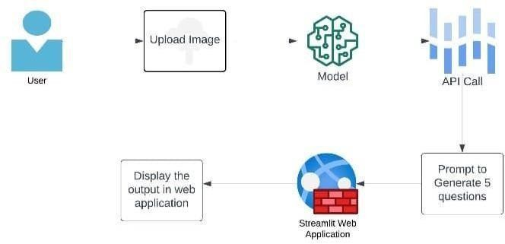
Proposed system architecture

Slide 15
Proposed Methods
User Upload: Remote-sensing image uploaded to web app.
API Call: Image sent to Gemini API Bert-3 server for analysis. Question Generation: Pre-trained model generates questions based on image analysis.
Display: Questions displayed on web app interface for user interaction.
BERT analyzes visual details, generating questions for deeper exploration. CNNs process image, extracting features to aid question generation.BERT's utilization in visual question generation from remote sensing images is vital as it can interpret intricate visual elements and convert them into coherent questions.
Its deep understanding of textual semantics ensures the relevance and contextuality of the generated questions, enabling insightful exploration of remote sensing data.

Slide 16
Comparison of the Proposed system with an existing system
Integration of Pre-trained Models: The proposed system utilizes advanced
Gemini API And BERT-3, surpassing traditional systems.
Efficiency and Accessibility: Unlike manual annotation, the proposed system efficiently
accesses data through Gemini API.
Contextual Understanding: Leveraging BERT-3's NLP, it generates contextually
relevant questions.
Scalability and Adaptability: With Gemini API and BERT-3, it offers scalability and
adaptability.
Performance and Evaluation: Demonstrates superior performance and reliability
in question generation.

Slide 17
Performance Measure:
Question Relevance: Evaluate the relevance of generated questions by comparing them with
ground truth annotations or human judgments.
Semantic Coherence: Assess the coherence and logical consistency of generated questions
using semantic similarity metrics or linguistic analysis techniques.
Diversity: Measure the diversity of generated questions to ensure a wide coverage of
semantic concepts and topics present in the remote sensing images.

Slide 18
Result Analysis
Quantitative Evaluation: Calculate evaluation metrics such as BLEU scores to quantify the
performance of the visual question generation system. Higher scores indicate better alignment
with ground truth annotations or human judgments.
2. Qualitative Analysis: Conduct a qualitative analysis by manually examining a subset of
generated questions to assess their relevance, coherence, and diversity. This allows
For insights into the system’s strengths and weaknesses.
3. User Feedback: Gather feedback from users, such as domain experts or end-users,
to understand their perceptions of the generated questions' usefulness and appropriateness.
Incorporate this feedback into refining and improving the system.

Slide 19
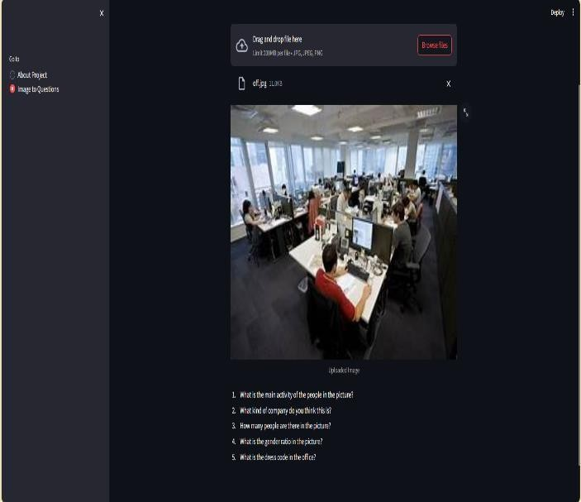

Slide 20
Conclusion
The Image to Questions Generator showcases the practicality of machine learning, simplifying question generation from visual content for various purposes. By leveraging the Gemini API, it enhances accessibility and analysis efficiency for remote sensing images. Ongoing research hints at novel applications in environmental fields, underlining the significance of interdisciplinary collaboration in tackling environmental challenges.

Slide 21
Future work
Improved Question Quality: Refinement of the generative model or integration of feedback mechanisms to enhance the quality of generated questions.
Support for Different Languages: Extension of the application to support question generation in multiple languages.
Customization Options: Addition of features allowing users to customize the types or number of questions generated

Slide 22
References
https://www.researchgate.net/publication/369516016_Visual_Question_Generation_From_Remote_Sensing_Imageseeexplore.ieee.org/document/9077721
https://ieeexplore.ieee.org/document/10081015/similar#similars://www.mdpi.com/2078-2489/12/8/334

Slide 23
Thank You!

