Slide 1

A INTERNSHIP PROJECT ON VALIDATION FORM
Under the guidance of
Under the guidance of
Mrs. SK.SALMA BEGUM M.Tech
Assistant Professor, Department of CSE
Presented By:
N.L.Pravallika(15481A05F7)
P.Prashanth(15481A05F8)
M.Yamuna(15481A05C8)
Y.Ashok(16485A0523)

Slide 2
Abstract:
a validation form is which validates the name, password and Gmail, phone number is in the correct form or not.
In recent period of time validation becomes more important.
GitHub is a web-based hosting service for version control, computer code.
It provides a centralized, Cloud-based location to store, share, publish, test and collaborate for web development projects.

Slide 3
Objective:
The rapid increase of web applications leads to increase of validation of data and data format.
So, we are developing the validation form to validate the data with the help of java script.
After developing it we are pushing that form to the cloud provider named as github.

Slide 4
System Configurations:
Software Requirements:
Languages : HTML, JavaScript
cloud used : GitHub
Hardware Requirements:
RAM : 4GB
OS : Windows

Slide 5
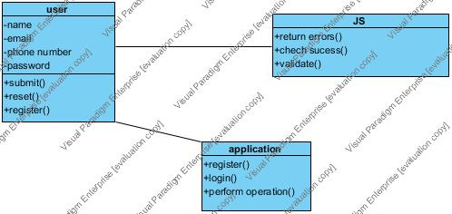
Methodology:
Class Diagram:

Slide 6
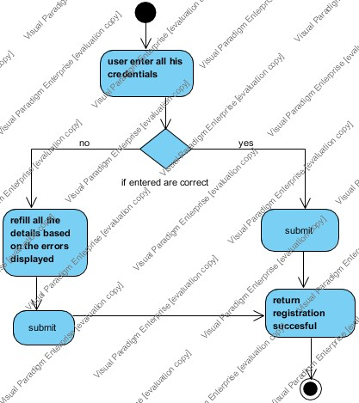
Activity Diagram:

Slide 7
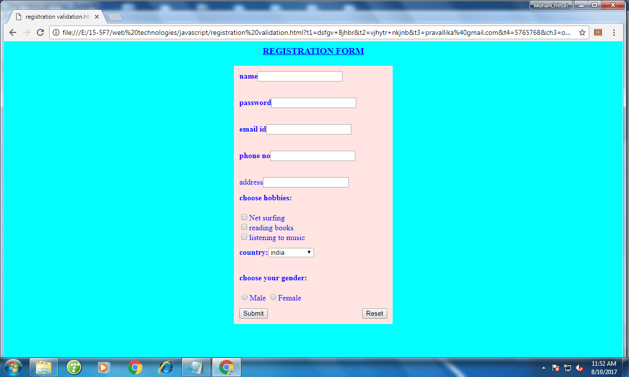
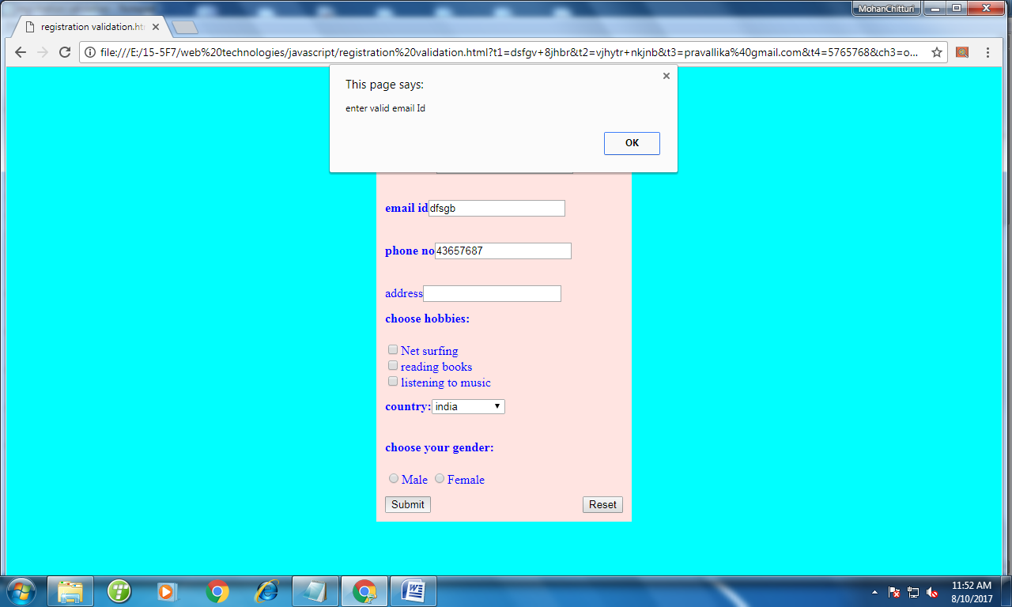
Screenshots:

Slide 8
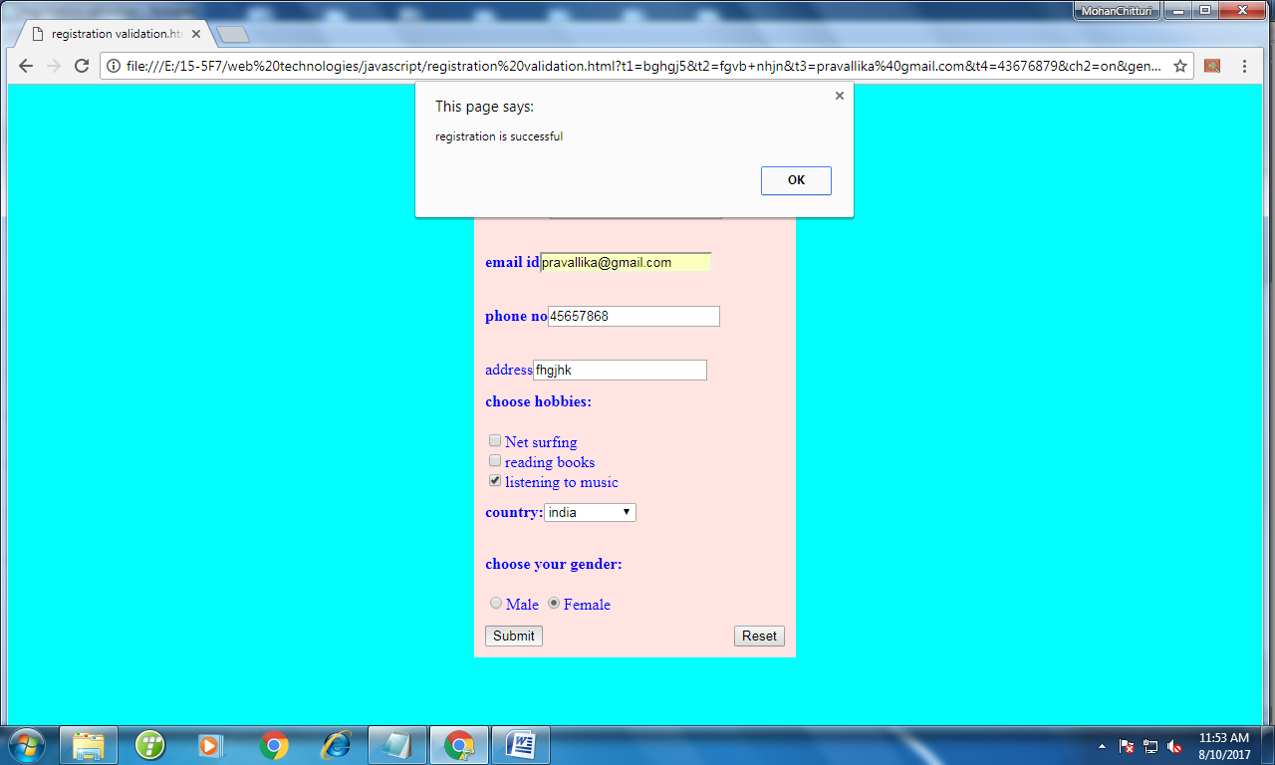

Slide 9
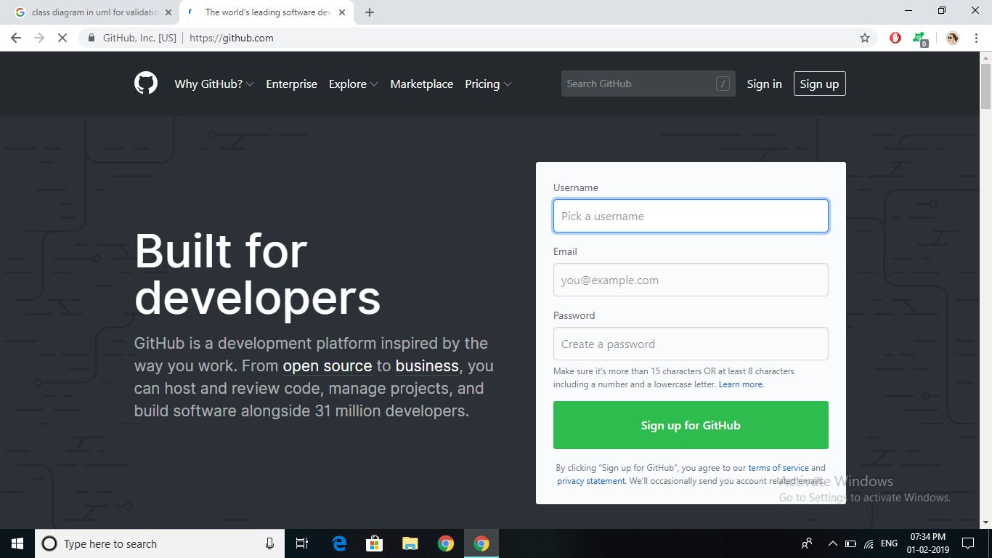
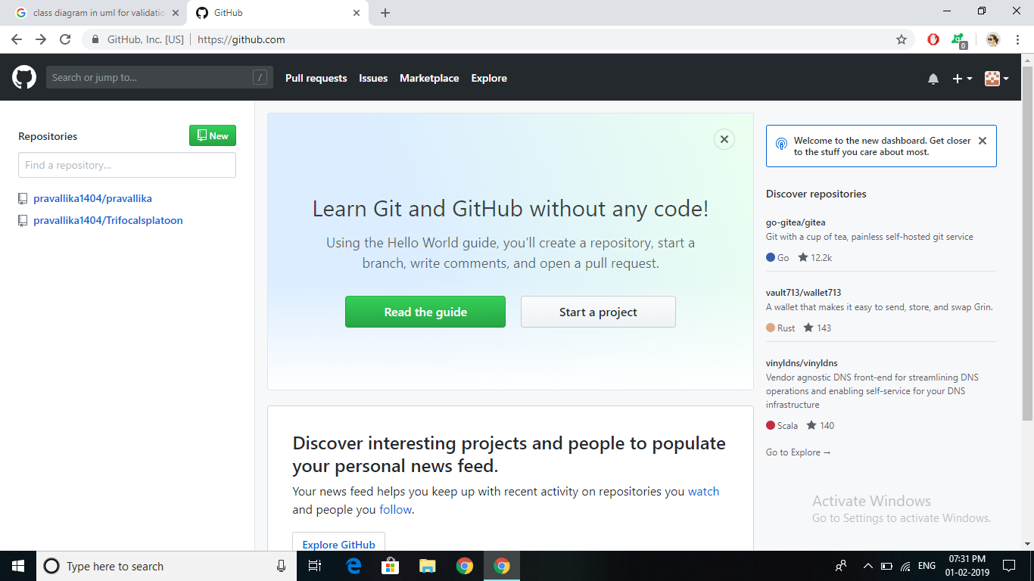

Slide 10
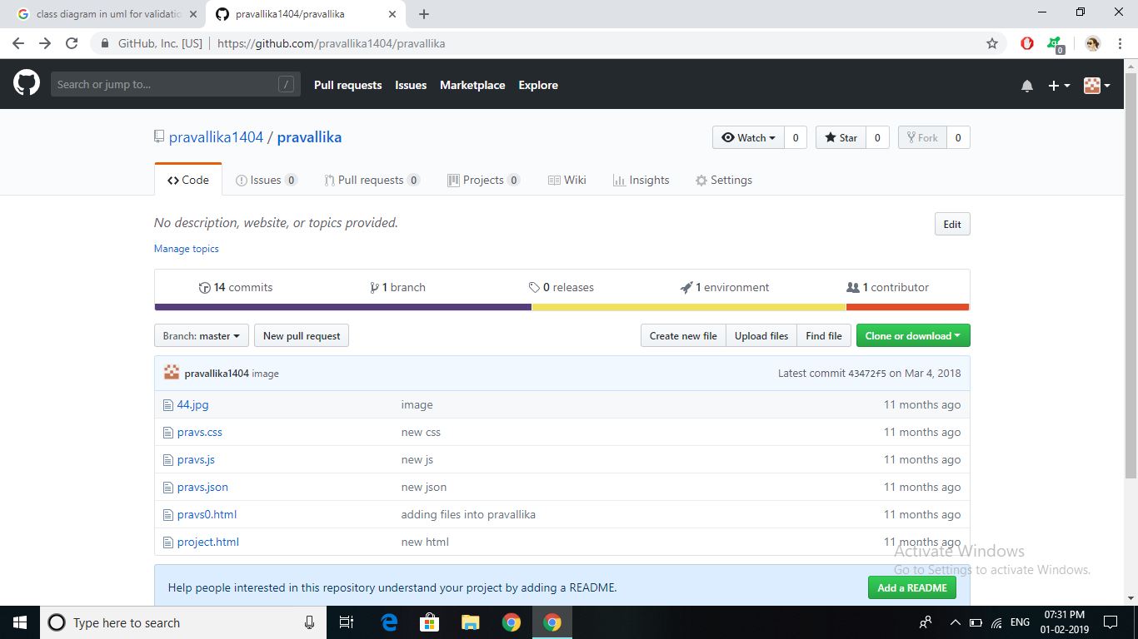

Slide 11
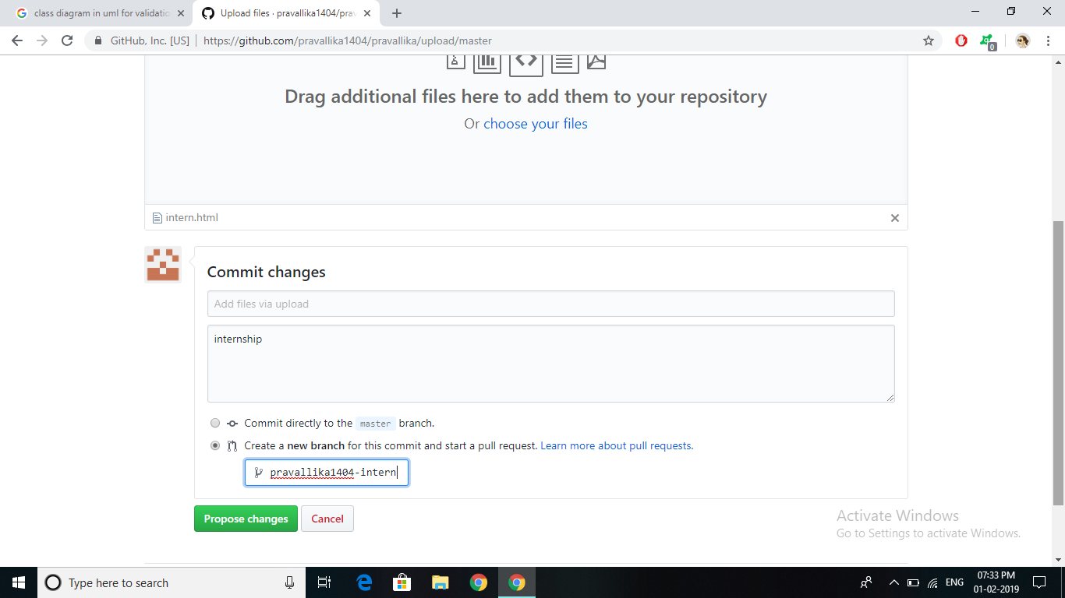

Slide 12
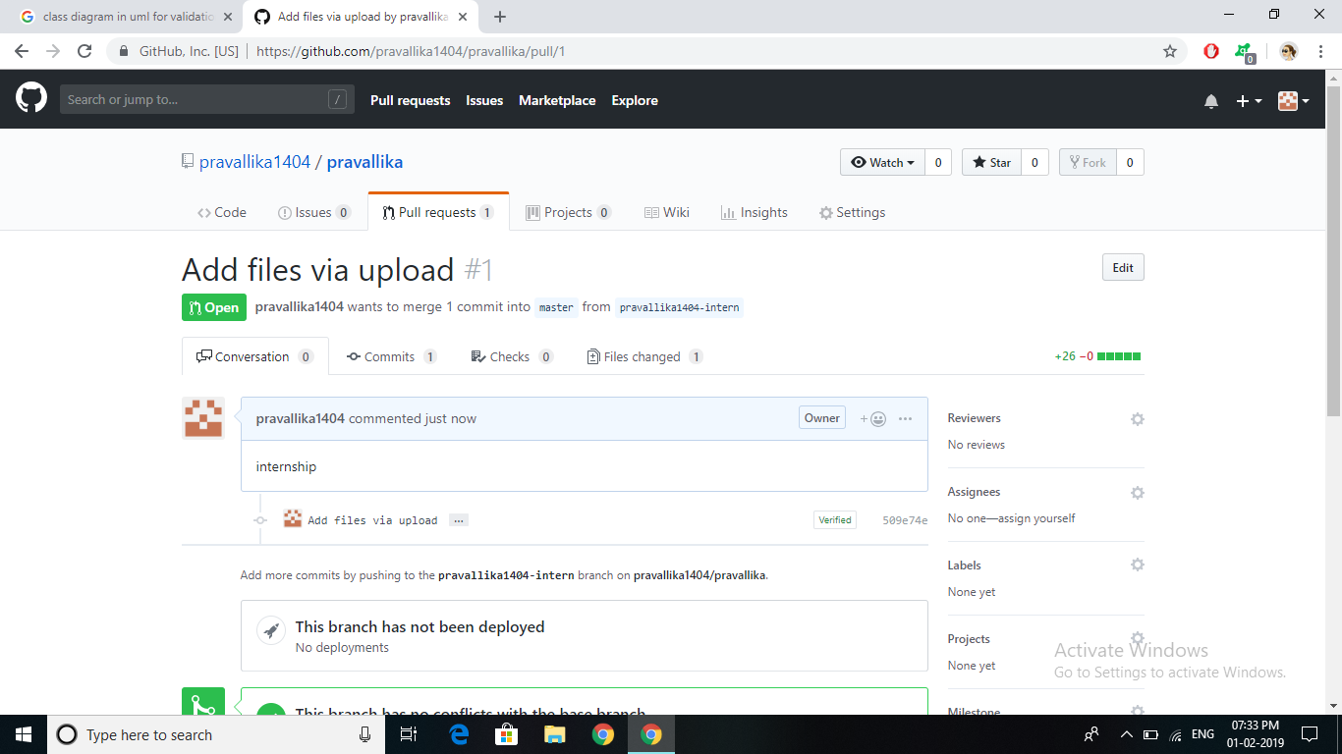

Slide 13
THANK YOU

