Slide 1

PROJECT TITLE : PREDICTION OF STROKE RISK USING MACHINE LEARNING
NAME: PRAVALLIKA K

Slide 2
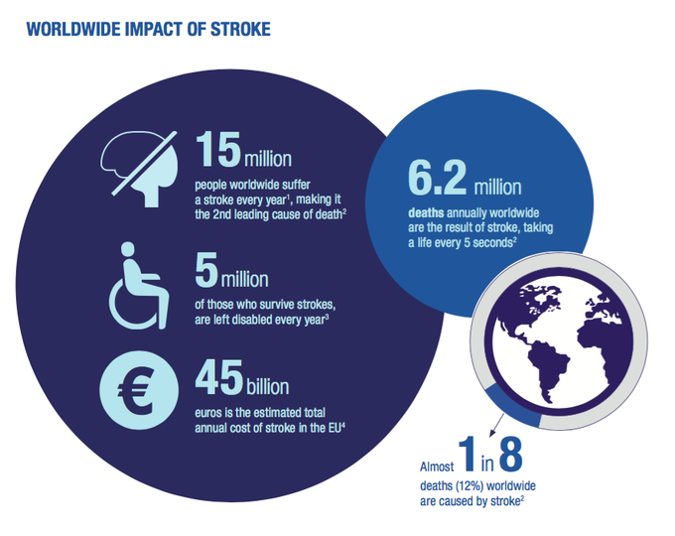
INTRODUCTION TO STROKE
A stroke is a life-threatening condition that happens when part of your brain doesn't have enough blood flow.
Stroke is a leading cause of death and disability globally, with a significant impact on health, the economy, and the lives of individuals and their caregivers.
According to the World Health Organization (WHO), over 15 million people experience a stroke every year
Mortality rate: Around 6.2 million deaths annually due to strokes.
Not only does the burden of stroke lie in the high mortality but the high morbidity also results in up to 50% of survivors being chronically disabled.

Slide 3

ROLE OF MACHINE LEARNING IN STROKE PREDICTION
Machine learning has the potential to improve stroke prediction and treatment in several ways:
Machine learning can analyze large amounts of data to identify patterns and risk factors that are difficult for humans to detect. This can help healthcare providers develop targeted prevention strategies and tailor treatments to each patient's needs
Machine learning can analyze data from individual patients, such as medical history, lifestyle factors, and genetic information, to help develop personalized treatment plans.
Machine learning can help identify patients at high risk of stroke so they can receive early intervention and appropriate treatment.
Machine learning models have demonstrated remarkable accuracy in imaging analysis, diagnosing stroke subtypes, risk stratifications, guiding medical treatment, and predicting patient prognosis.

Slide 4
OBJECTIVES OF THE PROJECT
Objectives for the Prediction of Stroke Project:
Building a Machine learning model to accurately predict the likelihood of a stroke based on individual health and lifestyle factors.
Analyze data to identify which attributes, such as age, hypertension, heart disease, or smoking habits, contribute most significantly to stroke risk.
Ensure the dataset is cleaned, balanced, and processed to improve prediction accuracy and avoid bias.
Extracting and engineering features such as BMI categories, Glucose levels to enhance model performance.
Using metrics like accuracy, precision, recall, and F1 score to validate the model's effectiveness in predicting stroke risk.

Slide 5
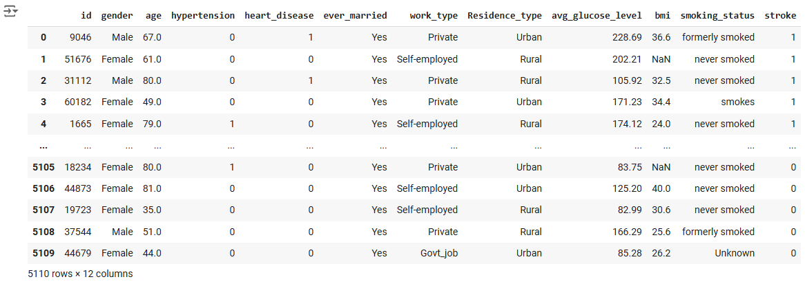
Dataset
The dataset contains medical and demographic information for 5,110 patients, aimed at identifying factors related to the occurrence of strokes. The dataset consists of 12 columns, each representing a feature or characteristic related to the patient’s health or lifestyle.

Slide 6
Dataset Overview
Dataset contains:
id: Unique identifier for each patient (integer).
gender: Gender of the patient (categorical: Male, Female).
age: Age of the patient (numeric).
hypertension: Whether the patient has hypertension (binary: 0 for no, 1 for yes).
heart_disease: Whether the patient has heart disease (binary: 0 for no, 1 for yes).
ever_married: Marital status of the patient (categorical: Yes, No).
work_type: Type of employment (categorical: Private, Self-employed, etc.).
Residence_type: Urban or rural residence (categorical: Urban, Rural).
avg_glucose_level: Average glucose level in the blood (numeric).
bmi: Body Mass Index (BMI) of the patient (numeric; some missing values).
smoking_status: Smoking habits (categorical: formerly smoked, never smoked, smokes).
stroke: Whether the patient has had a stroke (binary: 0 for no, 1 for yes).
There are 4 columns with numeric data (age, avg_glucose_level, bmi, id) and several categorical or binary columns (e.g., gender, smoking_status,). Additionally, the BMI column has some missing values.

Slide 7
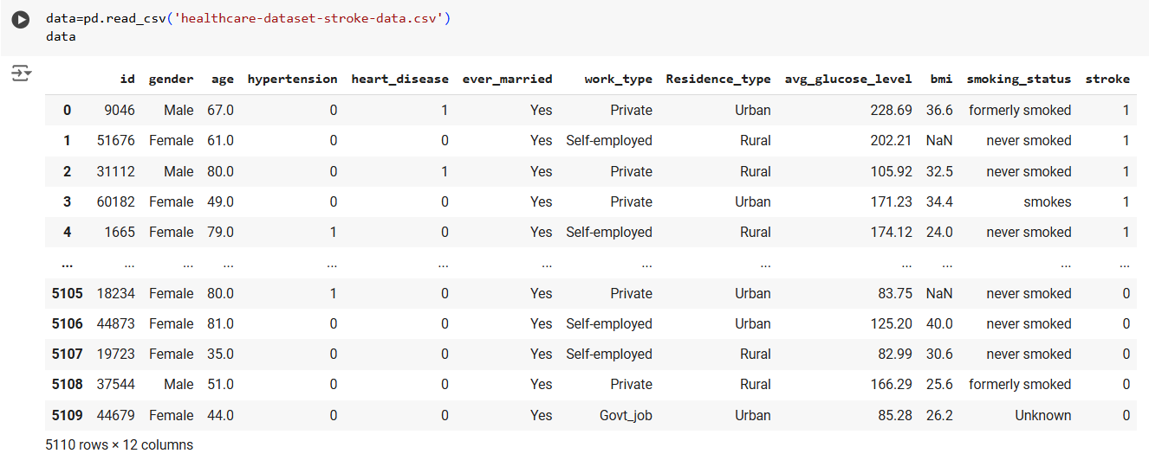
DATA LOADING
Loading the dataset using pandas library

Slide 8
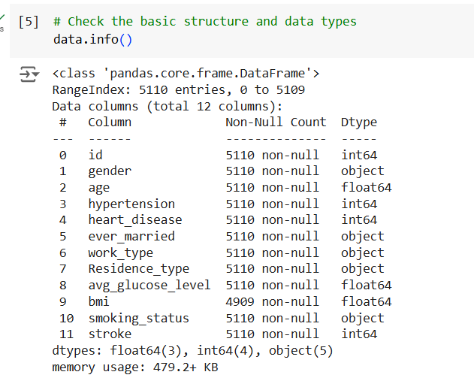
Initial Data Analysis
This output from the info() function helps you understand the basic structure of your dataset, including data types, missing values, and the overall memory usage
1.Data Types:
Numeric: age, avg_glucose_level, bmi, id, hypertension, heart_disease,(float64, int64).
Categorical/Binary: gender, ever_married, work_type,
smoking_status,Residence_type ,stroke
2. Non-Null Counts:
Most columns have 5110 non-null values (complete data).
The BMI column has 4909 non-null values (201 missing).
3. Memory Usage: 479.2 KB

Slide 9
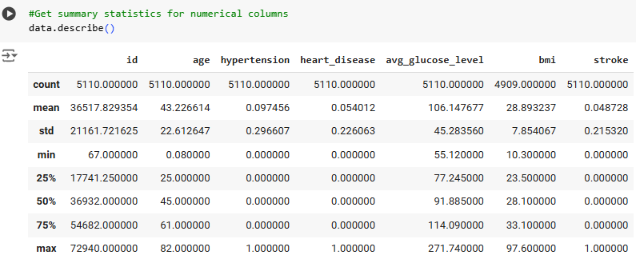
This describe() output gives a high-level statistical summary of the numeric columns in your dataset, helping to understand the data distribution and identify potential areas for preprocessing (like handling missing values in BMI).

Slide 10
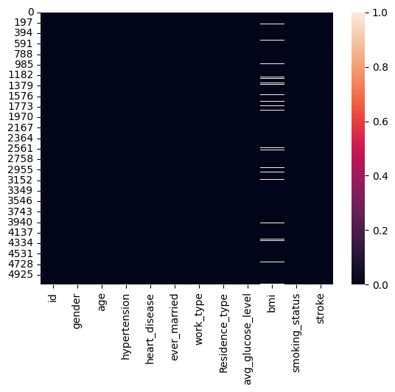
MISSING VALUES IN THE DATASET
Observations:
We can see that there are several rows with missing values of bmi. These are represented by the white rows in the heatmap.
There are 201 missing values in the bmi column
The percentage of missing values in the BMI column is approximately 3.93% of the total dataset.

Slide 11
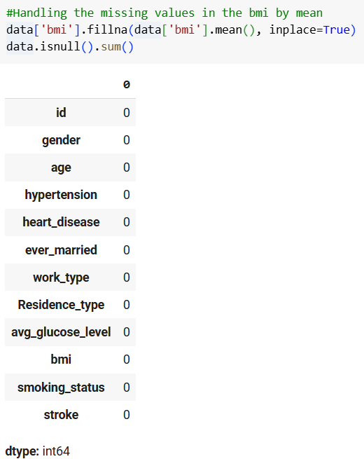
HANDLING THE MISSING VALUES
The missing BMI values were handled by filling them with the mean value of the existing BMI data.
Outcome:
After imputation, the BMI column has no missing values, and the dataset is ready for further analysis and model training.

Slide 12
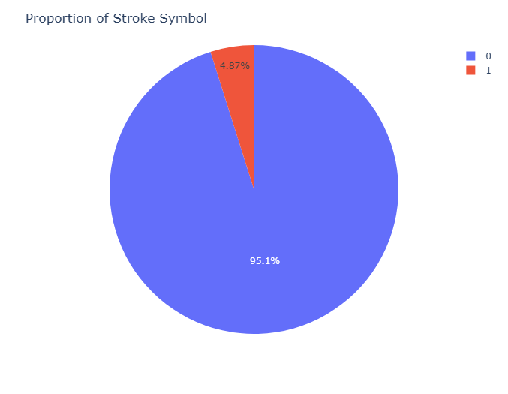
EXPLORATORY DATA ANALYSIS
Observations:
The pie chart indicates that stroke cases are indeed much less common in this dataset, with only about 4.87% of the data labeled as stroke cases.
We can understand that that the class is highly Imbalanced with : 95% "No Stroke," 5% "Stroke."

Slide 13
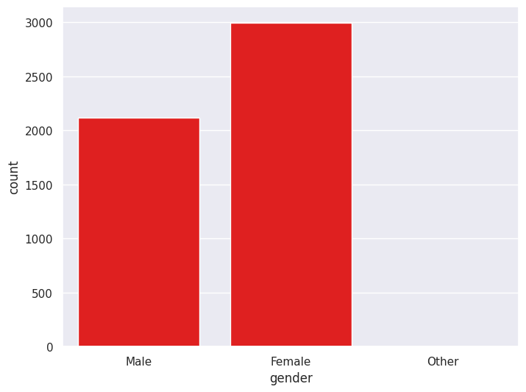
Count Plot for Gender
Observation:
The number of Females present in the Dataset is more than the males

Slide 14
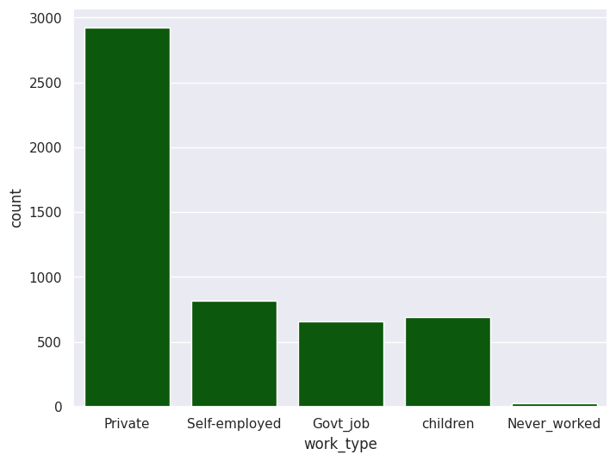
Count Plot for Work_type
Observations:
Private: The majority of patients belong to the Private sector, indicating it as the most common work type in the dataset.
Self-employed: There is a noticeable portion of patients in the Self-employed category, but it is less than Private.
Govt_job, Children, Never_worked: The counts for these categories are relatively smaller, with Children being more common than Govt_job and Never_worked.

Slide 15
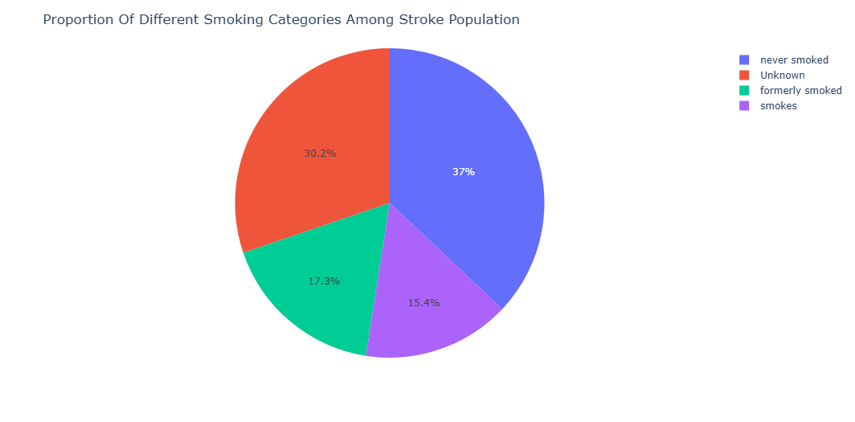
Pie Chart on Smoking status
Observations:
The pie chart or count plot visually demonstrates the distribution of smoking statuses in stroke patients, allowing for quick insights into how smoking might be linked to stroke incidence.
While never smoked is the most common smoking status among stroke patients, smoking remains a significant risk factor for stroke, as indicated by the presence of stroke cases in the "smokes" and "formerly smoked" categories.

Slide 16
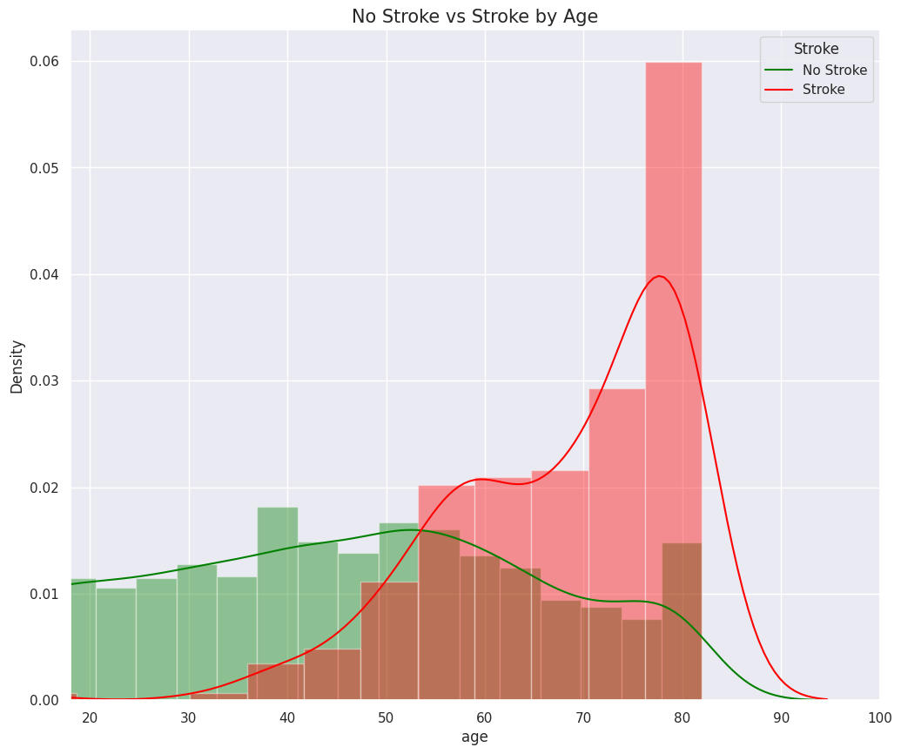
RELATIONSHIP OF INPUT FEATURES WITH STROKE
.
Variation of Stroke with Age
Observation:
The density of strokes increases significantly for individuals above the age of 60, peaking around 80 years.
Non-stroke cases are more uniformly distributed across all age groups.
Stroke cases are minimal in younger age groups (below 40).
Age is a strong predictor of stroke, with older individuals being at much higher risk.

Slide 17
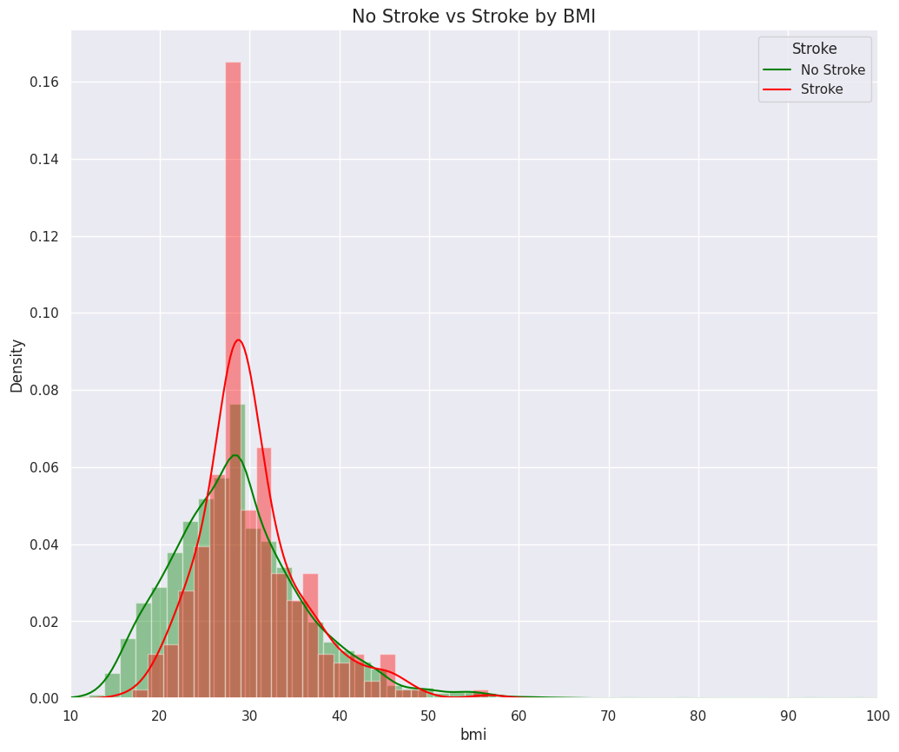
Variation of Stroke with BMI
Observations:
Individuals with stroke (red distribution) tend to have a higher mean BMI compared to those without stroke (green distribution). The peak of the stroke group is centered slightly rightward, indicating a higher BMI association with stroke cases.

Slide 18
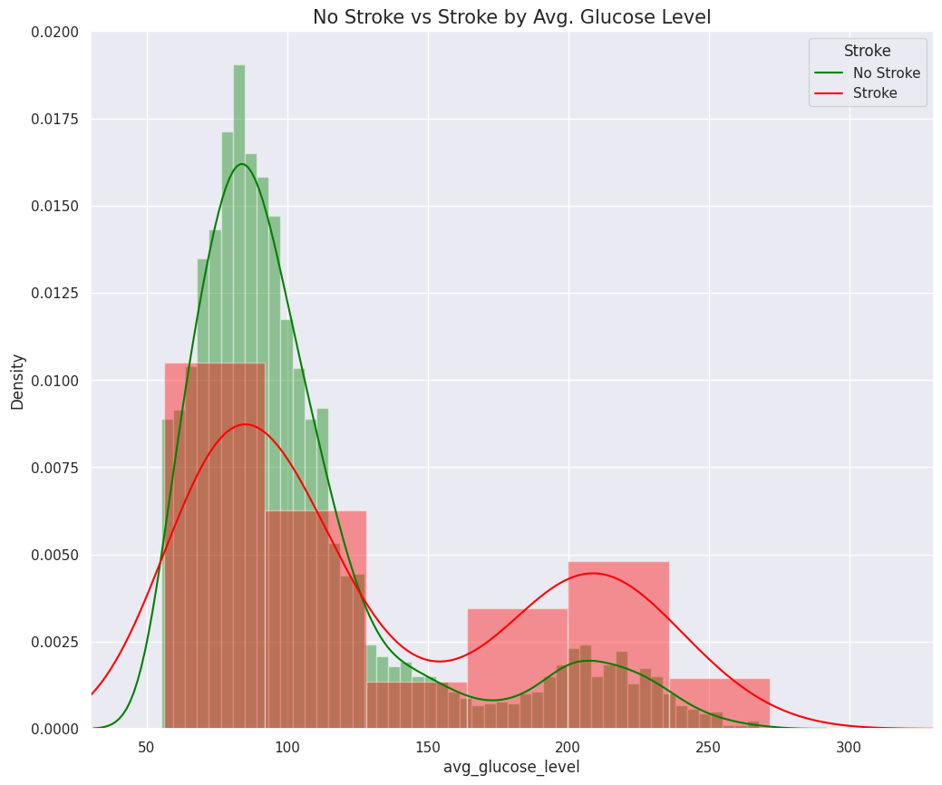
Variation of Stroke with Average Glucose Level
Observations:
The red curve, representing individuals who experienced a stroke, has a noticeable density increase around glucose levels of 150 and above, indicating that higher glucose levels are more associated with stroke cases.
The green curve, representing the "No Stroke" group, peaks around an average glucose level of 80-90. This suggests that individuals without strokes tend to have lower average glucose levels.

Slide 19
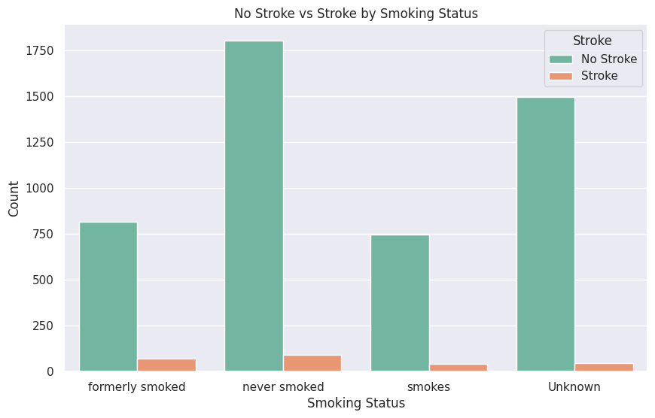
Variation of Stroke with Smoking Status
Observations:
Across all smoking statuses, the proportion of individuals with strokes (orange bars) is significantly lower compared to those without strokes (green bars). This highlights that smoking status alone may not explain stroke prevalence but still warrants attention.
The majority of individuals fall under the "never smoked" category for both stroke and no-stroke groups. However, even among "never smoked" individuals, strokes still occur, suggesting other factors like BMI, age, or comorbidities may play a role.

Slide 20
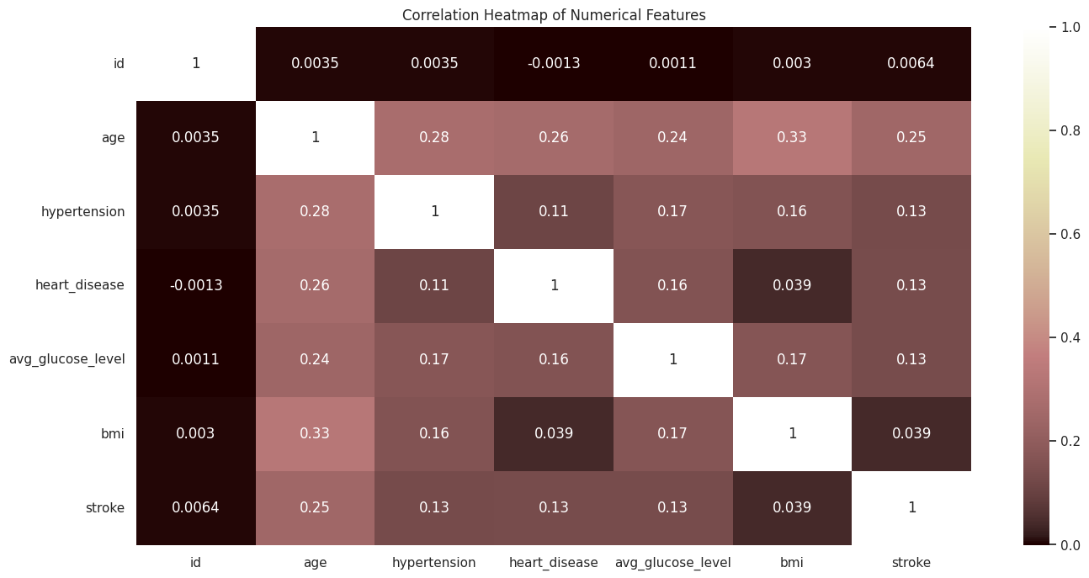
Correlation Heatmap
Observations:
Strongest Correlation: Age shows the highest positive correlation with stroke (0.25), suggesting that older individuals are more likely to experience strokes. This makes age a significant feature to consider in predictive models.
Weak Relationships with Stroke: Other features such as hypertension, heart disease, BMI, and average glucose level show weak correlations with stroke (all approximately 0.13). While these factors might contribute, their influence is less direct compared to age.

Slide 21
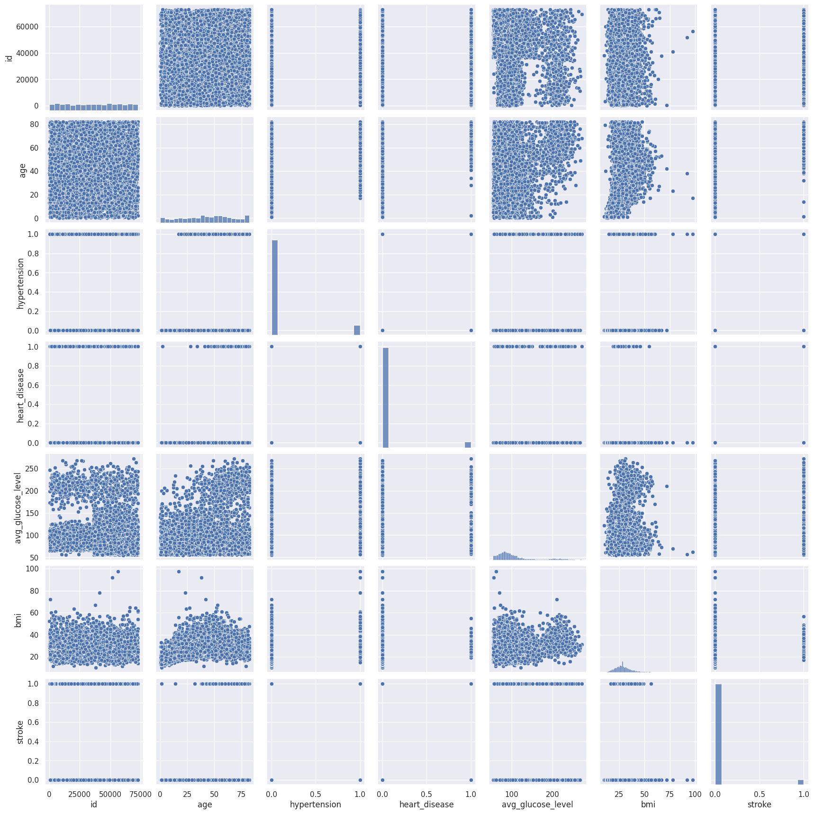
PairPlot
Observations:
Age vs. Stroke: There is a noticeable pattern where strokes are more common in older individuals.
Average Glucose Level vs. Stroke: Higher average glucose levels appear to correlate with a higher occurrence of strokes.
BMI vs. Stroke: it shows that the density of overweight people who suffered a stroke is more

Slide 22
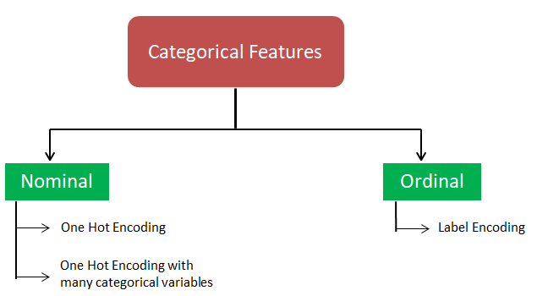
DATA PREPROCESSING
Feature Encoding
Feature encoding converts categorical data into numerical formats so that machine learning models can interpret and process them effectively.
In this dataset included categorical features such as gender, work_type, Residence_type ,ever_married and smoking_status
Benefits of Encoding
Improves model interpretability and performance.
Prevents models from misinterpreting ordinal relationships in categorical data.
Facilitates the use of algorithms that require numerical inputs.
Challenges and Limitations
Increased dimensionality with one-hot encoding for features with many categories (e.g.,work_type,smoking_status).
Potential risks of overfitting due to high-dimensional data.
Encoding may assign equal weight to all categories, which may not always align with feature importance.

Slide 23



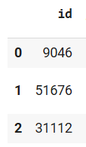
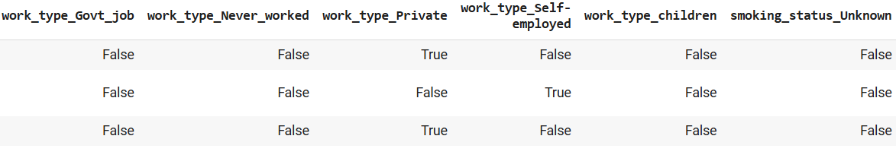
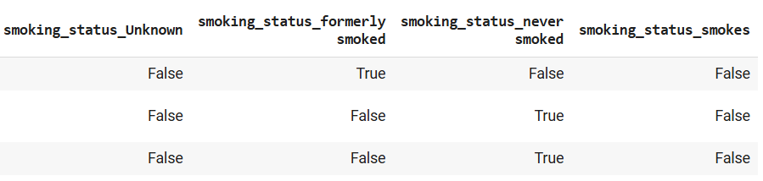
Before Encoding
For Identified categorical features like work_type and Smoking_status applied One-Hot Encoding
After Encoding

Slide 24
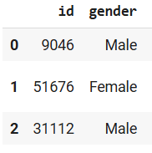
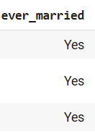
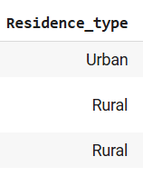
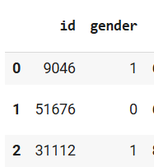
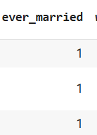
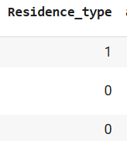
Before Encoding
Other categorical features such as gender, Residence_type , ever_married
Label Encoding is applied
After Encoding

Slide 25
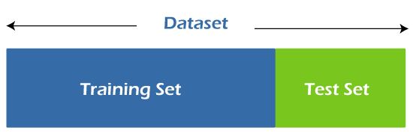
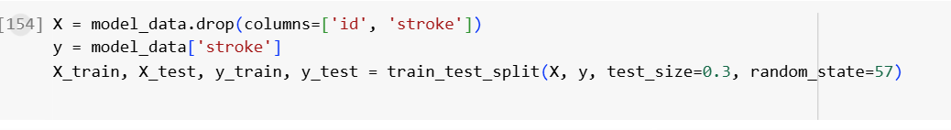
SPLITTING THE DATASET
To evaluate the model's ability to generalize to unseen data, we split the dataset into training and testing sets.
The training set is used to fit the model, while the testing set evaluates its performance on unseen data.
The dataset has been successfully split into training and testing sets, with 70% of the data allocated for training and 30% for testing.
The training set(X) will be used to train the machine learning model to learn patterns and relationships in the data. The testing set(Y) will be used to evaluate the model's performance on unseen data, ensuring its ability to generalize

Slide 26
MODEL TRAINING
Model training in machine learning is the process of building a mathematical representation of the relationship between data and a target label.
The goal is to create a model that can accurately predict outcomes and classify new data.
The models used for training are:
1. Linear Regression
2. Lasso Regression
3. Ridge Regression
4. Logistic Regression
5.RandomForest Classifier
Linear, Lasso, and Ridge Regression were included for evaluation but were found unsuitable for classification tasks.
Logistic Regression and Random Forest Classifier achieved high accuracy

Slide 27
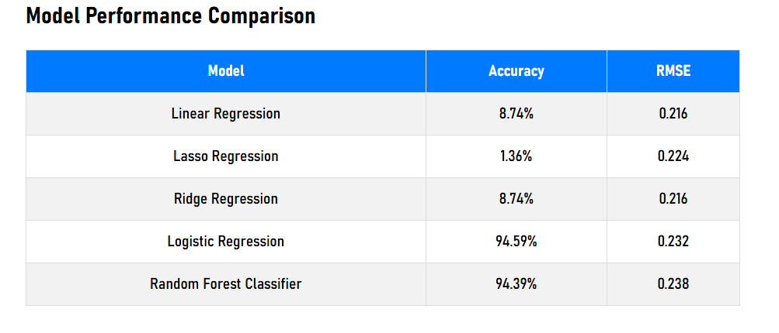
MODEL PERFORMANCE
Logistic Regression has the highest accuracy 94.59% in comparison with RandomForestClassifier with accuracy 94.39% implying that it classifies the data points correctly with the highest probability.

Slide 28
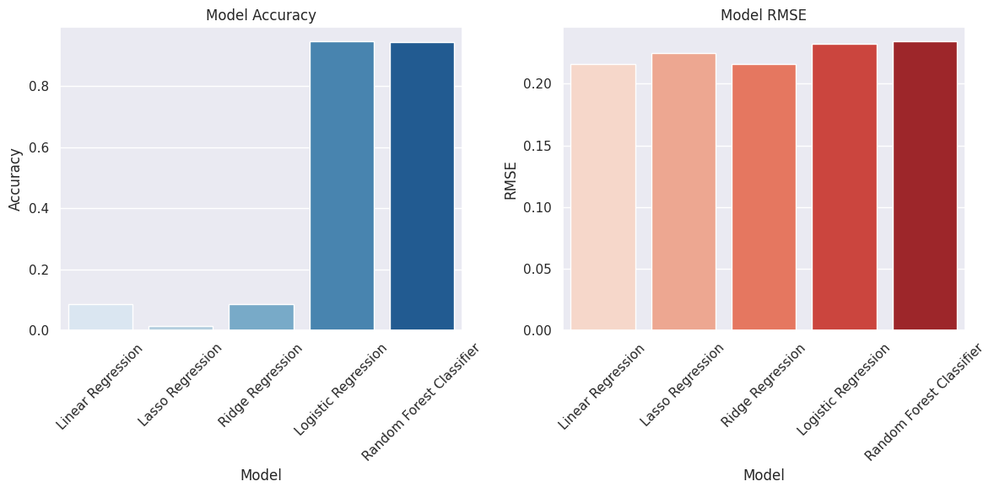

Slide 29
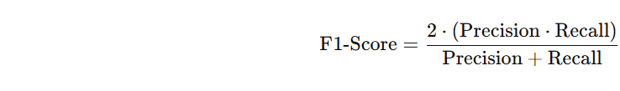
COMPARING EVALUATION METRICS FOR LOGISTIC REGRESSION
Precision is the proportion of correctly predicted positive cases (True Positives) out of all predicted positive cases.
Recall is the proportion of correctly predicted positive cases (True Positives) out of all actual positive cases..
F1-score is the harmonic mean of precision and recall. It provides a single metric to balance precision and recall.

Slide 30
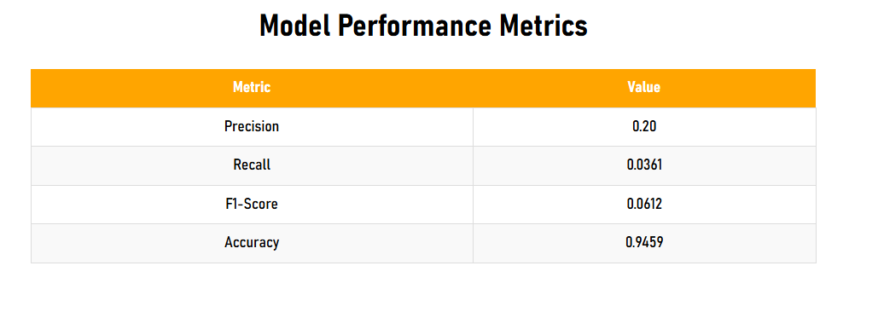
Observations:
Precision: 0.2-Out of the predicted strokes, only 20% are correct.
Recall: 0.0360-The model identifies only 3.6% of actual stroke cases.
F1-Score: 0.061-The low F1-score indicates poor overall performance due to the extremely low recall.
Accuracy: 0.946-High, but misleading due to class imbalance.

Slide 31
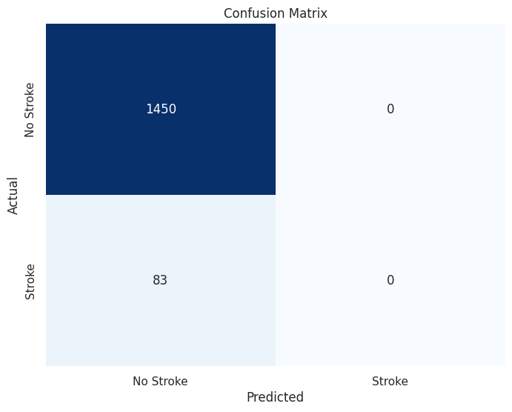
CONFUSION MATRIX
Observations:
True Negatives (TN): The model correctly predicted 1450 instances as "No Stroke," which means it performed well in identifying the majority class.
False Positives (FP): There are no instances where "No Stroke.“ being classified as “Stroke”
False Negatives (FN): The model missed 83 instances of "Stroke" and predicted them as "No Stroke." This is a significant number, highlighting a potential issue in identifying the minority class.
True Positives (TP): No instances of "Stroke" were correctly identified. This indicates a poor sensitivity (recall) for the "Stroke" class.

Slide 32
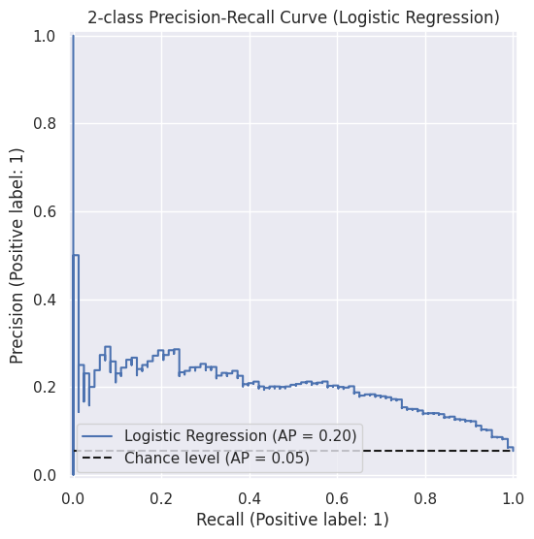
PRECISION RECALL CURVE
Observations:
Model Performance: The logistic regression model achieves an average precision (AP) of 0.20, which is slightly better than the chance level (AP = 0.05), but still indicates suboptimal performance.
Precision-Recall Trade-off: The PR curve shows that the model struggles to maintain high precision as recall increases, with precision remaining low across most recall values.
Class Imbalance or Weak Predictive Power: The curve's proximity to the baseline suggests the model may face challenges with class imbalance for predicting the positive class (label: 1).

Slide 33
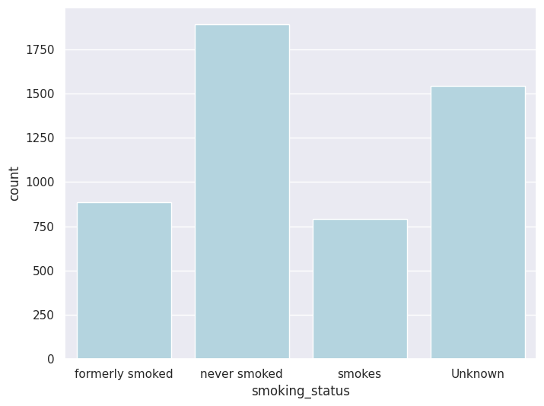
BIAS IN THE DATASET
Imbalance in Smoking and Health Indicators: Missing data for smoking status could also introduce biases.
Representation Bias: If certain demographic groups (e.g., gender) are under-represented, the model may become skewed to perform better for females.

Slide 34
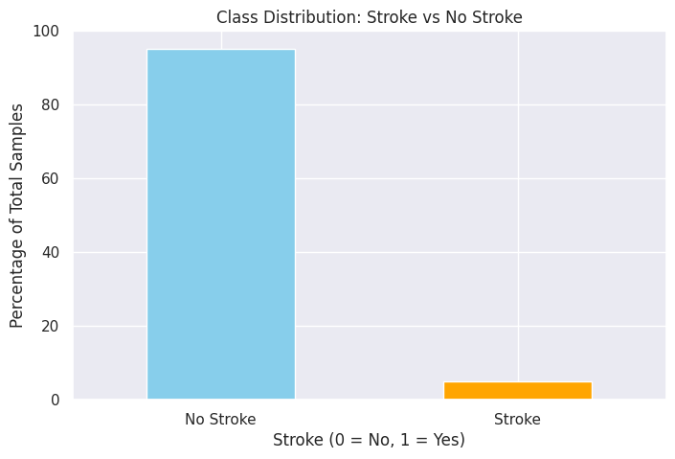
LIMITATIONS
Imbalance in Class Distribution
The target variable stroke is heavily imbalanced. A majority of the samples are labeled as "No Stroke," while only a small percentage corresponds to "Stroke.“
This imbalance biases models towards predicting the majority class, which reduces their ability to identify true stroke cases effectively.

Slide 35
OBSERVATIONS FROM THE PROJECT
Observations:
Class Imbalance: The dataset is heavily imbalanced, with only 5% of cases being strokes, which affects model sensitivity and recall.
Key Risk Factors: Age shows the strongest positive correlation with stroke occurrence, followed by average glucose level and BMI.
Model Performance: Logistic Regression achieved the highest accuracy (94.59%), but its low recall (3.6%) indicates poor detection of actual stroke cases.
Feature Relationships: Higher glucose levels and BMI are associated with increased stroke risk, while smoking, though relevant, is not the primary determinant.

Slide 36
THANK YOU

