Slide 1
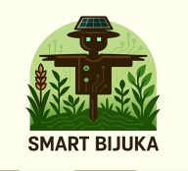
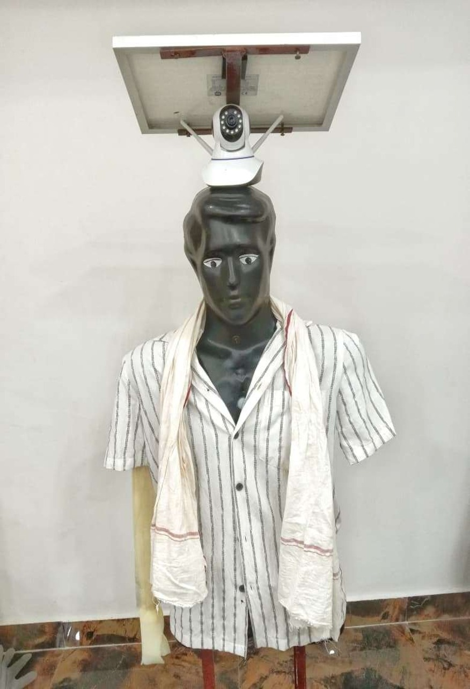
HACKCULT ’26 | GREEN ENERGY & SUSTAINABILITY
SMART BIJUKA
AI-Powered Crop Protection That Sees Before It Responds.
Detect → Decide → Deter → Record
A solar-powered scarecrow prototype that uses a camera and YOLOv8 object detection to tell supported animals from people, then triggers a selective audio and arm-movement response.
founder: Pravash Singh
Real prototype photograph
Notes:
Cover. Confirm founder name and that you are entering solo. Statuses: hardware parts are WORKING individually per the original deck; AI and software are IN PROGRESS. Update to match reality before submission.

Slide 2
Guarding fields is manual and alarms are blind
02 | THE PROBLEM
PROBLEM
LIMITATION
OPPORTUNITY
Animals enter fields and damage crops.
Today's tools do not look before they react.
Respond only when it matters.
Farmers respond by guarding by hand, often at night. That costs sleep and carries personal risk.
A static scarecrow stops working once animals get used to it. A generic motion alarm cannot tell an animal from a farmer or a worker.
Smart Bijuka aims to detect the object first, then trigger deterrence for supported animal classes and stay quiet for people.
Deepak Chand Meena and B.S. Meena, Sanchita Garai, H.R. Meena, Gopal Sankhala, Akshita Chadda, “Crop and Livestock Depredation by Wild Animals: The Case of Ranthambore Tiger Reserve, India”, Indian J Ext Edu, vol. 58, no. 4, pp. 38–41, Sept. 2022, Accessed: Oct. 27, 2026. [Online]. Available: https://epubs.icar.org.in/index.php/IJEE/article/view/128427
Notes:
Original figures (25%+ crop loss, 60% manual guarding, Rs 50,000+ electronic systems) were removed because no sources were supplied. Add a cited figure or delete the placeholder box.

Slide 3
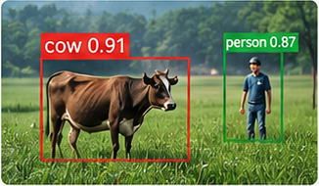
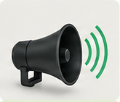
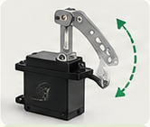
03 | THE SOLUTION
One system that detects, decides, deters and records
AI-assisted crop protection using vision, decision logic and a selective response.
01
DETECT
WORKING
02
DECIDE
WORKING
03
DETER
WORKING
04
RECORD
IN PROGRESS
Camera + YOLOv8
Class, threshold and decision logic
Audio and arm movement
Event log and optional alerts
Animal class?
No (human)
Recent events (example)
Detected object
No deterrence
Cow detected
Deterrence triggered
Human detected
No deterrence
Yes
No detection
Monitor
Trigger deterrence (if confidence ≥ threshold)
DFPlayer Mini + speaker
Servo motors
ILLUSTRATIVE
ILLUSTRATIVE
Camera captures frames in real time
YOLOv8 detects supported object classes
Outputs class and confidence score
Check class, confidence threshold and cooldown
Suppress deterrence for humans
Handle no-detection and error cases
Plays deterrent sound when triggered
Moves arms to create visual and motion scare
Response controlled by ESP32
Store detected events with timestamp
Optional mobile/email alerts (planned)
Dashboard for remote monitoring (planned)
What is Smart Bijuka?
  A smart, AI-powered digital scarecrow.
  Works using sensors, sounds, and movement.
Why was it created?
  To help farmers protect their crops without manual effort.
  To replace traditional scarecrows with a smarter solution.
3. How does it help?
  Detects birds/animals and reacts immediately.
  Uses sound and arm movement to scare intruders.
  Send real-time alerts.
  Watch live streaming at home.
4. Goal:
  Make farming easier, safer, and more productive for small and medium-scale farmers
Notes:
Editable slide. The cow/person detection image and the event-log panel are illustrative, labelled as such. Replace with a real screenshot once you have one.

Slide 4
A modular, AI-assisted crop protection system
04 | PROTOTYPE OVERVIEW
1
WORKING
2
WORKING
3
WORKING
Intrusion Sensing
AI-Based Decision Support
Selective Deterrence
PIR sensor detects motion and triggers the monitoring workflow.
Camera captures field imagery for visual analysis.
YOLOv8 processes images on a connected AI host.
Detected classes and confidence scores inform the response decision.
ESP32-based control is designed to trigger servo-driven arm movement.
DFPlayer Mini and speaker provide a pre-recorded deterrent voice for supported animal detections.
Human detections should not trigger deterrence.
4
WORKING
5
WORKING
PROTOTYPE STATUS
Monitoring & Alerts
Power System
Individual components have been tested; complete end-to-end integration and field validation remain in progress.
Planned event history and remote notifications through an IoT interface.
Live monitoring and device status depend on completed integration.
Solar panel, battery and voltage regulation are part of the intended power architecture.
Continuous overnight runtime remains to be validated.

Slide 5
The prototype: what is built and visible today
05 | THE PROTOTYPE
Solar panel
WORKING
Inside the enclosure (Back Side)
Mounted above the camera. Rating to confirm.
Camera
WORKING
PIR sensor
WORKING
Mounted. Frame feed to the AI is in progress.
DFPlayer Mini + speaker
WORKING
Servo motors
WORKING
ESP32 controller
WORKING
Body and arms
WORKING
Structure stands. Servo moves the arm.
12 V battery
WORKING
LM2596 regulator
WORKING
Waterproof enclosure
WORKING
Parts are tested one by one. Running them together end to end is the next step.
Notes:
Real photo from the original deck. The camera in the photo looks like a dome IP camera; your component list says ESP32-CAM. Confirm which camera is actually used and relabel. Add close-up photos of the enclosure if you have them.

Slide 6
From field images to class-based decisions
06 | AI & INTELLIGENCE LAYER
AI
AI Model
SELECTIVE RESPONSE POLICY
YOLOv8 object detection.
Class labels and confidence scores from model inference.
Supported classes depend on the loaded model.
DETERRENCE ON
NO RESPONSE
NO RESPONSE
Supported animal
Human
Low confidence or unsupported
Request deterrent audio and arm movement.
No deterrent response.
No automatic deterrence.
PROCESSING PIPELINE
1
2
3
4
5
Capture an image from the selected camera.
Run inference on the connected AI processing host.
Display bounding boxes, class names and confidence scores.
Apply class filtering, confidence threshold and cooldown rules.
Send an authorized response command to the controller.
87%
Current evidence: A sample cow image has displayed a detection with an 87% confidence score. This is a single-image demonstration, not a measurement of overall model accuracy.
NEXT MILESTONE
Validate supported animal classes and integrate the complete camera-to-controller pipeline.
SAMPLE COW IMAGE

Slide 7


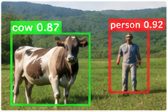














08 | ARCHITECTURE DETAIL
Goal
Smart Bijuka: System Architecture
Detect field intruders, respond selectively and record events using a reliable, low-cost, solar-assisted system.
Three layers, one data path
A
DEVICE AND HARDWARE LAYER
B
AI AND DECISION LAYER
C
SOFTWARE AND DATA LAYER
Field unit: senses and acts
Vision and logic: detects and decides
User interface: records and alerts
Camera
Image frames (Wi-Fi)
YOLOv8 Inference
FastAPI (REST API)
IN PROGRESS
(ESP32-CAM)
(on laptop / edge device)
WORKING
Receive events from device
Store in database
Provide data to dashboard
class + confidence
PIR sensor
GPIO
Frame from camera (illustrative)
WORKING
Event data (REST, planned)
(Motion trigger)
PostgreSQL Database
IN PROGRESS
WORKING
Detected class + confidence (e.g. cow: 0.87)
Store event logs (image path, class, time, location)
Device status and settings
Servo motor
PWM
ESP32 Controller
Decision Logic
(Arm movement)
WORKING
WORKING
Check supported class (animal)
Confidence threshold (e.g. ≥ 0.6)
Cooldown timer
Ignore humans and low confidence
Handle no-detection and errors
Web Dashboard
PLANNED
WORKING
Speaker
Serial (UART)
View live feed (optional)
Event history with images
Device status and configuration
(DFPlayer Mini)
WORKING
WORKING
Power (5 V / 12 V)
Human / No detection / Low confidence
Animal detected (sufficient confidence)
Farmer Alerts
PLANNED
Mobile / email notifications
Configurable alerts
Solar panel (~10-20 W)
Charge controller (LM2596)
12 V battery
No deterrence. Continue monitoring
Send command to ESP32 (audio and/or servo)
Arrow meaning:
Image / data flow
Control command
Sensor signal
Planned / optional
Status:
WORKING
IN PROGRESS
PLANNED
Notes:
Editable slide. Architecture shows planned and unverified parts with dashed borders. The camera frame is illustrative. Confirm camera type (ESP32-CAM vs the dome camera in your photo) and where inference runs.

Slide 8
Smarter decisions. Selective deterrence. Sustainable design
09 | KEY FEATURES & INNOVATION
1
AI-Based Animal Detection
2
Human-Aware Response Logic
3
Audio & Motion Deterrence
YOLOv8 identifies supported object classes and displays bounding boxes with confidence scores.
Designed to activate deterrence for supported animal detections while keeping the response inactive for human detections.
A pre-recorded voice and servo-driven arm movement provide configurable deterrent responses.
4
Dual Detection Modes
5
Modular IoT Architecture
6
Solar-Compatible Design
Upload an image from the device for analysis.
Use a laptop camera for live detection.
Designed for future event logging, device monitoring and remote notifications.
Solar charging and battery operation are part of the intended field deployment architecture; power autonomy is yet to be measured.
WHAT MAKES SMART BIJUKA DIFFERENT?
It combines visual classification with a class-dependent response policy instead of relying solely on a static scarecrow or a generic motion alarm.
DEVELOPMENT FOCUS
Reliable detection, safe selective response, low-power operation and field validation.

Slide 9
From a traditional scarecrow to intelligent crop protection
12 | CONCLUSION
Smart Bijuka is a student-built prototype exploring how AI-based visual detection, selective deterrence and renewable-energy-compatible hardware can support crop protection.
√
What has been demonstrated
→
What comes next
A physical Smart Bijuka prototype.
Individual hardware component tests.
A software interface demonstrating sample animal detection and bounding-box visualisation.
Complete camera-to-AI-to-ESP32 integration.
Verify that animal detections trigger the intended response and human detections trigger none.
Measure detection quality, response latency and hardware reliability.
Test power consumption, battery runtime and field suitability.
Gather feedback through controlled testing with agricultural stakeholders.
+
We are seeking
Mentorship in computer vision and agri-tech.
Access to a controlled field-testing site.
Feedback from farmers and agricultural experts.
OUR GOAL
Develop a practical, testable and sustainable approach to reducing crop damage, rather than claiming field effectiveness before it is measured.

Slide 10
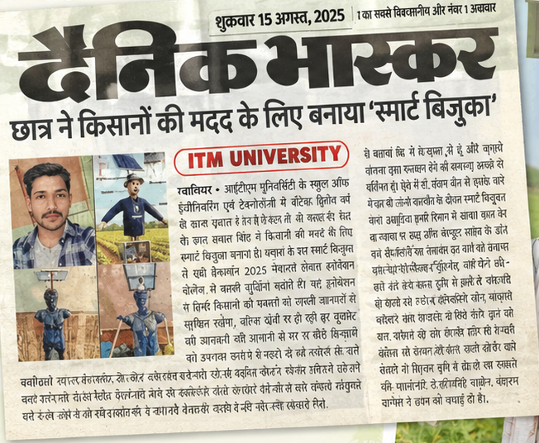



SMART BIJUKA | HACKCULT ’26
From a static scarecrow to intelligent, selective crop protection.
A student-built, AI-assisted solution inspired by a real farming problem and now recognized by local media.
Actual prototype
Featured in Dainik Bhaskar, 15 August 2025, Gwalior
Pravash Singh
Pravashs775@gmail.com
GitHub: []
Demo: []
Notes:
Editable slide. Add the real GitHub repo URL and unlisted YouTube URL, then replace the two dashed QR placeholders with real QR codes generated from those URLs. Swap the newspaper picture for your actual scan of the Dainik Bhaskar feature.

