Slide 1

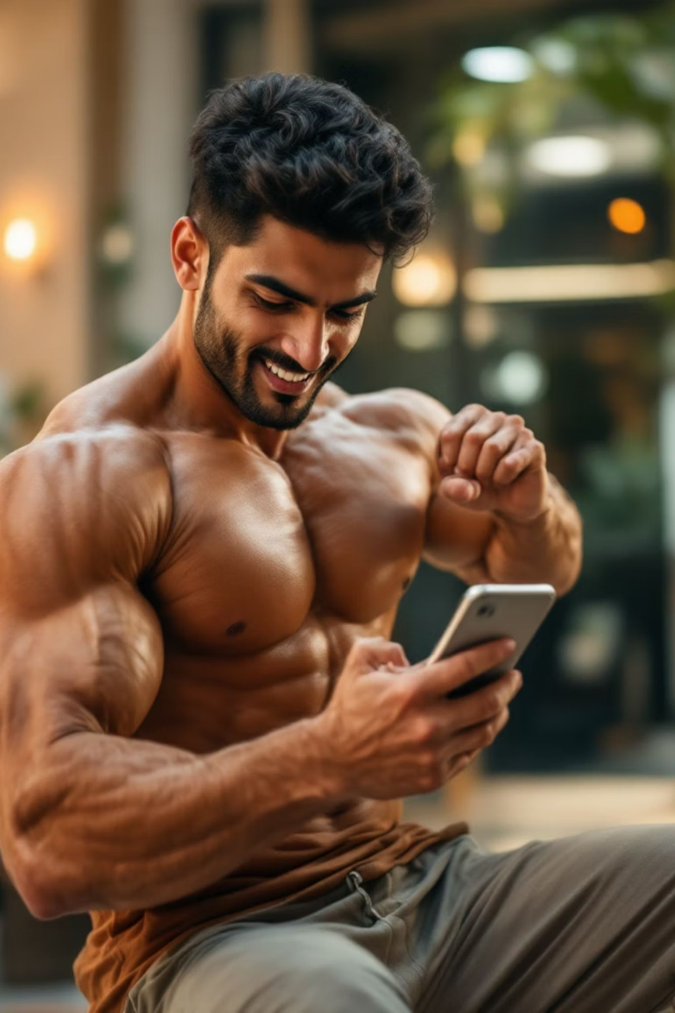
BFF
(BACHELORS FITNESS AND FOOD)
Case study:
Fitness for urban Indian bachelors.

Slide 2
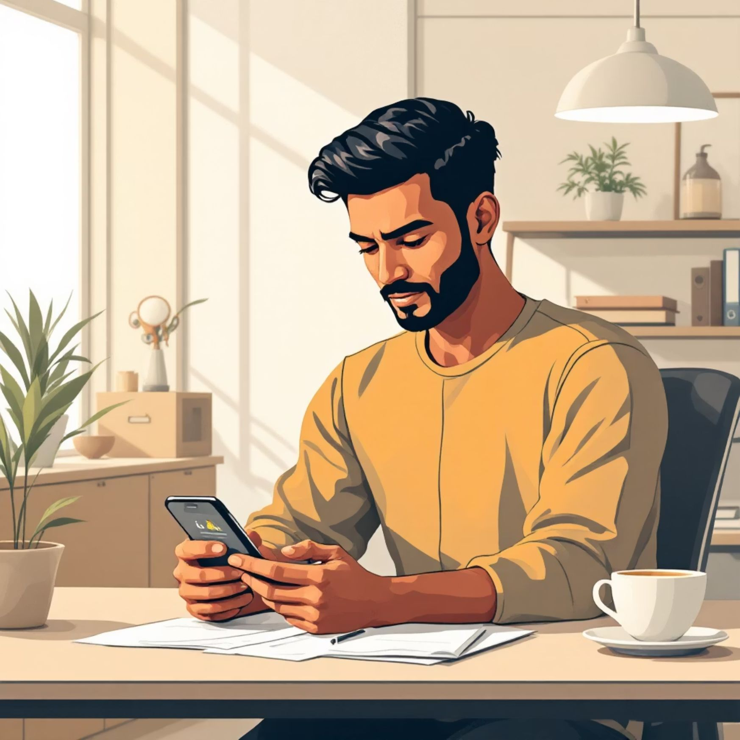



Project Overview: Why BFF?
FitLife addresses health challenges for
urban Indian bachelors.
Simplifies fitness & nutrition with
personalized guidance.
Integrated Approach
Market Opportunity
User-Centric Design
Workouts, meal tracking, motivation.
Taps India's 20% CAGR digital fitness boom.
Convenient health for busy bachelors.

Slide 3





Problem & Solution
The Problem
Busy bachelors lack time, motivation, & guidance for fitness.
Current Gaps
Fragmented apps; limited Indian relevance.
FitLife Solution
Integrated platform: tailored workouts, Indian cuisine, & progress tracking.
Differentiation
Motivates through progress, cultural content, & easy routines.

Slide 4
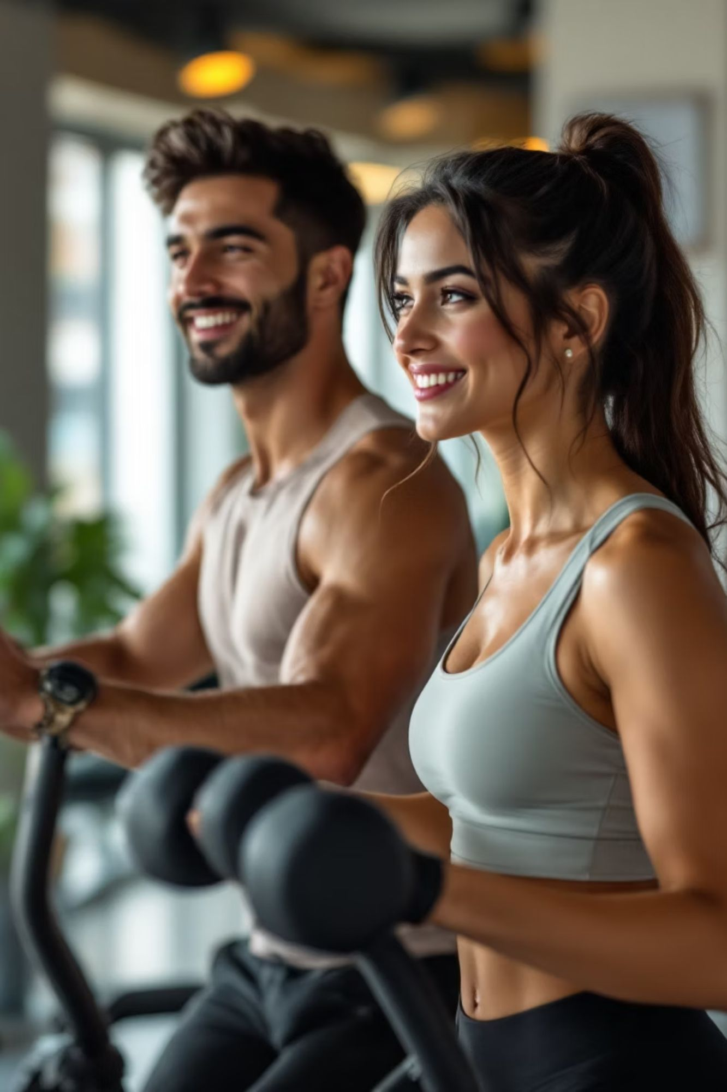
Target Audience
Demographics
Urban Indian bachelors (22-35), tech-savvy & busy.
Fitness Level
Beginner/intermediate, seeking sustainable habits.
Motivations
Boost confidence, energy, and long-term wellness.
Values
Culturally relevant content & authentic Indian food.

Slide 5

Design Process & Empathy Mapping
User research with 25+ bachelors revealed key fitness challenges and aspirations.
Says
"Quick, effective workouts & easy meal tracking."
Does
Juggles apps, struggles with consistency.
Thinks
"Fitness feels complicated. Needs one simple app."
Feels
Overwhelmed by info, guilty, but hopeful.
Iterative design focused on simplicity, motivation, and cultural relevance.

Slide 6
Ideation: User Flow & Architecture
01
02
03
Onboarding
Personalised Dashboard
Workout Module
Collect goals, experience, dietary preferences.
Display daily calories, workout, progress, and tips.
Select routine, watch videos, track progress.
04
05
Nutrition Tracking
Progress Visualisation
Log meals (Indian food DB), get calorie/macro summary.
View graphs, photos, earn badges.
Technical Architecture
Modular microservices for scalability. Secure cloud storage for data protection. API-first for future integrations.

Slide 7
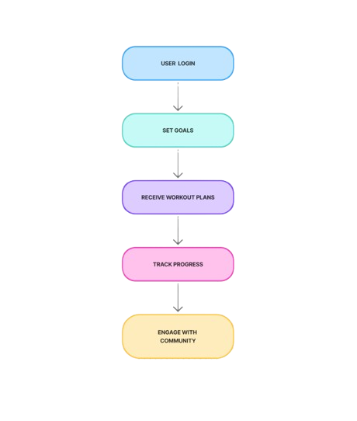
USER FLOW CHART

Slide 8
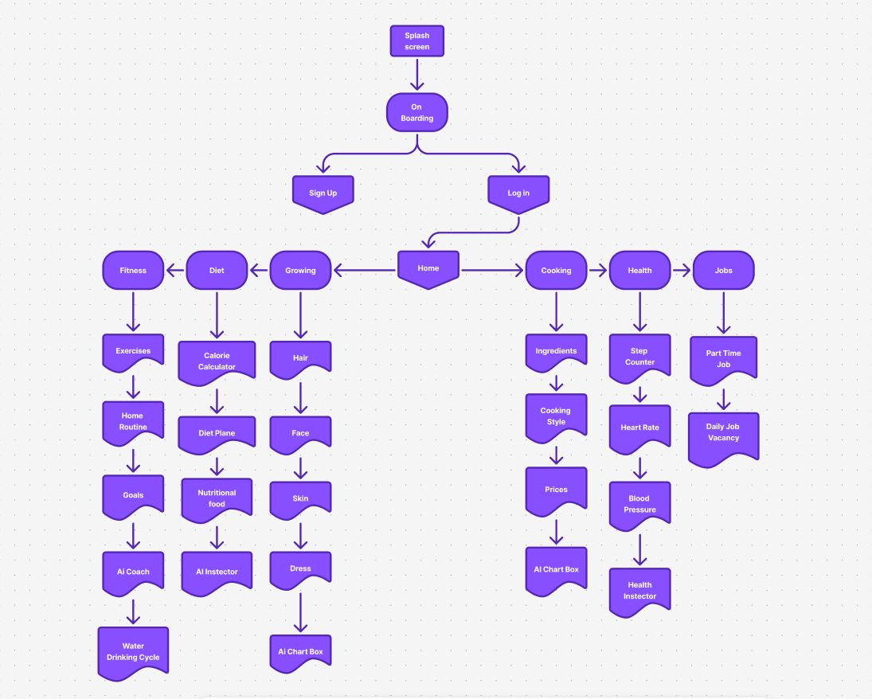
USERFLOW ARCHITECTUR

Slide 9
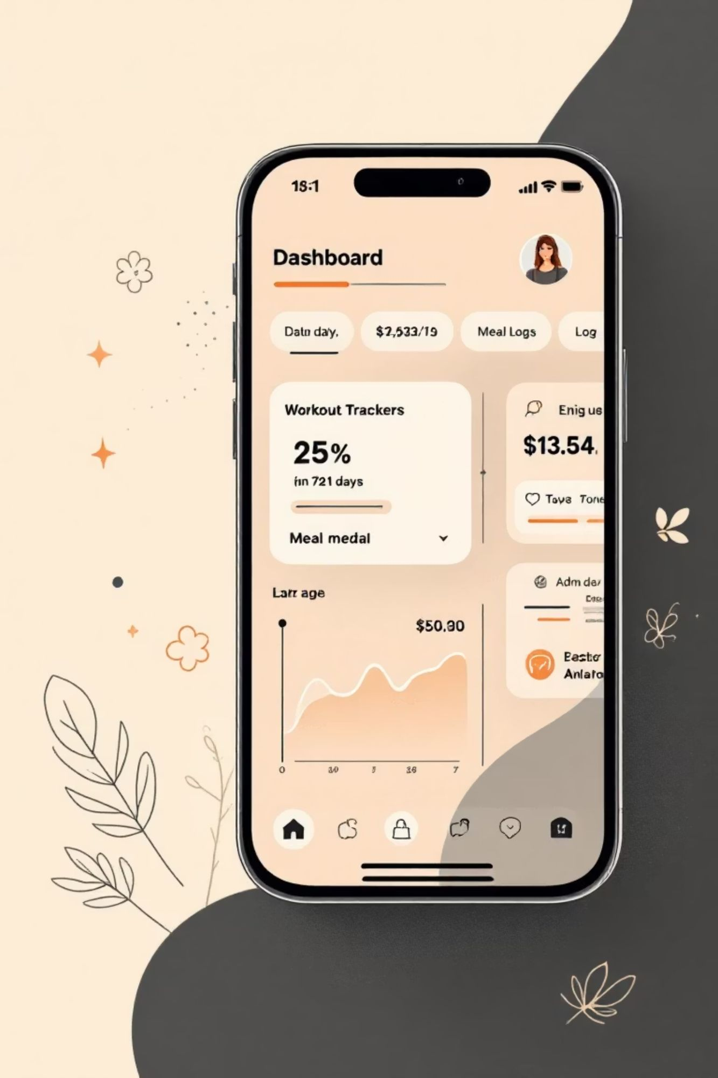
Low-Fidelity Wireframes: Shaping the User Journey
Wireframes visualizedBFF's core structure and user flows, enabling rapid iteration.
Defined layouts for key features like personalized workouts and the Indian cuisine database.
Emphasis remained on functionality and usability.

Slide 10
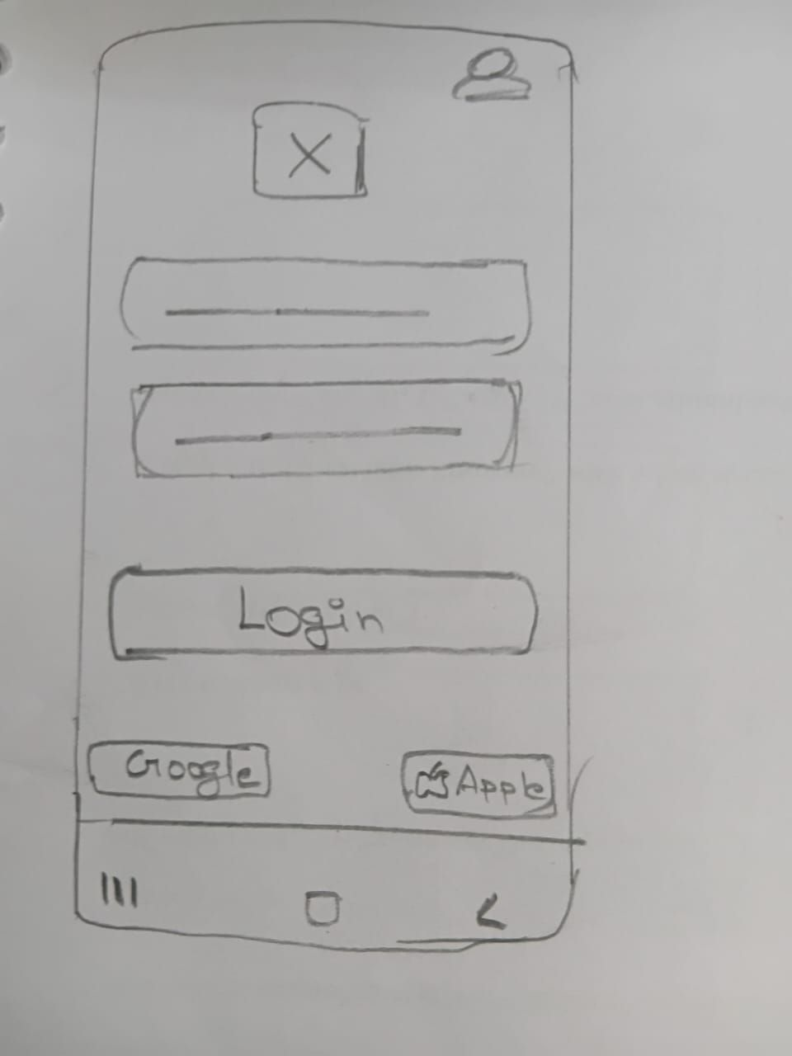
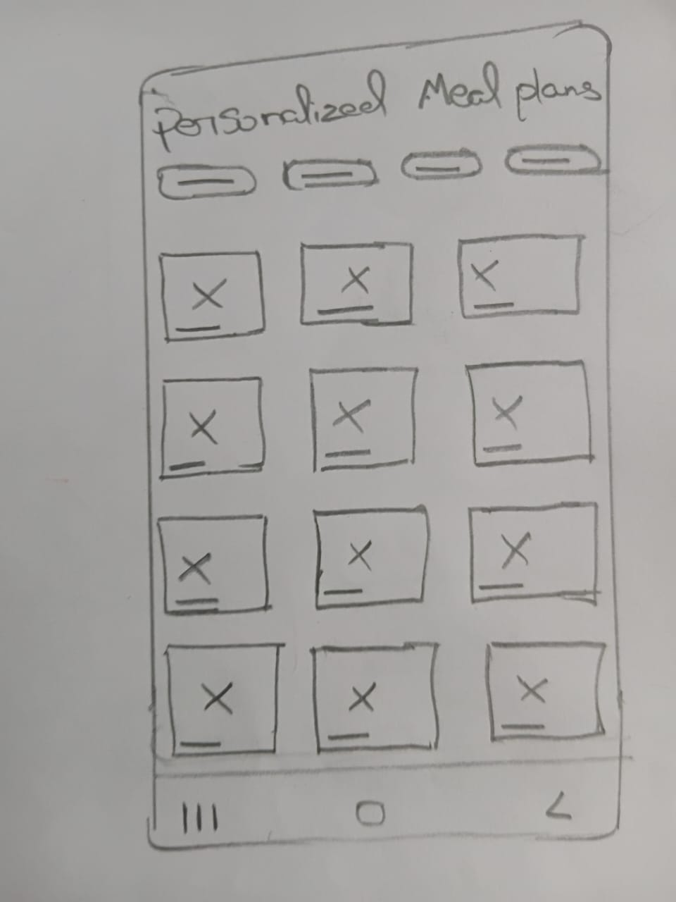
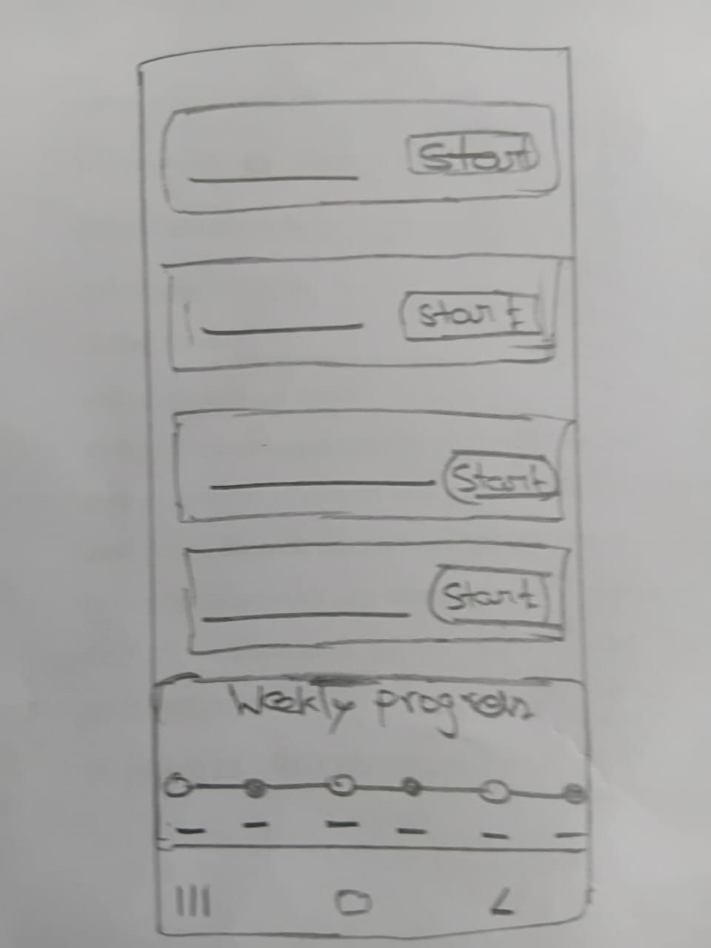
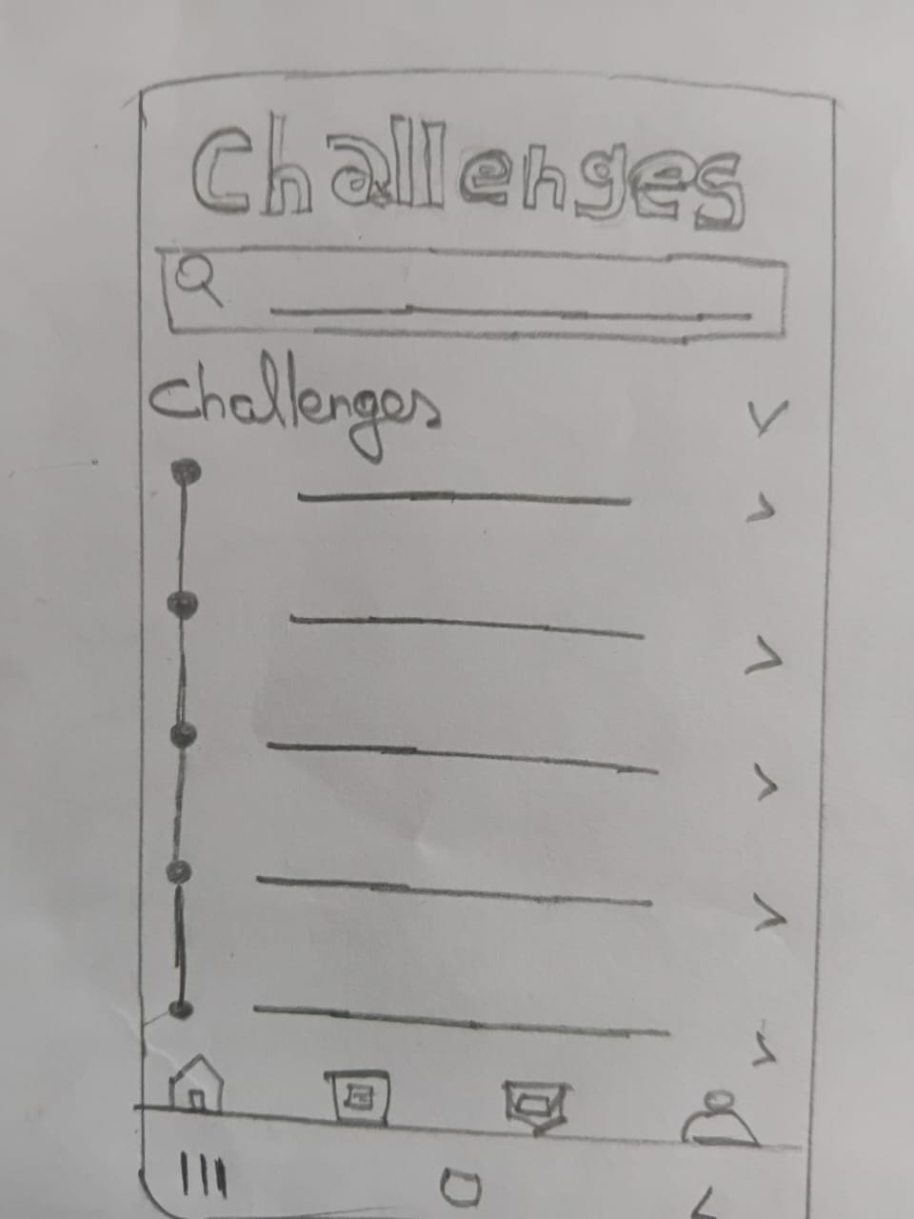
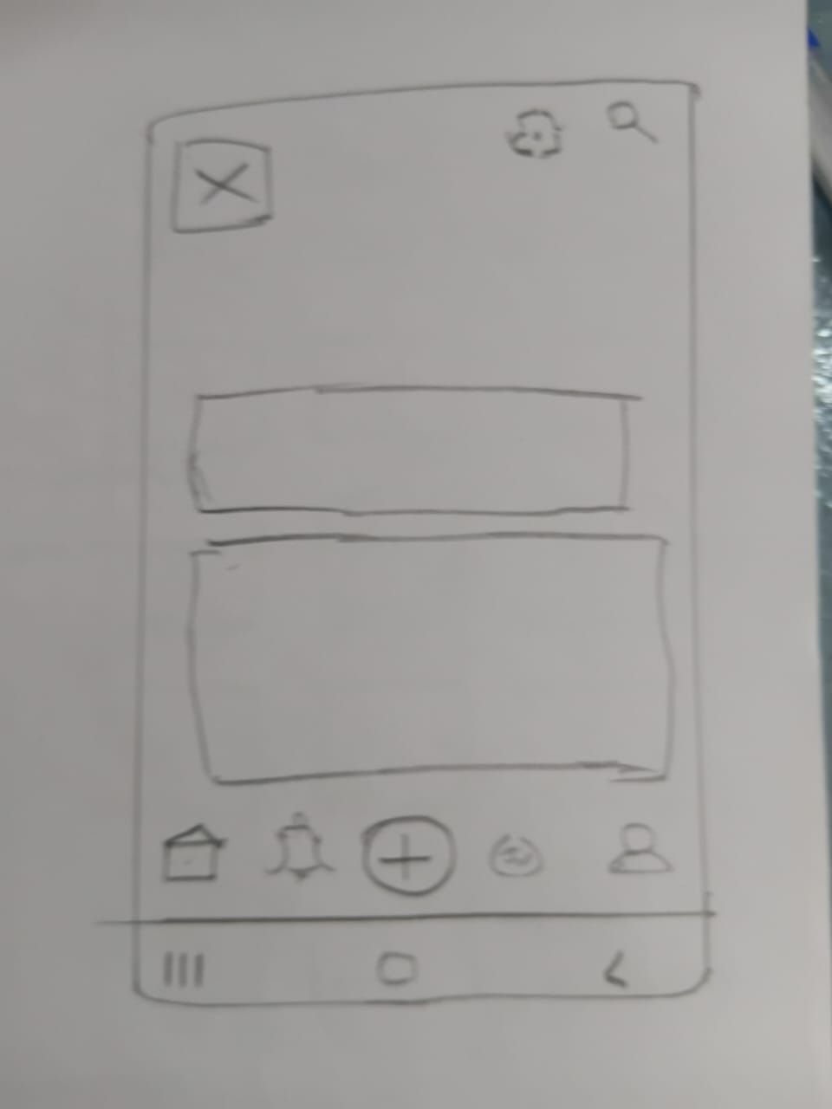
Low – Fidelity Wireframes : shaping The user

Slide 11
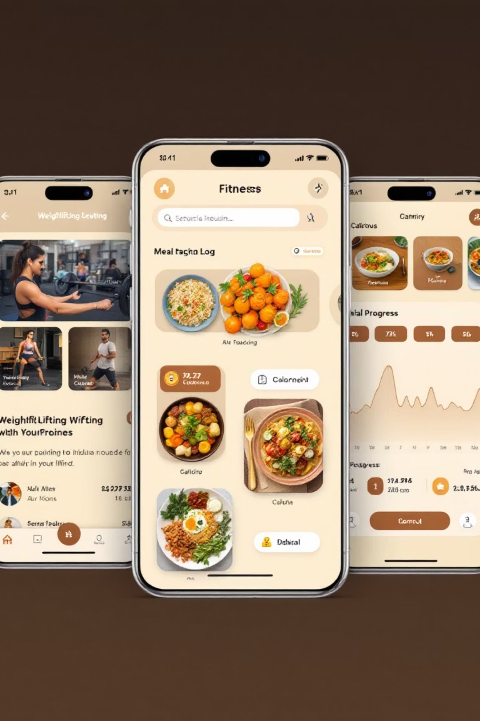
Mid-Fidelity Prototypes: Refining UX
Detailed Wireframes
Interactive designs from low-fidelity.
Refined User Flows
Clear interaction patterns for core features.
Content Hierarchy
Structured for enhanced usability.
Core Functionality
Essential functions tested pre-visuals.

Slide 12
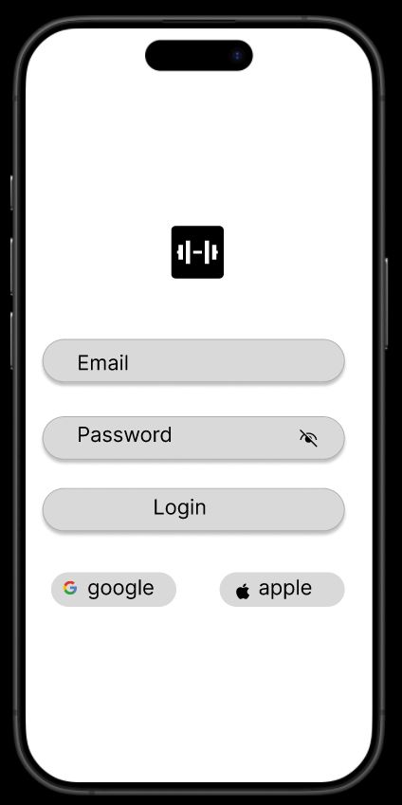
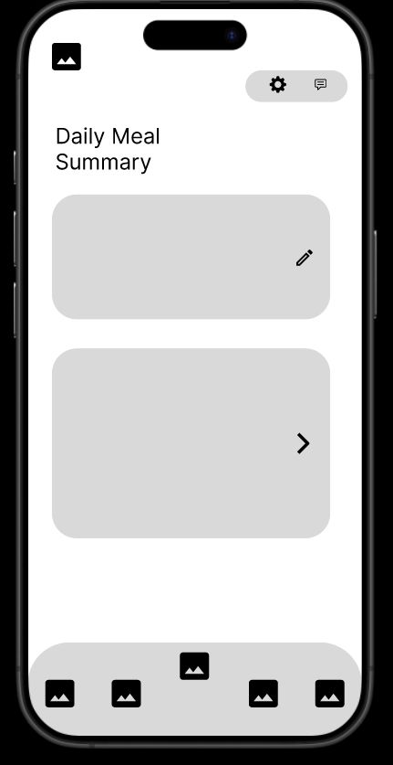
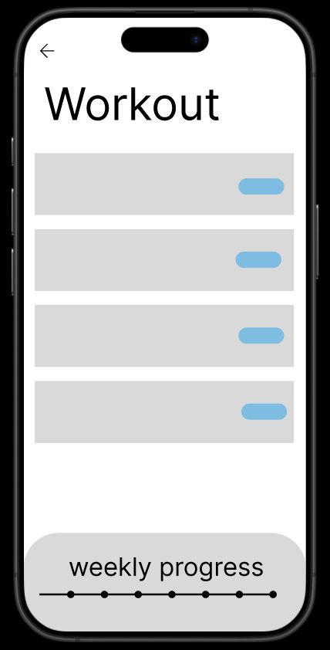
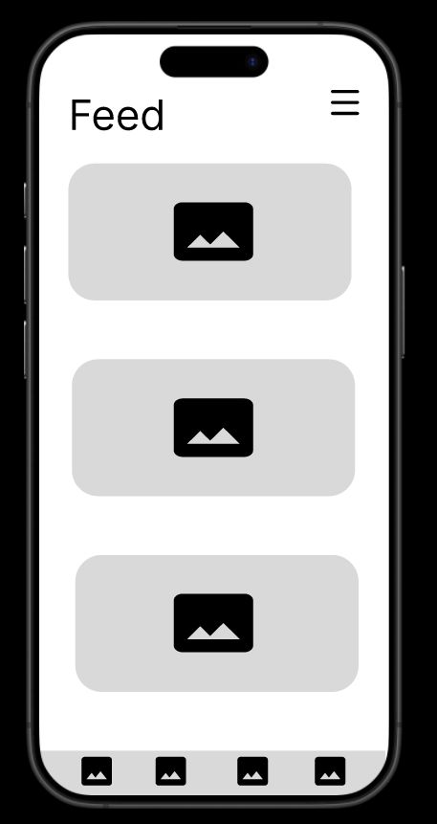
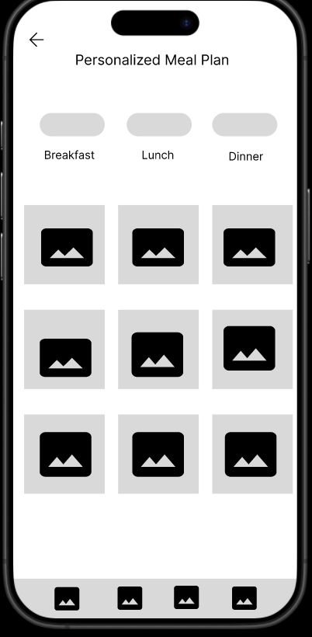

Slide 13
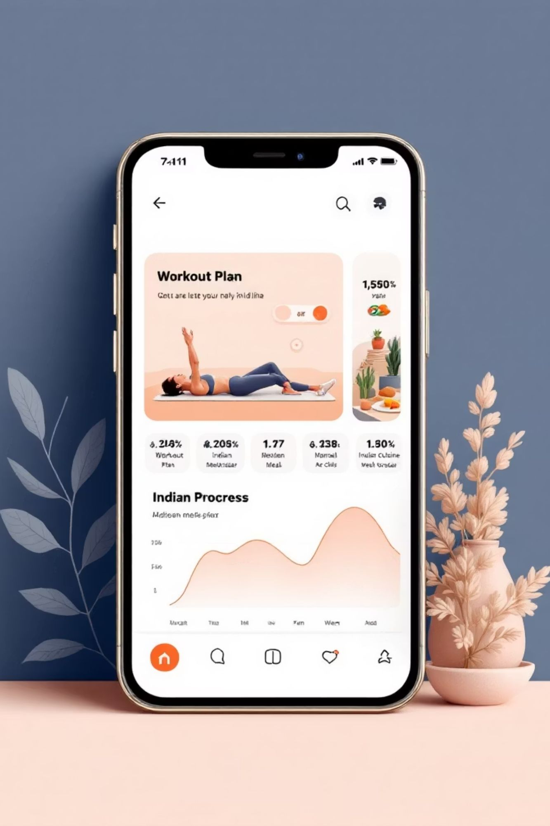
High-Fidelity Prototypes: Finalizing BFF's UX
High-fidelity prototypes integrated refined UI, visual polish, and branding, validated through user testing to finalize the experience.
Refined UI Design
Visual & Brand Polish
Seamless navigation and interactive components.
Culturally relevant aesthetics with brand identity.
User Validation
Testing confirmed ease of use and high engagement.

Slide 14
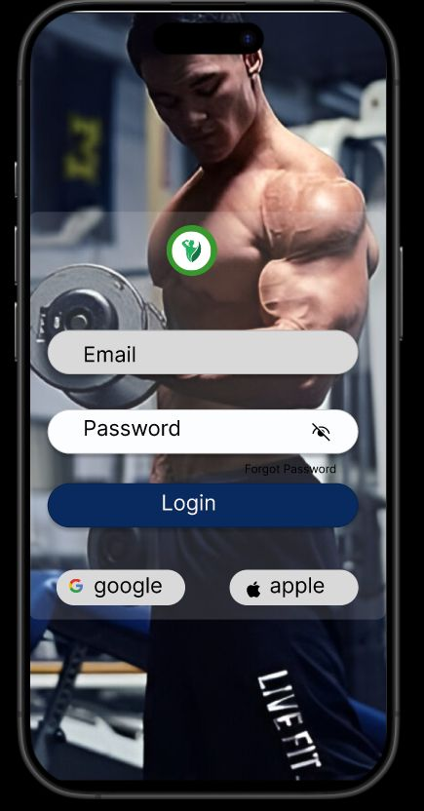
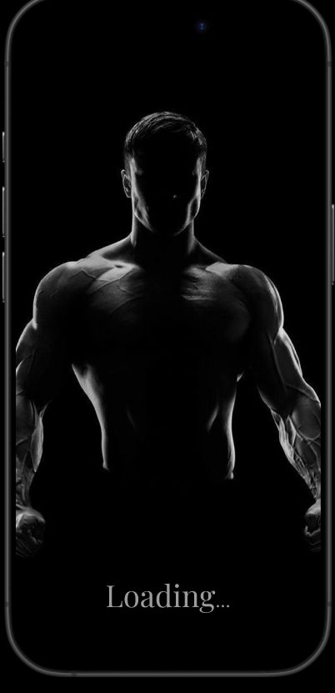
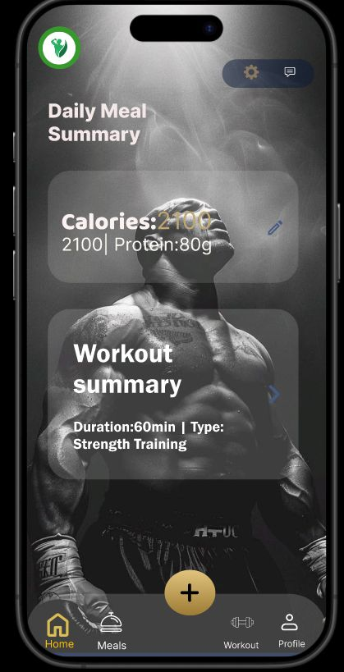
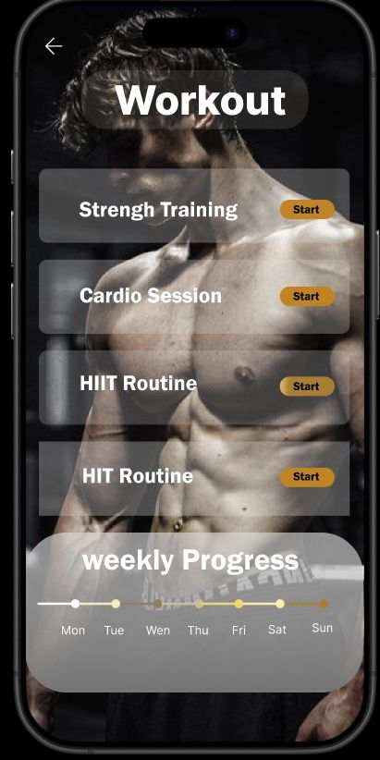
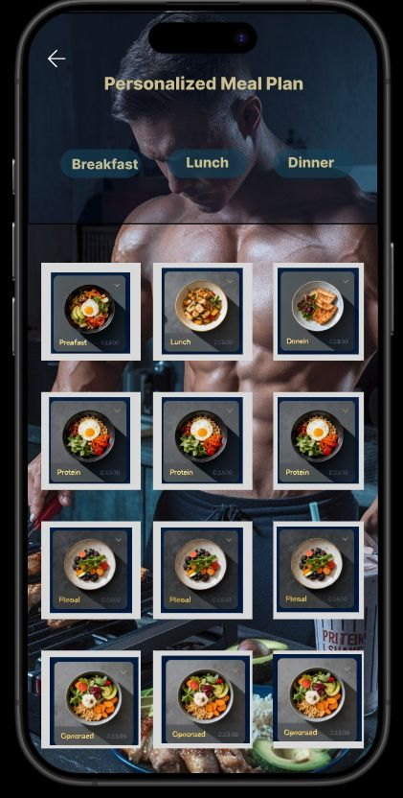
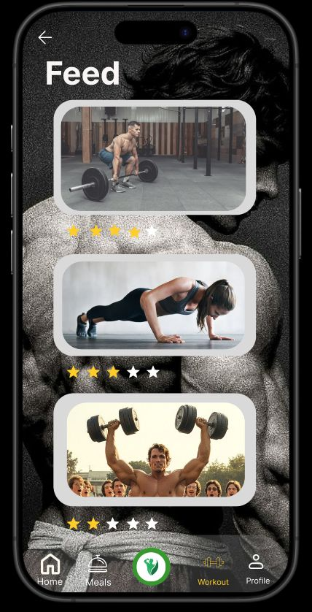
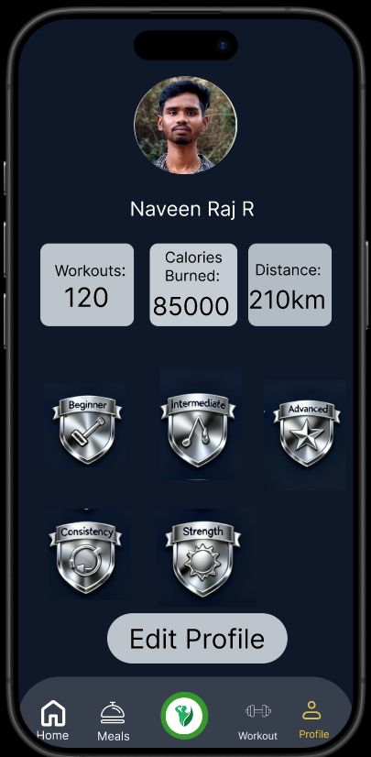

Slide 15
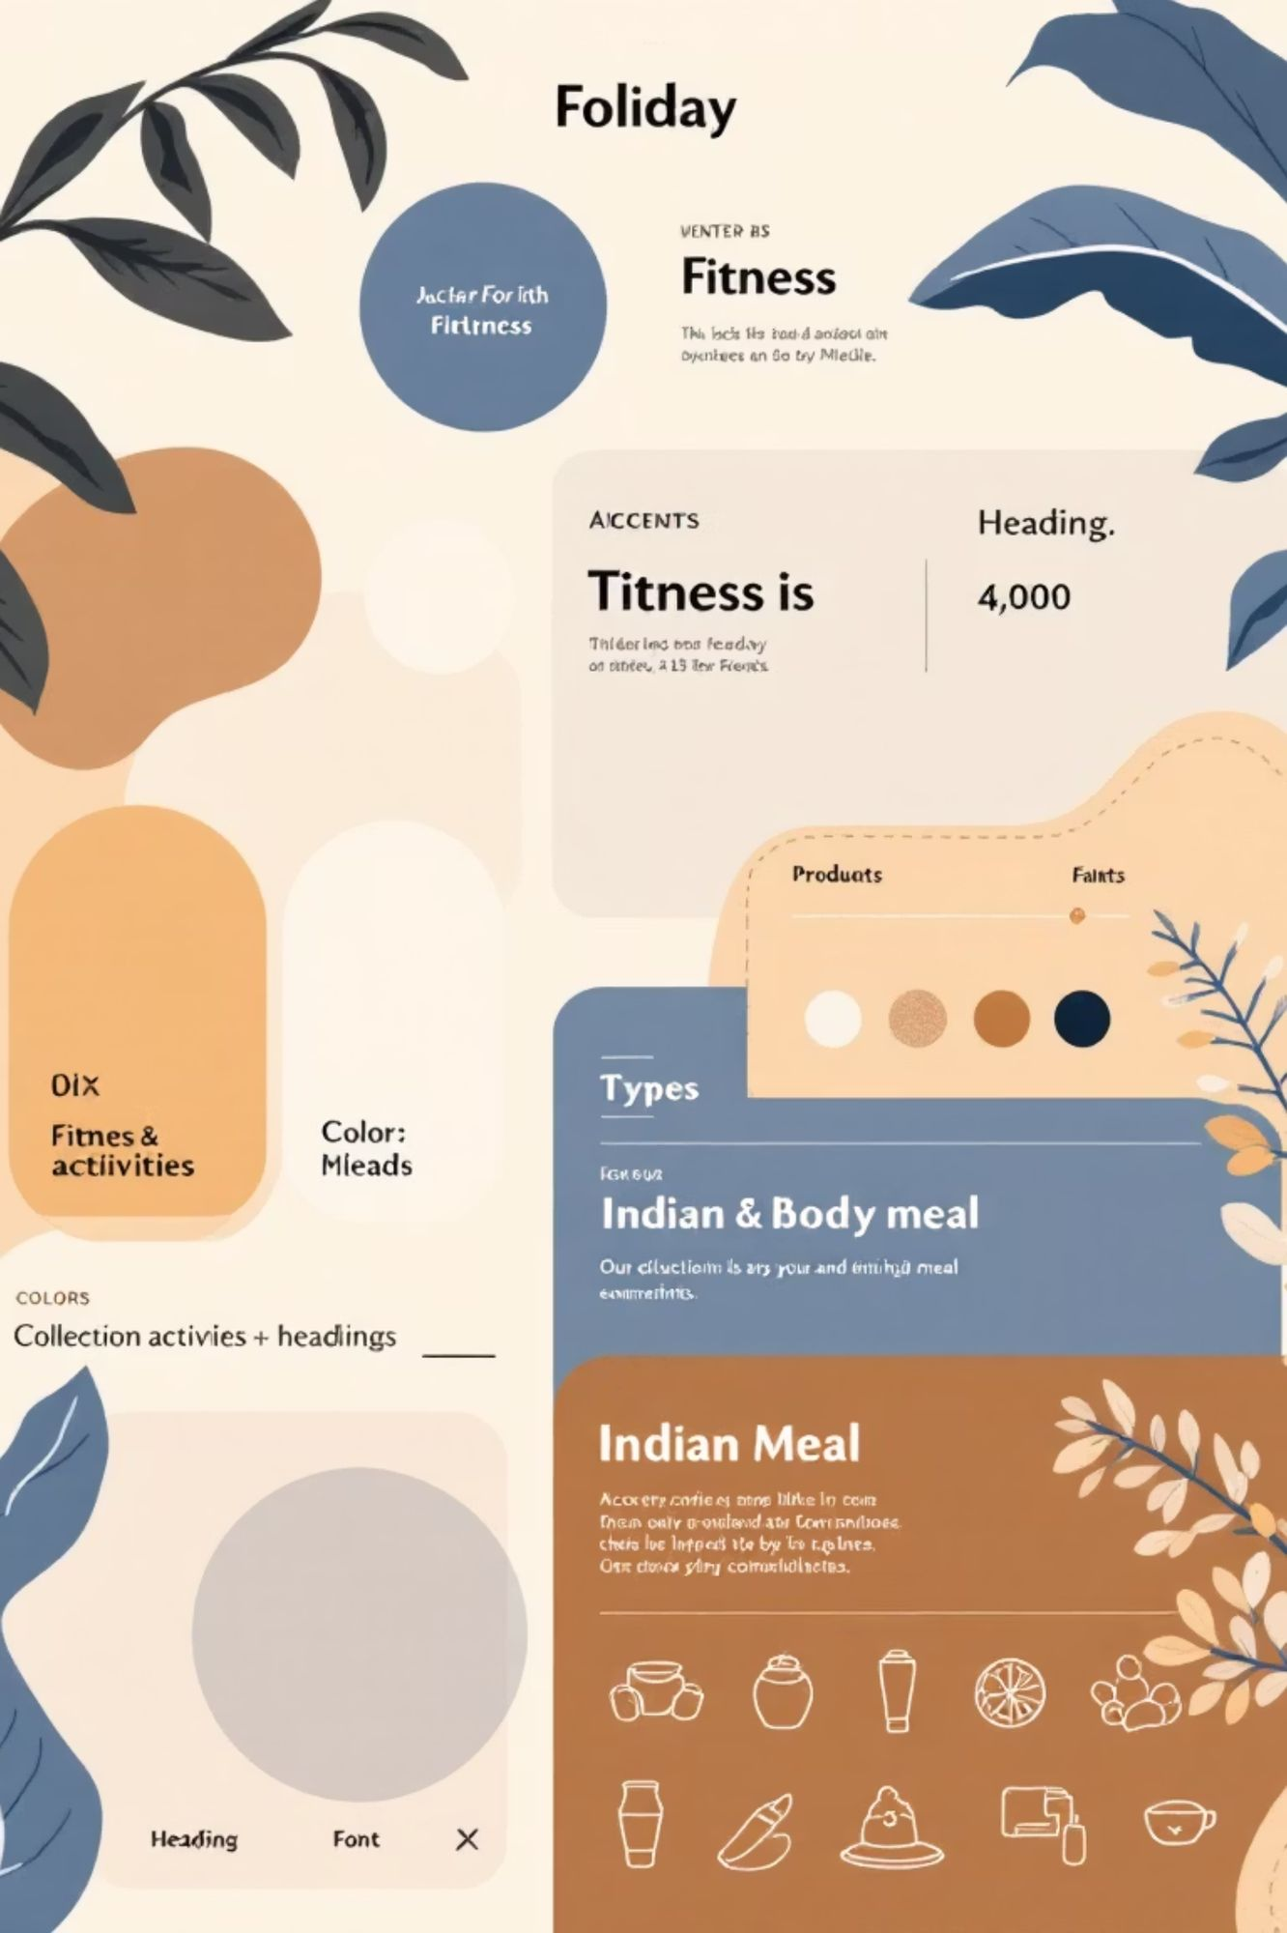
UI Design System:BFF's Visual Language
FitLife's UI Design System ensures visual consistency and culturally resonant experiences.
Color Palette
Vibrant blues and Indian accents for trust and cultural warmth.
Typography
Modern, sans-serif typefaces for mobile readability and clear hierarchy.
Iconography
Clean icons blend fitness symbols with subtle cultural elements.
Design Principles
Clean layouts, intuitive navigation, and encouraging feedback for progress.

Slide 16

Color Palette: BFF's Visual Foundation
FitLife's palette: modern, energetic, culturally resonant. Guides users with clear visual cues, enhancing usability and brand identity.
Primary
1
#1E3A8A, #3B82F6, #60A5FA. For core interactive elements, navigation, and brand identity.
2
Accent
#F97316, #EA580C, #DC2626. Highlights CTAs, key features, and progress.
3
Neutral
#F8FAFC, #E2E8F0, #64748B. Provides clean backgrounds, borders, and readable text.
4
System Feedback
#10B981, #F59E0B. Hues for user feedback: green (success), amber (warnings).

Slide 17
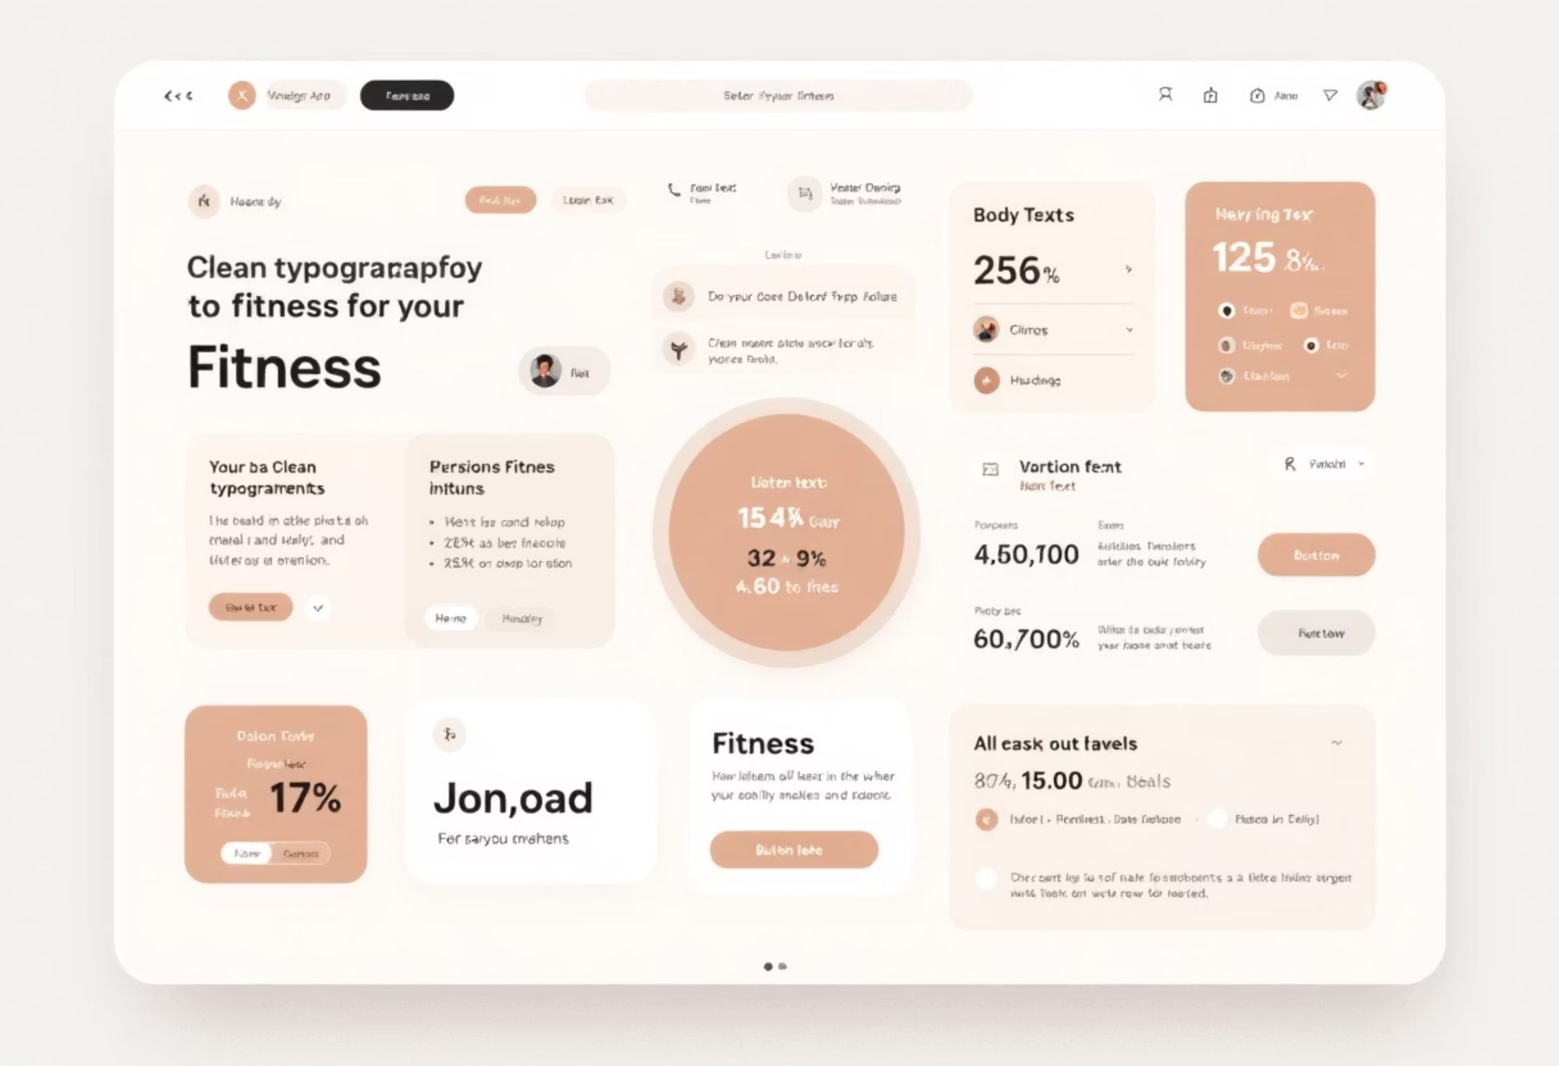
Typography System: Crafting BFF's Voice
FitLife uses Open Sans for clarity and visual hierarchy.
H1
Bold 700
32px
40px
-0.5px
H2
Semibold 600
24px
32px
-0.3px
H3
Medium 500
20px
28px
-0.2px
Body Text
Regular 400
16px
24px
0px
Caption
Light 300
14px
20px
0.1px
Typography in Action
Your Daily Progress
Personalized Workout Plan
Track Your Macros
H1: Primary titles.
H2: Section headings.
H3: Sub-headings.
Body: Detailed info.
Caption: Supplementary details.

Slide 18
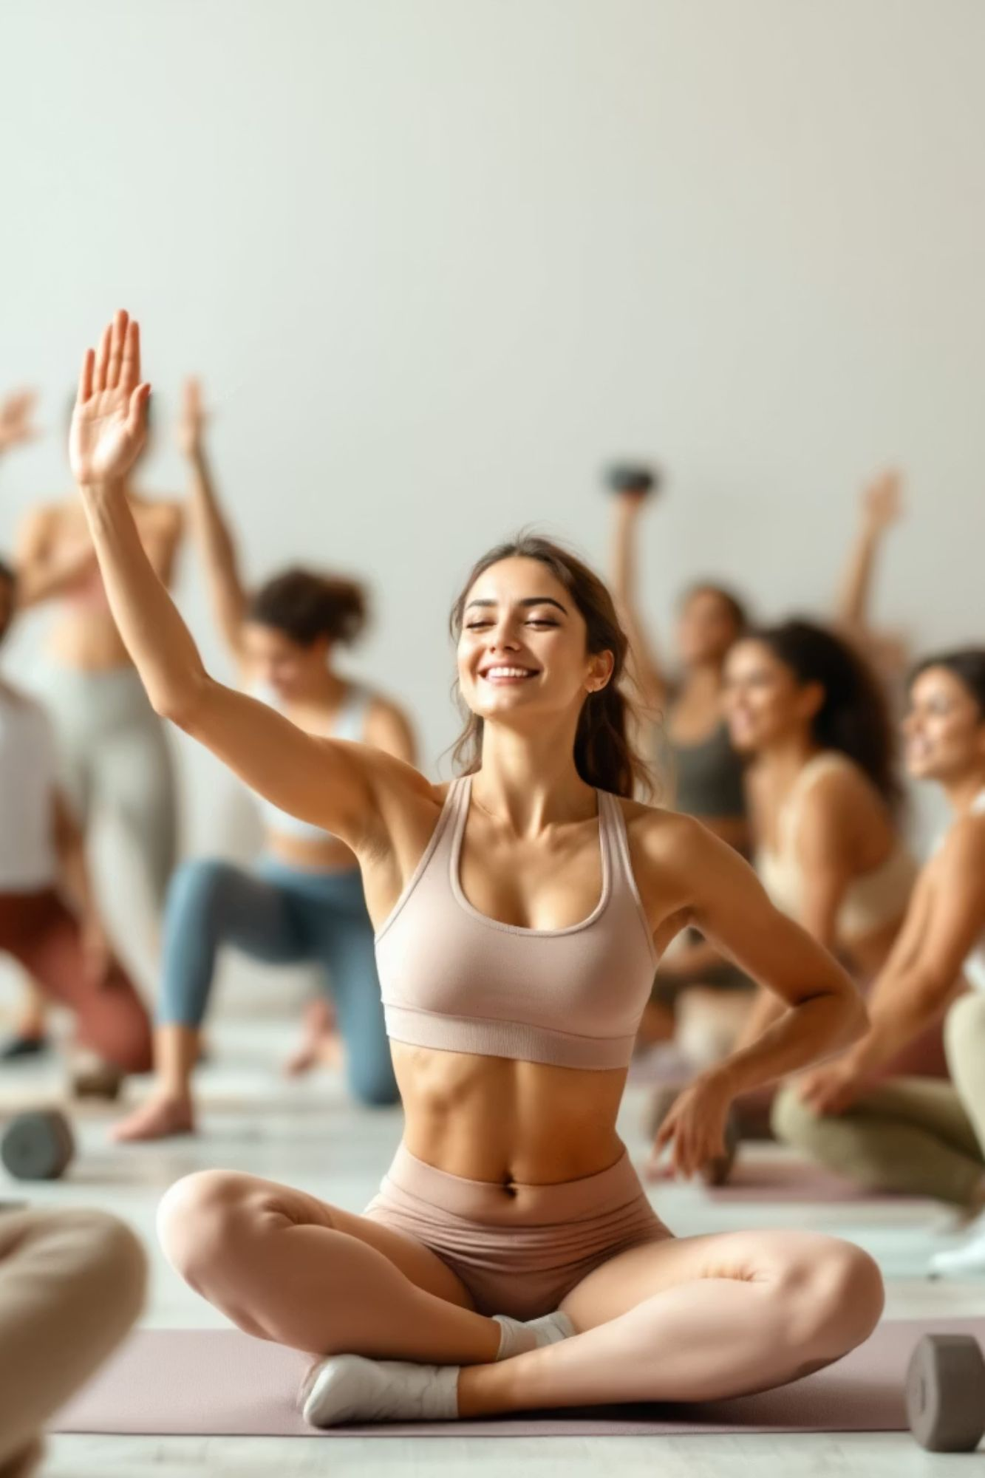




Iconography System: Guiding BFF Users
FitLife iconography: instant recognition and intuitive navigation.
Fitness & Activity
Dumbbell, running, heart rate.
Nutrition & Wellness
Apple, water, plate.
Progress & Achievements
Trophy, star, checkmark.
Navigation & Utility
Home, profile, settings.
Outlined icons for modern aesthetic; filled for active states.

Slide 19








Competitor & Feature Analysis
Competitive Landscape
FitLife Features
Analysis of top Indian and international fitness apps reveals strengths and market opportunities.
Unified Tracking
HealthifyMe
Integrated workout & nutrition.
Indian app: calorie tracking (Indian food), diet plans, human coaches.
Indian Cuisine Data
GOQii
Calorie tracking for regional dishes.
Health ecosystem: wearables, personal coaches, integrated services.
Fittr
Video Tutorials
Community-driven: expert guidance, strength training focus.
Professional exercise demos.
MyFitnessPal
Progress Motivation
Global leader: calorie counting, vast food database (less Indian specific).
Visuals & achievement badges.
Nike Training Club
Extensive library: guided workouts, sports performance focus.
Cult.fit
Digital classes & gym access: diverse workouts, meditation.
Adidas Training
Personalized plans, guided workouts, wearable integration.
Gaps: complex UIs, limited regional Indian food data, fragmented tracking.

Slide 20
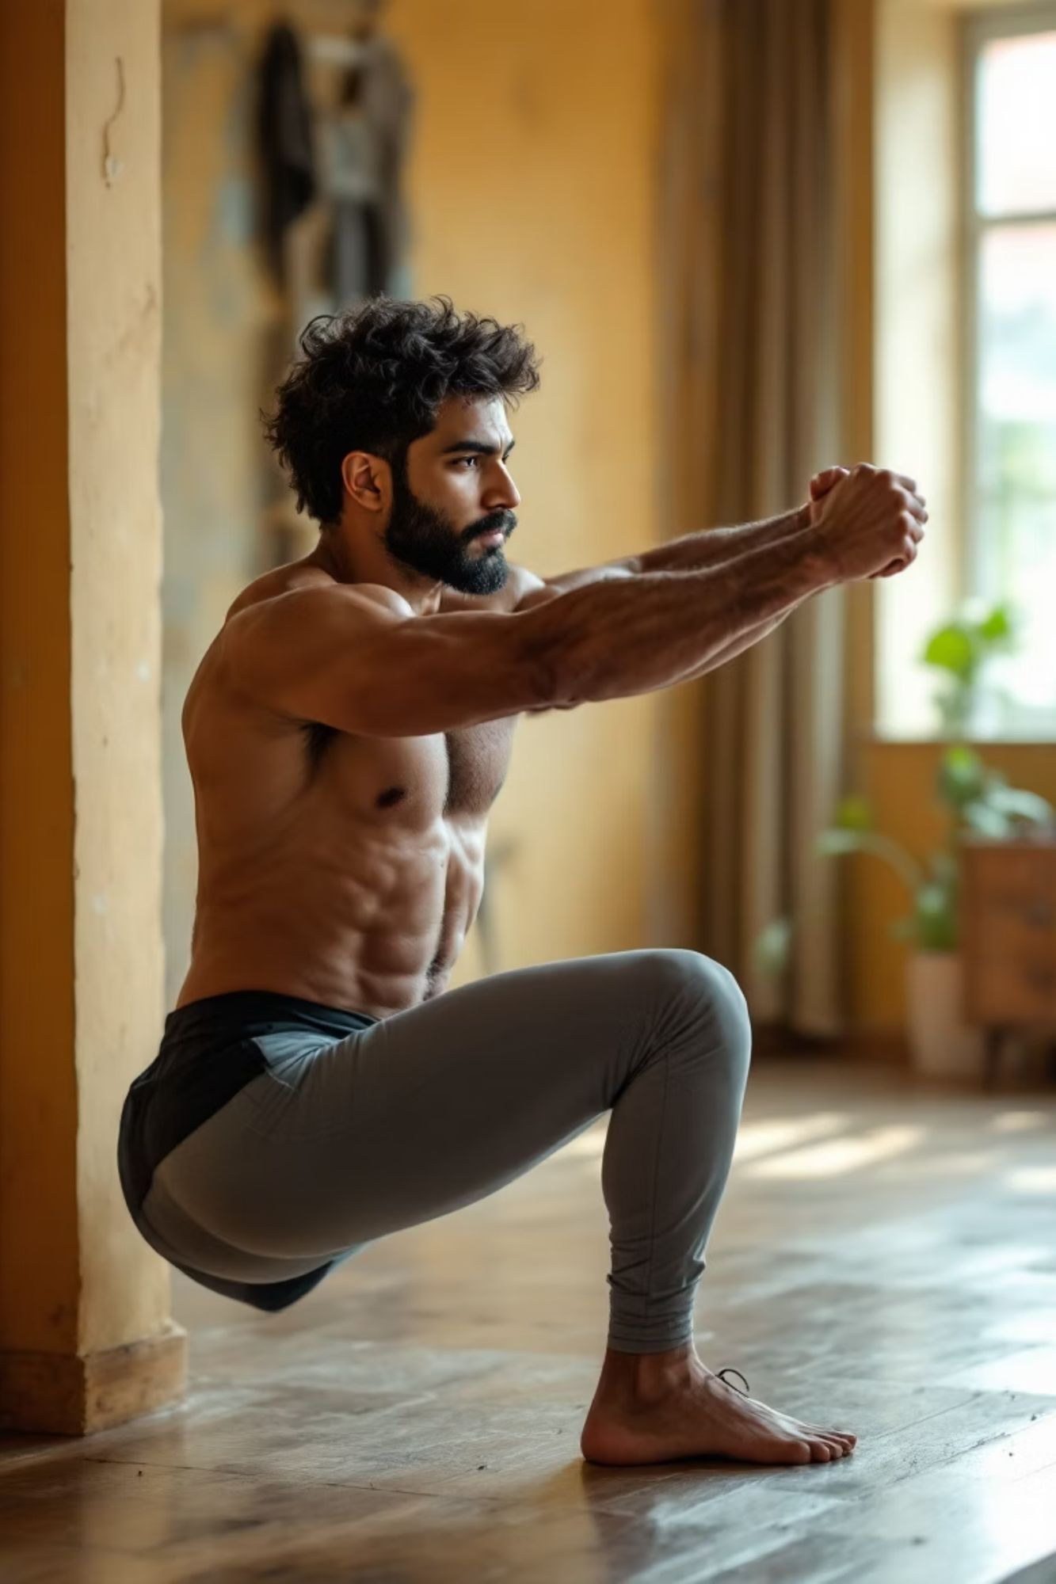




SWOT Analysis : BFF's Strategic Position
Strengths
Localized content
All-in-one platform
Motivational design
Bachelor focus
Indian food data
Weaknesses
Low brand recognition
User mass dependency
Limited marketing
Content update demands
Opportunities
Growing fitness market
Rising health awareness
Increased smartphone use
Partnership potential
Corporate wellness
Threats
Established competitors
Data privacy
Digital divide
Urban market saturation
Health regulations changes

Slide 21
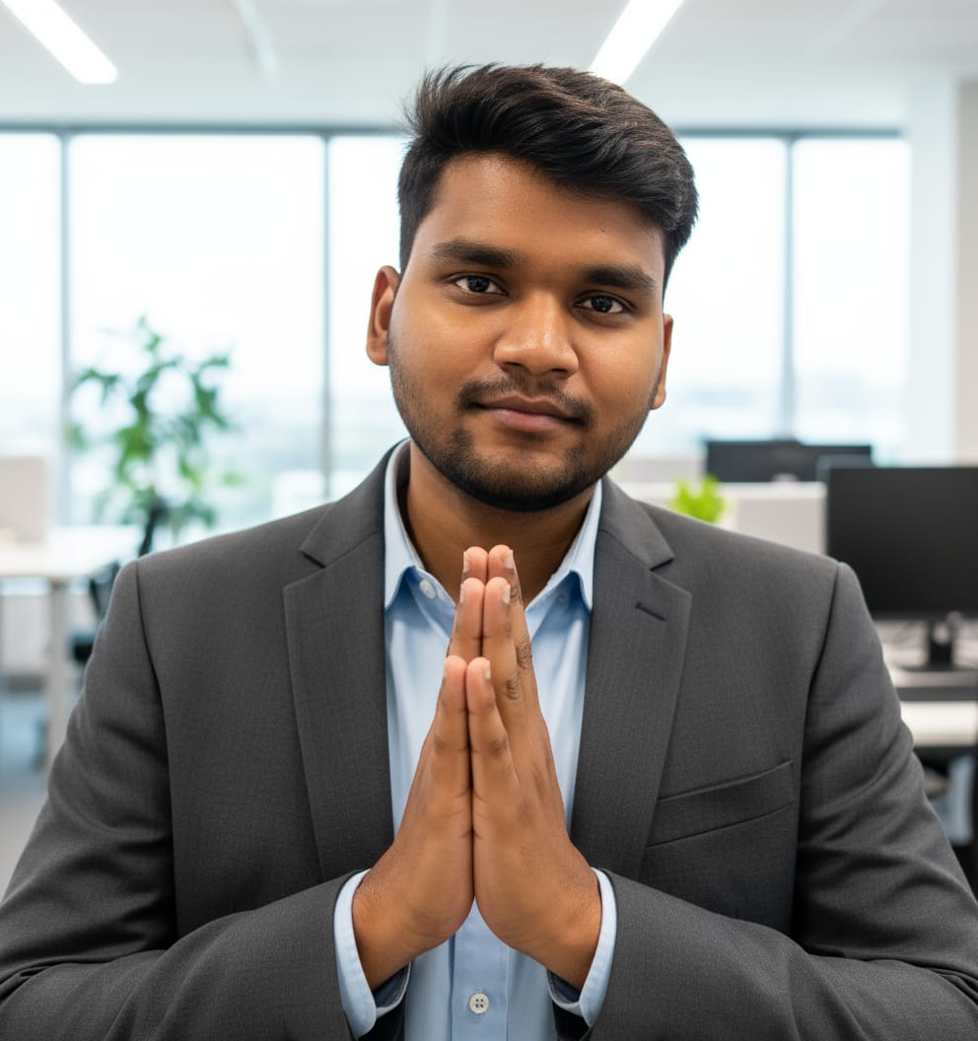
User Persona: Meet sundar
Sundar , a Mumbai software engineer, works long hours, eats takeout, and struggles with gym consistency.
Goals
Lose 5kg, improve stamina
Build routine for wedding
Boost energy
SUNDAR RAJI
Age: 28 Occupation: Software EngineerLocation: MumbaiStatus: Bachelor
Tech Behaviour
Fitness Preferences
Social Aspect
Prefers quick, app-based solutions on smartphone.
Wants 20-30 min home workouts, easy meal logging.
Motivated by community, sharing achievements.

Slide 22
Conclusion & Next Steps
FitLife is an integrated, personalized solution for urban Indian bachelors, boosting long-term health outcomes.
Phase 1: Beta Launch (Q2 2024)
Phase 3: Partnerships (Q4 2024)
Limited release for testing & feedback.
Collaborate with nutritionists, gyms.
1
2
3
4
Phase 2: Refinement (Q3 2024)
Phase 4: Scale (2025)
Integrate feedback, enhance features.
Full market launch in major Indian cities.
Our Vision
Empower Indian bachelors with accessible, culturally relevant fitness technology for healthier lives.
"Your health, your pace, your life — with BFF."

