Slide 1
SQL
Structured Query Language

Slide 2
What is Database?(DB)
Any collection of related information..
Phone book
Shopping list
Todo list
Your 5 best friends
Facebook’s User Base
Databases can be stored in different ways
On paper
In your mind
On a Computer
This powerpoint

Slide 3
Computer + Databases = <3
Amazon.com
Keeps track of Products, reviews, Purchase orders, Credit Cards, Users, Media, etc..
Trillions of pieces of information need to be stored and readily available.
Information is extremely valuable and Critical to Amazon.com's functioning.
Security is essential, Amazon stores people personal informations like
Credit Card, SSN (Social Security Number), Address, phone
Information is stored on a computer.
Shopping List
Keeps track of Consumer products that are need to be purchased.
10-20 pieces of information need to be stored and readily available.
Information is for convenience sake only and not necessary for shopping.
Security is not important
Information is stored on a piece of paper or even just in someone’s memory.
Computers are great at keeping track of large amount of informations.

Slide 4
Database Management Systems (DBMS)
A special software program that helps user create and maintain a database.
Makes it easy to manage large amounts of information
Handles Security
Backups
Importing / exporting data
Concurrency (it is the ability of a database to allow multiple users to affect multiple transactions.)
Interacts with software applications - Programming languages

Slide 5
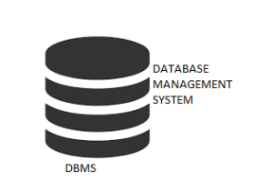

Amazon.com Database Diagram
Amazon will interact with the DBMS in
Order to Create, Read, Update and Delete information.

Slide 6
The four main operation
C.R.U.D
Read / Retrieve
Create
Update
Delete

Slide 7
Two Types of Databases
Non-Relational (noSQL / not just SQL)
Relational Databases (SQL)
Organise data into one or more tables
Each table has columns and rows
A unique key identifies each row
Organise data is anything but a traditional table
Key value stores
Documents - JSON (Java Script Object Notation), XML(eXtensible Markup Language), etc..
Graphs
Flexible Tables

Slide 8
Relational Databases (SQL)
Relational Database Management Systems (RDBMS)
Helps user to create and maintain a relational database
Like mySQL, Oracle, postgreSQL, mariaDB, etc
Structured Query Language (SQL)
- Standardized language for interacting with RDBMS.
- Used to perform CRUD operations, as well as other administrative tasks (user management, security, backup, etc)
- Used to define tables and structures.
- SQL code on one RDBMS is not always portable to another without modification.

Slide 9
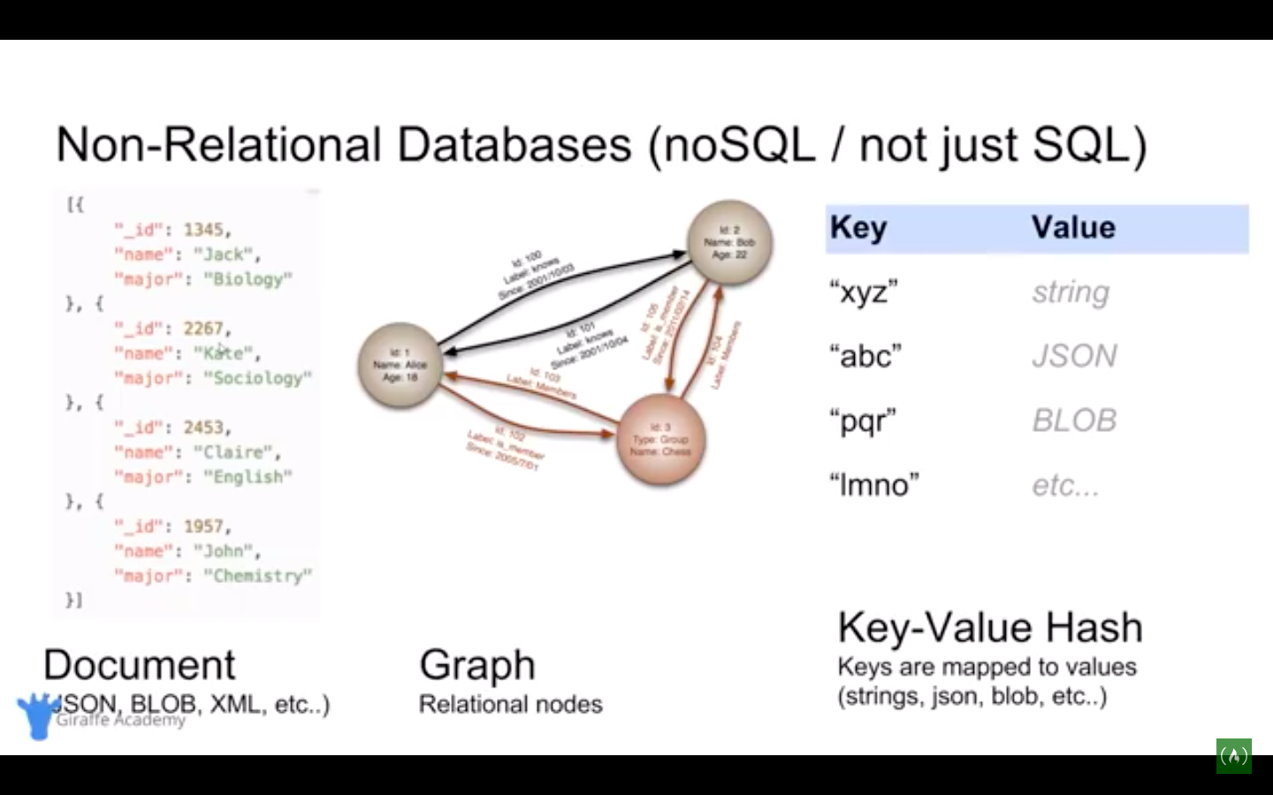

Slide 10
Non-Relational Databases (noSQL / not just SQL)
Non-Relational Database Management System (NRDBMS)
- Helps user to create and maintain a non relational database.
-> mongoDB, dynamicDB, apache cassandra, firebase, etc
Implementation Specific
- Any non- relational database fails under this category, so there’s no set of language standard.
- Most NRDBMS will implement their own language for performing CRUD and administrative operations on the database.

Slide 11
Database Queries
Queries are request made to the database management system for specific information.
As database’s structure become more and more complex, it becomes more difficult to get the specific pieces of information we want.
A google search is a query.

Slide 12
Wrap UP
Database is any collection of related information.
Computers are great for storing databases.
DBMS make it easy to create, maintain and secure a database.
DBMS allows you to preform the CURD operations and other administrative tasks.
Two types of Database, Relational and Non-Relational.
Relational database use SQL and stores data with rows and columns.
Non-Relational database stores data using other data structures.

Slide 13
Tables And Keys
Key:
A DBMS key is an attribute or set of an attribute which helps you to identify a row(tuple) in a relation(table).
Why do we need Keys?
Keys helps you to identify any row of table. In real world application, a table could contain thousands of records. Moreover, the records could be duplicated. Keys ensure that you can uniquely identify a table record despite these challenges.
Allows you to establish a relationship b/w tables .

Slide 14
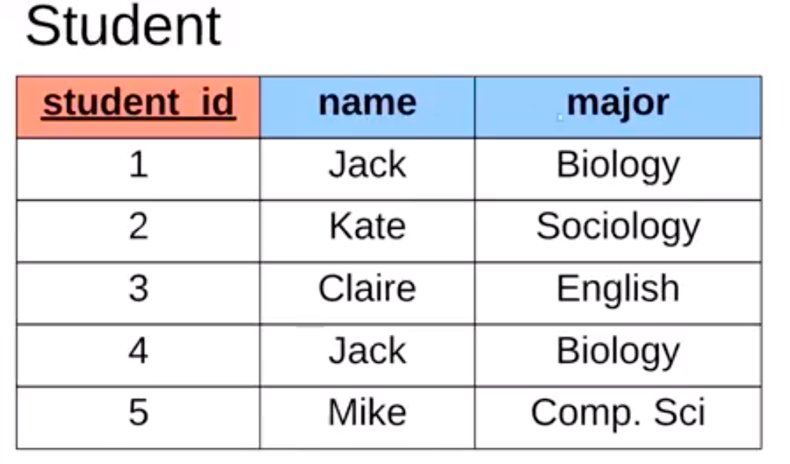
Primary Key

Slide 15
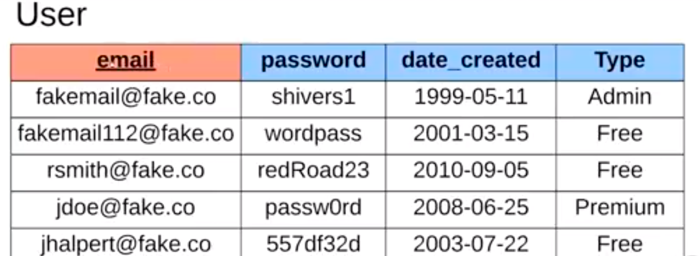
Primary Key

Slide 16
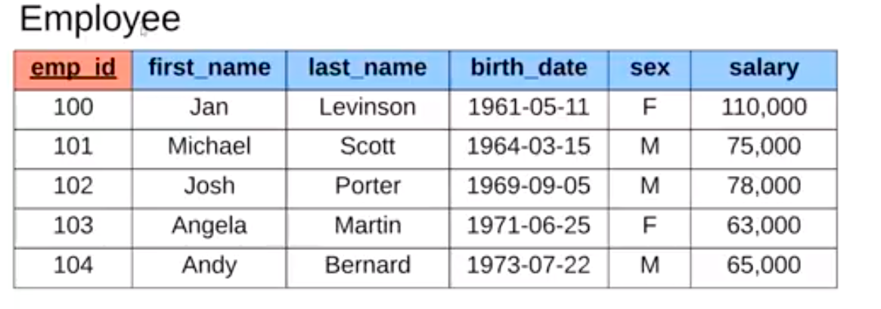
Surrogate Key
A Surrogate Key is a key that has no mapping to the real world.
It’s just a random number. Surrogate key’s are created when you don’t have any natural primary key.

Slide 17
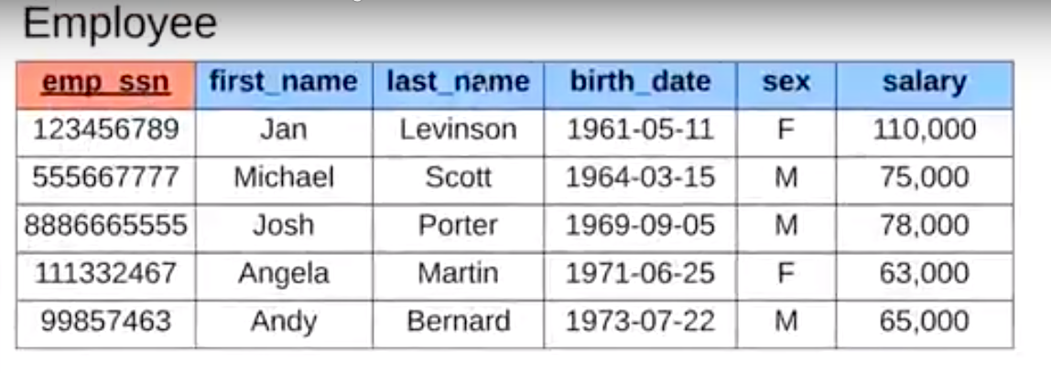
Natural Key
ssn - Social Security Number
A natural key is a key that has a mapping to the real world.

Slide 18
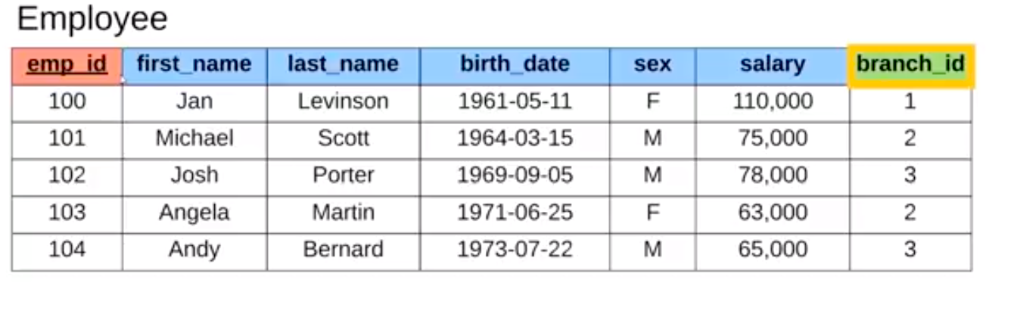
Foreign Key
A foreign key is a key that can link to the other databases.
The foreign key stores the primary key of a row in another table or database.

Slide 19
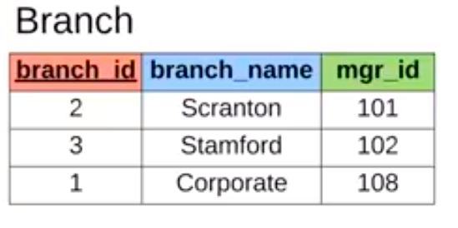

Slide 20
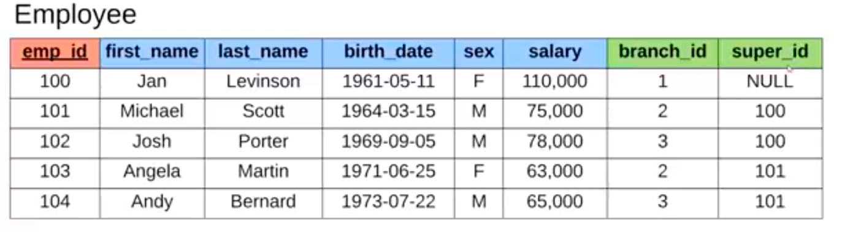

Slide 21
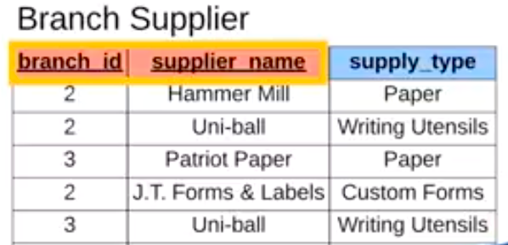
A Composite Key is a key that has a multiple attributes

Slide 22
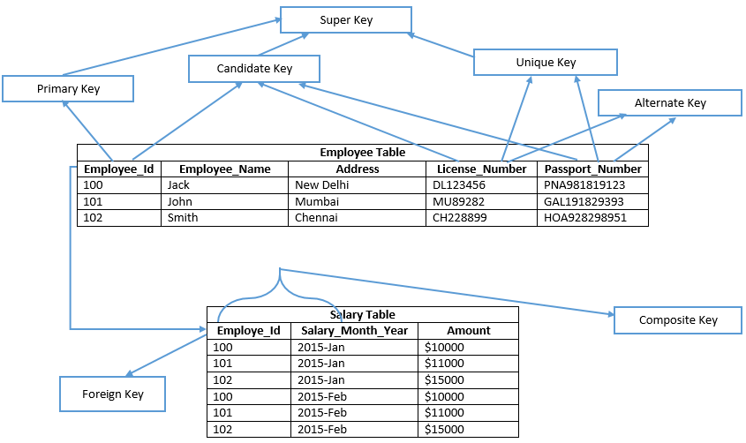

Slide 23
SQL- BASICS

Slide 24
Structured Query Language (SQL)
SQL is a language used for interacting with Relational Database Management Systems (RDBMS)
You can use SQL to get the RDBMS to do things fo you..
- CRUD
- Create & manage databases
- Design & create database tables
- Perform administration tasks (security, user management, import / export, etc…)

Slide 25
Structured Query Language (SQL)
SQL implementations vary between systems
- Not all RDBMS follows the same SQL Standard.
- The concepts are the same but the implementations may vary

Slide 26
Structured Query Language (SQL)
SQL is actually a hybrid language, it’s basically 4 types of languages in one.
Data Query Language (DQL)
used to query the database for information
Get information that is already stored.
Data Definition Language (DDL)
- used for defining database schemas.
Data Control Language (DCL)
- used for controlling access to the data in the database.
- user & permission management.
Data Manipulation Language (DML)
- Used for inserting, updating and deleting data from the database.

Slide 27
Queries
A query is a set of instruction given to the RDBMS (written in SQL) that tells the RDBMS what information you want to retrieve for you
- TONS of data in DB.
- Often hidden in a computer schema.
- Goal is to only get the data you need
Select employee.name, employee.age
FROM employee
WHERE employee.salary > 3000;

