Slide 1
Lights OFF
Team Packers:
Mohamad Shafaat Ali Khan
Purva Patel
Amrapali Sarkar
Praveen

Slide 2
INTRODUCTION
To develop a Smart Control and Monitoring System by harnessing the power of IoTs at low-cost which provides flexible and scalable architecture for university automation. It will provide security, energy efficiency.
Ref: http://www.ijarcce.com/upload/2016/may-16/IJARCCE%2093.pdf
Notes:
Reference: http://www.ijarcce.com/upload/2016/may-16/IJARCCE%2093.pdf
https://phys.org/news/2011-04-energy_1.html

Slide 3
PROBLEM STATEMENT
A survey of 2011 shows that more than half (58%) of the total energy produced in the US is wasted due to inefficiencies, such as waste heat from power plants, vehicles, and light bulbs.
16% is wasted in residential and commercial area due to ignorance.
Ref: https://phys.org/news/2011-04-energy_1.html

Slide 4
SOLUTION
To design and implement a system for automated notifications and real time monitoring of a lighted empty room. We are collaborating IoT, Cloud computing and Mobile Application Development.
Our system will help the user to get notified about empty rooms with lights ON.

Slide 5
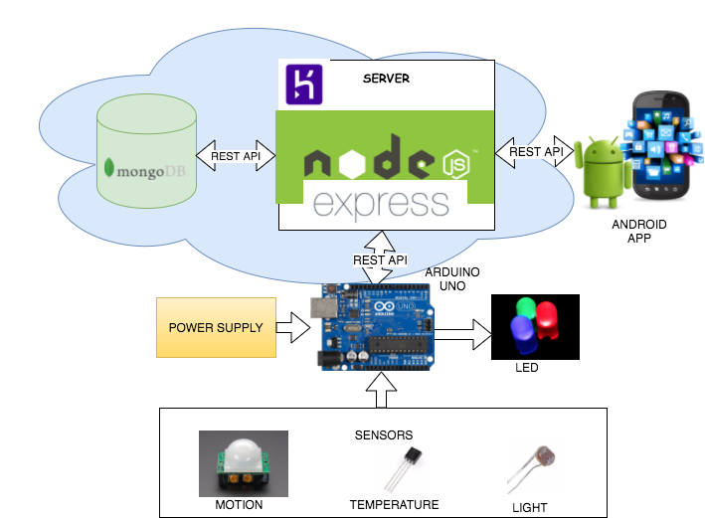
ARCHITECTURE

Slide 6
TECHNOLOGIES
Android
NodeJS
Express
MongoDB
Arduino
Heruko

Slide 7
DEMO
https://www.youtube.com/watch?v=byLJBi4Zkcg&feature=youtu.be

Slide 8
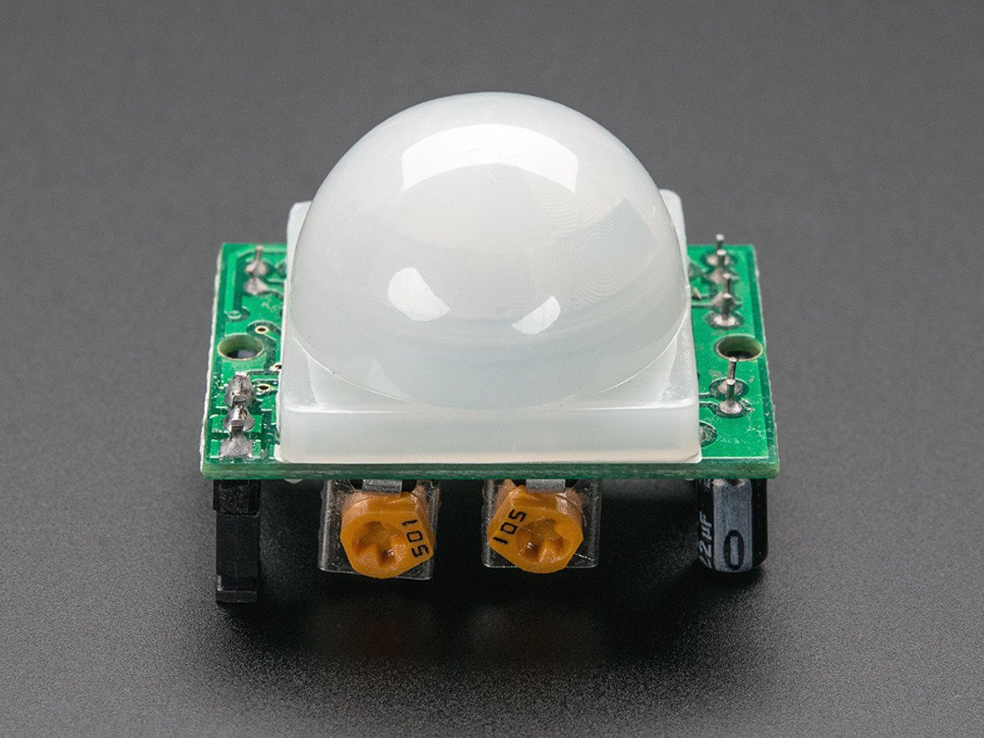
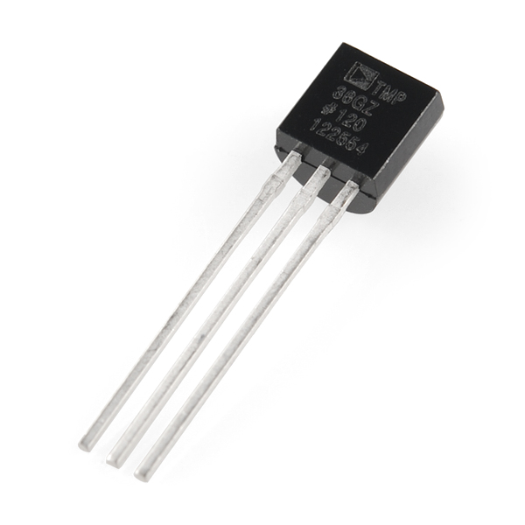
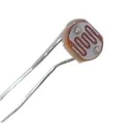
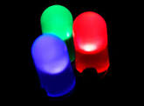
PRODUCT-SENSORS

Slide 9
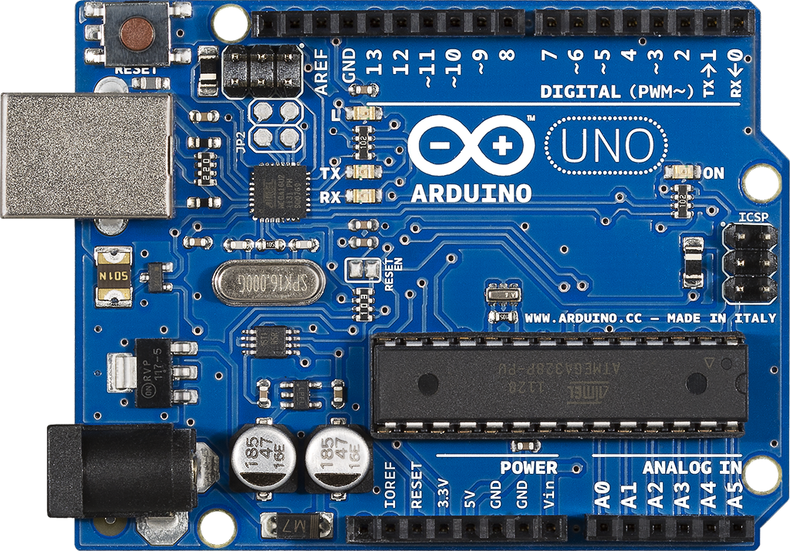
PRODUCT-MICROCONTROLLER

Slide 10
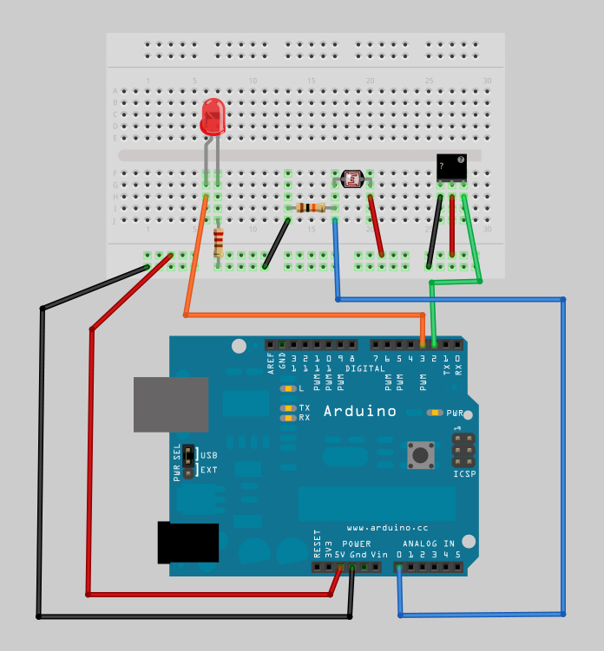
PRODUCT-CIRCUIT DIAGRAM

Slide 11
ANDROID FEATURES & LIBRARIES
Background Services
Retrofit Libraries
Security - Tokenization
Achartengine API
onSaveInstance
onRestoreInstance

Slide 12
ANDROID APP UI
Drawers
Charts

Slide 13
LIMITATIONS & CHALLENGES
Daylight
PIR Motion Sensor detects motion up to 30 feet.
Sleeping, Meditating, Sitting Idle etc will also notify as an empty room.

Slide 14
OVERCOMING LIMITATIONS & FUTURE SCOPE
LIMITATION | SOLUTION
Daylight | Machine Learning
PIR motion senses 30 feet | Use high range sensors
Sleeping, Meditating, Sitting Idle etc | Use more sensors like sound sensor etc.

Slide 15
Q & A
Thank you!!!

