Slide 1
ZIP-Find
(Location based Restaurant Search and Recommendation System)
Praveen Iyer (5549510111)
Sankalp Sharma (7672471024)

Slide 2
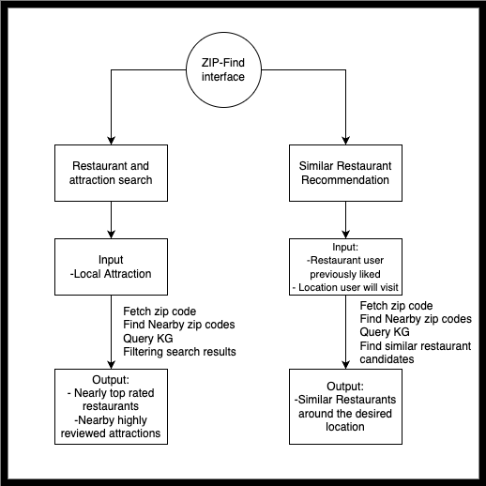
About the project
ZIP-Find is a location based restaurant search and recommendation system.
Our KG will be used for searching nearby top rated restaurants and attractions along with recommending similar restaurants around the attraction they are planning to visit.

Slide 3
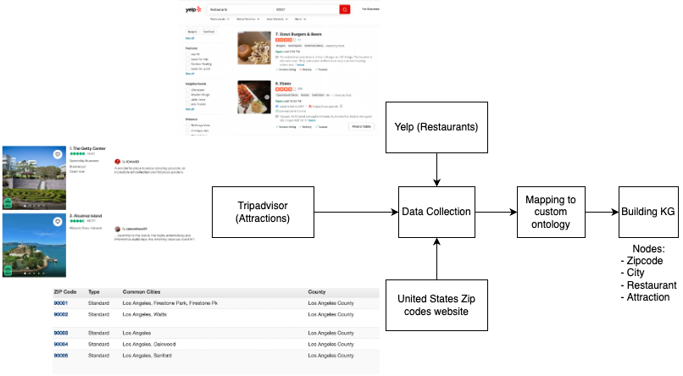
Data Source and Ontology

Slide 4
Technical Challenges
We will be using SPARQL queries for extracting highly rated restaurants and nearby local attractions using pattern matching.
This is a novel task because our system will be a one-stop platform that will link local attractions and restaurants in a single application.
We will use feature engineering for selecting the appropriate attributes to give fairly precise recommendations which is beyond the scope of this course.
To evaluate our system we will use human expertise to verify the recommendation and search results.

