Slide 1

Team ID : WNV2314

Slide 2
KnightWatch

Slide 3

Problem Statement

Slide 4
India lodged average 86 assaults daily, 49 offences against women per hour in 2021.
The problem our idea concentrates is about women safety, specifically when they are traveling alone or in places where they feel that their safety is at jeopardy. We employ a simple yet can be a solution for significant problems.

Slide 5
Solution Proposed

Slide 6
Our solution is basically an environment monitoring system cum SOS powered by artificially trained machine model that take in surrounding parameters and carefully process it to warn or alert the user.
Even though there are many SOS devices for women to use during emergency it is not as intelligent as this device as its based on a simple button press while our device is trained with many input test cases and made accurate on its own.

Slide 7
Our solution can we divided into two parts, the monitoring device installed in the women’s any day to day use materials like a hand bag.
The second part is actually an data trained ai model that can suggest police patrols places based on data received from the devices being used.
We will also be using an app that acts as an interface for setting the SOS hardware up and also for monitoring purposes

Slide 8
Hardware and Software requirements

Slide 9
HARDWARE | SOFTWARE
5 MP CAM MODULE | YOLO V5 (Training object detection dataset)
Jetson nano(NVDIA) | NLP module
GPS tag | Keras python library
GSM modules | Open CV
Microphone
Noise filtering module

Slide 10
Project Design

Slide 11
Our solution can we divided into two parts, the monitoring device installed in the women’s any day to day use materials.
The second part is actually an data trained ai model that can suggest police patrols places based on data received from the devices being used.
For the first part of our project we are implementing it in a handbag
The reason for this choice is that it can provide a more room for us to work with and can be easily set to monitor the surroundings.

Slide 12
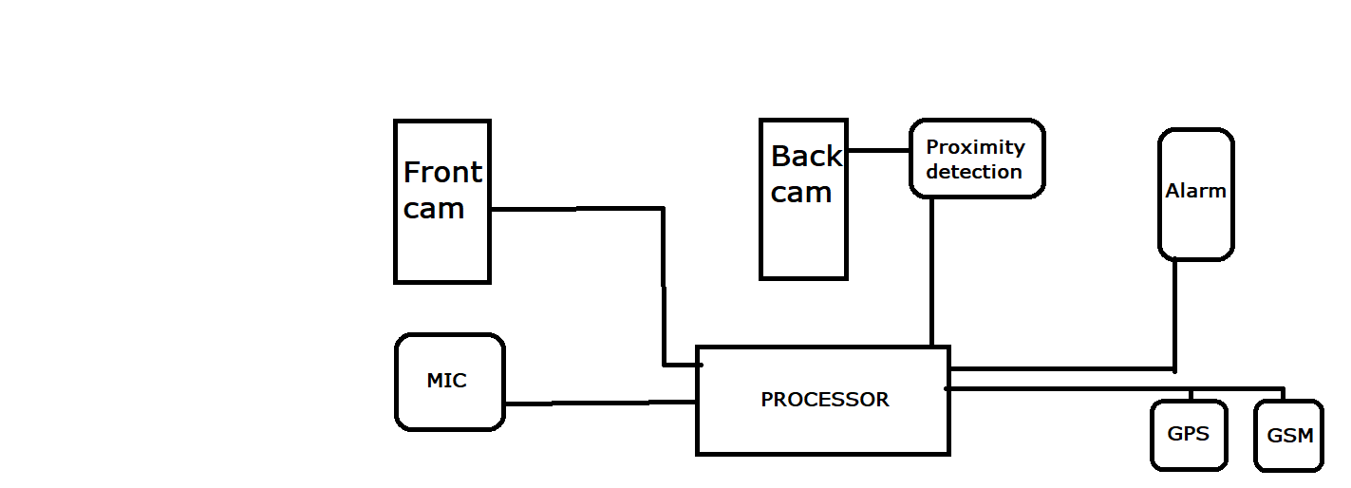
Sample block diagram of the monitoring device

Slide 13
A security system for women that would provide them with the ability to detect potential threats in their environment and alert them to take the necessary steps to protect themselves.
The system could use facial recognition technology to identify potential attackers, analyze their behavior and alert users to any suspicious activity. It could also use voice recognition to detect any suspicious conversations or noises in the vicinity and alert users to take the necessary steps.

Slide 14
The system could also use natural language processing to interpret conversations and detect any potentially dangerous language or threats. Finally, the system could use machine learning algorithms to continuously improve its accuracy and effectiveness in detecting potential threats.
The following slides will explain the project design in detail

Slide 15
Criminal Radar :
This part will be implemented in the front facing camera of the handbag. This system will be able to detect the face and recognize face automatically in real-time. Face detection classifiers are shared by open source communities, such as OpenCV. LBPH algorithm using Haar feature-based cascade classifier.
Audio Radar:
Most of the information about our environment that cant be seen can be heard. So we have this module to detect and constantly listen to the surroundings. A multi-headed model capable of detecting different types of online discussion toxicity like threats, obscenity, insults, and identity-based hate using Keras RNN

Slide 16
Rear proximity detector:
While the camera helps in face detection and warning system. The rear module detects if someone is moving fast behind the person in an attempt to attack them. So giving us ample time to react.
GPS and GSM :
This segment is used to track and manage notifications.
The data model :
This part is the backend of the project. When an alert is triggered in the device we register the location and data. We then use a data trained model to maintain an intelligent patrol police force in order to prevent future cases of problem.

Slide 17

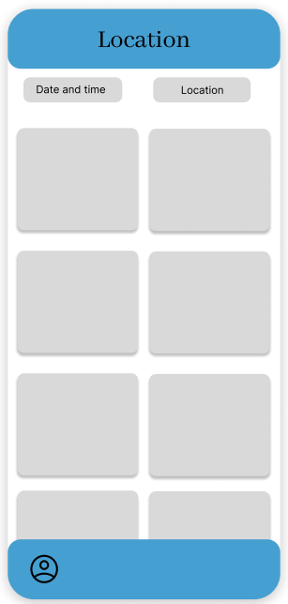
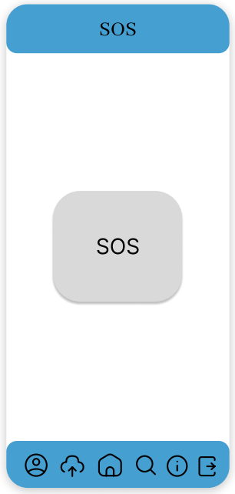
APP DESIGN

Slide 18
Challenges faced while developing the project

Slide 19
Training of facial recognition model
Increasing its accuracy
NLP Database creation.
Implementation in Jetson nano

Slide 20
Future Scope

Slide 21
This solution if taken time to train and implement properly can empower women and make them feel safe when they go out and work for our society to improve.
This solution is dependent on AI and machine learning models which means that its accuracy can be increased drastically and it can adaptive learn and be progressive

Slide 22

References
https://www.unwomen.org/en/what-we-do/ending-violence-against-women/facts-and-figures
https://developer.nvidia.com/embedded/jetson-nano-developer-kit
https://pytorch.org/hub/ultralytics_yolov5/#:~:text=Model%20Description,to%20ONNX%2C%20CoreML%20and%20TFLite.
https://jetsonhacks.com/2019/04/02/jetson-nano-raspberry-pi-camera/
https://andiosika.github.io/focal_loss_in_deep_learning
https://forums.developer.nvidia.com/t/using-hc-sr04-ultrasonic-sensor-with-jetson-nano/78861
https://www.edgeimpulse.com/blog/recognizing-your-blind-spots-pedestrian-detection-system-with-nvidia-jetson-nano

