Slide 1
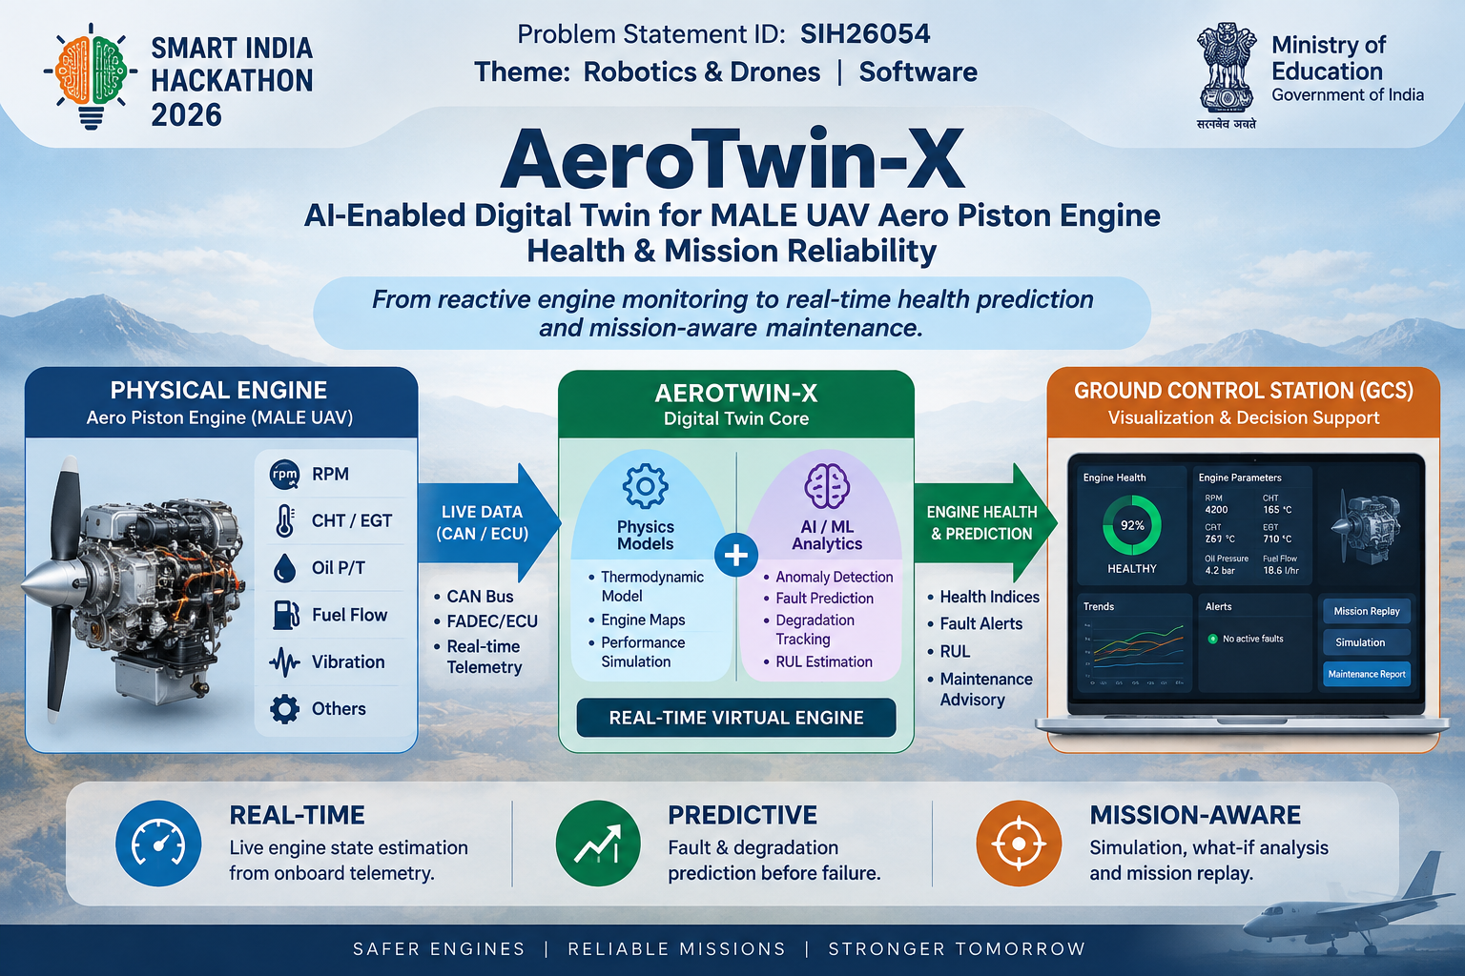
SMART INDIA HACKATHON 2026
Problem Statement Title : AI-Enabled Real-Time Digital Twin System for Health Monitoring, Fault Prediction and Mission Reliability Enhancement of Aero Piston Engines used in MALE UAVs.
Problem Statement ID : 26054
Theme : Robotics and Drones
PS Category : Software
Team Name :

Slide 2
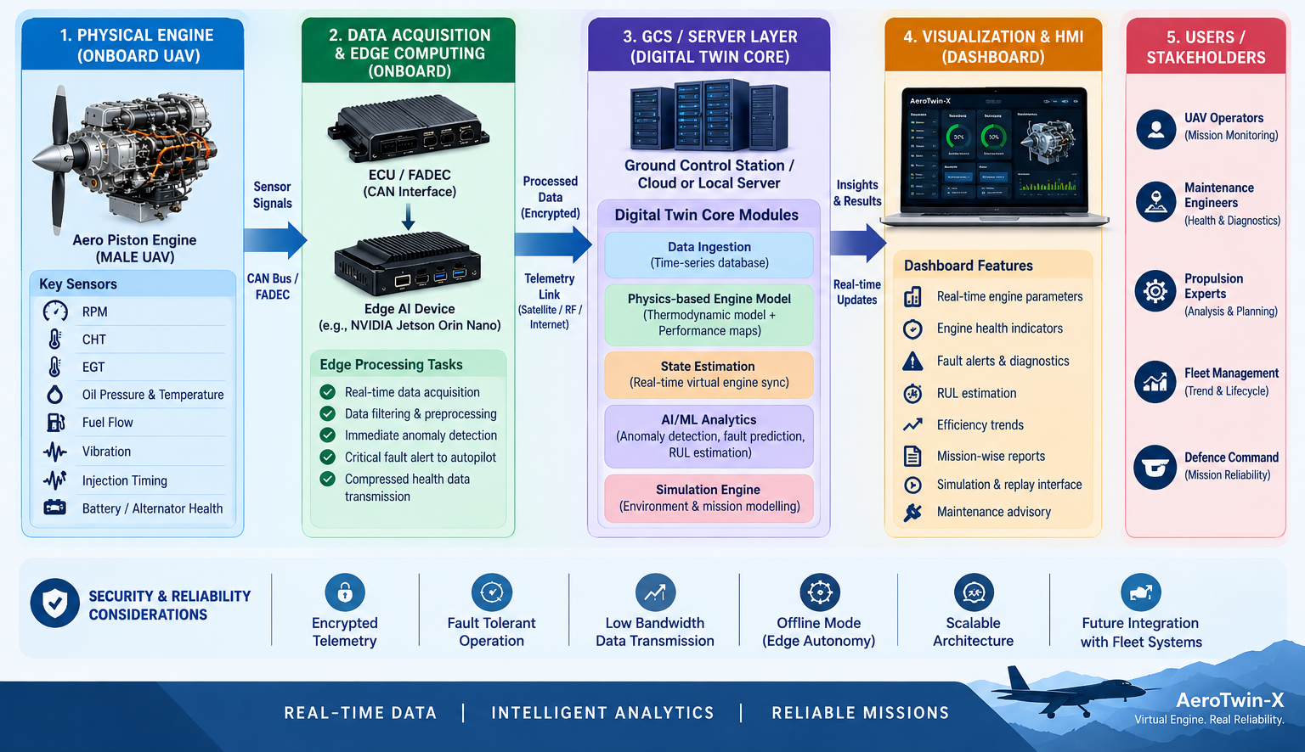
AeroTwin-X: Edge-Driven, Physics-Informed Digital Twin for MALE UAVs
Synus
Proposed Solution:
A hybrid Digital Twin framework integrating live CAN-bus telemetry, 1D thermodynamic engine models, and Explainable AI (XAI).
It creates a continuously synchronized virtual replica of the physical aero piston engine for real-time health scoring and mission replay.
How it Addresses the Problem:
Transitions UAV maintenance from reactive (threshold-based) to proactive by dynamically estimating Remaining Useful Life (RUL).
Simulates environmental variables (high altitude, hot weather) against the virtual model to predict engine behavior before a mission begins.
Innovation and Uniqueness:
Physics-Informed AI (PINNs): Combines thermodynamic laws with machine learning, allowing accurate fault prediction even with limited historical failure data.
Edge-to-Cloud Federated Architecture: Critical anomaly detection (misfires, sensor drift) happens onboard via Edge AI; lightweight state-vectors are sent to the Ground Control Station (GCS) to save bandwidth.
Explainable AI (XAI): Ensures ground crews receive transparent maintenance advisories (e.g., "75% probability of injector abnormality due to anomalous EGT + Vibration correlation").

Slide 3
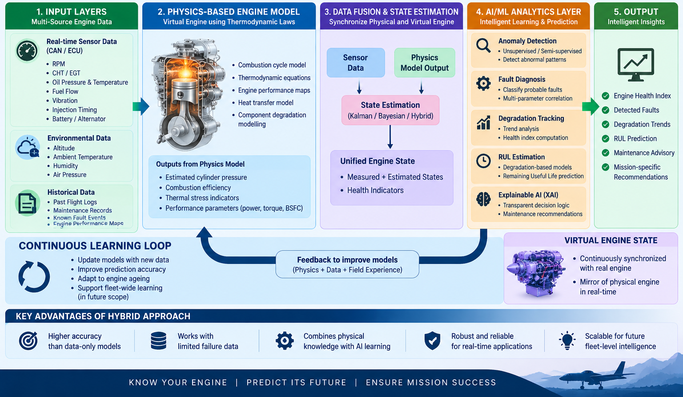
TECHNICAL APPROACH
Synus
Technologies to be Used:
Data Acquisition: CAN bus / SocketCAN, FADEC interface, MQTT (Secure Telemetry).
Edge Hardware (UAV Onboard): Lightweight Edge AI device (e.g., NVIDIA Jetson Orin Nano).
AI/ML Stack: Python, PyTorch (for PINNs), scikit-survival (for RUL), SHAP (for XAI).
Modeling: OpenModelica or GT-SUITE (for thermodynamic base models).
GCS Dashboard: React.js, WebGL (for 3D engine visualization), Grafana/InfluxDB for time-series telemetry.
Methodology and Implementation Process:
Ingestion: Real-time extraction of RPM, CHT, EGT, fuel flow, and vibration signatures via CAN.
Edge Analytics (Onboard): Ultra-fast isolation forest algorithms detect immediate anomalies (rapid throttle transitions, combustion instability) and alert the autopilot/operator.
DT Core Sync (GCS Server): Live telemetry synchronizes with the virtual thermodynamic model to calculate hidden states (e.g., internal cylinder pressures, coating degradation).
Predictive Engine: AI processes health indices to estimate RUL and track overheating/lubrication trends.
Replay & Simulation: Historical logs are fed into the simulator for post-flight analysis or pre-flight "what-if" environmental testing.

Slide 4
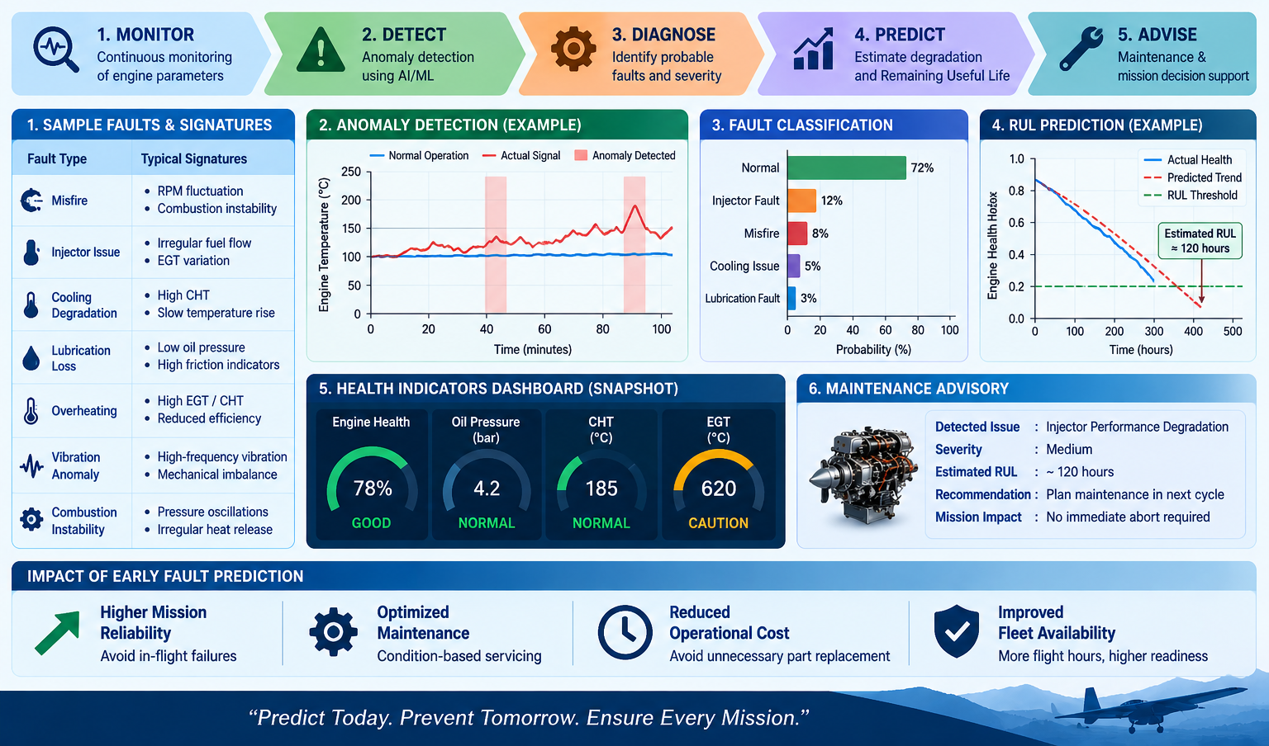
FEASIBILITY AND VIABILITY
Synus
Analysis of Feasibility:
Highly feasible. Modern UAVs already use CAN/FADEC, providing readily available data hooks.
Using COTS (Commercial Off-The-Shelf) Edge AI hardware ensures lightweight deployment without altering the UAV's core flight dynamics.
Potential Challenges and Risks:
Risk 1: Telemetry latency or data loss over weak, high-altitude communication links.
Risk 2: Scarcity of real-world "catastrophic failure" datasets to train the AI.
Risk 3: High computational load of running physics models in real-time.
Strategies for Overcoming Challenges:
Strategy 1: The Edge-AI layer ensures the UAV can self-diagnose critical faults independently, sending only essential alerts (not raw data) if bandwidth drops.
Strategy 2: The Physics-based engine model acts as a "Synthetic Data Generator," simulating misfires and sensor drifts to train the AI layer comprehensively.
Strategy 3: Replace heavy 3D thermodynamic models with "Surrogate AI Models"—neural networks trained to mimic the physics model instantly with a fraction of the computing power.

Slide 5
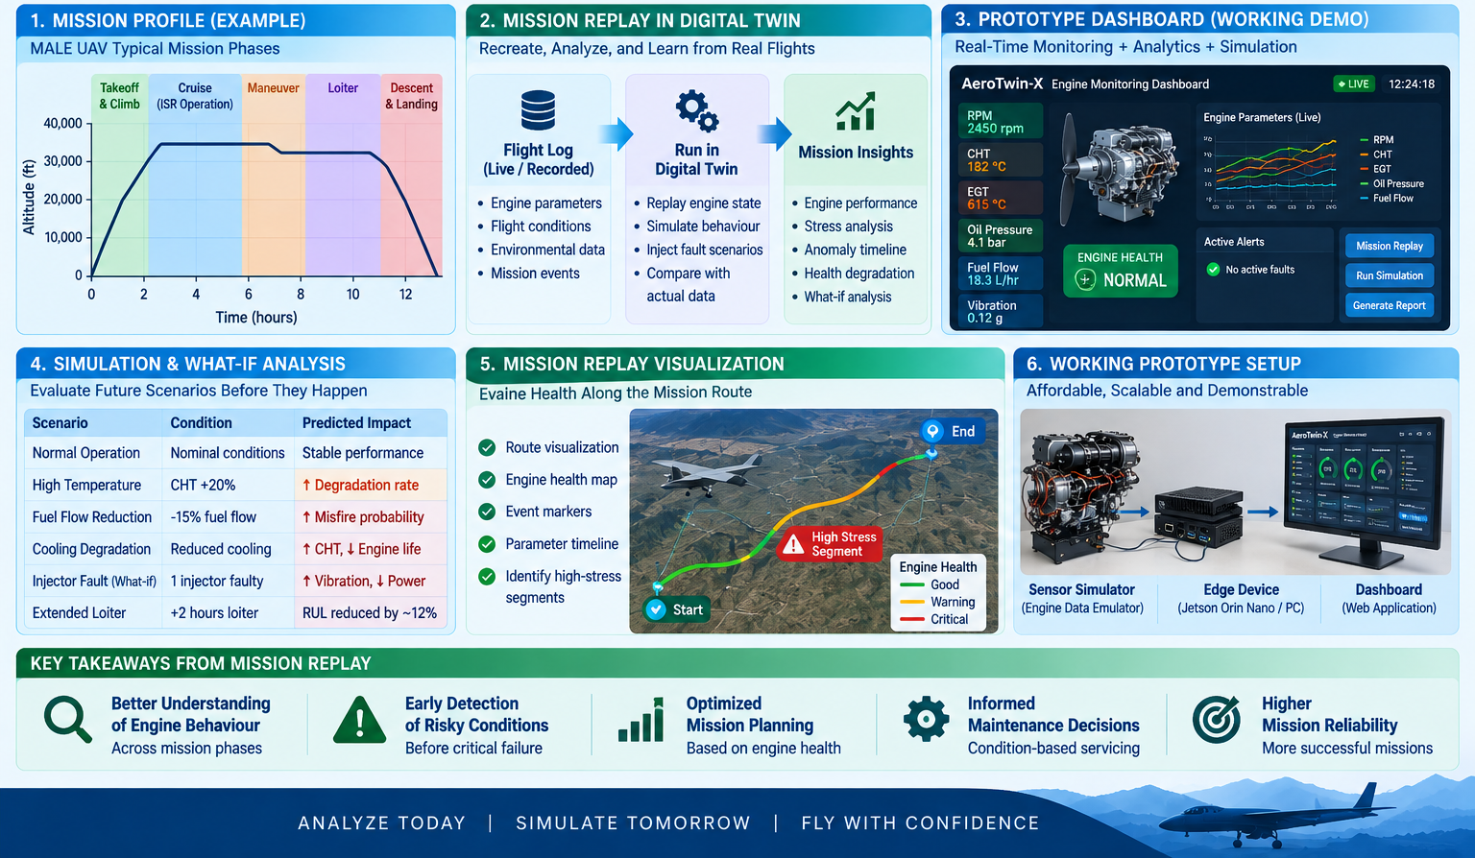
IMPACT AND BENEFITS
Synus
Potential Impact on the Target Audience:
UAV Operators & Defense Forces: Prevents catastrophic mid-air engine failures, ensuring high-value asset protection and mission success in strategic operations.
Propulsion & Maintenance Engineers: Provides an intuitive dashboard with precise fault isolation, eliminating guesswork during post-flight inspections.
Benefits of the Solution:
Economic: Shifts from costly scheduled maintenance to Condition-Based Maintenance (CBM), significantly reducing Grounding Time and MRO (Maintenance, Repair, Overhaul) costs.
Operational Reliability: The "Mission Replay" capability allows strategic planners to virtually test engine endurance against extreme weather profiles before actual deployment.
Security: Utilizing a secure telemetry architecture and Federated Learning ensures sensitive operational engine signatures remain decentralized and protected from interception.

Slide 6
RESEARCH AND REFERENCES
Synus
[1] Architecture Standard: Adheres to ISO 13374 standards for condition monitoring and diagnostics of machines.
[2] Physics-Informed Machine Learning: Research based on "Physics-informed neural networks: A deep learning framework for solving forward and inverse problems" (Raissi et al., 2019) to validate the hybrid DT approach.
[3] Edge Computing in UAVs: Application of SAE ARP4386 (UAV Engine Monitoring) guidelines adapted for distributed edge-cloud frameworks.
[4] RUL Estimation: Leveraging NASA’s C-MAPSS (Commercial Modular Aero-Propulsion System Simulation) data principles for designing the degradation and Remaining Useful Life algorithms.

