Slide 1


Slide 2


Slide 3
ABOUT US
We are proud not only of our work, but our team. Every member brings expertise and a diverse skill set that is valued by our clients. These are the people that drive our client success. We’re not limited nationally . Our services are as global as our people―meet the Socially Infused all-stars

Slide 4
OUR SKILL MADE US DIFFERENCE
We offer high-end technology that makes it effortless for you to convince the world what’s unusual and unique about your company so that you attract and reach better traffic and meet there needs accordingly.

Slide 5
GET IN TOUCH
Coax is Headquartered in India, with offices in Thrissur Kerala, Nehru Place New delhi. Bhageeratha Square, DewSpace Business Center, Kacheripady, Ernakulam, Kerala 682018. We’re on a mission to establish Coax in all states of India.

Slide 6
OUR COMMITMENT
Delivering best results every single time
Consistently growing improvising
Serve others and society over ourselves
Collaborative business models
Clients’ interest first

Slide 7
services

Slide 8
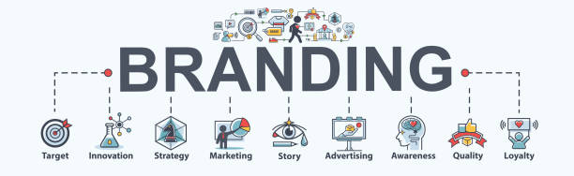
BRANDING
What matters is creating a brand that is effective. In order to do this we focus an equal amount of time to Brand Strategy as we do to Identity Design. Anyone can make a pretty looking logo. That’s like meeting a well dressed person, but what about their personality?

Slide 9
ILLUSTRATIONS
Illustration that is carefully curated and executed can grab an audience’s attention and remain in the forefront of people’s minds and create conversations. With attention spans decreasing, the demand for eye-catching and engaging illustration and imagery rises.

Slide 10
MARKETING
Within the industry of digital marketing, the phrase “search engine marketing” has a history of what it actually means and its meaning has changed over time. Some (correctly) interpret it to be a blanket term since “marketing” is a blanket term, while others use it interchangeably with just paid search advertising (PPC) as if it doesn’t include SEO.

Slide 11
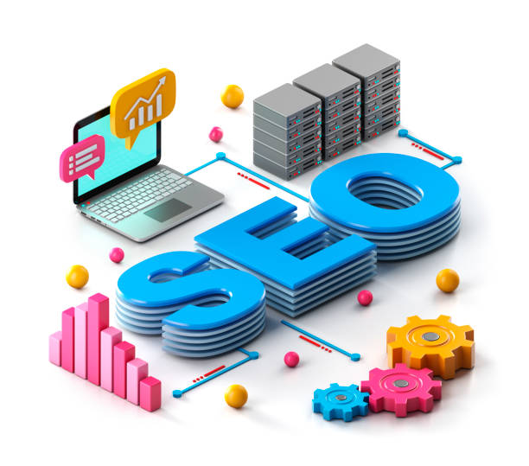
SEO STRATEGY
.
We optimize the site based on the most searched keywords related to your business and drive relevant traffic to your site through major articles and directories. We submit the site in all major search engines and improve the ranking altogether.

Slide 12
UI/UX
.
We are a UI/UX design company that emotes and innovates user experience by incorporating research and user-centric innovations. Here, we experiment with the various synergies of form and function. It’s not a School for designers but a bridge to finding their way.

Slide 13
APPLICATIONS
Mobile app development services have seen an upward spurt as mobile devices and smart phones have become increasingly popular and important. They have completely transformed the way we do business today.

Slide 14
PROCESS

Slide 15

PLANNING
Planning is the process of choosing among competing opportunities for communication so that you can set overall goals for a web. You’ll need to define your web’s intended audience, formulate a statement of your web’s purpose, and objective, and gather and maintain domain information to support your web.

Slide 16

DESIGNING
Creating a design brief is an important step in any web development project. It can help clarify the project’s goals and ensure that all stakeholders are on the same page. Well-written design concepts can also help reduce confusion and ensure that the final product meets customer expectations.

Slide 17

DEVELOPING
Yes, we know. There are so many different programs and options to choose from, and it can be hard to know which one is best for your needs. You should consider a few things when choosing a web design toolset.

Slide 18
RESPONSIVE WEB DESIGN
Achieve greater brand engagement with engaging and intuitive web designs that are mobile responsive. Generate higher conversions across desktop, tablet and mobile devices with engaging and user-friendly designs.

Slide 19
CORPORATE WEB DESIGN
Let our Digital Strategists and Web Designers devise a functional and appealing website that increases user engagement and accentuate your brand image.

Slide 20
CUSTOMISED WEB DESIGN
We conceptualise and create bespoke websites to tailor to the needs of your company and your audiences – improving the efficacy and probability of a desired action on your website.

Slide 21
CONTENT MANAGEMENT SYSTEM
Enjoy the convenience of a hassle-free CMS that is made for everyone.

Slide 22
DIGITAL MARKETING
Driven by the need to amplify brand loyalty and increase conversions in this digital adage, we are adept in crafting 360° integrated-based approach campaigns. From Social Media Marketing to Search Engine Optimisation, you can count on us to deliver turnkey digital marketing solutions with result-driven interactions and social engagements.

Slide 23
DIGITAL COPY WRITING
When writing copies, we believe less is more. A good web interface excites curiosity and get audiences intrigued. But a good copy accentuates that excitement, draws them in further and converts them on the website or the ad. Are you an F&B business owner?

Slide 24
HUMAN RESOURCE
In simplest terms, the HR (HumanResources) department is a group who is responsible for managing the employee life cycle (i.e., recruiting, hiring, onboarding, training, and firing employees) and administering employee benefits.

Slide 25
BUILDING THE BEST HR DEPARTMENT
The human resources department heavily contributes to a company’s culture. If HR genuinely cares about the well-being of employees, the culture will be one of openness and growth.

Slide 26
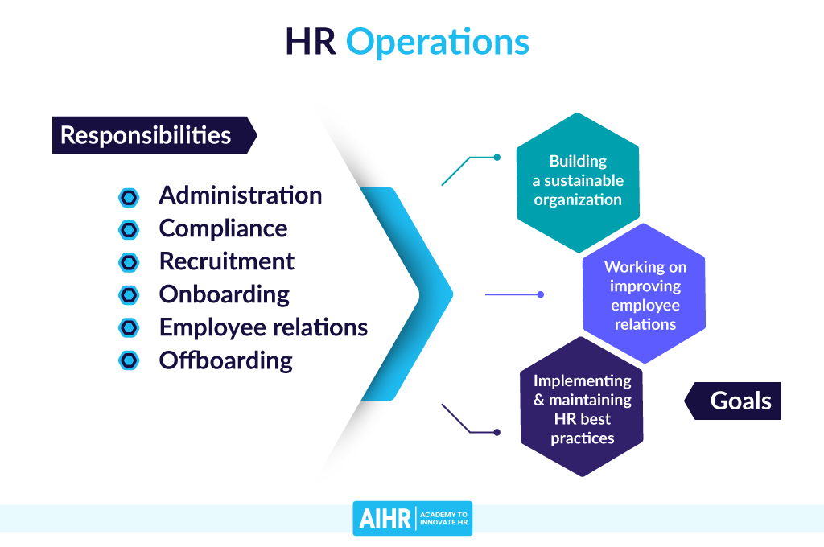
HR

Slide 27
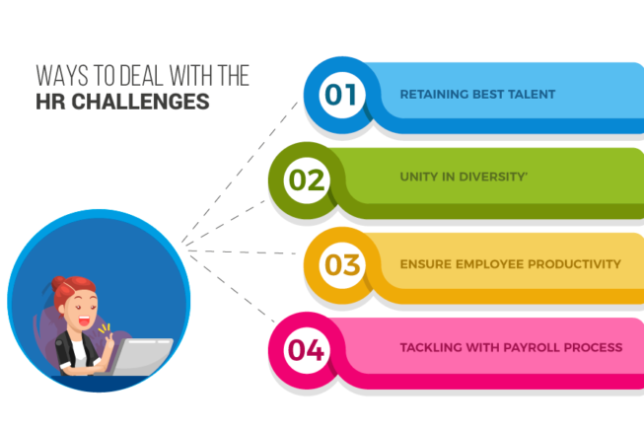

Slide 28


