Slide 1
Chapter 2
And Then There Was JavaScript

Slide 2
The Big Bang
The Dawn of Man
JavaScript

Slide 3
The First Important Discovery of the 21st Century
JavaScript has good parts.

Slide 4
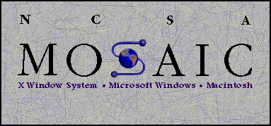

Slide 5


Slide 6
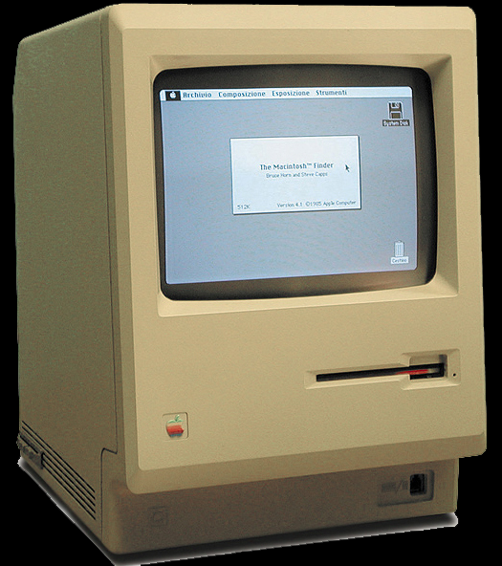

Slide 7
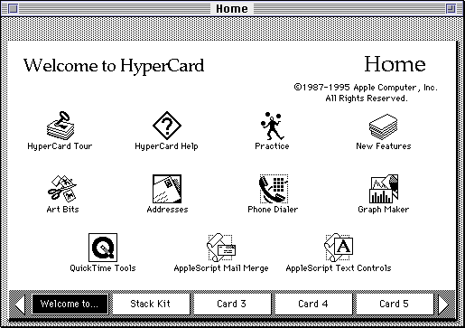

Slide 8
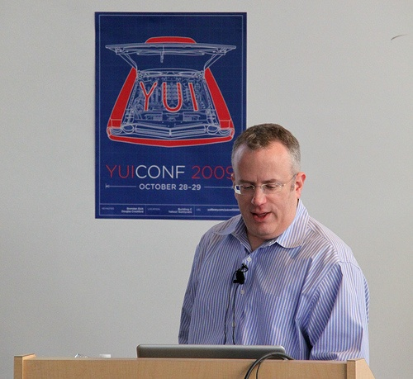

Slide 9
Java
Scheme
Self
LiveScript

Slide 10
Java
Scheme
Self
LiveScript
JavaScript

Slide 11
Java
Scheme
Self
LiveScript
JavaScript
JScript

Slide 12
Java
Scheme
Self
LiveScript
JavaScript
ECMAScript

Slide 13
ECMAScript
1999 Third Edition ES3
2009 Fifth Edition ES5
Default
Strict
2014? Sixth Edition ES6

Slide 14
Where do Bad Parts come from?
Legacy
Good Intentions
Haste
For the most part, the bad parts can be avoided.
The problem with the bad parts isn’t that they are useless.

Slide 15
Objects

Slide 16
An object is a dynamic collection of properties.
Every property has a key string that is unique within that object.

Slide 17
Get, set, and delete
get
object.name
object[expression]
set
object.name = value;
object[expression] = value;
delete
delete object.name
delete object[expression]

Slide 18
Object literals
An expressive notation for creating objects.
var my_object = {foo: bar};
var my_object = Object.defineProperties(
Object.create(Object.prototype), {
foo: {
value: bar,
writeable: true,
enumerable: true,
configurable: true
}
});

Slide 19
Classes v Prototypes

Slide 20
Working with prototypes
Make an object that you like.
Create new instances that inherit from that object.
Customize the new objects.
Taxonomy and classification are not necessary.

Slide 21
Delegation
Differential Inheritance

Slide 22
JavaScript didn’t get it quite right
function bump_count(word) {
if (word_count[word]) {
word_count[word] += 1;
} else {
word_count[word] = 1;
}
}
Accidental collisions: Fails when word === 'constructor'

Slide 23
JavaScript didn’t get it quite right
function bump_count(word) {
if (typeof word_count[word] ===
'number') {
word_count[word] += 1;
} else {
word_count[word] = 1;
}
}

Slide 24
The for in problem
Functions inherited from a prototype are included in the for in enumeration.
for (name in object) {
if (object.hasOwnProperty(name) {
…
}
}
This can fail if an object has a hasOwnProperty property.

Slide 25
The for in problem
Functions inherited from a prototype are included in the for in enumeration.
for (name in object) {
if (Object.prototype
.hasOwnProperty
.call(object, name)) {
...
}
}

Slide 26
Keys must be strings
Automatic type coercion.

Slide 27
Object and …
Number
Boolean
String
Array
Date
RegExp
Function

Slide 28
Number

Slide 29
Number literals
.01024e4
1.024e+3
10.24E2
102.4E+1
1024.e0
1024.00
1024
10240e-1

Slide 30
Numbers
Only one number type
No integer types
64-bit floating point
IEEE-754 (aka “Double”)

Slide 31
Good that we don’t have int
a > 0
b > 0
c = a + b;
Possible results:
c < a
c < b

Slide 32
Associative Law does not hold
(a + b) + c === a + (b + c)
Produces false for some values of a, b, c.
Integers under 9007199254740992 (9 quadrillion) are ok.
9007199254740992 === 9007199254740992 + 1

Slide 33
(a + 1) – 1 === a
Can be false.

Slide 34
Decimal fractions are approximate
a = 0.10;
b = 0.20;
c = 0.30;
(a + b) + c === a + (b + c)
false
a + b === c
false

Slide 35
Number methods
toExponential
toFixed
toLocaleString
toPrecision
toString
valueOf

Slide 36
Number methods
if (!Number.prototype.trunc) {
Number.prototype.trunc =
function trunc(number) {
return number >= 0
? Math.floor(number)
: Math.ceil(number);
};
}

Slide 37
Numbers are first class objects
A number can be stored in a variable.
A number can be passed as a parameter.
A number can be returned from a function.
A number can be stored in an object.
A number can have methods.

Slide 38
Math object
abs
acos
asin
atan
atan2
ceil
cos
exp
floor
log
max
min
pow
random
round
sin
sqrt
tan

Slide 39
Math object
E
LN10
LN2
LOG10E
LOG2E
PI
SQRT1_2
SQRT2
function log2(x) {
return Math.LOG2E *
Math.log(x);
}

Slide 40
NaN
Special number: Not a Number
Result of undefined or erroneous operations
Toxic: any arithmetic operation with NaN as an input will have NaN as a result
NaN is not equal to anything, including NaN
NaN === NaN is false
NaN !== NaN is true

Slide 41
x = x + 1
Mathematical nonsense.

Slide 42
x = x + 1
Infinity

Slide 43
x = x + 1
Infinity
Number.MAX_VALUE
1.7976931348623157e+308

Slide 44
x = x + 1
Infinity
Number.MAX_VALUE
9007199254740992

Slide 45
x = x + 1
But not NaN
because NaN === NaN is false

Slide 46
x = x + 1
But not NaN
because NaN === NaN is false
NaN !== NaN is true!

Slide 47
Boolean
true
false

Slide 48
String

Slide 49
Strings
A sequence of 0 or more 16-bit Unicode characters
UCS-2, not quite UTF-16
No awareness of surrogate pairs
No separate character type
Characters are represented as strings with length of 1
Strings are immutable
Similar strings are equal ( === )
String literals can use single or double quotes with \ escapement.
Use " for external strings.
Use ' for internal strings and characters.

Slide 50
Convert a number to a string
Use number’s method (toString)
Use String function
str = num.toString();
str = String(num);

Slide 51
Convert a string to a number
Use the Number function.
Use the + prefix operator.
Use the parseInt function.
num = Number(str);
num = +str;

Slide 52
parseInt function
parseInt(str, 10)
Converts the value into a number.
It stops at the first non-digit character.
parseInt("12em") === 12
The radix (10) should always be used.
parseInt("08") === 0
parseInt("08", 10) === 8

Slide 53
String length
string.length
The length property determines the number of 16-bit characters in a string.
Extended characters are counted as 2.

Slide 54
String methods
charAt
charCodeAt
compareLocale
concat
indexOf
lastIndexOf
localeCompare
match
replace
search
slice
split
substring
toLocaleLowerCase
toLocaleUpperCase
toLowerCase
toString
toUpperCase
trim
valueOf

Slide 55
trim
if (typeof String.prototype.trim !== 'function') {
String.prototype.trim = function () {
return this.replace(
/^\s*(\S*(\s+\S+)*)\s*$/, "$1");
};
}

Slide 56
supplant
var template = '<table border="{border}">' +
'<tr><th>Last</th><td>{last}</td></tr>' +
'<tr><th>First</th><td>{first}</td></tr>' +
'</table>';
var data = {
first: "Carl",
last: "Hollywood",
border: 2
};
mydiv.innerHTML = template.supplant(data);

Slide 57
supplant
if (typeof String.prototype.supplant !== 'function') {
String.prototype.supplant = function (o) {
return this.replace(/{([^{}]*)}/g,
function (a, b) {
var r = o[b];
return typeof r === 'string' ? r : a;
});
};
}

Slide 58
Array

Slide 59
Arrays
Array inherits from Object.
Indexes are converted to strings and used as names for retrieving values.
Very efficient for sparse arrays.
Not very efficient in most other cases.
One advantage: No need to provide a length or type when creating an array.

Slide 60
length
Arrays, unlike objects, have a special length property.
It is always 1 larger than the highest integer subscript.

Slide 61
Array Literals
An array literal uses []
It can contain any number of expressions, separated by commas
myList = ['oats', 'peas', 'beans'];
New items can be appended
myList[myList.length] = 'barley';
The dot notation should not be used with arrays.

Slide 62
Array methods
concat
every
filter
forEach
indexOf
join
lastIndexOf
map
pop
push
reduce
reduceRight
reverse
shift
slice
some
splice
toLocaleString
toString
unshift

Slide 63
sort
var n = [4, 8, 15, 16, 23, 42];
n.sort();
// n is [15, 16, 23, 4, 42, 8]

Slide 64
Deleting Elements
delete array[number]
Removes the element, but leaves a hole in the numbering.
array.splice(number, 1)
Removes the element and renumbers all the following elements.

Slide 65
Deleting Elements
myArray = ['a', 'b', 'c', 'd'];
delete myArray[1];
// ['a', undefined, 'c', 'd']
myArray.splice(1, 1);
// ['a', 'c', 'd']

Slide 66
Arrays v Objects
Use objects when the names are arbitrary strings.
Use arrays when the names are sequential integers.
Don't get confused by the term Associative Array.

Slide 67
Date
The Date function is based on Java's Date class.
It was not Y2K ready.

Slide 68
RegExp
/\/(\\[^\x00-\x1f]|\[(\\[^\x00-\x1f]|[^\x00-\x1f\\\/])*\]|[^\x00-\x1f\\\/\[])+\/[gim]*/

Slide 69
Function

Slide 70
All values are objects
Except null and undefined.

Slide 71
null
A value that isn't anything

Slide 72
undefined
A value that isn't even that.
The default value for variables and parameters.
The value of missing members in objects.

Slide 73
typeof
The typeof prefix operator returns a string identifying the type of a value.
type | typeof
object | 'object'
function | 'function'
array | 'object'
number | 'number'
string | 'string'
boolean | 'boolean'
null | 'object'
undefined | 'undefined'

Slide 74
Array.isArray
alert(Array.isArray([])); // true
if (typeof Array.isArray !== 'function') {
Array.isArray = function (value) {
return Object.prototype
.toString.apply(value) ===
'[object Array]';
};
}

Slide 75
Object.isObject
alert(Object.isObject({})); // true
if (typeof Object.isObject !== 'function') {
Object.isObject = function (value) {
return value !== null &&
typeof value === 'object';
};
}

Slide 76
Falsy values
false
null
undefined
"" (empty string)
0
NaN
All other values (including all objects) are truthy.
"0" "false"
All values can be said to be boolish.

Slide 77
Loosely Typed
Any of these types can be stored in an variable, or passed as a parameter to any function.
The language is not untyped.
This is a good part.

Slide 78
Reference
Objects can be passed as arguments to functions, and can be returned by functions
Objects are passed by reference.
Objects are not passed by value.
The === operator compares object references, not values
true only if both operands are the same object

Slide 79
C
JavaScript is syntactically a C family language
It differs from C mainly in its type system, which allows functions to be values

Slide 80
Identifiers
Starts with a letter or _ or $
Followed by zero or more letters, digits, _ or $
By convention, all variables, parameters, members, and function names start with lower case
Except for constructor functions which start with upper case
Initial _ should be reserved for implementations
$ should be reserved for machines.

Slide 81
Comments
// slashslash line comment
/*
slashstar
block
comment
*/

Slide 82
Operators
Arithmetic
+ - * / %
Comparison
== != < > <= >=
Logical
&& || !
Bitwise
& | ^ >> >>> <<
Ternary
?:

Slide 83
+
Addition and concatenation
If both operands are numbers,
then
add them
else
convert them both to strings concatenate them
'$' + 3 + 4 = '$34'

Slide 84
+
Unary operator can convert strings to numbers
+"42" = 42
Also
Number("42") = 42
Also
parseInt("42", 10) = 42
+"3" + (+"4") = 7

Slide 85
/
Division of two integers can produce a non-integer result
10 / 3 3.3333333333333335

Slide 86
%
The remainder operator, not the modulo operator.
-1 % 8 // -1, not 7

Slide 87
== !=
Equal and not equal
These operators can do type coercion
It is always better to use === and !==, which do not do type coercion.

Slide 88
Evils of type coercion
'' == '0' // false
0 == '' // true
0 == '0' // true
false == 'false' // false
false == '0' // true
false == undefined // false
false == null // false
null == undefined // true
' \t\r\n ' == 0 // true
1 == [1] // true
true == [1] // true
true == [true] // false

Slide 89
&&
The guard operator, aka logical and
If first operand is truthy
then result is second operand
else result is first operand
It can be used to avoid null references
if (a) {
return a.member;
} else {
return a;
}
can be written as
return a && a.member;

Slide 90
||
The default operator, aka logical or
If first operand is truthy
then result is first operand
else result is second operand
It can be used to fill in default values.
var last = input || nr_items;
(If input is truthy, then last is input, otherwise set last to nr_items.)
May not work as expected if the first operand is a number, because 0 is falsy.

Slide 91
!
Prefix logical not operator.
If the operand is truthy, the result is false. Otherwise, the result is true.
!! produces booleans.

Slide 92
Bitwise
& | ^ >> >>> <<
The bitwise operators convert the operand to a 32-bit signed integer, and turn the result back into 64-bit floating point.

Slide 93
Statements
expression
if
switch
while
do
for
break
continue
return
try/throw

Slide 94
Break statement
Statements can have labels.
Break statements can refer to those labels.
loop: for (;;) {
...
if (…) {
break loop;
}
...
}

Slide 95
For statement
Iterate through all of the elements of an array:
for (i = 0; i < array.length; i += 1) {
// within the loop,
// i is the index of the current member
// array[i] is the current element
}
It is usually better to use the forEach or map method instead.

Slide 96
For in statement
Iterate through all of the members of an object:
for (name in object) {
if (object.hasOwnProperty(name)) {
// within the loop,
// name is the key of current member
// object[name] is the current value
}
}
It is always better to use Object.keys instead.

Slide 97
Switch statement
Multiway branch.
The switch value does not need to a number. It can be a string.
The case values can be expressions.
Danger: Cases fall through to the next case unless a disruptive statement like break ends the case.

Slide 98
Switch statement
switch (expression) {
case ';':
case ',':
case '.':
punctuation();
break;
default:
noneOfTheAbove();
}

Slide 99
Throw statement
throw new Error(reason);
throw {
name: exceptionName,
message: reason
};

Slide 100
Try statement
try {
...
} catch (e) {
switch (e.name) {
case 'Error':
...
break;
default:
throw e;
}
}

Slide 101
Try Statement
The JavaScript implementation can produce these exception names:
'Error'
'EvalError'
'RangeError'
'SyntaxError'
'TypeError'
'URIError'

Slide 102
Next time:
Act III
Function the Ultimate

Slide 103
With statement
Intended as a convenient short-hand
Ambiguous
Error-prone
Don't use it
with (o) {
foo = koda;
}
o.foo = koda;
o.foo = o.koda;
foo = koda;
foo = o.koda;

Slide 104
With statement
with (o) {
foo = koda;
}
if ('foo' in o) {
o.foo = 'koda' in foo ? o.koda : koda;
} else {
foo = 'koda' in foo ? o.koda : koda;
}

