Slide 1
Today
Programming Style and Your Brain
And Then There Was JavaScript
Function the Ultimate
The Metamorphosis of Ajax
ES5: The New Parts

Slide 2
Programming Style & Your Brain
Douglas Crockford

Slide 3
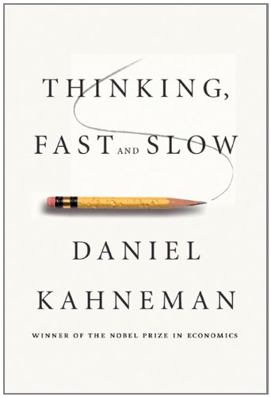

Slide 4
Head. Gut.
Two Systems.

Slide 5
Visual Processing.
An analogy.

Slide 6
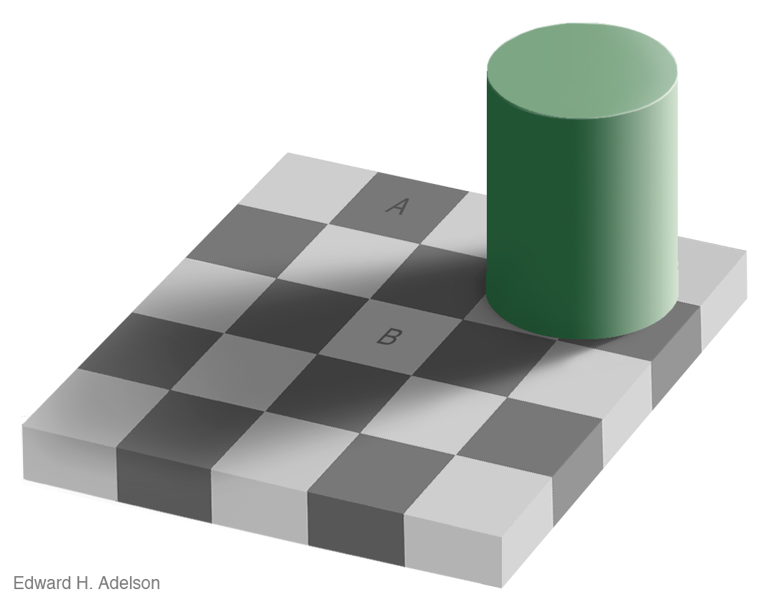

Slide 9
Advertising.

Slide 10
Tobacco.

Slide 11
Computer Programs.
The most complicated things people make.

Slide 12
Artificial Intelligence.

Slide 13
Programming Language.

Slide 14
Perfection.

Slide 15
Hunters and Gatherers.

Slide 16
Programming uses Head and Gut.
Tradeoffs.

Slide 17
JavaScript.
Good Parts.
Bad Parts.

Slide 18
JSLint.
JSLint defines a professional subset of JavaScript.
http://www.JSLint.com/

Slide 19
WARNING!
JSLint will hurt your feelings.

Slide 20
Left or Right?
block
{
....
}
block {
....
}

Slide 21
Left or Right?
block
{
....
}
Be consistent.
block {
....
}
Everyone should do it like I do.

Slide 22
Left or Right?
return
{
ok: false
};
SILENT ERROR!
return {
ok: true
};
Works well in JavaScript.

Slide 23
return
{
ok: false
};

Slide 24
return; // semicolon insertion
{
ok: false
};

Slide 25
return;
{ // block
ok: false
};

Slide 26
return;
{
ok: false // label
};

Slide 27
return;
{ // useless
ok: false // expression
}; // statement

Slide 28
return;
{
ok: false; // semicolon
}; // insertion

Slide 29
return;
{
ok: false;
}; // empty statement

Slide 30
return;
{ // unreachable statement
ok: false;
}

Slide 31
return
{
ok: false
};
return;
{
ok: false;
}

Slide 32
Prefer forms that are error resistant.

Slide 33
switch statement.
The fallthrough hazard.

Slide 34
“That hardly ever happens”
is another way of saying “It happens”.

Slide 35
A good style can help produce better programs.
Style is should not be about personal preference and self-expression.

Slide 36
THEROMANSWROTELATIN ALLINUPPERCASEWITH NOWORDBREAKS ORPUNCTUATION

Slide 37
Medieval copyists introduced lowercase, word breaks, and punctuation.
These innovations helped reduce the error rate.

Slide 38
Good use of style can help reduce the occurrence of errors.

Slide 39
The Elements of Style William Strunk
http://www.crockford.com/wrrrld/style.html

Slide 40
Programs must communicate clearly to people.

Slide 41
Use elements of good composition where applicable.
For example, use a space after a comma, not before.

Slide 42
Use spaces to disambiguate parens.
No space between a function name and (.
One space between all other names and (.
Wrong:
foo (bar);
return(a+b);
if(a=== 0) {…}
function foo (b) {…}
function(x) {…}

Slide 43
Immediately Invocable Function Expressions
function () {
...
}(); // Syntax error!

Slide 44
Immediately Invocable Function Expressions
(function () {
...
})();

Slide 45
Immediately Invocable Function Expressions
(function () {
...
})()
Dog balls

Slide 46
Immediately Invocable Function Expressions
(function () {
...
}()); // Neatness counts.

Slide 47
The Heartbreak of Automatic Semicolon Insertion
x = y // <-- Missing semicolon
(function () {
...
}());
Never rely on automatic semicolon insertion!

Slide 48
with statement.
with (o) {
foo = koda;
}
o.foo = koda;
o.foo = o.koda;
foo = koda;
foo = o.koda;

Slide 49
with statement.
with (o) {
foo = koda;
}
o.foo = koda;
o.foo = o.koda;
foo = koda;
foo = o.koda;
I am not saying that it isn’t useful.
I am saying that there is never a case where it isn’t confusing.

Slide 50
Confusion must be avoided.

Slide 51
Transitivity? What's That?
0 == '' // true
0 == '0' // true
'' == '0' // false
false == 'false' // false
false == '0' // true
" \t\r\n " == 0 // true
Always use ===, never ==.

Slide 52
If there is a feature of a language that is sometimes problematic, and if it can be replaced with another feature that is more reliable, then always use the more reliable feature.

Slide 53
Multiline string literals
var long_line_1 = "This is a \
long line"; // ok
var long_line_2 = "This is a \
long line"; // syntax error

Slide 54
Avoid forms that are difficult to distinguish from common errors.

Slide 55
if (a = b) {…}
a = b; if (a) {…}
if (a === b) {…}

Slide 56
Make your programs look like what they do.

Slide 57
Scope.
Block scope v function scope.

Slide 58
var statement.
It gets split into two parts:
The declaration part gets hoisted to the top of the function, initializing with undefined.
The initialization part turns into an ordinary assignment. So
function foo() {
...
var myVar = 0, myOtherVar;
Expands into
function foo() {
var myVar = undefined,
myOtherVar = undefined;
...
myVar = 0;

Slide 59
Declare all variables at the top of the function. Declare all functions before you call them.

Slide 60
for (var i …) {…}
Variable i is not scoped to the loop.

Slide 61
Write in the language you are writing in.

Slide 62
Let there be let.

Slide 63
Global variables.
Global variables are evil.
Avoid global variables.
When using global variables, be explicit.
UPPER_CASE
Global variables should be as rare as hens teeth and stick out like a sore thumb.

Slide 64
new prefix
Forgetting new causes a constructor to clobber global variables without warning.
Fixed in ES5/strict.

Slide 65
Constructor functions should be named with InitialCaps.
Nothing else should be named with InitialCaps.

Slide 66
var a = b = 0;
var a = 0, b = 0;
b = 0;
var a = b;

Slide 67
Write in a way that clearly communicates your intent.

Slide 68
if (a) b(); c();

Slide 69
if (a) b(); c();
if (a) {b(); c();}
if (a) {b();} c();

Slide 70
As our processes become more agile, our coding must be more resilient.

Slide 71
++

Slide 72
++
x += 1

Slide 73
++
x += 1
x++

Slide 74
++
x += 1
x++
++x

Slide 75
++x; ++x;
x += 2;

Slide 76
For no cost, by adopting a more rigorous style, many classes of errors can be automatically avoided.

Slide 77
Bad stylists
Under educated.
Old school.
Thrill seeker.
Exhibitionist.

Slide 78
“That was intentional.”
“I know what I’m doing.”

Slide 79
Performance.
Performance specific code is usually crufty.
Clean code is easier to reason about.
Premature optimization is the root of all evil. Donald Knuth
Most of the code has a negligible impact on performance. Only optimize the code that is taking the time.
Algorithm replacement is vastly more effective than code fiddling.

Slide 80
Programming is the most complicated thing that humans do.
Computer programs must be perfect.
Humans are not good at perfect.

Slide 81
Designing a programming style demands discipline.
It is not selecting features because they are liked, or pretty, or familiar.

Slide 82
The Abyss

Slide 83
The JSLint style was driven by the need to automatically detect defects.
Forms that can hide defects are considered defective.

Slide 84
Language Subsetting.
Only a madman would use all of C++.

Slide 85
There will be bugs.
Do what you can to move the odds to your favor.

Slide 86
Good style is good for your gut.

Slide 87
;

