Slide 1
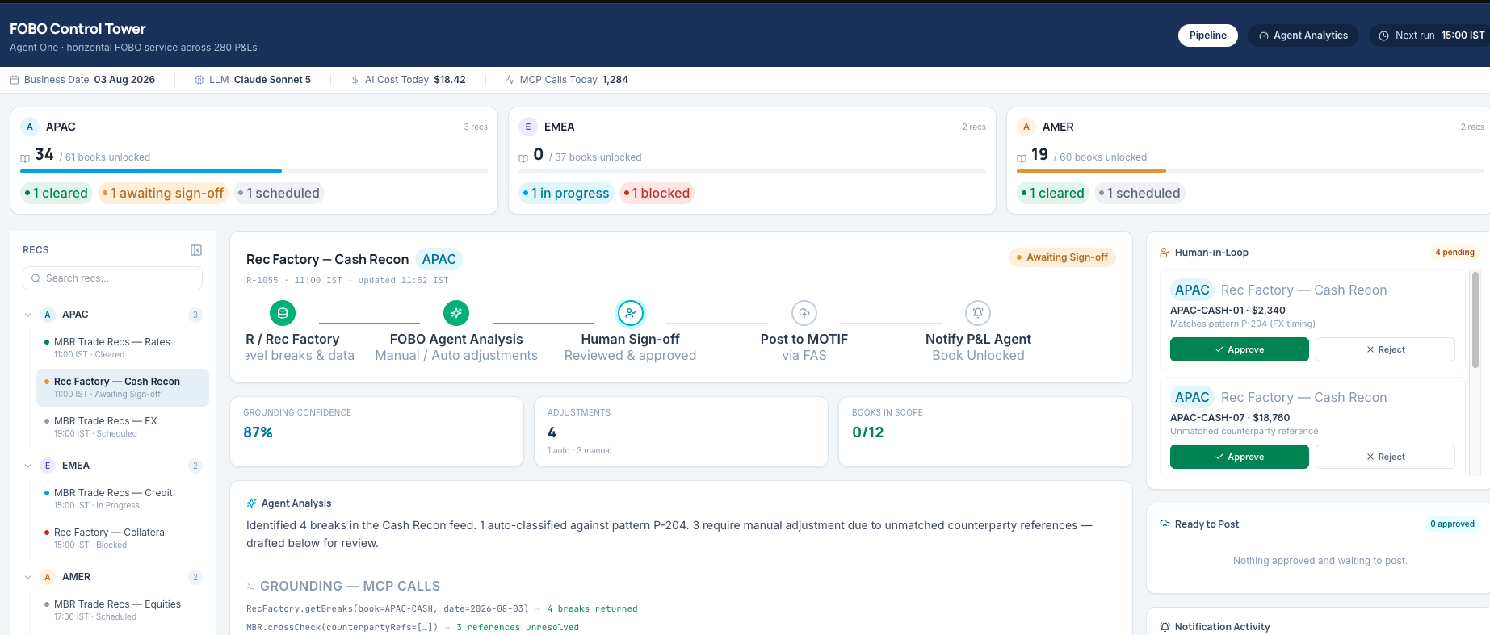
Agent One for FOBO: Architecture at a Glance
One horizontal FOBO service across 280 P&Ls — the agent reasons on AWS Bedrock, but touches our world only through governed enterprise APIs
EXPERIENCE
ORCHESTRATION
ENTERPRISE APIs — VIA MCP
FOBO Control Tower · React UI
Agent One — FOBO Service
Governed, deterministic tool calls
STEPS engine drives the run deterministically
Grounding validator: every number must trace to a system call
Sessions, audit trail and cost telemetry
STEPS API — run orchestration, state and step control
Rec Factory API — book-level breaks and reconciliation data
MBR API — trade recs and counterparty cross-checks
Live pipeline across regions — APAC · EMEA · AMER
Human-in-loop: approvals and sign-off on every adjustment
Real-time updates via WebSocket · scheduled agent runs
AI REASONING
FAS API — posts approved adjustments to MOTIF
AWS Bedrock · Claude
Break classification, adjustment drafting, commentary — no direct data access; every action goes through governed tools
P&L Agent · Notifications — book-unlocked handoff downstream
CONTROLS BUILT IN
Human sign-off gates every adjustment · Grounding enforced — unproven numbers blocked · Full trace observability (Arize Phoenix) · End-to-end audit trail
One horizontal FOBO service today — the same pattern extends to every STEPS process tomorrow.
Notes:
Walkthrough (2 min): left — the Control Tower the team uses daily (live screenshot), human-in-loop by design. Center — the FOBO service: STEPS orchestrates deterministically; the agent reasons on AWS Bedrock (Claude) but has NO direct data access. Right — everything it touches goes through five governed enterprise APIs via MCP: STEPS, Rec Factory, MBR, FAS (posting to MOTIF), and the P&L Agent handoff. Bottom — the controls: sign-off gates, grounding enforcement, Phoenix observability, audit. Close: it is one horizontal service across 280 P&Ls, and the pattern reuses for any STEPS process.

Slide 2
Inside the FOBO Control Tower
One screen tells the whole story — what the agent did, what it is asking permission for, and what it cost
1
1. Run telemetry — business date, model, AI cost, MCP calls today
2. Regional command view — APAC · EMEA · AMER book status
3. Pipeline per rec — Rec Factory → Agent Analysis → Sign-off → Post to MOTIF → Notify P&L
4. Human-in-loop — a person approves or rejects every adjustment
5. Grounding confidence — figures traced to system calls
6. Agent narrative + MCP call log — the why behind every action
2
4
3
5
6
Transparent by default
Nothing silent
Built to scale
Cost, calls and confidence are on the header — not buried in a report
Every pending action sits in the approval queue until a person decides
Same screen, 280 P&Ls, three regions — one horizontal service
Notes:
Let the screenshot breathe — walk the six numbered zones with the legend. Takeaways: transparency on the header, nothing silent (approval queue), one horizontal screen for 280 P&Ls.

Slide 3
System Diagram: Components and Connections
Everything server-side lives inside our AWS boundary; the model reaches systems only through the MCP layer
OUR AWS BOUNDARY — VPC · PRIVATE ENDPOINTS · IAM LEAST-PRIVILEGE
Product Control users
3 regions · maker-checker
Entitlements
central · role-based
Rec Factory API
breaks & book data
FOBO Control Tower
React SPA · live approvals
Agent API
FastAPI · sessions · files · runs
Agent Runtime
tool-calling harness · bounded
AWS Bedrock
Claude · guardrails
MBR API
trade recs · cross-checks
HTTPS / WSS
invoke
FAS API → MOTIF
post approved adjustments
STEPS Engine
orchestration & step state
Skill Registry
approved versions only
MCP Layer
FastMCP · typed tools
Notify · P&L Agent
book-unlocked handoff
tool calls
Oracle 19c
run state + immutable audit
Object Store
input & generated files
Arize Phoenix
traces · evals · cost telemetry
Notes:
Classic box-and-line view. Left to right: users → React SPA → (HTTPS/WSS) → Agent API + STEPS inside the AWS boundary → Agent Runtime → Bedrock (invoke) and MCP layer (tool calls) → four enterprise systems. Gold-bordered boxes = control points (entitlements, Bedrock guardrails). Bottom: Oracle, object store, Phoenix. Dashed = telemetry/audit flows.

Slide 4
Technical Architecture: Five Layers, One Contract
Every layer talks to the next through defined interfaces — the model never bypasses them
EXPERIENCE
React 18 SPA
Control Tower · role-based views
WebSocket stream
live agent output & run status
Human-in-loop UI
approve / reject / sign-off
CROSS-CUTTING
Entitlements — central, role-based
IAM & private networking — nothing leaves our AWS boundary
Audit — every prompt, tool call and decision recorded
SERVICES
Agent API
sessions · files · prompts · run state
STEPS engine
deterministic orchestration & step state
Grounding validator
figures matched to tool results
Context store
step context versioned V1→Vn
AI RUNTIME
AWS Bedrock · Claude
reasoning & drafting
Agent harness
tool-calling loop, bounded actions
Skill registry
versioned skills & prompts, approved only
INTEGRATION
MCP servers (FastMCP)
one per system · typed tools
Rec Factory · MBR
breaks · cross-checks
FAS → MOTIF
posting approved adjustments
STEPS · Notify
state control · P&L handoff
DATA & OPS
Oracle 19c
run state + immutable audit history
Object store
input & generated files per session
Arize Phoenix
trace per run · eval scores
Cost telemetry
per call · per skill · per P&L
The contract: the model acts only through the harness; the harness acts only through MCP; MCP acts only within entitlements. Three fences, independently enforced.
Notes:
Walk top-down: UI, services, AI runtime (dark = the only layer with the model), integration via MCP, data & ops. Right rail: cross-cutting controls. Close on the three-fence contract line.

Slide 5
Anatomy of One Agent Run
From trigger to posted adjustment — eight steps, every one traced
1
Trigger
2
STEPS activates
3
Agent reasons
4
Tools via MCP
Scheduled run (e.g. 15:00 IST) or user start from the Control Tower
The rec step opens deterministically; session attached
Bedrock · Claude plans the work with approved skills only
RecFactory.getBreaks · MBR.crossCheck — typed, logged calls
8
Post & handoff
7
Human sign-off
6
Drafts prepared
5
Grounding check
FAS posts to MOTIF · book unlocked · P&L agent notified
Reviewer approves or rejects each adjustment in the UI
Auto-classified breaks + drafted adjustments and commentary
Every figure matched to a tool result — unmatched output is blocked
Every step above emits a trace to Arize Phoenix — one run, one complete evidence chain, replayable end to end.
Notes:
Snake flow 1→8. Gold nodes = control moments: grounding (5) and human sign-off (7). Close on the trace line — one run, one evidence chain.

Slide 6
Security & Governance: The Technical Guarantees
Four guarantees management can hold us to
IDENTITY & ACCESS
DATA BOUNDARIES
Who can do what
Where data can go
Central entitlement service — role-based access for UI, APIs and tools
The agent inherits the invoking user's entitlements — never more
IAM least-privilege on every AWS component
All processing inside our AWS boundary; private endpoints to Bedrock
Bedrock does not train on our data — model isolation by contract
The model holds no credentials and has no direct database access
CHANGE CONTROL
OBSERVABILITY & AUDIT
How the agent changes
How we prove it
Skills and prompts are versioned (V1→Vn); only approved versions load
Every change passes evaluation + business approval before release
Rollback to any prior version in minutes, per P&L if needed
Arize Phoenix trace for every run — prompts, tool calls, outputs, scores
Immutable audit history for state and decisions (who, what, when, why)
Cost and latency telemetry per call, per skill, per P&L
Net position: the AI is powerful inside the fences and powerless outside them — and we can evidence that, run by run.
Notes:
Four guarantees: access, data boundaries, change control, audit. Each bullet is verifiable. Close on the fences line.

