Slide 1




What is R?
“R is an integrated suite of software facilities for data manipulation, calculation and graphical display”
Dialect of the S language developed by John Chambers and others at the Bell Labs in 1976
Created in New Zealand by Ross Ihaka and Robert Gentleman in 1991. In 1997 R Core group is formed who control the source code for R.
Version 1.0.0 February 2000
Version 2.0.0 October 2004
Version 4.6.0 May 2026

Slide 2






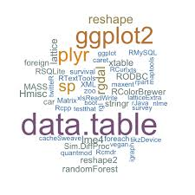
Why R?
Available for almost all operating systems
Lingua franca of the statistical community
State-of-the-art graphics capabilities
General purpose programming language
Contains advanced statistical routines
Good online documentation & vibrant user community
R
Free

Slide 3
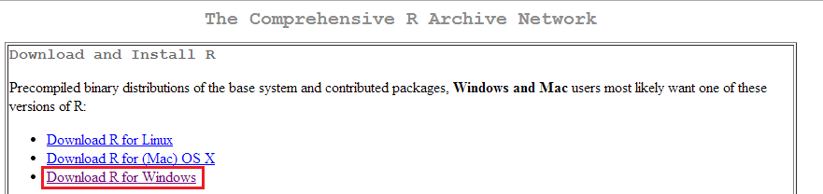
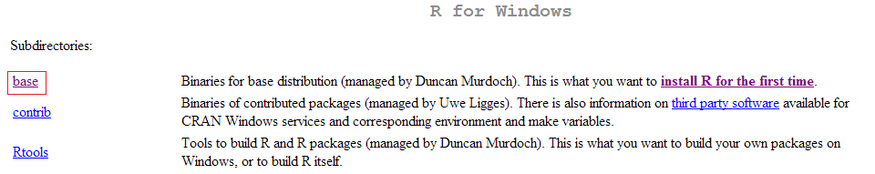
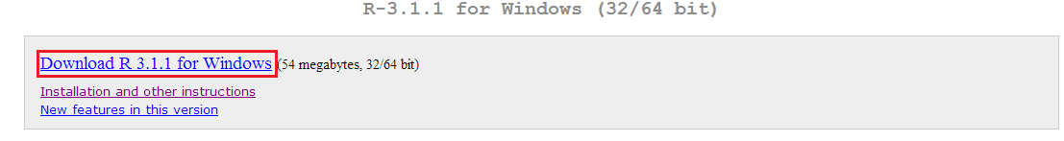
Download R
Visit https://lib.stat.cmu.edu/R/CRAN/
For downloading Rstudio go to http://www.rstudio.com/

Slide 4
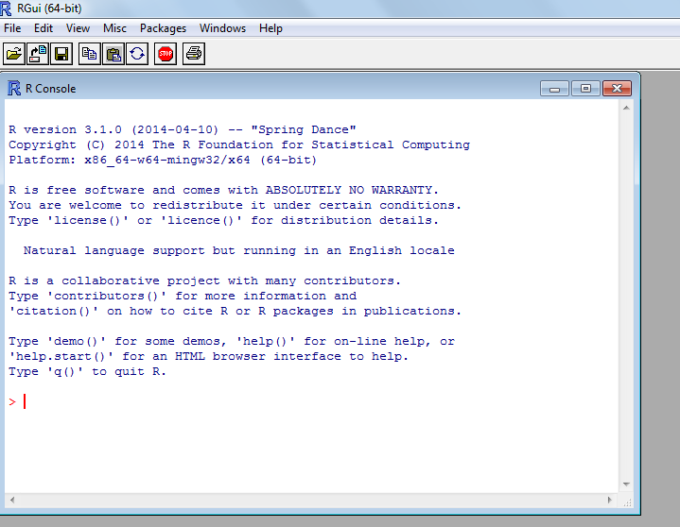
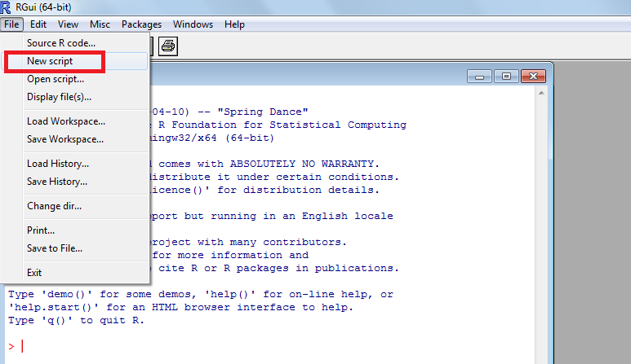
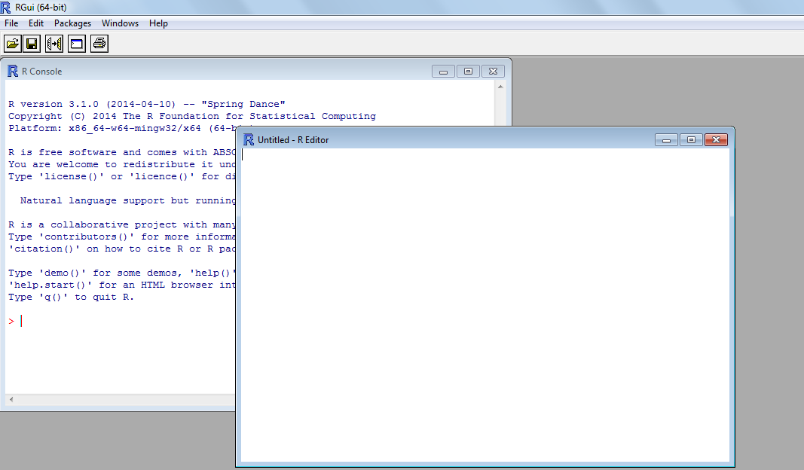
R Interface

Slide 5
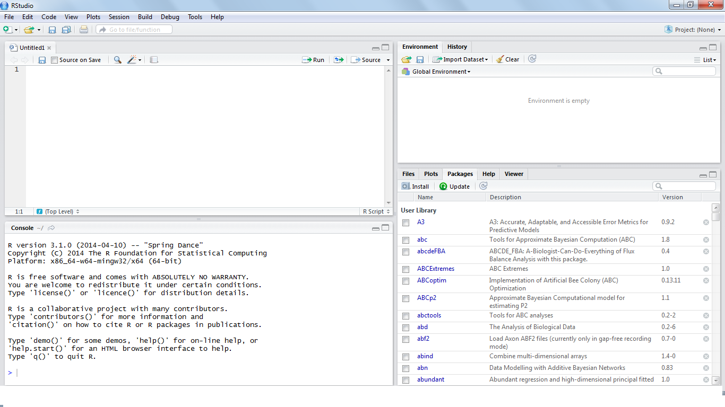
RStudio Interface
History/
Workspace
R Script
R Console
Help/Packages/Plots

Slide 6
Graphic User Interfaces
R provides simple Command line interface(CLI) where user enters statements at command prompt (> by default) and each command is executed one at a time. This is a limitation of R.
So, many GUIs ranging from syntax editors to full blown GUIs for doing analysis with drop down menus available
Integrated development environments and syntax editors
Comprehensive GUIs
Name | URL
Eclipse with StatET plug-in | http://www.eclipse.org and http://www.walware.de/goto/statet
ESS (Emacs Speaks Statistics) | http://ess.r-project.org/
Komodo Edit with SciViews-K plug-in | http://www.activestate.com/komodo_edit/ http://www. sciviews.org/SciViews-K/
JGR | http://www.rforge.net/JGR/
RStudio | http://www.rstudio.org
Tinn-R (Windows only) | http://www.sciviews.org/Tinn-R/
Notepad++ with NppToR (windows only) | http://notepad-plus-plus.org/ http://sourceforge.net/projects/npptor/
Name | URL
JGR/ Deducer | http://ifellows.ucsd.edu/pmwiki/pmwiki.php?n=Main.DeducerManua
R AnalyticFlow | http://www.ef-prime.com/products/ranalyticflow_en/
Rattle (for data mining) | http://rattle.togaware.com/
R Commander | http://socserv.mcmaster.ca/jfox/Misc/Rcmdr/
Red R | http://www.red-r.org/
Rkward | http://rkward.sourceforge.net/

Slide 7
First Session
R is a interpreted, command based language
R is case sensitive
Statements need not end with a semicolon. However if multiple statements are written in a line, semicolon is required.
Comments begin with # symbol
Results of calculations can be stored in objects using the assignment operators:
An arrow (<-) formed by a smaller than character and a hyphen without a space
The equal character (=)
Object names cannot contain `strange' symbols like !, +, -, #
A dot (.) and an underscore (_) are allowed, also a name starting with a dot.
Object names can contain a number but cannot start with a number
Explicit print statements are not necessary
Script files are saved with .R extension
Quit R using q() command or File menu->Exit

Slide 8
Getting Help
Plethora of resources are available to help us learn about R. This include several facilities within R and the Web
R Internal Help
R Internet Help
Function | Action
help.start() | Getting help
help("foo") or ?foo | Help on function foo (the quotation marks are optional)
help.search("foo") or ??foo | Search the help system for instances of the string foo
help(package=foo) | Learn about entire package
example("foo") | Examples of function foo (the quotation marks are optional)
RSiteSearch("foo") | Search for the string foo in online help manuals and archived mailing lists
apropos("foo", mode="function") | List all available functions with foo in their name
data() | List all available example datasets contained in currently loaded packages
vignette() | List all available vignettes for currently installed packages
vignette("foo") | Display specific vignettes for topic foo
Manuals available from http://www.r-project.org/
Search engines listed on R home page. Click Search
“sos” package in R
Rseek search engine: http://www.rseek.org/
http://stackoverflow.com/
http://r.789695.n4.nabble.com/

Slide 9
R Workspace
Objects (vectors, matrices, functions, data frames, or lists). that you create during an R session are held in memory, the collection of objects that you currently have is called the workspace. This workspace is not saved on disk unless you tell R to do so.
Functions for managing R Workspace
Function | Action
getwd() | List the current working directory
setwd("mydirectory") | Change the current working directory to mydirectory
ls() | List the objects in the current workspace
rm(objectlist) | Remove (delete) one or more objects
help(options) | Learn about available options
options() | View or set current options
history(#) | Display your last # commands (default = 25)
savehistory("myfile") | Save the commands history to myfile ( default =.Rhistory)
loadhistory | ("myfile") Reload a command’s history (default = .Rhistory).
save.image("myfile") | Save the workspace to myfile (default = .RData).
save(objectlist,file="myfile") | Save specific objects to a file.
load("myfile") | Load a workspace into the current session (default =.RData)
RAM
Mass Storage
RAM
.Rdata
The workspace is saved as a file called .Rdata and when R starts up, it checks for such a file in the current working directory and loads it automatically

Slide 10
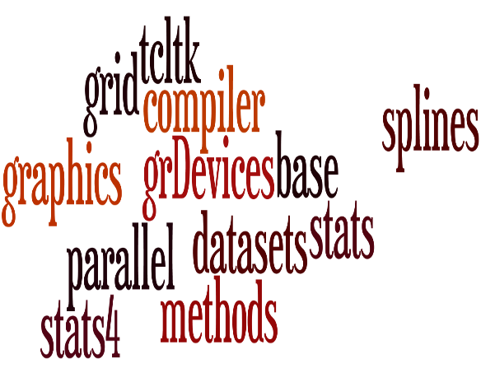

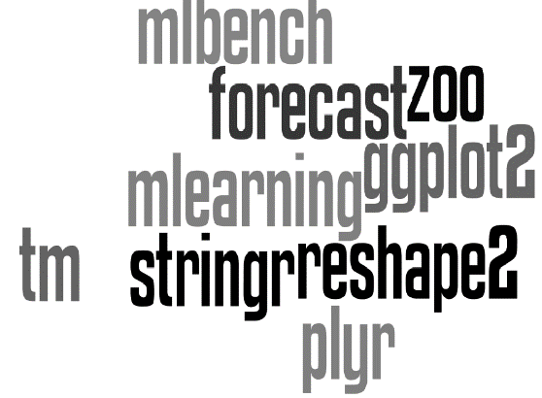
Design of R
R System
“base” R
Everything else
Other remaining packages
Recommended packages
“base” package and other fundamental packages
30 packages
+5800 packages
+5700 packages

Slide 11
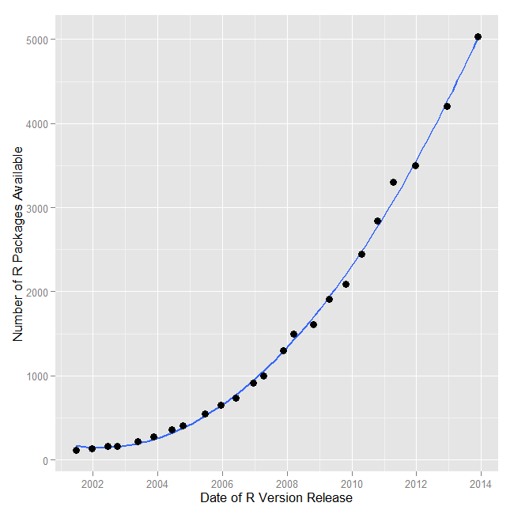
R Packages
Functionality of R is divided into a number of packages. Packages are collections of R functions, data, and compiled code in a well-defined format. The directory where packages are stored on your computer is called the library.
Function | Action
.libPaths() | Where library is located
library() | Shows packages stored in
search() | Which packages are loaded
install.packages(“packagename”,dependencies=TRUE) | Loads required package as well as dependent packages
update.packages(“packagename”) | Updates required package
library(packagename)/require(packagename) | Load package
help(package="package_name") | Help about required package
detach(“package:package_name”,unload=TRUE) | Unload package
remove.packages(“packagename”) | Permanently delete package
ls("package:package_name", all = TRUE) | Shows all functions and datasets in package
data(package = “packagename")$results | all datasets with brief description in package

Slide 12
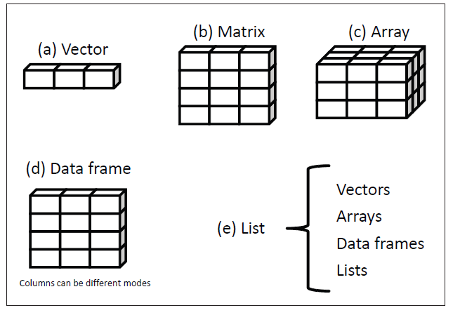
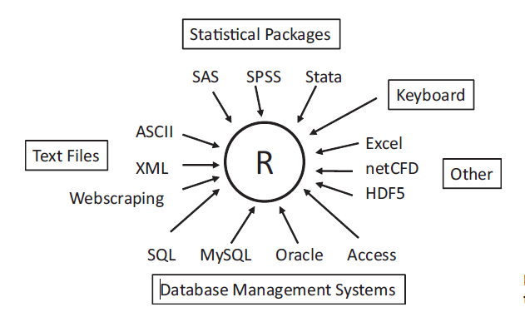
Data Creation
Data Creation
Data Input
Data Structure

Slide 13
R Objects
R Objects
Constants
Special Symbols
Data Structures
Predefined things
Functions
Graphs
An object is anything that can be assigned to a variable
R objects come in a variety of types. Given an object, the functions mode and class tell us about its type.
mode(object) has to do with how the object is stored. R has 5 basic modes:
Numeric
Integer
Character
Logical
Complex
class(object) gives the class of an object. The main purpose of the class is so that generic functions (like print and plot) know what to do with it.

Slide 14
Data Structures
Vectors
The vector type is really the heart of R. Vectors are one-dimensional arrays that can hold numeric data, character data, or logical data
The concatenate function c() is used to form the vector
x<-c(1,2,3) #Numeric
y<-c(“one”, “two”, “three”) #Character
z<-c(TRUE, TRUE, FALSE) #Logical
Note that the data in a vector must only be one type or mode (numeric, character, or logical)
You can refer to elements of a vector using a numeric vector of positions within brackets
x[c(1,3)] refers to the 1st & 3rd elements of vector x

Slide 15
Matrices
A matrix is a two-dimensional array where each element has the same mode (numeric, character, or logical). Matrices are created with the matrix function . The general format is
mymatrix <- matrix(vector, nrow=number_of_rows, ncol= number_of_columns, byrow= logical_value, dimnames=list(
char_vector_rownames, char_vector_colnames))
y1<-matrix(1:30,nrow=5,ncol=6)
y2<-1:30
dim(y2)<-c(5,6)
y3<-cbind(1:5,6:10,11:15,16:20,21:25,26:30)
You can identify rows, columns, or elements of a matrix by using subscripts and brackets
y1[2, ] #Second row of matrix
y1[ ,3] #Third column of matrix
y1[2,3] #Element in the second row & third column of matrix
y1[3,c(1,5)] #Elements in third row & 1st & 5th columns of matrix

Slide 16
Arrays
Arrays are similar to matrices but can have more than two dimensions. They’re created with an array function of the following form:
myarray <- array(vector, dimensions, dimnames)
dim1<- c(“A1”, “A2”)
dim2<- c(“B1”, “B2”, “B3”)
dim3<- c(“C1”, “C2”, “C3”, “C4”, “C5”)
z<- array(1:30, c(2,3,5), dimnames=list(dim1,dim2,dim3))
Like matrices and vectors, they must be of a single mode.
Extracting elements of an array is similar to that of matrices

Slide 17
Data Frames
The most common data structure in R is data frame. A data frame is more general than a matrix in that different columns can contain different modes of data (numeric, character, etc.)
A data frame is created with the data.frame() function :
where col1, col2, col3, … are column vectors of any type (such as character, numeric, or logical)
index<- c(1,2,3)
name<- c(“Peter”, “ Roger”, “Hansen”)
marks<- c(83, 56, 95)
marksheet<- data.frame( index, name, marks)
marksheet[ ,1:2] # Extracting first 2 columns
marksheet[1:2, ] # Extracting first 2 rows
marksheet[ , c(“name”, “marks”)] # Extracting columns using column names
marksheet$marks # Extracting a particular column of a data frame
mydata.frame <- data.frame(col1, col2, col3,…)

Slide 18
Lists
Lists are the most complex of the R data types. Basically, a list is an ordered collection of objects (components). A list may contain a combination of vectors, matrices, data frames, arrays and even other lists.
You create a list using the list() function :
mylist <- list(object1, object2, …) or mylist <- list(name1=object1, name2=object2, …)
listR<-list( title=“First list”, x= c(1,4,5), matrix(1:10,2,5), marksheet=marksheet)
Note, extraction of elements from list is slightly different.
listR[[2]] # Extracting second object of list
listR[[“x”]] # Extracting object by name
listR$x # Alternate way of extracting single object of list
listR[[2]] [3] # Extracting a particular element in an object of the list
listR[c(1,3)] # Extracting multiple objects

Slide 19
Factors
Variables
Nominal
Ordinal
Qualitative
Quantitative
Continuous
Discrete
Factors
Numeric
Integer

Slide 20
Categorical (nominal) and ordered categorical (ordinal) variables in R are called factors
The function factor() stores the categorical values as a vector of integers internally. The factor function is used to create a factor.
.
Nominal data:
data <- c("Type1", "Type2", "Type1", "Type1“,"Type3")
fdata <- factor(data)
rdata <- factor(data,labels=c("I","II","III"))
Ordinal data:
status <- c(“Ailing", "Improved", "Excellent", “Ailing")
status <- factor(status, order= TRUE, levels=c("Poor", "Improved", "Excellent"))
assigns the levels of the factor variable as 1=Poor, 2=Improved, 3=Excellent.

Slide 21
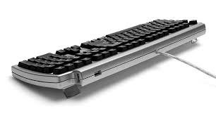
Data Input
Keyboard
Simplest method of data entry. The edit() function in R will invoke a text editor that will allow you to enter your data manually. Here are the steps involved:
1 Create an empty data frame (or matrix) with the variable names and modes you want to have in the final dataset.
2 Invoke the text editor on this data object, enter your data, and save the results back to the data object.
keyboard.data<- data.frame( name=character(0),gender=character(0),age=numeric(0),marks=numeric(0))
keyboard.data<- edit( keyboard.data) #Alternative for this line: fix(keyboard.data)
If you click on a column title, the editor gives you the option of changing the variable name and type (numeric, character). You can add additional variables by clicking on the titles of unused columns.
Note: This method of data entry works well for small datasets

Slide 22
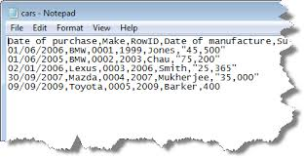
Delimited Text File
Use read.table function
mydataframe <- read.table (file, header=logical_value, sep="delimiter", row.names="name")
where file is a delimited ASCII file , header is a logical value indicating whether the first row contains variable names (TRUE or FALSE), sep specifies the delimiter separating data values, and row.names is an optional parameter specifying one or more variables to represent row identifiers
cars.data <- read.table(“C:\\Users\\Suprit\\Desktop\\cars.csv", header=TRUE, sep=",", row.names="ID")
Note:
Use “\\” or “/” for specifying file path in R
The default separator in read.table is sep="", which denotes one or more spaces, tabs, new lines, or carriage returns
By default, character variables are converted to factors. Including the option stringsAsFactors=FALSE will turn this behaviour off for all character variables
You can use the colClasses option to specify a class (for example, logical, numeric, character, factor) for each column.

Slide 23

EXCEL Spreadsheets
AVOID IMPORTING DATA IN EXCEL FORMAT !!!
Reasons:
Cells could be merged, colored, bold etc.
Several data tables could be put anywhere
Charts inside sheets
For more issues with importing excel files go to :http://biostat.mc.vanderbilt.edu/wiki/Main/ExcelProblems
Solution:
Save your excel data in a pure text format : CSV or tab-delimited
CSV:
mycsv <- read.csv(file, header=logical_value) or mycsv <- read.table (file, header=logical_value, sep=“,”)
Tab-delimited:
mytab<- read.delim(file, header=logical_value) or mytab <- read.table (file, header=logical_value, sep=“\t”)

Slide 24


SPSS
SPSS datasets can be imported into R via the read.spss() function in the foreign package . Alternatively, you can use the spss.get() function in the Hmisc package .
install.packages("Hmisc")
library(Hmisc)
myspssdata <- spss.get("mydata.sav", use.value.labels=TRUE)
SAS
A number of functions in R are designed to import SAS datasets, including read.ssd() in the foreign package , sas.get() in the Hmisc package .and read.sas7bdat in sas7bdat package. But it is recommended to save SAS datasets in csv format
SAS program:
proc export data= mydata
outfile ="mydata.csv"
dbms =csv;
run;
R program:
mydata <- read.table("mydata.csv", header=TRUE, sep=",")

Slide 25
Annotating datasets
Variable labels
Use names function to edit variable names in data frame
x<- data.frame (a=c(21,33,43),b=c(“Jeffrey”, “Pat”, “Maurice”), c=c(“M”, “M”, “M”))
names(x) <-c(“Age”, “Name”, “Gender”)
Value labels
The factor() function can be used to create value labels for categorical variables
Nominal data
patientdata$gender <- factor(patientdata$gender, levels = c(1,2),labels = c("male", "female"))
Ordinal data
student$grade <- ordered(student$grade, levels = c(1,3, 5), labels = c("Low", "Medium", "High"))

Slide 26
Vectors
Fundamental data type in R
Adding/Deleting
x<- c(23,12,43,1)
x<- c(x[1:3],456,x[4]) #Insert 456 before 1
Obtaining length of vector
length(x)
Declaration
y<- c(5,12,13)
#Alternative
y<- vector(length=3)
y[1]<-5
y[2]<-12
y[3]<-13
Always reassign the vector while editing/appending the vector
Length of a null vector is 0
Do not need to mention the variable type of the vector like C

Slide 27
Vector Arithmetic
x<-c(1,2,3)
y<-c(2,4,6)
x+y #addition
x*y #multiplication
y/x #division
x^y #exponentiation
y%%x #just the remainder
y%/%x #Integer part of the quotient
Vector Indexing
x<-c(1,4,5,12,-9)
x[c(1,3)] #Extract 1st & 3rd elements of x
x[1:3] #Extract 1st , 2nd & 3rd elements of x
x[-5] #Exclude the 5th element of x
x[-c(2,4)] #Exclude 2nd & 4th element of x
R can be used as a calculator. Note that the operations occurs element by element
Frequently used operation. Negative subscripts mean that we want to exclude elements in our output

Slide 28
Generating vectors
x<- c(2,4,6,8,10,11,11,11,11,11.5,11.5,11.75,11.75,12,13,14,15)
x1<- 12:15 # “:” Produces consecutive integers
x2<- seq (from=2,to=10,by=2) # “seq” generates a AP sequence
x2.1<-seq(from=2,to=10,length=5)
x3<- rep(11,times=4) # Repeat constants
x4<- rep(c(11.5,11.75),each=2)
x<- c(x2, x3,x4,x1)
Using all() and any()
x<-1:15
any(x>4)
all(x>4)
Very useful in data creation. Frequently required
any() & all() functions are shortcuts to report whether any or all of their arguments are TRUE

Slide 29
Vectorized Operations
One of the most effective ways to achieve speed in R code is to use operations that are vectorized. Meaning that a function applied to a vector is actually applied individually to each element.
u<- c(5,2,8)
v<- c(1,3,9)
u>v #Checking condition element wise
sum(u>v) #Number of instances where condition is TRUE
sqrt (1:9) # Mathematical functions are vectorized
w<- c(1.2,3.9,0.4)
round(w)
u+4
NA & NULL
x<-c(12,NA,20,28)
mean(x)
mean(x,na.rm=TRUE)
y<-c(12,NULL,20,28)
mean(y)
In R, vectorization is often done for both (a) readability and (b) performance
Missing data in R is represented by NA. NULL on the other hand represents non existent values

Slide 30
Filtering
This allows us to extract vector elements that satisfy certain conditions. Very useful in data manipulation.
x<-c(2,6,3,8,10)
y<- x>5
x[y]
# Alternative
x[x>5]
price<-c(10,30,20,50)
sales<-c(1000,200,500,100)
price[(sales*2)>300]
z<-c(1,3,8,2,20)
z[z>3]<-0
z
Extraction of vector elements based on multiple conditions is also possible
Here we are using one vector to determine indices to use in filtering another vector
Assignment can be compactly done based on certain conditions easily

Slide 31
Filtering with the subset() function
x<-c(2,6,3,8,10)
subset(x, x>5)
y<- c(6,1:3,NA,12)
y[y>5]
subset(y, y>5)
Filtering using which() function
x<-c(2,6,3,8,10)
which(x>5)
x[which(x>5)]
Difference between ordinary filtering & this is the manner in which NA values are handled
which() allows us to find out the positions that satisfy the given conditions

Slide 32
Vectorized ifelse() function
In addition to the usual if-then-else construct found in most languages, R includes a vectorized version, the ifelse() function
ifelse( b, u, v)
where b is a Boolean vector , u & v are vectors
x<-2:10
ifelse(x%%2==0, “Even”, “Odd”)
ifelse(x>5, x+2, x+3)
Vector Element Names
x<-c(1,2,4)
names(x)
names(x)<- c(“a”, “b”, “c”)
names(x)
names(x)<-NULL
Advantage over standard if-else construct is that it is vectorized, thus potentially much faster
Assign vector element names using names() function. Remove names by assigning NULL

Slide 33
Matrices
A matrix is a vector with two additional attributes: number of rows & number of columns. Matrices are special cases of arrays which can be multidimensional.
Creating Matrices
Matrix row & column subscripts begin with 1. Ex: a[1,1] is the first element of the matrix a
Use matrix() function:
y<- matrix(c(1,2,3,4), nrow=2, ncol=2)
#Alternative
y<- matrix(nrow=2,ncol=2)
y[1,1]<-1
y[2,1]<-2
y[1,2]<-3
y[2,2]<-4
y1<-matrix(c(1,2,3,4),nrow=2,ncol=2,byrow=TRUE)
#Alternative
y2<- cbind(c(1,2),c(3,4))
y3<- rbind(c(1,3),c(2,4))
When we construct a matrix directly with data elements, the matrix content is filled along the column orientation by default
The byrow argument enables input to be read along row orientation form
cbind() & rbind() combines vectors, matrices, data frames by column & row respectively

Slide 34
Matrix Computations
Most matrix operations use the same symbols as the math operations
mat1<-matrix(1:6,nrow=2,ncol=3)
mat2<-matrix(1:6,nrow=2,ncol=3,byrow=TRUE)
t(mat1) # Transpose
mat1+mat2 # Addition
mat1-mat2 # Subtraction
mat3<-mat1 %*% t(mat2) # Matrix multiplication
det(mat3) # Determinant
solve(mat3) # Inverse
mat1*2 # Element wise multiplication
mat1*mat2
mat1/2 # Element wise division
mat1/mat2
Matrix Indexing
mat<- matrix(1:12,3,4)
mat[2:3,] # Extract 2nd to 3rd row
mat[, c(1,3)] # Extract 1st & 3rd column
mat[,-4] # Exclude 4th column
Note the difference in symbols used for matrix multiplication & element wise multiplication
Similar to vector indexing

Slide 35
Filtering
mat<-matrix(c(1,2,2,3,3,4),nrow=3,ncol=2,byrow=TRUE)
i<-mat[ ,2]>=3
mat[i, ]
# Alternative
mat[mat[,2]>=3, ]
z<-c(5,12,13)
x[z%%2==1, ]
m<-matrix(1:6,2,2)
m[m[ ,1]>1 & m[ ,2]>5, ]
m[m[ ,1]>1 & m[ ,2]>5, ,drop=FALSE]
m<- matrix(c(5,2,9,-1,10,11),3,2)
which(m>2)
Matrix filtering is similar to vector filtering
Filtering criterion can be based on a different variable from the one to which filtering will be applied
The drop=FALSE argument retains the two dimensional nature of the data

Slide 36
Using the apply() function
One of the most famous & popular features is the apply() family of functions, such as apply(), lapply(), sapply(), mapply(), tapply(). Let us look at apply() which is used to evaluate a function over the margins of a matrix.
apply(m, dimcode, f, fargs) where
m is the matrix
dimcode is the dimension, 1 if function applies to rows, 2 for columns
f is the function to be applied
fargs is an optional set of arguments to be supplied to f
m<-matrix(1:6,3,2)
apply(m,2,mean) #Column means
apply(m,1,max) #Row maximum
x<-matrix( rnorm(200),20,10)
apply(x,1,quantile,probs=c(0.25,0.75))#1st & 3rd quartile of each row
Do not loop , use apply() in R
Makes code compact, easier to read, modify and avoid possible bugs

Slide 37
Adding/Deleting matrix rows & columns
mat<- matrix(1:12,3,4)
one<- c(1,1,1)
mat<-cbind( one, mat)
odd<- c(3,5,7,9,11)
mat<-rbind( mat, odd)
mat<-mat[c(1,3), ]
Naming matrices/Other functions
mat<-matrix(1:4,2,2)
colnames(mat)
colnames(mat)<-c(“a”, “b”)
rownames(mat)<-c(“Row1”, “Row2”)
mat
dim(mat) #Get dimensions of matrix
nrow(mat) #Alt: dim(mat)[1]
ncol(mat) #Alt: dim(mat)[2]
cbind() & rbind() functions let you add columns & rows to a matrix
Delete columns/rows by reassignment
Similar to names() function for vectors
Useful while writing functions whose argument is a matrix

Slide 38
Lists
A list is a collection of objects. The elements of a list can be different types of object and can be of different lengths.
Plays a central role in R and forms a basis for data frames & object oriented programming.
Creating Lists
x<-list( first=1:10, second=c("yes", "no"), third=c(T,F), fourth= gl(2,3) )
x1<-list(1:10, c("yes", "no"), c(T,F), gl(2,3) )
#Alternative
y<-vector(mode="list")
y[["first"]]<-1:10
y[["second"]]<-c("yes","no")
y[["third"]]<-c(T,F)
y[["fourth"]]<-gl(2,3)
Indexing
x$first #Extract component of list
x[[1]] # Alternative
x[[“first”]] # Alternative
x[1:3] #Extract more than 1 component
x[[“first”]][5] #Extract a particular element of component
Using names in lists makes it clearer & less error prone
Lists are also vectors so they can be created via vector()
Use [[ ]] to access list components

Slide 39
Adding/Deleting List Elements
z <-list(a=“abc”, b=12)
z$c <-"New” #Adding
z[[4]] <-27
z[5:7] <-c(FALSE,TRUE,FALSE)
z$b <-NULL #Deleting
z1<-c( z, list(last=matrix(1:6,3,2))) #Concatenate lists
unlist() & names() function
l<-list(a=1:100,b=2:5)
names(l) #Get tags of list
unlist(l) # List to vector
list1<-list(name="Joe", salary=5500,Graduate=TRUE)
unlist(list1)
names(list1)<-NULL #Remove names from list
#Alternative
list1<-unname(list1)
Adding/Deleting list elements are often required in R
Indices of list get adjusted after deletion
Concatenating lists is another way for adding list elements
unlist() function flattens the list into a vector, and coerce types so that all elements are of the same type

Slide 40
lapply() & sapply() functions
Two functions are handy for applying functions to lists: lapply and sapply
x<-list(a=1:5,b=rnorm(100), c=c(23,45,67))
lapply(x, median)
lapply(x, function(y) (max(y)+min(y))/3)
lapply(x, function(y) c(min(y),max(y),mean(y),median(y)))
sapply(x, median)
sapply(x, function(y) (max(y)+min(y))/3)
desc<-sapply(x, function(y) c(min(y),max(y),mean(y),median(y)))
rownames(desc)<-c("Min", "Max", "Mean", "Median")
lapply() is the workhorse of many other *apply functions. Peel back their code and you will find lapply underneath.
lapply() loops over a list and evaluates a function on each component
sapply() is a user-friendly version of lapply() by default returning a vector or matrix if appropriate

Slide 41
Data Frames
A data frame is like a matrix, with a two dimensional row & column structure. However each column may have different modes. Technically, a data frame is a list of equal length vectors. Most of the real life datasets are data frames.
Creating data frames
kids=c("Jack", "Jill")
ages<-c(12,10)
d<-data.frame( kids, ages, stringsAsFactors=FALSE)
Accessing data frames
#Since data frame is a list
d[[1]] #First column
d$kids
#Since data frame is matrix like
d[ , 1] # First column
d[ , colnames(d)=="kids"]
d[ , "kids"]
By default all character vectors are converted to factors while creating data frames
It is clearer & safer to extract columns by column names

Slide 42
Filtering
data<-read.table("C:\\Users\\Suprit\\Desktop\\example.txt",header=TRUE)
data[2:5, ] # 2nd to 5th rows
data[2:5,4] # 4th column of above
data[2:5,4,drop=FALSE] # Retains the data frame structure
data[ data$maths >80 & data$statistics >90, ]
#Alternative
subset(data, maths >80 & statistics >90)
rbind() & cbind()
kids=c("Jack", "Jill")
ages<-c(12,10)
d<-data.frame( kids, ages, stringsAsFactors=FALSE)
d<-rbind(d, list(" Laura ",19))
d<-cbind(d, c(89,45,76))
names(d)[3]<-"Marks"
Mostly imported data sets are stored as data frames
rbind() & cbind() are used to append data frames

Slide 43
apply, lapply & sapply
data<-read.table("C:\\Users\\Suprit\\Desktop\\example.txt",header=TRUE)
apply(data[ ,3:5],1,max)
data1<-lapply(data, sort)
data2<-sapply(data[ ,3:5], function(x) c(sum(x),mean(x)))
rownames(data2)<-c("Total Marks", "Average Marks")
attach(), detach() & with()
The attach() function adds the data frame to the R search path. The detach() function removes the data frame from
the search path.
attach(data)
statistics
maths + computer
detach(data)
#Alternative
with(data, {
print(statistics)
print(maths + computer)})
Since data frame is both a list & matrix like we are able to apply all three functions
The attach() function in R makes objects within data frames accessible in R with fewer keystrokes. Should be avoided since there may be multiple objects with same name.

