Slide 1
Placement Groups:
A Placement Group is a logical grouping of instances within a single Availability Zone and are recommended for applications that benefits from low network latency, high network throughput, or both.
Placement group don’t span across Availability Zones
Placement group is only available within a single Availability Zone either in the same VPC or peered VPCs
Placement group is more of an hint to AWS that the instances need to be launched physically close to each together
Using placement groups enables applications to participate in a low-latency, 10 Gbps network.
Only Specific Instance types (General Purpose, GPU, Compute, Memory, Storage Optimized – m4.10xlarge, c4.8xlarge, c3.8xlarge, g2.8xlarge, r3.8xlarge, i2.8xlarge, d2.8xlarge) which support 10 Gigabyte network performance can take full advantage of Placement Group

Slide 2
Placement Groups cannot be merged. Instances in one placement group should be terminated, and then re launched into an other placement group
Existing EC2 instance can’t be moved into a Placement Group as it might be physically located away from the existing instances
For moving an instance into the placement group,
create an AMI from the existing instance,
and then launch a new instance from the AMI into a placement group.
AWS recommends using the same homogenous instance type for all instances in a placement group
Placement group can span peered VPCs

Slide 3
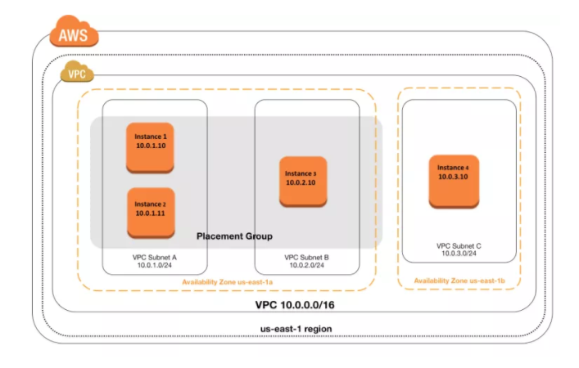

Slide 4
EC2 Storages:-
Amazon EC2 provides flexible, cost effective and easy-to-use EC2 storage options with a unique combination of performance and durability .
Amazon Elastic Block Store (EBS)
Amazon EC2 Instance Store
Amazon Simple Storage Service (S3)

Slide 5
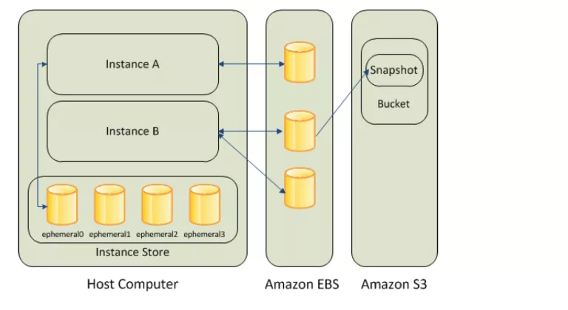

Slide 6
EBS Storages:-
Amazon EBS provides highly available, reliable, durable, block-level storage volumes that can be attached to a running instance
EBS as a primary storage device is recommended for data that requires frequent and granular updates for e.g. running a database or file systems
An EBS volume behaves like a raw, unformatted, external block device that can be attached to a single EC2 instance at a time
EBS volume persists independently from the running life of an instance.
An EBS volume can be attached to any instance within the same Availability Zone, and can be used like any other physical hard drive.
EBS volumes allows encryption using the Amazon EBS encryption feature. All data stored at rest, disk I/O, and snapshots created from the volume are encrypted. Encryption occurs on the EC2 instance, providing encryption of data-in-transit from EC2 to the EBS volume.
EBS volumes can be backed up by creating a snapshot of the volume, which is stored in Amazon S3. EBS volumes can be created from a snapshot can be attached to an another instance within the same region.
Snapshots can also be copied to other regions and then restored to new volumes, making it easier to leverage multiple AWS regions for geographical expansion, data center migration, and disaster recovery.

Slide 7
Benefits:-
Data Availability
EBS volume is automatically replicated in an Availability Zone to prevent data loss due to failure of any single hardware component.
Data Persistence
EBS volume persists independently of the running life of an EC2 instance
EBS volume persists when an instance is stopped and started or rebooted
All attached volumes persist, by default, on instance termination
Data Encryption
EBS volumes can be encrypted by EBS encryption feature
EBS encryption uses 256-bit Advanced Encryption Standard algorithms (AES-256) and an Amazon-managed key infrastructure.
Encryption occurs on the server that hosts the EC2 instance, providing encryption of data-in-transit from the EC2 instance to EBS storage.
Snapshots of encrypted EBS volumes are automatically encrypted.

Slide 8
Snapshots:-
EBS provides the ability to create snapshots (backups) of any EBS volume and write a copy of the data in the volume to Amazon S3, where it is stored redundantly in multiple Availability Zones
Snapshots can be used to create new volumes, increase the size of the volumes or replicate data across Availability Zones
Snapshots are incremental backups and store only the data that was changed from the time the last snapshot was taken.
Snapshots size can probably be smaller then the volume size as the data is compressed before being saved to S3
Even though snapshots are saved incrementally, the snapshot deletion process is designed so that you need to retain only the most recent snapshot in order to restore the volume.

Slide 9
EBS Types:-
AWS provides the following EBS volume types, which differ in performance characteristics and price which can be tailored for storage performance and cost to the needs of the applications:
General Purpose SSD Volumes (gp2)
Provisioned IOPS SSD Volumes (io1)
Magnetic Volumes (standard)

Slide 10
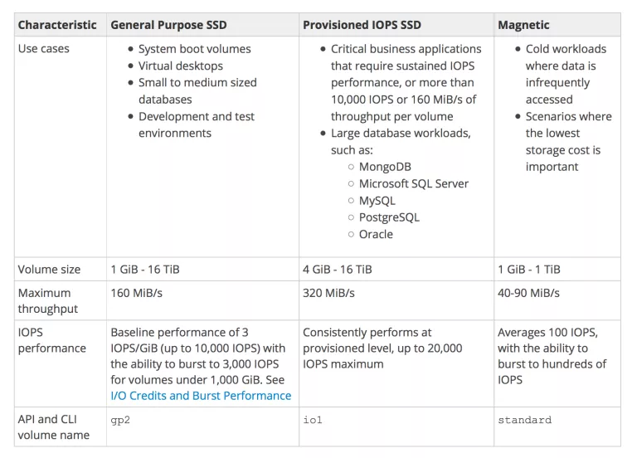

Slide 11
Provisioned IOPS SSD Volumes
Provisioned IOPS SSD volumes are designed to meet the needs of I/O intensive workloads, particularly database workloads, that are sensitive to storage performance and consistency in random access I/O throughput.
IOPS rate can be specified when the volume is created, and EBS delivers with in 10 percent of the provisioned IOPS performance 99.9 percent of the time over a given year.
Magnetic Volumes (standard)
Magnetic volumes provide the lowest cost per gigabyte of all EBS volume types. Magnetic volumes are backed by magnetic drives and are ideal for workloads performing sequential reads, workloads where data is accessed infrequently, and scenarios where the lowest storage cost is important.

Slide 12
EC2 Network Features :-
EC2 Network covers a lot of features for High Performance Computing, Ehanced Networking, low latency access.
EC2 and VPC:-
All the EC2 instance types can be launched in a VPC
Instance types C4, M4 & T2 are available in VPC only and cannot be launched in EC2-Classic
Launching an EC2 instance within an VPC provides the following benefits
Assign static private IP addresses to instances that persist across starts and stops
Assign multiple IP addresses to your instances
Define network interfaces, and attach one or more network interfaces to the instances
Change security group membership for the instances while they’re running
Control the outbound traffic from the instances (egress filtering) in addition to controlling the inbound traffic to them (ingress filtering)
Add an additional layer of access control to your instances in the form of network access control lists (ACL)
Run the instances on single-tenant dedicated hardware

Slide 13
EC2 Instance IP Addressing:-
Private IP address & Internal DNS Hostnames
Private IP address is the IP address that’s not reachable over the internet and can be resolved only within the network
When an instance is launched, the default network interface eth0 is assigned a private IP address and an internal DNS hostname which resolves to the private IP address and can be used for communication between the instances in the same network only
Private IP address and DNS hostname cannot be resolved outside the network that the instance is in
Private IP address behaviour
remains associated with the Instance when it is stopped or rebooted
is disassociated only when the instance is terminated
An instance when launched can be assigned a private IP address or EC2 will automatically assign an IP address to the instance within the address range of the subnet
An additional private IP addresses, known as secondary private IP addresses can also be assigned. Unlike primary private IP addresses, secondary private IP addresses can be reassigned from one instance to another.

Slide 14
Public IP address and External DNS hostnames
A public IP address is reachable from the Internet
Each instance assigned a public IP address is also given an External DNS hostname. External DNS hostname resolves to the public IP address outside the network and to the private IP address within the network.
Public IP address is associated with the primary Private IP address through NAT
Within a VPC, an instance may or may not be assigned a public IP address depending upon the subnet Assign Public IP attribute
Public IP address assigned to the pool is from the public IP address pool and is assigned to the instance, and not to the AWS account. It cannot be reused once disassociated and is released back to the pool
Public IP address behaviour
cannot be manually associated or disassociated with an instance
is released when an instance is stopped or terminated. Stopped instance when started receives a new public IP address
is released when an instance is assigned an Elastic IP address
is not assigned if there are more than one network interface attached to the instance

Slide 15
Multipe Private IP addresses
In EC2-VPC, multiple private IP addresses can be specified to the instances.
This can be useful in the following cases
Host multiple websites on a single server by using multiple SSL certificates on a single server and associating each certificate with a specific IP address.
Operate network appliances, such as firewalls or load balancers, that have multiple private IP addresses for each network interface.
Redirect internal traffic to a standby instance in case the instance fails, by reassigning the secondary private IP address to the standby instance.

Slide 16
Multiple IP addresses work with Network Interfaces :-
Secondary IP address can be assigned to any network interface, which can be attached or detached from an instance
Secondary IP address must be assigned from the CIDR block range of the subnet for the network interface
Security groups apply to network interfaces and not to IP addresses
Secondary private IP addresses can be assigned and unassigned to ENIs attached to running or stopped instances.
Secondary private IP addresses that are assigned to a network interface can be reassigned to another one if you explicitly allow it.
Primary private IP addresses, secondary private IP addresses, and any associated Elastic IP addresses remain with the network interface when it is detached from an instance or attached to another instance.
Although primary network interface cannot be moved from an instance, the secondary private IP address of the primary network interface can be reassigned to another network interface.

Slide 17
Elastic IP Addresses:-
An Elastic IP address is a static IP address designed for dynamic cloud computing.
Elastic IP address can help mask the failure of an instance or software by rapidly remapping the address to another instance in your account.
Elastic IP address is associated with the AWS account, not to a particular instance, and it remains associated with the account until released explicitly
When an instance is launched in the default vpc, it is assigned 2 IP address, a private and a public IP address, which is mapped to the private IP address through NAT
An instance launched in a non default vpc is assigned only a private IP address unless a public address is specifically requested or the subnet public ip attribute is enabled
For an instance, without a public IP address, to communicate to internet it must be assigned an Elastic IP address
When an Elastic IP address is assigned to an instance, the public IP address is disassociated with the instance
When the Elastic IP address is dissociated the public IP address is assigned back to the instance. However, if secondary network interface is attached to the instance, public IP address is not automatically assigned
Elastic IP addresses are not charged when associated with a running instance
All AWS accounts are limited to 5 EIPs (soft limit), because public (IPv4) Internet addresses are a scarce public resource

Slide 18
Elastic Network Interfaces (ENI):-
Elastic Network Interfaces (ENIs) are virtual network interfaces that can be attached to the instances running in an VPC only
ENI can be created without being attached to an instance
ENI can be attached to an instance, detached from that instance and attached to an other instance. Attributes of an ENI like elastic IP address, private IP address follow the ENI and when moved from one instance to an other instance & all traffic to the ENI will be routed to the new instance.
An instance in a VPC always has a default primary ENI attached (eth0) with a private ip address assigned from vpc range and cannot be detached
Additional ENI (eth1-ethn) can be attached to the instance and the number varies depending upon the instance type
Most important difference between eth0 and eth1 is that eth0 cannot be dynamically attached or detached from a running instance. Primary ENIs (eth0) are created automatically when an EC2 instance is launched and are also deleted automatically when the instance is terminated unless the administrator has changed a property of the ENI to keep it alive afterward

Slide 19
Multiple elastic network interfaces are useful for use cases:
Create a management network
Primary ENI eth0 handles backend with more restrictive control
Secondary ENI eth1 handles the public facing traffic
Licensing authentication
Fixed MAC address associated with a license authentication
Use network and security appliances in your VPC
configure a third party network and security appliances (load balancers, NAT, proxy) with the secondary ENI
Create dual-homed instances with workloads/roles on distinct subnets.
Create a low-budget, high-availability solution
If one of the instances serving a particular function fails, its elastic network interface can be attached to a replacement or hot standby instance pre-configured for the same role in order to rapidly recover the service
As the interface maintains its private IP, EIP, and MAC address, network traffic will begin flowing to the standby instance as soon as it is attached to the replacement instance

Slide 20
IMP Points:-
ENI can be attached to an instance when it’s running (hot attach), when it’s stopped (warm attach), or when the instance is being launched (cold attach).
Primary (eth0) interface can’t be detached
Secondary (ethN) ENI can be detached when the instance is running or stopped.
ENI in one subnet can be attached to an instance in another subnet, but the same AZ and same VPC

Slide 21
EC2 Enhanced Networking :-
Enhanced networking results in higher bandwidth, higher packet per second (PPS) performance, lower latency, consistency, scalability and lower jitter
EC2 provides enhanced networking capabilities using single root I/O virtualization (SR-IOV) only on supported instance types
SR-IVO is a method of device virtualization which provides higher I/O performance and lower CPU utilization
Amazon Linux AMIs and Windows Server 2012 R2 AMI already have the module installed with the attributes set and does not require any additional configurations.
It can be enabled for other OS distributions by installing the module with the correct attributes configured

Slide 22
Enhanced Networking Key Requirements :-
VPC, as enhanced networking can’t be enabled for instance in EC2-Classic
an HVM virtualization type AMI
Instance kernel version
Linux kernel version of 2.6.32+
Windows: Server 2008 R2+
Appropriate Virtual Function (VF) driver
Linux – should have the ixgbevf module (for best performance version 2.14.2 or higher) installed and that sriovNetSupport attribute set for the instance
Windows- Intel 82599 Virtual Function driver
supported instance types i.e. C3, C4, D2, I2, M4 and R3

Slide 23
EFS(Elastic File System):-
Amazon Elastic file system (Amazon EFS) is a file storage service for amazon elastic compute cloud (Amazon Ec2) Instances.
Amazon EFS is easy to use and provides a simple interfaces that allows you to create and configure file systems quickly and easily . with Amazon EFS storage capacity is elastic , growing and shrinking automatically as you add and remove files ,so your applications have the storage need, when they need it.
EFS Features:-
Supports the network file version -4 (NFSV4) Protocol .
You only pay for the storage you use (no- pre-provisioning required)
Can scale up to the petabytes.
Can supports thousands of concurrent NFS connections.
Data is stored across multiple AZ’s with in a region.
Read After write consistency.

Slide 24
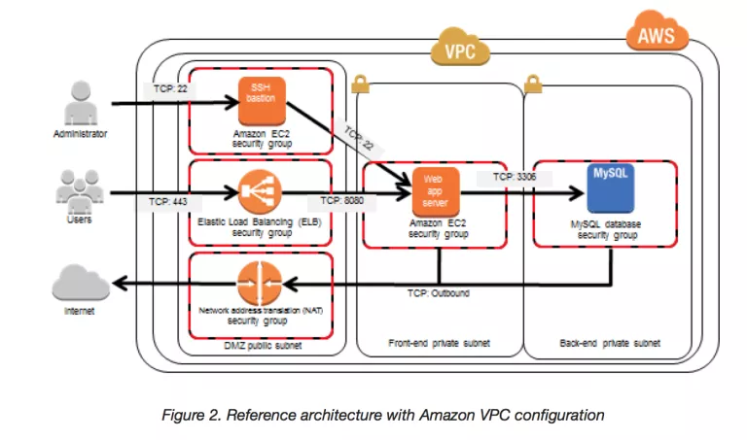
Bastion Host Overview:-
Bastion means a structure for Fortification to protect things behind it
In AWS, a Bastion host (also referred to as a Jump server) can be used to securely access instances in the private subnets.
Bastion host launched in the Public subnets would act as a primary access point from the Internet ands acts as a proxy to other instances.

Slide 25
Key points
Bastion host is deployed in the Public subnet and acts as a proxy or a gateway between you and your instances
Bastion host is a security measure that helps to reduce attack on your infrastructure and you have to concentrate to hardening a single layer
Bastion host allows you to login to instances in the Private subnet securely without having to store the private keys on the Bastion host (using ssh-agent forwarding or RDP gateways)
Bastion host security can be further tightened to allow SSH/RDP access from specific trusted IPs or corporate IP ranges
Bastion host for your AWS infrastructure shouldn’t be used for any other purpose, as that could open unnecessary security holes
Security for all the Instances in the private subnet should be hardened to accept SSH/RDP connections only from the Bastion host
Deploy a Bastion host within each Availability Zone for HA, cause if the Bastion instance or the AZ hosting the Bastion server goes down the ability to connect to your private instances is lost completely

