Slide 1

SMART INDIA HACKATHON 2026
TITLE PAGE
Problem Statement ID – 26052
Problem Statement Title- To develop an AI/ML-enabled adaptive noise cancellation (ANC) system that effectively suppresses stationary, non-stationary, and impulsive defence noises while maintaining high speech intelligibility and real-time performance on embedded hardware.
Theme- [THEME — confirm on SIH portal]
PS Category- Software/Hardware – Hardware
Team ID- [TEAM ID]
Team Name (Registered on portal)- [TEAM NAME]

Slide 2
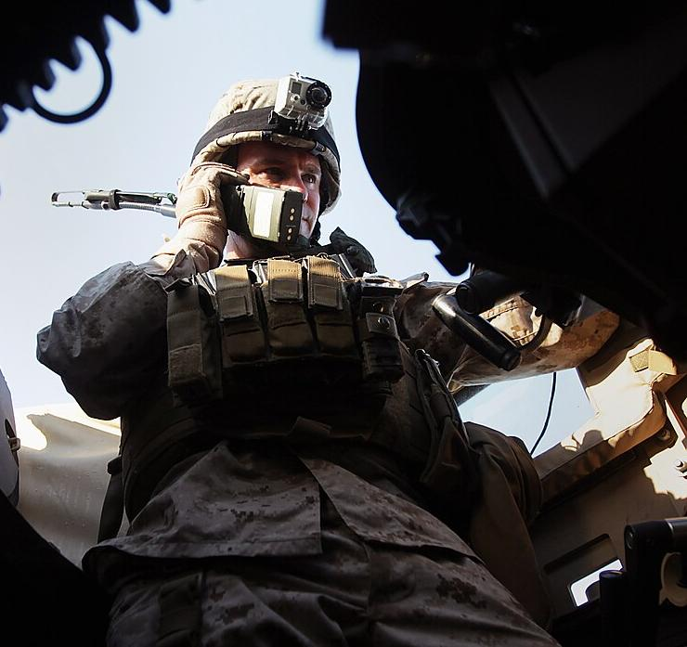
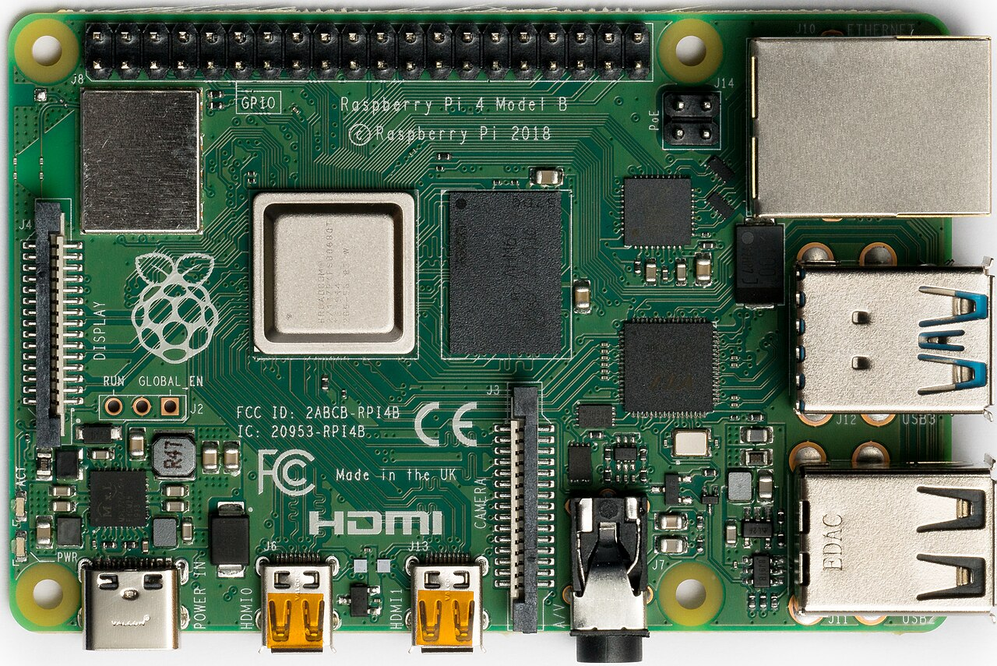
IDEA TITLE
[TEAM NAME]
THE PROBLEM: In gunfire, artillery or helicopter noise, soldiers on the radio often can’t be understood — today’s gear is fixed and can’t adapt to sounds it hasn’t seen.
Proposed Solution: two mics + a tiny on-device AI clean your voice in real time (architecture below). How it addresses the problem: removes battlefield noise so radio speech stays clear, and recovers automatically if a mic fails. Innovation: reference-mic conditioning + failure-safe guard, measured on real Pi 4 hardware.
PROPOSED SYSTEM ARCHITECTURE
PRIMARY MIC
Voice + Noise
(near the mouth)
GTCRN-X
AI Noise Suppression
runs on the Pi — uses both mic streams
ENHANCED SPEECH
REFERENCE MIC
Ambient / Reference Noise
(outward-facing)
RASPBERRY PI 4
Real-time embedded processing
TACTICAL HEADSET / RADIO
BATTLEFIELD NOISE
NOISY AUDIO
→ GTCRN-X →
ENHANCED SPEECH
Gunfire · Rotor · Engine · Drone · Wind · Siren · Artillery · Mixed
Speech + battlefield noise
Speech preserved, noise suppressed
Technical pipeline (secondary): Dual-Mic Audio → STFT (time–frequency analysis) → GTCRN-X → Complex Mask → iSTFT → Enhanced Speech
Real hardware validation: 2× INMP441 + Raspberry Pi 4 + headphone output — 5.3 ms processing per 16 ms audio hop, 0 missed deadlines in the current hardware benchmark.

Slide 3
TECHNICAL APPROACH
[TEAM NAME]
Technologies to be used (e.g. programming languages, frameworks, hardware)
Methodology and process for implementation (Flow Charts / working prototype)
H
Hardware: 2 mics + Raspberry Pi 4 (8 GB), CPU-only
1
2
3
Two Microphones Listen
Voice mic (mouth) + noise mic (outward), 2× INMP441, 16 kHz
Sound Is Broken Into Pieces
Split into tiny 16 kHz time slices the AI can compare, mic to mic
AI Removes the Noise
Tiny neural network (GTCRN-X), 23.7K params — small enough to run live
T
Training: PyTorch on a laptop GPU (RTX 4050)
R
On-device: ONNX Runtime on the Pi’s own CPU
→
6
5
4
M
AI model: compact neural network (GTCRN-X family)
Deployed on Pi 4
8 GB, CPU-only. 5.3 ms per 16 ms hop, 0 missed deadlines
Runs on the Pi’s Own Processor
No GPU or cloud needed — ONNX Runtime, fp32
Fails Safe, Not Silent
If the noise mic dies or is blocked, the system detects it and recovers
E
Scoring: 3 clarity scores — explained on the Feasibility slide
HARDWARE AT A GLANCE
7 Enhanced speech → tactical radio / headset
🎙
2× INMP441
🖥
Pi 4, 8 GB
⚡
RTX 4050 GPU
Offline training: LibriSpeech + real gunshots + synthetic defence classes (SPL-calibrated) → SI-SNR + spectral losses on RTX 4050 → export ONNX
Prototype status
Model trained & evaluated on fresh held-out sets
Pi 4 benchmark done: 5.3 ms/hop, 0 missed deadlines
Both mics wired & verified over I2S on the Pi
Live end-to-end demo (capture + playback): in progress

Slide 4
FEASIBILITY AND VIABILITY
[TEAM NAME]
Analysis of the feasibility of the idea
Technical: 23.7K-param causal model, ~24 ms algorithmic latency; measured 5.3 ms per 16 ms hop on real Pi 4 (RTF 0.33)
Economic: commodity hardware (2 MEMS mics + Pi 4); trains on one consumer GPU; no cloud cost at inference
Operational: offline, CPU-only; drops into an existing radio/headset audio path; keeps working if one mic fails
Proof: Measured Results Against the PS Targets
Deployed system (ONNX path) vs. official target — dashed line = target
SNR gain — noise turned down
9.9 dB target 15.0 dB
STOI — how understandable the speech is
0.88 target 0.85 ✓ met
PESQ — how natural/clear it sounds
2.31 target 2.50
Bottom line: we meet the official target in moderate-to-heavy battlefield noise (12 of 48 tested conditions today). In the most extreme, very-low-signal conditions we’re not there yet — that’s our next milestone, not a hidden gap.
Potential challenges and risks
Strategies for overcoming these challenges
⚠ Very heavy noise (extreme low SNR): target not yet met — our next milestone
⚠ Reference mic fails or leaks: a naive two-mic model collapses
⚠ Wind noise is uncorrelated between the two mics, so it’s the hardest case
⚠ Real-headset data: leakage and most noise classes are simulated; live demo untested
✓ Report per-condition results honestly; target moderate-to-high-noise field use first, then close the gap
✓ Reference-dropout training + runtime guard: dead reference recovers +2.5 → +8.8 dB
✓ Flagged for future multi-mic array work
✓ Record real headset audio with our own tools (record_stereo.py, analyze_two_mic.py), then retrain

Slide 5
IMPACT AND BENEFITS
[TEAM NAME]
💥
→
📵
→
🤖
→
📡
Battlefield noise
Speech unreadable
Our AI cleans it live
Radio usable again
Potential impact on the target audience
1
2
3
4
Infantry & Field Comms
Intelligible radio/headset speech under gunfire, artillery, rotor and vehicle noise
Disaster Response Teams
Clear comms amid generators, sirens and collapsed-structure noise
Border & Remote Ops
Fully offline, CPU-only edge inference — no cloud or connectivity dependency
Indigenous Defence Electronics
Open, reproducible pipeline on commodity hardware — Atmanirbhar Bharat
Benefits of the solution (social, economic, technological)
Social
Safer, clearer communication for soldiers and disaster responders in life-threatening noisy conditions; builds trust in indigenous defence technology.
Economic
Commodity hardware (2 mics + Pi 4) vs. proprietary ANC DSP modules; a single consumer GPU to train; no recurring cloud cost at inference.
Technological
Causal real-time (~24 ms), CPU-only inference; keeps working if one mic fails; reusable open defence-noise benchmark.

Slide 6
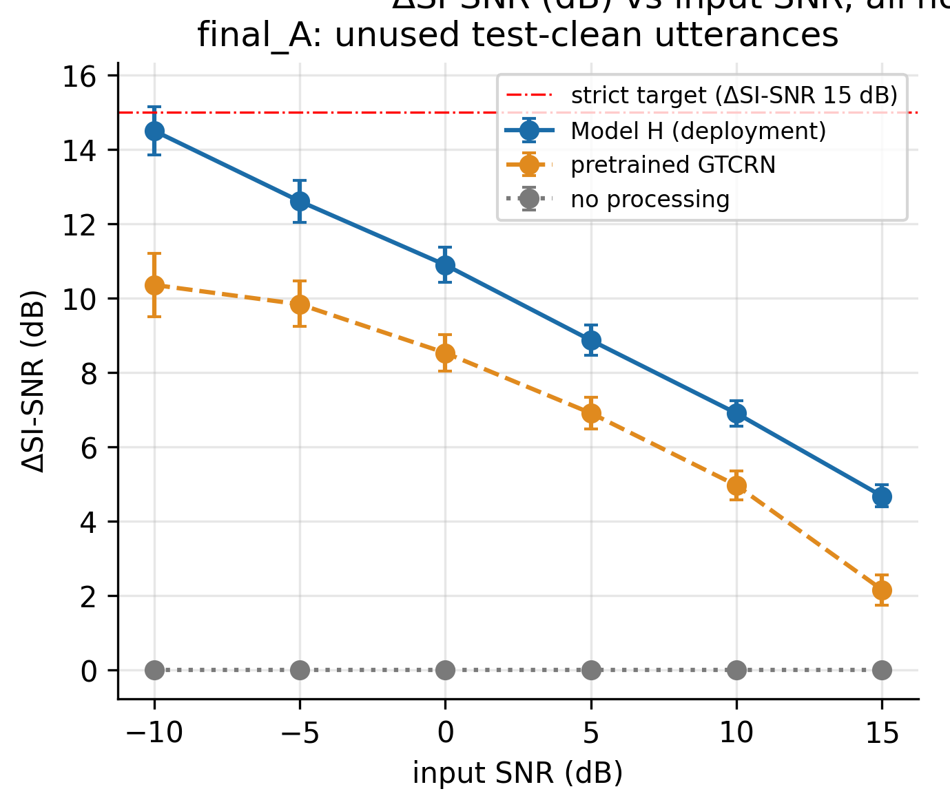
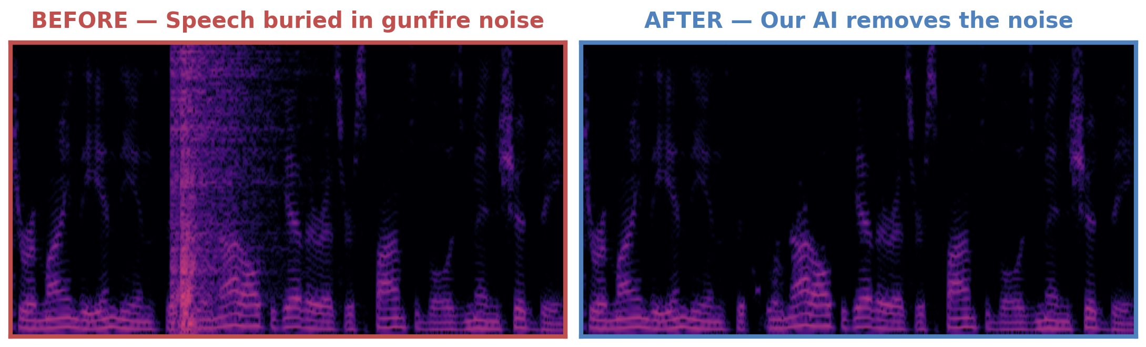
RESEARCH AND REFERENCES
[TEAM NAME]
Details / links of the reference and research work
What we tried — kept only what measurably helped
Own validation (fresh, untouched test recordings)
Idea tested | Measured effect | Verdict
Reference-mic conditioning | +1.0 dB, +0.017 STOI, +0.21 PESQ | ✓ Deployed
Reference dropout + guard | Dead ref +2.5 → +8.8 dB | ✓ Deployed
Also tried: impulse flag, NLMS filter | No gain (see notes) | ✗ Dropped
How we got here
Baseline Pretrained speech-enhancement model
+ Defence-noise training Fine-tuned on real gunfire, artillery, helicopter noise
+ Reference microphone Second mic added — measurably smarter
+ Failure-safe guard Recovers if the reference mic dies or leaks
Blue = our AI · Orange = basic AI (no defence training) · Gray = no cleanup. Higher line = clearer speech; our AI stays highest at every noise level tested.
Current system Deployed & measured on real Pi 4 hardware
Prior art & data sources
GTCRN (Rong et al.): ultra-low-compute base we extend into Tiny / Small / Base
DC-GTCRN, arXiv:2505.19597: dual-channel, far-field; ours is close-talk primary + outward reference for defence use
DeepFilterNet (Schröter et al.): lightweight real-time enhancement reference point
LibriSpeech and Zenodo 7004819 gunshots (both CC BY 4.0); other noise classes synthetic, SPL-calibrated
Scope: established techniques integrated for defence use; our contribution is the calibrated evaluation protocol and measured results, not a new architecture.
A real gunshot recording, before and after — the bright noise burst is gone, the voice pattern remains.
Notes:
Dropped-idea exact deltas: impulse/clipping flag input +0.01 dB overall, weapon STOI -0.003; impulse-frame loss weight -0.03 dB when removed (no effect); gated NLMS filter -1.2 to -3.4 dB, kept only as an optional module, not in the deployed pipeline.

