Slide 1

SMART INDIA HACKATHON 2026
TITLE PAGE
Problem Statement ID - 26052
Problem Statement Title - AI/ML-enabled adaptive noise suppression for defence communication
Theme - [THEME]
PS Category - Hardware
Team ID - [TEAM ID]
Team Name (Registered on portal) - [TEAM NAME]
@SIH Idea submission- Template
1
Notes:
Fill [THEME], [TEAM ID], [TEAM NAME] and confirm the exact problem statement title from the SIH portal.

Slide 2
[TEAM NAME]
VaaniRaksha: AI-Powered Adaptive Noise Cancellation
for Defence Communication
SMART INDIA
HACKATHON
2026
Proposed Solution
System overview
Noise-Robust Voice Communication for Defence
Gunfire, artillery, helicopter, vehicle and siren noise make field radio and headset speech unintelligible; fixed-filter suppression struggles with impulsive, non-stationary noise.
Adaptive Two-Microphone AI Enhancement
A causal deep-learning model (GTCRN-X) takes a primary mic (mouth) and an outward reference mic and outputs clean speech frame by frame.
23.7K parameters, ~33 MMACs/s: runs on a Raspberry Pi 4 (CPU only), measured 5.3 ms per 16 ms hop.
Trained on SPL-calibrated defence noise (gunshot, artillery, helicopter, drone, engine, wind, siren) including real MEMS-mic clipping.
Reference-dropout training + runtime guard keep it working if the second mic fails or leaks.
Primary mic
(mouth)
GTCRN-X model
on Raspberry Pi 4
(causal, CPU-only)
Reference mic
(outward)
Enhanced speech → radio / headset
Offline: trained on a laptop GPU, exported to ONNX
Innovation & Uniqueness
How it Addresses the Problem
Reference mic helps a tiny model: +1.0 dB SI-SNR, +0.017 STOI, +0.21 PESQ (two seeds agree)
Physically calibrated data: SPL levels through an INMP441 model, so clipping near weapons is realistic
Defence-noise benchmark: per-class × per-SNR grid, peak-SPL weapon set, unseen-noise split
Fail-safe design: dead reference recovers from +2.5 to +8.8 dB via dropout training; copy-guard
Intelligibility: STOI 0.789 → 0.882, PESQ 1.33 → 2.31 (deployed path)
Low cost, scalable: commodity mics + Pi 4; one consumer GPU to train
Honest scope: targets met at moderate-to-high input SNR
@SIH Idea submission- Template
2

Slide 3
[TEAM NAME]
TECHNICAL APPROACH
SMART INDIA
HACKATHON
2026
1
2
3
Hardware & Software
Dual-Mic Capture
Feature Extraction
GTCRN-X Network
2× INMP441 I2S MEMS mics (primary + reference)
Raspberry Pi 4 (8 GB), Pi OS 64-bit
PyTorch for training, ONNX Runtime for inference, NumPy/SciPy
SI-SNR, STOI, PESQ evaluation on held-out sets
RTX 4050 laptop GPU for training
Primary (mouth, close-talk) + reference (outward). 2× INMP441 I2S MEMS mics, 16 kHz.
STFT frames; reference-mic conditioning (level ratio, coherence, magnitude).
Causal complex-spectral mask. Small: 23.7K params, ~33 MMACs/s, ~24 ms algorithmic delay.
6
5
4
Deployed on Raspberry Pi 4
ONNX Runtime (fp32)
Reference-Dropout + Guard
8 GB, CPU-only. Measured 5.3 ms per 16 ms hop, 0 missed deadlines, no throttling.
INT8 tested: same quality but not faster on the Pi, so fp32 is deployed.
Robust if the reference mic dies or leaks: copy-detector in the runtime.
Prototype status
Model trained and evaluated on fresh held-out sets
Pi 4 benchmark done: 5.3 ms/hop
Both mics captured over I2S on the Pi
Live end-to-end demo: in progress
7 Enhanced speech → tactical radio / headset
Offline training: LibriSpeech + real gunshots + synthetic defence classes (SPL-calibrated) → SI-SNR + spectral losses on RTX 4050 → export ONNX
@SIH Idea submission- Template
3

Slide 4
[TEAM NAME]
FEASIBILITY AND VIABILITY
SMART INDIA
HACKATHON
2026
Analysis of the Feasibility of the Idea
Headline Results
Model Size Trade-off
Technical Feasibility
Ultra-light causal model: 23.7K params, ~24 ms algorithmic latency
Measured on Pi 4: 5.3 ms per 16 ms hop (RTF 0.33)
Economic Feasibility
Commodity hardware: two MEMS mics + Pi 4
Trains on one consumer GPU; no cloud cost
Operational Feasibility
Offline, CPU-only; drops into radio/headset path; works if one mic fails
 | SNR gain | STOI | PESQ
No processing | 0 dB | 0.789 | 1.33
Pretrained GTCRN | +7.5 dB | 0.847 | 1.91
Ours (Small + ref mic) | +10.3 dB | 0.888 | 2.40
Deployed (ONNX path) | +9.9 dB | 0.882 | 2.31
PS 26052 target | > 15 dB | > 0.85 | > 2.5
Model | Params | SNR gain
Tiny | 8K | +7.9 dB
Small (deployed) | 24K | +9.3 dB
Base | 81K | +10.2 dB
Trained from scratch, same conditions. Warm-starting Small from pretrained GTCRN adds +1.07 dB and matches Base at 2.8× less compute.
Fresh held-out sets: +9.7 / +10.1 dB, STOI 0.88 / 0.87, PESQ 2.28 / 2.25. Targets met in 12 of 48 class × SNR cells (moderate-to-high input SNR only).
Potential Challenges and Risks
Strategies for Overcoming Challenges
Low input SNR (≤ 0 dB): targets not yet met
Reference mic fails or leaks: a naive two-mic model collapses
Wind noise is uncorrelated between the two mics
Real-headset data: leakage and most noise classes are simulated
Report per-SNR results; target moderate-to-high SNR field use; close the gap next
Dropout training + runtime guard: dead reference +2.5 → +8.8 dB
Future multi-mic array for wind
Record real headset and noise with our tools, then retrain
@SIH Idea submission- Template
4

Slide 5
[TEAM NAME]
IMPACT AND BENEFITS
SMART INDIA
HACKATHON
2026
Potential Impact on the Target Audience
Compared with Conventional Approaches
Infantry & field communications: intelligible radio/headset speech under gunfire, artillery, rotor and vehicle noise
Disaster response teams: clear comms amid generators, sirens and collapsed-structure noise
Border & remote operations: fully offline, CPU-only edge inference
Indigenous defence electronics: open, reproducible pipeline on commodity hardware
Aspect | Typical fixed-filter / passive | VaaniRaksha
Noise adaptation | Hand-tuned, fixed filters | Learned; per-class benchmark
Impulsive noise | Weak on gunfire bursts | Trained with calibrated clipping
Hardware | Dedicated DSP module | Commodity mics + Pi 4 CPU
Mic-fault handling | Not addressed | Dropout training + guard
Transparency | Closed | Open, reproducible results
Benefits of the Solution
Operational: causal real-time (~24 ms), keeps working if one mic fails
Economic: no proprietary DSP chip; single consumer GPU to train; no cloud at inference
Strategic: reusable open defence-noise benchmark; supports Atmanirbhar Bharat
Comparison is qualitative; we did not benchmark commercial modules.
Measured on the Deployed Path
+9.9 dB
0.882
2.31
5.3 ms
SNR improvement
STOI (0.789 unprocessed)
PESQ (1.33 unprocessed)
per 16 ms hop on Pi 4
@SIH Idea submission- Template
5

Slide 6
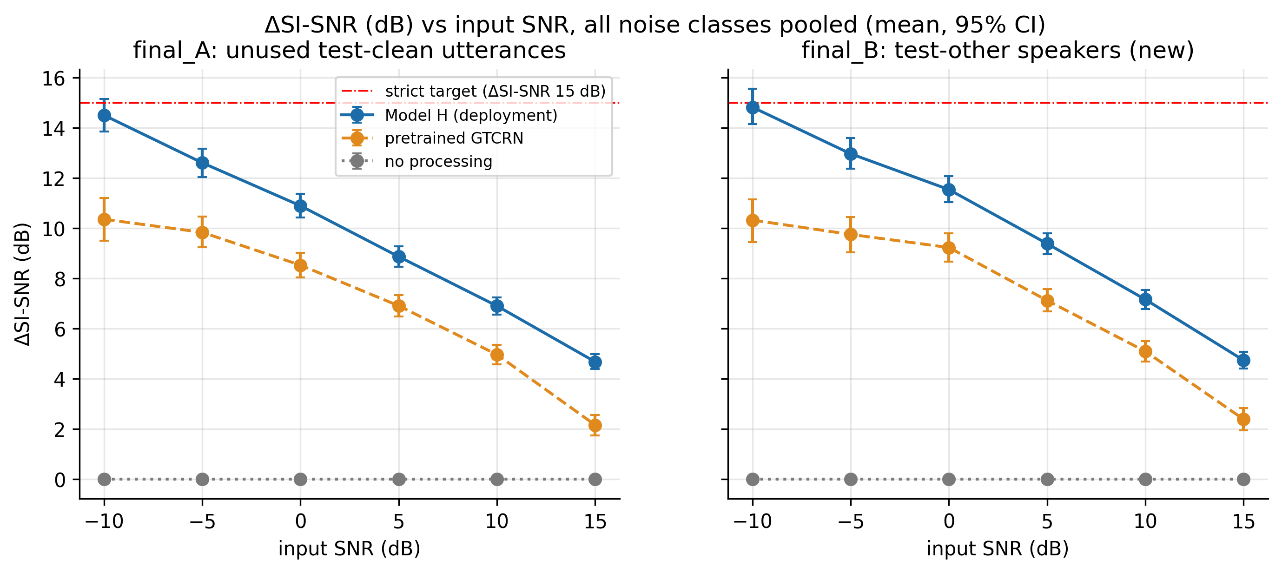
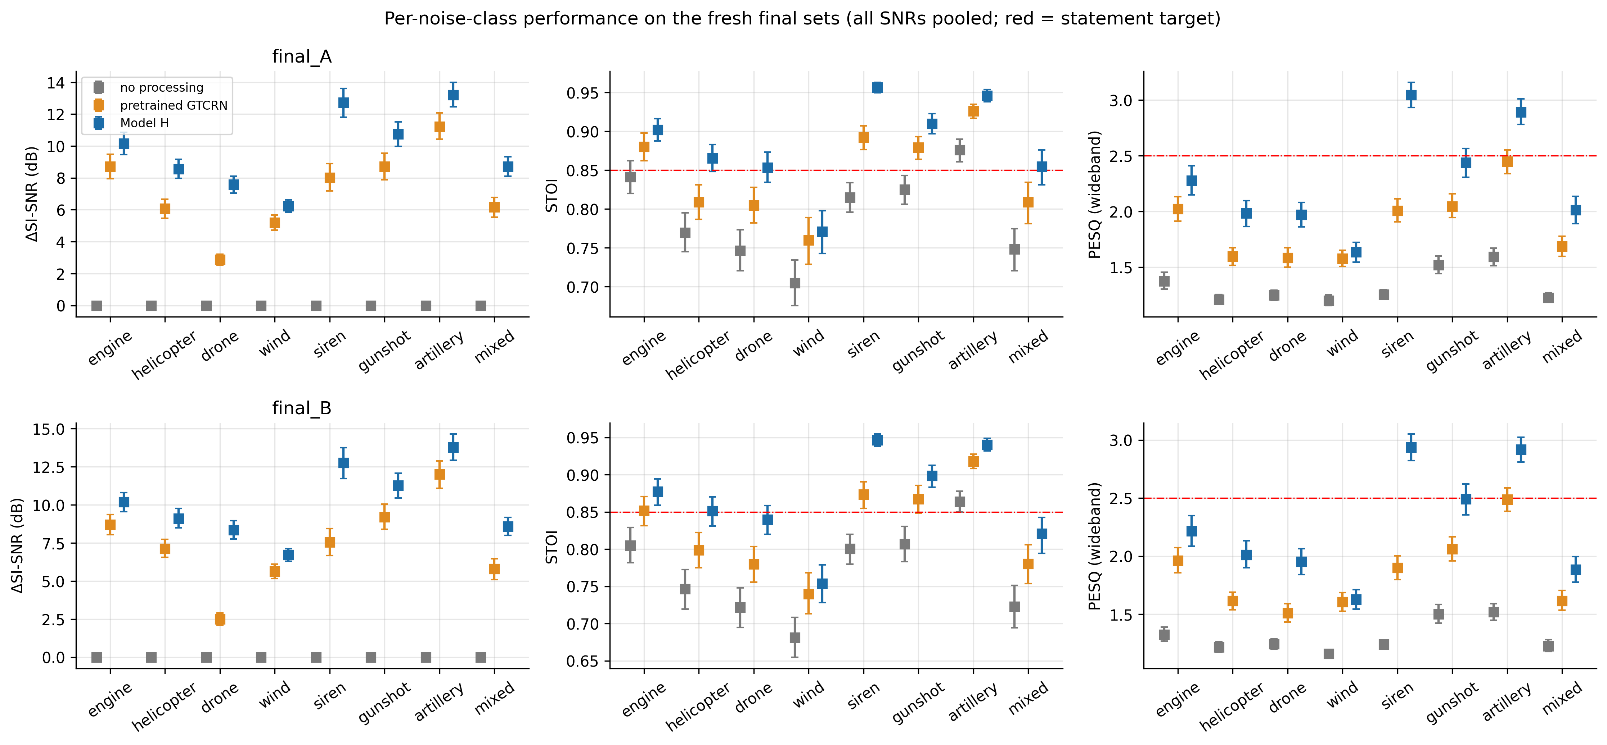
[TEAM NAME]
RESEARCH AND REFERENCES
SMART INDIA
HACKATHON
2026
Field Tests & Simulation Results
What We Tested: Kept vs Dropped
Idea tested | Measured effect | Verdict
Reference-mic conditioning | +1.0 dB, +0.017 STOI, +0.21 PESQ | ✓ Deployed
Fine-tune on calibrated noise | +1.8 dB vs pretrained | ✓ Deployed
Reference dropout + guard | Dead ref +2.5 → +8.8 dB | ✓ Deployed
Impulse/clipping flag input | +0.01 dB; weapon STOI −0.003 | ✗ Dropped
Impulse-frame loss weight | −0.03 dB when removed | ✗ Dropped
Gated NLMS filter | −1.2 to −3.4 dB | ✗ Optional only
SI-SNR improvement vs input SNR (fresh sets A and B)
Prior Art & Data Sources
GTCRN (Rong et al.): ultra-low-compute base we extend into Tiny/Small/Base
DC-GTCRN, arXiv:2505.19597: dual-channel, far-field; ours is close-talk primary + outward reference
DeepFilterNet (Schröter et al.): lightweight real-time enhancement reference
LibriSpeech and Zenodo 7004819 gunshots (both CC BY 4.0); other classes synthetic
Scope: established techniques integrated for defence use; contribution is the calibrated evaluation and measured results, not a new architecture.
Per-class performance (statement targets in red)
@SIH Idea submission- Template
6

