Slide 1
SMART INDIA HACKATHON 2026
PS 26052 · DRDO · HARDWARE
VaaniRaksha
AI-Powered Adaptive Noise Cancellation for Defence Communication
Dual-microphone, causal, edge-deployed speech enhancement for gunfire, artillery, rotor,
vehicle and siren noise — trained and measured, not just simulated.
TEAM NAME
TEAM ID
THEME
CATEGORY
[TEAM NAME]
[TEAM ID]
[THEME]
Hardware
Notes:
Fill in TEAM NAME, TEAM ID and THEME on this slide before submitting. Project codename 'VaaniRaksha' is a suggested placeholder — rename freely.

Slide 2
PROPOSED SOLUTION
The Problem, and Our Idea
Currently Faced Problems
Our Idea
Gunshot, artillery, helicopter, vehicle and siren noise routinely make field radio and headset speech unintelligible.
Passive/mechanical hearing protection blocks sound but does not restore speech clarity.
Existing ANC/DSP modules are fixed-filter, bulky, imported, and do not adapt to unseen defence-noise classes.
Embedded AI noise suppression on low-power (CPU-only) hardware is largely unproven for this noise regime.
A causal, two-microphone deep-learning model (GTCRN-X): primary mic at the mouth + outward reference mic.
Ultra-light complex-spectral network — 23.7K parameters, ~33 MMACs/s — runs frame-by-frame on a Raspberry Pi 4 CPU.
Trained on physically calibrated defence noise, including real MEMS-microphone clipping near weapons.
Reference-dropout training + a runtime guard keep it working even if the second microphone fails or leaks.
Two-Mic Fusion
~24 ms Latency
Runs on Pi 4 (CPU)
23.7K Parameters
Defence-Calibrated Data
Mic-Failure Robust
SIH 2026 · PS 26052
02

Slide 3
TECHNICAL APPROACH
Signal Chain: Mics → Model → Edge Deployment
1
2
3
Dual-Mic Capture
Feature Extraction
GTCRN-X Network
OFFLINE TRAINING
Primary (mouth, close-talk) + Reference (outward), 2× INMP441 I2S MEMS
16 kHz frames, STFT, reference-mic conditioning (level ratio, coherence)
Causal complex-spectral mask, Small: 23.7K params, ~33 MMACs/s
Defence-noise dataset — gunshot, artillery, helicopter, drone, engine, wind, siren (SPL-calibrated clipping)
GPU training — RTX 4050 (6 GB), SI-SNR + spectral losses
Export → ONNX (fp32 deployed; INT8 evaluated)
6
5
4
Deployed on Pi 4
ONNX Runtime (fp32)
Ref-Dropout + Guard
Pi 4 (8 GB), CPU-only. Measured 5.3 ms per 16 ms hop, 0 missed deadlines
INT8 tested: same quality, not faster on Pi, so fp32 is deployed
Robust if the reference mic dies or leaks (copy-detector in the runtime)
Enhanced Speech → Tactical Radio / Headset
SIH 2026 · PS 26052
03

Slide 4
FEASIBILITY AND VIABILITY
Measured Results Against the PS Targets
Headline Results (held-out test speakers & gunshots)
Technical Feasibility
 | SNR Impr. | STOI | PESQ
No processing | 0 dB | 0.789 | 1.33
Pretrained GTCRN (1-mic) | +7.5 dB | 0.847 | 1.91
Ours — Small + reference mic | +10.3 dB | 0.888 | 2.40
Deployed (ONNX, robust + guard) | +9.9 dB | 0.882 | 2.31
PS 26052 target | > 15 dB | > 0.85 | > 2.5
23.7K params, ~33 MMACs/s — causal, ~24 ms algorithmic latency
Measured on Pi 4: 5.3 ms per 16 ms hop (RTF 0.33), 0 missed deadlines, no throttling
Economic Feasibility
Commodity hardware: 2× INMP441 + Raspberry Pi 4, no proprietary DSP chip
Trains on one consumer GPU (RTX 4050) — no HPC/cloud cluster needed
Fresh, untouched held-out sets (final_A / final_B): deployed model +9.7 / +10.1 dB, STOI 0.88 / 0.87, PESQ 2.28 / 2.25. Targets are met in 12 of 48 noise-class × input-SNR cells — at moderate-to-high input SNR only; further work is needed below 0 dB input SNR.
Low-SNR Gap
Reference-Mic Loss
Wind Is Weakest
Below 0 dB input SNR, targets are not yet met. Report per-SNR bin honestly; prioritize field-realistic moderate/high-SNR use; roadmap to close the gap.
A naive two-mic model collapses if the reference dies (+2.5 dB) or leaks. Reference-dropout training + runtime guard: dead ref recovers to +8.8 dB.
Wind noise is uncorrelated between the two mics, so the reference cannot help. Flagged for future multi-mic array work beyond this prototype.
SIH 2026 · PS 26052
04

Slide 5
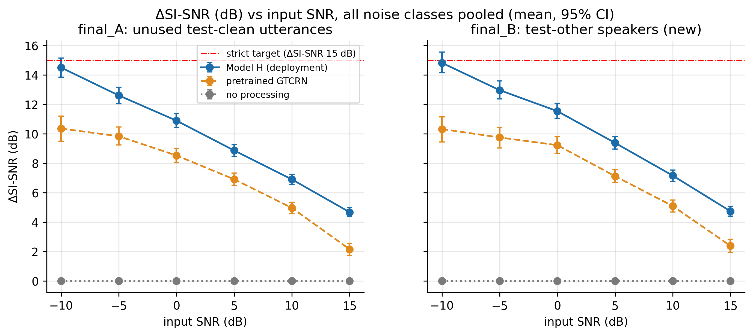
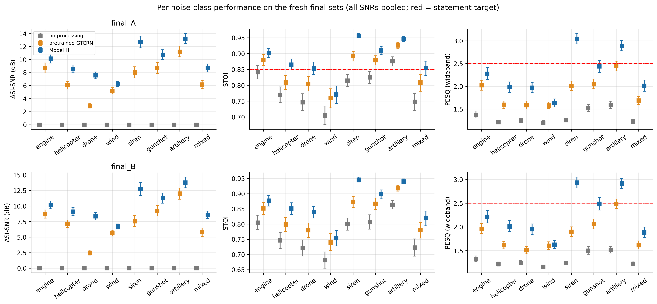
RESULTS AND VALIDATION
Not Simulated — Measured
+9.9 dB
0.882
2.31
23.7K
SNR improvement (deployed ONNX path)
STOI (0.789 unprocessed)
PESQ (1.33 unprocessed)
parameters · ~33 MMACs/s
SI-SNR improvement vs. input SNR, per noise class
Per-class performance breakdown
SIH 2026 · PS 26052
05

Slide 6
ENGINEERING RIGOR
What We Tested — Kept What Worked, Dropped What Didn't
Idea Tested | Measured Effect | Verdict
Reference-mic conditioning | +1.0 dB SI-SNR, +0.017 STOI, +0.21 PESQ (2 seeds agree) | ✓ Supported — deployed
Fine-tuning on calibrated defence noise | +1.8 dB over pretrained model; weapon STOI 0.563 → 0.602 | ✓ Supported — deployed
Reference-dropout + runtime guard | Dead ref: +2.5 → +8.8 dB. Leaked ref: −15.7 → 0.0 dB recovered | ✓ Supported — deployed
Impulse / clipping flag as model input | +0.01 dB overall; weapon STOI −0.003 | ✗ Not supported — dropped
Extra loss weight on impulsive frames | −0.03 dB when removed — no measurable effect | ✗ Not supported — dropped
Gated NLMS adaptive filter (reference mic) | −1.2 to −3.4 dB; speech fidelity −5.9 dB | ✗ Not supported — kept optional only
The problem statement lists an adaptive filter as optional — we implemented and measured it, then left it out of the deployed pipeline on evidence.
SIH 2026 · PS 26052
06

Slide 7
IMPACT AND BENEFITS
Who This Helps, and Why It Matters
1
2
3
4
Infantry & Field Comms
Disaster Response Teams
Border & Remote Ops
Indigenous Defence Electronics
Intelligible radio/headset speech under gunfire, artillery, rotor and vehicle noise.
Clear comms amid generator noise, sirens and collapsed-structure environments.
Fully offline, CPU-only edge inference — no cloud or connectivity dependency.
Atmanirbhar Bharat: open, reproducible pipeline — no imported proprietary DSP chip.
Economic
Operational
Strategic
Commodity hardware (≈₹300 mic pair + ≈₹5,500 Pi 4) vs. proprietary ANC headset DSPs; trains on a single consumer GPU — no HPC/cloud training cost.
Causal, real-time (~24 ms), CPU-only inference; drops into an existing radio/headset audio path; keeps working if one mic fails.
A reusable, open defence-noise benchmark (per-class × per-SNR grid) as a lasting research asset for indigenous ANC development.
SIH 2026 · PS 26052
07

Slide 8
RESEARCH AND REFERENCES
Prior Art, Data Sources, and Target Definitions
Prior Art
Data Sources
GTCRN (Rong et al.) — ultra-low-compute speech enhancement; base architecture we extend into the GTCRN-X Tiny/Small/Base family.
DC-GTCRN, arXiv:2505.19597 — prior dual-channel GTCRN for far-field, spatially separated mics; our design is close-talk primary + outward reference, tuned for defence comms.
DeepFilterNet (Schröter et al.) — reference point for lightweight real-time speech enhancement.
LibriSpeech (CC BY 4.0) — clean speech corpus.
Zenodo 7004819 (CC BY 4.0) — real gunshot recordings.
Engine, helicopter, drone, wind, siren, artillery: synthetic, SPL-calibrated to a real INMP441 clipping model.
PS 26052 (DRDO) target definitions: SNR > 15 dB, STOI > 0.85, PESQ > 2.5, low-latency embedded demo with primary + reference mics.
Scope of Claims
Neural speech enhancement, dual-microphone processing and adaptive filtering are established techniques. Our contribution is the defence-specific integration, the physically calibrated evaluation protocol, and results measured on held-out, untouched test sets — not a claim of a fundamentally new architecture.
SIH 2026 · PS 26052
08

Slide 9
THE TEAM
[TEAM NAME]
Team ID: [TEAM ID]
1
2
3
4
5
6
[Member Name]
[Member Name]
[Member Name]
[Member Name]
[Member Name]
[Member Name]
[Role]
[Role]
[Role]
[Role]
[Role]
[Role]
[Branch · Year]
[Branch · Year]
[Branch · Year]
[Branch · Year]
[Branch · Year]
[Branch · Year]
SIH 2026 · PS 26052
09
Notes:
Replace all six [Member Name]/[Role]/[Branch/Year] placeholders, and delete any unused member cards, before submission.

