Slide 1

Project Title -
Seasonal Agriculture Performance Analysis
[Student Name-
College Name-
Praveen Santhosh S
Amrita college of Engineering and Technology,Nagercoil
AICTE STU ID :
STU6a65c1898f4fe1785053577

Slide 2

PROBLEM STATEMENT
(Agricultural activities are influenced by seasonal variations in environmental conditions, farming practices, resource availability and market conditions. As a result, agricultural performance may differ from one season to another. However, raw agricultural data does not clearly explain how agricultural performance changes across seasons or what patterns can be observed in different seasonal conditions. The problem is to analyze the given agricultural dataset and investigate seasonal differences in agricultural performance by identifying meaningful patterns, trends, relationships and variations within the available data.

Slide 3
Project Description
This project performs an end-to-end exploratory and statistical analysis of a seasonal agriculture dataset covering 4,000 farm-level records from 8 Indian states, 8 crops and 3 growing seasons (Kharif, Rabi, Zaid).
The dataset includes environmental factors (rainfall, temperature, humidity, soil health), farming inputs (fertilizer, pesticide, irrigation method), and outcomes (yield, cost, revenue, profit, water use, disease/pest risk).
Key steps: data cleaning (handling missing values), season-wise comparison of performance metrics, correlation analysis, and benchmarking of irrigation methods and states.
The analysis was carried out in Python (Pandas, Matplotlib) inside a Jupyter Notebook, and findings are translated into practical, evidence-based recommendations for seasonal agricultural planning.

Slide 4

WHO ARE THE END USERS?
Farmers & farmer cooperatives – plan sowing, irrigation and input use season-wise
State agriculture departments & policymakers – design season-specific support schemes and subsidies
Agri-input & agri-tech companies – target fertilizer, seed and irrigation-equipment offerings by season and region
Crop insurance & agricultural lending institutions – assess seasonal risk while pricing products
Agricultural researchers & data analysts – study seasonal performance patterns for further research

Slide 5

Technology Used
Python 3 (Pandas, NumPy) – data cleaning, aggregation and statistical computation
Matplotlib / Seaborn – exploratory visualizations and seasonal comparison charts
Jupyter Notebook – documented, end-to-end analysis workflow
Descriptive & inferential statistics – season-wise comparisons and correlation analysis
Excel / CSV – source dataset format and cross-verification
GitHub – version control and project submission

Slide 6
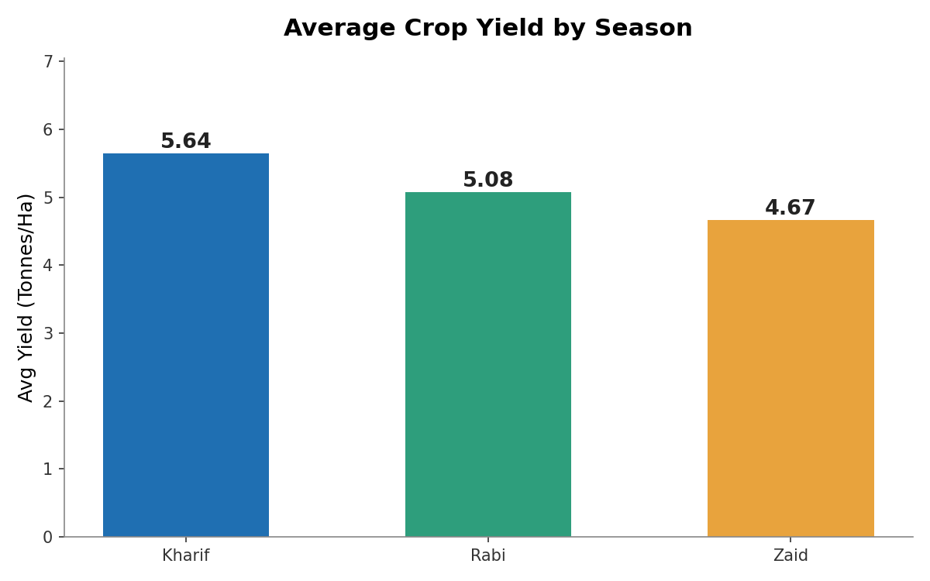
RESULTS
Dataset Overview & Seasonal Yield Comparison
4,000 farm records analyzed across 8 states, 8 crops and 4 irrigation methods
Season split: Kharif 1,779 farms | Rabi 1,627 | Zaid 594
Kharif shows the highest average yield (5.64 t/ha) — about 21% higher than Zaid (4.67 t/ha)
Better monsoon-driven growing conditions in Kharif help explain the gap

Slide 7
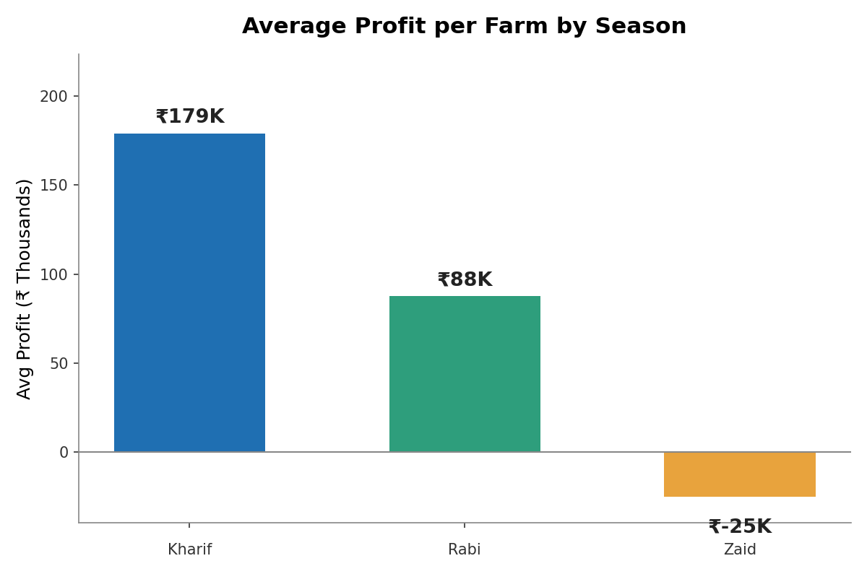
RESULTS
Economic Performance by Season
Kharif delivers the highest average profit per farm (≈ ₹1.79 lakh); Zaid runs a net average loss (≈ -₹25,000)
Share of loss-making farms rises sharply: 42% (Kharif) → 51% (Rabi) → 65% (Zaid)
Falling revenue combined with steady-to-rising costs squeezes margins moving into Zaid

Slide 8
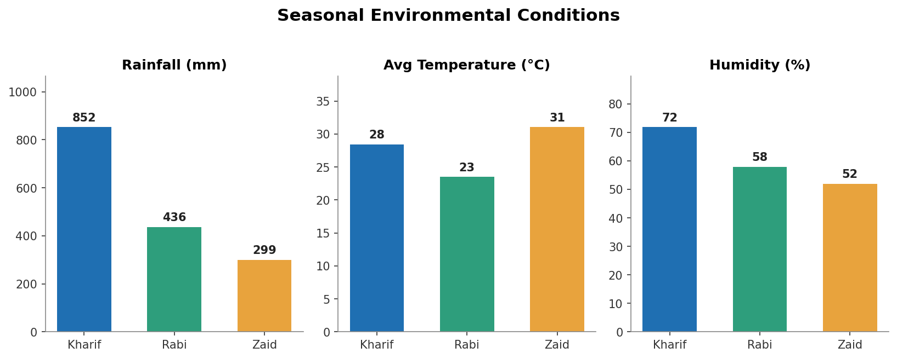
RESULTS
Seasonal Environmental Conditions
Kharif is the wettest and most humid season (852 mm rainfall, 72% humidity) — driven by the monsoon
Zaid is the hottest and driest season (31°C avg, 52% humidity, only 299 mm rainfall)
Rabi is the mildest season (23°C avg), well suited to winter crops such as wheat
These environmental shifts explain much of the season-wise gap seen in yield and irrigation demand

Slide 9
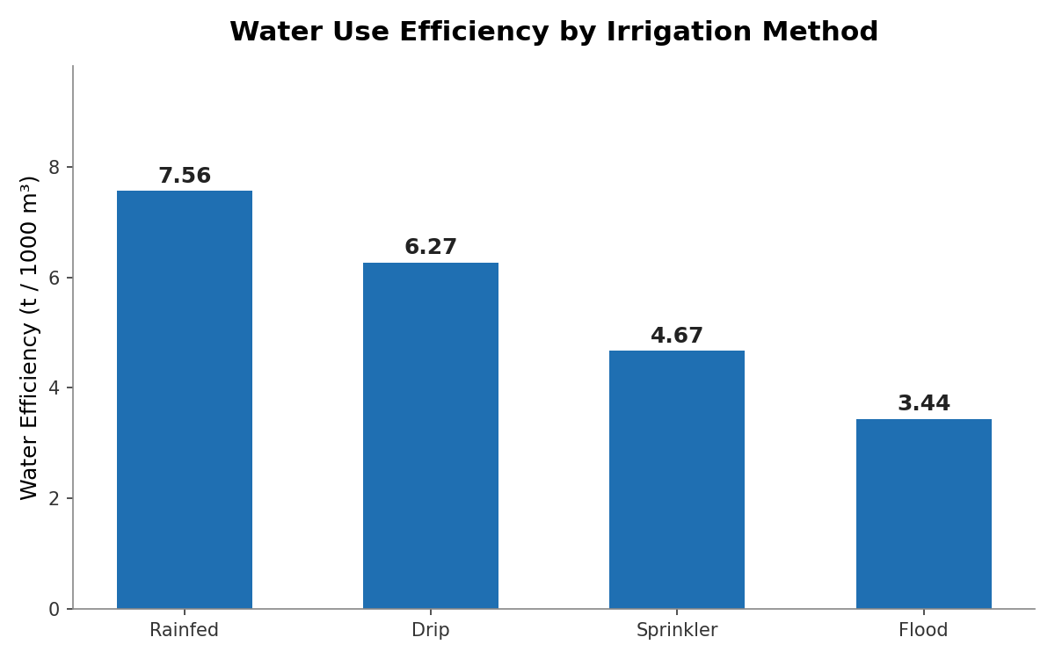
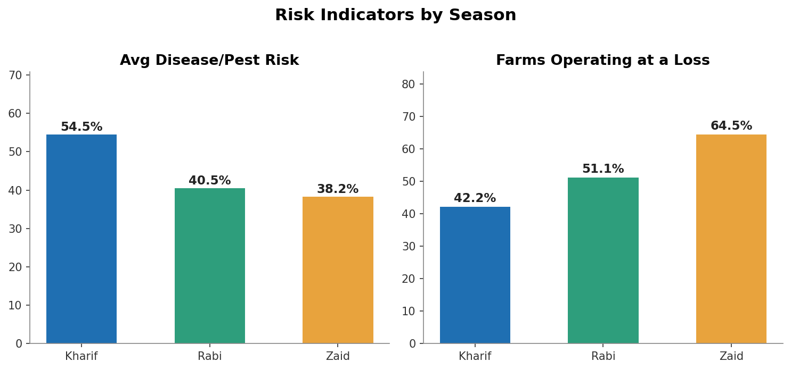
RESULTS
Irrigation Efficiency & Risk Indicators
Rainfed fields show the best raw water efficiency, but Drip irrigation gives the highest yield (6.62 t/ha) with much lower flood/disease risk
Disease/pest risk and the share of loss-making farms both climb steadily from Kharif → Rabi → Zaid, peaking in the driest season

Slide 10
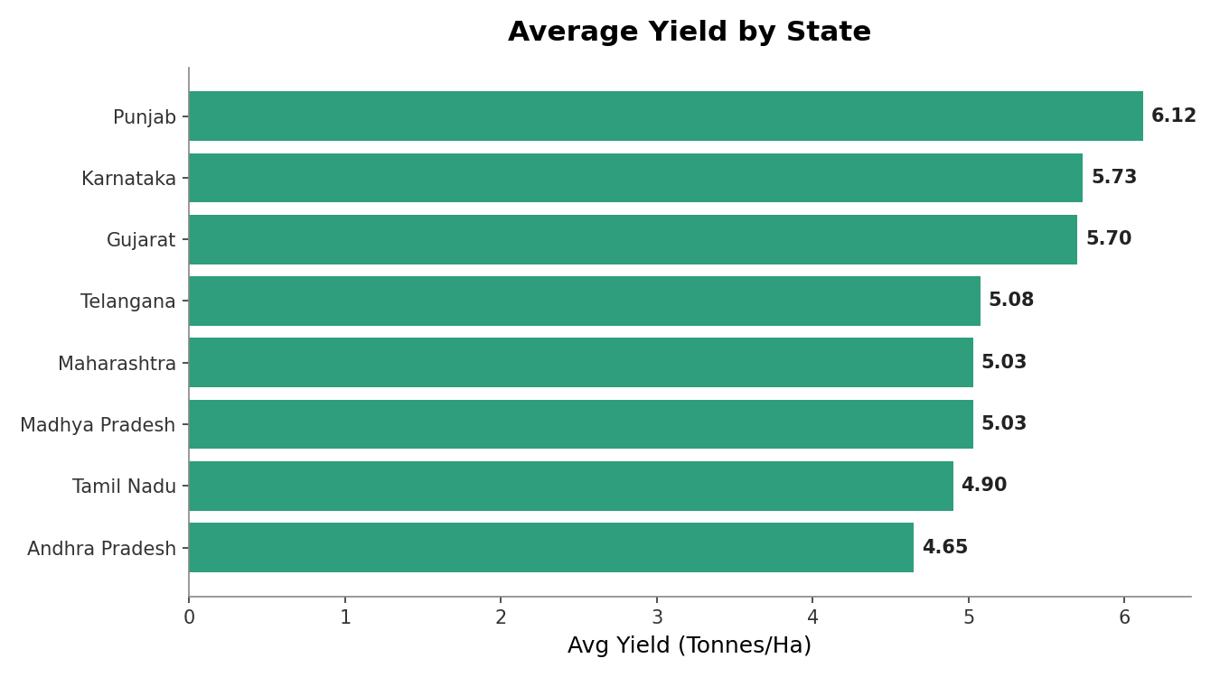
RESULTS
Yield by State & Key Takeaways
Punjab records the highest average yield (6.12 t/ha); Andhra Pradesh the lowest (4.65 t/ha)
Season is a far stronger yield driver than fertilizer or pesticide dose (near-zero correlation)
Water-use efficiency is the strongest yield driver (r ≈ 0.92) — irrigation strategy matters more than raw water volume
Recommendation: prioritize Kharif-season planning, promote efficient irrigation (drip), and build season-specific risk buffers for Zaid

Slide 11
Future scope
Extend the analysis with district-level and multi-year (time-series) data to capture year-on-year seasonal trends
Build a predictive model (regression / machine learning) to forecast yield and profit from season, irrigation and soil inputs
Develop an interactive dashboard (Power BI / Tableau / Streamlit) for real-time seasonal monitoring by farmers and policymakers
Incorporate satellite and weather-API data for more granular, location-specific environmental tracking
Extend the profitability analysis with market-price forecasting to guide crop and season selection

Slide 12
GitHub Link
https://github.com/praveen707433/Seasonal-Agriculture-Performance-Analysis-.git

Slide 13

VOIS Course completion certificate - Course name- Data Visualization

Slide 14
Thank you
.
.

