Slide 1


pyexpo 2021
Team 13
Monika.B (B.E CSE)
Manojkumar.S (B.E CSE)
Praveen.A (B.E CSE)
Deivapandeeswaran.B (B.E ECE)
Abdulrasith.H (B.E ECE)
Reported by
Mentor
Ms.Lathika

Slide 2

Intro
AGENDA
Prophase investigation
Objective​ ,Outcomes​
Prophase investigation
Modules​,Code​,Demo output
Project draft
Uses​,Merits
Design sketch

Slide 3

DOWNLODING A VIDEO FROM YOUTUBE
Prophase investigation
From Youtube,Google Drive
Sharp corner
From Instagram,Facebook
Insufficient interest
From Website,twitter
Excessive hazardous substances

Slide 4
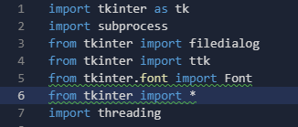
MODULES USED​
tkinter
subprocess
threading
PIL

Slide 5

tkinter
tkinter is Python's de-facto standard GUI (Graphical User Interface) package. It is a thin object-oriented layer on top of Tcl/Tk. tkinter is not the only GUI Programming toolkit for Python.
GUI(Graphical User Interface) To display widge space
importing filedialog from tk​
filedialog asks for the destination of the video to be saved​

Slide 6
threading
It allows you to have different parts of your program run concurrently and can simplify your design​
Module threading improves the throughput and power efficiency of a memory module by applying parallelism to module data accesses. This innovation partitions the module into two individual memory channels and interleaves the commands to each respective channel ​

Slide 7
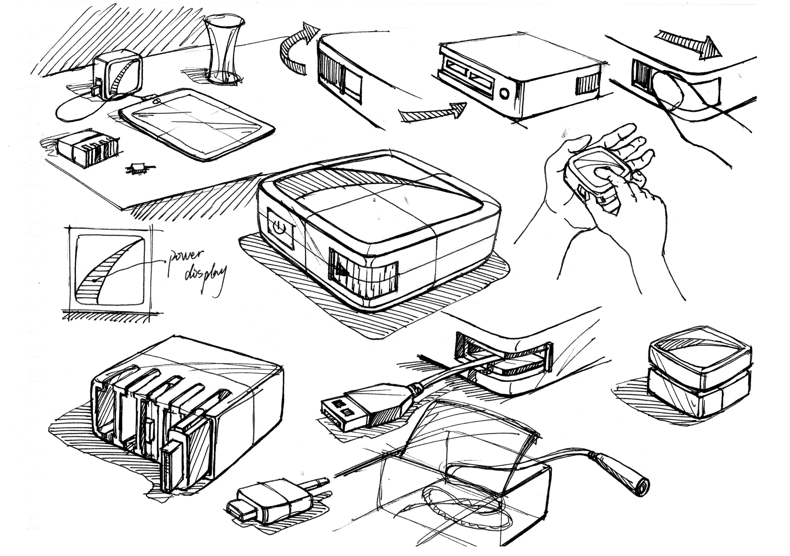
SUBPROCESS​
The subprocess module allows you to spawn new processes , connect to their input/output/error pipes ,and obtain their return code. This module intends to replace several older modules and functions ​

Slide 8


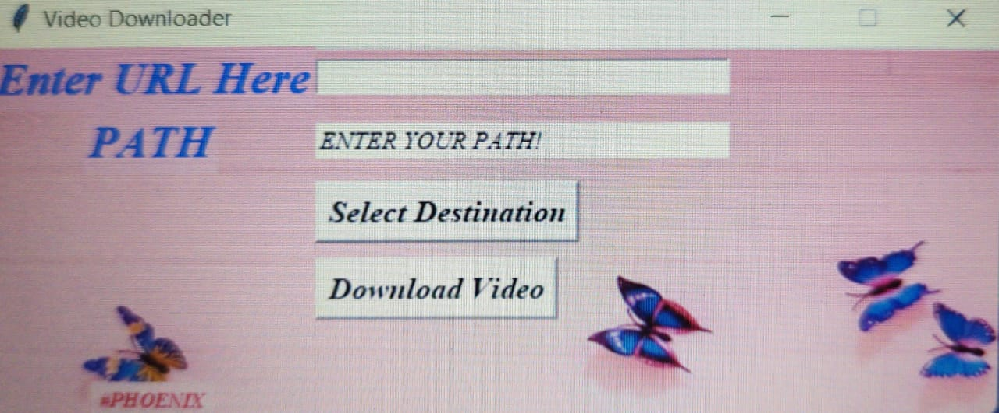

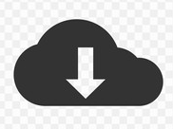

DEMO OUTPUT

Slide 9
MERITS
Single code can be used to download videos from various websites and applications.​
Automatically the download will continue when any interruption in network while downloading
This program consumes less memory and user friendly to use ​
Download path can be choosen

Slide 10
DEMERITS
Download time depends on the size of the video and resolution
Video resolution can’t be determined
Video download can’t be pause in between downloading time
Every time an application gets its update the same goes for the progam, it should also be updated

Slide 11

Thank You

Slide 12
