Slide 1

BINARY NEURAL NETWORKS
Praveen Tangarajan
PXT190003

Slide 2
Introduction and Motivation
Neural networks have made great progress- outperforming traditional state of the art algorithms in various fields.
Some Examples : Computer vision problems –Object detection, Image classifications etc. Natural Language processing – Question answering, language modelling etc.
Downside : requires huge memory and computation cost, thus rely on high performance hardware like GPU which make it practically infeasible to deploy on devices like mobile, watches, glasses, FPGA etc.
Some generic solutions proposed in literature :
1. Parameter Pruning 2. Parameter Quantization 3. low rank parameter factorization 4. Knowledge distillation
Parameter pruning and quantizing mainly focus on eliminating the redundancy in the model parameters respectively by removing the redundant/uncritical ones or compressing the parameter space.
Quantization yields fast solution and compact models by representing network weights with low precision.
Binarization is extreme 1bit quantization, data with 0 or 1.

Slide 3


Quantization
Quantization of neural networks imply parameters are represented using 1bit i.e. either +1 or -1(0).
In neural networks, either weights can be binarized or both input and weights can be binarized
binarization can be - deterministic or stochastic.
In deterministic binarization, the result of binarization is 1 when the input value is bigger than a certain threshold, 0/-1 otherwise. In stochastic binarization, the result could be 1 with probability related to the input value.
advantages: reduces memory consumptions, make it more deployable in devices like mobile , makes computations faster and easier. for example, convolution operation using bitwise manipulations.
Problems: degradation in accuracy due to information loss, difficult to train- sign function is not differentiable so traditional backpropagation fails. etc.
we shall look into algorithm and design developments to make the BNN work well (on tasks like ImageNet classification) and bridge the gap between the accuracy of its floating point counterparts.

Slide 4
Timeline
Binary Connect
2015
Binarize Neural Nets
2016
Binary Weight Nets and XNOR-Nets
2016
ABC-Nets
2017
Bi-Real-Nets
2018
Melius Net
2020
Tentacle-Net
2019
XNOR-Net++
2019
MoBiNets
2019
Group Nets
2018
ReAct Net
2020

Slide 5
Binary Connect (Courbariaux)
weights in neural network constrained to two values either + or -1. Therefore, multiply-accumulate operations are replaced by simple additions and subtractions.
In forward prop: a stochastic binarization method is adopted to quantize the weights
In backprop prop: a clip function is introduced to cut off the update range of the full-precision weights - prevent the real-valued weights from growing too large.
Parameter updates are performed using computed gradients and previous real valued weights.
This model’s performance was good in permutation invariant of some small datasets like MNIST,CFAIR etc for image classification tasks.
It was shown to drastically reduce the memory size.

Slide 6
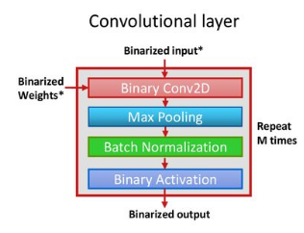
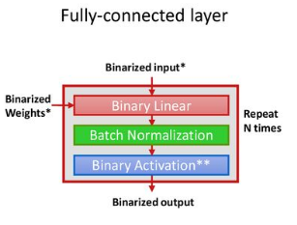
Binarized Neural Networks (Courbariaux)
Both weights and activations were binarized (-1/1)
Forward prop: arithmetic operations replaced with bit-wise operations.
Backprop: Since the gradients of the sign function is zero it is difficult to train such models, the solution that was proposed was to use straight through estimators in the backpropagation to estimate the gradients.
Straight through estimator: sets the incoming gradients to a threshold function equal to it's outgoing gradients, disregarding the derivative of the threshold function.
In this paper a straight-through estimator that takes into account the saturation effect, and use deterministic sampling of the bit.
Consider sign function q = Sign(r), the grad obtained by straight through estimator was given by gr = dC/dq * 1|r|≤1. it preserves the gradient’s information and cancels the gradient when r is too large.
updating binary weights is not possible so real weights was kept and updated during the training.
the real weights was constrained to reduce the mismatch with binary weight and after learning binary weights are stored and real weights discarded
BNNs drastically reduce memory size and accesses, and replace most arithmetic operations with bit-wise operations, which might lead to a great increase in power-efficiency

Slide 7






XNOR Nets & Binary Weight Nets(Rastegari)
Proposed two efficient approximations to standard convolutional neural networks: Binary-Weight-Networks (filters are approximated with binary values) and XNOR-Networks (both filters and activation are approximated with binary)
In this paper, they estimate the real valued weight filter using binary weight matrix and a scaling factor α in case of BWN (and in case of XNOR Net they estimate input/activation using a scaling matrix k.)
Binary convolutions for BWN and XNOR Net becomes the following. B is binary approximating of weights, α is a scaling factor, Kα is real valued scaling matrix. These scaling factors help to minimize difference between binary convolution in full precision.
⊕ operation is implemented using XNOR + bit counting in case of XNOR net and the scaling parameters α and k are estimated analytically.
The also proved that the layer orderings improves training so they place pooling layer before activation.
58× faster convolutional operations (high precision operations), 32× memory savings and outperformed existing methods by large margins on ImageNet, more than 16% in top-1 accuracy.

Slide 8

ABC-Nets(Xiaofan Lin)
Two key ideas of this paper was to 1) approximate full-precision weights with the linear combination of multiple binary weight bases and 2) Use multiple binary activations to alleviate information loss.
Real valued weight W is estimated using a linear combination of M binary filters B1,B2, …..Bm (3-5 in this paper) such that W ≈ α1*B1+α2*B2+· · ·+αM*BM., where αi is the scaling parameter.
If M=1 , it reduces to Binary Weight Networks.
Each and every binary base is constructed using user defined set of shifting parameters ui over the standard deviation of W ie Bi = sign(W-mean(W)-ui · Std(W))
Scaling parameters are calculated by solving linear regression problem:
One advantage of this architecture was it is parallelizable and hardware friendly.

Slide 9


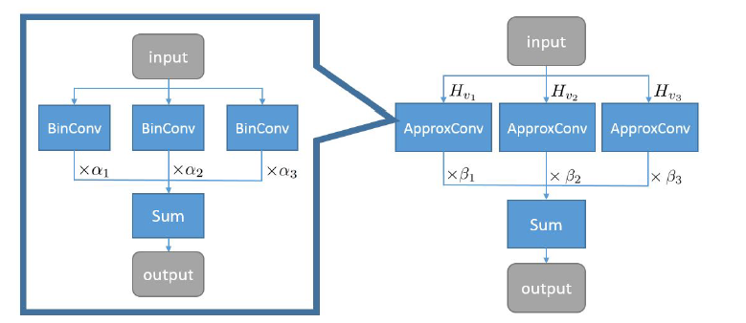
ABC-Nets
Full precision activations are also estimated using N binary bases : R ≈ β1*A1+ β2 *A2+· · ·+ βm *AM and each activation is binarize for every base using a shift vector v and a clip function hv= clip(sign(x+vi),0,1) and
Therefore convolution operation, forward prop and backprop(uses STE) are given below respectively.
Workload increase by M*N and number of weights increase by M times.
Results: The prediction accuracy was comparable to it full precision counter part on Imagenet and also in comparison with other state of the arts its performance was better. The experiment was performed on different resnet architectures.
Following is the architecture:

Slide 10
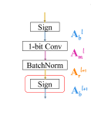
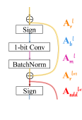
Bi-Real Nets(Zenchun Liu)
The main idea here is to introduce shortcuts to improve information flow in the network, similar to Resnet architecture. (Improving representational capacity)
real activations are connected to (after the 1-bit convolution and/or BatchNorm layer, before the sign function)activations of the consecutive block, through an identity shortcut.
magnitude-aware gradient with respect to the weight for updating the weight parameters.
pre-train the real-valued CNN model with a clip function, rather than the ReLU function, to better initialize the Bi-Real net.
They approximate its derivative by a piecewise linear function in the backward pass, derived from the piecewise polynomial function that is a second-order approximation of the sign function also show that it is more effective than clip function
Results on experiments show that their performance was better in comparison to the state of art architectures. (around 10% increase in accuracy in comparison to XNOR Net on Imagenet)
Normal Binary convolution block
Bi-real Net architecture

Slide 11

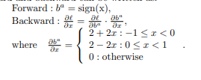
Group Nets(Zhuang)
Intuition- considering different network architecture may lead to deriving better accuracy. (structure approximation).
Redesigning a binary architecture that can directly match the capability of a floating-point model - done by partitioning the full precision model into groups and use a set of parallel binary bases to approximate its floating-point structure counterpart.
automatically learn decomposition using soft-connections (using a gate structure)
The weights are binarized using sign function similar to BWN, are estimated using STE and the activations are estimated using the piecewise polynomial function to approximate the sign function like (BiRealNets).
Given floating-point residual network with N blocks, we decompose into P binary fragments [F1….FP ], where Fi() can be any binary structure.
Two decomposition strategies proposed: Layer-wise binary decomposition and Group-wise binary decomposition

Slide 12



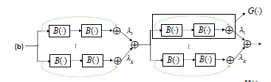

Group Nets
Layer wise binary decomposition :
Group wise binary decomposition :
Results: On comparison to the other state of the arts like BNN, XNOR, ABC-Nets the group nets achieves better performance. (same setup of different RestNet Config in Imagenet dataset.)
It however requires K times more storage and complexity. It can be parallelized for performance.
Floating point residual block
Direct binarization
Layer-wise binary decomposition
Floating point residual block-2
Group wise decomposition

Slide 13
MoBiNet(Phan)
Attempts to binarize the depth wise layer separable layers in MobileNet (Current compact SOTA network.)
Binarizing the separable depth-wise module in MobileNet is not straightforward due to double-approximation and can cause convergence problems due to loss of information.
MoBiNet architecture introduces skip connections (similar to Bi-realNets) and channel dependency enhancement between separable layers for solving vanishing gradient problems through depth-wise layers and binarizes it.
K channel dependency strategy to control dependency within the channels and to keep the net small and efficient. This concept is something similar to grouping mentioned in group nets.
The term K can be also considered as group convolutions with #groups = c/2^k , where c is the number of input channels.
Uses Prelu(trainable parameter) instead of relu and uses pooling layer to shrink spatial dimensions through out the network
Three different block designs were proposed: Pre , Mid and Post depending on position.
The result showed that the training was able to converge properly while also getting performance close to it MobileNet architecture and also better or comparable performance to some of the state of the art counter parts

Slide 14
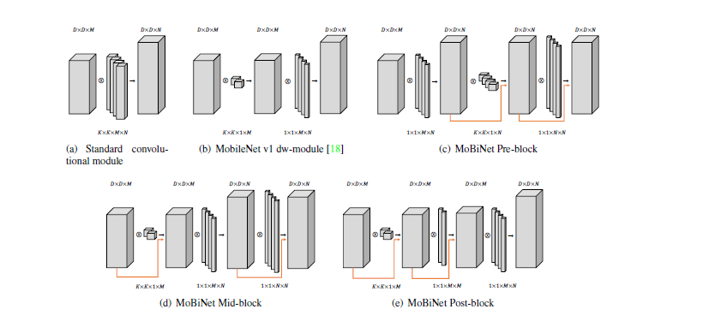
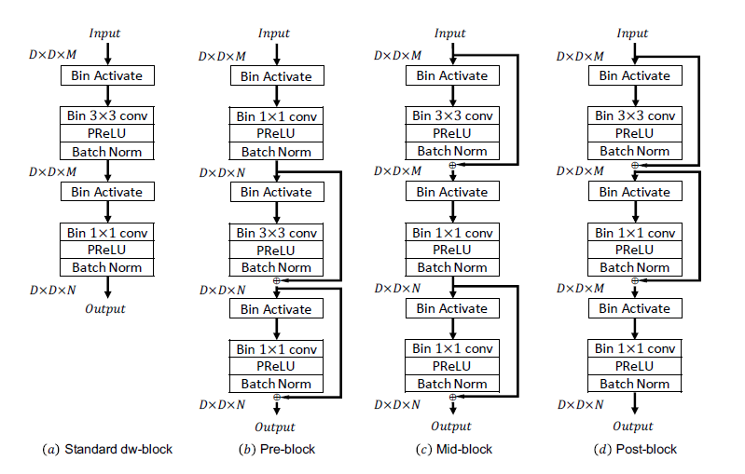
MoBiNet
Architecture

Slide 15

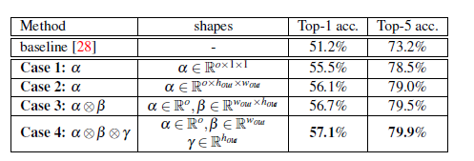
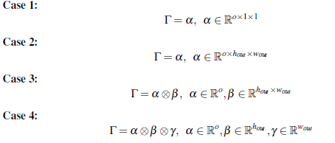
XNOR Net++ (Adrian Bulat)
This is an extension of XNOR Net architecture.
The authors propose that analytical calculation of the scaling factor is suboptimal.
They fuse the scaling factor of both the activation and weight into a single one that is learned discriminatively via backpropagation. Γ is the fused parameter in the equation given below
Performance better than XNOR.
Several ways of constructing the shape of the scale factors were explored and following were the results.
XNOR Net
XNOR Net++

Slide 16
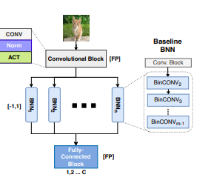
Tentacle-Net (Luca)
The concept here is to use ensembled logic to improve the predictive performance of binarized CNNs via parallelization.
It consists of a compact topology that is end-to-end trainable and organized to minimize memory utilization.
The idea is to apply binarization in parallel except for the first and last layer of the network.
Can be thought as a pseudo-ensemble that implements some mixed features belonging to the stacking and boosting methods.
The stack is composed of heterogeneous learners with different data-representation the outputs of the weak estimators are evaluated through a linear transformation.
All the layers, including the first and last block, are trained within a single procedure using the same data-set. The result is an end-to-end trainable model whose parameters can be learned through classical back-propagation.
In order to guarantee enough expressive power and reduce the risk of under-/over-fitting, the tentacles are initialized with different seeds.
Architecture

Slide 17
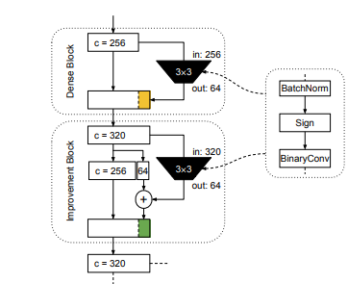
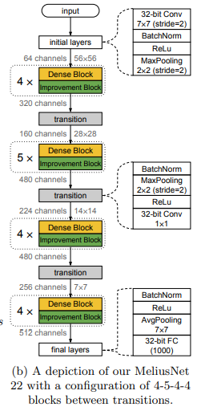
MeliusNet (Bethge)
consists of alternating DenseBlock, which increases the feature capacity, and ImprovementBlock, which increases the feature quality.
DenseBlock - consists of a binary convolution which derives 64 channels of new features based on the input feature, these features are concatenated to the feature map itself, resulting in 320 channels afterwards, thus increasing feature capacity.
Improvement Block increases the quality of these newly concatenated channels. Uses a binary convolution to compute 64 channels again based on the input feature map of 320 channels.
These 64 output channels are added to the previously computed 64 channels through a residual connection, without changing the first 256 channels of the feature map

Slide 18
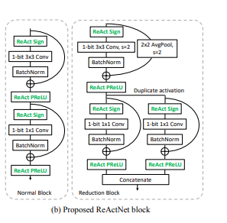



ReActNet(Zechun Liu)
core idea- performance of binary networks is sensitive to activation distribution variations.
Generalize the traditional Sign and PReLU functions, denoted as RSign and RPReLU such that they are learnable coefficients - increases the flexibility and explicitly reshapes and shifts the activation distribution.
Matches the outputs via a distributional loss defined between binary and real-valued networks, which is KL divergence between the softmax output pc of a real-valued network Rθ and a binary network Bθ.
achieves 69.4% top-1 accuracy on ImageNet, exceeding the benchmarking ResNet-level accuracy (69.3%) while achieving more than 22× reduction in computational complexity.

Slide 19
Conclusion
The development in binarizing the neural network started with just binarizing just the weights in BinaryConnet, followed by series of developments in BNN, BWN, XNOR Nets etc.
ABC Net extended the concept of XNOR Nets to linear combination series of binarized based to get more accurate bounds.
Moving further Bi-real Nets was introduced shortcuts to improve information flow in the network as the information flow was not preserved in previous architectures.
While the previous algorithms till from BinaryConnect to BiReal Net was focused on value approximations, GroupNets was introduced that focused on approximating the structure.
MobileNet was the state of the art algorithm which reduced the number of parameters using depth wise separable convolutions, while MoBiNets attempt was focused on binarizing the depth wise separable convolution architecture.
TentacleNet tried applying parallelable ensemble concept, MeliusNet used blocks to improve feature quality and quantity
Finally ReActNet tried activation distribution variations and created generalized learnable sign and relu function thus was able to perform well.

Slide 20
REFERENCE
BinaryConnect: Training Deep Neural Networks with binary weights during propagations https://arxiv.org/abs/1511.00363
Binarized Neural Networks: Training Deep Neural Networks with Weights and Activations Constrained to +1 or -1 https://arxiv.org/abs/1602.02830.
XNOR-Net: ImageNet classification using binary convolutional neural networks https://arxiv.org/abs/1603.05279
Towards accurate binary convolutional neural network https://arxiv.org/abs/1711.11294
Bi-Real Net: enhance performance of 1-bit CNNs with improved representational capability and advanced training algorithm https://arxiv.org/abs/1808.00278
Structured binary neural networks for accurate image classification and semantic segmentation https://arxiv.org/abs/1811.10413
MoBiNet: a mobile binary network for image classification https://arxiv.org/abs/1907.12629
Structured binary neural networks for image recognition https://arxiv.org/abs/1909.09934
XNOR-Net++: improved binary neural networks https://arxiv.org/abs/1909.13863
TentacleNet: a pseudo-ensemble template for accurate binary convolutional neural networks https://arxiv.org/abs/1912.10103
MeliusNet: can binary neural networks achieve MobileNet-level accuracy? https://arxiv.org/abs/2001.05936
ReActNet: towards precise binary neural network with generalized activation functions https://arxiv.org/abs/2003.03488

Slide 21
THANK YOU

