Slide 1
Products API
Contains endpoints related to Products

Slide 2
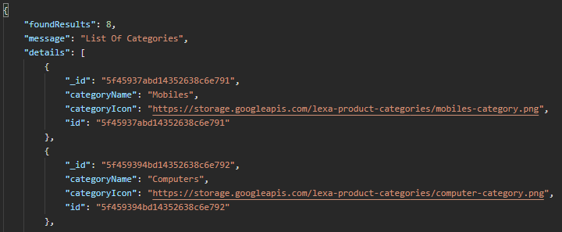
Get All Product Categories (Method : GET)
API Endpoint : https://lexa-api.uc.r.appspot.com/api/v1/getAllCategories
This endpoints fetches all products categories!
Product categories contains
Category Name
Category Icon
ID
Example :

Slide 3
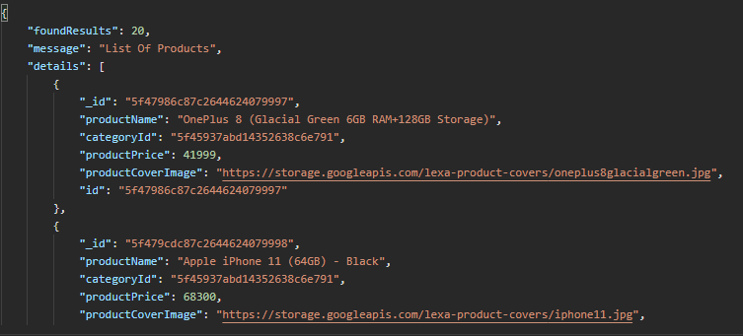
GET ALL PRODUCTS (Method : GET)
API Endpoint : https://lexa-api.uc.r.appspot.com/product/getProducts
Example : {
Gets all the products by uploaded order.
This route may not be that much useful that much ,but this route has chained queries attached to it!!!

Slide 4
Chained Methods OF GET Products (Method : GET)
API ENDPOINTS : https://lexaapi.uc.r.appspot.com/ ---- chains?
Get products by category type(takes: categoryId) : /product/getProducts?categoryId=5f45937abd14352638c6e791
Get product by Exact ProductName (rare use case) : /product/getProducts?productName=Apple iPhone 11 (64GB) – Black
Get product by Search Term(takes : fieldname/searchTerm): /product/getProducts?searchin=productName&searchTerm=z
Any methods can be chained to one another!!!
Additional Query methods available:
Pagination : ?page=1
Fields : fields=ProductName , Id, etc...,
Pagination with Results restriction : ?page=1&limit=10

Slide 5
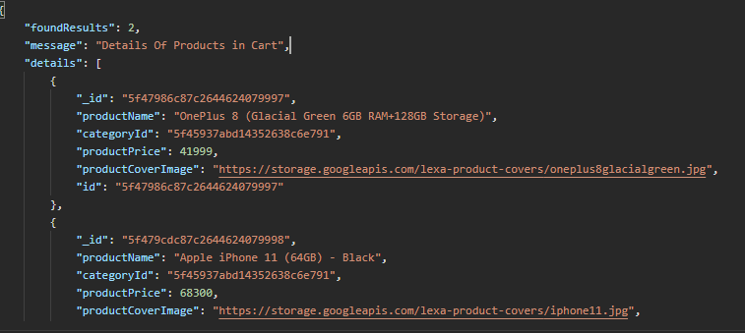
Get Details About Products in cart(METHOD : POST)
API ENDPOINT : https://lexaapi.uc.r.appspot.com/api/v1/product/getProductsDetailsInCart
This Routes Doesn’t loop through list and reduce fetch time instead it uses mongo DB's $in method with collection to find the list of products with there unique Ids.
This routes take exact cartsItems as req.body’s key
Example

Slide 6
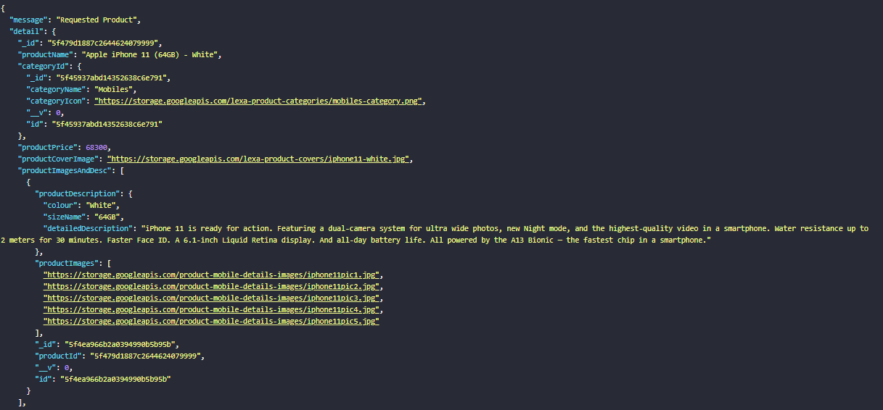
GET Product by Id or Individual (METHOD: GET)
Gets Complete detail about the product through virtual fields.
This route gets different sets of data through reference.
Example

