Slide 1
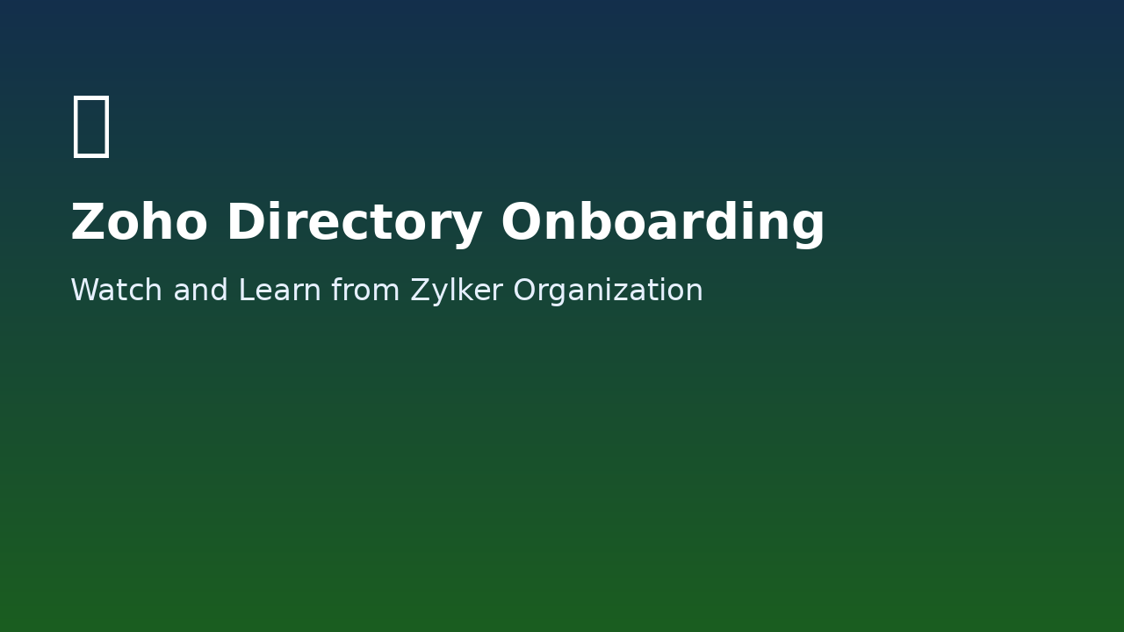
Onboarding New Users to Zoho Directory
Concept: Watch and Learn from Zylker Organization
A real-world scenario from sign-in to delegated administration

Slide 2

Meet Zylker Organization
Growth-stage IT product company with ~150 employees
Offices in Bengaluru and Chennai, plus a lean US remote team
Builds SaaS products for both B2B and B2C markets

Slide 3

Why Zylker Needed Zoho Directory
20+ apps in daily use: Zoho CRM, Jira, Slack, GitHub, Google Workspace
Manual provisioning and deprovisioning consumed IT bandwidth
MFA was not enforced consistently across the organization
A former intern retained production Jira access for 2 weeks

Slide 4

Step 1: Sign-in / Sign-up
Amelia logs in with existing Zoho credentials
New users can sign up at www.directory.zoho.com
Email verification is required before most admin actions
Then open Admin Panel to start setup

Slide 5
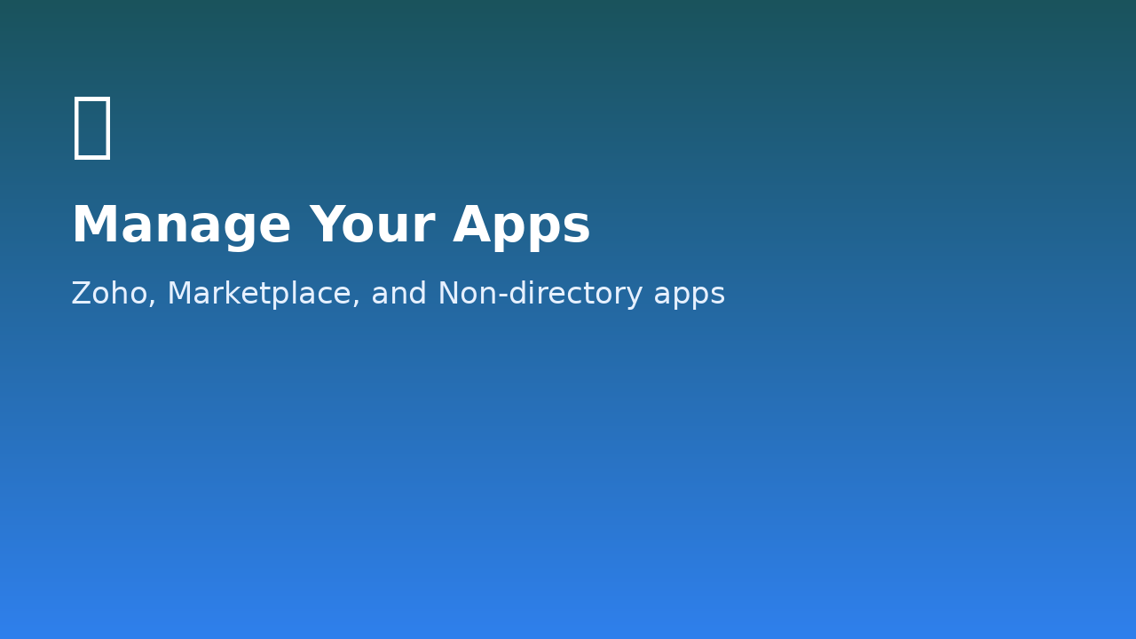
Step 2: Manage Your Apps
Configure app access before onboarding employees
Three app types: Zoho apps, Marketplace apps, Non-directory apps
Business category auto-adds relevant Zoho apps
Default apps include Meeting, WorkDrive, Cliq, and Notebook

Slide 6

Step 3: Create Groups
Departments mirror organization structure
Collaboration Groups support cross-functional needs
Smart Groups auto-add users based on criteria
Group-first design simplifies onboarding at scale

Slide 7
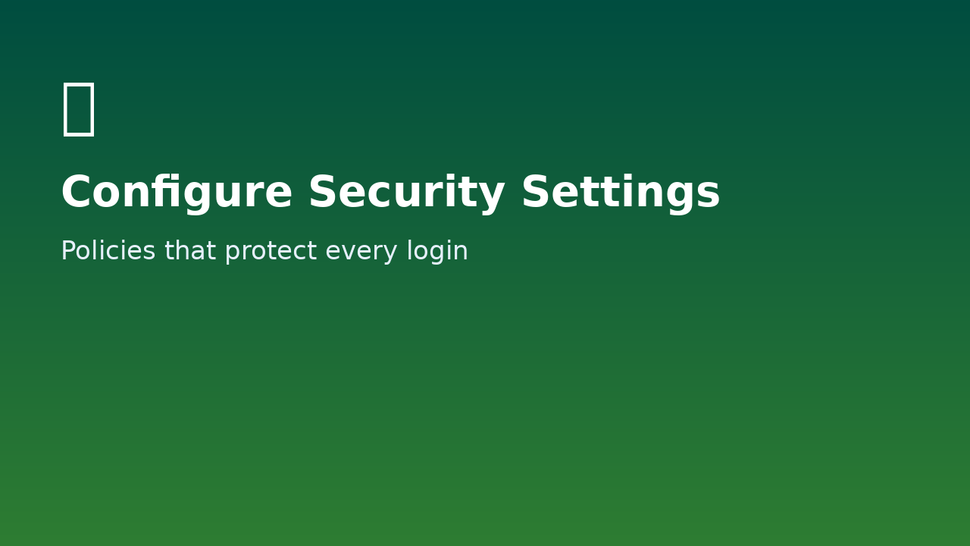
Step 4: Configure Security Settings
Conditional Access Policy controls context-based login
Routing Policy enforces authentication methods
BYOK enables customer-managed encryption key usage
Identity Providers and Security Policies harden access

Slide 8
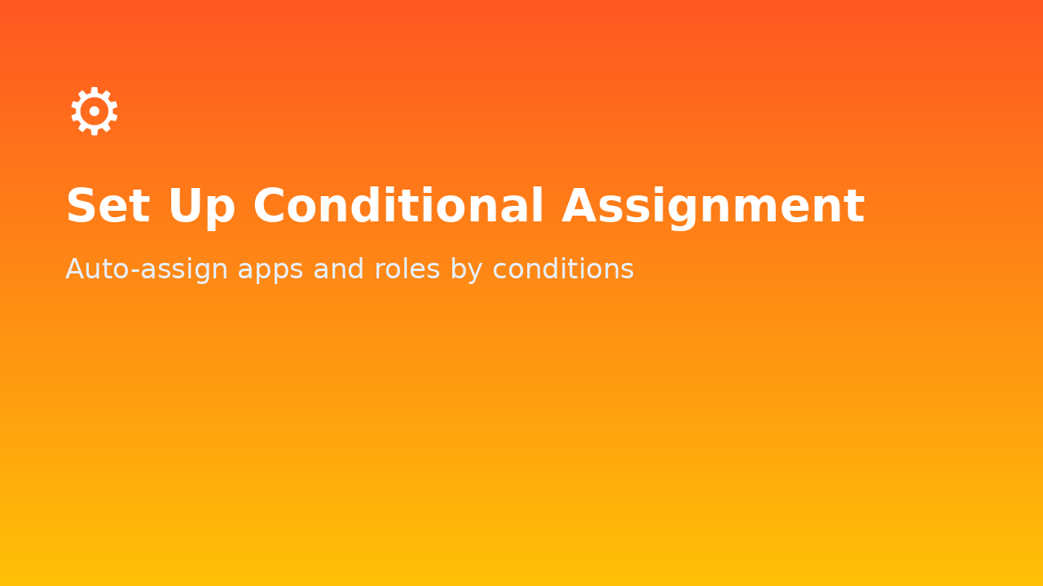
Step 5: Set Up Conditional Assignment
Assign apps automatically based on group and role conditions
Example: group members get Zoho Mail users, moderators get admin
New group additions inherit app and policy assignments instantly
Reduces repetitive manual assignment work

Slide 9
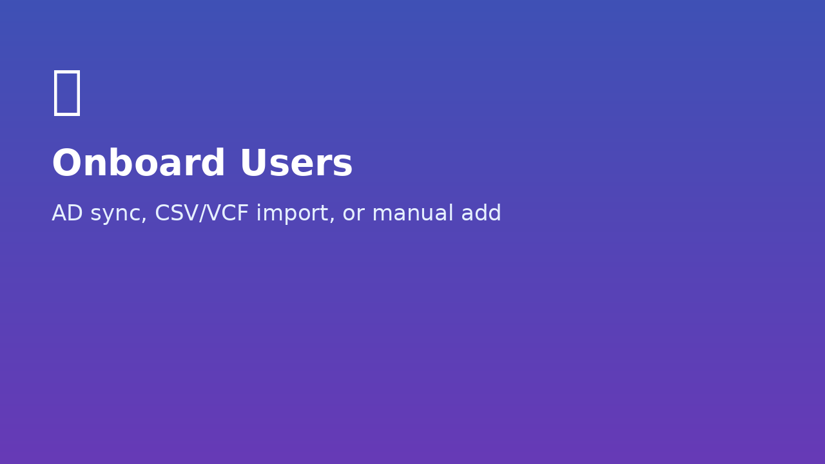
Step 6: Onboard Users
Preferred migration path: sync from AD server
Alternative path: import users via CSV or VCF
First SaaS deployment: manually add users in Users tab
Users receive apps and policies as soon as they join groups

Slide 10
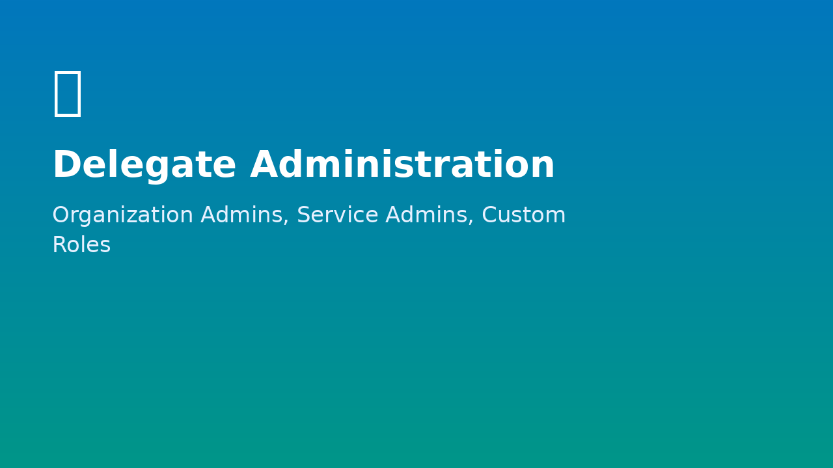
Step 7: Delegate Administration
Organization Admins manage users, groups, and policies
Service Admins manage specific applications
Custom Roles allow tailored permission sets
Keeps governance scalable as Zylker grows

Slide 11
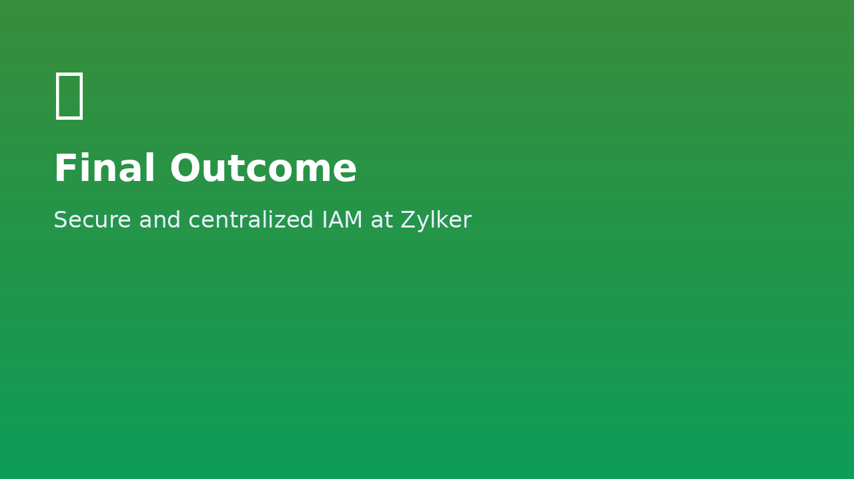
Zylker’s Outcome with Zoho Directory
Centralized identity and access management
Faster, policy-driven onboarding and offboarding
Reduced security risk with enforced controls
IT team shifts from reactive fixes to strategic work

Slide 12
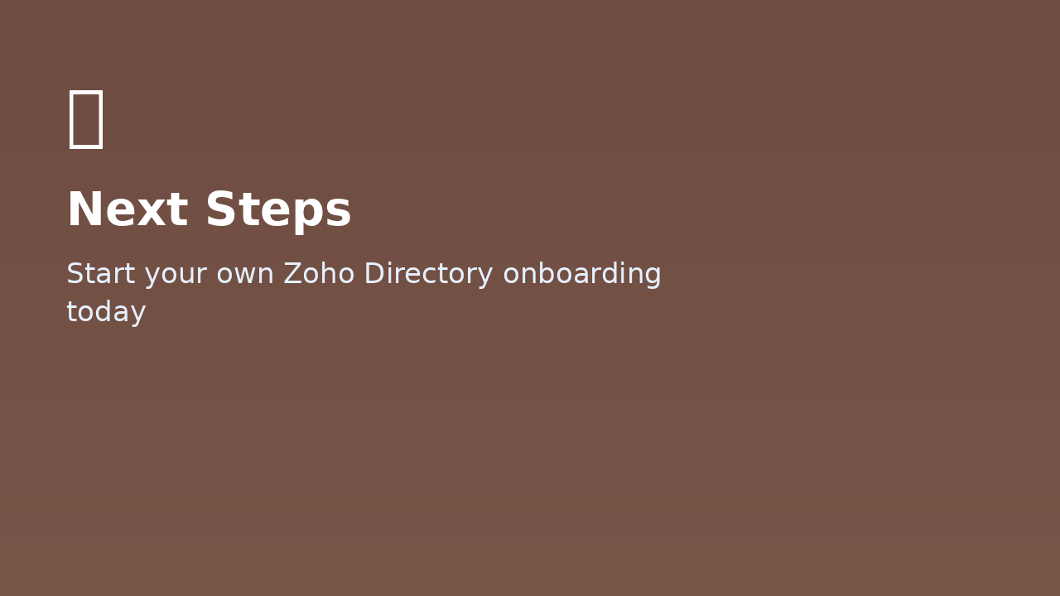
Wrap-up: Your Turn
Use Zylker’s blueprint to set up your own organization
Start with apps, groups, and security before onboarding users
Automate assignment and delegate admin to sustain scale
Build secure onboarding from day one with Zoho Directory

