Slide 1
Introduction
Chapter 1
Computer Networks, Fifth Edition by Andrew Tanenbaum and David Wetherall, © Pearson Education-Prentice Hall, 2011

Slide 2
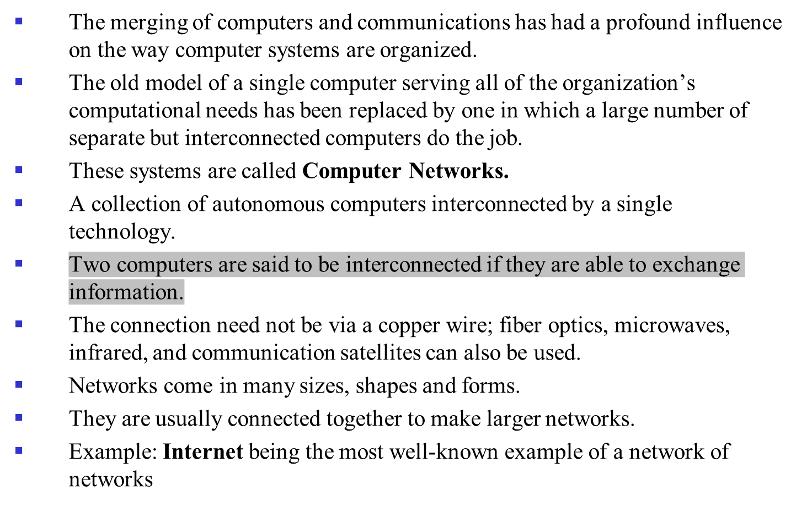
Computer Network?

Slide 3
Computer Network Vs Distributed System
The key distinction is that in a distributed system, a collection of independent computers appears to its users as a single coherent system.
A layer of software on top of the operating system, called middleware, is
responsible for implementing this model.
A well-known example of a distributed system is the World Wide Web.
In a computer network, this coherence, model, and software are absent.
Users are exposed to the actual machines.
If the machines have different hardware and different operating systems, that is fully visible to the users.
If a user wants to run a program on a remote machine, he has to log onto that machine and run it there.
Thus, the distinction between a network and a distributed system lies with the software (especially the operating system), rather than with the hardware.

Slide 4
Uses of Computer Networks
Business Applications
Home Applications
Mobile Users
Social Issues
Computer Networks, Fifth Edition by Andrew Tanenbaum and David Wetherall, © Pearson Education-Prentice Hall, 2011

Slide 5
Business Applications (1)
Most companies have a substantial number of computers.
For example, a company may have a computer for each worker and use them to design products, write brochures, and do the payroll.
The management may have decided to connect them to be able to distribute information throughout the company.
Resource Sharing: The goal is to make all programs, equipment, and especially data available to anyone on the network without regard to the physical location of the resource or the user.
Example: a group of office workers share a common printer.
Even more important than sharing physical resources is sharing information.
The companies are now highly dependent on computer networks for allowing employees to access relevant information and documents
instantly.

Slide 6
Business Applications (1)
Networks called VPNs (Virtual Private Networks) maybe used to join the individual networks at different sites into one extended network.
It is an attempt to end the ‘‘tyranny of geography.’’
That is a user happens to be 15,000 km away from his data should not prevent him from using the data as though they were
local.
A company’s information system as consisting of one or more databases with company information and some number
of employees who need to access them remotely.
In this model, the data are stored on powerful computers called servers. Often these are centrally housed and maintained by a system administrator.
In contrast, the employees have simpler machines, called clients, on their desks, with which they access remote data.

Slide 7
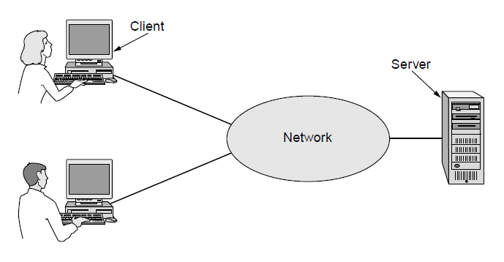
Business Applications (1)
A network with two clients and one server
Computer Networks, Fifth Edition by Andrew Tanenbaum and David Wetherall, © Pearson Education-Prentice Hall, 2011

Slide 8
Business Applications (1)
This whole arrangement is called the client-server model.
It is widely used and forms the basis of much network usage.
The most popular realization is that of a Web application.
The server generates Web pages based on its database in response to client requests that may update the database.
The client-server model is applicable when the client and server are both in the same building but also when they are far apart.
Under most conditions, one server can handle a large number (hundreds or thousands) of clients simultaneously .
In the he client-server model two processes are involved, one on the client machine and one on the server machine.
Communication takes the form of the client process sending a message
over the network to the server process.
The client process then waits for a reply message.
When the server process gets the request, it performs the requested
work or looks up the requested data and sends back a reply.

Slide 9
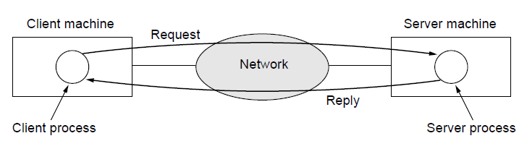
Business Applications (1)
The client-server model involves requests and replies
Computer Networks, Fifth Edition by Andrew Tanenbaum and David Wetherall, © Pearson Education-Prentice Hall, 2011

Slide 10
Business Applications (2)
The second goal of setting up a computer network has to do with people .
A computer network can provide a powerful communication medium among employees.
Every company has email (electronic mail), which employees generally use for a great deal of daily communication.
Telephone calls between employees may be carried by the computer network instead of by the phone company.
This technology is called IP telephony or Voice over IP (VoIP) when Internet technology is used.
Companies find this a wonderful way to save on their telephone bills.
Other forms of communication are
  Video can be added to audio so that employees at distant locations can see and hear each other as they hold a meeting.
  Desktop sharing lets remote workers see and interact with a graphical computer screen.

Slide 11
Business Applications (3)
A third goal for many companies is doing business electronically, especially with customers and suppliers.
This new model is called e-commerce (electronic commerce) and it has grown rapidly in recent years .
Airlines, bookstores, and other retailers have discovered that many customers like the convenience of shopping from home.
Consequently, many companies provide catalogs of their goods
and services online and take orders online.
Using computer networks, manufacturers can place
orders electronically as needed.
This reduces the need for large inventories and enhances efficiency .

Slide 12
Home Applications (1)
Internet access provides home users with connectivity to remote computers.
Home users can access information, communicate with other
people, and buy products and services with e-commerce.
Metcalfe’s law: The value of a network is proportional to the
square of the number of users because this is roughly the number
of different connections that may be made.
Access to remote information comes in many forms
  Surfing the World Wide Web for information : Ex: arts, business, cooking, government, health, history, hobbies, recreation, science, sports, travel, and many others
  For fun.
  Many newspapers have gone online and can be personalized.

Slide 13
Home Applications (1)
Many professional organizations, such as the ACM and the IEEE Computer Society already have all their journals and conference proceedings online.
The popular model for accessing information that goes by the name of peer-to-peer communication.
Individuals who form a loose group can communicate with others in the group.
Every person can, in principle, communicate with one or more other
people
There is no fixed division into clients and servers.
Each user maintains his own database locally and provides a list of other nearby people who are members of the system.
A new user can then go to any existing member to see what he has and get the names of other members to inspect for more content and more names

Slide 14
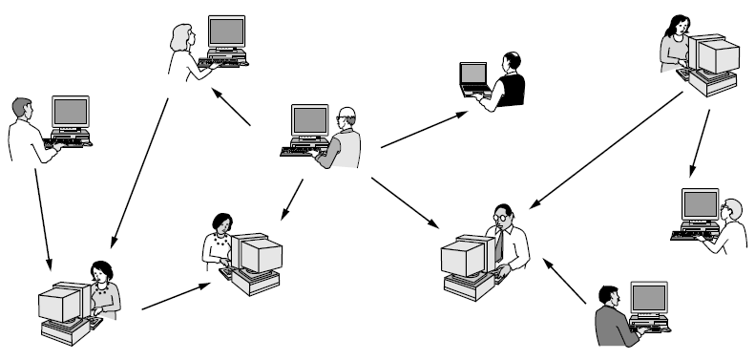
Home Applications (1)
In a peer-to-peer system there are no fixed clients and servers.
Computer Networks, Fifth Edition by Andrew Tanenbaum and David Wetherall, © Pearson Education-Prentice Hall, 2011

Slide 15
Home Applications (2)
The second broad category of network use is person-to-person communication.
E-mail is already used on a daily basis by millions of people
all over the world and its use is growing rapidly.
Instant messaging:
  Allows two people to type messages at each other in real time.
  Multi-person messaging services :lets people send short text
  messages called to their circle of friends or other willing audiences.
  Ex: Twitter.
Applications can provide rich experiences such as telelearning.
Social network :The flow of information is driven by the relationships that people declare between each other.
Wiki: Groups of people can work together to create content.

Slide 16
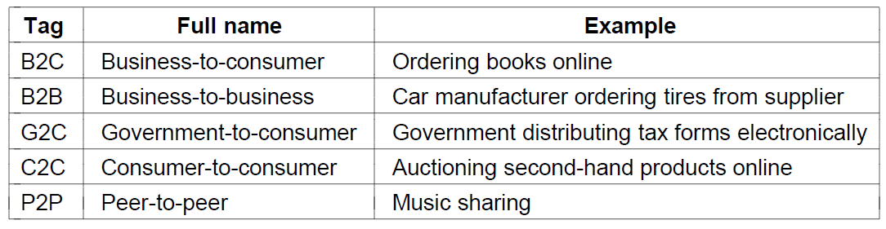
Home Applications (3)
Third category is electronic commerce : Enables users to inspect the online catalogs of thousands of companies.
Online technical support : how to use a product that was bought electronically.
People pay their bills, manage their bank accounts, and
handle their investments electronically.
E-flea:Online auctions of second-hand goods .
Following is the table showing some forms of e-commerce.

Slide 17
Home Applications (4)
The fourth category is entertainment.
Distribution of music, radio and television programs, and
movies over the Internet.
TV shows now reach many homes via IPTV (IP TeleVision) systems that are based on IP technology .
Game playing: We have multiperson real-time simulation of games.
Ubiquitous computing :computing is embedded into everyday life.
  Many homes are already wired with security systems that include door and window sensors, sensors monitor energy consumption.
  smoke detectors could call the fire department instead of making a big noise .
  high-end cameras already have a wireless network capability and use it to send photos to a nearby display for viewing.
  RFID tags are passive (i.e., have no battery) chips the size of stamps and they can already be affixed to books, passports,etc.
  This lets RFID readers locate and communicate with the items over a distance of up to several meters, depending on the kind of RFID.

Slide 18
Mobile Users
People want to use their mobile devices to read and send email, tweet, watch movies, download music, play games, or simply to surf the Web for information.
A wired connection is impossible in cars, boats, and airplanes, there is a lot of interest in wireless networks.
Cellular networks operated by the telephone companies are one familiar kind of wireless network for mobiles phones
Wireless hotspots based on the 802.11 standard are another kind of wireless network for mobile computers.
They have sprung up everywhere for example at cafes, hotels, airports,
schools, trains and planes.
Anyone with a laptop computer and a wireless modem can just turn on their computer on and be connected to the Internet through the
hotspot.
Wireless networks are of great value to fleets of trucks, taxis, delivery vehicles, and repair persons for keeping in contact with their home base.

Slide 19
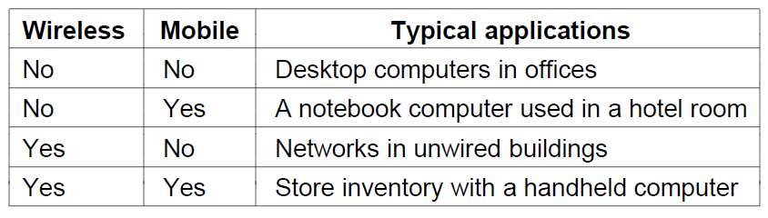
Mobile Users
Wireless networks are also important to the military.
Distinction between fixed wireless and mobile wireless networks is as follows.
Some mobile,wireless applications are
  car rental clerks work in the parking lot with wireless mobile computers.
  Text messaging or texting.
  Smart phones combine aspects of mobile phones and mobile computers.

Slide 20
Mobile Uses
Sensor Networks: They are made up of nodes that gather and wirelessly relay information they sense about the state of the physical world.
Example:
  Tell you if you are a ‘‘gas guzzler’’ compared to other drivers on the same stretch of road.
  Tracking the migration of individual zebras
  Parking meters can help drivers to find an available spot more easily.
Wearable Computers:
  Smart Wtches
  Pacemakers and Insulin pumps.

Slide 21
Network Hardware
The classifying into which all computer networks fit is based on two aspects such as transmission technology and scale.
There are two types of transmission technology that are in
widespread use: broadcast links and point-to-point links.
Point-to-point links
  Connect individual pairs of machines.
  Source to the destination on a network made up of point-to-point links.
  Short messages called packets have to first visit one or more intermediate machines.
  Point-to-point transmission with exactly one sender and exactly one receiver is sometimes called unicasting.
Broadcast network
  The communication channel is shared by all the machines on the network
  Packets sent by any machine are received by all the others.

Slide 22
Network Hardware
  An address field within each packet specifies the intended recipient.
  If the packet is intended for some other machine, it is just ignored otherwise the machine processes the packet.
  Ex: wireless network.
  Allow the possibility of addressing a packet to all destinations by using a special code in the address field.This mode of operation is called broadcasting.
  Some broadcast systems also support transmission to a subset of the machines, which known as multicasting.
Scale: Distance is important as a classification metric because different technologies are used at different scales.
Example: Personal Area Network, Locla Are Network etc...

Slide 23
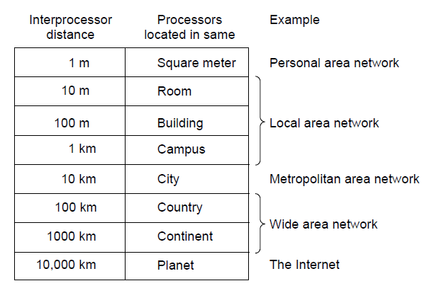
Network Hardware (2)
Classification of interconnected processors by scale.

Slide 24
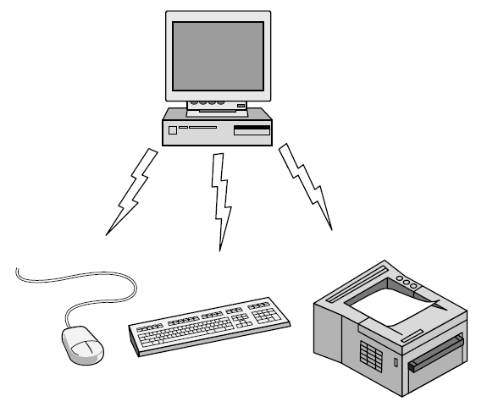
Personal Area Network
Bluetooth PAN configuration

Slide 25
Personal Area Network
Devices communicate over the range of a person.
Example: Bluetooth that connects a computer with its locating.
Bluetooth networks use the master-slave paradigm .
The system unit (the PC) is normally the master, talking to the mouse, keyboard, etc., as slaves.
The master tells the slaves what addresses to use, when they can broadcast, how long they can transmit, what frequencies they can use, and so on.
PANs can also be built with other technologies that communicate over short ranges, such as RFID on smartcards and library books.

Slide 26
Local Area Networks
A LAN is a privately owned network that operates within and nearby a single building like a home, office or factory.
Connect personal computers and consumer electronics to let them share resources (e.g., printers) and exchange information.
LANs are used by companies, they are called enterprise networks.
Wireless LANs:every computer has a radio modem and an antenna that it uses to communicate with other computers.
An AP (Access Point), wireless router, or base station, relays packets between the wireless computers and also between them and the Internet.
There is a standard for wireless LANs called IEEE 802.11, popularly known as WiFi,
It runs at speeds anywhere from 11to hundreds of Mbps.

Slide 27
Local Area Networks
Wired LANs use copper wires, but some use optical fiber.
LANs are restricted in size,worst-case transmission time is bounded and known in advance.
Wired LANs run at speeds of 100 Mbps to 1 Gbps, have low delay
(microseconds or nanoseconds), and make very few errors.
IEEE 802.3, popularly called Ethernet, is, by far, the most common type of wired LAN.
Switched Ethernet: Each computer connects to a box called a switch with a point-to-point link.
A switch has multiple ports, each of which can connect to one computer.

Slide 28
Local Area Networks
The job of the switch is to relay packets between computers that are attached to it, using the address in each packet to determine
which computer to send it to.
Both wireless and wired broadcast networks can be divided into static and dynamic designs, depending on how the channel is allocated.
A typical static allocation would be to divide time into discrete intervals and use a round-robin algorithm, allowing each machine to broadcast only when its time slot comes up.
Static allocation wastes channel capacity when a machine has nothing to say during its allocated slot, so most systems attempt to allocate the channel dynamically.
Dynamic allocation methods for a common channel are either centralized or decentralized.

Slide 29
Local Area Networks
Home network properties:
  First, the networked devices have to be very easy to install.
  Second, the network and devices have to be foolproof in operation.
  Third, low price is essential for success.
  Fourth, it must be possible to start out with one or two devices and expand the reach of the network gradually.
  Fifth, security and reliability will be very important.
Convenience and cost favors wireless networking because there are no wires to fit, or worse, retrofit.
Security favors wired networking because the radio waves that wireless networks use are quite good at going through walls.
A third option that may be appealing is to reuse the networks that are already in the home.
Power-line networks let devices that plug into outlets
broadcast information throughout the house.

Slide 30
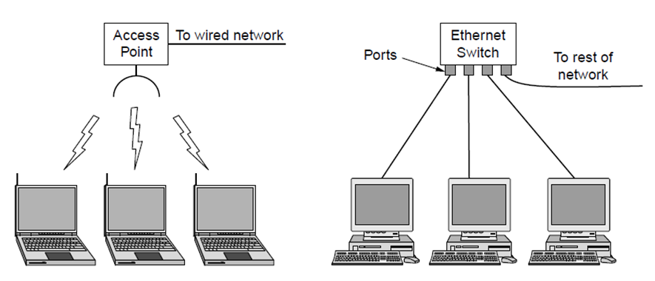
Local Area Networks
Wireless and wired LANs. (a) 802.11. (b) Switched Ethernet.

Slide 31
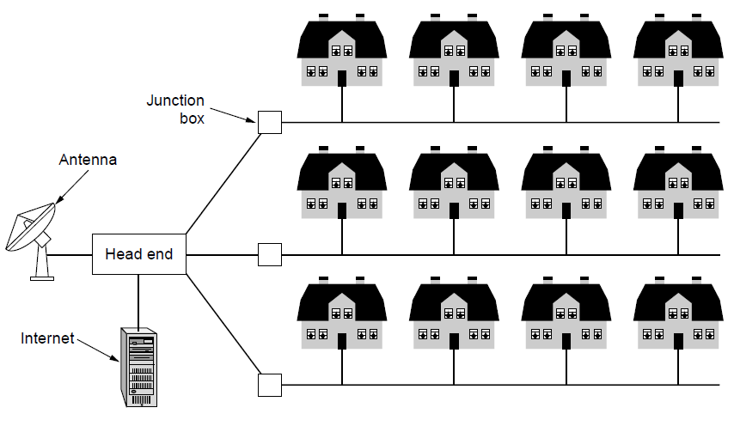
Metropolitan Area Networks
A metropolitan area network based on cable TV.

Slide 32
Metropolitan Area Networks
A MAN (Metropolitan Area Network) covers a city.
The best-known examples of MANs are the cable television networks available in many cities.
When the Internet began attracting a mass audience, the cable TV network operators began to realize that with some changes to the system, they could provide two-way Internet service in unused parts of the spectrum.
In the figure we see both television signals and Internet being fed into the centralized cable headend for subsequent distribution
to people’s home
Recent developments in highspeed wireless Internet access have resulted in another MAN, which has been standardized as IEEE 802.16 and is popularly known as WiMAX.

Slide 33
Wide Area Networks
A WAN (Wide Area Network) spans a large geographical area, often a country or continent.
The WAN in the following figure is a network that connects offices in Perth, Melbourne and Brisbane.
Each of these offices contains computers intended for running user (i.e., application) programs
These machines are called hosts.
The rest of the network that connects these hosts is then called the communication subnet, or just subnet.
The job of the subnet is to carry messages from host to host.
The subnet consists of two distinct components: transmission
lines and switching elements.
Transmission lines move bits between machines.
They can be made of copper wire, optical fiber, or even radio links.

Slide 34
Wide Area Networks
Switching elements, or just switches, are specialized computers that connect two or more transmission lines.
When data arrive on an incoming line, the switching element must choose an outgoing line on which to forward them.
These switching computers are called routers.

Slide 35
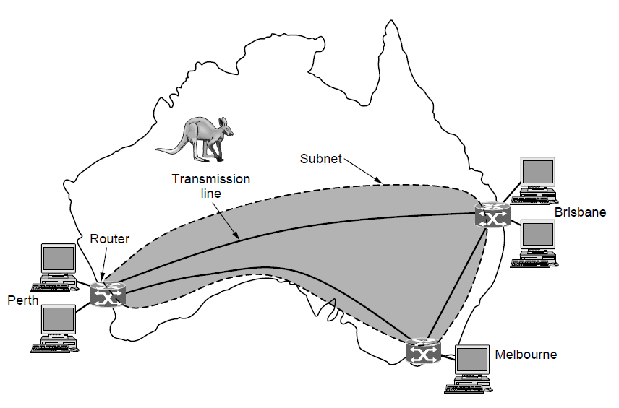
Wide Area Networks (1)
WAN that connects three branch offices in Australia

Slide 36
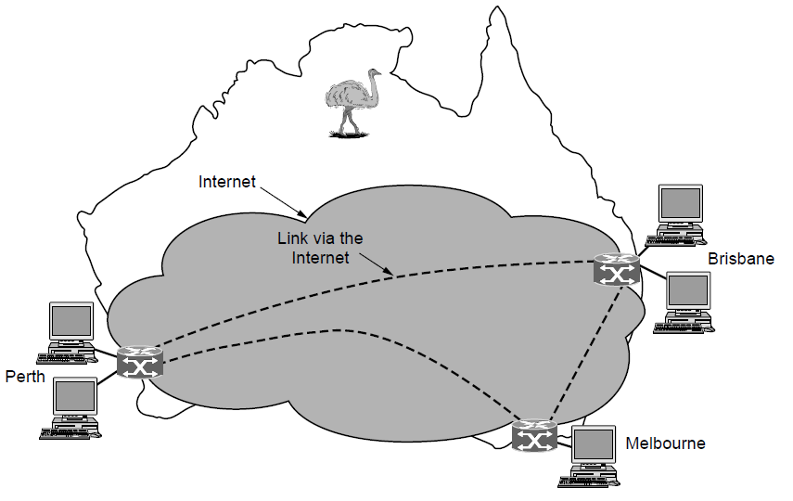
Wide Area Networks (2)
WAN using a virtual private network.

Slide 37
Internetworks
A collection of interconnected networks is called an internetwork or internet.
The Internet uses ISP networks to connect enterprise
networks, home networks, and many other networks.
Connecting a LAN and a WAN or connecting two LANs is the usual way to form an internetwork.
Machine that makes a connection between two or more networks and provides the necessary translation, both in terms of hardware and software, is a gateway.
We do not want to use too low-level a gateway or we do not want to use too high-level a gateway either.

Slide 38
Network Software
Computer networks with the hardware as the main concern and the software as an afterthought no longer works.
The following are the approaches for network software.
  Protocol hierarchies
  Design issues for the layers
  Connection-oriented versus connectionless service
  Service primitives
  Relationship of services to protocols

Slide 39
Protocol Hierarchies (1)
To reduce their design complexity, most networks are organized as a stack of layers or levels, each one built upon the one below it.
The purpose of each layer is to offer certain services to the higher layers while shielding those layers from the details of how the offered services are actually implemented
A protocol is an agreement between the communicating parties on how communication is to proceed.
Violating the protocol will make communication more difficult, if
not completely impossible.
For example, consider a 5 layer network.
The entities comprising the corresponding layers on different machines are called peers
It is the peers that communicate by using the protocol to talk to each other.

Slide 40
Protocol Hierarchies (1)
Each layer passes data and control information to the layer immediately below it, until the lowest layer is reached.
Below layer 1 is the physical medium through which actual communication occurs
Between each pair of adjacent layers is an interface.
The interface defines which primitive operations and services the lower layer makes available to the upper one.
A set of layers and protocols is called a network architecture.

Slide 41
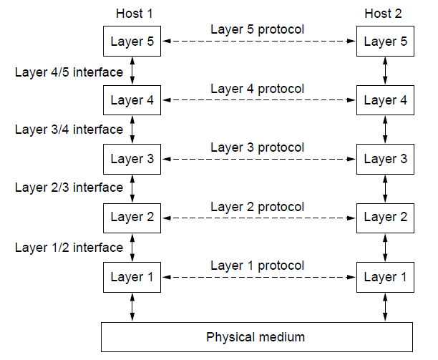
Protocol Hierarchies (1)
Layers, protocols, and interfaces.

Slide 42
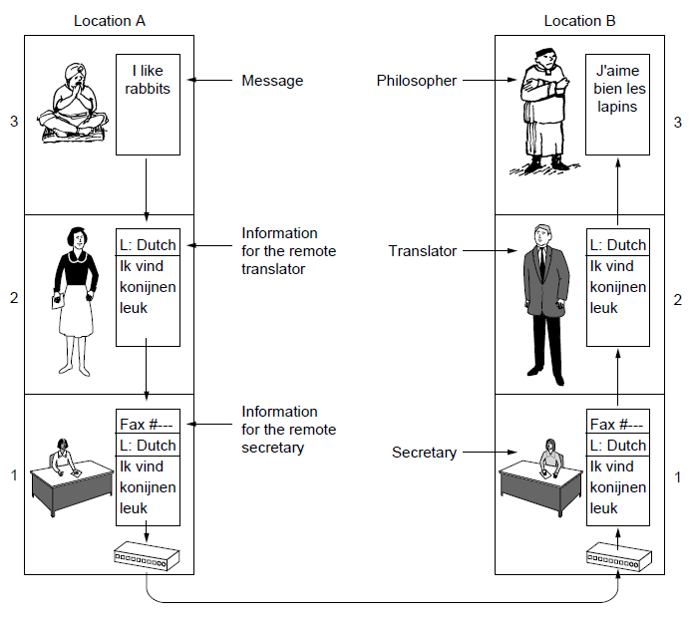
Protocol Hierarchies (2)
The philosopher-translator-secretary architecture

Slide 43
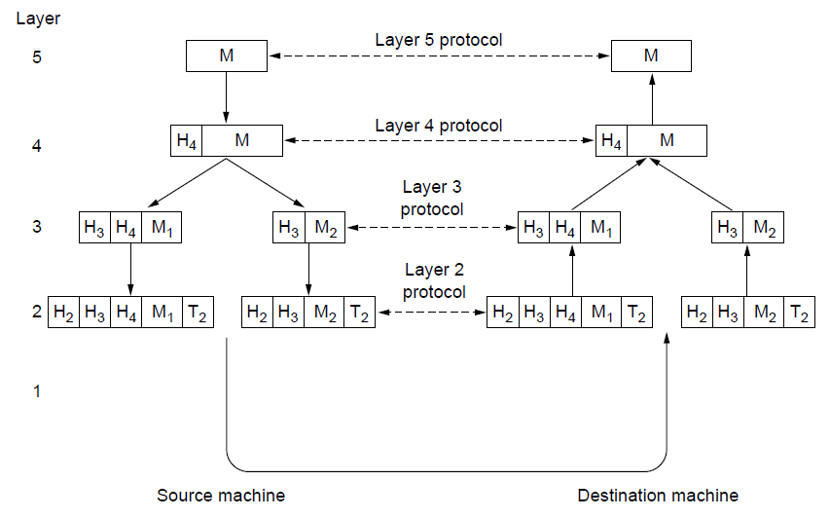
Protocol Hierarchies (3)
Example information flow supporting virtual
communication in layer 5.

Slide 44
Design Issues for the Layers
Reliability
Making a network that operates correctly even though it is made up of a collection of components that are themselves unreliable.
Ex: some of bits will be received damaged (inverted) due to
fluke electrical noise. Use error detection or correction codes.
There are multiple paths between a source and destination, and in a large network, there may be some links or routers that are broken.
The network should automatically find a working path through a network. This is called Routing.
Scalability
Networks grow larger and new designs emerge that need to be connected to the existing network.
To hide implementation details use protocol layering.

Slide 45
Design Issues for the Layers
In large networks addressing or naming of a device is a major concern.
Another limitations are number of messages sent over a channel, the size of the message .
Resource allocation
Many designs share network bandwidth dynamically, according to the short term needs of hosts. This design is called statistical multiplexing.
Feedback from the receiver to the sender is often used to control fast sender and slow receiver This subject is called flow control.
Too many computers want to send too much traffic, and the network cannot deliver it all. This overloading of the network is called congestion.

Slide 46
Design Issues for the Layers
Quality of service: Most networks must provide service to applications that want the real-time delivery at the same time that they provide service to applications that want high throughput.
Security
Mechanisms such as confidentiality, authentication and integrity are used secure the network by defending it against different kinds of threats.

Slide 47
Connection-Oriented Versus
Connectionless Service
Layers can offer two different types of service to the layers above them: connection-oriented and connectionless.
Connection-oriented service:
  The service user first establishes a connection, uses the connection, and then releases the connection.
  Example:Telephone system.
  The sender pushes objects (bits) in at one end, and the receiver takes them out at the other end.
  In most cases the order is preserved so that the bits arrive in the order they were sent.
  During connection establishment,the sender, receiver, and subnet
conduct a negotiation about the parameters to be used.
  Example parameters:maximum message size, quality of service
  A circuit is another name for a connection with associated resources,
such as a fixed bandwidth

Slide 48
Connection-Oriented Versus
Connectionless Service
Connectionless service:Each message (letter) carries the full destination address,and each one is routed through the intermediate nodes inside the system independent of all the subsequent messages
Example:Postal system.
Here the message is called packet.
There are two types of switching possible.They are
  Store and forward Switching: When the intermediate
nodes receive a message in full before sending it on to the next node
  Cut-through switching:Node starts the transmission of packets before it is completely recieved.
When two messages are sent to the same destination,it
is possible that the first one sent can be delayed so that the second one arrives first.

Slide 49
Connection-Oriented Versus
Connectionless Service
Reliability:Reliable is in the sense that they never lose data.
The receiver acknowledge the receipt of each message so the sender is sure that it arrived.
The acknowledgement process introduces overhead and delays, which are often worth it but are sometimes undesirable.
Example :File transfer.Reliable connection oriented service.
Reliable connection-oriented service has two minor variations: message sequences and byte streams.
  Message sequence:The message boundaries are preserved.For example When two 1024-byte messages are sent, they arrive as two distinct 1024- byte messages, never as one 2048-byte message.
  Ex:Sending of pages of a book.
  Byte stream:The connection is simply a stream of bytes, with no message boundaries.
  Ex:Downloading a DVD movie.

Slide 50
Connection-Oriented Versus
Connectionless Service
Unreliable connectionless service: This is also called datagram service.
To send a single message that has a high probability of arrival, but no guarantee.
Example :Telegram.
The acknowledged datagram service is not having to establish a connection to send one message is desired, but reliability is essential.
Ex: SMS
Request-reply service:The sender transmits a single datagram containing a request; the reply contains the answer.
Ex:client-server communication.

Slide 51
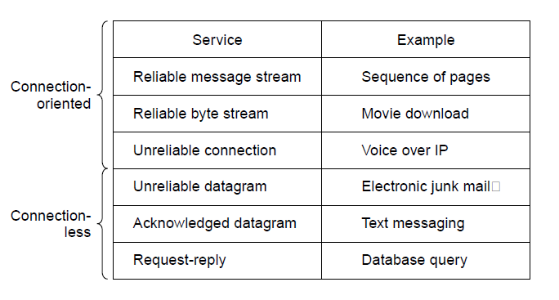
Connection-Oriented Versus
Connectionless Service
Six different types of service.

Slide 52
Service Primitives
Service is formally specified by a set of primitives (operations) available to user processes to access the service.
These primitives tell the service to perform some action or report on an action taken by a peer entity.
Eg: System calls.
The set of primitives available depends on the nature of the service being provided.
service primitives that might provide a reliable byte stream are listed in the following table.
These primitives might be used for a request-reply interaction in a client-server environment.

Slide 53
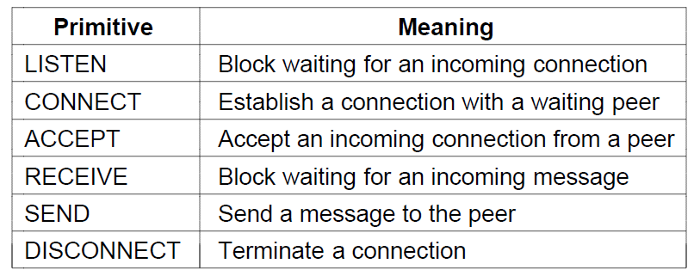
Service Primitives (1)
Six service primitives that provide a simple
connection-oriented service

Slide 54
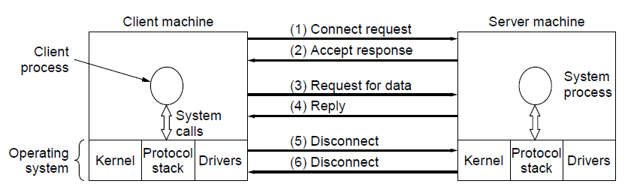
Service Primitives (2)
A simple client-server interaction using
acknowledged datagrams.

Slide 55
The Relationship of Services to Protocols
Service Vs Protocol
Service:
A service is a set of primitives (operations) that a layer provides to the layer above it.
The service defines what operations the layer is prepared to perform on behalf of its users, but it says nothing at all about how these operations are implemented.
A service relates to an interface between two layers, with the lower layer being the service provider and the upper layer being the service user.
Protocol: It is a set of rules governing the format and meaning of
the packets, or messages that are exchanged by the peer entities within a layer.
Entities use protocols to implement their service definitions.
They are free to change their protocols at will, provided they do not change the service visible to their users.

Slide 56
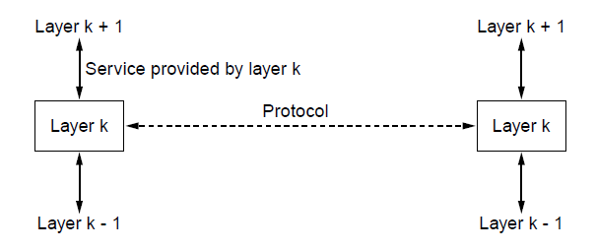
The Relationship of Services to Protocols
The relationship between a service and a protocol.

Slide 57
The Relationship of Services to Protocols
Services relate to the interfaces between layers and protocols relate to the packets sent between peer entities on different machines.
A service is like an abstract data type or an object in an object-oriented language.
A protocol relates to the implementation of the service and as such is not visible to the user of the service.

Slide 58
Reference Models
OSI reference model
TCP/IP reference model
Model used for this text
Comparison of OSI and TCP/IP
Critique of OSI model and protocols
Critique of TCP/IP model

Slide 59
The OSI Reference Model
This model is based on a proposal developed by the International Standards Organization (ISO) as a first step toward international standardization of the protocols used in the various layers.
The model is called the ISO OSI (Open Systems Interconnection) Reference Model because it deals with connecting open systems—that is, systems that are open for communication with other systems.
Principles for the seven layers
Layers created for different abstractions.
Each layer performs well-defined function
Function of layer chosen with definition of international standard protocols in mind
Minimize information flow across interfaces between boundaries
Number of layers is optimum(not too large nor too small).

Slide 60
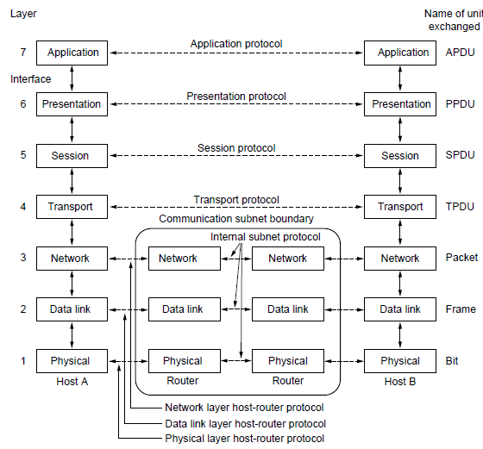
The OSI Reference Model
The OSI reference model

Slide 61
OSI Reference Model Layers
Physical layer
Data link layer
Network layer
Transport layer
Session layer
Presentation layer
Application layer

Slide 62
The OSI Reference Model
Application Layer
Application layer is used by computers applications such as Google chrome, outlook, skype..etc.
Application layer defines the protocols that are used by computer applications.
contains a variety of protocols that are commonly needed by users.
Ex: HTTP (HyperText Transfer Protocol), which is the basis for the World Wide Web.
When a browser wants a Web page, it sends the name of the page it wants to the server hosting the page using HTTP.
The server then sends the page back.
Other application protocols are used for file transfer, electronic mail, and network news.
It provides services to the computer applications.

Slide 63
The OSI Reference Model
Presentation Layer
Presentation layer receives the data from top most layer which is application layer.
Functions of presentation layer:
1.Translation:Data received from application layer is in form of characters and numbers. The presentation layer converts these characters and numbers into Binary format.
Ex:1010101
2.Encryption:Encrypts the data at the sender side, before the transmission data. This data decrypted at receiver side.
3.Compression:Compression the data to small size so that it can be transferred faster over network.

Slide 64
The OSI Reference Model
Session Layer
Main role of session layer is to setup and maintain the connection b/w different systems.
Functions of Session Layer:
1.Authentication
2.Authorization
3.Session management

Slide 65
The OSI Reference Model
Transport layer
Main role of transport layer is to check the reliability of data communication.
Functions of Transport layer:
1.Segmentation:Data receiving from session layer, Divided into small data units called segments. Each segment contains sender & receiver port number along with sequence number.
2.Flow control: Controls the flow of data.
Ex:sender-100mbps,receiver-10mbps controls the data doesn’t get lost during transmitting over network.
3.Error Control: If data is lost during transmission, it is send again using automatic repeat request.
4.Connection oriented transmission
5.Connectionless transmission: It is using user datagram protocol(UDP) is faster than TCP

Slide 66
The OSI Reference Model
Network layer
The main purpose of network layer is to receive the data segments from transport layer and transfer them from one computer to another on different network.
Functions of Network layer:
1.Logical Addressing: Each computer has a unique IP address. Network layer assigns the sender and receiver IP so that the data packet reach the correct destination.
2.Routing:Transferring data packets from source to destination. i.e. Routing combination of MASK+IP address. Each packet contains 3 components Mask+ Sender IP+Receiver IP.
3.Path determination

Slide 67
The OSI Reference Model
Data Link Layer
Data link layer receives the data from network layer.
There are 2 types of addressing done to the packets transfers from one computer to another computer.
1.Logical addressing: It is assigning sender and receiver Ip addresses to data packets. This is done at the network layer.
2.Physical addressing: It is done at data link layer where MAC addresses of sender and receiver are assigned to each data packets.
Functions of Data link layer:
1.Access the media: Allows upper layers of OSI model to use the media using a technique called framing.
2.Media Access control: How data is placed and received from the media.
3.Error Detection: Each frame contains certain bits to check whether the data read on the side is corrupted or not

Slide 68
The OSI Reference Model
Physical layer
  Transmitting raw bits over a communication channel.
  Design issues :
  Make sure that when one side sends a 1 bit it is received by the other side as a 1 bit, not as a 0 bit.
  What electrical signals should be used to represent a 1 and a 0?
  How many nanoseconds a bit lasts.
  Whether transmission may proceed simultaneously in both directions.
  How the initial connection is established, how it is torn down when both sides are finished?
  How many pins the network connector has, and what each pin is used for.

Slide 69
The TCP/IP Reference Model Layers
TCP/IP Reference Model is a four-layered suite of communication protocols. It was developed by ARPANET (Advanced Research Project Agency Network). It is named after the two main protocols that are used in the model, namely, TCP and IP. TCP stands for Transmission Control Protocol and IP stands for Internet Protocol.
Layers
  Link layer
  Internet layer
  Transport layer
  Application layer

Slide 70
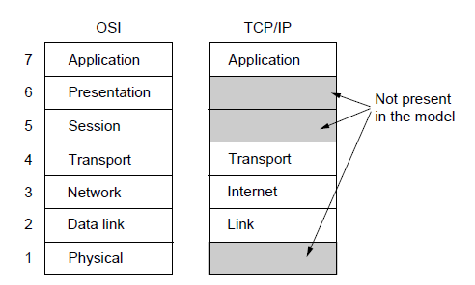
The TCP/IP Reference Model (1)
The TCP/IP reference model

Slide 71
The TCP/IP Reference Model (1)
Link layer:
It is the lowest layer of the TCP/IP model.
It is the combination of the Physical layer and Data Link layer defined in the OSI reference model.
It defines how the data should be sent physically through the network.
This layer is mainly responsible for the transmission of the data between two devices on the same network.
The functions carried out by this layer are encapsulating the IP datagram into frames transmitted by the network and mapping of IP addresses into physical addresses.
The protocols used by this layer are Ethernet, token ring, FDDI, X.25, frame relay.

Slide 72
The TCP/IP Reference Model (1)
Internet layer
An internet layer is the second layer of the TCP/IP model.
An internet layer is also known as the network layer.
The main responsibility of the internet layer is to send the packets from any network, and they arrive at the destination irrespective of the route they take.
Following are the protocols used in this layer are:
IP Protocol: The Internet Protocol (IP) is a protocol, or set of rules, for routing and addressing packets of data so that they can travel across networks and arrive at the correct destination.
ICMP stands for Internet Control Message Protocol.
It is a mechanism used by the hosts or routers to send notifications regarding datagram problems back to the sender.

Slide 73
The TCP/IP Reference Model (1)
Transport Layer
The transport layer is responsible for the reliability, flow control, and correction of data which is being sent over the network.
The two protocols used in the transport layer are User Datagram protocol and Transmission control protocol.
UDP: Unreliable, Connectionless protocol. It is used for request-reply type queries type applications.
  UDP consists of the following fields:
  Source port address: The source port address is the address of the application program that has created the message.
  Destination port address: The destination port address is the address of the application program that receives the message.
  Total length: It defines the total number of bytes of the user datagram in bytes.
  Checksum: The checksum is a 16-bit field used in error detection.

Slide 74
The TCP/IP Reference Model (1)
TCP:
Reliable connection-oriented protocol that allows a byte stream originating on one machine to be delivered without error on any other machine in the internet.
It segments the byte stream into messages and pass them to internet layer.
At destination, it reassembles the received message into output stream.
Handles flow control to make sure that a fast sender cannot swamp a slow receiver with more messages.

Slide 75
The TCP/IP Reference Model (1)
Application Layer
An application layer is the topmost layer in the TCP/IP model.
It is responsible for handling high-level protocols, issues of representation.
This layer allows the user to interact with the application.
When one application layer protocol wants to communicate with another application layer, it forwards its data to the transport layer.
Following are the main protocols used in the application layer:
Telnet, HTTP, FTP, SMTP, etc.

Slide 76
The TCP/IP Reference Model (1)
HTTP:HTTP stands for Hypertext transfer protocol. This protocol allows us to access the data over the world wide web. It transfers the data in the form of plain text, audio, video.
FTP: FTP stands for File Transfer Protocol. FTP is a standard internet protocol used for transmitting the files from one computer to another computer.
TELNET: It is an abbreviation for Terminal Network. It establishes the connection between the local computer and remote computer in such a way that the local terminal appears to be a terminal at the remote system.
SMTP: SMTP stands for Simple mail transfer protocol. The TCP/IP protocol that supports the e-mail is known as a Simple mail transfer protocol. This protocol is used to send the data to another e-mail address.

Slide 77
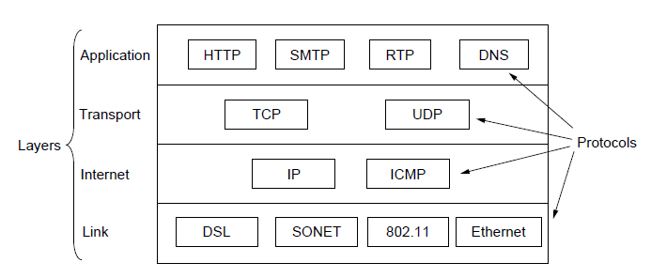
The TCP/IP Reference Model (1)

Slide 78
Comparison of the OSI and
TCP/IP Reference Models
Similarities
  Both are based on the concept of a stack of independent protocols.
  The functionality of the layers is roughly similar.
Concepts central to OSI model
Services
Interfaces
Protocols

Slide 79
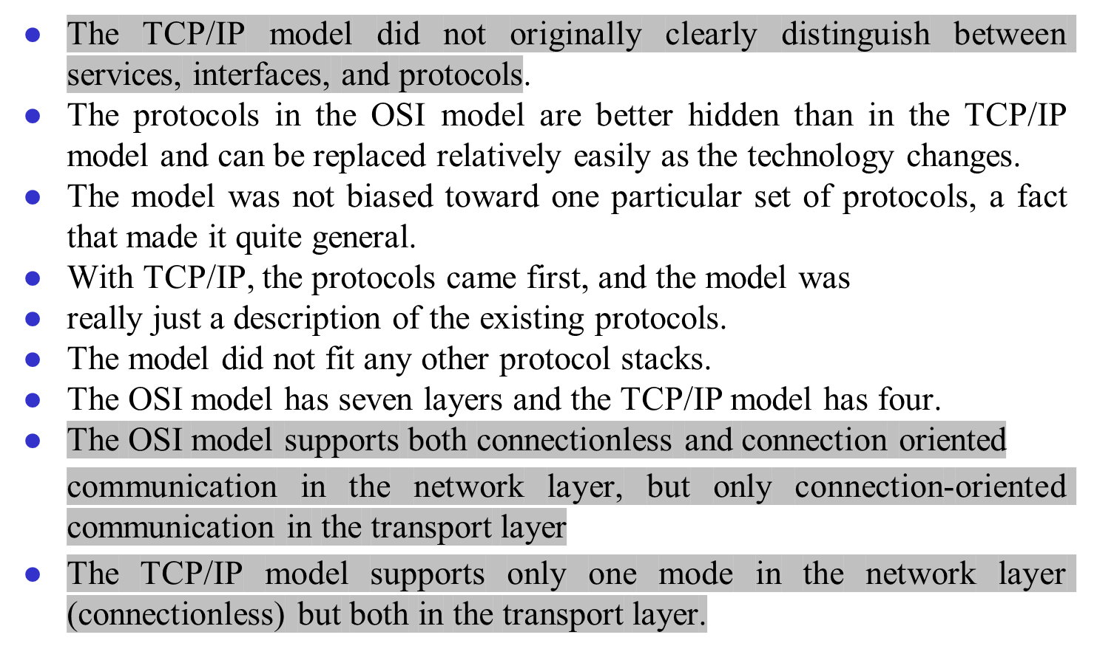
Comparison of the OSI and
TCP/IP Reference Models

Slide 80
Critique of the OSI Model and Protocols
Bad timing:
  The time at which a standard is established is absolutely critical to its success
  The competing TCP/IP protocols were already in widespread use by research universities by the time the OSI protocols appeared.
Bad technology.
  The OSI model, along with its associated service definitions and protocols, is extraordinarily complex.
  They are also difficult to implement and inefficient
in operation.

Slide 81
Critique of the OSI Model and Protocols
Bad implementations.
  initial implementations were huge, unwieldy, and slow.
  Everyone who tried them got burned. It did not take long for people to associate ‘‘OSI’’ with ‘‘poor quality.’’
Bad politics.
  It was widely thought to be the creature of the European
telecommunication ministries, the European Community, and later the U.S. Government.

Slide 82
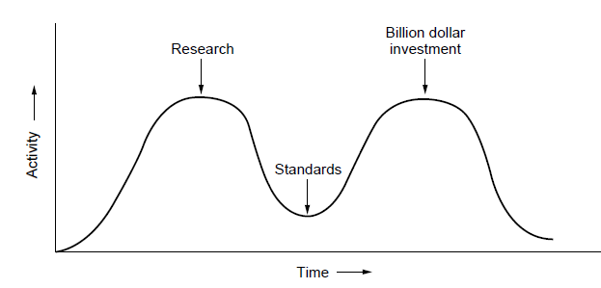
OSI Model Bad Timing
The apocalypse of the two elephants.

Slide 83
A Critique of the TCP/IP Reference Model
Requires good software engineering practice requires differentiating between the specification and the implementation,
Poorly suited to describing any protocol stack other than TCP/IP.
The link layer is not really a layer . It is an interface between the network
and data link layers.
The TCP/IP model does not distinguish between the physical and data
link layers.A proper model should include both as separate layers.
Many of the other protocols were ad hoc, generally produced
by a couple of graduate students and the implementations were then distributed free,
Ex: TELNET

