Slide 1
The Physical Layer
Chapter 2

Slide 2
The Physical Layer
The lowest layer of the OSI reference model is the physical layer.
It is responsible for the actual physical connection between the devices.
The physical layer contains information in the form of bits.
It is responsible for transmitting individual bits from one node to the next.
When receiving data, this layer will get the signal received and convert it into 0s and 1s and send them to the Data Link layer, which will put the frame back together.

Slide 3
Data and Signals
To be transmitted, data must be transformed to electromagnetic signals.
Both data and the signals that represent them can be either analog or digital in form.
Analog data refers to information that is continuous.
Ex: An analog clock that has hour, minute, and second hands gives information in a continuous form.
Ex: Digital data refers to information that has discrete state.
A digital clock that reports the hours and the minutes will change suddenly from 8:05 to 8:06.
An analog signals has infinitely many levels of intensity over a period of time.
A digital signal can have only a limited number of values.

Slide 4
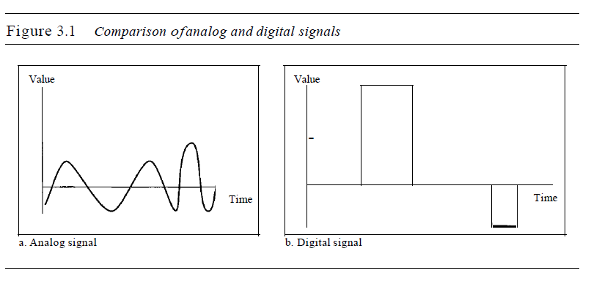
Data and signals

Slide 5
Data and signals
A periodic signal completes a pattern within a measurable time frame, called a period.
The completion of one full pattern is called a cycle.
A non periodic signal changes without exhibiting a pattern
or cycle that repeats over time.
In data communications, we commonly use periodic
analog signals and non periodic digital signals.
The sine wave is the most fundamental form of a periodic analog signal.
A sine wave can be represented by three parameters: the peak amplitude, the frequency, and the phase.
Peak amplitude is normally measured in volts. Frequency refers to the number of periods in I s.
The term phase describes the position of the waveform relative to time O.

Slide 6
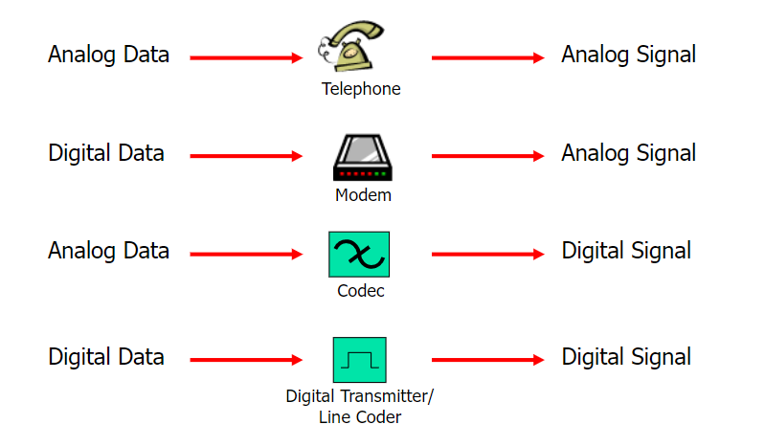

Slide 7
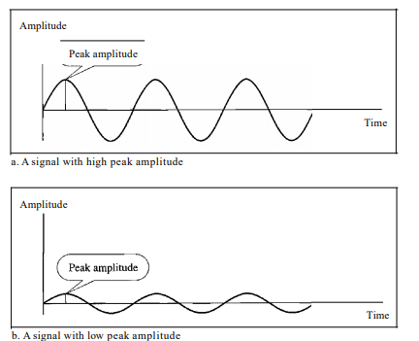
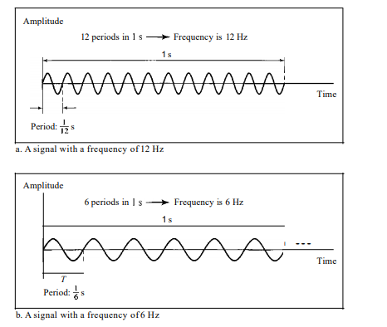

Slide 8
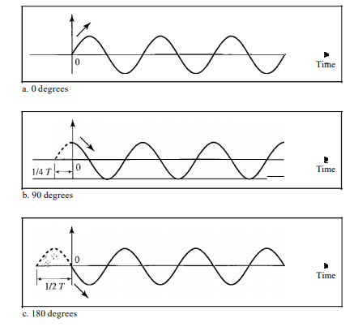

Slide 9

Data and Signals
Wavelength: The wavelength is the distance a simple signal can travel in one period.
A single frequency sine wave is not useful in data communications; we need to send a composite signal, a signal made of many simple sine waves.
Bandwidth :The bandwidth of a composite signal is the difference between the highest and the lowest frequencies contained in that signal.

Slide 10
Theoretical Basis for Data Communication
Information can be transmitted on wires by varying some physical property such as voltage or current.
By representing the value of this voltage or current as a single-valued function of time, f(t), we can model the behavior of the signal and analyze it mathematically.
Fourier analysis
Bandwidth-limited signals
Maximum data rate of a channel
Computer Networks, Fifth Edition by Andrew Tanenbaum and David Wetherall, © Pearson Education-Prentice Hall, 2011

Slide 11
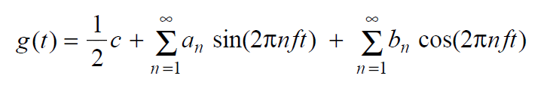
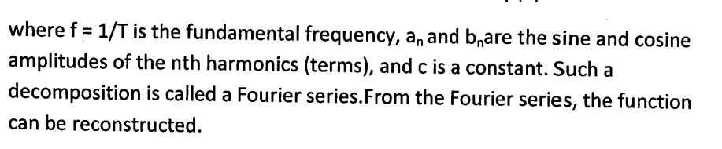
Fourier Analysis
The French mathematician Jean-Baptiste Fourier proved that any reasonably behaved periodic function, g(t) with period T, can be constructed as the sum of a (possibly infinite) number of sines and cosines:
Fourier series is used
where f = 1/T is the fundamental frequency, an and bn are the sine and cosine amplitudes of the nth harmonics.
Computer Networks, Fifth Edition by Andrew Tanenbaum and David Wetherall, © Pearson Education-Prentice Hall, 2011

Slide 12

Fourier Analysis
Function reconstructed with

Slide 13
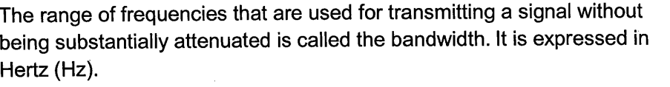
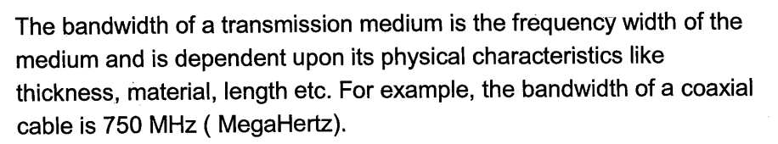
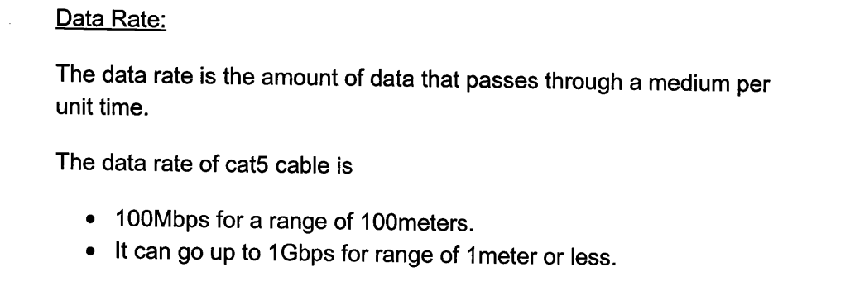
Bandwidth-Limited Signals (1)
amounts, thus introducing distortion.
The width of the frequency range transmitted without being.

Slide 14
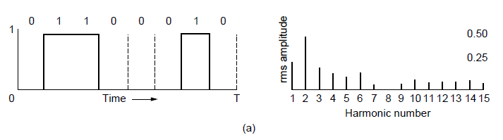
Bandwidth-Limited Signals (1)
Signals that run from 0 up to a maximum frequency are called baseband signals.
Signals that are shifted to occupy a higher range of frequencies, as is the case for all wireless transmissions, are called pass band signals.
Let us consider a specific example: the transmission of the ASCII character ‘‘b’’ encoded in an 8-bit byte.
The bit pattern that is to be transmitted is 01100010.

Slide 15
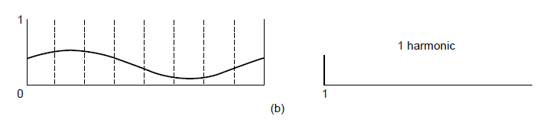
Bandwidth-Limited Signals (2)
(b)-(e) Successive approximations to the original signal.
Computer Networks, Fifth Edition by Andrew Tanenbaum and David Wetherall, © Pearson Education-Prentice Hall, 2011

Slide 16
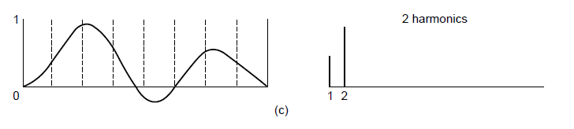
Bandwidth-Limited Signals (3)
(b)-(e) Successive approximations to the original signal.
Computer Networks, Fifth Edition by Andrew Tanenbaum and David Wetherall, © Pearson Education-Prentice Hall, 2011

Slide 17
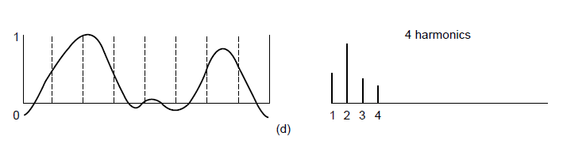
Bandwidth-Limited Signals (4)
(b)-(e) Successive approximations to the original signal.
Computer Networks, Fifth Edition by Andrew Tanenbaum and David Wetherall, © Pearson Education-Prentice Hall, 2011

Slide 18
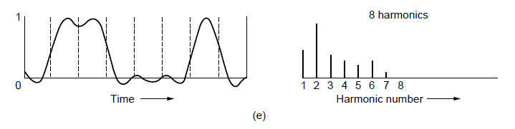
Bandwidth-Limited Signals (5)
(b)-(e) Successive approximations to the original signal.
Computer Networks, Fifth Edition by Andrew Tanenbaum and David Wetherall, © Pearson Education-Prentice Hall, 2011

Slide 19
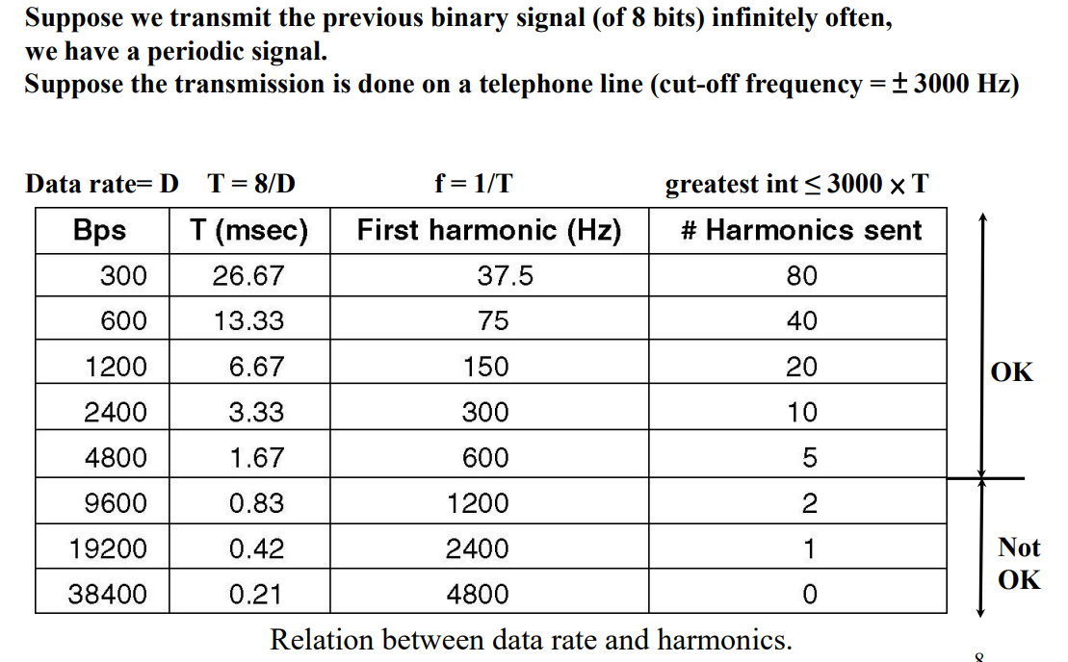
Bandwidth-Limited Signals (6)
Computer Networks, Fifth Edition by Andrew Tanenbaum and David Wetherall, © Pearson Education-Prentice Hall, 2011

Slide 20
Bandwidth-Limited Signals
Example: Assume you want to send 8 bits at 9600 bps over an ordinary phone line
The time to send 8 bits is 8/9600 = 0.83 msec.
The frequency of the first harmonic is 9600/8 = 1200 Hz (periods per second)
Ordinary phone lines have an artificial cut-off bandwidth of 3000Hz. Thus the highest harmonic passed through is 3000/ 1200 = 2.5 => highest harmonic is 2!
The signal received would be tricky to reconstruct => limiting the bandwidth limits the data rate

Slide 21
The Maximum Data Rate of a Channel
If the signal consists of V discrete levels, Nyquist’s theorem states:
There is always random (thermal) noise present due to the motion of the molecules in the system.
Shannon’s formula for capacity of a noisy channel
Computer Networks, Fifth Edition by Andrew Tanenbaum and David Wetherall, © Pearson Education-Prentice Hall, 2011

Slide 22
Guided Transmission Media
The purpose of the physical layer is to transport bits from one machine to another.
Various physical media can be used for the actual transmission. Each one has its own niche in terms of bandwidth, delay, cost, and ease of installation and maintenance.
Guided Media
Magnetic media
Twisted pairs
Coaxial cable
Power lines
Fiber optics
Computer Networks, Fifth Edition by Andrew Tanenbaum and David Wetherall, © Pearson Education-Prentice Hall, 2011

Slide 23
Magnetic Media
Write data onto magnetic tape or removable media (e.g., recordable DVDs), physically transport the tape or disks to the destination machine, and read them back in again.
Data transmission speed
Ex: A box containing 1000 tapes each having capacity of 800 gigabytes and it requires 24 hours to move from one place to other then the bandwidth is 70 Gbps.
Never underestimate the bandwidth of a station wagon full of tapes hurtling down the highway.
Computer Networks, Fifth Edition by Andrew Tanenbaum and David Wetherall, © Pearson Education-Prentice Hall, 2011

Slide 24
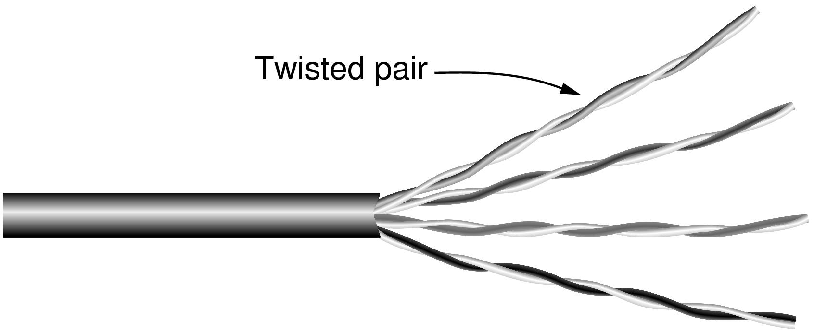
Twisted Pairs
Category 5 UTP cable with four twisted pairs
Computer Networks, Fifth Edition by Andrew Tanenbaum and David Wetherall, © Pearson Education-Prentice Hall, 2011

Slide 25
Twisted Pairs
The delay characteristics are poor in magnetic media.
For many applications an online connection is needed.
One of the oldest transmission media is twisted pair.
A twisted pair consists of two insulated copper wires, typically about 1 mm thick
When the wires are twisted, the waves from different twists cancel out, so the wire radiates less effectively.
A signal is usually carried as the difference in voltage between the two wires in the pair.
This provides better immunity to external noise
E.g.: Telephone system.
Twisted pairs can run several kilometers without amplification, but for longer distances the signal becomes too attenuated and repeaters are needed.

Slide 26
Twisted Pairs
Twisted pairs can be used for transmitting either analog or digital information.
The bandwidth depends on the thickness of the wire and the distance traveled, but several megabits/sec can be achieved for a few kilometers in many cases.
Types:
Category 5 :Four such pairs are typically grouped in a plastic sheath to protect the wires and keep them
together.
Example
LAN 100Mbps-uses two (out of the four) pairs, one pair for each direction.
1-Gbps Ethernet uses all four pairs in both directions simultaneously.

Slide 27
Twisted Pairs
Links that can be used in both directions at the same time, like a two-lane road, are called full-duplex links.
Links that can be used in either direction, but only one way at a time, like a single-track railroad line. are called half-duplex links.
A third category consists of links that allow traffic in only one direction, like a one-way street. They are called simplex links.
Category 3-Uses the same connector, but has more twists per meter.
More twists result in less crosstalk and a better-quality signal over longer distances
Category 6 and above are rated for signals of 500 MHz and can support the 10-Gbps links that will soon be deployed.
These wiring types are referred to as UTP (Unshielded Twisted Pair) as they consist simply of wires and insulators.
Category 7 cables have shielding on the individual twisted pairs, as well as around the entire cable (but inside the plastic protective sheath). Shielding reduces the Susceptibility to external interference and crosstalk with other cables.

Slide 28
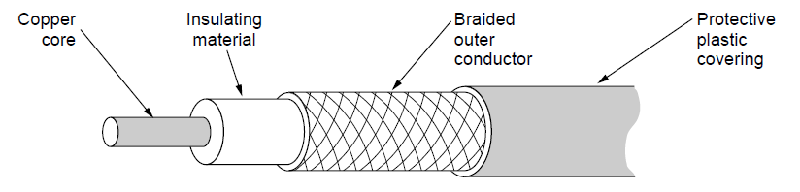
Coaxial Cable
A coaxial cable
Computer Networks, Fifth Edition by Andrew Tanenbaum and David Wetherall, © Pearson Education-Prentice Hall, 2011

Slide 29
Coaxial Cable
It has better shielding and greater bandwidth than unshielded twisted pairs, so it can span longer distances at higher speeds.
One kind, 50-ohm cable, is commonly used when it is intended for digital transmission.
. The other kind, 75-ohm cable, is commonly used for analog transmission and cable television.
A coaxial cable consists of a stiff copper wire as the core, surrounded by an insulating material.
The insulator is encased by a cylindrical conductor, often as a
closely woven braided mesh.
The outer conductor is covered in a protective plastic sheath.
The bandwidth possible depends on the cable quality and length.
Modern cables have a bandwidth of up to a few GHz.
Coaxial cables used to be widely used within the telephone system for long-distance line,cable television and metropolitan area
networks

Slide 30
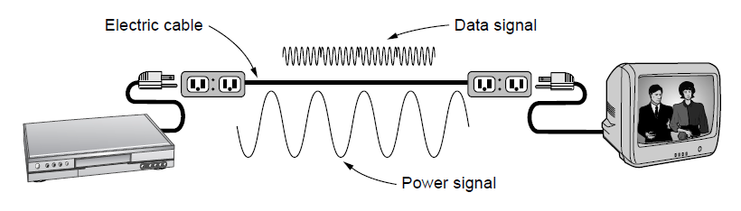
Power Lines
A network that uses household electrical wiring.
Computer Networks, Fifth Edition by Andrew Tanenbaum and David Wetherall, © Pearson Education-Prentice Hall, 2011

Slide 31
Power Lines
Power lines have been used by electricity companies for low-rate communication such as remote metering for many years, as well in the home to control devices.
Example:Using electrical wires inside the home.
Plug a TV and a receiver into the wall, which you must do anyway because they need power, and they can send and receive movies over the electrical wiring.
Disadvantages
The electrical properties of the wiring vary from one house to the next and change as appliances are turned on and off, which causes data signals to bounce around the wiring.
Transient currents when appliances switch on and off create electrical noise over a wide range of frequencies.
To meet regulatory requirements, the data signal must exclude licensed frequencies.
It is practical to send at least 100 Mbps over typical household electrical wiring by using communication schemes

Slide 32
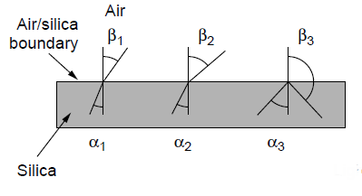
Fiber Optics (1)
Three examples of a light ray from inside a silica fiber impinging on the air/silica boundary at different angles.
Computer Networks, Fifth Edition by Andrew Tanenbaum and David Wetherall, © Pearson Education-Prentice Hall, 2011

Slide 33
Fiber Optics (1)
Here we see a light ray incident on the boundary at an angle α1 emerging at an angle β1.
The amount of refraction depends on the properties of the two media (in particular, their indices of refraction).
For angles of incidence above a certain critical value, the light is
refracted back into the silica; none of it escapes into the air.
Thus, a light ray incident at or above the critical angle is trapped inside the fiber, as shown in Figure and can propagate for many kilometers with virtually no loss.
If the fiber’s diameter is reduced to a few wavelengths of light the fiber acts like a wave guide and the light can propagate only in a straight line, without bouncing, yielding a single-mode fiber
Currently available single-mode fibers can transmit data at 100 Gbps for 100 km without amplification.

Slide 34
Fiber Optics (1)
Fiber optics are used for long-haul transmission in network backbones, highspeed LANs and high-speed Internet access such as FttH (Fiber to the Home).
An optical transmission system has three key components: the light source, the transmission medium, and the detector.
Conventionally, a pulse of light indicates a 1 bit and the absence of light indicates a 0 bit.
The transmission medium is an ultra-thin fiber of glass.
The detector generates an electrical pulse when light falls on it.
By attaching a light source to one end of an optical fiber and a detector to the other, we have a unidirectional data transmission system that accepts an electrical signal, converts and transmits it by light pulses, and then reconverts the output to an electrical signal at the receiving end.

Slide 35
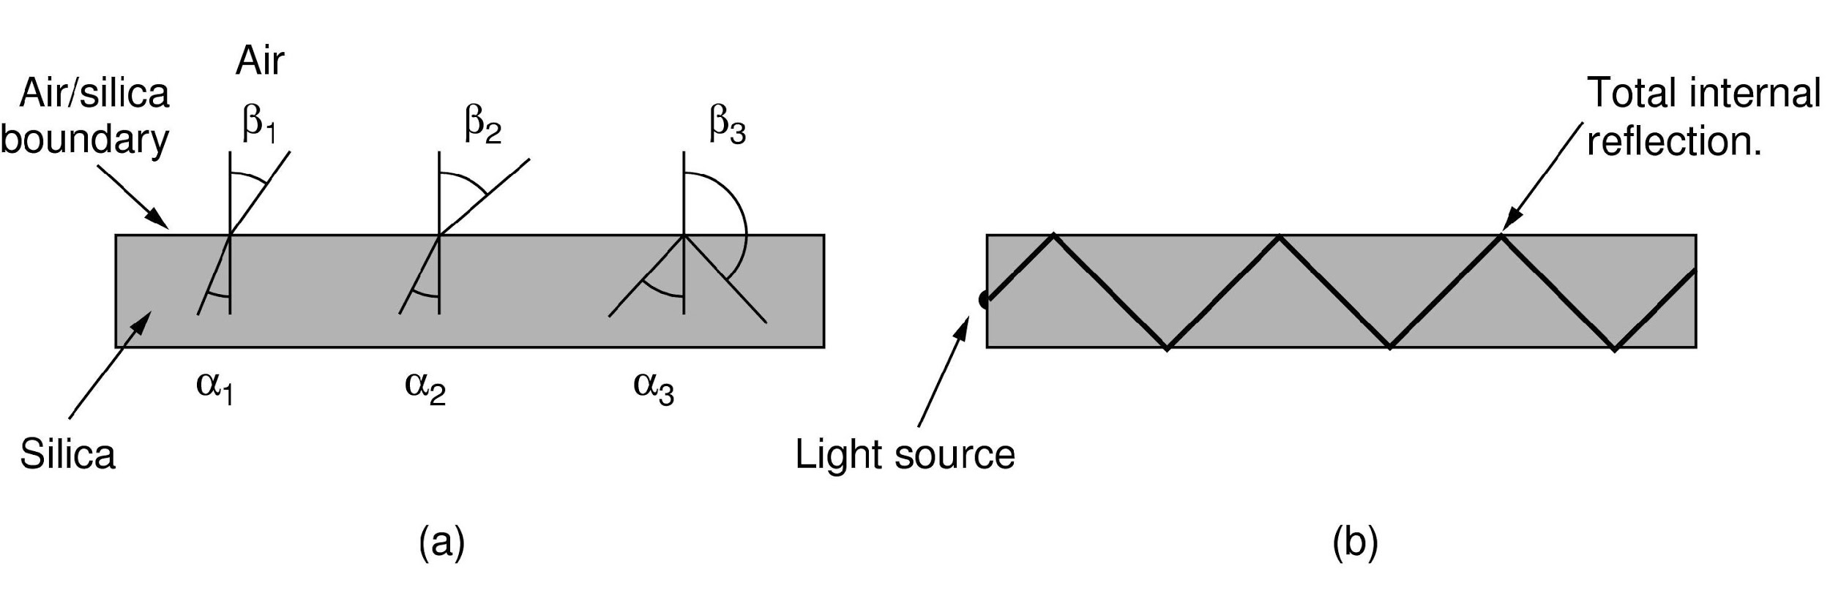
Fiber Optics (2)
Light trapped by total internal reflection.
Computer Networks, Fifth Edition by Andrew Tanenbaum and David Wetherall, © Pearson Education-Prentice Hall, 2011

Slide 36
Transmission of Light Through Fiber
Three wavelength bands are most commonly used at present for optical communication.
They are centered at 0.85, 1.30, and 1.55 microns, respectively.
All three bands are 25,000 to 30,000 GHz wide. The 0.85-micron band was used first.
It has higher attenuation and so is used for shorter distances, but at that wavelength the lasers and electronics could be made from the same material (gallium arsenide).
The last two bands have good attenuation properties (less than 5% lossper kilometer).
The 1.55-micron band is now widely used with erbium-doped
amplifiers that work directly in the optical domain.

Slide 37
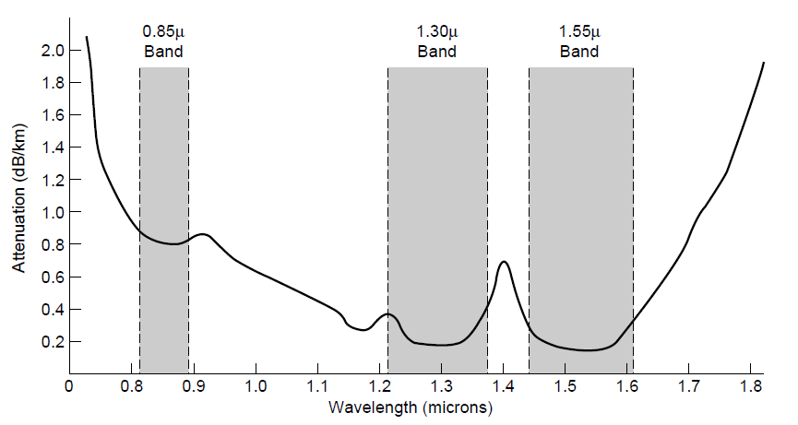
Transmission of Light Through Fiber
Attenuation of light through fiber in the infrared region
Computer Networks, Fifth Edition by Andrew Tanenbaum and David Wetherall, © Pearson Education-Prentice Hall, 2011

Slide 38
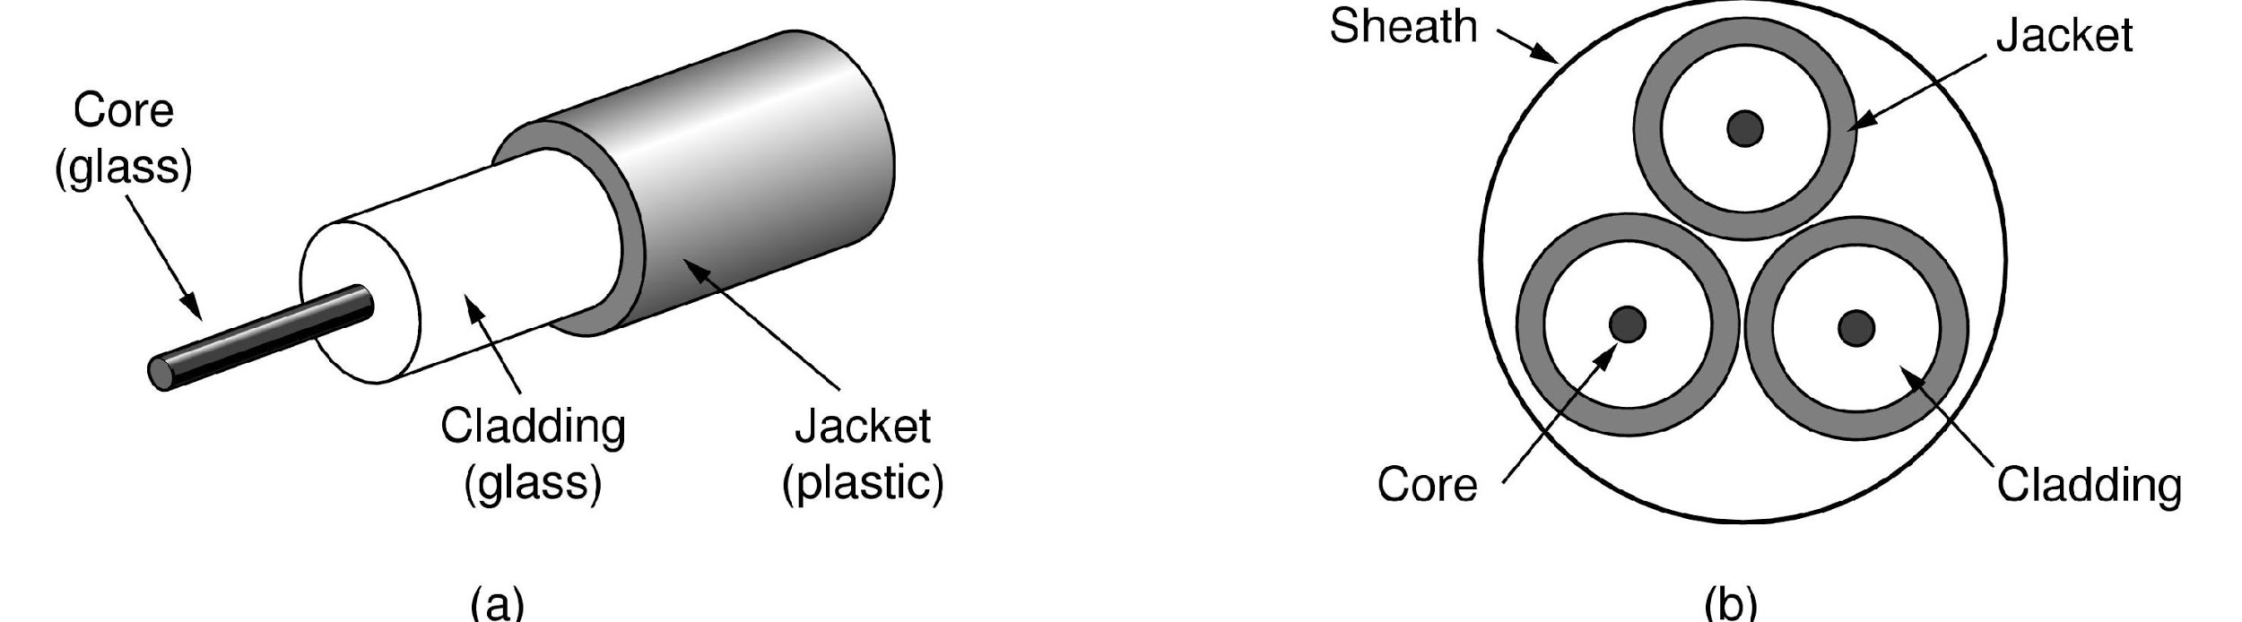
Fiber Cables (1)
Views of a fiber cable
Computer Networks, Fifth Edition by Andrew Tanenbaum and David Wetherall, © Pearson Education-Prentice Hall, 2011

Slide 39
Fiber Cables (1)
At the center is the glass core through which the light propagates.
In multimode fibers, the core is typically 50 microns in diameter and in single-mode fibers, the core is 8 to 10 microns.
The core is surrounded by a glass cladding with a lower index of refraction than the core, to keep all the light in the core.
Next comes a thin plastic jacket to protect the cladding.
Fibers are typically grouped in bundles, protected by an
outer sheath.
Fibers can be connected in three different ways.
They can terminate in connectors and be plugged into fiber sockets.
They can be spliced mechanically.
Two pieces of fiber can be fused (melted) to form a solid connection.

Slide 40
Fiber Cables (1)
The light sources are LEDs (Light Emitting Diodes) and semiconductor lasers.
They can be tuned in wavelength by inserting Fabry-Perot or Mach-Zehnder interferometers between the source and the fiber.
Fabry-Perot interferometers are simple resonant cavities consisting of two parallel mirrors.
The light is incident perpendicular to the mirrors.
The length of the cavity selects out those wavelengths that fit inside an integral number of times.
Mach-Zehnder interferometers separate the light into two beams.
The two beams travel slightly different distances.
They are recombined at the end and are in phase for only certain wavelengths.

Slide 41
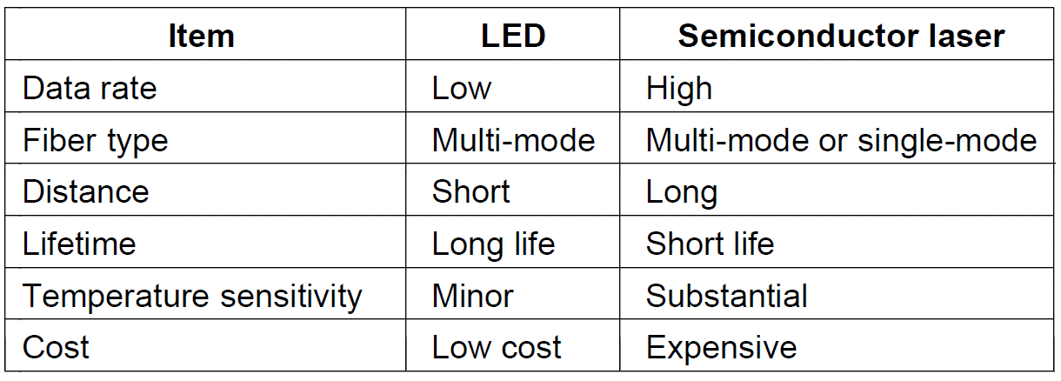
Fiber Cables (2)
A comparison of semiconductor diodes and LEDs as light sources

Slide 42
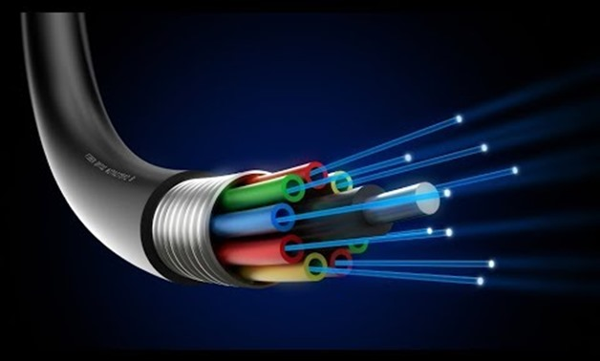

Slide 43
Fiber Cables
The receiving end of an optical fiber consists of a photodiode, which gives off an electrical pulse when struck by light.
The response time of photodiodes, which convert the signal from the optical to the electrical domain, limits data rates to
about 100 Gbps.
Thermal noise is also an issue, so a pulse of light must carry
enough energy to be detected. By making the pulses powerful enough, the error rate can be made arbitrarily small.
https://www.youtube.com/watch?v=0MwMkBET_5I.
Disadvantages:
fiber is a less familiar technology.
fibers can be damaged easily by being bent too much.
two-way communication requires
either two fibers or two frequency bands on one fiber
fiber interfaces cost more than electrical interfaces

Slide 44
Fibre cable vs copper wire
Fibre cable
copper wire
It can handle much higher bandwidth.
Due to the low attenuation, repeaters are needed only about every 50 km on long lines
Not being affected by power surges, electromagnetic interference, or power failures. corrosive chemicals in the air
Low cost for installation and are difficult to tap.
Bandwidth is lower than fibre cable
High attenuation,repeaters are needed for every 5 km for copper.
It is affected.
High cost and wire tapping is possible.

Slide 45
The Public Switched Telephone Network
When two computers owned by the same company or organization and located close to each other need to communicate, it is often easiest just to run a cable between them.
When the distances are large the costs of running private cables are usually prohibitive.
The network designers must rely on the existing telecommunication facilities.
These facilities, the PSTN (Public Switched Telephone Network) ,transmitting the human voice in a more-or-less recognizable form.
Their suitability for use in computer-computer communication is often marginal at best.
Computer Networks, Fifth Edition by Andrew Tanenbaum and David Wetherall, © Pearson Education-Prentice Hall, 2011

Slide 46
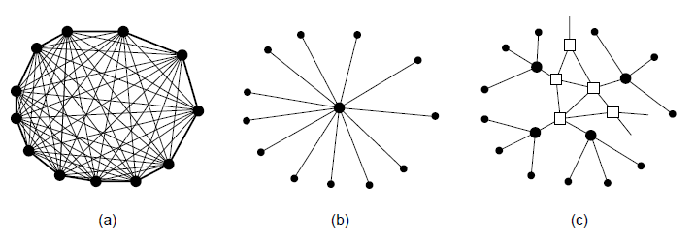
Structure of the Telephone System (1)
Fully interconnected network.
Centralized switch.
Two-level hierarchy.
Computer Networks, Fifth Edition by Andrew Tanenbaum and David Wetherall, © Pearson Education-Prentice Hall, 2011

Slide 47
Structure of the Telephone System
If a telephone owner wanted to talk to n other telephone owners, separate wires had to be strung to all n houses.
T solve this problem a switching office is established.
To make a call, the customer would crank the phone to make a ringing sound in the telephone company office.
Then the operator manually connect the caller to the callee by using a short jumper cable to connect the caller to the callee.
For long distance communications multiple second-level offices were needed and the hierarchy grew to five levels.
The three major parts of the telephone system were:
The switching offices.
The wires between the customers and the switching offices
The long-distance connections between the switching offices.

Slide 48
Structure of the Telephone System
Each telephone has two copper wires coming out of it that go directly to the telephone company’s nearest end office
This is also called local loop.
Example
Case 1:If a subscriber attached to a given end office calls another subscriber attached to the same end office, the switching mechanism within the office sets up a direct
electrical connection between the two local loops. This connection remains intact for the duration of the call.
Case 2:If the called telephone is attached to another end office.
Each end office has a number of outgoing lines to one or more nearby switching centers, called toll offices

Slide 49
Structure of the Telephone System
If both the caller’s and callee’s end offices happen to have a toll connecting trunk to the same toll office then the connection may be established within the toll office.
Case 3:If the caller and callee do not have a toll office in common.
The toll offices communicate with each other via high-bandwidth intertoll trunks
In summary, the telephone system consists of three major components:
1. Local loops (analog twisted pairs going to houses and businesses).
2. Trunks (digital fiber optic links connecting the switching offices).
3. Switching offices (where calls are moved from one trunk to another).

Slide 50
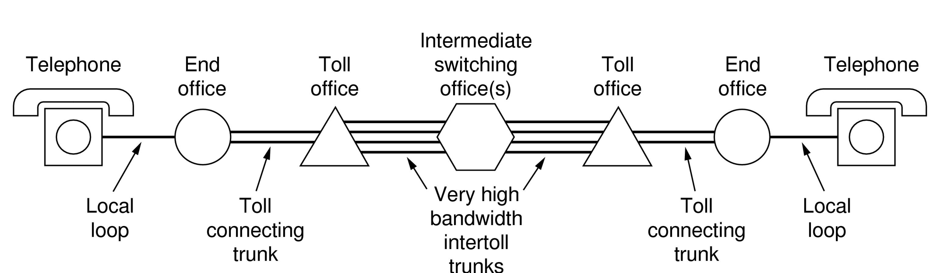
Structure of the Telephone System (2)
A typical circuit route for a long-distance call.
Computer Networks, Fifth Edition by Andrew Tanenbaum and David Wetherall, © Pearson Education-Prentice Hall, 2011

Slide 51
Switching
Two different switching techniques are used by the network nowadays: circuit switching and packet switching.
The traditional telephone system is based on circuit
switching, but packet switching is beginning to make inroads with the rise of voice over IP technology.
Circuit switching
It seeks out a physical path between sender and receiver.
Example:
When a call passes through a switching office, a physical connection is (conceptually) established between
the line on which the call came in and one of the output lines, as shown by the dotted lines.
Once a call has been set up, a dedicated path between both ends exists and will continue to exist until the call is finished

Slide 52
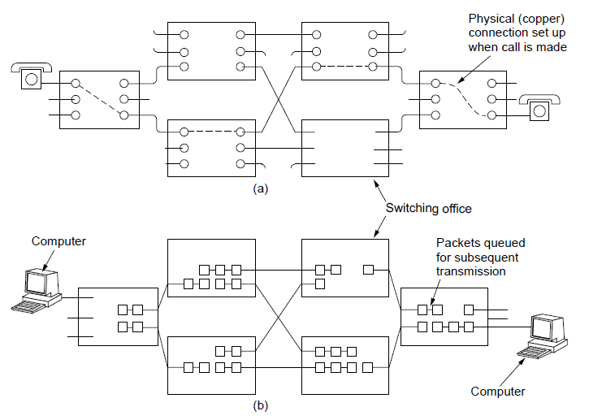
Circuit Switching/Packet Switching (1)
(a) Circuit switching. (b) Packet switching.
Computer Networks, Fifth Edition by Andrew Tanenbaum and David Wetherall, © Pearson Education-Prentice Hall, 2011

Slide 53
Switching
The elapsed time between the end of dialing and the start of ringing can easily be 10 sec, more on long-distance or international calls.
For many computer applications (e.g., point-of-sale credit verification), long setup times are undesirable.
Advantages
The only delay for data is the propagation time for the
electromagnetic signal.
There is no danger of congestion.

Slide 54
Switching
Packet Switching
Packets are sent as soon as they are available.
There is no need to set up a dedicated path in advance
It is up to routers to use store-and-forward transmission to
send each packet on its way to the destination on its own.
There is no fixed path, so different packets can follow different paths, depending on network conditions at the time they are sent, and they may arrive out of order.
Packet-switching networks place a tight upper limit on the size of packets.
Packets may have to wait to be forwarded. This introduces queuing delay and congestion if many packets are sent at the
same time.

Slide 55
Switching
Packet switching does not waste bandwidth and thus is more efficient from a system perspective.
Packet switching is more fault tolerant than circuit switching.
With packet switching, connect time is not an issue, but the
volume of traffic is so charging is based on volume of traffic.

Slide 56
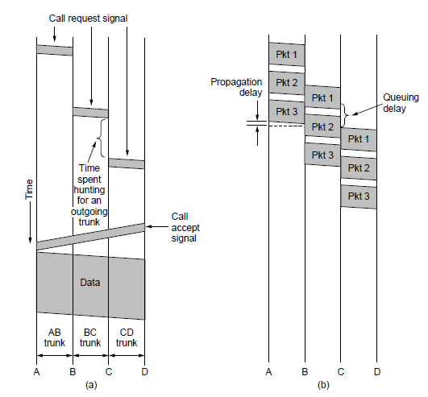
Circuit Switching/Packet Switching (2)
Timing of events in (a) circuit switching, (b) packet switching
Computer Networks, Fifth Edition by Andrew Tanenbaum and David Wetherall, © Pearson Education-Prentice Hall, 2011

Slide 57
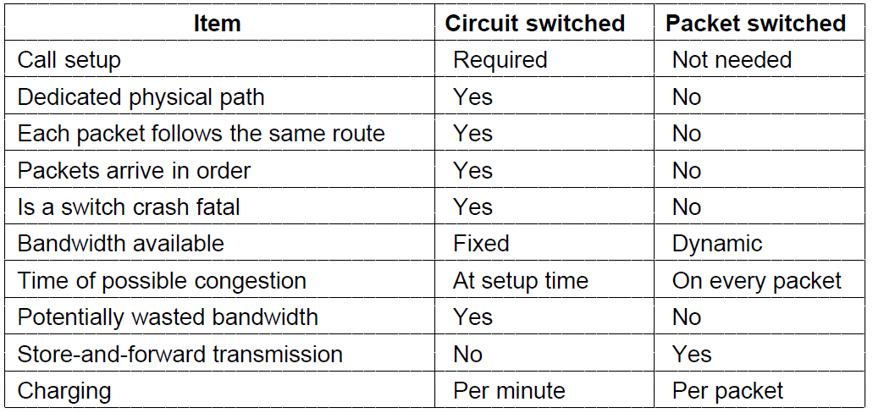
Circuit Switching/Packet Switching (3)
A comparison of circuit-switched and packet-switched networks.
Computer Networks, Fifth Edition by Andrew Tanenbaum and David Wetherall, © Pearson Education-Prentice Hall, 2011

Slide 58
Digital Modulation and Multiplexing
The process of converting between bits and signals that represent them is called digital modulation.
Baseband Transmission: In which the signal occupies frequencies from zero up to a maximum that depends on the signalling rate.
Passband Transmission: Schemes that regulate the amplitude, phase, or frequency of a carrier signal to convey bits.
Multiplexing : It is convenient that a single wire to carry several signals than to install a wire for every signal. This kind of sharing is called multiplexing.

Slide 59
Baseband Transmission
Use a positive voltage to represent a 1 and a negative voltage to represent a 0.
Ex: Presence of light might represent a 1 and the absence of light might represent a 0.
This scheme is called NRZ (Non-Return-to-Zero).
The receiver converts it into bits by sampling the signal at regular intervals of time.
Disadvantage:
Bandwidth Efficiency: We need a bandwidth of at least B/2 Hz when the bit rate is B bits/sec. We cannot run NRZ faster without using more bandwidth.

Slide 60
Baseband Transmission
By using four voltages, for instance, we can send 2 bits at once as a single symbol.
The rate at which the signal changes is then half the bit rate, so the needed bandwidth has been reduced.
Clock recovery: The receiver must know when one symbol ends and the next symbol begins to correctly decode the bits. With NRZ, in which the symbols are simply voltage levels, a long run of 0s or 1s leaves the signal unchanged.
A clever trick here is to mix the clock signal with the data signal by XORing them together so that no extra line is needed.
This scheme is called Manchester encoding and was used for classic Ethernet.

Slide 61
Baseband Transmission
The downside of Manchester encoding is that it requires twice as much bandwidth as NRZ because of the clock.
We can simplify the situation by coding a 1 as a transition and a 0 as no transition, or vice versa. This coding is called NRZI (Non-Return-to-Zero Inverted), a twist on NRZ.
Example: USB .
Example coding:4B/5B.
This scheme adds 25% overhead, which is better than the 100% overhead of Manchester encoding.
There are still some codes left and can be used as control signals.

Slide 62
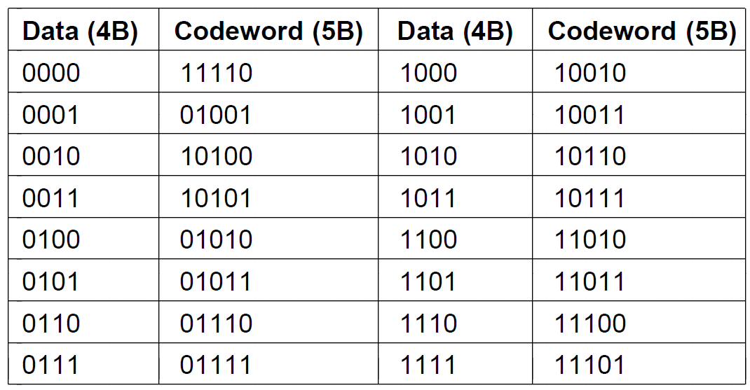
Clock Recovery
4B/5B mapping.

Slide 63
Baseband Transmission
Scrambling: A scrambler works by XORing the data with a pseudorandom sequence before it is transmitted.
The receiver then XORs the incoming bits with the same pseudorandom sequence to recover the real data.
Balanced Signals:Signals that have as much positive voltage as negative voltage even over short periods of time are called balanced signals.
Balancing helps to provide transitions for clock recovery since there is a mix of positive and negative voltages.
It also provides a simple way to calibrate receivers
because the average of the signal can be measured and
used as a decision threshold to decode symbols.

Slide 64
Baseband Transmission
A straightforward way to construct a balanced code is to use two voltage levels to represent a logical 1, (say +1 V or −1 V) with 0 V representing a logical zero.
This scheme is called bipolar encoding. In telephone networks it is called AMI (Alternate Mark Inversion).
Bipolar encoding adds a voltage level to achieve balance. Alternatively we can use a mapping like 4B/5B to achieve balance.
Example of this kind of balanced code is the 8B/10B line code. It maps 8 bits of input to 10 bits of output, so it is 80% efficient, just like the 4B/5B line code.

Slide 65
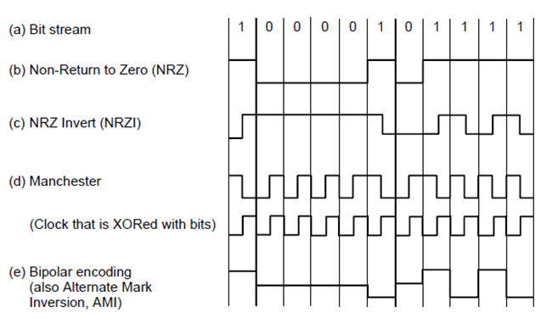
Baseband Transmission
Line codes: (a) Bits, (b) NRZ, (c) NRZI, (d) Manchester, (e) Bipolar or AMI.

Slide 66
Passband Transmission
For wireless channels, it is not practical to send very low frequency signals because the size of the antenna needs to be a fraction of the signal wavelength, which becomes large.
Digital modulation is accomplished with passband transmission by regulating or modulating a carrier signal that sits in the passband.
We can modulate the amplitude, frequency, or phase of the carrier signal.
In ASK (Amplitude Shift Keying), two different amplitudes are used to represent 0 and 1.
More than two levels can be used to represent more symbols. Similarly, with FSK (Frequency Shift Keying), two or more different tones are used.

Slide 67
Passband Transmission
In the simplest form of PSK (Phase Shift Keying), the carrier wave is systematically shifted 0 or 180 degrees at each symbol period.
Because there are two phases, it is called BPSK (Binary Phase Shift Keying).
For more efficient usage of channel bandwidth use four
shifts, e.g., 45, 135, 225, or 315 degrees, to transmit 2 bits of information per symbol.
This version is called QPSK (Quadrature Phase Shift Keying).
We can combine these schemes and use more levels to transmit more bits per symbol.

Slide 68
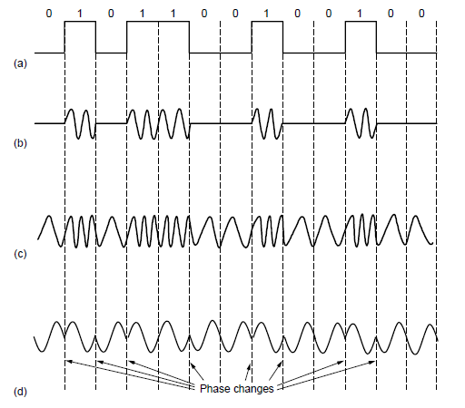
Passband Transmission (1)
(a) A binary signal. (b) Amplitude shift keying. (c) Frequency shift keying. (d) Phase shift keying.

Slide 69
Passband Transmission
Three examples are taken..
In each example, the points give the legal amplitude and phase combinations of each symbol.
In Example 1we see equidistant dots at 45, 135, 225, and 315 degrees.
The phase of a dot is indicated by the angle a line from it to the origin makes with the positive x-axis.
The amplitude of a dot is the distance from the origin.
This figure is a representation of QPSK.
This kind of diagram is called a constellation diagram.
Example 2: Sixteen combinations of amplitudes and phase are used, so the modulation scheme can be used to transmit

Slide 70
Passband Transmission
bits per symbol. It is called QAM-16, where QAM stands for Quadrature Amplitude Modulation.
Example 3: It is a still denser modulation scheme with 64
different combinations, so 6 bits can be transmitted per symbol. It is called QAM-64.
A better solution is to map bits to symbols so that adjacent symbols differ in only 1 bit position.
This mapping is called a Gray code.
Example: QAM-16 constellation that has been Gray coded.

Slide 71
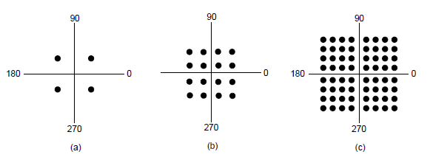
Passband Transmission (2)
(a) QPSK. (b) QAM-16. (c) QAM-64.

Slide 72
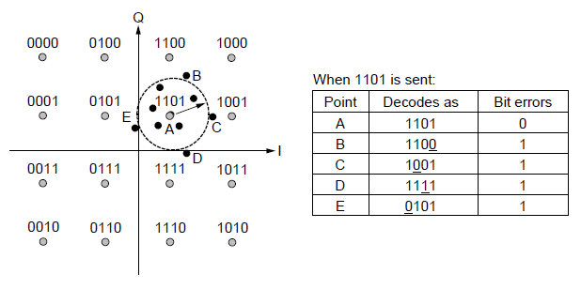
Frequency Division Multiplexing (1)
Gray-coded QAM-16.

Slide 73
Frequency Division Multiplexing
FDM (Frequency Division Multiplexing) takes advantage of passband transmission to share a channel.
It divides the spectrum into frequency bands, with each user having exclusive possession of some band in which to send their signal.
AM radio broadcasting illustrates FDM. The allocated spectrum is about 1 MHz, roughly 500 to 1500 kHz.
Different frequencies are allocated to different logical channels (stations), each operating in a portion of the spectrum, with the inter channel separation great enough to prevent interference.

Slide 74
FDM
We show three voice-grade telephone channels multiplexed using FDM.
Filters limit the usable bandwidth to about 3100 Hz per voice-grade channel.
When many channels are multiplexed together 4000 Hz is allocated per channel.
The excess is called a guard band. It keeps the channels well separated.
First the voice channels are raised in frequency, each by a different amount.
Then they can be combined because no two channels now occupy the same portion of the spectrum.

Slide 75
OFDM
The channel bandwidth is divided into many subcarriers that independently send data
signals from each subcarrier extend into adjacent ones.
The subcarriers can therefore be sampled at their center frequencies without interference from their neighbors.
To make this work, a guard time is needed to repeat a portion of the symbol signals in time so that they have the desired frequency response.
OFDM is used in 802.11, cable networks and power line networking, and is planned for fourth-generation cellular systems.
Usually, one high-rate stream of digital information
is split into many low-rate streams that are transmitted on the subcarriers in parallel.

Slide 76
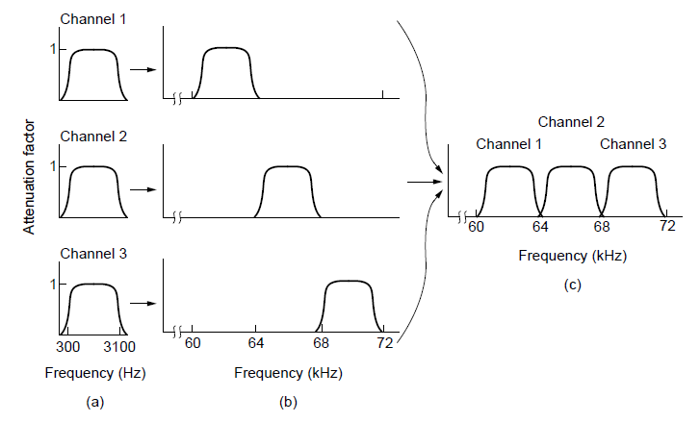
Frequency Division Multiplexing (2)
Frequency division multiplexing. (a) The original bandwidths. (b) The bandwidths raised in frequency. (c) The multiplexed channel.

Slide 77
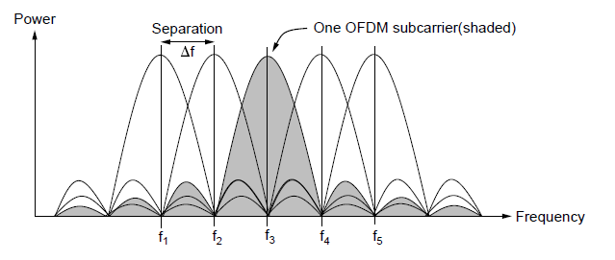
Frequency Division Multiplexing (3)
Orthogonal frequency division multiplexing (OFDM).

Slide 78
TDM
the users take turns (in a round-robin fashion), each one periodically getting the entire bandwidth for a little burst of time.
An example of three streams being multiplexed
with TDM is shown in Figure.
Bits from each input stream are taken in a fixed time slot and output to the aggregate stream.
This stream runs at the sum rate of the individual streams.
For this to work, the streams must be synchronized
in time.

Slide 79
TDM
Small intervals of guard time analogous to a frequency guard band may be added to accommodate small timing variations.
STDM:The individual streams contribute to the multiplexed stream not on a fixed schedule, but according to the statistics of their demand.

Slide 80
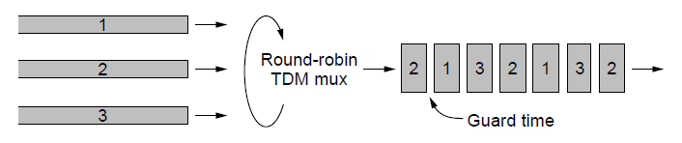
Time Division Multiplexing
Time Division Multiplexing (TDM).

Slide 81
CDMA
CDMA allows each station to transmit over the entire frequency spectrum all the time.
Multiple simultaneous transmissions are separated using coding theory.
TDM is comparable to pairs of people in the room taking turns speaking.
FDM is comparable to the pairs of people speaking at different pitches,
CDMA is comparable to each pair of people talking at once, but in a different language.

Slide 82
CDMA
each bit time is subdivided into m short intervals called chips.
Typically, there are 64 or 128 chips per bit, but in the example given here we will use 8 chips/bit for simplicity.
Each station is assigned a unique m-bit code called a chip sequence.
EXAMPLE:for m = 8, if station A is assigned the chip sequence (−1 −1 −1 +1 +1 −1 +1 +1), it can send a 1 bit by transmiting the chip sequence and a 0 by transmitting (+1 +1 +1 −1 −1 +1 −1 −1).
The bandwidth needed for CDMA is greater by a factor of m than the bandwidth needed for a station not using CDMA

Slide 83
CDMA
Let us use the symbol S to indicate the m-chip vector for station S, and S for its negation.
All chip sequences are pairwise orthogonal, by which we mean that the normalized inner product of any two distinct chip sequences, S and T (written as S T), is 0.
The normalized inner product of any chip sequence with itself is 1:
When two or more stations transmit simultaneously, their bipolar sequences add linearly.

Slide 84
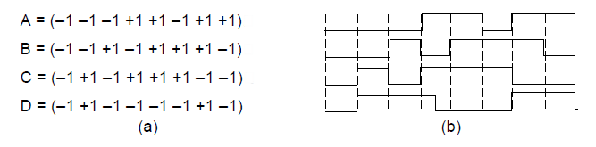
Code Division Multiplexing (1)
Chip sequences for four stations.
Signals the sequences represent

Slide 85
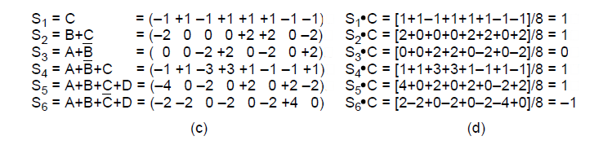
Code Division Multiplexing (2)
Six examples of transmissions.
Recovery of station C’s

